Slide 1
Wireless WG
Monthly Teleconference
18-Jan-2017
RFID Interoperability Testing

Slide 2
RFID Interoperability Testing

Slide 3
RFID Tag-Encoding: Interoperability Test Plan Schedule
RFID Tag-Encoding Red Book (CCSDS 881.1-R-1) activities
Aug
2016
Sep
2016
Oct
2016
Nov
2016
Dec
2016
Jan
2017
Feb
2017
Mar
2017
Apr
2017
May
2017
Jun
2017
2016 Fall Meeting
Rome, Italy (ASI)
17-21 Oct-2016
2017 Spring Meeting
San Antonio, TX
08-12 May-2017
Current Date →
Test Plan Development;
Yellow Book composition:
Overview, Procedures, PICS
Prototype
software
FSA/NASA
Interop Testing
Test
Report
Draft: 30-Nov-2016
Final: 15-Dec-2016
01-Jan-2017 → 15-Feb-2017
16-Feb-2017 → 15-Mar-2017
16-Mar-2017 → 15-Apr-2017
CMC Approval
(Fall 2017)
RFID Tag Object-ID
space design
SANA Registry
Creation (Kevin/NASA)
Participating Agencies: FSA, NASA
Points of Contact (FSA, NASA):
Yuriy Sheynin, FSA
Vladimir Fetisov, FSA
Ray Wagner, NASA
Draft: 01-Jan-2017
Final: 01-Feb-2017
Draft: 15-Mar-2017
Final: 15-May-2017
Published deliverable date to SOIS Chair and the CESG
Wireless WG internal activity
Wireless WG internal working milestone
CCSDS Biannual Meeting
Notes:
Planning Notes 11-Mar-2013:
Discuss SABL Project Plan with Shea and Louis
Coordinate dates for RSA 2FA TIM at HOSC (Shea, Jim, Shankini); cost share this trip with BioServe
Determine timeline on DTN2 Simulator – coordinate HOSC DTN2 G/W testing, test plan, with the HOSC
Will need to plan Automation support for additional BioServe SABL tasks
Have an IDSCam close-out sprint; can transition to SABL early as necessary
HOSC RSA 2FA meeting this week and travel coordination

Slide 4
Old Notes & Strategies

Slide 5
HDR WLAN Book Organizational Plan(s)
Agency use cases to characterize need (Use Case update of Green Book - Completed)
  Is ISS the only real customer at this point? Is NASA SCaN a customer? Alignment for future purposes? Can we extrapolate to identify other customers?
Scope properly (customer focus emphasis);
  This means Wi-Fi for ISS if short-term focus; ISS EVA focus
  Application profiles specifying PHY modes selection
  Implies short-term focus right now
  Agency roadmaps for additional HDR WLAN use cases??
Important Observation: Expect our (WWG) path to be evolutionary as well which dictates a staged approach (802.11 evolution; 802.11/LTE co-existence).
[NASA, FSA]: ISS as a testbed for future exploration wireless communication technologies; For the WWG is there too much risk in being overly ISS-focused? ISS cultural problems, expectations, etc.
NASA (AES, SCaN, NDSWG) concerns: How to handle EVA, EVA suits, tele-robotic activity, sensor networks, vehicle monitoring, ubiquitous networking, vehicle docking support; ISS EVA focus: Use ISS as a testbed for wireless technology maturation (any location-based services, e.g. 802.11az). Not just an ISS book; but will mature exploration wireless communication technologies.
FSA wireless focus (DLR agreement): ISS testbed for future exploration wireless communications; Intra-spacecraft wireless networking; proximate EVA activities; HDR Sensor rates; Docking; On-orbit assembly activities; Planetary surface wireless?? (FSA not convinced this is a SOIS area); Correlation/coordination with SOIS architecture.

Slide 6
HDR WLAN Book Organizational Plan(s)
DLR (agreement with FSA): WLAN interest as well; focus on ISS as a testbed
ESA (strong agreement with FSA, DLR): communication within a spacecraft; could check with ESA human spaceflight program; important problem reduce/eliminate power constraints to sensors; AIT is a primary focus.
CSA priorities: Body-area nets, EVA activities, robotics, astro-skin; most of CSA investment is in the ISS; CSA not interested in RFID or RFID-sensing currently. No long-term space plan in Canada (possibly environmental-focused communications will arise); ISS is for technology development for Exploration; Stephen Braham: Planetary surface communications.
CNSA?
JAXA: difficult to adapt wireless for space missions – do step-by-step; first integrate wireless in AIT, then in vehicle wireless avionics, then intra-satellite. ISS EVA activities. ISAS interested in sensor networking; science mission projects including robotic surface activities, communication with relay orbiter (e.g., prox-2 link capability)

Slide 7
HDR WLAN Book Organizational Plan(s)
What the standard can do and can’t do (with possible recommendations?)
What do our sponsors want us to do; can we seek sponsor guidance? Customer guidance?
WWG external-stakeholder input for clarification of needs and tasks
Blue Book must be terse; what makes it worth doing
Candidate Proposal: Wi-Fi based Blue Book(?): specify the PHY/MAC standard
  Internal habitat and intra-satellite communication
  Inter-satellite communication? (SLS coordination)
  External communication
  Launchers
  AIT (this is important and is a key driver/importance for ground testing and verification)
  Sub-orbital, high-altitude terrestrial network communications (SLS coordination)
  Note sensor-centric emphasis in many above domains (here the key constraint is power consumption)
  How important is meshing?
  Low-power Wi-Fi, TSN
  Wi-Fi/LTE in broadcast TV whitespace?
  802.11aa specifically for Video Transport?
  Interoperability testing issues (“802.11” vs. “.b”, “.g”, “.n”, “.s”, “ac”, “ax”, “az”)
Importance of space qualification and TRL maturation
Past history of wanting high-speed wireless sensing

Slide 8
HDR WLAN Book Organizational Plan(s)
Extract generalized and specific (when possible) requirements
Characterize engineering metrics / figures of merit
Identify constraints
Market surveys (what is out there: commercial/industry/IEEE, IEEE TSN, ITU, IETF)
Technology evaluations; technology maturation
Identify applicable standards and anticipated evolution roadmaps
  E.g., 802.11x, 3GGP 5G, etc..
Identify trade-offs
  E.g., power, data rates, range, centralized vs. distributed; modulation
Identify specific coordination strategies (SOIS Deterministic networking BoF)
Blue Book Outline:
  1. Boilerplate scope and purpose; 2. Overview; 3. Recommendation(s)
Where to put HDR WLAN engineering analyses (GB?)
Time domain of recommendation applicability:
Very short-term: 1 – 2 years
Short-term: 3 – 5 years
Medium term: 6 – 10 years
Longer term: 10 – 20 years
Long-term: 20+ years

Slide 9
HDR WLAN Book Organizational Plan(s): SIS MIA/VOICE
Date: 11-Feb-2016
Attendees: Rodney Grubbs (NASA-MSFC), Rick Barton (NASA-JSC), Osvaldo Peinado (ESA/DLR), Kevin Gifford (NASA-JSC sponsor)
Focus of discussion: How to best incorporate user and stakeholder (e.g, MIA, VOICE, ISS, EWC, JEM) requirements for a High Data-Rate Wireless Local Area Network ("HDR-WLAN") CCSDS Recommended Standard.
Primary Outcome: SOIS-WIR, SIS-MIA, SIS-VOICE are in agreement to work in a coordinated fashion to gather concerns, inputs, requirements, test data, etc., in an effort to best inform the Wireless WG regarding stakeholder requirements and concerns relating to a HDR-WLAN CCSDS Recommended Standard.
Action Items:
KKG: Coordinate WWG Agenda for 2016 Spring Meetings (Cleveland); once ratified by the WWG, publish the agenda to RPG/OP in an effort to coordinate SIS-MIA/VOICE potential attendance to the WWG HDR-WLAN discussions
KKG: Agreed to reserve 1/2 day (4 hours) during the 2016 Fall Meetings (Rome) for a SOIS-WIR, SIS-MIA/VOICE technical discussion
RPG: Provide SIS-MIA requirements and constraints regarding wireless LAN video transmission including H.264 and ATVC video streaming
RPG: Determine if can obtain any technical information regarding a JEM-EF external Wi-Fi system (JAXA?).
RJB: Get KSC (and any other available) ground testing data for the ISS EWC; determine if a system design was developed and documented (obtain if available)
RJB/RPG: Determine if can get latest ELC Wi-Fi system requirements (or is this just part of the EWC design?)
RJB: Talk with Chatwin Lansdowne to coordinate EWC involvement
RJB/RPG: Talk with Penny Roberts to coordinate EWC involvement
RJB: Determine the plausibility of having Chatwin and/or Penny either attend the Cleveland meetings for a day; or to give a remote presentation to the WWG overviewing the EWC system design along with requirements and constraints
KKG: Look to get EWC operational performance data at end of CY2016 / start of CY 2017

Slide 10
CCSDS SOIS Wireless WG Monthly Webcon – RFID Tag-Encoding
RFID Tag-Encoding Red Book (CCSDS 881.1-R-1) activities
  Interoperability Test Plan document (current draft)
    Comments/inputs from FSA
    Any comments/inputs from NASA
    Any comments/inputs from other WWG participating agencies
    Interoperability Test preparation and (FSA, NASA) prototyping
      Consensus for current project timeline
    RFID Tag-Encoding interoperability testing sample size review
    ECMA-113 character blacklist
    Update WWG Project Schedule on the CWE (coordinate with SOIS A.D)
  RFID Tag Encoding Object-ID design
    Top-level categorization
      Review proposed Object-ID design schema
    Alignment with current UPC Class-ID schemes for forward compatibility? ** Not Needed **
    SANA Registry updates scheduling

Slide 11
RFID Tag-Encoding Red Book (CCSDS 881.1-R-1) activities
RFID Tag-ID Interoperability Testing
Valid Tag-ID Characters
Discussion

Slide 12
ISO / IEC 8824-1
RFID Tag-Encoding Red Book (CCSDS 881.1-R-1) activities
ISO/IEC 15961, 15962, 15963 → ISO-IEC 8824-1
ISO-IEC 8824-1: ASN.1 character set, 79 chars
  A to Z
  a to z
  0 to 9
  ! ; : = , . ‘ “ & * { } @ [ ] | ^
GS1 Tag Data Standard (TDS version 1.9, Nov. 2014), 82 chars
  A to Z
  a to z
  0 to 9
  ! “ % & ‘ ( ) * + , - . / : ; < = > ? _
NOTE – GS1 (http://www.gs1.org/locations/russia) does not utilize Cyrillic characters

Slide 13
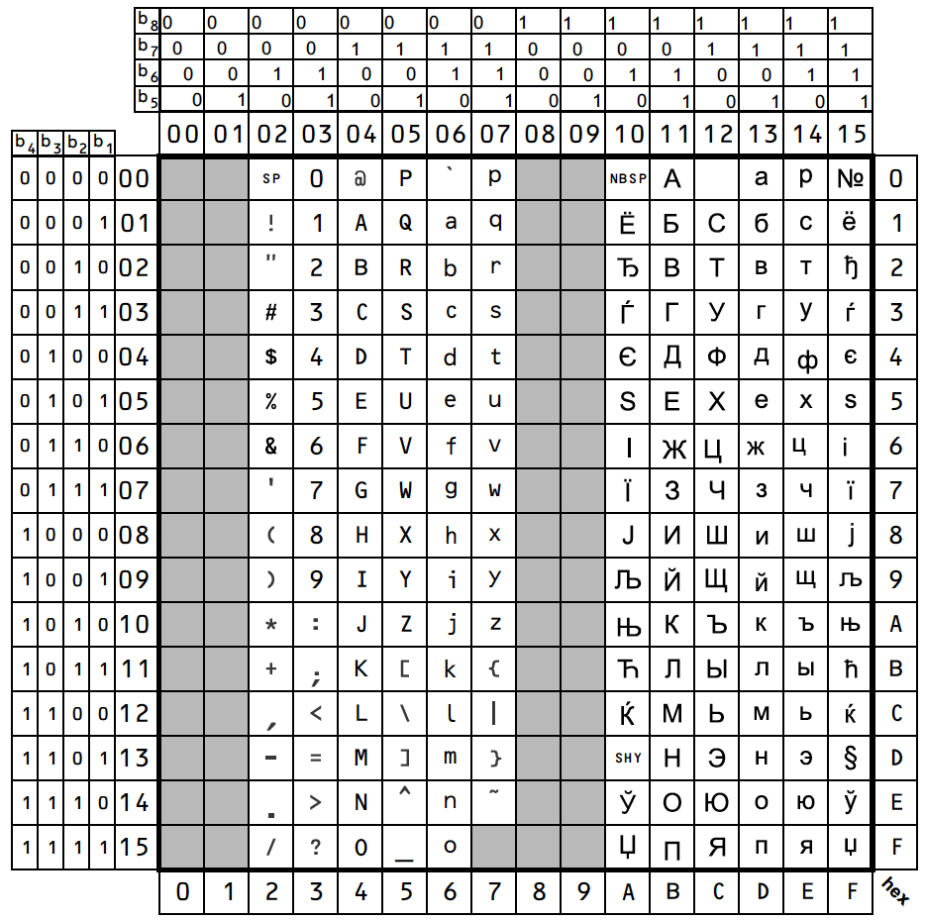
ECMA-113:
Cyrillic
Blacklist?
Non-GS1
RFID Tag-Encoding Red Book (CCSDS 881.1-R-1) activities
Do we want to be GS1 compliant for future tag-encoding?

Slide 14
RFID Tag-Encoding Red Book (CCSDS 881.1-R-1) activities
Test Coverage Analysis:
RFID Tag-ID Interoperability Testing (Yellow Book)

Slide 15
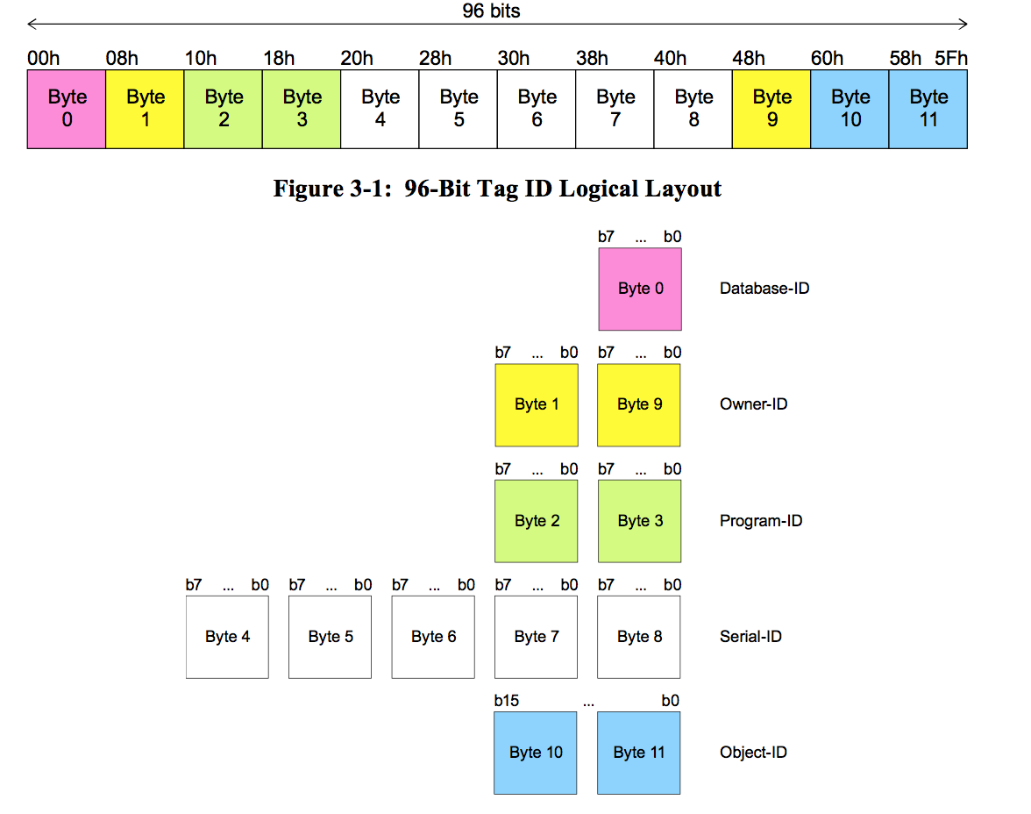
Tag-Encoding Specification (1/2)

Slide 16
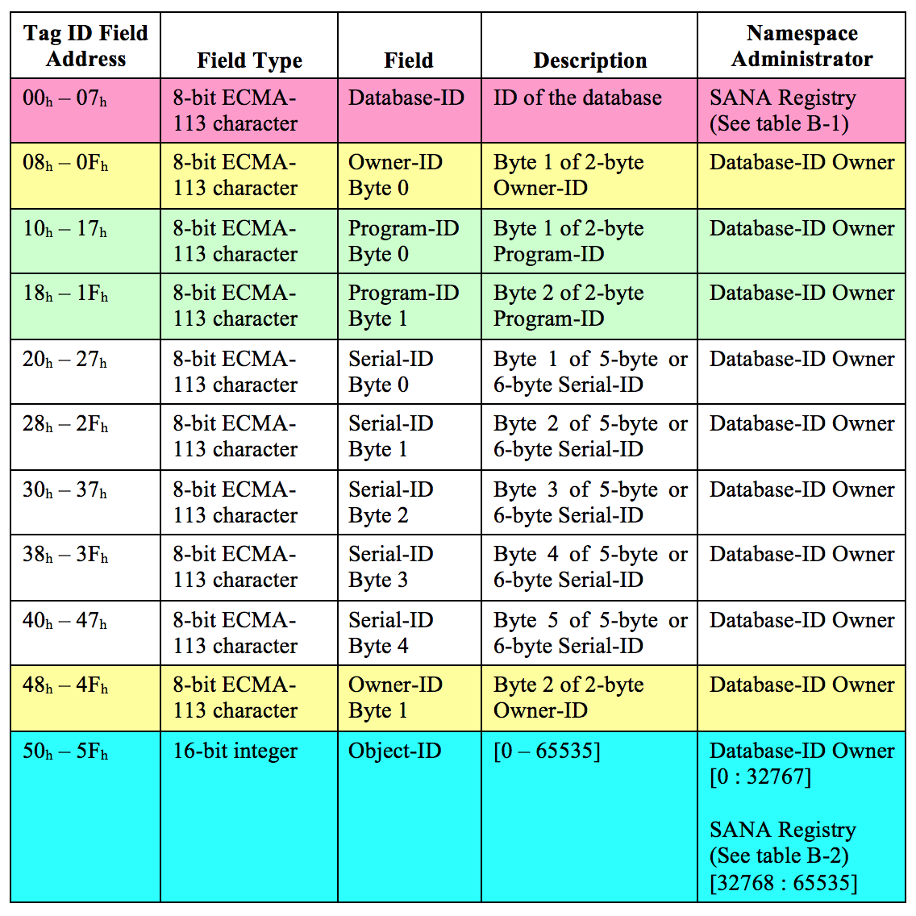
Tag-Encoding Specification (2/2)

Slide 17
Test Coverage Classes
Test Class | Test Class Description | Expected Test Result
Class-1 | Invalid ECMA-113 character | FAIL
Class-2 | Invalid GS1 (ECMA-113 Latin) character? | FAIL
Class-3 | Invalid ECMA-113 Cyrillic character? | FAIL
Class-4 | Invalid Tag-ID field { Database-ID, Owner-ID, Program-ID, Serial-ID & entire Tag-ID } length | FAIL
Class-5 | Invalid Tag-ID Object-ID value <0 .. 65535> | FAIL
Class-6 | Single Invalid Tag-ID[0]..[9] character field | FAIL
Class-7 | Randomly generated Invalid and Valid characters for {Database-ID, Owner-ID, Program-ID, Serial-ID} fields from entire ECMA-113 character set for a statistically based result for sample size N. | PASS / FAIL

Slide 18
Test Coverage: Class-1 Invalid ECMA-113 character
Test Case | Character index range | Test Basis Description | Expected Test Result
Test-01 | [00_{h}] – [1F_{h}] | Invalid ECMA-113 character | FAIL
Test-02 | [7F_{h}] – [9F_{h}] | Invalid ECMA-113 character | FAIL

Slide 19
Test Coverage: Class-2 Invalid GS1 (ECMA-113 Latin) character
Test Case | Character index range | Test Basis Description | Expected Test Result
Test-03 | [20_{h}] | Valid ECMA-113 character but Invalid GS1 character | FAIL
Test-04 | [23_{h}] – [24_{h}] | Valid ECMA-113 characters but Invalid GS1 characters | FAIL
Test-05 | [40_{h}] | Valid ECMA-113 character but Invalid GS1 character | FAIL
Test-06 | [5B_{h}] – [5E_{h}] | Valid ECMA-113 characters but Invalid GS1 characters | FAIL
Test-07 | [60_{h}] | Valid ECMA-113 character but Invalid GS1 character | FAIL
Test-08 | [7B_{h}] – [7E_{h}] | Valid ECMA-113 characters but Invalid GS1 characters | FAIL

Slide 20
Test Coverage: Class-3 Invalid ECMA-113 Cyrillic character
Test Case | Character index range | Test Basis Description | Expected Test Result
Test-09 | [A0_{h}] | Invalid ECMA-113 Cyrillic character | FAIL
Test-10 | [C0_{h}] | Invalid ECMA-113 Cyrillic character | FAIL

Slide 21
Test Coverage: Class 4 Invalid Tag-ID field length
Test Case | Input Field | Test Basis Description | Expected Test Result
Test-11 | Database-ID | Length = 1 | PASS
Test-12 | Database-ID | Length < 1 | FAIL
Test-13 | Database-ID | Length > 1 | FAIL
Test-14 | Owner-ID | Length = 2 | PASS
Test-15 | Owner-ID | Length < 2 | FAIL
Test-16 | Owner-ID | Length > 2 | FAIL
Test-17 | Program-ID | Length = 2 | PASS
Test-18 | Program-ID | Length < 2 | FAIL
Test-19 | Program-ID | Length > 2 | FAIL
Test-20 | Serial-ID | Length = 5 | PASS
Test-21 | Serial-ID | Length < 5 | FAIL
Test-22 | Serial-ID | Length > 5 | FAIL

Slide 22
Test Coverage: Class 5 Invalid Object-ID value
Test Case | Input Field | Test Basis Description | Expected Test Result
Test-23 | Object-ID | Bad Object-ID (< 0) ONLY | FAIL
Test-24 | Object-ID | Bad Object-ID (> 65535) ONLY | FAIL

Slide 23
Test Coverage: Class-6 Single Invalid Tag-ID[0]..[9] character field
Test Case | Input Field | Test Basis Description | Expected Test Result
Test-25 | Database-ID | Invalid Database-ID[0] ONLY | FAIL
Test-26 | Owner-ID | Invalid Owner-ID[0] ONLY | FAIL
Test-27 | Owner-ID | Invalid Owner-ID[1] ONLY | FAIL
Test-28 | Program-ID | Invalid Program-ID[0] ONLY | FAIL
Test-29 | Program-ID | Invalid Program-ID[1] ONLY | FAIL
Test-30 | Serial-ID | Invalid Serial-ID[0] ONLY | FAIL
Test-31 | Serial-ID | Invalid Serial-ID[1] ONLY | FAIL
Test-32 | Serial-ID | Invalid Serial-ID[2] ONLY | FAIL
Test-33 | Serial-ID | Invalid Serial-ID[3] ONLY | FAIL
Test-34 | Serial-ID | Invalid Serial-ID[4] ONLY | FAIL

Slide 24
Test Coverage: Class-7 Randomly generated Invalid and Valid characters for {Database-ID, Owner-ID, Program-ID, Serial-ID} from entire ECMA-113 character set for a Chi-square statistically based result for sample size N.
Test Case | All Input Fields | Test Basis Description | Expected Test Result
Test-35 |  | Randomly generate both Valid and Invalid cases { (Database-ID, Owner-ID, Program-ID, Serial-ID), (Object-ID) } for large N, so that the FAIL rate is statistically based | PASS / FAIL
For ECMA-113 character set: 65 of 256 (25.39%)

Slide 25
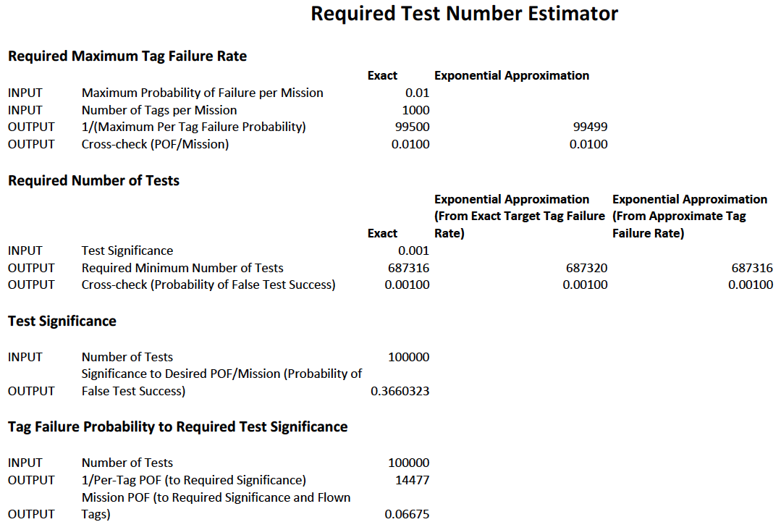
RFID Tag-Encoding Red Book
(CCSDS 881.1-R-1) activities

Slide 26
RFID Tag-Encoding Red Book (CCSDS 881.1-R-1) activities
Object-ID space design:
RFID Tag-ID Interoperability Testing (Yellow Book)

Slide 27
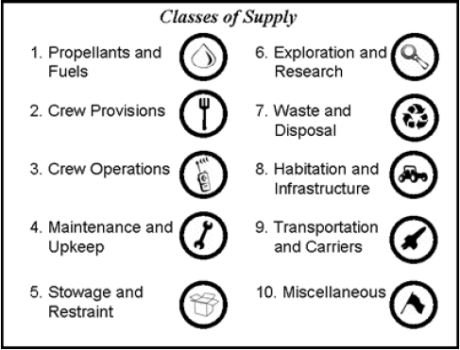
RFID Tag Object-ID space design considerations
Goal: Design the RFID Object-ID space to support ISS and future Exploration activities
Support current ISS inventory schemas
  Not “golden” solution; provide transition pathway
Ensure ample room for anticipated increase in number of inventory items tracked
Design the space in a flexible, easy to evolve manner
Initial high-level inventory categories based on O. de Weck’s work at MIT
Reference: Shull, Gralla, Siddiqi, de Weck, and Shishko, September 2006, AIAA 2006-7232

Slide 28
NASA Flight Crew Systems Hardware Database
16 Top-level categories:
Housekeeping
Exercise
Portable Illumination
Tools
PERS: Payload Equip Restraint System
Stowage & Racks
R&MA: Restraints & Mobility Aids
OC Catalogue
Third Party
Non Flight Control System (FCS)
Non-FCS
ATCS
ECLSS
Habitability
EC Crew Provisions
Shuttle H/W on ISS
Shuttle only FCS

Slide 29
NASA Flight Crew Systems (FCS) Hardware Database
FCS Category | Owner(s) | Number of sub-categories | Number of object classes
Housekeeping | EC7 | 1 | 45
Exercise | EC7 | 1 | 14
Portable Illumination | EC7 | 1 | 24
Tools | EC6, EC7 | 1 | 659
PERS | EC6 | 1 | 7
Stowage and Racks | EC6, EC7, OZ3 | 1 | 89
R&MA | EC6, EC7 | 1 | 98
OC Catalogue | OC | 11 | 382
Third Party | --- | 1 | 15
Non FCS | --- | 1 | 28
Non-FCS ATCS | --- | 1 | 1
ECLSS | EC3 | 1 | 34
Habitability | EC3, EC6 | 5 | 708
EC Crew Provisions | EC7 | 1 | 905
Shuttle H/W on ISS | --- | 1 | 341
Shuttle only - FCS | --- | 1 | 18
TOTALS | 4 | 30 | 3368

Slide 30
De Weck, FCS Integrated Classification
MIT/de Weck | Flight Control System (FCS)
Propellants & Fuels
Crew Provisions | EC Crew Provisions, OC Catalogue
Crew Operations | Portable Illumination, Tools*
Maintenance & Upkeep | Housekeeping, Tools*
Stowage & Restraint | PERS, Stowage & Racks, R&MA
Exploration & Research
Waste & Disposal
Habitation & Infrastructure | ECLSS, Habitability, Exercise
Transportation & Carriers
Miscellaneous | Shuttle H/W, Shuttle only, Non-FCS, non-FCS ATCS, 3rd Party
* Need WWG consensus decision for categorization of all items highlighted in red

Slide 31
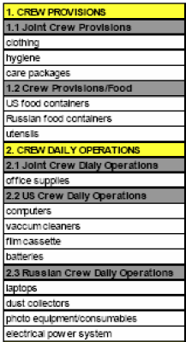
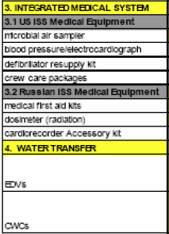
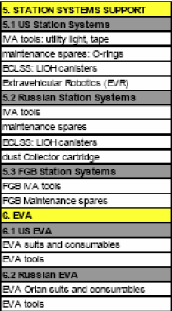
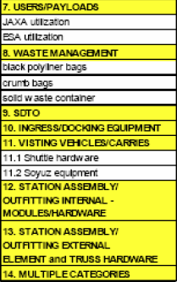
ISS Cargo Category Allocation Rates Table (CCART) Categories
Question: Separate top-level categories for Medical*, EVA*, Crew Consumables*?
These items are absent from the FCS catalogue
EVA could be Crew Operations; Medical and Consumables could be Crew Provisions

Slide 32
DRAFT #1: Wireless WG Proposed Integrated Classification
MIT/de Weck | Flight Control System (FCS) | FCS-Only Object Class Count | ISS CCART | Possible allocation width
Propellants & Fuels |  |  |  | 1000
Crew Provisions | EC Crew Provisions, OC Catalogue | 1287 | 1. Crew Provisions 3. Integrated Medical System* 4. Water Transfer* | 4000
Crew Operations | Portable Illumination, Tools | 683 | 2. Crew Daily Operations | 2000
Maintenance & Upkeep | Housekeeping | 45 | 5. Station Systems Support 6. EVA* | 1000
Stowage & Restraint | PERS, Stowage & Racks, R&MA | 194 |  | 1000
Exploration & Research (focus on research) |  |  | 6. EVA* 7. Users/Payloads* 9. SDTO; RFID Sensors* | 7000
Waste & Disposal |  |  | 8. Waste Management* | 1000
Habitation & Infrastructure | ECLSS, Habitability, Exercise | 756 | 5. Station Systems Support (ECLSS) | 4000
Transportation & Carriers |  |  | Ingress/Docking Equipment* Visiting Vehicles/Carriers* Assembly Hardware*? | 7000
Miscellaneous | Shuttle H/W, Shuttle only, Non-FCS, non-FCS ATCS, 3rd Party | 403 | ?? Make separate top-level categories?? {EVA*, Medical*, Crew Consumables*} | 2000 (leaves 2768 in reserve)

Slide 33
DRAFT #2: Wireless WG Proposed Integrated Classification
MIT/de Weck | Flight Control System (FCS) | FCS-Only Object Class Count | ISS CCART | Possible allocation width
Propellants & Fuels |  |  |  | 1000
Crew Provisions | EC Crew Provisions, OC Catalogue | 1287 | 1. Crew Provisions 3. Integrated Medical System Water Transfer All Medical Supplies → Crew Consumables | 11000
Crew Operations | Portable Illumination | 683 | Crew Daily Operations → Includes tools? | 2000
Maintenance & Upkeep | Housekeeping | 45 | 5. Station Systems Support | 1000
Stowage & Restraint | PERS, Stowage & Racks, R&MA | 194 |  | 1000
EVA Activities; Research activities support |  |  | 6. EVA 7. Users/Payloads 9. SDTO; RFID Sensors | 7000
Waste & Disposal |  |  | 8. Waste Management | 1000
Habitation & Infrastructure | ECLSS, Habitability, Exercise | 756 | 5. Station Systems Support (ECLSS) | 4000
Transportation & Carriers |  |  | Ingress/Docking Equipment Visiting Vehicles/Carriers Assembly Hardware | 7000 1000
Miscellaneous | Shuttle H/W, Non-FCS, 3rd Party | 403 |  | 3768
KKG-updated; need WWG review

