Slide 1
CCSDS SOIS Wireless WG Monthly Telecon
12-July-2016
Primary Topics:
HDR WLAN #1 and HDR WLAN #2 Discussion and Resource Verification
RFID Tag-Encoding Object Class Schema review

Slide 2
CCSDS SOIS Wireless WG Monthly Webcon – GBv3 project
Green Book updates for HDR WLAN Use Cases inclusion (“GBv3 updates”)
  SOIS A.D. to issued an Area Resolution Request to CCSDS Secretariat for “Request for Publication”
  Disposition any comments received (e.g., from SLS)

Slide 3
CCSDS SOIS Wireless WG Monthly Webcon – RFID Tag-Encoding
RFID Tag-Encoding Red Book (CCSDS 881.1-R-1) activities
  Interoperability Test Plan document (current draft)
    Comments/inputs from FSA
    Any comments/inputs from NASA
    Any comments/inputs from other WWG participating agencies
    Interoperability Test preparation and (FSA, NASA) prototyping
      Consensus for current project timeline
    RFID Tag-Encoding interoperability testing sample size review
    ECMA-113 character blacklist
    Update WWG Project Schedule on the CWE (coordinate with SOIS A.D)
  RFID Tag Encoding Object-ID design (final background research in-progress)
    Top-level categorization
      Review Proposed Object-ID design presentation
    Alignment with current UPC Class-ID schemes for forward compatibility?
    SANA Registry updates

Slide 4
CCSDS SOIS Wireless WG Approved Projects (07-Jun-2016):
Project | Priority | Agency Resources (N)one, (O)bserver, (P)articipant; (T)BD?
CCSDS 881.1-R-1: Spacecraft Onboard Interface Services—RFID Tag Encoding Specification (Blue Book) | High | FSA, NASA
High Data Rate Wireless Local Area Network Communications HDR WLAN #1 ISS/Habitat-centric; Blue Book (Decide forward interest and activities in Oct-2016) | High | FSA (N); NASA (N); CSA (?); ESA (?); JAXA(N); DLR (O) | Interest rapidly declining
High Data Rate Wireless Local Area Network Communications HDR WLAN #2 launchers, AIT, satellites; Blue Book (Decide forward interest and activities in Oct-2016) | High | FSA (?); DLR (P); NSSC (?); JAXA (O/P); ESA (O/P); NASA (N) | ESA, JAXA, DLR, FSA interest; more commercially aligned

Slide 5
RFID Tag-Encoding: Interoperability Test Plan Schedule
RFID Tag-Encoding Red Book (CCSDS 881.1-R-1) activities
February
2016
March
2016
April
2016
May
2016
June
2016
July
2016
August
2016
September
2016
October
2016
November
2016
December
2016
2016 Spring Meeting
Cleveland, OH USA
04-08 Apr-2016
2016 Fall Meeting
Rome, Italy (ASI)
17-21 Oct-2016
Current Date →
Kick-off
Test Plan Development;
Yellow Book composition:
Overview, Procedures, PICS
Test Set-up (h/w)
Prototype (s/w)
FSA/NASA
Interop Testing
Test
Report
Draft: 01-Mar-2016
Final: 15-Jun-2016
01-Jul-2016 → 15-Aug-2016
16-Aug-2016 → 15-Sep-2016
16-Sep-2016 → 15-Oct-2016
CMC Approval
(Fall 2016)
RFID Tag Object-ID
space design
SANA Registry
Updates
Participating Agencies: FSA, NASA
Points of Contact (FSA, NASA):
Yuriy Sheynin, FSA
Vladimir Fetisov, FSA
Ray Wagner, NASA
Draft: 01-May-2016
Final: 01-Aug-2016
Draft: 15-Sep-2016
Final: 15-Nov-2016
Published deliverable date to SOIS Chair and the CESG
Wireless WG internal activity
Wireless WG internal working milestone
CCSDS Biannual Meeting
Notes:
Planning Notes 11-Mar-2013:
Discuss SABL Project Plan with Shea and Louis
Coordinate dates for RSA 2FA TIM at HOSC (Shea, Jim, Shankini); cost share this trip with BioServe
Determine timeline on DTN2 Simulator – coordinate HOSC DTN2 G/W testing, test plan, with the HOSC
Will need to plan Automation support for additional BioServe SABL tasks
Have an IDSCam close-out sprint; can transition to SABL early as necessary
HOSC RSA 2FA meeting this week and travel coordination

Slide 6
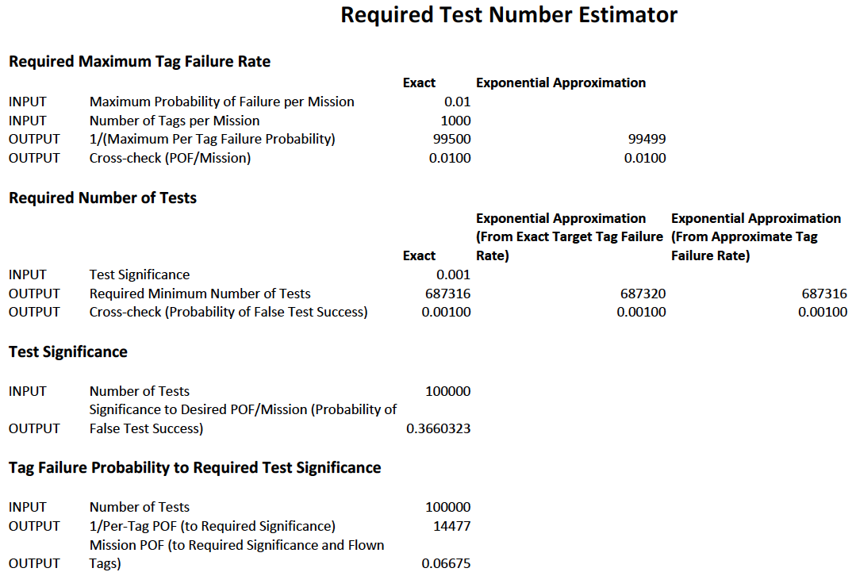
RFID Tag-Encoding Red Book
(CCSDS 881.1-R-1) activities

Slide 7
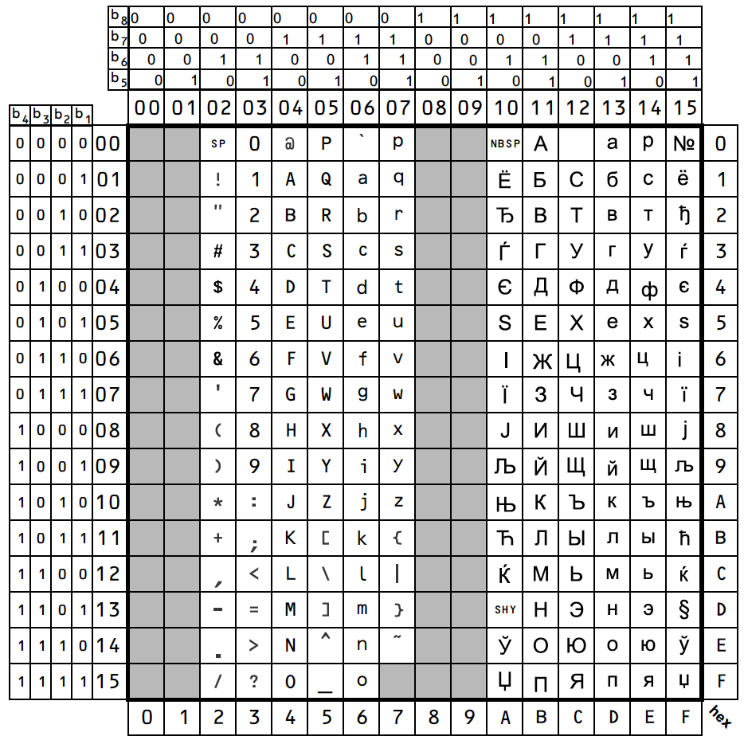
ECMA-113:
Cyrillic
Blacklist?
Non-GS1
RFID Tag-Encoding Red Book (CCSDS 881.1-R-1) activities

Slide 8
ISO / IEC 8824-1
RFID Tag-Encoding Red Book (CCSDS 881.1-R-1) activities
ISO/IEC 15961, 15962, 15963 → ISO-IEC 8824-1
ISO-IEC 8824-1: ASN.1 character set (79 chars)
  A to Z
  A to z
  0 to 9
  : = , { } . @ [ ] ‘ “ | & ^ * ; !

Slide 9
RFID Tag-Encoding Red Book (CCSDS 881.1-R-1) activities
Test Coverage Analysis:
RFID Tag-ID Interoperability Testing (Yellow Book)

Slide 10
Test Coverage Classes
Test Class | Test Class Description | Expected Test Result
Class-1 | Invalid ECMA-113 character | FAIL
Class-2 | Invalid GS1 (ECMA-113 Latin) character? | FAIL
Class-3 | Invalid ECMA-113 Cyrillic character? | FAIL
Class-4 | Invalid Tag-ID field { Database-ID, Owner-ID, Program-ID, Serial-ID } length | FAIL
Class-5 | Invalid Tag-ID Object-ID value <0 .. 65535> | FAIL
Class-6 | Single Invalid Tag-ID[0]..[9] character field | FAIL
Class-7 | Randomly generated Invalid and Valid characters for {Database-ID, Owner-ID, Program-ID, Serial-ID} fields from entire ECMA-113 character set for a Chi-square statistically based result for sample size N. | PASS / FAIL

Slide 11
Test Coverage: Class-1 Invalid ECMA-113 character
Test Case | Character index range | Test Basis Description | Expected Test Result
Test-01 | [00_{h}] – [1F_{h}] | Invalid ECMA-113 character | FAIL
Test-02 | [7F_{h}] – [9F_{h}] | Invalid ECMA-113 character | FAIL

Slide 12
Test Coverage: Class-2 Invalid GS1 (ECMA-113 Latin) character
Test Case | Character index range | Test Basis Description | Expected Test Result
Test-03 | [20_{h}] | Valid ECMA-113 character but Invalid GS1 character | FAIL
Test-04 | [23_{h}] – [24_{h}] | Valid ECMA-113 characters but Invalid GS1 characters | FAIL
Test-05 | [40_{h}] | Valid ECMA-113 character but Invalid GS1 character | FAIL
Test-06 | [5B_{h}] – [5E_{h}] | Valid ECMA-113 characters but Invalid GS1 characters | FAIL
Test-07 | [60_{h}] | Valid ECMA-113 character but Invalid GS1 character | FAIL
Test-08 | [7B_{h}] – [7E_{h}] | Valid ECMA-113 characters but Invalid GS1 characters | FAIL

Slide 13
Test Coverage: Class-3 Invalid ECMA-113 Cyrillic character
Test Case | Character index range | Test Basis Description | Expected Test Result
Test-09 | [A0_{h}] | Invalid ECMA-113 Cyrillic character | FAIL
Test-10 | [C0_{h}] | Invalid ECMA-113 Cyrillic character | FAIL

Slide 14
Test Coverage: Class 4 Invalid Tag-ID field length
Test Case | Input Field | Test Basis Description | Expected Test Result
Test-11 | Database-ID | Length = 1 | PASS
Test-12 | Database-ID | Length < 1 | FAIL
Test-13 | Database-ID | Length > 1 | FAIL
Test-14 | Owner-ID | Length = 2 | PASS
Test-15 | Owner-ID | Length < 2 | FAIL
Test-16 | Owner-ID | Length > 2 | FAIL
Test-17 | Program-ID | Length = 2 | PASS
Test-18 | Program-ID | Length < 2 | FAIL
Test-19 | Program-ID | Length > 2 | FAIL
Test-20 | Serial-ID | Length = 5 | PASS
Test-21 | Serial-ID | Length < 5 | FAIL
Test-22 | Serial-ID | Length > 5 | FAIL

Slide 15
Test Coverage: Class 5 Invalid Object-ID value
Test Case | Input Field | Test Basis Description | Expected Test Result
Test-23 | Object-ID | Bad Object-ID (< 0) ONLY | FAIL
Test-24 | Object-ID | Bad Object-ID (> 65535) ONLY | FAIL

Slide 16
Test Coverage: Class-6 Single Invalid Tag-ID[0]..[9] character field
Test Case | Input Field | Test Basis Description | Expected Test Result
Test-25 | Database-ID | Invalid Database-ID[0] ONLY | FAIL
Test-26 | Owner-ID | Invalid Owner-ID[0] ONLY | FAIL
Test-27 | Owner-ID | Invalid Owner-ID[1] ONLY | FAIL
Test-28 | Program-ID | Invalid Program-ID[0] ONLY | FAIL
Test-29 | Program-ID | Invalid Program-ID[1] ONLY | FAIL
Test-30 | Serial-ID | Invalid Serial-ID[0] ONLY | FAIL
Test-31 | Serial-ID | Invalid Serial-ID[1] ONLY | FAIL
Test-32 | Serial-ID | Invalid Serial-ID[2] ONLY | FAIL
Test-33 | Serial-ID | Invalid Serial-ID[3] ONLY | FAIL
Test-34 | Serial-ID | Invalid Serial-ID[4] ONLY | FAIL

Slide 17
Test Coverage: Class-7 Randomly generated Invalid and Valid characters for {Database-ID, Owner-ID, Program-ID, Serial-ID} from entire ECMA-113 character set for a Chi-square statistically based result for sample size N.
Test Case | All Input Fields | Test Basis Description | Expected Test Result
Test-35 |  | Randomly generate both Valid and Invalid cases { (Database-ID, Owner-ID, Program-ID, Serial-ID), (Object-ID) } for large N, so that the FAIL rate is statistically based? | PASS / FAIL
For ECMA-113 character set: 65 of 256 (25.39%)

Slide 18
RFID Tag-Encoding Red Book (CCSDS 881.1-R-1) activities
Object-ID space design:
RFID Tag-ID Interoperability Testing (Yellow Book)

Slide 19
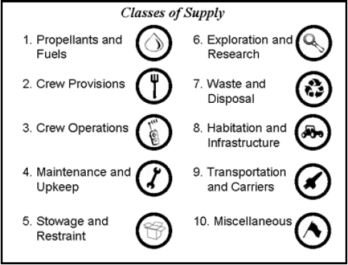
RFID Tag Object-ID space design considerations
Goal: Design the RFID Object-ID space to support ISS and future Exploration activities
Support current ISS inventory schemas
  Not “golden” solution; provide transition pathway
Ensure ample room for anticipated increase in number of inventory items tracked
Design the space in a flexible, easy to evolve manner
Initial high-level inventory categories based on O. de Weck’s work at MIT
Reference: Shull, Gralla, Siddiqi, de Weck, and Shishko, September 2006, AIAA 2006-7232

Slide 20
NASA Flight Crew Systems Hardware Database
16 Top-level categories:
Housekeeping
Exercise
Portable Illumination
Tools
PERS: Payload Equip Restraint System
Stowage & Racks
R&MA: Restraints & Mobility Aids
OC Catalogue
Third Party
Non Flight Control System (FCS)
Non-FCS
ATCS
ECLSS
Habitability
EC Crew Provisions
Shuttle H/W on ISS
Shuttle only FCS

Slide 21
NASA Flight Crew Systems (FCS) Hardware Database
FCS Category | Owner(s) | Number of sub-categories | Number of object classes
Housekeeping | EC7 | 1 | 45
Exercise | EC7 | 1 | 14
Portable Illumination | EC7 | 1 | 24
Tools | EC6, EC7 | 1 | 659
PERS | EC6 | 1 | 7
Stowage and Racks | EC6, EC7, OZ3 | 1 | 89
R&MA | EC6, EC7 | 1 | 98
OC Catalogue | OC | 11 | 382
Third Party | --- | 1 | 15
Non FCS | --- | 1 | 28
Non-FCS ATCS | --- | 1 | 1
ECLSS | EC3 | 1 | 34
Habitability | EC3, EC6 | 5 | 708
EC Crew Provisions | EC7 | 1 | 905
Shuttle H/W on ISS | --- | 1 | 341
Shuttle only - FCS | --- | 1 | 18
TOTALS | 4 | 30 | 3368

Slide 22
De Weck, FCS Integrated Classification
MIT/de Weck | Flight Control System (FCS)
Propellants & Fuels
Crew Provisions | EC Crew Provisions, OC Catalogue
Crew Operations | Portable Illumination, Tools*
Maintenance & Upkeep | Housekeeping, Tools*
Stowage & Restraint | PERS, Stowage & Racks, R&MA
Exploration & Research
Waste & Disposal
Habitation & Infrastructure | ECLSS, Habitability, Exercise
Transportation & Carriers
Miscellaneous | Shuttle H/W, Shuttle only, Non-FCS, non-FCS ATCS, 3rd Party
* WWG consensus decision for categorization of all items highlighted in red

Slide 23
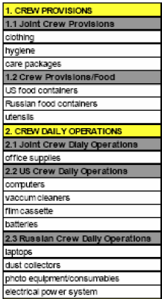
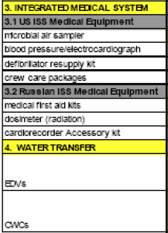
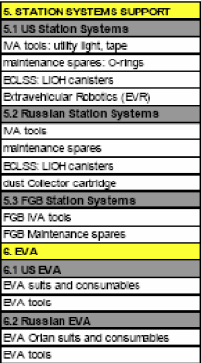
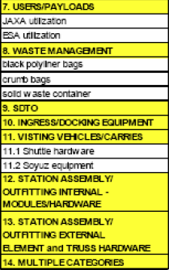
ISS Cargo Category Allocation Rates Table (CCART) Categories
Question: Separate top-level categories for Medical*, EVA*, Crew Consumables*?
These items are absent from the FCS catalogue
EVA could be Crew Operations; Medical and Consumables could be Crew Provisions

Slide 24
DRAFT #1: Wireless WG Proposed Integrated Classification
MIT/de Weck | Flight Control System (FCS) | FCS-Only Object Class Count | ISS CCART | Possible allocation width
Propellants & Fuels |  |  |  | 1000
Crew Provisions | EC Crew Provisions, OC Catalogue | 1287 | 1. Crew Provisions 3. Integrated Medical System* 4. Water Transfer* | 4000
Crew Operations | Portable Illumination, Tools | 683 | 2. Crew Daily Operations | 2000
Maintenance & Upkeep | Housekeeping | 45 | 5. Station Systems Support 6. EVA* | 1000
Stowage & Restraint | PERS, Stowage & Racks, R&MA | 194 |  | 1000
Exploration & Research (focus on research) |  |  | 6. EVA* 7. Users/Payloads* 9. SDTO; RFID Sensors* | 7000
Waste & Disposal |  |  | 8. Waste Management* | 1000
Habitation & Infrastructure | ECLSS, Habitability, Exercise | 756 | 5. Station Systems Support (ECLSS) | 4000
Transportation & Carriers |  |  | Ingress/Docking Equipment* Visiting Vehicles/Carriers* Assembly Hardware*? | 7000
Miscellaneous | Shuttle H/W, Shuttle only, Non-FCS, non-FCS ATCS, 3rd Party | 403 | ?? Make separate top-level categories?? {EVA*, Medical*, Crew Consumables*} | 2000 (leaves 2768 in reserve)

Slide 25
DRAFT #2: Wireless WG Proposed Integrated Classification
MIT/de Weck | Flight Control System (FCS) | FCS-Only Object Class Count | ISS CCART | Possible allocation width
Propellants & Fuels |  |  |  | 1000
Crew Provisions | EC Crew Provisions, OC Catalogue | 1287 | 1. Crew Provisions 3. Integrated Medical System Water Transfer All Medical Supplies → Crew Consumables | 11000
Crew Operations | Portable Illumination | 683 | Crew Daily Operations → Includes tools? | 2000
Maintenance & Upkeep | Housekeeping | 45 | 5. Station Systems Support | 1000
Stowage & Restraint | PERS, Stowage & Racks, R&MA | 194 |  | 1000
EVA Activities; Research activities support |  |  | 6. EVA 7. Users/Payloads 9. SDTO; RFID Sensors | 7000
Waste & Disposal |  |  | 8. Waste Management | 1000
Habitation & Infrastructure | ECLSS, Habitability, Exercise | 756 | 5. Station Systems Support (ECLSS) | 4000
Transportation & Carriers |  |  | Ingress/Docking Equipment Visiting Vehicles/Carriers Assembly Hardware | 7000 1000
Miscellaneous | Shuttle H/W, Non-FCS, 3rd Party | 403 |  | 3768
KKG-updated; need WWG review

Slide 26
HDR WLAN Activities
HDR WLAN#1
and
HDR WLAN#2

Slide 27
Wireless WG Approved Project Milestones
Jun
2015
Jul
2015
Aug
2015
Sep
2015
Oct
2015
Nov
2015
Dec
2015
Jan
2016
Feb
2016
Mar
2016
Apr
2016
May
2016
Jun
2016
Jul
2016
Aug
2016
Sep
2016
2015 Fall Meeting
Darmstadt, Germany
09-13 Nov-2015
2016 Spring Meeting
Cleveland, OH USA
04-08 Apr-2016
Current Date →
HDR WLAN:
Use Case
Organization
Use Case Completion –
Finalize GBv3 document for submission
HDR WLAN Organizational & Project Activities
Green Book (GBv3) Updates for HDR WLAN [Poll request in-progress 08-Apr-2016]
High Data Rate
WLAN Blue Book
initial outline draft
15-Apr-2016
HDR WLAN
Blue Book
Final Draft #1
(Fall 2016)
Published deliverable date to SOIS Chair and the CESG
Wireless WG internal activity
Wireless WG internal working milestone
CCSDS Biannual Meeting
Notes:
Planning Notes 11-Mar-2013:
Discuss SABL Project Plan with Shea and Louis
Coordinate dates for RSA 2FA TIM at HOSC (Shea, Jim, Shankini); cost share this trip with BioServe
Determine timeline on DTN2 Simulator – coordinate HOSC DTN2 G/W testing, test plan, with the HOSC
Will need to plan Automation support for additional BioServe SABL tasks
Have an IDSCam close-out sprint; can transition to SABL early as necessary
HOSC RSA 2FA meeting this week and travel coordination

Slide 28
HDR WLAN Blue Book Publicized (single-book) Project Schedule
Q4
2015
Q1
2016
Q2
2016
Q3
2016
Q4
2016
Q1
2017
Q2
2017
Q3
2017
Q4
2017
Q1
2018
Q2
2017
Q3
2017
Q4
2017
2015 Fall Meeting
2016 Spring Meeting
2016 Fall Meeting
2017 Spring Meeting
2017 Fall Meeting
2018 Spring Meeting
2018 Fall Meeting
Current Date →
HDR WLAN Organizational & Project Activities:
Identify use cases, requirements,
solution space, candidate recommendations
HDR WLAN Continued Activities: Technology review/updates; Engineering
Recommendations; Identify expected Blue Book recommended standards
HDR WLAN
Interoperability Testing….
Green Book (GBv3) Updates for HDR WLAN
08-Apr-2016
High Data Rate WLAN
Blue Book Final Draft #1
(Fall 2016)
High Data Rate WLAN
Blue Book Final Draft #2
(Spring 2018)
Published deliverable date to SOIS Chair and the CESG
Wireless WG internal activity
Wireless WG internal working milestone
CCSDS Biannual Meeting
Notes:
Planning Notes 11-Mar-2013:
Discuss SABL Project Plan with Shea and Louis
Coordinate dates for RSA 2FA TIM at HOSC (Shea, Jim, Shankini); cost share this trip with BioServe
Determine timeline on DTN2 Simulator – coordinate HOSC DTN2 G/W testing, test plan, with the HOSC
Will need to plan Automation support for additional BioServe SABL tasks
Have an IDSCam close-out sprint; can transition to SABL early as necessary
HOSC RSA 2FA meeting this week and travel coordination

Slide 29
HDR WLAN Blue Book Project Schedule DRAFT Proposal
Q4
2015
Q1
2016
Q2
2016
Q3
2016
Q4
2016
Q1
2017
Q2
2017
Q3
2017
Q4
2017
Q1
2018
Q2
2018
Q3
2018
Q4
2018
2015 Fall Meeting
2016 Spring Meeting
2016 Fall Meeting (Rome)
2017 Spring Meeting
2017 Fall Meeting
2018 Spring Meeting
2018 Fall Meeting
Current Date →
Organizational Activities: Use cases,
requirements, solution space,
candidate recommendations
HDR WLAN ISS-centric
Standard recommendation (802.11ac):
Network Deployment/Management,
PHY layer considerations
HDR WLAN #1 (ISS)
Interoperability Testing
(NASA, FSA?, CSA?)
Green Book (GBv3)
08-Apr-2016
High Data Rate
WLAN #1 Draft (ISS)
Blue Book (Fall 2016)
High Data Rate
WLAN #1 Final (ISS)
Blue Book (Fall 2016)
High Data Rate
WLAN #1 Complete
(Spring 2018)
Published deliverable date to SOIS Chair and the CESG
Wireless WG internal activity
Wireless WG internal working milestone
CCSDS Biannual Meeting
Notes:
Planning Notes 11-Mar-2013:
Discuss SABL Project Plan with Shea and Louis
Coordinate dates for RSA 2FA TIM at HOSC (Shea, Jim, Shankini); cost share this trip with BioServe
Determine timeline on DTN2 Simulator – coordinate HOSC DTN2 G/W testing, test plan, with the HOSC
Will need to plan Automation support for additional BioServe SABL tasks
Have an IDSCam close-out sprint; can transition to SABL early as necessary
HOSC RSA 2FA meeting this week and travel coordination

Slide 30
HDR WLAN Blue Book Project Schedule DRAFT Proposal
Q4
2015
Q1
2016
Q2
2016
Q3
2016
Q4
2016
Q1
2017
Q2
2017
Q3
2017
Q4
2017
Q1
2018
Q2
2018
Q3
2018
Q4
2018
2015 Fall Meeting
2016 Spring Meeting
2016 Fall Meeting (Rome)
2017 Spring Meeting
2017 Fall Meeting
2018 Spring Meeting
2018 Fall Meeting
Current Date →
Preliminary:
Expect further definition over next 3 months
Time scale considerations (too optimistic?)
Organizational Activities: Use cases,
requirements, solution space,
candidate recommendations
HDR WLAN ISS-centric
Standard recommendation (802.11ac):
Network Management, Tuning,
PHY layer considerations
HDR WLAN #1 (ISS)
Interoperability Testing
Green Book (GBv3)
08-Apr-2016
High Data Rate
WLAN #1 Draft (ISS)
Blue Book (Fall 2016)
High Data Rate
WLAN #1 Final (ISS)
Blue Book (Spring 2017)
High Data Rate
WLAN #1 Complete
(Fall 2017)
Time scale considerations (too short?)
Pre-activities:
Additional non-ISS
(launchers, AIT, satellites, etc.)
Identify candidate solutions;
better define time scale for Phase 2
HDR WLAN #2 Standard recommendation:
(Investigate non-802.11, Wi-Fi, LTE, LTE-U, LWA)
HDR WLAN #2
Interoperability Testing
High Data Rate
WLAN #2 Draft
Blue Book (Fall 2017)
High Data Rate
WLAN #2 Final
Blue Book (Spring 2018)
High Data Rate
WLAN #2 Complete
(Fall 2018)
Published deliverable date to SOIS Chair and the CESG
Wireless WG internal activity
Wireless WG internal working milestone
CCSDS Biannual Meeting
Notes:
Planning Notes 11-Mar-2013:
Discuss SABL Project Plan with Shea and Louis
Coordinate dates for RSA 2FA TIM at HOSC (Shea, Jim, Shankini); cost share this trip with BioServe
Determine timeline on DTN2 Simulator – coordinate HOSC DTN2 G/W testing, test plan, with the HOSC
Will need to plan Automation support for additional BioServe SABL tasks
Have an IDSCam close-out sprint; can transition to SABL early as necessary
HOSC RSA 2FA meeting this week and travel coordination

Slide 31
HDR WLAN #1, #2 forward strategies
HDR WLAN #1 (ISS-focused; NASA-lead, FSA participant, CSA?)
  3 months to decide (resources allocation first of week of July)
  Blue Book, Interop testing to be done by JSC/Chatwin Lansdowne
  Strategic/Outreach planning: communicate with trusted supervisory personnel at NASA (Pat Fink, et al)
  We determine JSC amenability to our proposed ISS (WLAN #1 plan: BB → who does Interop testing and resources)
  Project vs. Program issues to discuss (want NASA to have a wider view for the future)
  Do we want to get in front of EWC personnel and talk about WWG perceived potential problems (can we make this happen); network controller, intersymbol smearing issue/ delay-spread issues)
  Emphasize utilizing ISS as exploration-forward testbed
  EVA interest; Payloads; Operations; Exploration and EVA for Exploration (recall SBIR effort)
  Opportunity analysis strategy (administration change, modern networking, commercial interest, international participation)
  Technical expertise: can we get required (NASA) personnel involved?
  Right, correct Interop Testing concerns
HDR WLAN #2 (no ISS-focus) (FSA, DLR, ESA, JAXA, NASA-not lead)
  3 months for resources commitments from agencies
  Launchers, satellites, AIT
  Exploration-forward as well
  Could still utilize ISS as exploration-forward testbed
  We expect ESA to strongly support HDR WLAN #2 – NEEDS VERIFICATION

Slide 32
HDR WLAN high-level discussion points

Slide 33
HDR WLAN Book Organizational Plan(s)
Agency use cases to characterize need (Use Case update of Green Book - Completed)
  Is ISS the only real customer at this point? Is NASA SCaN a customer? Alignment for future purposes? Can we extrapolate to identify other customers?
Scope properly (customer focus emphasis);
  This means Wi-Fi for ISS if short-term focus; ISS EVA focus
  Application profiles specifying PHY modes selection
  Implies short-term focus right now
  Agency roadmaps for additional HDR WLAN use cases??
Important Observation: Expect our (WWG) path to be evolutionary as well which dictates a staged approach (802.11 evolution; 802.11/LTE co-existence).
[NASA, FSA]: ISS as a testbed for future exploration wireless communication technologies; For the WWG is there too much risk in being overly ISS-focused? ISS cultural problems, expectations, etc.
NASA (AES, SCaN, NDSWG) concerns: How to handle EVA, EVA suits, tele-robotic activity, sensor networks, vehicle monitoring, ubiquitous networking, vehicle docking support; ISS EVA focus: Use ISS as a testbed for wireless technology maturation (any location-based services, e.g. 802.11az). Not just an ISS book; but will mature exploration wireless communication technologies.
FSA wireless focus (DLR agreement): ISS testbed for future exploration wireless communications; Intra-spacecraft wireless networking; proximate EVA activities; HDR Sensor rates; Docking; On-orbit assembly activities; Planetary surface wireless?? (FSA not convinced this is a SOIS area); Correlation/coordination with SOIS architecture.

Slide 34
HDR WLAN Book Organizational Plan(s)
DLR (agreement with FSA): WLAN interest as well; focus on ISS as a testbed
ESA (strong agreement with FSA, DLR): communication within a spacecraft; could check with ESA human spaceflight program; important problem reduce/eliminate power constraints to sensors; AIT is a primary focus.
CSA priorities: Body-area nets, EVA activities, robotics, astro-skin; most of CSA investment is in the ISS; CSA not interested in RFID or RFID-sensing currently. No long-term space plan in Canada (possibly environmental-focused communications will arise); ISS is for technology development for Exploration; Stephen Braham: Planetary surface communications.
CNSA?
JAXA: difficult to adapt wireless for space missions – do step-by-step; first integrate wireless in AIT, then in vehicle wireless avionics, then intra-satellite. ISS EVA activities. ISAS interested in sensor networking; science mission projects including robotic surface activities, communication with relay orbiter (e.g., prox-2 link capability)

Slide 35
HDR WLAN Book Organizational Plan(s)
What the standard can do and can’t do (with possible recommendations?)
What do our sponsors want us to do; can we seek sponsor guidance? Customer guidance?
WWG external-stakeholder input for clarification of needs and tasks
Blue Book must be terse; what makes it worth doing
Candidate Proposal: Wi-Fi based Blue Book(?): specify the PHY/MAC standard
  Internal habitat and intra-satellite communication
  Inter-satellite communication? (SLS coordination)
  External communication
  Launchers
  AIT (this is important and is a key driver/importance for ground testing and verification)
  Sub-orbital, high-altitude terrestrial network communications (SLS coordination)
  Note sensor-centric emphasis in many above domains (here the key constraint is power consumption)
  How important is meshing?
  Low-power Wi-Fi, TSN
  Wi-Fi/LTE in broadcast TV whitespace?
  802.11aa specifically for Video Transport?
  Interoperability testing issues (“802.11” vs. “.b”, “.g”, “.n”, “.s”, “ac”, “ax”, “az”)
Importance of space qualification and TRL maturation
Past history of wanting high-speed wireless sensing

Slide 36
HDR WLAN Book Organizational Plan(s)
Extract generalized and specific (when possible) requirements
Characterize engineering metrics / figures of merit
Identify constraints
Market surveys (what is out there: commercial/industry/IEEE, IEEE TSN, ITU, IETF)
Technology evaluations; technology maturation
Identify applicable standards and anticipated evolution roadmaps
  E.g., 802.11x, 3GGP 5G, etc..
Identify trade-offs
  E.g., power, data rates, range, centralized vs. distributed; modulation
Identify specific coordination strategies (SOIS Deterministic networking BoF)
Blue Book Outline:
  1. Boilerplate scope and purpose; 2. Overview; 3. Recommendation(s)
Where to put HDR WLAN engineering analyses (GB?)
Time domain of recommendation applicability:
Very short-term: 1 – 2 years
Short-term: 3 – 5 years
Medium term: 6 – 10 years
Longer term: 10 – 20 years
Long-term: 20+ years

Slide 37
HDR WLAN Book Organizational Plan(s): SIS MIA/VOICE
Date: 11-Feb-2016
Attendees: Rodney Grubbs (NASA-MSFC), Rick Barton (NASA-JSC), Osvaldo Peinado (ESA/DLR), Kevin Gifford (NASA-JSC sponsor)
Focus of discussion: How to best incorporate user and stakeholder (e.g, MIA, VOICE, ISS, EWC, JEM) requirements for a High Data-Rate Wireless Local Area Network ("HDR-WLAN") CCSDS Recommended Standard.
Primary Outcome: SOIS-WIR, SIS-MIA, SIS-VOICE are in agreement to work in a coordinated fashion to gather concerns, inputs, requirements, test data, etc., in an effort to best inform the Wireless WG regarding stakeholder requirements and concerns relating to a HDR-WLAN CCSDS Recommended Standard.
Action Items:
KKG: Coordinate WWG Agenda for 2016 Spring Meetings (Cleveland); once ratified by the WWG, publish the agenda to RPG/OP in an effort to coordinate SIS-MIA/VOICE potential attendance to the WWG HDR-WLAN discussions
KKG: Agreed to reserve 1/2 day (4 hours) during the 2016 Fall Meetings (Rome) for a SOIS-WIR, SIS-MIA/VOICE technical discussion
RPG: Provide SIS-MIA requirements and constraints regarding wireless LAN video transmission including H.264 and ATVC video streaming
RPG: Determine if can obtain any technical information regarding a JEM-EF external Wi-Fi system (JAXA?).
RJB: Get KSC (and any other available) ground testing data for the ISS EWC; determine if a system design was developed and documented (obtain if available)
RJB/RPG: Determine if can get latest ELC Wi-Fi system requirements (or is this just part of the EWC design?)
RJB: Talk with Chatwin Lansdowne to coordinate EWC involvement
RJB/RPG: Talk with Penny Roberts to coordinate EWC involvement
RJB: Determine the plausibility of having Chatwin and/or Penny either attend the Cleveland meetings for a day; or to give a remote presentation to the WWG overviewing the EWC system design along with requirements and constraints
KKG: Look to get EWC operational performance data at end of CY2016 / start of CY 2017

Slide 38
Back-up Charts &
High-Level CCSDS Schedules

Slide 39
RFID Tag-Encoding Specification: Interoperability Testing
Determine timeline requirements
Summarize technical requirements / constraints
  What will ISS OC allow?
  What is allowed for DTO / Experiments
Complete prototype of hardware & software
Procure/configure Testing Facility
Compose Test Plan
  Testing basis and goals overview
    Software-based: test random IDs
    Hardware-based: physical tag exchange
  Summary testing diagram(s)
  Specify testing procedures with protocol implementation conformance statements (PICS); expected results must be specified
Information exchange specification
  E-mail is fine; but if any VPN remote connectivity is being contemplated then specify and start ASAP
Consensus on Object-ID space design prior to interoperability testing (Not required)
  Object-ID verification will be part of formal testing
  But it is formally required to verify read/write of Tag ID fields, not to verify “what the fields mean” in an operational setting
Specify SANA registries and content after successful interoperability testing
Yellow Book (results reviewed by CESG):
  Ch. 1: Introduction
  Ch. 2: Testing basis and description overview (short, concise)
  Annex: Test Procedures (detailed, step-by-step, with expected results)
  Annex: Test Results including PICS
Protocol Implementation Conformance Statements (ICS)
  Software identification and version recording
  Hardware identification and version recording
  Base operational and configuration parameter conformance specification
  Any software or hardware calibration procedures
  Tag writer and tag reader h/w and s/w
  Any test facility specific (environment) conditions specified and recorded (test configuration, read distance, etc.)
  Must specify Pass/Fail Criteria for each test
  Basis (fundamental) Test Cases
  Failure Test Cases
  Bad Data Test Cases
  Other Test Cases
  “Random-ID” Test Cases (non-sensical)
  “Expected-IDs” Test Cases
  Field limit test cases
  Out-of-bounds (ECMA-113) test cases
  Out-of-bounds (GS1) test cases
  Cyrillic character test cases

Slide 40
SOIS Area Report (Spring 2016)
  Planning
  WWG RFID Encoding Blue Book:
  Spring 2015: Final draft#2 RFID Encoding Blue Book [completed]
  Release to Area Director [completed]
  Submission to Secretariat
  Fall 2015: Final Agency review completion
  Summer 2016: Prototype development completion
  Fall 2016 Interoperability Testing complete
  Fall 2016: CMC approval
  WWG Wireless Local Area Network Blue Book (HDR WLAN #1, HDR WLAN #2):
  Spring 2015: Initiation of standardization specification
  Fall 2016: Final draft#1 WLAN Blue Book
  Spring 2018: Final draft#2 WLAN Blue Book
  Release to Area Director
  Spring 2019: Final Agency review completion
  Fall 2020: First/second prototype development completion
  Winter 2020: CMC approval
Notes:
40

Slide 41
CCSDS SOIS Wireless WG Projects Summary

Slide 42
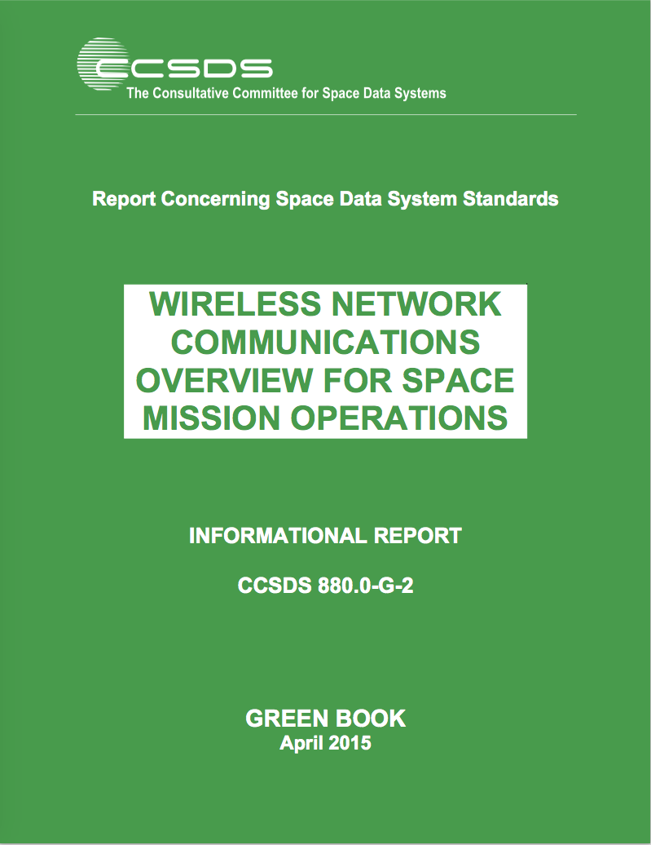


CCSDS SOIS Wireless WG Published Documents
Wireless Network Communications Overview (Green Book,
Revision 2):
Set Basis via: Overview, Use Cases, Technologies
“Green Book”
“GBv2”
RFID-Based Inventory Management Systems (Magenta Book):
Specifies ISO-18000-6c (EPC Class-1, Gen-2) as the over-the-air
interface and protocol recommendation.
→ “RFID Magenta Book”
Low Data-Rate Wireless Communications for Spacecraft Monitoring
and Control as the over-the-air; Specifies PHY/MAC interface and
protocol recommendations (IEEE 802.15.4-2011, ISA100.11a-2011).
→ “LDR Magenta Book”

Slide 43
CCSDS SOIS Wireless WG Current Projects
CCSDS 881.1-R-1: Spacecraft Onboard Interface Services—RFID Tag Encoding Specification. This document provides a Recommended Standard for the utilization of Radio Frequency Identification (RFID) protocol and communication standards in support of inventory management activities associated with space missions.
Spacecraft Onboard Interface Services – High Data Rate Wireless Local Area Network Communications (HDR WLAN): Develop, specify, and standardize Wireless LAN networked communications for space agency utilization via a “Wireless Local Area Network Blue Book”. This would be followed by an anticipated Magenta Book with application profiles for several canonical use-cases. Why this is important: Required to enable multi-agency interoperability for ISS proximity EVA/IVA/Robotics, for intra-spacecraft communications and sensing, and for Exploration-class internal & external vehicle proximity, including surface, communications (e.g., robotics, habitat, and EVA). It is necessary to perform this work now rather than later to avoid future interoperability issues and resulting operational impacts. Expected benefits: Improved crew operations, enhanced safety, increased science return, decreased costs

Slide 44
CCSDS SOIS Wireless WG Draft Projects
881x0m1: The RFID Magenta Book RFID-Based Inventory Management Systems (Revision 2) will be updated to provide enhanced security mechanisms. The original (version 1) of the Magenta Book (880x0r1) on RFID-Based Inventory Management Systems is based upon the combined ISO 18000-6c and EPCGlobal Class-1 Gen-2 standards dated 2008. An important update is to provide security mechanisms for authentication, authorization, data integrity and privacy that is facilitated by the EPCGlobal Class-2 Gen 2 Version 2 specification released in 2013.
RFID Sensing Recommended Standard (proposed new Blue Book): This recommended standard will specify requirements and best practices to enable interoperable RFID tag sensing. As RFID has transitioned to mainstream commercial terrestrial utilization the capability to add sensors (temperature, pressure, light, acoustic, etc.) to the RFID tag silicon for periodic sampling enables small form-factor IoT type of devices directly onboard the RFID tag. It is anticipated that this combined form-factor, in either passive or active RFID devices, will be of significant interest to commercial, military, and space market segments.

Slide 45
CCSDS SOIS Wireless WG Draft Projects
881x1r1: RFID Tag-Encoding Specification (Blue Book) for RFID-Based Inventory Management Systems will be updated (Revision 2) to provide a recommended standard based upon EPC- and ISO-compliant RFID tag naming specifications. Version 1 of the RFID Tag-Encoding Specification provided a tag-encoding schema that was purposefully designed to enable a smooth transition to a fully compliant modern tag-naming schema as evidenced by the wide-scale world-wide adoption of the EPC/ISO RFID Tag-Encoding data standards.
880x0g2: WWG Green Book (880x0g3; GBv3) updates for HDR WLAN and dated LTE verbiage:
880x0g3: WWG Green Book (880x0g4; GBv4) updates for Wi-Fi technology evolution (propose when GBv3 updates completed):

Slide 46
ISS IMS tag-encoding augmentation proposal
Designate a {OwnerID, ProgramID, ObjectID} tuple
Manage the OwnerID/ProgramID namespace to uniquely identify additional Owners (Space Agencies) and associated Programs
Manage the ObjectID namespace to improve automated inventory management practices and provide a transition path for future standardized tag-encoding
Does not alter/affect current IMS naming conventions or operations
  Defines {OwnerID, ProgramID, ObjectID} namespace in an engineered manner to support future IMS operations

Slide 47
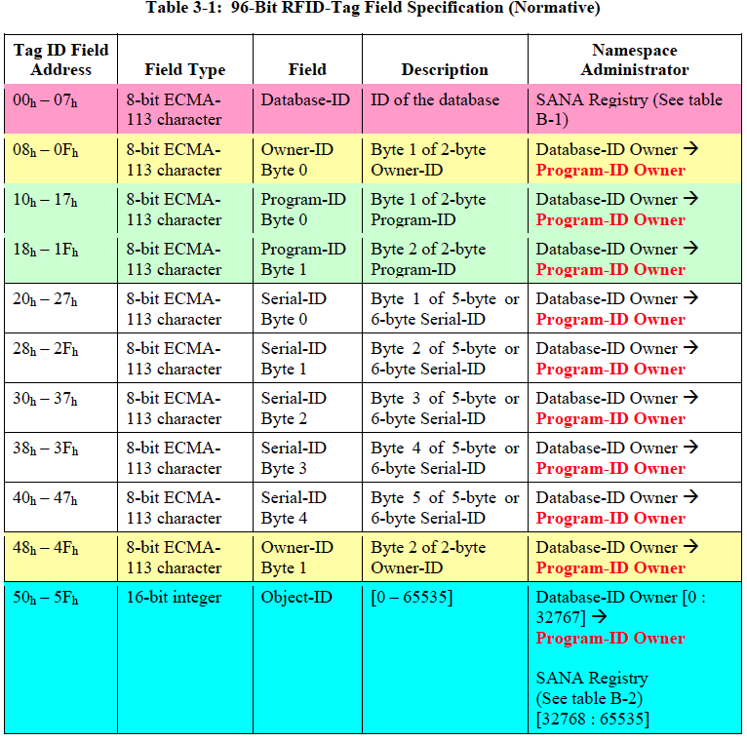

Slide 48
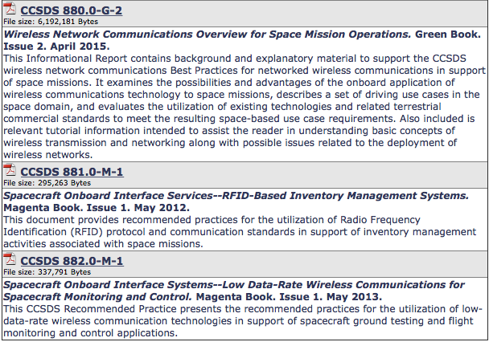
CCSDS SOIS Wireless WG Publications

Slide 49
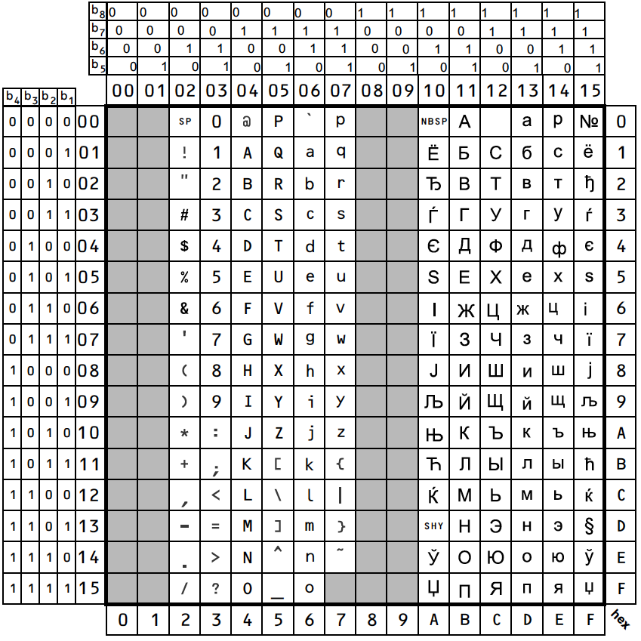
Code Table of Latin/Cyrillic Alphabet

