Slide 1
CCSDS SOIS Wireless WG Monthly Webcon
01-Mar-2016
Primary Topics:
RFID Interoperability Plan coordination
RFID Tag Encoding Object-ID namespace
HDR WLAN Blue Book organization outline

Slide 2
CCSDS SOIS Wireless WG Monthly Webcon
RFID Tag-Encoding Red Book (CCSDS 881.1-R-1) activities:
CCSDS 881.1-R-1 Document Status:
Sent to CCSDS Secretariat for publication (19-Oct-2015)
KKG updated three items in Figure 3-1 and Annex C encoding example
KKG to update WWG Project Schedules on the CWE
Activities for CCSDS 881.1-R-1 to satisfy Blue Book requirements
Interoperability Test Plan preparation and (FSA, NASA) prototyping
Set expectations and project timeline
Object-ID space design: Discuss initial design strategies and concerns
Review Proposed Object-ID design presentation
Interoperability Test Plan execution
SANA Registry updates

Slide 3
CCSDS SOIS Wireless WG Monthly Webcon
Green Book updates for HDR WLAN Use Cases inclusion (“GBv3 updates”)
GBv3 project has requested CMC poll for resource approval
Final GBv3 draft () put on CWE for WWG internal review: Review inputs due 15-Mar-2016
HDR WLAN discussion:
Magenta book vs. Blue book: Come to WWG consensus
Report on conversation with Keith Scott: Leverage commercial interoperability testing with agencies
11-Feb-2016: Telecon w/ Osvaldo Peinado (DLR) & Rodney Grubbs (NASA): Agreement to hold coordination meetings with SIS-MIA and SIS-VOICE regarding HDR WLAN inputs and concerns
Spring 2016 primary discussion topic:
Draft project schedule discussion
Book organization/contents discussion (draft outline)

Slide 4
CCSDS SOIS Wireless WG Monthly Webcon
Additional topics:
Poll: WWG meeting attendance for the CCSDS 2016 Spring Meetings in Cleveland
Prioritize CCSDS 2016 Spring WWG meeting topics:
Object-ID schema discussion and consensus of draft namespace schema
RFID Interoperability Testing
Brainstorm/discussion regarding HDR WLAN content and organization
SOIS A.D. and Deputy A.D. transition
Open items for group discussion
Backlog Items
User Guide reference for integration of WWG with SOIS Subnetwork activity

Slide 5
CCSDS SOIS Wireless WG Projects Prioritization: Fall 2015
Project | Priority | Agency Resources
CCSDS 881.1-R-1: Spacecraft Onboard Interface Services—RFID Tag Encoding Specification | High | FSA, NASA
Spacecraft Onboard Interface Services – High Data Rate Wireless Local Area Network Communications (HDR WLAN) | High | CSA, FSA, NASA, ESA
Draft Project | Fall 2015 Rank | When to start??
881x0m1: RFID Magenta Book RFID-Based Inventory Management Systems (Revision 2: Security updates) | #1b | 2017; after GBv4 updates completed
RFID Sensing Recommended Standard (proposed new MB, BB?) | #2 | 2017?
881x1r1: RFID Tag-Encoding Specification (Blue Book: ISO/EPC compliancy updates) | #4 | ??
880x0g2: WWG Green Book (880x0g3; GBv3) (Use Case updates for HDR WLAN and dated LTE verbiage) | #1a | Now: 2016 project; CMC Poll Requested
880x0g3: WWG Green Book (880x0g4; GBv4) (updates for Wi-Fi technology evolution proposes) | #3 | 2017?

Slide 6
Updated: CCSDS SOIS Wireless WG Approved Project Milestones
Jan
2016
Feb
2016
Mar
2016
Apr
2016
May
2016
Jun
2016
Jul
2016
Aug
2016
Sep
2016
Oct
2016
Nov
2016
Dec
2016
Jan
2017
Feb
2017
Mar
2017
Apr
2017
Current
Date →
2016 Spring Meeting
Cleveland, OH USA
04-08 Apr-2016
2016 Fall Meeting
Rome, Italy
31-Oct → 04-Nov 2016
Prototype development /
Test Plan
Interoperability
testing
Potentially start new project…
Fall 2016*
CMC Approval
* Need CESG Update
RFID Tag Object-ID
space design
SANA Registry
Updates
Green Book (GBv3) Updates for HDR WLAN Submit Date? 15-Feb-2016
HDR WLAN Organizational
& Project Activities
Draft #1 HDR WLAN Project
Activities & Composition
Draft #2 HDR WLAN Project Activities & Composition
(to be completed Spring 2018)
High Data Rate WLAN Blue Book initial outline draft
15-Apr-2016
High Data Rate WLAN
Blue Book Final Draft #1
(Fall 2016)
Published deliverable date to SOIS Chair and the CESG
Wireless WG internal activity
Wireless WG internal working milestone
CCSDS Biannual Meeting
Notes:
Planning Notes 11-Mar-2013:
Discuss SABL Project Plan with Shea and Louis
Coordinate dates for RSA 2FA TIM at HOSC (Shea, Jim, Shankini); cost share this trip with BioServe
Determine timeline on DTN2 Simulator – coordinate HOSC DTN2 G/W testing, test plan, with the HOSC
Will need to plan Automation support for additional BioServe SABL tasks
Have an IDSCam close-out sprint; can transition to SABL early as necessary
HOSC RSA 2FA meeting this week and travel coordination

Slide 7
RFID Tag-Encoding: Interoperability Test Plan Schedule
January
2016
February
2016
March
2016
April
2016
May
2016
June
2016
July
2016
August
2016
Current Date →
2016 Spring Meeting
Cleveland, OH USA
04-08 Apr-2016
Need CESG update
Kick-off
Mtg →
Test Plan Development;
Yellow Book composition:
Overview, Procedures, PICS
Test Set-up (h/w)
Prototype (s/w)
FSA/NASA
Interop Testing
Test
Report
Draft: 01-Mar-2016
Final: 01-Apr-2016
Complete: 01-Jun-2016
Complete:
15-Aug-2016
CMC Approval
(Spring 2016;
move to Fall 2016)
Complete:
15-Jul-2016
RFID Tag Object-ID
space design
SANA Registry
Updates
Participating Agencies: FSA, NASA
Points of Contact (FSA, NASA):
Yuriy Sheynin, FSA
Vladimir Fetisov, FSA
Ray Wagner, NASA
Draft: 01-May-2016
Final: 01-Aug-2016
Draft: 01-Aug-2016
Final: 01-Sep-2016
Published deliverable date to SOIS Chair and the CESG
Wireless WG internal activity
Wireless WG internal working milestone
CCSDS Biannual Meeting
Notes:
Planning Notes 11-Mar-2013:
Discuss SABL Project Plan with Shea and Louis
Coordinate dates for RSA 2FA TIM at HOSC (Shea, Jim, Shankini); cost share this trip with BioServe
Determine timeline on DTN2 Simulator – coordinate HOSC DTN2 G/W testing, test plan, with the HOSC
Will need to plan Automation support for additional BioServe SABL tasks
Have an IDSCam close-out sprint; can transition to SABL early as necessary
HOSC RSA 2FA meeting this week and travel coordination

Slide 8
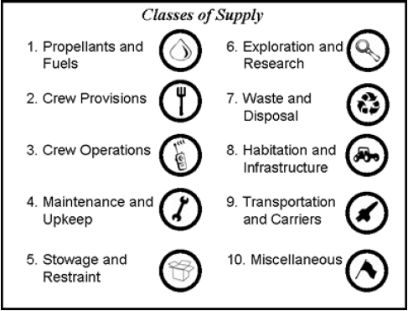
RFID Tag Object-ID space design considerations
Goal: Design the RFID Object-ID space to support ISS and future Exploration activities
Support current ISS inventory schemas
Not “golden” solution; provide transition pathway
Ensure ample room for anticipated increase in number of inventory items tracked
Design the space in a flexible, easy to evolve manner
Initial high-level inventory categories based on O. de Weck’s work at MIT
Reference: Shull, Gralla, Siddiqi, de Weck, and Shishko, September 2006, AIAA 2006-7232

Slide 9
NASA Flight Crew Systems Hardware Database
16 Top-level categories:
Housekeeping
Exercise
Portable Illumination
Tools
PERS: Payload Equip Restraint System
Stowage & Racks
R&MA: Restraints & Mobility Aids
OC Catalogue
Third Party
Non Flight Control System (FCS)
Non-FCS
ATCS
ECLSS
Habitability
EC Crew Provisions
Shuttle H/W on ISS
Shuttle only FCS

Slide 10
NASA Flight Crew Systems (FCS) Hardware Database
FCS Category | Owner(s) | Number of sub-categories | Number of object classes
Housekeeping | EC7 | 1 | 45
Exercise | EC7 | 1 | 14
Portable Illumination | EC7 | 1 | 24
Tools | EC6, EC7 | 1 | 659
PERS | EC6 | 1 | 7
Stowage and Racks | EC6, EC7, OZ3 | 1 | 89
R&MA | EC6, EC7 | 1 | 98
OC Catalogue | OC | 11 | 382
Third Party | --- | 1 | 15
Non FCS | --- | 1 | 28
Non-FCS ATCS | --- | 1 | 1
ECLSS | EC3 | 1 | 34
Habitability | EC3, EC6 | 5 | 708
EC Crew Provisions | EC7 | 1 | 905
Shuttle H/W on ISS | --- | 1 | 341
Shuttle only - FCS | --- | 1 | 18
TOTALS | 4 | 30 | 3368

Slide 11
De Weck, FCS Integrated Classification
MIT/de Weck | Flight Control System (FCS)
Propellants & Fuels
Crew Provisions | EC Crew Provisions, OC Catalogue
Crew Operations | Portable Illumination, Tools
Maintenance & Upkeep | Housekeeping, Tools
Stowage & Restraint | PERS, Stowage & Racks, R&MA
Exploration & Research
Waste & Disposal
Habitation & Infrastructure | ECLSS, Habitability, Exercise
Transportation & Carriers
Miscellaneous | Shuttle H/W, Shuttle only, Non-FCS, non-FCS ATCS, 3rd Party

Slide 12
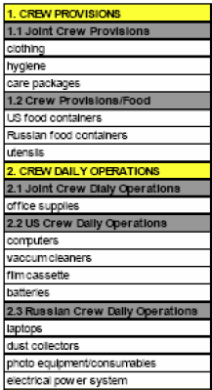
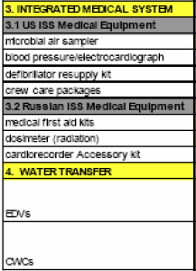
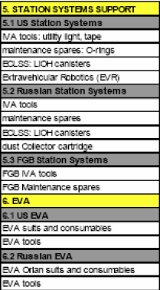
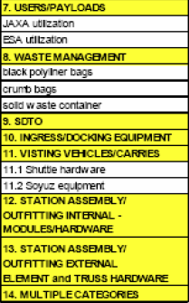
ISS Cargo Category Allocation Rates Table (CCART) Categories
Question: Separate top-level categories for Medical, EVA, Crew Consumables?
These items are absent from the FCS catalogue
EVA could be Crew Operations; Medical and Consumables could be Crew Provisions

Slide 13
DRAFT: Wireless WG Proposed Integrated Classification
MIT/de Weck | Flight Control System (FCS) | FCS-Only Object Class Count | ISS CCART | Possible allocation width
Propellants & Fuels |  |  |  | 1000
Crew Provisions | EC Crew Provisions, OC Catalogue | 1287 | 1. Crew Provisions 3. Integrated Medical System 4. Water Transfer | 4000
Crew Operations | Portable Illumination, Tools | 683 | 2. Crew Daily Operations | 2000
Maintenance & Upkeep | Housekeeping | 45 | 5. Station Systems Support 6. EVA | 1000
Stowage & Restraint | PERS, Stowage & Racks, R&MA | 194 |  | 1000
Exploration & Research |  |  | 6. EVA 7. Users/Payloads 9. SDTO; RFID Sensors | 7000
Waste & Disposal |  |  | 8. Waste Management | 1000
Habitation & Infrastructure | ECLSS, Habitability, Exercise | 756 | 5. Station Systems Support (ECLSS) | 4000
Transportation & Carriers |  |  | Ingress/Docking Equipment Visiting Vehicles/Carriers Assembly Hardware? | 7000
Miscellaneous | Shuttle H/W, Shuttle only, Non-FCS, non-FCS ATCS, 3rd Party | 403 |  | 2000 (leaves 2768 in reserve)

Slide 14
HDR WLAN Book Organizational Plan(s)
Agency use cases to characterize need (Use Case update of Green Book)
Is ISS the only real customer at this point? Is NASA SCaN a customer? Alignment for future purposes? Can we extrapolate to identify other customers?
Scope properly (customer focus emphasis);
This means Wi-Fi for ISS if short-term focus; ISS EVA focus
Application profiles specifying PHY modes selection
Implies short-term focus right now
Important Observation: Expect our (WWG) path to be evolutionary as well which dictates a staged approach.
[NASA, FSA]: ISS as a testbed for future exploration wireless communication technologies; For the WWG is there too much risk in being overly ISS-focused? ISS cultural problems, expectations, etc.
NASA (AES, SCaN, NDSWG) concerns: How to handle EVA, EVA suits, tele-robotic activity, sensor networks, vehicle monitoring, ubiquitous networking, vehicle docking support; ISS EVA focus: Use ISS as a testbed for wireless technology maturation (any location-based services). Not just an ISS book; but will mature exploration wireless communication technologies.
FSA wireless focus (DLR agreement): ISS testbed for future exploration wireless communications; Intra-spacecraft wireless networking; proximate EVA activities; HDR Sensor rates; Docking; On-orbit assembly activities; Planetary surface wireless?? (FSA not convinced this is a SOIS area: SOIS: networks; communications: non-networking); Correlation/coordination with SOIS architecture.

Slide 15
HDR WLAN Book Organizational Plan(s)
DLR (agreement with FSA): WLAN interest as well; focus on ISS as a testbed
ESA (strong agreement with FSA, DLR): communication within a spacecraft; could check with ESA human spaceflight program; important problem reduce/eliminate power constraints to sensors; AIT is a primary focus.
CSA priorities: Body-area nets, EVA activities, robotics, astro-skin; most of CSA investment is in the ISS; CSA not interested in RFID or RFID-sensing currently. No long-term space plan in Canada (possibly environmental-focused communications will arise); ISS is for technology development for Exploration; Stephen Braham: Planetary surface communications.
CNSA?
JAXA: difficult to adapt wireless for space missions – do step-by-step; first integrate wireless in AIT, then in vehicle wireless avionics, then intra-satellite. ISS EVA activities. ISAS interested in sensor networking; science mission projects including robotic surface activities, communication with relay orbiter (e.g., prox-2 link capability)

Slide 16
HDR WLAN Book Organizational Plan(s)
What the standard can do and can’t do (with possible recommendations?)
What do our sponsors want us to do; can we seek sponsor guidance? Customer guidance?
WWG external-stakeholder input for clarification of needs and tasks
Blue Book must be terse; what makes it worth doing
Candidate Proposal: Wi-Fi based Blue Book(?): specify the PHY/MAC standard
Internal habitat and intra-satellite communication
Inter-satellite communication? (SLS coordination)
External communication
Launchers
AIT (this is important and is a key driver/importance for ground testing and verification)
Sub-orbital, high-altitude terrestrial network communications (SLS coordination)
Note sensor-centric emphasis in many above domains (here the key constraint is power consumption)
How important is meshing?
Low-power Wi-Fi, TSN
Interoperability testing issues – MB eliminates (“802.11” vs. “.g”, “.n”, “.s”)
Importance of space qualification and TRL maturation
Past history of wanting high-speed wireless sensing

Slide 17
HDR WLAN Book Organizational Plan(s)
Extract generalized and specific (when possible) requirements
Characterize engineering metrics / figures of merit
Identify constraints
Market surveys (what is out there: commercial/industry/IEEE, IEEE TSN, ITU, IETF)
Technology evaluations; technology maturation
Identify applicable standards and anticipated evolution roadmaps
E.g., 802.11x, 3GGP 5G, etc..
Identify trade-offs
E.g., power, data rates, range, centralized vs. distributed; modulation
Identify specific coordination strategies (SOIS Deterministic networking BoF)
Blue Book Outline:
1. Boilerplate scope and purpose; 2. Overview; 3. Recommendation(s)
Where to put HDR WLAN engineering analyses (GB?)
Time domain of recommendation applicability:
Very short-term: 1 – 2 years
Short-term: 3 – 5 years
Medium term: 6 – 10 years
Longer term: 10 – 20 years
Long-term: 20+ years

Slide 18
HDR WLAN Book Organizational Plan(s): SIS MIA/VOICE
Date: 11-Feb-2016
Attendees: Rodney Grubbs (NASA-MSFC), Rick Barton (NASA-JSC), Osvaldo Peinado (ESA/DLR), Kevin Gifford (NASA-JSC sponsor)
Focus of discussion: How to best incorporate user and stakeholder (e.g, MIA, VOICE, ISS, EWC, JEM) requirements for a High Data-Rate Wireless Local Area Network ("HDR-WLAN") CCSDS Recommended Standard.
Primary Outcome: SOIS-WIR, SIS-MIA, SIS-VOICE are in agreement to work in a coordinated fashion to gather concerns, inputs, requirements, test data, etc., in an effort to best inform the Wireless WG regarding stakeholder requirements and concerns relating to a HDR-WLAN CCSDS Recommended Standard.
Action Items:
KKG: Coordinate WWG Agenda for 2016 Spring Meetings (Cleveland); once ratified by the WWG, publish the agenda to RPG/OP in an effort to coordinate SIS-MIA/VOICE potential attendance to the WWG HDR-WLAN discussions
KKG: Agreed to reserve 1/2 day (4 hours) during the 2016 Fall Meetings (Rome) for a SOIS-WIR, SIS-MIA/VOICE technical discussion
RPG: Provide SIS-MIA requirements and constraints regarding wireless LAN video transmission including H.264 and ATVC video streaming
RPG: Determine if can obtain any technical information regarding a JEM-EF external Wi-Fi system.
RJB: Get KSC (and any other available) ground testing data for the ISS EWC; determine if a system design was developed and documented (obtain if available)
RJB/RPG: Determine if can get latest ELC Wi-Fi system requirements (or is this just part of the EWC design?)
RJB: Talk with Chatwin Lansdowne to coordinate EWC involvement
RJB/RPG: Talk with Penny Roberts to coordinate EWC involvement
RJB: Determine the plausibility of having Chatwin and/or Penny either attend the Cleveland meetings for a day; or to give a remote presentation to the WWG overviewing the EWC system design along with requirements and constraints
KKG: Look to get EWC operational performance data at end of CY2016 / start of CY 2017

Slide 19
HDR WLAN Blue Book DRAFT Project Schedule
Q4
2015
Q1
2016
Q2
2016
Q3
2016
Q4
2016
Q1
2017
Q2
2017
Q3
2017
Q4
2017
Q1
2017
Q2
2017
Q3
2017
Q4
2017
2015 Fall Meeting
2016 Spring Meeting
2016 Fall Meeting
2017 Spring Meeting
2017 Fall Meeting
2018 Spring Meeting
2018 Fall Meeting
HDR WLAN Organizational & Project Activities:
Identify use cases, requirements,
solution space, candidate recommendations
HDR WLAN Continued Activities…
Green Book (GBv3) Updates for HDR WLAN Submit Date? 01-Mar-2016
High Data Rate WLAN
Blue Book Final Draft #1
(Fall 2016)
High Data Rate WLAN
Blue Book Final Draft #2
(Spring 2018)
Published deliverable date to SOIS Chair and the CESG
Wireless WG internal activity
Wireless WG internal working milestone
CCSDS Biannual Meeting
Notes:
Planning Notes 11-Mar-2013:
Discuss SABL Project Plan with Shea and Louis
Coordinate dates for RSA 2FA TIM at HOSC (Shea, Jim, Shankini); cost share this trip with BioServe
Determine timeline on DTN2 Simulator – coordinate HOSC DTN2 G/W testing, test plan, with the HOSC
Will need to plan Automation support for additional BioServe SABL tasks
Have an IDSCam close-out sprint; can transition to SABL early as necessary
HOSC RSA 2FA meeting this week and travel coordination

Slide 20
Back-up Charts & High-Level CCSDS Schedules

Slide 21
RFID Tag-Encoding Specification: Interoperability Testing
Determine timeline requirements
Summarize technical requirements / constraints
What will ISS OC allow?
What is allowed for DTO / Experiments
Complete prototype of hardware & software
Procure/configure Testing Facility
Compose Test Plan
Testing basis and goals overview
Software-based: test random IDs
Hardware-based: physical tag exchange
Summary testing diagram(s)
Specify testing procedures with protocol implementation conformance statements (PICS); expected results must be specified
Information exchange specification
E-mail is fine; but if any VPN remote connectivity is being contemplated then specify and start ASAP
Consensus on Object-ID space design prior to interoperability testing (Not required)
Object-ID verification will be part of formal testing
But it is formally required to verify read/write of Tag ID fields, not to verify “what the fields mean” in an operational setting
Specify SANA registries and content after successful interoperability testing
Yellow Book (results reviewed by CESG):
Ch. 1: Introduction
Ch. 2: Testing basis and description overview (short, concise)
Annex: Test Procedures (detailed, step-by-step, with expected results)
Annex: Test Results including PICS
Protocol Implementation Conformance Statements (ICS)
Software identification and version recording
Hardware identification and version recording
Base operational and configuration parameter conformance specification
Any software or hardware calibration procedures
Tag writer and tag reader h/w and s/w
Any test facility specific (environment) conditions specified and recorded (test configuration, read distance, etc.)
Must specify Pass/Fail Criteria for each test
Basis (fundamental) Test Cases
Failure Test Cases
Bad Data Test Cases
Other Test Cases
“Random-ID” Test Cases (non-sensical)
“Expected-IDs” Test Cases
Field limit test cases
Out-of-bounds (ECMA-113) test cases
Out-of-bounds (GS1) test cases
Cyrillic character test cases

Slide 22
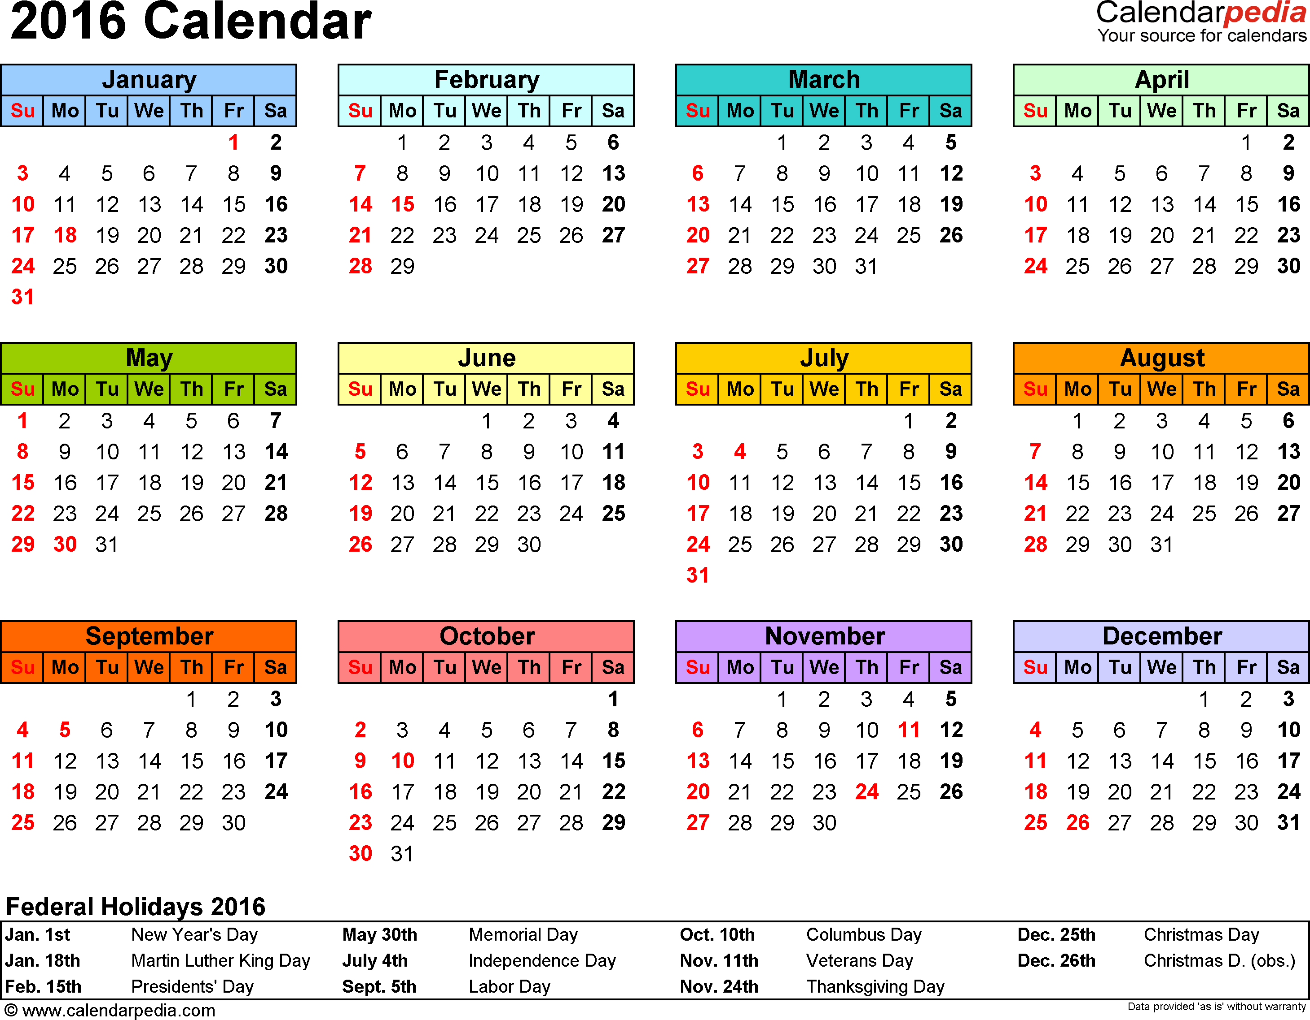

Slide 23
SOIS (WWG) Area Report to CESG, Spring 2015
WWG RFID Encoding Blue Book:
Spring 2015: Final draft#2 RFID Encoding Blue Book [completed]
Release to Area Director [completed]
Submission to Secretariat [completed]
Fall 2015: Final Agency review completion
First/second prototype development completion
Spring 2016: CMC approval
WWG Wireless Local Area Network Blue Book:
Spring 2015: Initiation of standardization specification
Fall 2016: Final draft#1 WLAN Blue Book
Spring 2018: Final draft#2 WLAN Blue Book
Release to Area Director
Spring 2019: Final Agency review completion
Fall 2020: First/second prototype development completion
Winter 2020: CMC approval
Notes:
23

Slide 24
CCSDS SOIS Wireless WG DRAFT Project Milestones
2016
2017
2018
2019
Q1
2016
Q2
2016
Q3
2016
Q4
2016
Q1
2017
Q2
2017
Q3
2017
Q4
2017
Q1
2018
Q2
2018
Q3
2018
Q4
2018
Q1
2019
Q2
2019
Q3
2019
Q4
2019
CCSDS
881.0-M-1
RFID
Inventory
Management
Systems
Magenta
Book
Updates
Start Date
Nov-2016
1st Draft
Mar-2017
2nd Draft
Jul-2017
Submit
to A.D.
Nov-2017
1st Agency Review
Feb-2018
RID
Resolution
May-2018
Final Agency
Review
Aug-2018
RID
Resolution Sep-2018
Submit to Secretariat
Jan-2018
Secretariat Processing
Jul-2018
CMC Approval
Nov-2018
CCSDS
88X.0-M-1
RFID Sensing
Communications
Protocol
Specification
Start Date
May-2016
1st Draft
Oct-2016
2nd Draft
Jan-2017
Submit
to A.D.
Apr-2017
1st Agency Review
Sep-2017
RID
Resolution
Nov-2017
Final Agency
Review
May-2018
RID
Resolution Jul-2018
1st Prototype
Nov-2018
2nd Prototype
Mar-2019
Submit to Secretariat
Jul-2017
Secretariat Processing
Feb-2018
CMC Approval
Nov-2018
CMC Approval
May-2019
Published deliverable date to SOIS Chair and the CESG
Wireless WG internal activity
Wireless WG internal working milestone
CCSDS Biannual Meeting
Notes:
Planning Notes 11-Mar-2013:
Discuss SABL Project Plan with Shea and Louis
Coordinate dates for RSA 2FA TIM at HOSC (Shea, Jim, Shankini); cost share this trip with BioServe
Determine timeline on DTN2 Simulator – coordinate HOSC DTN2 G/W testing, test plan, with the HOSC
Will need to plan Automation support for additional BioServe SABL tasks
Have an IDSCam close-out sprint; can transition to SABL early as necessary
HOSC RSA 2FA meeting this week and travel coordination

Slide 25
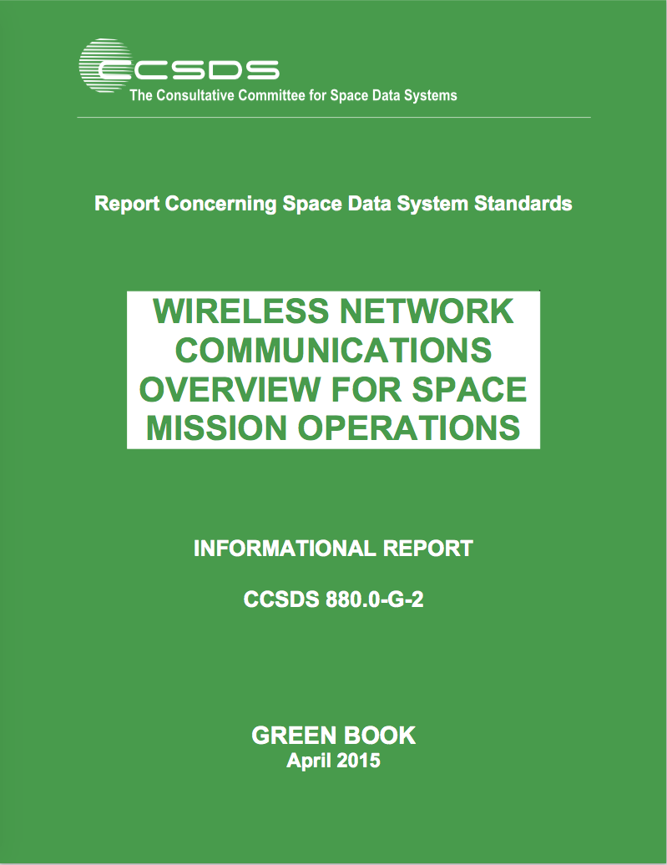
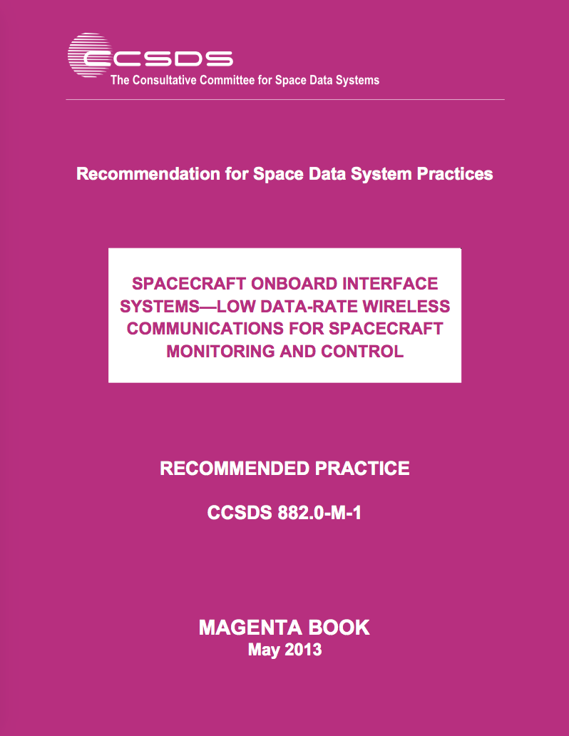
CCSDS SOIS Wireless WG Published Documents
Wireless Network Communications Overview (Green Book,
Revision 2):
Set Basis via: Overview, Use Cases, Technologies
“Green Book”
“GBv2”
RFID-Based Inventory Management Systems (Magenta Book):
Specifies ISO-18000-6c (EPC Class-1, Gen-2) as the over-the-air
interface and protocol recommendation.
→ “RFID Magenta Book”
Low Data-Rate Wireless Communications for Spacecraft Monitoring
and Control as the over-the-air; Specifies PHY/MAC interface and
protocol recommendations (IEEE 802.15.4-2011, ISA100.11a-2011).
→ “LDR Magenta Book”

Slide 26
CCSDS SOIS Wireless WG Current Projects
CCSDS 881.1-R-1: Spacecraft Onboard Interface Services—RFID Tag Encoding Specification. This document provides a Recommended Standard for the utilization of Radio Frequency Identification (RFID) protocol and communication standards in support of inventory management activities associated with space missions.
Spacecraft Onboard Interface Services – High Data Rate Wireless Local Area Network Communications (HDR WLAN): Develop, specify, and standardize Wireless LAN networked communications for space agency utilization via a “Wireless Local Area Network Blue Book”. This would be followed by an anticipated Magenta Book with application profiles for several canonical use-cases. Why this is important: Required to enable multi-agency interoperability for ISS proximity EVA/IVA/Robotics, for intra-spacecraft communications and sensing, and for Exploration-class internal & external vehicle proximity, including surface, communications (e.g., robotics, habitat, and EVA). It is necessary to perform this work now rather than later to avoid future interoperability issues and resulting operational impacts. Expected benefits: Improved crew operations, enhanced safety, increased science return, decreased costs

Slide 27
CCSDS SOIS Wireless WG Draft Projects
881x0m1: The RFID Magenta Book RFID-Based Inventory Management Systems (Revision 2) will be updated to provide enhanced security mechanisms. The original (version 1) of the Magenta Book (880x0r1) on RFID-Based Inventory Management Systems is based upon the combined ISO 18000-6c and EPCGlobal Class-1 Gen-2 standards dated 2008. An important update is to provide security mechanisms for authentication, authorization, data integrity and privacy that is facilitated by the EPCGlobal Class-2 Gen 2 Version 2 specification released in 2013.
RFID Sensing Recommended Standard (proposed new Blue Book): This recommended standard will specify requirements and best practices to enable interoperable RFID tag sensing. As RFID has transitioned to mainstream commercial terrestrial utilization the capability to add sensors (temperature, pressure, light, acoustic, etc.) to the RFID tag silicon for periodic sampling enables small form-factor IoT type of devices directly onboard the RFID tag. It is anticipated that this combined form-factor, in either passive or active RFID devices, will be of significant interest to commercial, military, and space market segments.

Slide 28
CCSDS SOIS Wireless WG Draft Projects
881x1r1: RFID Tag-Encoding Specification (Blue Book) for RFID-Based Inventory Management Systems will be updated (Revision 2) to provide a recommended standard based upon EPC- and ISO-compliant RFID tag naming specifications. Version 1 of the RFID Tag-Encoding Specification provided a tag-encoding schema that was purposefully designed to enable a smooth transition to a fully compliant modern tag-naming schema as evidenced by the wide-scale world-wide adoption of the EPC/ISO RFID Tag-Encoding data standards.
880x0g2: WWG Green Book (880x0g3; GBv3) updates for HDR WLAN and dated LTE verbiage:
880x0g3: WWG Green Book (880x0g4; GBv4) updates for Wi-Fi technology evolution (propose when GBv3 updates completed):

Slide 29
ISS IMS tag-encoding augmentation proposal
Designate a {OwnerID, ProgramID, ObjectID} tuple
Manage the OwnerID/ProgramID namespace to uniquely identify additional Owners (Space Agencies) and associated Programs
Manage the ObjectID namespace to improve automated inventory management practices and provide a transition path for future standardized tag-encoding
Does not alter/affect current IMS naming conventions or operations
Defines {OwnerID, ProgramID, ObjectID} namespace in an engineered manner to support future IMS operations

Slide 30
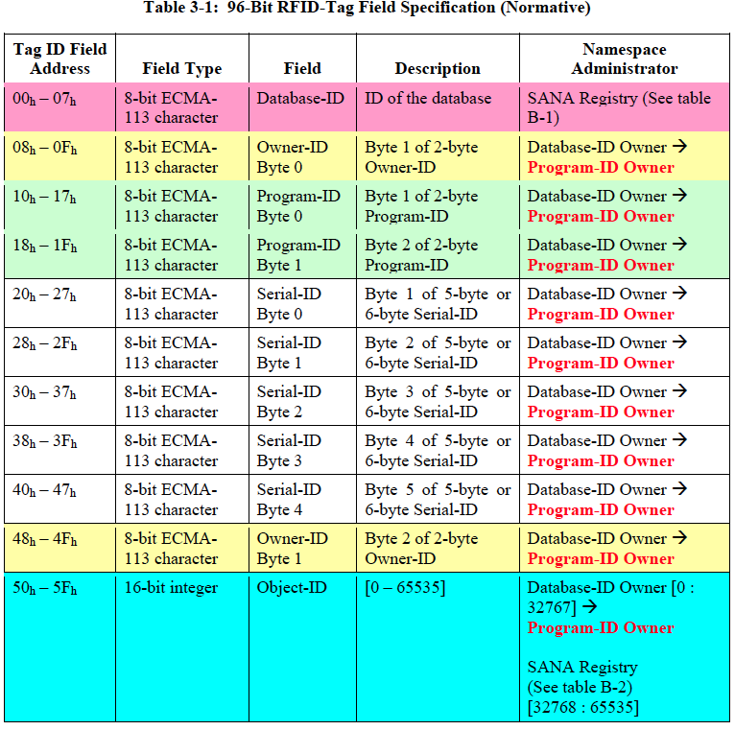

Slide 31
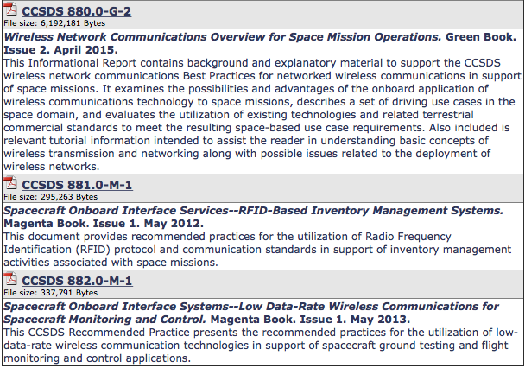
CCSDS SOIS Wireless WG Publications

Slide 32
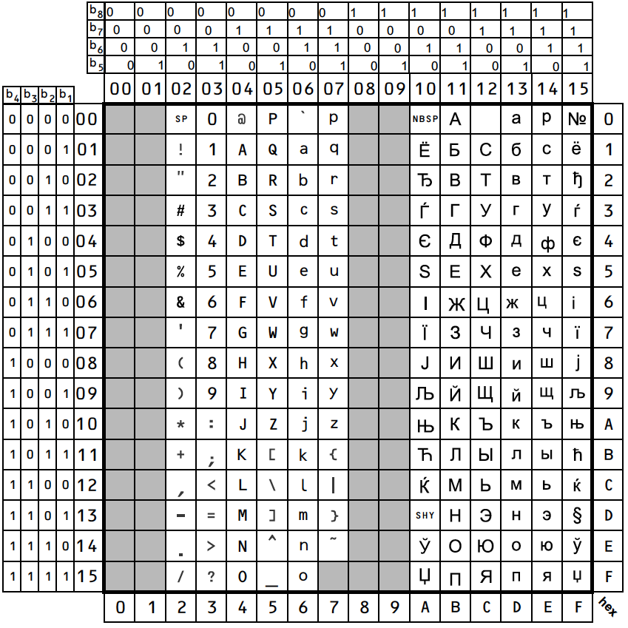
Code Table of Latin/Cyrillic Alphabet

