Slide 1
CCSDS SOIS Wireless WG Monthly Webcon
03-Nov-2015

Slide 2
CCSDS SOIS Wireless WG Monthly Webcon
RFID Tag-Encoding Red Book (CCSDS 881.1-R-1) activities:
CCSDS 881.1-R-1 Document Status:
Sent to CCSDS Secretariat for publication (19-Oct-2015)
Follow-on activities for CCSDS 881.1-R-1 (to satisfy Blue Book requirements)
Object-ID space design: Discuss initial design strategies and concerns
Interoperability Test Plan preparation and (FSA, NASA) prototyping
Interoperability Test Plan execution
SANA Registry updates

Slide 3
CCSDS SOIS Wireless WG Monthly Webcon: 16-Sep-2015
HDR WLAN Use Case development and strategies (timeliness and relevant)
Achieved Consensus to update Wireless Communications Green Book Annex E : HDR driving use cases with specific references to agency needs
CSA, ESA, FSA, NASA inputs status: Green Book pages: E-2 → E-8
Green Book Use Case write-up additions (4 new write-ups required)
880x0g3.08.docx uploaded to CWE (SOIS-WIR/Draft Documents/HDR WLAN)
Additional Topics:
Fall CCSDS WWG Meetings Agenda discussion for maximum participation.
WWG Charter updated/posted on CWE (align w/Strategic Plan & Goals)
Open items for group discussion

Slide 4
HDR WLAN-based Green Book Use Case Additions (write-ups)
Multiple hosted payloads with high data rate (internal/external) (e.g., ISS external/EWC, internal payloads and equipment)
Consider ISS research summaries Proposal: NASA, ESA, FSA, CSA, Kevin?
Responsible WWG member/agency: NASA JSC-EV8 Rick Barton
Rendezvous & Docking (e.g., ISS visiting vehicles)
FSA inputs? Proposal: FSA takes lead on the use case description?
Look at NASA Roadmap TA 5?
Responsible WWG member/agency: FSA, Yuriy Sheynin??
Crew member location tracking (HRP gap: how does crew utilize available volume; Human machine interaction & safety)
FSA, ESA inputs? Proposal: NASA takes lead on the use case description?
Possibly from NASA SA/SD?
Responsible WWG member/agency: NASA JSC-EV8 Patrick Fink
Planetary crew comms: IVA-IVA, IVA-EVA, Habitat-to-LRV, LRV-internal (e.g., ETDP-CxP Lunar Surface scenario)
Responsible WWG member/agency: CSA: Stephen Braham
Inputs from CxP ETDP surface comm scenario (NASA, Casey Bakula)?

Slide 5
CCSDS SOIS Wireless WG Approved Project Milestones
Jun
2015
Jul
2015
Aug
2015
Sep
2015
Oct
2015
Nov
2015
Dec
2015
Jan
2016
Feb
2016
Mar
2016
Apr
2016
May
2016
Jun
2016
Jul
2016
Aug
2016
Sep
2016
Current
Date →
2015 Fall Meeting
Darmstadt, Germany
09-13 Nov-2015
2016 Spring Meeting
Cleveland, OH USA
04-08 Apr-2016
RFID Tag Encoding
Red Book Review
Prototype development / Test
Plan / Interoperability testing
30-Jun-2015 →
31-Aug-2015
Final Agency Review
(Fall 2015)
CMC Approval
(Spring 2016)
RFID Tag Object-ID
space design
SANA Registry
Updates
Use Case
Organization
Use Case
Completion
HDR WLAN Organizational
& Project Actvities
High Data Rate WLAN
Use Case Organization
10-Oct-2015
Green Book (GBv3) Updates for HDR WLAN Submitted? 01-Dec-2015
High Data Rate WLAN Blue Book initial outline draft
15-Apr-2016
High Data Rate WLAN
Blue Book Final Draft #1
(Fall 2016)
Published deliverable date to SOIS Chair and the CESG
Wireless WG internal activity
Wireless WG internal working milestone
CCSDS Biannual Meeting
Notes:
Planning Notes 11-Mar-2013:
Discuss SABL Project Plan with Shea and Louis
Coordinate dates for RSA 2FA TIM at HOSC (Shea, Jim, Shankini); cost share this trip with BioServe
Determine timeline on DTN2 Simulator – coordinate HOSC DTN2 G/W testing, test plan, with the HOSC
Will need to plan Automation support for additional BioServe SABL tasks
Have an IDSCam close-out sprint; can transition to SABL early as necessary
HOSC RSA 2FA meeting this week and travel coordination

Slide 6
RFID Tag-Encoding Specification: DRAFT Interoperability Testing
November
2015
December
2015
January
2016
February
2016
March
2016
April
2016
May
2016
June
2016
Current Date →
Final Agency Review
(Fall 2015)
2016 Spring Meeting
Cleveland, OH USA
04-08 Apr-2016
CMC Approval
(Spring 2016)
Prototype development / Test Plan / Interoperability testing
Participating Agencies: FSA, NASA
Points of Contact:
Yuriy Sheynin, FSA
Ray Wagner, NASA
Prototype
Test Plan
Interop Test
Draft: dd-mmm-yyyy
Final: dd-mmm-yyyy
Draft: dd-mmm-yyyy
Final: dd-mmm-yyyy
Draft: dd-mmm-yyyy
Final: dd-mmm-yyyy
RFID Tag Object-ID
space design
SANA Registry
Updates
Responsible Point of Contact
Kevin Gifford (?)
Rick Barton (?)
Draft: dd-mmm-yyyy
Final: dd-mmm-yyyy
Draft: dd-mmm-yyyy
Final: dd-mmm-yyyy
Published deliverable date to SOIS Chair and the CESG
Wireless WG internal activity
Wireless WG internal working milestone
CCSDS Biannual Meeting
Notes:
Planning Notes 11-Mar-2013:
Discuss SABL Project Plan with Shea and Louis
Coordinate dates for RSA 2FA TIM at HOSC (Shea, Jim, Shankini); cost share this trip with BioServe
Determine timeline on DTN2 Simulator – coordinate HOSC DTN2 G/W testing, test plan, with the HOSC
Will need to plan Automation support for additional BioServe SABL tasks
Have an IDSCam close-out sprint; can transition to SABL early as necessary
HOSC RSA 2FA meeting this week and travel coordination

Slide 7
RFID Tag-Encoding Specification: Interoperability Testing
Determine timeline requirements
Summarize technical requirements
What will OC allow?
What is allowed for DTO / Experiments
Complete prototype of any software
Procure/configure Testing Facility
Specify SANA registries and content after successful interoperability testing
Compose Test Plan
Summary testing diagram(s)
Information exchange specification
E-mail is fine; but if any VPN remote connectivity is being contemplated then specify and start ASAP
Consensus on Object-ID space design prior to interoperability testing?
Object-ID verification will be part of formal testing
But it is formally required to verify read/write of Tag ID fields, not to verify “what the fields mean” in an operational setting
Testing Implementation Conformance Statements (TICS)
Base operational and configuration parameter conformance specification
Software identification and version recording
Any software calibration procedures
Tag writer and tag reader h/w and s/w
Any test facility specific (environment) conditions specified and recorded
Must specify Pass/Fail Criteria for each test
Basis (fundamental) Test Cases
Failure Test Cases
Bad Data Test Cases
Other Test Cases
“Random-ID” Test Cases (non-sensical)
“Expected-IDs” Test Cases
Field limit test cases
Out-of-bounds (ECMA-113) test cases

Slide 8
HDR WLAN Blue Book DRAFT Project Schedule
Q4
2015
Q1
2016
Q2
2016
Q3
2016
Q4
2016
Q1
2017
Q2
2017
Q3
2017
Q4
2017
Q1
2017
Q2
2017
Q3
2017
Q4
2017
2015 Fall Meeting
2016 Spring Meeting
2016 Fall Meeting
2016 Spring Meeting
2017 Fall Meeting
2018 Spring Meeting
2018 Fall Meeting
RFID Tag Encoding
Red Book Review
Prototype development / Test
Plan / Interoperability testing
30-Jun-2015 →
31-Aug-2015
Final Agency Review
(Fall 2015)
CMC Approval
(Spring 2016)
RFID Tag Object-ID
space design
SANA Registry
Updates
Use Case
Organization
Use Case
Completion
HDR WLAN Organizational
& Project Actvities
High Data Rate WLAN
Use Case Organization
10-Oct-2015
Green Book (GBv3) Updates for HDR WLAN Submitted? 01-Dec-2015
High Data Rate WLAN Blue Book initial outline draft
15-Apr-2016
High Data Rate WLAN
Blue Book Final Draft #1
(Fall 2016)
Published deliverable date to SOIS Chair and the CESG
Wireless WG internal activity
Wireless WG internal working milestone
CCSDS Biannual Meeting
Notes:
Planning Notes 11-Mar-2013:
Discuss SABL Project Plan with Shea and Louis
Coordinate dates for RSA 2FA TIM at HOSC (Shea, Jim, Shankini); cost share this trip with BioServe
Determine timeline on DTN2 Simulator – coordinate HOSC DTN2 G/W testing, test plan, with the HOSC
Will need to plan Automation support for additional BioServe SABL tasks
Have an IDSCam close-out sprint; can transition to SABL early as necessary
HOSC RSA 2FA meeting this week and travel coordination

Slide 9
Back-up Charts & High-Level CCSDS Schedules

Slide 10
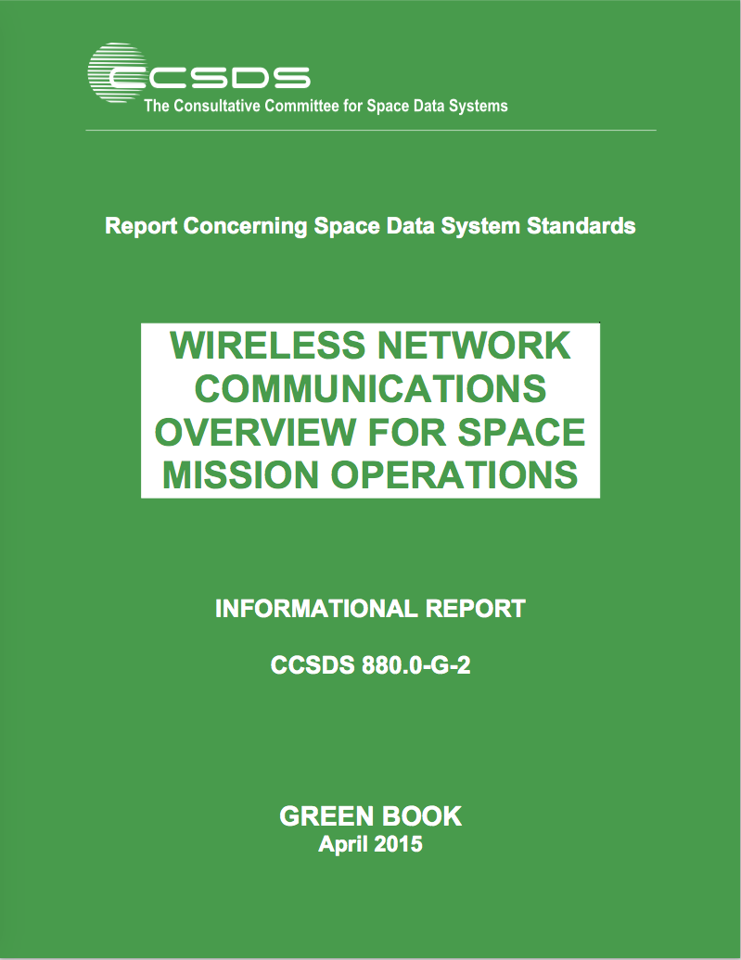
CCSDS SOIS Wireless WG Published Documents
Wireless Network Communications Overview (Green Book,
Revision 2):
Set Basis via: Overview, Use Cases, Technologies
“Green Book”
“GBv2”
RFID-Based Inventory Management Systems (Magenta Book):
Specifies ISO-18000-6c (EPC Class-1, Gen-2) as the over-the-air
interface and protocol recommendation.
→ “RFID Magenta Book”
Low Data-Rate Wireless Communications for Spacecraft Monitoring
and Control as the over-the-air; Specifies PHY/MAC interface and
protocol recommendations (IEEE 802.15.4-2011, ISA100.11a-2011).
→ “LDR Magenta Book”

Slide 11
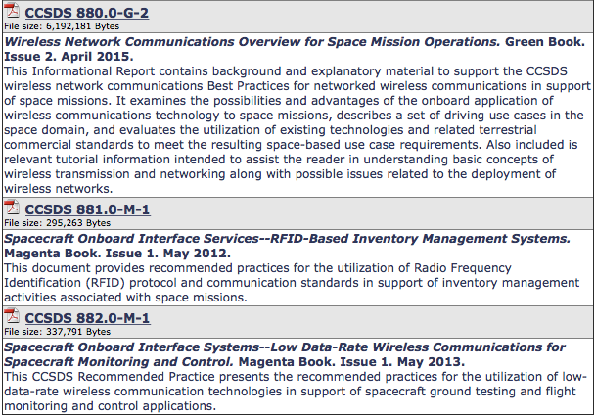
CCSDS SOIS Wireless WG Publications

Slide 12
SOIS (WWG) Area Report to CESG, Spring 2015
WWG RFID Encoding Blue Book:
Spring 2015: Final draft#2 RFID Encoding Blue Book [completed]
Release to Area Director [completed]
Submission to Secretariat [completed]
Fall 2015: Final Agency review completion
First/second prototype development completion
Spring 2016: CMC approval
WWG Wireless Local Area Network Blue Book:
Spring 2015: Initiation of standardization specification
Fall 2016: Final draft#1 WLAN Blue Book
Spring 2018: Final draft#2 WLAN Blue Book
Release to Area Director
Spring 2019: Final Agency review completion
Fall 2020: First/second prototype development completion
Winter 2020: CMC approval
Notes:
12

Slide 13
CCSDS SOIS Wireless WG HDR WLAN Project
Spacecraft Onboard Interface Services – High Data Rate Wireless Local Area Network Communications (HDR WLAN): Develop, specify, and standardize Wireless LAN networked communications for space agency utilization via a “Wireless Local Area Network Blue Book”. This would be followed by an anticipated Magenta Book with application profiles for several canonical use-cases. Why this is important: Required to enable multi-agency interoperability for ISS proximity EVA/IVA/Robotics, for intra-spacecraft communications and sensing, and for Exploration-class internal & external vehicle proximity, including surface, communications (e.g., robotics, habitat, and EVA). It is necessary to perform this work now rather than later to avoid future interoperability issues and resulting operational impacts. Expected benefits: Improved crew operations, enhanced safety, increased science return, decreased costs
NOTE: Summarize Current and Draft Projects in a table and discuss with WWG members their ranking of project importance/priority, any inputs on draft project timelines and whether or not their agency would commit resources to the draft project

Slide 14
CCSDS SOIS Wireless WG Draft Projects
881x0m1: The RFID Magenta Book RFID-Based Inventory Management Systems (Revision 2) will be updated to provide enhanced security mechanisms. The original (version 1) of the Magenta Book (880x0r1) on RFID-Based Inventory Management Systems is based upon the combined ISO 18000-6c and EPCGlobal Class-1 Gen-2 standards dated 2008. An important update is to provide security mechanisms for authentication, authorization, data integrity and privacy that is facilitated by the EPCGlobal Class-2 Gen 2 Version 2 specification released in 2013.
RFID Sensing Recommended Standard (proposed new Blue Book): This recommended standard will specify requirements and best practices to enable interoperable RFID tag sensing. As RFID has transitioned to mainstream commercial terrestrial utilization the capability to add sensors (temperature, pressure, light, acoustic, etc.) to the RFID tag silicon for periodic sampling enables small form-factor IoT type of devices directly onboard the RFID tag. It is anticipated that this combined form-factor, in either passive or active RFID devices, will be of significant interest to commercial, military, and space market segments.

Slide 15
CCSDS SOIS Wireless WG Draft Projects
881x1r1: RFID Tag-Encoding Specification (Blue Book) for RFID-Based Inventory Management Systems will be updated (Revision 2) to provide a recommended standard based upon EPC- and ISO-compliant RFID tag naming specifications. Version 1 of the RFID Tag-Encoding Specification provided a tag-encoding schema that was purposefully designed to enable a smooth transition to a fully compliant modern tag-naming schema as evidenced by the wide-scale world-wide adoption of the EPC/ISO RFID Tag-Encoding data standards.
880x0g2: WWG Green Book (880x0g3; GBv3) updates for HDR WLAN: This
880x0g3: WWG Green Book (880x0g4; GBv4) updates for Wi-Fi technology evolution: This

Slide 16
CCSDS SOIS Wireless WG Draft Projects & Agency Interest
Draft Project Title | KKG | CSA | ESA | FSA | JAXA | NASA
881x0m1: The RFID Magenta Book RFID-Based Inventory Management Systems (Revision 2) will be updated to provide enhanced security mechanisms. | M/M
RFID Sensing Recommended Standard (proposed new Blue Book): This recommended standard will specify requirements and best practices to enable interoperable RFID tag sensing. | L
881x1r1: RFID Tag-Encoding Specification (Blue Book) for RFID-Based Inventory Management Systems will be updated (Revision 2) to provide a recommended standard based upon EPC- and ISO-compliant RFID tag naming specifications. | M/H
880x0g2: WWG Green Book (880x0g3; GBv3) updates for HDR WLAN | H/L
880x0g3: WWG Green Book (880x0g4; GBv4) updates for Wi-Fi technology evolution | M/M

Slide 17
CCSDS SOIS Wireless WG DRAFT Project Milestones
2016
2017
2018
2019
Q1
2016
Q2
2016
Q3
2016
Q4
2016
Q1
2017
Q2
2017
Q3
2017
Q4
2017
Q1
2018
Q2
2018
Q3
2018
Q4
2018
Q1
2019
Q2
2019
Q3
2019
Q4
2019
CCSDS
881.0-M-1
RFID
Inventory
Management
Systems
Magenta
Book
Updates
Start Date
Nov-2016
1st Draft
Mar-2017
2nd Draft
Jul-2017
Submit
to A.D.
Nov-2017
1st Agency Review
Feb-2018
RID
Resolution
May-2018
Final Agency
Review
Aug-2018
RID
Resolution Sep-2018
Submit to Secretariat
Jan-2018
Secretariat Processing
Jul-2018
CMC Approval
Nov-2018
CCSDS
88X.0-M-1
RFID Sensing
Communications
Protocol
Specification
Start Date
May-2016
1st Draft
Oct-2016
2nd Draft
Jan-2017
Submit
to A.D.
Apr-2017
1st Agency Review
Sep-2017
RID
Resolution
Nov-2017
Final Agency
Review
May-2018
RID
Resolution Jul-2018
1st Prototype
Nov-2018
2nd Prototype
Mar-2019
Submit to Secretariat
Jul-2017
Secretariat Processing
Feb-2018
CMC Approval
Nov-2018
CMC Approval
May-2019
Published deliverable date to SOIS Chair and the CESG
Wireless WG internal activity
Wireless WG internal working milestone
CCSDS Biannual Meeting
Notes:
Planning Notes 11-Mar-2013:
Discuss SABL Project Plan with Shea and Louis
Coordinate dates for RSA 2FA TIM at HOSC (Shea, Jim, Shankini); cost share this trip with BioServe
Determine timeline on DTN2 Simulator – coordinate HOSC DTN2 G/W testing, test plan, with the HOSC
Will need to plan Automation support for additional BioServe SABL tasks
Have an IDSCam close-out sprint; can transition to SABL early as necessary
HOSC RSA 2FA meeting this week and travel coordination

Slide 18
ISS IMS tag-encoding augmentation proposal
Designate a {OwnerID, ProgramID, ObjectID} tuple
Manage the OwnerID/ProgramID namespace to uniquely identify additional Owners (Space Agencies) and associated Programs
Manage the ObjectID namespace to improve automated inventory management practices and provide a transition path for future standardized tag-encoding
Does not alter/affect current IMS naming conventions or operations
Defines {OwnerID, ProgramID, ObjectID} namespace in an engineered manner to support future IMS operations

Slide 19
