Slide 1
CCSDS SOIS Wireless WG Monthly Webcon: 16-Sep-2015
16-Sep-2015

Slide 2
CCSDS SOIS Wireless WG Monthly Webcon: 16-Sep-2015
Welcome ESA Wireless WG member Dirk Thurnes!
RFID Tag-Encoding Red Book (CCSDS 881.1-R-1) activities:
Document Status:
Released for Agency Review scheduled to be completed 31-Aug-2015
Today: Discuss RID summary & forward actions
Follow-on Activities Required: Update CCSDS 881.1-R-1 as required
Object-ID space design:
Downstream: Discuss initial design strategies and concerns
SANA Registry updates (FY2016 activity)
HDR WLAN Use Case development and strategies (timeliness and relevant)
Ensure Consensus to update Wireless Communications Green Book Annex E : HDR driving use cases with specific references to agency needs?
CSA, ESA, FSA, NASA inputs status: Green Book pages: E-2 → E-8
Green Book Use Case write-up additions (4 new write-ups required)
880x0g3.08.docx uploaded to CWE (SOIS-WIR/Draft Documents/HDR WLAN)
Additional Topics:
WWG Charter updates and posted on the CWE (align w/Strategic Plan & Goals)
Open items for group discussion

Slide 3
CCSDS 881.1-R-1 RFID Tag Encoding RID Processing
See Spreadsheet
Recommended accepting all editorial RIDs (Consensus?)
Document editor incorporates changes
Discuss FSA RIDs and come to consensus regarding how to disposition (accept, reject, postpone)
Table 3-1 Namespace Administrator text updates (Consensus?)
Parity check capability for ECMA-113 character encoding (Consensus?)
Forward updated CCSDS 881.1-R-1 document to Secretariat in preparation for Final Agency Review once consensus and documented updated
Move on to other CCSDS 881.1-R-1 work:
RFID Object-ID space design
SANA registry initial creation
Prototyping and Interoperability Test Plan
Interoperability Test Plan execution

Slide 4
ISS IMS tag-encoding augmentation proposal
Designate a {OwnerID, ProgramID, ObjectID} tuple
Manage the OwnerID/ProgramID namespace to uniquely identify additional Owners (Space Agencies) and associated Programs
Manage the ObjectID namespace to improve automated inventory management practices and provide a transition path for future standardized tag-encoding
Does not alter/affect current IMS naming conventions or operations
Defines {OwnerID, ProgramID, ObjectID} namespace in an engineered manner to support future IMS operations

Slide 5
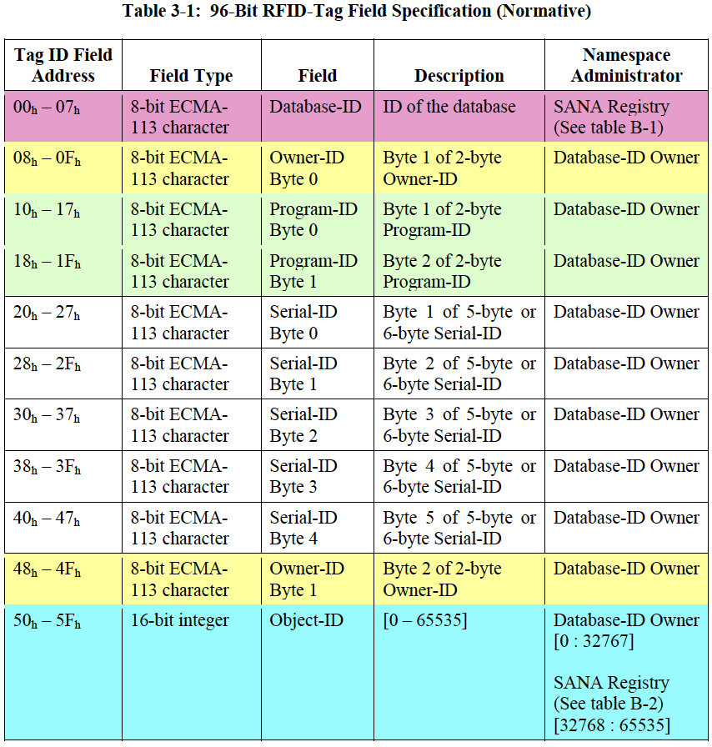

Slide 6
HDR WLAN-based Green Book Use Case Additions (write-ups)
Multiple hosted payloads with high data rate (internal/external) (e.g., ISS external/EWC, internal payloads and equipment)
Consider ISS research summaries Proposal: NASA, ESA, FSA, CSA, Kevin?
Rendezvous & Docking (e.g., ISS visiting vehicles)
FSA inputs? Proposal: FSA takes lead on the use case description?
Look at NASA Roadmap TA 5?
Crew member location tracking (HRP gap)
FSA, ESA inputs? Proposal: NASA takes lead on the use case description?
Possibly from NASA SA/SD?
Planetary crew comms: IVA-IVA, IVA-EVA, Habitat-to-LRV, LRV-internal (e.g., ETDP-CxP Lunar Surface scenario)
CSA: Commit: Stephen Braham to take lead on this use case description
Inputs from CxP ETDP surface comm scenario (NASA, Casey Bakula)?

Slide 7
CCSDS SOIS Wireless WG Project Milestones
Jun
2015
Jul
2015
Aug
2015
Sep
2015
Oct
2015
Nov
2015
Dec
2015
Jan
2016
Feb
2016
Mar
2016
Apr
2016
May
2016
Jun
2016
Jul
2016
Aug
2016
Sep
2016
Current
Date →
2015 Fall Meeting
Darmstadt, Germany
09-13 Nov-2015
2016 Spring Meeting
Cleveland, OH USA
04-08 Apr-2016
Prototype development / interoperability test
RFID Tag Encoding
Red Book Agency Review
30-Jun-2015 →
24-Aug-2015
Final Agency Review
(Fall 2015)
CMC Approval
(Spring 2016)
RFID Tag Object-ID space design
SANA Registry Updates
Use Case Organization/Composition
High Data Rate WLAN
Use Case Organization
10-Oct-2015
HDR WLAN Green Book Updates SUBMITTED?
01-Dec-2015
High Data Rate WLAN Blue Book initial outline draft
15-Apr-2016
High Data Rate WLAN
Blue Book Final Draft #1
(Fall 2016)
Published deliverable date to SOIS Chair and the CESG
Wireless WG internal activity
Wireless WG internal working milestone
CCSDS Biannual Meeting
Notes:
Planning Notes 11-Mar-2013:
Discuss SABL Project Plan with Shea and Louis
Coordinate dates for RSA 2FA TIM at HOSC (Shea, Jim, Shankini); cost share this trip with BioServe
Determine timeline on DTN2 Simulator – coordinate HOSC DTN2 G/W testing, test plan, with the HOSC
Will need to plan Automation support for additional BioServe SABL tasks
Have an IDSCam close-out sprint; can transition to SABL early as necessary
HOSC RSA 2FA meeting this week and travel coordination

Slide 8
Back-up Charts & High-Level CCSDS Schedules

Slide 9
CCSDS SOIS Wireless WG Draft Projects
881x0r0 Revision 2: The Magenta Book for RFID-Based Inventory Management Systems will be updated to provide enhanced security mechanisms. The original (version 1) of the Magenta Book (880x0r0) on RFID-Based Inventory Management Systems is based upon the combined ISO 18000-6c and EPCGlobal Class-1 Gen-2 standards dated 2008. An important update is to provide security mechanisms for authentication, authorization, data integrity and privacy that is facilitated by the EPCGlobal Class-2 Gen 2 Version 2 specification released in 2013.
RFID Sensing Recommended Standard (Blue Book): This recommended standard will specify requirements and best practices to enable interoperable RFID tag sensing. As RFID has transitioned to mainstream commercial terrestrial utilization the capability to add sensors (temperature, pressure, light, acoustic, etc.) to the RFID tag silicon for periodic sampling enables small form-factor IoT type of devices directly onboard the RFID tag. It is anticipated that this combined form-factor, in either passive or active RFID devices, will be of significant interest to commercial, military, and space market segments.

Slide 10
SOIS (WWG) Area Report to CESG, Spring 2015
WWG RFID Encoding Blue Book:
Spring 2015: Final draft#2 RFID Encoding Blue Book [completed]
Release to Area Director [completed]
Submission to Secretariat [completed]
Fall 2015: Final Agency review completion
First/second prototype development completion
Spring 2016: CMC approval
WWG Wireless Local Area Network Blue Book:
Spring 2015: Initiation of standardization specification
Fall 2016: Final draft#1 WLAN Blue Book
Spring 2018: Final draft#2 WLAN Blue Book
Release to Area Director
Spring 2019: Final Agency review completion
Fall 2020: First/second prototype development completion
Winter 2020: CMC approval
Notes:
10

