Slide 1
Deterministic Communication with SpaceWire
Martin Suess CCSDS Spring Meeting 2015 23/03/2015

Slide 2
Overview
Introduction
SpaceWire-D Protocol Main Requirements
Scheduling of SpaceWire Traffic
SpaceWire-D Protocol Stack
SpaceWire-D Prototyping
Conclusion

Slide 3
Introduction
SpaceWire is a widely used on-board data link standard for payload communication.
The SpaceWire standard ECSS-E-ST-50-12C defines the point to point links as well as networks.
The communication over the bi-directional SpaceWire links and the network is asynchronous, i.e. no synchronization between data sources.
If communication channels share the same hardware resources the access is arbitrated.
As result the message latency through the network is not fixed.
The mean latency and the jitter around the mean is a function of many parameters: link speed, network traffic, network topology, segment or packet size.
The maximum (worse case) latency has always an upper bound but this bound depends on many parameters.
This makes it difficult to manage the latency in a system.

Slide 4
SpaceWire-D Main Protocol Requirements
Provide deterministic data delivery
Using Remote Memory Access Protocol (RMAP) ECSS-E-ST-50-52C as the basic communication mechanism.
Operates on existing SpaceWire networks with current routing switches.
Compatible with existing SpaceWire RMAP target devices.
SpaceWire-D protocol initiator part can be implemented in software.
Other SpaceWire packets can be sent without disrupting deterministic traffic
Allows SpaceWire to be used for
Time critical avionics applications (e.g. AOCS)
Concurrently with regular payload data handling
Basic service shall be very simple to implement

Slide 5
Determinism with a Single Initiator
Initiating
Node
Data-Handling
Processor
Read Command
Read Command
Read Reply
Read Reply
SpaceWire Router
Inst. 1
Inst. 2
Inst. 3
SpaceWire Router
Mass
Memory
Target
Nodes
Inst. 4
Inst. 5

Slide 6
Multiple Initiators
Data-Handling
Processor
Read Command
SpaceWire Router
Read Command
Inst. 1
Inst. 2
Inst. 3
SpaceWire Router
Mass
Memory
Inst. 4
Inst. 5

Slide 7
Determinism through Scheduling
Data-Handling
Processor
0
1
2
3
4
...
Y
N
N
Y
N
...
Each initiator has a schedule table
SpaceWire Router
Inst. 1
Inst. 2
Inst. 3
Mass
Memory
Specifies in which time-slots an initiator is allowed to initiate an RMAP command
0
1
2
3
4
...
N
Y
Y
N
N
...

Slide 8
Time-Slot 0
Data-Handling
Processor
0
1
2
3
4
...
Y
N
N
Y
N
...
Write Command
Write Reply
SpaceWire Router
Inst. 1
Inst. 2
Inst. 3
Mass
Memory
0
1
2
3
4
...
N
Y
Y
N
N
...

Slide 9
Time-Slot 1
Data-Handling
Processor
0
1
2
3
4
...
Y
N
N
Y
N
...
SpaceWire Router
Read Command
Read Reply
Inst. 1
Inst. 2
Inst. 3
Mass
Memory
0
1
2
3
4
...
N
Y
Y
N
N
...

Slide 10
Concurrent Data Transfer
Data-Handling
Processor
0
1
2
3
4
...
Y
N
Y
Y
N
...
Write Command
Write Reply
SpaceWire Router
Read Command
Read Reply
Inst. 1
Inst. 2
Inst. 3
Mass
Memory
Doubles the effective network bandwidth
0
1
2
3
4
...
N
Y
Y
N
N
...

Slide 11
Schedule
Schedule arranged to avoid conflicting use of network resources
In a single slot can have
Parallel Initiators with non conflicting Targets or groups of Targets
Single Initiator that can send commands to any Target
The synchronization of the schedule between the SpaceWire-D initiators is achieved using SpaceWire Time-Codes.

Slide 12
SpaceWire-D Transaction
Transaction
SpaceWire RMAP transaction:
Send an RMAP command
Receive an RMAP reply
Transaction Group
A group of transactions that can fit into a single slot
The basic entity which is scheduled on the network

Slide 13
SpaceWire-D Virtual Bus
A “virtual bus” or “bus” comprises
An initiator
A group of targets it is allowed to talk to
One or more slots for executing transactions between initiator and target
Over a bus an initiator can
Read or write to memory
In a target node
Two or more buses scheduled in the same slot
Must not use the same resources (links)

Slide 14
SpaceWire-D Services
Static Bus
Deterministic.
Transaction group sent one specific slot per schedule round.
Dynamic Bus
Not fully deterministic.
Transaction group sent in one of several slots assigned to the virtual bus.

Slide 15
SpaceWire-D Services
Asynchronous Bus
Not deterministic.
Individual transactions with priority grouped into transaction group and sent in one of several assigned slots.
Packet Bus
Not deterministic.
Sends and receives SpaceWire packets using RMAP.
Packet segmented if necessary to fit into slot.
One or more or part of a packet sent in one of several assigned slots.

Slide 16
SpaceWire-D Services
SpaceWire- D provides 4 different services with different properties and applications
Static Bus Service
Dynamic Bus Service
Asynchronous Bus Service
Packet Bus Service

Slide 17
SpaceWire-D Services
Static Bus
Fully deterministic
One slot assigned to it
Group of transactions executed in specific time slot
Can be a fixed or varying group of transactions

Slide 18
SpaceWire-D Services
Dynamic Bus
Not fully deterministic
One or more slots assigned to it
Group of transactions executed in one of several time slots
Two buffers
Current Transaction Group
Next Transaction Group

Slide 19
SpaceWire-D Services
Asynchronous Bus
One or several slots are assigned to it
Accepts individual transactions with priority
Sorts out transaction group to be sent in next time-slot assigned to the bus
Not deterministic
Provides a means of reading and writing to memory in target devices without upsetting deterministic traffic
Each bus has its own transaction queue

Slide 20
SpaceWire-D Services
Packet Bus
One or more slots assigned to it
Accepts requests to send packet or receive packet
Requests converted into RMAP transactions executed which are collected in a transaction group
Not deterministic
Provides a means of sending and receiving packets from target devices without upsetting deterministic traffic

Slide 21
SpaceWire-D Protocol Stack
Initiator
Target
User Application
User
Application
User Application
SpaceWire-D
Static Bus
Initiator
Dynamic Bus
Initiator
Async Bus
Initiator
Packet Bus
Initiator
Static Bus
Target
Dynamic Bus
Target
Async Bus
Target
Packet Bus
Target
RMAP
RMAP
Initiator
RMAP
Target
SpaceWire
SpaceWire
SpaceWire
Network

Slide 22
SpaceWire-D FDIR
Fault Detection, Isolation and Recovery (FDIR) requirements have been considered from the beginning and addressed in SpaceWire-D.
Initiator can monitor the completion of all transactions within the time slot.
If an error is detected the network manager is informed to perform isolation and recovery.
For faster failure isolation a schedule conscious bus guarding function can be integrated in the SpaceWire routing switches.
This function is not yet available in current routing switches.

Slide 23
SpaceWire-D Prototype
AT6981 Castor system-on-chip
Used for both RMAP initiators and targets
8-port SpaceWire router
Dedicated RMAP engines
LEON2-FT processor
Software built using the RTEMS real-time operating system
Board support package ports the OS to the AT6981 board
Link Analyser Mk2 used to monitor traffic
USB Brick Mk2 used as time-code master

Slide 24
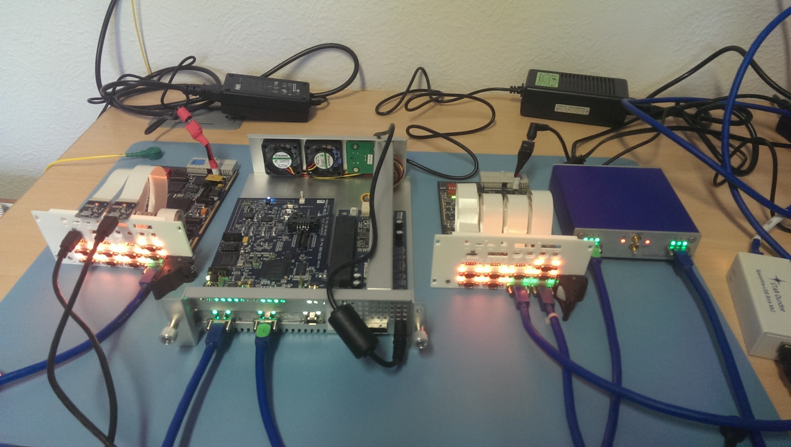
SpaceWire Prototype
Castor-PXI
Castor-PCIe
Castor-PXI
Link
Analyser Mk2
Brick
Mk2

Slide 25
SpaceWire-D Protocol Definition
The SpaceWire-D protocol has been defined by the University of Dundee under ESA contract.
Protocol requirements have been have been established with active involvement of two major European System Integrators (TAS-F, Airbus Defense & Space)
The SpaceWire-D protocol specification has been regularly reviewed by
ESA
TAS-F
Airbus D&S
SpaceWire Working Group
The prototype implementation is performed by UoD
The protocol definition is very advanced
SpaceWire-D Standard Draft D v0.15 (July 2014)

Slide 26
Conclusion
SpaceWire-D addresses the need of deterministic data delivery over SpaceWire.
Based on currently existing SpaceWire devices
Routers
RMAP Target devices
RMAP Initiators
Additional software to handle the protocol only required on Initiators.
Further error resilience can be gained by introducing the bus guarding function in the routers.
SpaceWire-D is planned for standardization in ECSS in 2016-2017

