Slide 1
OSI Model
Application
Application
Presentation
Presentation
Session
Session
Transport
Transport
Network
Network
DataLink
DataLink
Physical
Physical

Slide 2
MO Scope
Monitor and Control
Common Infrastructure
Data Product Distribution
Planning
Plan Execution
Navigation
Software Management
File Transfer and Management

Slide 3
Details of an MO Service
Consumer
Provider
Service
Operation

Slide 4
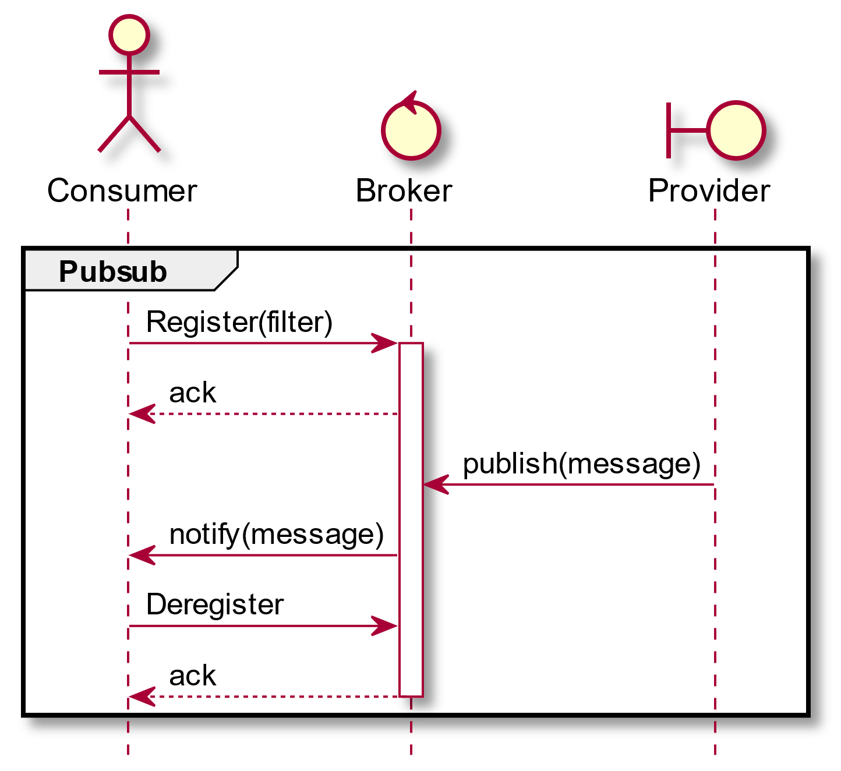
MAL Interaction Patterns

Slide 5
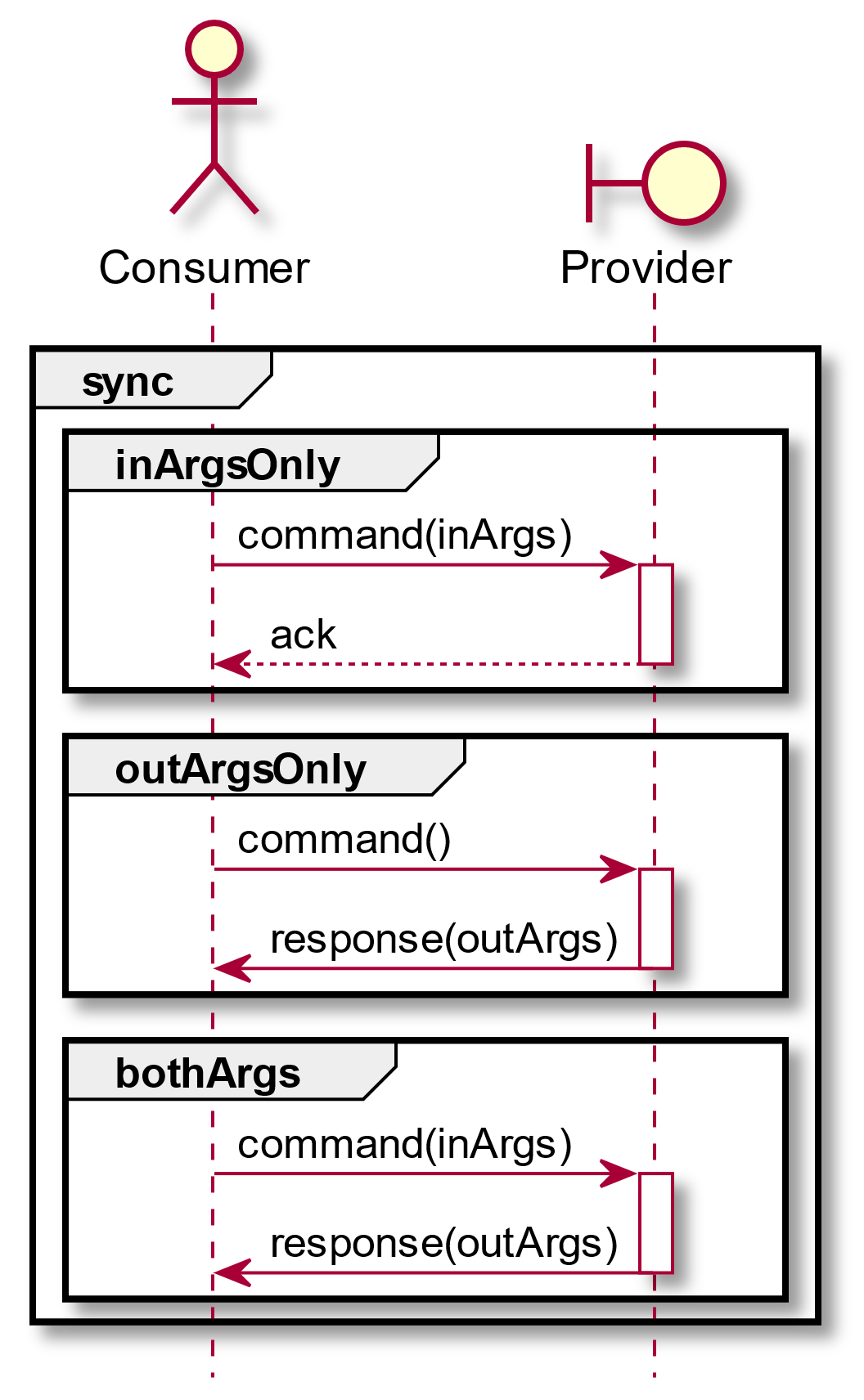
EDS Interaction Patterns

Slide 6
Space Packet Primary Header
Packet Version Number | Packet Type | Secondary Header Flag | Application Process Identifier | Sequence Flags | Packet Sequence Count | Packet Data Length
Binary value (3 bits) | Binary value (1 bit) | Binary value (1 bit) | Unsigned 11-bit integer (11 bits) | Binary value (2 bits) | Unsigned 14-bit integer (14 bits) | Unsigned 16-bit integer (16 bits)
Always equal to ‘000’ |  | Always equal to ‘1’

Slide 7
MAL Space Packet Secondary Header
Version Number | SDU Type | Service Area | Service | Operation | Area Version | Is Error Message | QoS Level | Session | Secondary APID | Secondary APID Qualifier | Transaction Id | Source Id Flag | Destination Id Flag | Priority Flag | Timestamp Flag
Binary value (3 bits) | Unsigned integer (5 bits) | Unsigned integer (16 bits) | Unsigned integer (16 bits) | Unsigned integer (16 bits) | Unsigned integer (8 bits) | Binary value (1 bit) | Unsigned integer (2 bits) | Unsigned integer (2 bits) | Unsigned integer (11 bits) | Unsigned integer (16 bits) | Signed integer (64 bits) | Binary value (1 bit) | Binary value (1 bit) | Binary value (1 bit) | Binary value (1 bit)
Network Zone Flag | Session Name Flag | Domain Flag | Authen-tication Id Flag | Source Id | Destination Id | Segment Counter | Priority | Timestamp | Network Zone | Session Name | Domain | Authen- tication Id
Binary value (1 bit) | Binary value (1 bit) | Binary value (1 bit) | Binary value (1 bit) | Unsigned integer (8 bits) | Unsigned integer (8 bits) | Unsigned integer (32 bits) | Unsigned integer (n*8 bits) | Time (n*8 bits) | Identifier (n*8 bits) | Identifier (n*8 bits) | List <Identifier> (n*8 bits) | Blob (n*8 bits)
 |  |  |  | If ‘Source Id Flag’ is ‘1’ | If ‘Destination Id Flag’ is ‘1’ | If ‘Sequence Flags’ is ‘00’, ‘01’, or ‘10’ | If ‘Priority Flag’ is ‘1’ | If ‘Timestamp Flag’ is ‘1’ | If ‘Network Zone Flag’ is ‘1’ | If ‘Session Name Flag’ is ‘1’ | If ‘Domain Flag’ is ‘1’ | If ‘Authen- tication Id Flag’ is ‘1’

