Slide 1
Debris Avoidance and the
CCSDS Navigation Working Group
Presentation to NSPO in Taiwan
November 2013
Mike Kearney
CCSDS Chair & General Secretary
NASA MSFC EO-01
256-544-2029
Mike.Kearney@nasa.gov
CCSDS
Advancing Technology
With International Agreements
To Use That Technology

Slide 2
Navigation WG Products
Mission Ops &
Info Mgt Services
3.
The CCSDS Navigation Working Group is chartered to develop standards covering exchange of spaceflight dynamics related data
Past Progress and Current Work
Orbit Data Messages (version 2.0 published 11/2009)
Three standard message formats for exchanging orbit descriptions
Tracking Data Message (version 1.0 published 11/2007)
Message format for exchanging tracking data; supports widely used tracking data types: Doppler, range, angle, ΔDOR, ancillary information
Attitude Data Messages (version 1.0 published 05/2008)
Two message formats for exchanging spacecraft attitude descriptions
Navigation Green Book (version 3.0 published 05/2010)
Contains technical background related to the Nav WG Recommendations
Nav Data Messages XML Specification (version 1.0 published 12/2010)
Contains XML representations of all above Nav WG standards
Conjunction Data Message (pub June 2013)
Standard message format for informing spacecraft operators of object conjunctions in space (spacecraft/spacecraft, spacecraft/debris, debris/debris)
Future work
Pointing Requests Message – communicating complex on-orbit cross-support pointing requests (e.g., inertial, limb, terminator, velocity, nadir, track)
Navigation Hardware Message – exchanging onboard navigation H/W data between space agencies (e.g., thrusters, accelerometers, star trackers, etc.)
Spacecraft Maneuver Message – exchanging information regarding spacecraft maneuvers (requirements, design, reconstructed performance)

Slide 3
Navigation WG - Scope
The CCSDS Conjunction Data Message provides a warning of a predicted spacecraft conjunction
It does not specify how to make such a prediction nor what to do in the event of a warning
This is consistent with the approach taken for all of the CCSDS flight dynamics related standards
The NAV WG standardized the format in which a trajectory designed/determined by one party could be exchanged with another party.
It also standardized a format for exchanging the tracking data that could be input to an orbit determination process.
It also standardized the format in which attitude state(s) designed/determined by one party could be exchanged with another party.
The NAV WG did NOT standardize:
the process of orbit determination or designing a trajectory
the process of attitude determination or design
the process of analyzing spacecraft conjunctions, but we did standardize the format in which a conjunction warning analyzed by one party could be conveyed to the affected satellite operator(s).
what one might do in the event that they received a conjunction warning.
There are too many variables, and some implied liabilities to making recommendations in this area.

Slide 4
Recommendations on Navigation Ops Research
US StratCom (Strategic Command) has hosted technical workshops on Navigation and Collision Avoidance topics in the US, Europe and Japan.
NSPO has not attended as far as they know
Recommend participating in future events
(Contact info?)
Recommendation: Request the Conjunction Summary Message from JSPOC.
Available via www.space-track.org (login required)
Send email to Ms. Diana McKissock (diana.mckissock.1@us.af.mil)
Include a list of satellites that NSPO operates, and a list of e-mail addresses for people in their organization who are authorized to have access to that data.
Operational Information from NASA GSFC is publically available:
NASA Robotic Conjunction Assessment Process - AIAA Info
Addresses safety volumes, etc.

Slide 5
Potential ISO resources for Collision Avoidance
CCSDS only works on data exchange for navigation
CCSDS functions as ISO TC20/SC13
Our “Sister” organization is ISO TC20/SC14.
They develop spaceflight standards for processes, algorithms, procedures, etc.
ISO TC20/SC14/WG3 has over the past few years initiated attempts to develop international standards in some of these areas, but later changed the document types to "Technical Report" (the equivalent of a CCSDS Green Book).
This is TR-16158, “Avoiding Collisions”
The complete ISO document tree on Debris avoidance is on the next chart.

Slide 6
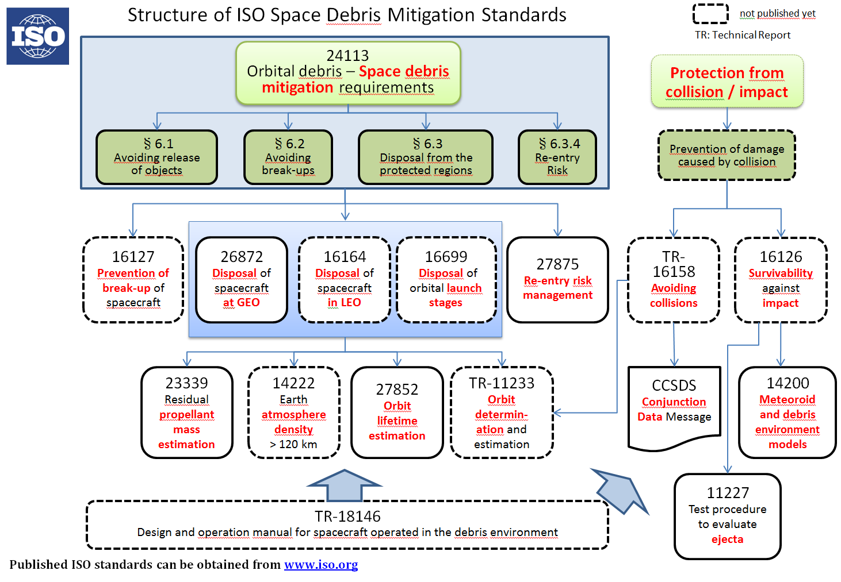
ISO TC20/WG14 Documents on Debris Mitigation

