Slide 1

CCSDS SLE and CSS
Space Link Extension
Cross Support Services
Mike Kearney
CCSDS Chair & General Secretary
NASA MSFC EO-01
256-544-2029
Mike.Kearney@nasa.gov
Erik Barkley
Cross Support Services Area Director
NASA JPL 3970
Erik.J.Barkley@jpl.nasa.gov
CCSDS
Advancing Technology
With International Agreements
To Use That Technology

Slide 2
Agenda
Space Link Extension (SLE)
Transition from SLE to CSTS
Cross Support Transfer Services (CSTS)
Cross Support Service Management (CSSM)
Cross Support Area Projects
Conclusions

Slide 3
The Situation circa 1990
(State of CCSDS Standardization of S/C Communications)
NOT included in the space link protocols: standards for completing the communication path between the spacecraft and controllers, data processing facilities, and users
CCSDS space link Protocols for highly efficient communications in resource-constrained environments:
- Telecommand
- Packet Telemetry
- Advanced Orbiting
System
Control Center
?
Ground Station
?
?
Return Link Data
Processing Facility
Remote User Facility

Slide 4
The Situation Circa 1990:
Agency Specific Solutions
Spaceflight missions “roll their own” ground services to transfer CCSDS
space link data units to and from the ground termination of the space-ground link
Spaceflight missions and/or institutional ground facilities “roll their own” ground services to transfer CCSDS space link data units among remote ground facilities and users
CCSDS Space Link protocols operating natively over space link
CCSDS Space Link protocols tunneled through terrestrial networks
Control Center
Multiple communication
service protocols
Non-standard Mission/facility-specific terrestrial communication
Ground Station
Multiple sets of
value-added features
Multiple management
capabilities and protocols
Return Link Data
Processing Facility
Remote User Facility
Notes:
Examples of a “Return Link Data Processing Facility:”
An architecture where the Front-End-Processors are are located somewhere not in the ground station nor the MCC?
Historically (before 1990), the notion of "staging" was sometimes used… baseband would be run into a separate facility which would then in fact turned it into usable bits for the mission.
More currently, some organizations have packet extraction capabilities which takes the telemetry frames and extract various virtual streams of packets based on a set of rules for particular mission.
The point here is that the two CCSDS links are standardized, and the three mission/facility specific links are non-standard.
“Multiple communication service protocols” means that they support multiple underlying transport mechanisms, everything from NASCOM 4800 bit blocks to X.25.

Slide 5
The Situation from 2001 to present
Space Link Extension
Standard services for exchanging CCSDS space link data units between ground termination of the space link and remote users
  Standardizing terrestrial links as well as space links
  Evolution of mission-unique/provider-unique services
  Only requires that CCSDS link protocols be used on the space-ground link
Domain
of
Space Link
Extension
Control Center
Return Link Data
Processing Facility
Remote User Facility

Slide 6
Standardized Capabilities of SLE Services
Service association establishment, configuration, and termination
Access control and authentication
Transfer of CCSDS space link data units with ancillary data, e.g.:
  Ground receipt time for return link data
  Radiation time window for forward link data
Offline storage and retrieval
Space link data status information
Transfer service status and accounting information
Production status information
Reliable transmission to multiple service users
(Limited) Service management – some mechanisms for control of executing transfer services
Notes:
“Production status” data is really talking about the annotation data that can be included as part of the SLE service -- examples are to send such information as the signal-to-noise ratio that was observed on the Spacelink in line with the particular telemetry frame that is being transferred via the terrestrial SLE.

Slide 7
Space Link Extension
One Example Configuration
This makes it very cost-effective to:
  Participate in joint missions
  Get comm support from other agencies and commercial providers
  Provide comm support to other agencies’ missions and programs
CCSDS Space Link protocols operating natively over space link
Service Management
Control Center
Forward CLTU service
Return Channel Frames
service
Forward Space
Packet service
Return All Frames
service
Service
Management
Return Space
Packet service
Return Link Data
Processing Facility
Remote User Facility
Notes:
This is just a sample configuration. It tends to be towards the maximal side but it is not necessarily the maximum example per se.

Slide 8
Benefits of SLE Services
SLE services address more than just data transfer
  Connections management, service configuration, status and accounting reports
SLE services are designed to operate over commercially-available packet network infrastructure
Common data and management interface simplifies operation of spaceflight missions across multiple space-ground network service providers
Services are scalable - only those services that are required by a user mission or service provider need be implemented
Standardized services increase market for space-ground network services providers
Expanded global market for COTS SLE products: increased number of vendors and/or lower costs for products
Reduced costs and technical and schedule risks
SLE places no additional requirements on spacecraft that already use CCSDS space link protocols

Slide 9
Space Link Extension Transfer Services
Seventeen (17) SLE transfer services
as identified in SLE Reference Model
  Ten (10) forward (uplink) services
    Forward CLTU (Command Link Transmission Unit)
    Forward TC (Telecommand) Frame
    Forward TC-VCA (Virtual Channel Access)
    Forward Space Packet
    Forward proto-VCDU (Virtual Channel Data Unit)
    Forward Insert
    Forward C/VCDU ((Coded)/VCDU)
    Forward VCA
    Forward Bitstream
  Seven (7) return (downlink) services
    Return All Frames
    Return Insert
    Return Channel Frames
    Return FSH (Frame Secondary Header)
    Return OCF (Operations Control Field)
    Return Bitstream
    Return Space Packet
Notes:
Not all of these are published standards;
(published stds are green)
A next generation framework for data transfer standards is in progress (more on next slides)
This list may be revised as new priorities are received from the IOAG
Notes:
The point is that this is what will be seen if the SLE reference model is read. But I think we can also keep in mind that there have been some changes since then and so it is not definitive at this point and should probably be treated as more of an example of the kinds of services that were envisioned.
“Not all of these are published standards”… This is what the SLE reference model will describe as the intended capabilities of SLE services that at one time were needed/planned by the agencies. However the IOAG catalog has superseded this at least partially. And then there has been some afterthoughts relative to this reference model which now include return unframed telemetry which does not show up in the original SLE reference model but is indeed now chartered as part of CSTS (albeit at a lower priority – its not quite the same as bitstream as there is a notion of locking-up providing TLM frames if possible).

Slide 10
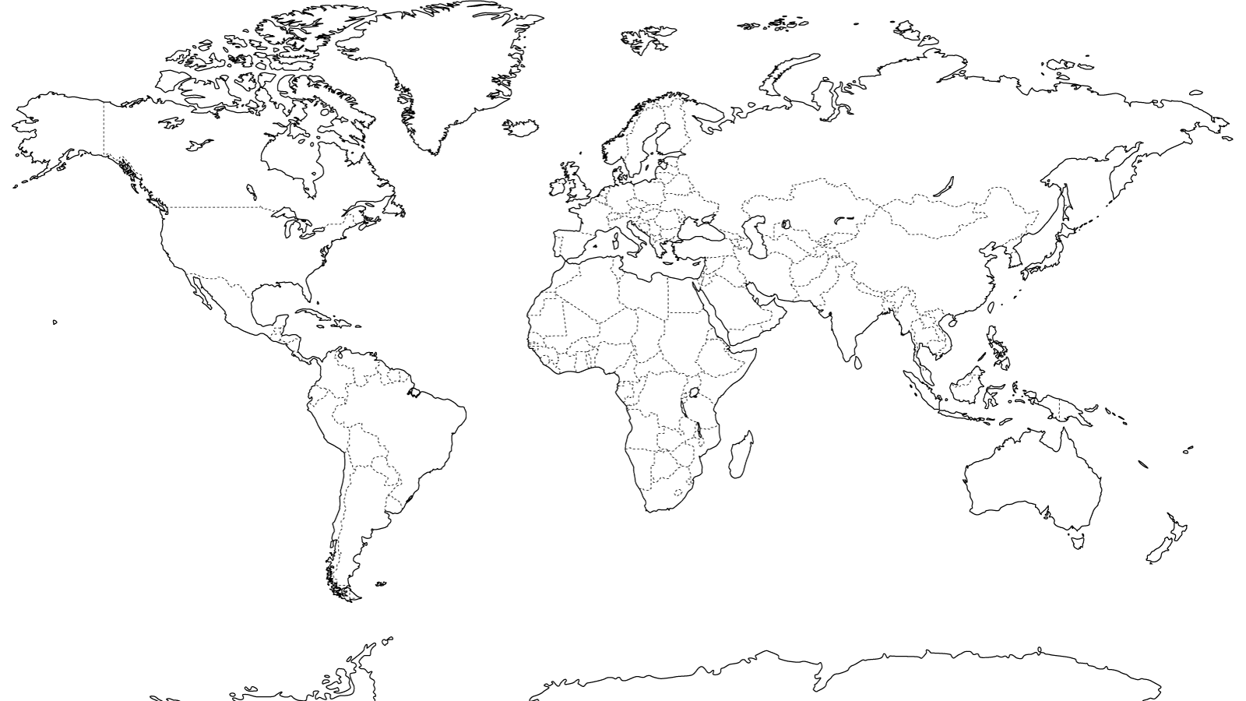
SLE Success Story (2002 to 2009)
Svalbard
Tromsø
ESOC
Kiruna
Saskatoon
Redu
Roskosmos
St. Hubert
Neustrelitz
CNES/
Toulouse
Weilheim
Denver
DLR/GSOC
Goldstone
Whitesands
Goddard
Madrid/CEB/VIL
CNSA
Usuda
JAXA
JPL
Xi'an
Ibaraki
Huston
Maspalomas
Uchinoura
Kourou
Bangalore
ISRO
Malinidi
Santiago
Hartebeestoek
New Norcia
Perth
Canberra
O'Higgins
Kerguelen
SLE Service Provider
SLE Service User
Troll
Notes:
This slide shows the widespread adoption of SLE, leading to successful cross-support. This may not be all-inclusive. Some agencies have not reported all SLE capabilities. A better source might be the IOAG catalog.

Slide 11
This is all great, but….
Seventeen (17) SLE transfer services →17 separate recommendations, prototyping, sets of agency reviews, maintenance issues, etc
  Recommendations tended to be duplicative in terms of substantial technical content
  CCSDS should be able to do something better…
CCSDS decided to take a new approach that factors all of the common technical stuff into a re-usable framework and re-use framework to meet agency needs for inter-operation, data transfer, including data that does not necessarily have a spacelink component
  E.g, what about ground station service production monitor data?

Slide 12
Transition from SLE to Cross Support Services
Cross Support Services consist of CSTS and CSSM
The Cross Support Transfer Services (CSTS) are designed to pick up where SLE left off:
  Creating new services (not duplicating SLE services) which are needed for future missions
  New approach – New services are built on a reusable framework.
  However, the new reusable framework makes CSS not interoperable with SLE.
  The CCSDS agencies have decided to leave SLE capabilties in place while adding CSTS capabilities for new functions
As a result, agencies are expected to implement both SLE and CSTS, depending on the capabilities they need to interface with at their and others’ comm sites.
  Implementing SLE for those services addressed by SLE (TM/TC)
  Implementing CSTS for additional services not addressed by SLE
Similarly CSSM will add new management services that supplement what is currently done with SLE… management of ground station and antenna site functions remotely from the user facility (MCC, etc.).

Slide 13

Cross Support Transfer Services (CSTS)
Overview

Slide 14
CSTS builds on SLE success (1)
CSTS builds on SLE success by supporting additional types of data.
SLE
CSTS
Provider
(e.g. Ground Station)
Provider
(e.g. Ground Station)
Unframed telemetry data, tracking data, Station monitoring
Telemetry frames (or portions)
Telecommand data (Packet or CLTU)
User
(e.g. Control Center)
User
(e.g. Control Center)
Notes:
SLE and CSTS are similar; they both transfer data between a Provider (typically a ground station) and a User (typically a mission control center). However, the types of data that can be transferred with CSTS are different than for SLE.
At this time, the services being developed are restricted to the ‘return’ of data (i.e. data flows from the Provider to the User). However, there is nothing preventing the development of services in which the data flow is from the User to the Provider.
The point of this slide is that we're using CSTS to address those things that have yet to be addressed via the SLE approach and are now being taken on by the CSTS approach. What is listed is really the first set of standards to be developed on top of the CSTS framework.

Slide 15
CSTS builds on SLE success (2)
CSTS reuses all the protocol layers underneath SLE, as well as the abstract syntax concept for its protocol messages.
SLE
(abstract syntax)
CSTS
(abstract syntax)
Encoding
Encoding
Transport Mapping Layer
Transport Mapping Layer
reuse
Transport Layer
(tcp)
Transport Layer
(tcp)
Network Layer
(ip)
Network Layer
(ip)
Notes:
A substantial part of the software source code that implements SLE can be reused for CSTS.

Slide 16
CSTS adds new services efficiently
The CSTS Framework provides a reusable foundation that allows services to be defined and implemented efficiently.
CSTS 1
CSTS L
service
CSTS Specification Framework
PRC 1
PRC 2
PRC M
procedure
OP 1
OP 2
OP 3
OP 4
OP N
operation
Notes:
Operations provide the most basic capabilities – e.g. “transfer these bytes”.
Procedures build on the capabilities provided by operations. To ensure that they are generally useful, procedures are purposely abstract. They typically define mechanisms (e.g. for buffering and releasing data) but do not specify the type of data being carried. (The services that use a procedure make the abstract parts concrete)
The combination of the procedures and operations is known as the Framework.
The Framework is specified once, and can then be referenced from multiple service specifications. This allows the service specifications to be quite small – the normative section of the Monitored Data Service is only 6 pages long!
Similarly, the Framework can be implemented once, and that implementation can be reused across all the CSTS services.
Said another way: the reusable Framework allows new services to be defined and implemented efficiently.

Slide 17
CSTS Services use the Framework
Each service uses only those Framework procedures that are needed to get the job done. For example:
Monitored
Data
Service
Association
Control
Cyclic
Report
Information
Query
Notification
Framework
Procedures
“establish connection”
“periodic reports”
“one report per request”
“notify User when certain events occur”
Notes:
The Monitored-Data service allows the User to monitor the overall status of service being provided by, say, a ground station for a particular pass. Monitoring is accomplished via periodic reports and/or specific queries, plus the User is notified when “events of interest” occur.
As always, the Association-Control procedure establishes a connection between the User and Provider.
The Cyclic-Report procedure allows the User to request (and receive) periodic status reports.
The Information-Query procedure allows the User to request (and receive) a single status report.
The Notification procedure is used to notify the User when an “event of interest” occurs.
Note that there are other Framework procedures, but they are not needed to accomplish the Monitored-Data service.

Slide 18
A CSTS service may extend the Framework
If a service needs capabilities that are not supplied by the Framework, it may extend the Framework – it can create a new procedure that adds new behavior and/or new data to an existing procedure.
Real-time
Tracking Data
uses
Buffered Tracking Data Message Delivery
Service + new procedure
uses
extends
Association
Control
Buffered Data
Delivery
Framework
Procedures
“establish connection”
“deliver data; buffer as needed”
The new procedure adds one capability to the existing procedure - it delivers one context message prior to a stream of Tracking Data messages.
Notes:
The Real-time Tracking Data service delivers “fresh” Tracking Data Messages to the User for real-time monitoring. The service must ensure that a ‘metadata’ message is delivered at startup (the metadata will provide the context for the data that follows).
As always, the Association-Control procedure establishes a connection between the User and Provider.
The service defines a new procedure that extends an existing Framework procedure by specifying that ‘metadata’ shall be sent as part of the startup mechanism. Again, this metadata provides the context for the data that follows.
The new procedure reuses the buffering and delivery mechanism from the Buffered-Data-Delivery procedure – therefore, the specification of the new procedure is very small (only 3 pages long!). (The implementation of the new procedure can be very small as well)

Slide 19
A CSTS service may refine the Framework
If a service needs more precise capabilities than the abstract capabilities provided by the Framework, it may refine the Framework -- for example, a new procedure narrows the possibilities provided by an existing procedure.
Real-time
Tracking Data
uses
Buffered Tracking Data Message Delivery
Service + derived procedure
uses
refines
Association
Control
Buffered Data
Delivery
Framework
Procedures
“establish connection”
“deliver data; buffer as needed”
The Buffered-Data-Delivery procedure does not specify the format of the data to be delivered; the new procedure specifies that the data will match the standard Tracking Data Message format.
Notes:
Note that the Real-time Tracking Data service uses both extension (see previous slide) and refinement (this slide). Generally speaking, extension is used to add capabilities, while refinement is used to narrow existing capabilities.

Slide 20
CSTS Lower-layer Building Block – Operations
Service User
Service Provider
BIND
Service User
INVOKER
START
TRANSFER-DATA
Invocation
TRANSFER-DATA
Return
TRANSFER-DATA
port
STOP
Service Provider
PERFORMER
UNBIND
Notes:
All operations do their work by means of protocol messages. These messages are defined using Abstract Syntax Notation, and are very similar to the SLE protocol messages.
This slide shows some of the available operations; there are others.
The typical operation has two steps – invocation and return. The return may be positive (indicating that the invocation was accepted) or negative (indicating that the invocation was rejected).

Slide 21
CSTS Lower-layer Building Block – Operations
Establish an association with the provider for the service instance
Service Provider
BIND
Service User
Service User
INVOKER
START
Start data flow
TRANSFER-DATA
Transfer one Data Unit
Invocation
TRANSFER-DATA
Return
TRANSFER-DATA
port
STOP
Stop data flow
Service Provider
PERFORMER
Release the association with the service provider
UNBIND
Notes:
All operations do their work by means of protocol messages. These messages are defined using Abstract Syntax Notation, and are very similar to the SLE protocol messages.
This slide shows some of the available operations; there are others.
The typical operation has two steps – invocation and return. The return may be positive (indicating that the invocation was accepted) or negative (indicating that the invocation was rejected).

Slide 22
CSTS Higher-layer Building Block - Procedures
Service Provider
Service User
Bind
Start (data selection)
Transfer-Data
Association
Control
Buffered Data Delivery
Transfer Data
Notify (end of data)
Stop
Unbind
Note: The Buffered Data Delivery procedure includes mechanisms for buffering and releasing of data units.
Notes:
All procedures use operations to help accomplish their work.
Procedures typically add behavior around the operations. For example, the Buffered-Data-Delivery procedure uses the Transfer-Data operation to send data from the Provider to the User, and adds mechanisms for buffering data at the Provider and deciding when to send (or possibly, discard) the buffered data.
While procedures define specific mechanisms for flowing data, they do not specify what type of data is being transferred. This abstract nature enables the procedure specifications to be used for services that transfer a variety of different types of data.

Slide 23

CCSDS CSTS Major Documents
Increasing Level
Of Detail and Specification
GREEN BOOK – Informative Report
Cross Support Transfer Service
Specification Framework Concepts
MAGENTA BOOK – Recommended Practice
Guidelines for Specification of
Cross Support Transfer Services
BLUE BOOK – Recommended Standard
Cross Support Transfer Service
Specification Framework
Current draft of Framework Blue Book is available in the private area of CCSDS CWE for WG participants, or it can be provided on request. HOWEVER, be careful not to implement systems to that specification until it is approved by CCSDS.
Notes:
The Framework specification defines the procedures and operations that make up the Framework. This includes specifying the format of all CSTS protocol messages.
The Guidelines specification is intended to guide people who want to create new services. This specification attempts to ensure that:
Services make maximum use of the reusable Framework.
When a service extends the Framework, that it does so in the most efficient way that is practical.
Service specifications follow a consistent outline.
Services are consistent in how they use Service Management to configure themselves.
The Concepts report explains:
How the Framework fits into the bigger picture.
The approach taken within the Framework
Capabilities that are assumed to be provided by protocol layers below the Framework.
How to use the Framework to build a service.

Slide 24
CCSDS CSTS Major Documents
The Concepts report explains:
  How the Framework fits into the bigger picture.
  The approach taken within the Framework
  Capabilities that are assumed to be provided by protocol layers below the Framework.
  How to use the Framework to build a service.
The Guidelines specification is intended to guide people who want to create new services. This specification attempts to ensure that:
  Services make maximum use of the reusable Framework.
  When a service extends the Framework, that it does so in the most efficient way that is practical.
  Service specifications follow a consistent outline.
  Services are consistent in how they use Service Management to configure themselves.
The Framework specification defines the procedures and operations that make up the Framework. This includes specifying the format of all CSTS protocol messages.

Slide 25
CSTS - Reading the Framework specification
For managers and others interested in the bigger picture, sections 1 and 2 are recommended.
For implementers and others interested in the detailed rules to be followed, sections 3 and 4 are recommended.
Note that the formal definition of protocol message formats is found in Annex C.
Notes:
The formal name of the Framework specification is “Cross Support Transfer Service – Specification Framework”.

Slide 26
CSTS Conclusions
The CSTS Framework builds on proven SLE concepts, and much of the source code developed for SLE can be reused for CSTS.
The CSTS Framework provides an efficient path to defining and implementing new services – it enables savings in time and cost.
  The Framework specification provides building blocks that can be used to build new services.
  These building blocks can easily be extended and/or refined as necessary.
While it is possible to transition the existing SLE services to the CSTS approach, there are no plans to do so at this time.
Notes:
CSTS makes significant reuse of SLE concepts and source code, while providing a more efficient way to define and implement new services.
Last bullet: We could indeed re-develop RAF, RCF, F-CLTU and other SLE recommendations that already exist to be "clients" of the CSTS framework (recall that SLE and CSTS-based services do not interoperate). But the collective wisdom of the agencies is that we do not want to burn resources doing this when SLE is already doing the job just because it would clean up the engineering.

Slide 27
…But it all needs to be managed…
Real-world spacecraft tracking requires planning and coordination of many different types of information ranging from spacecraft telecommunications capabilities, to trajectory data, to real-time service execution control to accounting for services rendered.
Define an approach that factors all of the common technical stuff into a re-usable framework and re-use framework to meet agency needs for inter-operation, data transfer, including data that does not necessarily have a spacelink component
  E.g, what about ground station service production monitor data?
The CCSDS Cross Support Service Management (CSSM) project was created to answer that need.

Slide 28
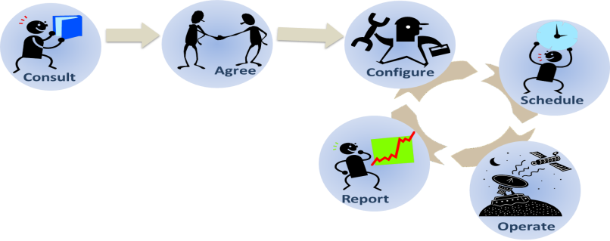
Cross Support Service Management (CSSM)
A Brief Overview
Objective
  Define management service standards for cross support management of Telemetry, Command, Ranging and future CCSDS inter-agency services
Space Element
SCCS Complex
MDOS
Data Transfer
Interface (Spacelink)
Service Mgmt Interface
Utilization
Complex Management
Management
Internal Management
Space Link Services
Internal
(Transfer Service Production)
Transfer
Management
Service Provision
Frames
Data Transfer Interfaces (Terrestrial)
Service
RF and
Provider
Modulation
Equipment
Transfer
CLTU
Service
Service
Users
Provider

Slide 29
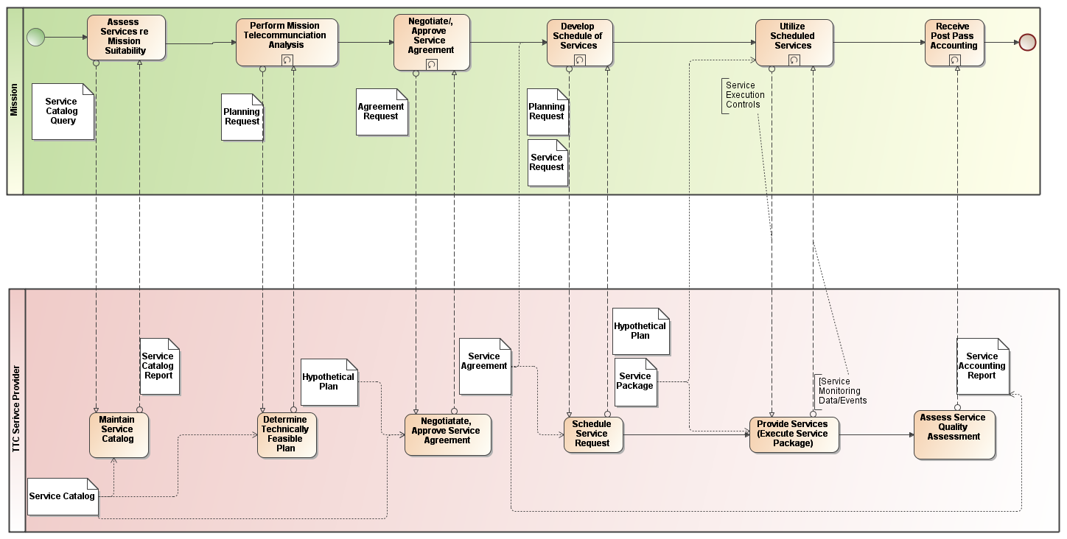
The CCSDS Service Management Lifecycle

Slide 30
Current CCSDS Service Management Projects
Service Catalog – definition of how to state characteristics of TTC Services offered; telemtry services supported at S, X bands up to 50 Mbps, with LDPB coding
Planning Information – definition of planning information such as predicted communication geometry
Schedule of Services – definition of data format for publication of network schedules
Configuration/Service Agreement information – definition of space link, terrestrial data transfer (i.e. SLE and CSTS), and levels of services to be provided (for example number of spacecraft contacts for a given period of time)
Service request/service package – definition of a request for TTC network services and response for such a request
Event Sequence – Definition of how spacecraft, especially those in deep space, may change the configuration such that the ground systems can respond properly when it is impossible to convey the changes in real time (i.e. preplanning required because of long light time delays)
Service Accounting – definition of accounting for services and qualities of services rendered; e.g, 1.2 million telemetry frames returned; 99% successful decoding

Slide 31
Cross Support Services Area
Current CSS Projects
CSTS and CSSM Project Status
  Red cells indicate important support is needed
  NSPO participation in these WGs is welcome
Project | Working Group | Doc type | Book Editor | Prototype 1 | Prototype 2 | Contributors
Cross-Support Specification Framework | CSTS WG | Blue | ESA | ESA | NASA | CNES, DLR, ESA, NASA
Cross-Support-Transfer Services Specification Framework Concept | CSTS WG | Green | DLR | N/A | N/A | CNES, DLR, ESA, NASA
Guidelines for Specification of Cross Support Transfer Services | CSTS WG | Magenta | DLR | N/A | N/A | CNES, DLR, ESA, NASA
Monitored Data - Cross Support Transfer Services | CSTS WG | Blue | NASA | CNES | NASA | CNES, DLR, ESA, NASA
SLE API for Return All Frames Service. Magenta Book: M-1 Update | CSTS WG | Magenta | DLR | N/A | N/A | CNES, DLR, ESA, NASA
SLE API for Return Channel Frames Service: M-1 Update | CSTS WG | Magenta | DLR | N/A | N/A | CNES, DLR, ESA, NASA
SLE API for Return Operational Control Fields: M-1 Update | CSTS WG | Magenta | DLR | N/A | N/A | CNES, DLR, ESA, NASA
SLE API for the Forward CLTU Service. Magenta Book: M-1 Update | CSTS WG | Magenta | DLR | N/A | N/A | CNES, DLR, ESA, NASA
SLE API for the Forward Space Packet Service: M-1 Update | CSTS WG | Magenta | DLR | N/A | N/A | CNES, DLR, ESA, NASA
SLE API for Transfer Services—Core Specification: M-1 Update | CSTS WG | Magenta | DLR | N/A | N/A | CNES, DLR, ESA, NASA
Tracking Data Cross support Transfer Service | CSTS WG | Blue | NASA |  |  | CNES, DLR, ESA, NASA
CSSM Service Agreement and Service Config Profile Data Formats | CSSM WG | Blue
CSSM Simple Schedule Format Specification | CSSM WG | Blue | ESA | DLR | NASA | CNES, DLR, ESA, NASA
CSSM Event Sequence Data Format | CSSM WG | Blue
CSSM Planning Data Formats | CSSM WG | Blue | ESA | NASA | ESA | DLR, ESA, JAXA, NASA
CSSM Service Accounting | CSSM WG | Blue
CSSM Service Catalog | CSSM WG | Blue
CSSM Service Request and Service Package Data Formats | CSSM WG | Blue
Extensible Space Comm CSSM -- Concept | CSSM WG | Green | NASA | N/A | N/A | ESA, NASA

Slide 32
Conclusions
NSPO would benefit from:
  Adopting existing SLE standards
  Helping to develop new CSS Area Standards (CS Transport Services and CS Service Management)
Because…
  After initial investment, these solutions are long-term more cost effective
  Provides ability for NSPO to use other agencies’ comm assets
  Provides ability for NSPO to provide services to other agencies from NSPO comm assets
  SLE software code is partly reusable for CSTS projects
  NSPO participation in CCSDS can make CSTS and CSSM better aligned with NSPO needs

Slide 33
Backup Material

Slide 34

Field Guide to CCSDS Book Colors
BLUE BOOKS
Recommended Standards
Normative and sufficiently detailed (and pre-tested) so they can be used to directly and independently implement interoperable systems (given that options are specified).
ORANGE BOOKS
Experimental
Normative, but may be very new technology that does not yet have consensus of enough agencies to standardize.
MAGENTA BOOKS
Recommended Practices
Normative, but at a level that is not directly implementable for interoperability. These are Reference Architectures, APIs, operational practices, etc.
YELLOW BOOKS
Administrative
CCSDS Procedures, Proceedings, Test reports, etc.
GREEN BOOKS
Informative Documents
Not normative. These may be foundational for Blue/Magenta books, describing their applicability, overall archtecture, ops concept, etc.
SILVER BOOKS
Historical
Deprecated and retired documents that are kept available to support existing or legacy implementations. Implication is that other agencies may not cross-support.
RED BOOKS
Draft Standards/Practices
Drafts of future Blue/Magenta books that are in agency review. Use caution with these… they can change before release.
PINK BOOKS/SHEETS
Draft Revisions For Review
Draft Revisions to Blue or Magenta books that are circulated for agency review.
Pink Books are reissues of the full book, Pink Sheets are change pages only.

Slide 35



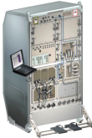















CCSDS Overview
End-to-End Architecture
Six Areas
Twenty-Eight working groups
Systems Engineering
Working Group (producing standards)
Birds-Of-a-Feather stage (pre-approval)
Special Interest Group (integration forum)
Security
Space Assigned Numbers Auth.
Delta-DOR
Timeline Data Exchange
Standards and Guidelines
One Organization’s Assets
MISSION CONTROL
CENTER
End Users
Applications/Archives
MISSION CONTROL
CENTER
End Users
Another Organization’s Assets
Spacecraft Onboard
Interface Services
Space Link
Services
Cross Support
Services
Space Internetworking
Services
Mission Ops &
Info Mgt Services
Onboard Wireless WG
Application Supt Services (incl. Plug-n-Play)
RF & Modulation
Space Link Coding & Sync.
Multi/Hyper Data Compress.
Space Link Protocols
Next Generation Uplink
Space Data Link Security
Planetary Communications
Optical Coding and Mod
CS Service Management
CS Transfer Services
Cross Supt Service Arch.
Asynchonous Messaging
Motion Imagery & Apps
Delay Tolerant Networking
Voice
CFDP over Encap
Data Archive Ingestion
Navigation
Spacecraft Monitor & Control
Digital Repository Audit/Certification
Telerobotics

