Slide 1
CCSDS Applied To
Remote Sensing Programs
Presentation to NSPO in Taiwan
November 2013
Mike Kearney
CCSDS Chair & General Secretary
NASA MSFC EO-01
256-544-2029
Mike.Kearney@nasa.gov
CCSDS
Advancing Technology
With International Agreements
To Use That Technology

Slide 2
Agenda
CCSDS Background
CCSDS Architecture
CCSDS Areas of Interest to Remote Sensing Programs
Summary
Notes:
Please confirm agenda reflects final changes to document

Slide 3
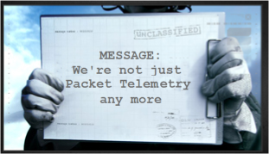
CCSDS – Scope and Origins
CCSDS = The Consultative Committee for Space Data Systems
The primary goal of CCSDS is interoperability between communications and data systems of space agencies’ vehicles, facilities, missions and programs.
Of all of the technologies used in spaceflight, standardization of communications and data systems brings the most benefit to multi-agency interoperability.
CCSDS Started in 1982 developing standards at the lower layers of the protocol stack. The CCSDS scope has grown to cover standards throughout the entire ISO communications stack, plus other Data Systems areas (architecture, archive, security, XML exchange formats, etc.

Slide 4
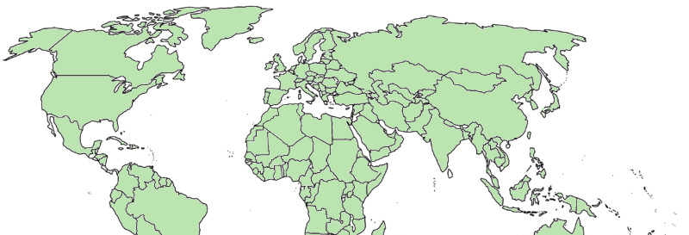
CCSDS Overview - Participation
CCSDS – An Agency-Led International Committee
Currently 11 Member agencies
Currently 28 Observer Agencies
Agencies represent 26 nations
Currently 151 Commercial Associates
~160-180 attendees at Spring/Fall meetings
Also functions as an ISO Subcommittee
TC20/SC13 - Space Data & Info Transfer Systems
Represents 20 nations
OBSERVER
AGENCIES
ASA/Austria
BFSPO/Belgium
CAS/China
CAST/China
CLTC/China
CSIR/South Africa
CSIRO/Australia
DCTA/Brazil
DNSC/Denmark
EUMETSAT/Europe
EUTELSAT/Europe
GISTDA/Thailand
HNSC/Greece
IKI/Russia
ISRO/India
KARI/Korea
KFKI/Hungary
MOC/Israel
NCST/USA
NICT/Japan
NOAA/USA
NSARK/Kazakhstan
NSPO/Taiwan
SSC/Sweden
SUPARCO/Pakistan
TsNIIMash/Russia
TUBITAK/Turkey
USGS/USA
MEMBER
AGENCIES
ASI/Italy
CNES/France
CNSA/China
CSA/Canada
DLR/Germany
ESA/Europe
FSA/Russia
INPE/Brazil
JAXA/Japan
NASA/USA
UKSA/UK
e
e
e

Slide 5
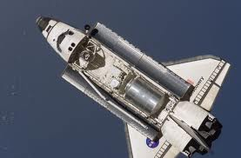
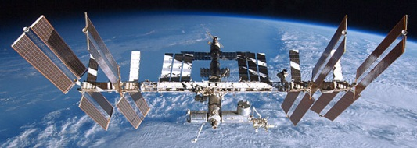
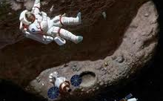
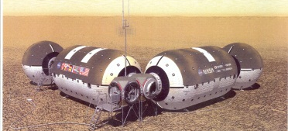
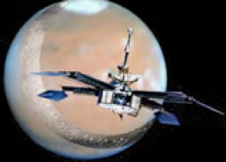
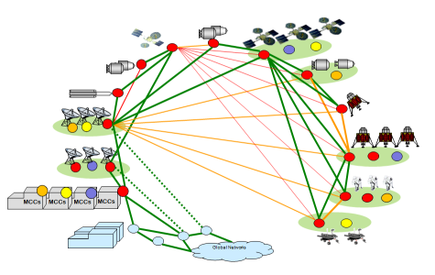
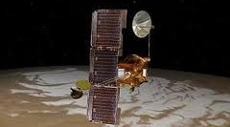
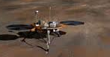
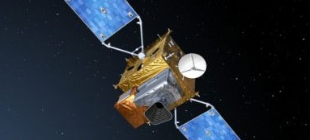
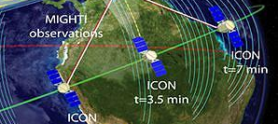
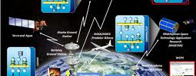
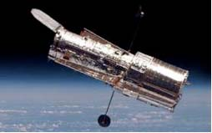
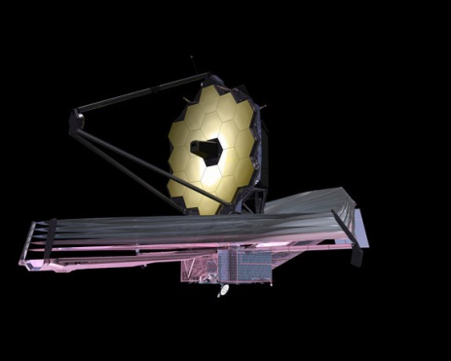
Future Mission Drivers
PAST
PRESENT
DRIVERS FOR THE
FUTURE
In Situ Exploration
Human Expeditions
Long Duration, High Reliability
Mobile comm protocols
Voice, Video, Medical handling
Onboard Autonomy
Highly integrated ops
Shuttle/SpaceLab
CCSDS packets
International Space Station
Adv. Orbital Sys (AOS)
Early DTN Prototyping
Asteroid/Surface Exploration
Autonomy, High bandwidth
Multi-Agency Mission Ops
Complex Deep Space Missions
Human or robotic exploration
Longer Duration
Mobile comm protocols
Fully automated routing
Network-Managed DTN
Optical Communications
Complex human or robotic
Scenarios for remote surface missions
Fully automated Space Internetworking
Brief Recon Flyby,
Short-Lived Probes
Direct-to-Earth links
Missions designed for orbital relays, Longer duration
Orbital Remote Sensing
Long Duration, high bandwidth
High Spatial, Spectral, & Temporal Resolution
Low Latency Comm
Complex link topologies
SensorWebs for synchronized remote sensing
Single-Spacecraft Survey/Sensors
Spacecraft Constellations
and formation flying
Multi-Discipline and
Multi-Resource SensorWebs
Next Generation Observatories
More Capability
Multiple Spacecraft drive network needs
Even Greater Capacities require new coding schemes
Located Even Farther from Earth
Single-Spacecraft Observatories in LEO
Greater Distances
Higher bandwidth
Next Generation
Observatory Complexes

Slide 6
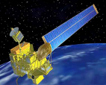
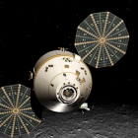
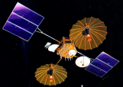
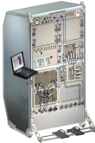
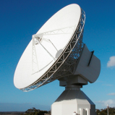
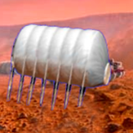
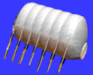
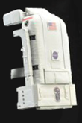
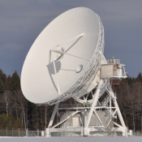
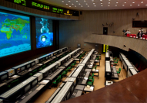
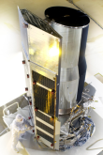
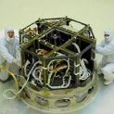
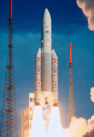
CCSDS Overview End-to-End Architecture
Six Technical Areas,
Twenty-Nine Teams
Systems Engineering
Working Group (producing standards)
Birds-Of-a-Feather stage (pre-approval)
Special Interest Group (integration forum)
Security
Space Assigned Numbers Auth.
Delta-DOR
Timeline Data Exchange
XML Standards and Guidelines
Typical Mission Profile
One Organization’s Assets
MISSION CONTROL
CENTER
End Users
Applications/Archives
MISSION CONTROL
CENTER
End Users
Another Organization’s Assets
Spacecraft Onboard
Interface Services
Space Link
Services
Cross Support
Services
Space Internetworking
Services
Mission Ops &
Info Mgt Services
Onboard Wireless WG
Application Supt Services (incl. Plug-n-Play)
RF & Modulation
Space Link Coding & Sync.
Multi/Hyper Data Compress.
Space Link Protocols
Next Generation Uplink
Space Data Link Security
Planetary Communications
Optical Coding and Mod
CS Service Management
CS Transfer Services
Cross Supt Service Arch.
Generic Gnd-to-Gnd File Transfer
Motion Imagery & Apps
Delay Tolerant Networking
Voice
CFDP over Encap
CFDP Revisions
Data Archive Ingestion
Navigation
Spacecraft Monitor & Control
Digital Repository Audit/Certification
Telerobotics

Slide 7
CCSDS Areas of Potential Interest for Remote Sensing Programs
Systems Engineering
Sys Eng
Security Techniques for All Missions: Encryption, Key Management, Threats, etc.
SOIS
Spacecraft Design Benefits
Plug-n-Play for Spacecraft Data Busses, Electronic Data Sheets
Space Link Svcs
RF & Mod techniques for more bandwidth efficiencies
Space-adapted Image Compression, Link level security, Optical (laser) comm for both cross-links and space-ground links
CSS
Capabilities to use Comm Assets (antennas) from other agencies and network providers, both transport and automated management
SIS - Space Internet
CFDP = proven onboard file management for remote sensing. Will be even better when rehosted on DTN (Delay Tolerant Networking). Voice helps ground comm. Video (?)
MOIMS
Navigation – Avoid Collisions; Data Archives; SM&C = Service Oriented Architecture approach to MCCs and migration of apps to onboard spacecraft.
Security
Spacecraft Onboard
Interface Services
Space Link
Services
Cross Support
Services
Space Internetworking
Services
Mission Ops &
Info Mgt Services
Application Supt Services (incl. Plug-n-Play)
RF & Modulation
Space Link Coding & Sync.
Multi/Hyper Data Compress.
Space Link Protocols
Space Data Link Security
Optical Coding and Mod
CS Service Management
CS Transfer Services
Generic Gnd-to-Gnd File Transfer
Motion Imagery & Apps
Delay Tolerant Networking
Voice
CFDP over Encap
CFDP Revisions
Data Archive Ingestion
Navigation
Spacecraft Monitor & Control

Slide 8
MultiSpectral Hyperspectral Data Compression
MHDC WG standards of use for Remote Sensing:
future compression standards in the working group include a spectral decorrelating transform that would provide effective lossy and lossless compression of multi- and hyperspectral images.
We believe that FORMOSAT-5 is implementing CCSDS 122B
 | 121B: Lossless Data Compression (Issue-1: 1997, Issue-2: 2013) | 122B: Image Data Compression (Issue-1: 2005) | 123B: Lossless Multispectral & Hyperspectral Image Compression
Input Data | 1D, 2D, 3D, … , serialized | 2D, 3D, …, formatted as 2D image data | 3D spectral Image Data
Algorithm | Predictor + entropy coder | Discrete Wavelet Transform (DWT) + Bit Plane Encoder (BPE) | Adaptive filtering as predictor + entropy coder
Algorithm Complexity | Low: no multiplier, mostly bit-shift and integer operations | Very high: DWT with multipliers and adders; BPE with data structure and scanning | Medium due to adaptive filtering in predictor calculation
Compression Performance in Coded Bits/Sample (coded rate) | Lossless only: coded rate not controllable, depending on data characteristics | Lossless mode: coded rate not controllable; Lossy mode: tunable to precise desirable rate | Lossless only: coded rate not controllable, depending on data
Additional Capability | Support hyper-/multi-spectral compression utilizing a user-supplied preprocessor with excellent result | Enabling intelligent data rate allocation based on extracted science data priority or quality right before downlink | Over 30% improvement achievable compared to using 121B

Slide 9
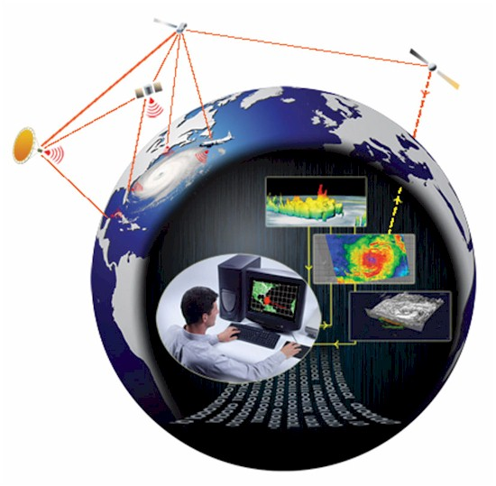
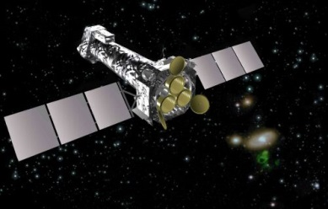
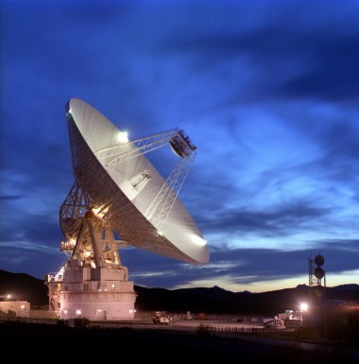
Important Scenarios
Future SensorWeb Scenario:
Multiple Earth-Observing Satellites utilize automated network communications.
Built on foundation of CCSDS DTN, AMS, and Space Internetworking standards.
Major event (earthquake, volcano) occurs
First observation sends automated signal to all satellites, and they simultaneously observe the event
Contingency Scenarios
Even if your mission does not initially have requirements for international interfaces, you need CCSDS compatibility for emergency support.
We have had two scenarios (XMM-Newton and STRS) where a disabled satellite was rescued with assistance from another agency, because of CCSDS compatibility.

Slide 10
CCSDS Summary
As a minimum, Remote Sensing programs should work for maximum CCSDS compatibility with existing, published standards.
Go to www.ccsds.org, click on “Publications”.
Even better, your programs should have their experts become engaged in the development of new CCSDS standards.
To insure future CCSDS standards meet your needs.
Contribute by telecon and electronic reviews, or even attend meetings.
Go to www.ccsds.org, click on “CWE”.
If you don’t see a data or communications standard that you need to promote remote sensing interoperability between agencies, then you can propose a new project to CCSDS.

