Slide 1

CCSDS Overview
Presentation to NSPO in Taiwan
November 2013
Mike Kearney
CCSDS Chair & General Secretary
NASA MSFC EO-01
256-544-2029
Mike.Kearney@nasa.gov
CCSDS
Advancing Technology
With International Agreements
To Use That Technology

Slide 2
Agenda
CCSDS Background (scope, participation, etc.)
CCSDS Architecture, Organization, Processes
Access to CCSDS Online
CCSDS Strategic Goals by Technical Area
Closeup on CCSDS Activities in Select Working Groups
Notes:
Please confirm agenda reflects final changes to document

Slide 3
CCSDS Overview
Advancing Technology
simultaneous with international agreements
to use that technology

Slide 4
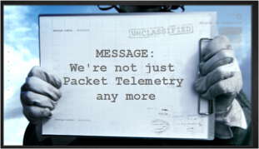
CCSDS – Scope and Origins
CCSDS = The Consultative Committee for Space Data Systems
The primary goal of CCSDS is interoperability between communications and data systems of space agencies’ vehicles, facilities, missions and programs.
Of all of the technologies used in spaceflight, standardization of communications and data systems brings the most benefit to multi-agency interoperability.
CCSDS Started in 1982 developing standards at the lower layers of the protocol stack. The CCSDS scope has grown to cover standards throughout the entire ISO communications stack, plus other Data Systems areas (architecture, archive, security, XML exchange formats, etc.

Slide 5

On CCSDS Standards
MYTH
When an innovative technology is rapidly brought to the standards community, it is vetted with a larger user base, facilitating widespread adoption of innovative technology.
This reduces the risk of new technology with “more eyes on the problem.”
Standards stifle innovation
FACT
CCSDS stimulates advanced technology
by adopting, adapting, developing
and solidifying innovations with
exposure to a wider community
This spreads the cost of technology development over a larger user base.
This enables joint missions, for cost sharing and increased capabilities.
This improves operations,
with familiar interfaces and more options for contingency recovery.
MYTH
Standards delay implementation
FACT
Not if the innovation is brought into the
standards process early. Delays result
from reluctance to standardize,
not from standardization

Slide 6


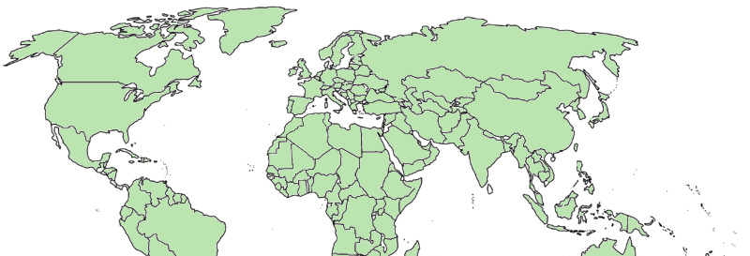

CCSDS Overview - Participation
CCSDS – An Agency-Led International Committee
  Currently 11 Member agencies
  Currently 28 Observer Agencies
  Agencies represent 26 nations
  Currently 151 Commercial Associates
  ~160-180 attendees at Spring/Fall meetings
Also functions as an ISO Subcommittee
  TC20/SC13 - Space Data & Info Transfer Systems
  Represents 20 nations
OBSERVER
AGENCIES
ASA/Austria
BFSPO/Belgium
CAS/China
CAST/China
CLTC/China
CSIR/South Africa
CSIRO/Australia
DCTA/Brazil
DNSC/Denmark
EUMETSAT/Europe
EUTELSAT/Europe
GISTDA/Thailand
HNSC/Greece
IKI/Russia
ISRO/India
KARI/Korea
KFKI/Hungary
MOC/Israel
NCST/USA
NICT/Japan
NOAA/USA
NSARK/Kazakhstan
NSPO/Taipei
SSC/Sweden
SUPARCO/Pakistan
TsNIIMash/Russia
TUBITAK/Turkey
USGS/USA
MEMBER
AGENCIES
ASI/Italy
CNES/France
CNSA/China
CSA/Canada
DLR/Germany
ESA/Europe
FSA/Russia
INPE/Brazil
JAXA/Japan
NASA/USA
UKSA/UK
e
e
e

Slide 7
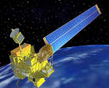
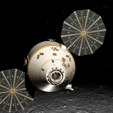
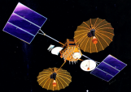
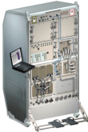



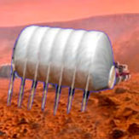

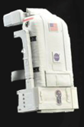



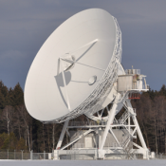


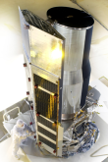
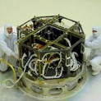

CCSDS Overview
End-to-End Architecture
Six Technical Areas,
Twenty-Nine Teams
Systems Engineering
Working Group (producing standards)
Birds-Of-a-Feather stage (pre-approval)
Special Interest Group (integration forum)
Security
Space Assigned Numbers Auth.
Delta-DOR
Timeline Data Exchange
XML Standards and Guidelines
Typical Mission Profile
One Organization’s Assets
MISSION CONTROL
CENTER
End Users
Applications/Archives
MISSION CONTROL
CENTER
End Users
Another Organization’s Assets
Spacecraft Onboard
Interface Services
Space Link
Services
Cross Support
Services
Space Internetworking
Services
Mission Ops &
Info Mgt Services
Onboard Wireless WG
Application Supt Services (incl. Plug-n-Play)
RF & Modulation
Space Link Coding & Sync.
Multi/Hyper Data Compress.
Space Link Protocols
Next Generation Uplink
Space Data Link Security
Planetary Communications
Optical Coding and Mod
CS Service Management
CS Transfer Services
Cross Supt Service Arch.
Generic Gnd-to-Gnd File Transfer
Motion Imagery & Apps
Delay Tolerant Networking
Voice
CFDP over Encap
CFDP Revisions
Data Archive Ingestion
Navigation
Spacecraft Monitor & Control
Digital Repository Audit/Certification
Telerobotics

Slide 8

CCSDS Structure and Organization
Systems Engineering
Liaisons
Infrastructure providers
Stakeholders
Missions / Programs
CCSDS
CCSDS Secretariat
CCSDS Management Council (CMC)
Space Assigned Numbers Authority
CCSDS Engineering Steering Group
Spacecraft Onboard
Interface Services
Space Link
Services
Cross Support
Services
Space Internetworking
Services
Mission Ops &
Info Mgt Services
WG’s
WG’s
WG’s
WG’s
WG’s
WG’s
WG’s
WG’s
WG’s
WG’s
WG’s
WG’s
WG’s
WG’s
WG’s
WG’s
WG’s
WG’s

Slide 9
CCSDS Relationships with ISO
Technical Committee 20 (ISO/TC20): Aircraft and Space Vehicles
Other
TCs
Missions / Programs
CCSDS
Subcommittee 13
(ISO/TC20/SC13):
Space Data and
Information Transfer
Systems
Other
SCs
Subcommittee 14
(ISO/TC20/SC14):
Space Systems
and Operations
TC20/SC13
Heads of Delegation
(CCSDS CMC)
CCSDS Secretariat
CCSDS Management Council (CMC)
ISO
CCSDS Management Council (CMC)
Space Assigned Numbers Authority
(Secretariat: AIAA)
(Secretariat: NASA)
CCSDS Engineering Steering Group
CCSDS Engineering Steering Group
Space
Debris
Interfaces,
Integration
& Test
Operations &
Ground Support
Design
Engineering
& Production
Systems Engineering
Space Link
Services
Space Internetworking
Services
Environment
(natural &
induced)
Program
Management
Materials and
Processes
Spacecraft Onboard
Interface Services
Cross Support
Services
Mission Ops &
Info Mgt Services
WG’s
WG’s
CCSDS
WG’s
WG’s
WG’s
WG’s
WG’s
WG’s
WG’s
WG’s
WG’s
WG’s
WG’s
WG’s
WG’s
WG’s
WG’s
WG’s

Slide 10
CCSDS Strategic Plan
The CCSDS Plan for the Future
Towards Cross-cutting functions and coherent architecture-wide integration
Towards standardized Onboard Interfaces and Services
Towards Standardized Mission Operations Services and complete Navigation Message Standardization
Towards an extensible Space Communications Cross Support Service Management and Transfer Services
  (Cross Support of Communications Assets)
Towards an unified Space Data Link Protocol, optical links, new sync and channel coding schemes and compression
Towards standardized Space System Internetworking Services and the Solar System Internet (SSI)
Systems Engineering
Space Link
Services
Space Internetworking
Services
Spacecraft Onboard
Interface Services
Cross Support
Services
Mission Ops &
Info Mgt Services

Slide 11
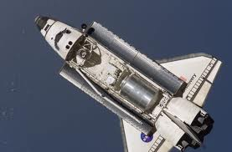


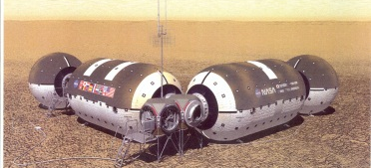
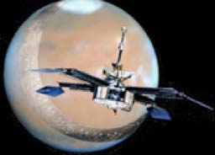

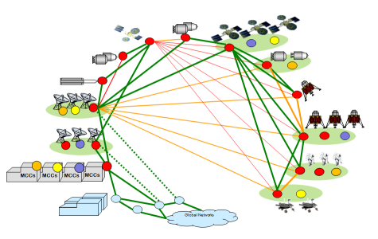
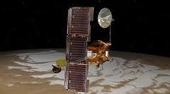
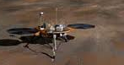

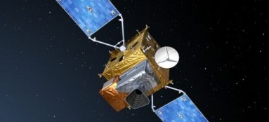
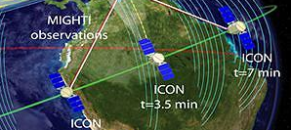
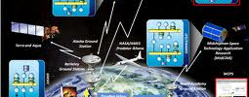
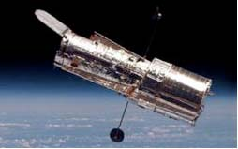
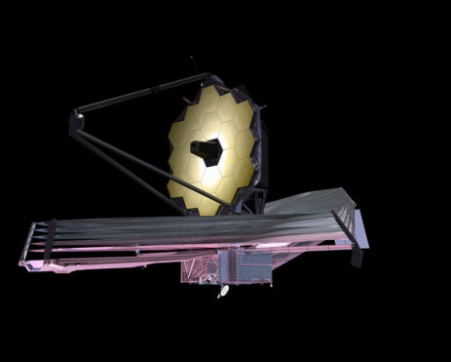
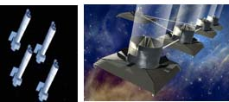
Future Mission Drivers
PAST
PRESENT
DRIVERS FOR THE
FUTURE
In Situ Exploration
Human Expeditions
Long Duration, High Reliability
Mobile comm protocols
Voice, Video, Medical handling
Onboard Autonomy
Highly integrated ops
Shuttle/SpaceLab
CCSDS packets
International Space Station
Adv. Orbital Sys (AOS)
Early DTN Prototyping
Asteroid/Surface Exploration
Autonomy, High bandwidth
Multi-Agency Mission Ops
Complex Deep Space Missions
Human or robotic exploration
Longer Duration
Mobile comm protocols
Fully automated routing
Network-Managed DTN
Optical Communications
Complex human or robotic
Scenarios for remote surface missions
Fully automated Space Internetworking
Brief Recon Flyby,
Short-Lived Probes
Direct-to-Earth links
Missions designed for orbital relays, Longer duration
Orbital Remote Sensing
Long Duration, high bandwidth
High Spatial, Spectral, & Temporal Resolution
Low Latency Comm
Complex link topologies
SensorWebs for synchronized remote sensing
Single-Spacecraft Survey/Sensors
Spacecraft Constellations
and formation flying
Multi-Discipline and
Multi-Resource SensorWebs
Next Generation Observatories
More Capability
Multiple Spacecraft drive network needs
Even Greater Capacities require new coding schemes
Located Even Farther from Earth
Single-Spacecraft Observatories in LEO
Greater Distances
Higher bandwidth
Next Generation
Observatory Complexes

Slide 12

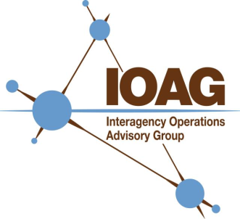


CCSDS Overview
Organizational Interrelationships
IOAG provides to CCSDS the IOAG priorities and guidance for future communications/operations plans
IOP
CCSDS Participants bring in other agencies/industry inputs, mission needs and technology drivers.
ISECG, SFCG, ICG and other peer groups
CCSDS participant inputs bring in needs of individual organizations
Close Coordination for Discipline Topics
Technology
Drivers
SISG
OLSG
& Other
sub-groups
CCSDS MEMBER AGENCIES (11) direct inputs
OBSERVER AGENCIES (28) direct inputs
MISSIONS AND PROGRAMS with direct funding

Slide 13
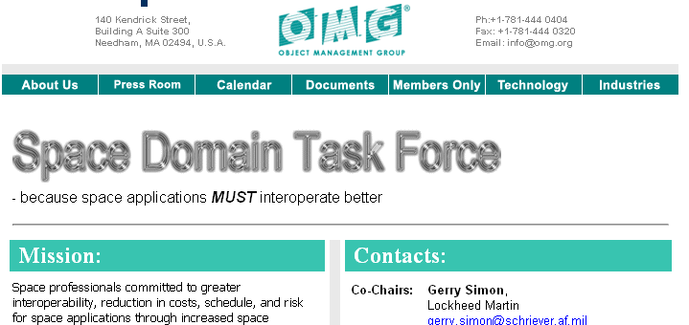

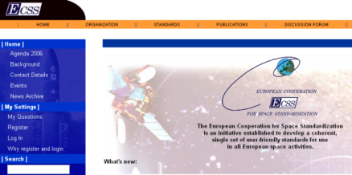
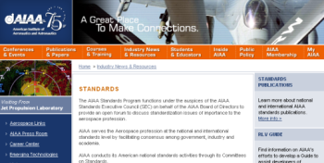
Some Organizational Interrelationships
OMG: Object Management Group
Industry standards for exchange of application information among vendor products
CCSDS/OMG have some common standards and periodic joint meetings
IETF: Internet Engineering Task Force
IRTF: Internet Research Task Force
Open international standards for IP suite and DTN
CCSDS uses such industry standards as a basis, whenever possible
ECSS: European Consortium for Space Standards - European regional standards for space mission support
CCSDS/ECSS coordinate on compatible standards
AIAA: American Institute of Aeronautics and Astronautics
North American regional standards for space mission support
Regional Standards coordination, and AIAA provides Secretariat support for CCSDS, ISO TC20/SC13 and SC14

Slide 14
CCSDS Overview
Adoption by Missions
Currently Active Publications: 127 Normative: 78
Informative: 49
Downloadable for free from www.ccsds.org
All major pubs since 1982: 275
Some were historical mission needs or superseded technology
Active Publications
Missions
609 space missions have adopted and used various CCSDS standards

Slide 15
CCSDS Summary Schedule Chart
Total Books
28 (done)
36 (done)
35 (done)
53 (done)
64 (planned)
17 (planned)
12 (planned)
More efforts expected in the future.
When will CCSDS be done?
When technology stops changing.

Slide 16
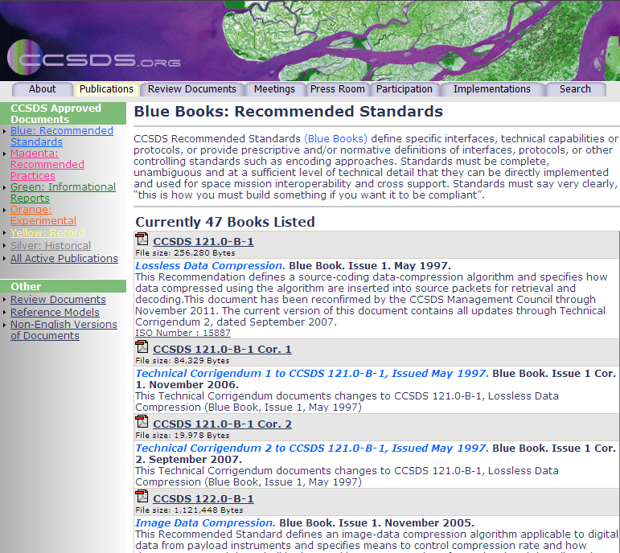
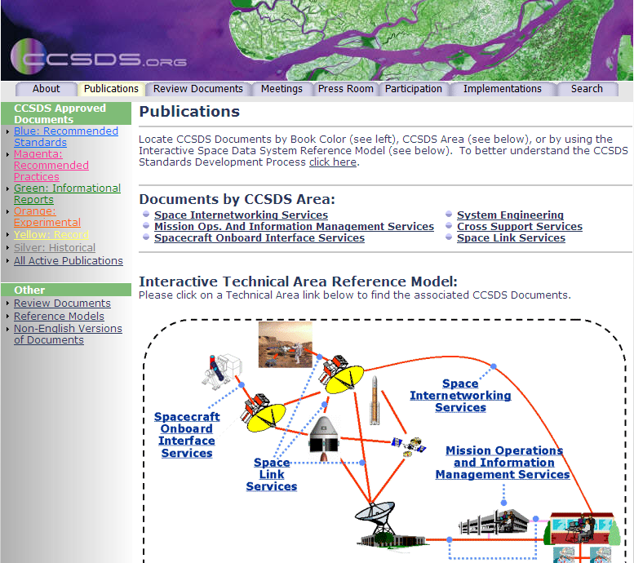
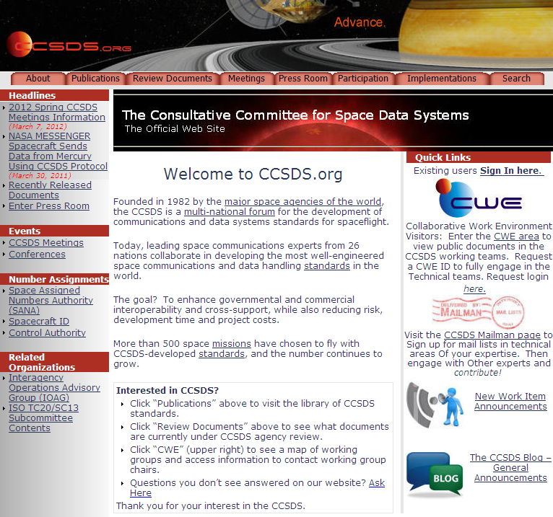



Access to CCSDS Publications
www.ccsds.org > Publications

Slide 17


Field Guide to CCSDS Book Colors
BLUE BOOKS
Recommended Standards
Normative and sufficiently detailed (and pre-tested) so they can be used to directly and independently implement interoperable systems (given that options are specified).
ORANGE BOOKS
Experimental
Normative, but may be very new technology that does not yet have consensus of enough agencies to standardize.
MAGENTA BOOKS
Recommended Practices
Normative, but at a level that is not directly implementable for interoperability. These are Reference Architectures, APIs, operational practices, etc.
YELLOW BOOKS
Administrative
CCSDS Procedures, Proceedings, Test reports, etc.
GREEN BOOKS
Informative Documents
Not normative. These may be foundational for Blue/Magenta books, describing their applicability, overall archtecture, ops concept, etc.
SILVER BOOKS
Historical
Deprecated and retired documents that are kept available to support existing or legacy implementations. Implication is that other agencies may not cross-support.
RED BOOKS
Draft Standards/Practices
Drafts of future Blue/Magenta books that are in agency review. Use caution with these… they can change before release.
PINK BOOKS/SHEETS
Draft Revisions For Review
Draft Revisions to Blue or Magenta books that are circulated for agency review.
Pink Books are reissues of the full book, Pink Sheets are change pages only.

Slide 18
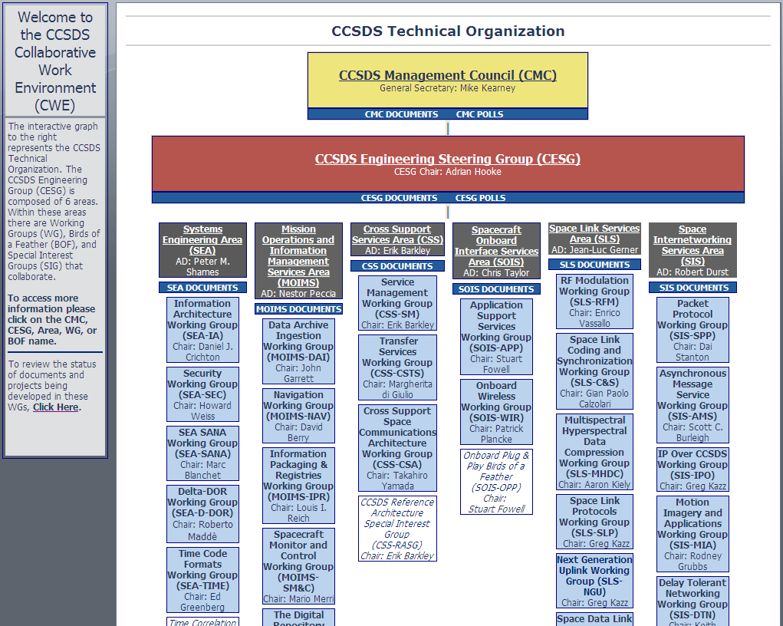

Access to CCSDS Technical WG info: www.ccsds.org > CWE

Slide 19

Access to CCSDS General Announcements
New Work Item Announcements
Find out about new initiatives and technology developments that you can contribute to, and you missions can benefit from.
The CCSDS Blog
General events, meetings, new publications, etc.
Under Construction: The CCSDS WIKI
Soon to come

Slide 20
CCSDS Strategic Goals by Technical Area

Slide 21
CCSDS Strategic Plan
The CCSDS Plan for the Future
Systems Engineering
Towards Cross-cutting functions and coherent architecture-wide integration
Towards Standardized Onboard Interfaces and Services
Towards Standardized Mission Operations Services and complete Navigation Message Standardization
Towards an Extensible Space Communications Cross Support Service Management and Transfer Services
  (Cross Support of Communications Assets)
Towards a Unified Space Data Link Protocol, optical links, new sync and channel coding schemes and compression
Towards Standardized Space System Internetworking Services and the Solar System Internet (SSI)
Spacecraft Onboard
Interface Services
Mission Ops &
Info Mgt Services
Cross Support
Services
Space Link
Services
Space Internetworking
Services

Slide 22
Systems Engineering Area Goals
Systems Engineering
1.
To define cross-cutting functions and end-to-end system architectures, in support of interoperability and cross support, overarching and underpinning the above goals and that facilitate addressing global challenges, including:
  Cyber security;
  Reference system architectures;
  Information models and architectures;
  Systems-of-systems interoperability;
  CCSDS support services and capabilities.

Slide 23
Spacecraft Onboard Area Goals
To define reference onboard communications architectures and services supporting efficient data handling applications and future system evolution, including:
  Standardized avionics architectures;
  Advanced technologies, such as wireless communications and software defined radios;
  Innovative approaches such as Plug-and-play approaches and Electronic Data Sheets.
  Onboard Autonomy Capabilities
Spacecraft Onboard
Interface Services
2.

Slide 24
Spacecraft Universal Modular
Arch. (SUMO)
2.
Spacecraft Onboard
Interface Services
Satellite
Components
Interoperable spacecraft components from “bounding” design characteristics/features, test environments, and specifications
  Standard electrical interfaces
  Standard testing that applies LEO to GEO and Minotaur to Atlas
  Benefits: cost savings, innovation & improvement, mission assurance and assembly time
Modular architecture with plug & play (P&P)
  High speed data bus; pin out and data definitions
Leverages existing initiatives and standard development
  Space Modular and P&P standards from ESA, NASA and industry
Focus on satellite bus interface with sub-systems & components
  Data & electrical interoperability; avoid defining mechanical I/Fs
  Emphasize capabilities over requirements
  Potential benefits for payload interoperability
  Retain intellectual property and unique designs “inside the box”
SUMO Standards Progress
  Broad support achieved during CCSDS Fall Plenary (Cleveland)
  Initially considered as a new CCSDS WG proposal
  Now, Discussing how to integrate SUMO into existing SOIS teams
Remote Interface
Units (RIUs)
Guidance, Nav & Controls - Torque Rods, Reaction Wheels/CMGs
Spacecraft
Satellite
Bus
Solar Cells
Payload
Sun Sensors
Star Trackers
Processor Boards
Transponders
GPS Receivers
Focus on interoperability
of interfaces

Slide 25
Mission Ops & Info Mgt Area Goals
To define the full suite of mission operations standard functions and services to enable ground and on-board interoperability at the application layer level in support of of the standardization of the corresponding ground data systems, including:
  Implementation of multimission spacecraft and instrument Monitoring and Control systems;
  Exchange of mission plans between cooperating agencies;
  Conjunction assessment, navigation and trajectory prediction;
  Interoperability of robotic systems for cross-agency support.
Mission Ops &
Info Mgt Services
3.

Slide 26
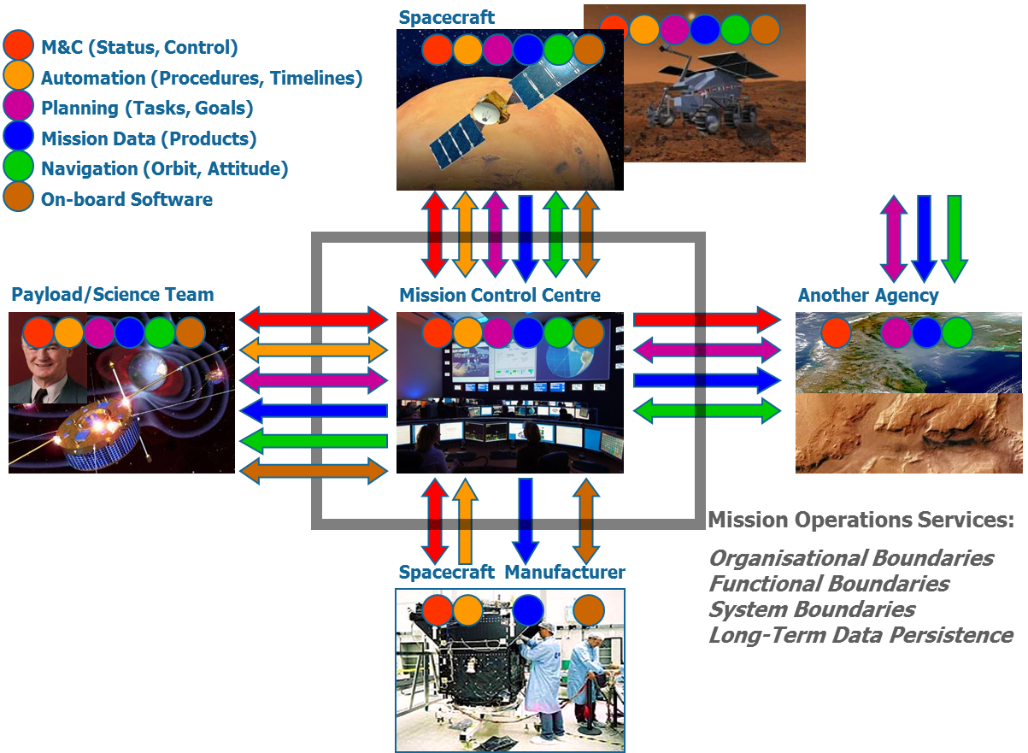
Distributable Mission Operations Functions
3.
Mission Ops &
Info Mgt Services
Notes:
What Do we Want to Achieve?
Prepare for the future
Future missions will be more complex and require more collaboration across organisation
Better interoperability between systems (e.g. X monitoring its lander via Y’s orbiter, Z submitting planning requests for its payload on W’s S/C, …)
Scalability
Expandable systems
Difficult to predict now what will be needed tomorrow
Protect from technology evolution
Replace implementation technology without major system redesign
Reduce cost (i.e. schedule, risks, …) of
[On-board and Ground-based] system development
Facilitate availability of generic software infrastructure
Facilitate availability of new, state-of-the-art, plug-in [commercial] components
Re-use components (including legacy systems)
… and mission operations
Re-use operational concepts across missions
Increase operational commonality across components (less training costs)

Slide 27
Cross Support Services Area Goals
To define a complete suite of interoperable, cross support planning, data delivery, and control service interfaces, implementing an efficient management of the cross support services, providing end to end solutions, and meeting mission challenges, including:
  Integrated mission planning for combined interagency operations taking into account resource needs;
  Simplification and improved efficiency of cross support service request, delivery and governance;
  Call-up of international cross-support during spacecraft emergencies.
  A complete suite of cross support interfaces supporting forward and return data transfers, radiometric data, monitor data and service control;
  End-to-end file transfer operations
Cross Support
Services
4.

Slide 28
Framework for extensible Space Communications Cross Support Service
Cross Support
Services
4.
CCSDS Cross Support
Service Management
Ground Tracking Asset
Control Center
Service
Mgmt
Interface
Service
Mgmt
Interface
Service
Management
Interface
Forward
Data Delivery
Services
Service
Delivery
Interface
Return
Data Delivery
Services
Service
Delivery
Interface
Service
Delivery
Interface
Radio Metric
Services
CCSDS Cross Support
Transfer Services
Other Services
Monitored Data,
Tracking, DDOR,
Service User
Service Provider

Slide 29
Space Link Services Area Goals
To define innovative, secure, widely applicable communication standards and related architectures that facilitate interoperability and cross support and meet the challenges and anticipated needs of the future projects, including:
  Increased bandwidth capacity approaches (radio frequency and optical);
  The achievement of higher information data rates and greater spectral efficiency
  more capable protocols, modulation, coding and compression techniques;
  The introduction of advanced physical and link layer communications technology providing significantly higher data return;
  The use of secure communication protocols and links, to protect associated systems and information flows.
Space Link
Services
5.

Slide 30
Space Link Services Layered approach
Space Link
Services
5.
5

Slide 31
Space Internetworking Area Goals
To define an integrated set of Space Internetworking standard services in support of end-to-end communications between applications covering the entire solar system and meeting future project needs, including:
  Jointly conducted human and robotic operations;
  Management of space-to-space and direct-to-earth links as part of the network;
  Sensorweb and other innovative technologies for LEO operations;
  Application to the space domain of well-established internetworking technologies.
  Fully Automated Routing across networks end-to-end.
Space Internetworking
Services
6.

Slide 32
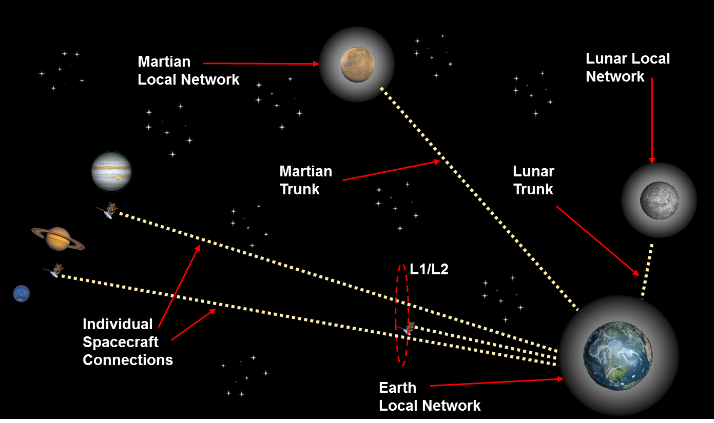
Top Level Comm/Nav Architecture
The Solar System Internet
Space Internetworking
Services
6.

Slide 33
CLOSEUP on CCSDS Activities
In Select Working Groups

Slide 34
Security Working Group
Systems Engineering
1.
The CCSDS Security Working Group:
  Develops CCSDS security recommendations (standards)
  Develops security guides and informative documents
  Provides security advice and guidance to CCSDS working group for security factors and practices in other CCSDS standards.
Documents developed:
  Green Book on use of security in CCSDS
  CCSDS Security Architecture
  Algorithm trade studies for encryption and authentication
  System interconnection guide
  Threat guide
  Key management guide and standard
  Mission planner’s security guide
On-going work:
  Encryption and authentication algorithm standard
  CCSDS Encryption Algorithms (blue book)
  Network layer security profile
  Information security glossary

Slide 35
Onboard Wireless Working Group
Spacecraft Onboard
Interface Services
2.
Overview of Onboard Wireless activity
  For basic spacecraft design, reduces launch mass of vehicles
  For operations concepts, allows untethered mobility of crew and instruments
  On the ground, potential utility for standards in test and integration
Approved documents:
  Green Book: Wireless Network Communications Overview for Space Mission Operations
    Examines the possibilities and advantages of the application of wireless communications technology to space missions
  Magenta Book: RFID-Based Inventory Management Systems
    Improve ground system and spaceflight vehicle inventory tracking & visibility
  Magenta Book: Low Data-Rate Wireless Communications for Spacecraft Monitoring and Control
    targeted towards low data-rate and low-power applications transmitting in the 850 MHz – 950 MHz and 2.45 GHz (ISM) radio frequency band
Future work:
  High data rate wireless communications for space missions:
    Focus is on high-rate wireless for voice, video, medical service provision.

Slide 36
Spacecraft Monitor and Control
Mission Ops &
Info Mgt Services
3.
Emphasis is on standardizing service interfaces for common functions that are in every mission, at the application level
  Early emphasis is for ground-to-ground interfaces
  Starting testing for flight systems interfaces as well
Capitalizes on industry-accepted approach of a SOA (Service Oriented Architecture)
  Standardizing interactions of providers and consumers of service
  Includes discovery of services (auto-configuring interfaces)
  Plug-n-play characteristics: Finally allowing operational/management decisions to be independent of software development projects
  Provides application portability as well as interoperability
Progress to date:
  Basic framework (Message Abstraction Layer, etc.) is published.
  First applications (Telemetry, Command, common services) published
  Alerts (alarm limits, etc.) currently in review cycle
  Some future work will be spin-offs (Telerobotics, Planning, etc.)
New Development: IOAG committee considering oversight of MO Services (note – SM&C protocols and MO Services are equivalent)

Slide 37
Mission Ops TLM Services
ISS Current formats
Mission Ops &
Info Mgt Services
3.
Possible scenario for all agencies to exchange all data;
Even more with payload formats.
Current status of telemetry service formats exchanged between ISS control centers
ESA
USOC
ESA
USOC
ESA
USOC
2
ESA
USOC
CSA
CSA Internal
data formats
Col-CC
ESA Internal
data formats
ASI
ASI Internal
data formats
SSIPC
JAXA Internal
data formats
MCC-M
FSA Internal
data formats
MCC-H
JSC Internal
data formats
POIC
MSFC Internal
data formats
JSC ISP TLM Service
MSFC EHS TLM Service
ESA DASS TLM Service
JAXA TLM Service
NASA
TSC
NASA
TSC
NASA
TSC
NASA
TSC

Slide 38
Mission Ops TLM Services
Future Harmony
Mission Ops &
Info Mgt Services
3.
Possible scenario for all agencies to exchange all TLM data;
Even more with payload formats. And this is TLM only.
Current status of telemetry service formats exchanged between ISS control centers
Solution: A standard interface, built on international standards when available, otherwise on program standards
ESA
USOC
ESA
USOC
ESA
USOC
2
Service I/F
Service I/F
ESA
USOC
CSA
CSA Internal
data formats
Col-CC
ESA Internal
data formats
Service I/F
ASI
FSA Internal
data formats
Service I/F
SSIPC
JAXA Internal
data formats
Service I/F
MCC-M
FSA Internal
data formats
MCC-H
JSC Internal
data formats
POIC
MSFC Internal
data formats
NASA
TSC
NASA
TSC
Transactions based on
Service Oriented Architectures, web services and
service interfaces
NASA
TSC
NASA
TSC
Service I/F
Service I/F

Slide 39
How CCSDS MO Services Work
Mission Ops &
Info Mgt Services
3.
Service Oriented Architecture
→widely used in other industries
Service
Function
TLM, CMD, Plan, etc.
Application Layer
Discovery of Services
(allows automated access)
Service Description
Transport

Slide 40
How CCSDS MO Services Work
Mission Ops &
Info Mgt Services
3.
Cross-support is based on operational configuration and on security
→ NOT on a new software development project.
Service
Function
TLM, CMD, Plan, etc.
Application Layer
TLM
CMD
Plan
Video
TLM
CMD
Plan
Video
FSA Module
ESA Module
Spacecraft
Service Description
Ground
TLM
CMD
Plan
Video
TLM
CMD
Plan
Video
Transport
NASA MCC
ESA MOC

Slide 41
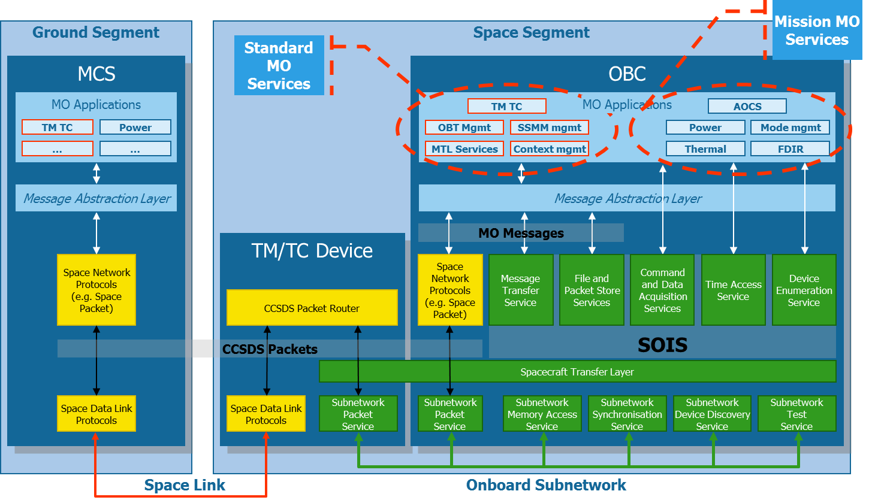
Future architecture
Mission Ops &
Info Mgt Services
3.
2
Notes:
Here you may also easily reinforce the concept of being able to use MO on different transport. For instance you could say that, in the case of PUS, the space link must be CCSDS ptk TM/TC, while in the case of MO services one could use several different technologies (e.g. TCP/IP, DTN, files) with no impact on the higher layers

Slide 42
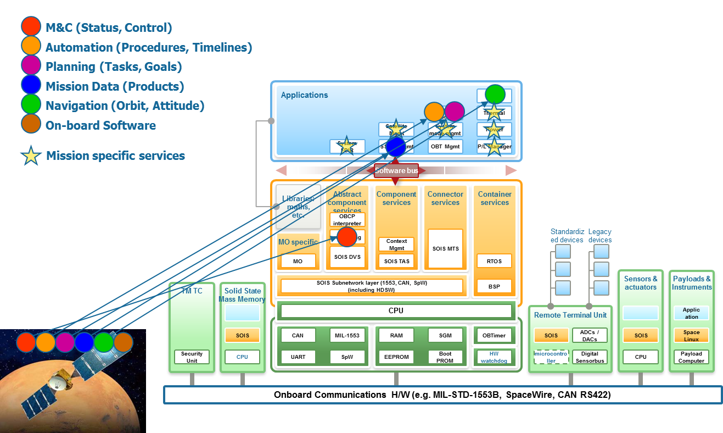
Distributable Mission Operations Functions
Mission Ops &
Info Mgt Services
3.
2

Slide 43
Navigation WG
Mission Ops &
Info Mgt Services
3.
The CCSDS Navigation Working Group is chartered to develop standards covering exchange of spaceflight dynamics related data
Past Progress and Current Work
  Orbit Data Messages (version 2.0 published 11/2009)
    Three standard message formats for exchanging orbit descriptions
  Tracking Data Message (version 1.0 published 11/2007)
    Message format for exchanging tracking data; supports widely used tracking data types: Doppler, range, angle, ΔDOR, ancillary information
  Attitude Data Messages (version 1.0 published 05/2008)
    Two message formats for exchanging spacecraft attitude descriptions
  Navigation Green Book (version 3.0 published 05/2010)
    Contains technical background related to the Nav WG Recommendations
  Nav Data Messages XML Specification (version 1.0 published 12/2010)
    Contains XML representations of all above Nav WG standards
  Conjunction Data Message (pub June 2013)
    Standard message format for informing spacecraft operators of object conjunctions in space (spacecraft/spacecraft, spacecraft/debris, debris/debris)
Future work
  Pointing Requests Message – communicating complex on-orbit cross-support pointing requests (e.g., inertial, limb, terminator, velocity, nadir, track)
  Navigation Hardware Message – exchanging onboard navigation H/W data between space agencies (e.g., thrusters, accelerometers, star trackers, etc.)
  Spacecraft Maneuver Message – exchanging information regarding spacecraft maneuvers (requirements, design, reconstructed performance)

Slide 44
Mission Ops &
Info Mgt Services
3.
The Navigation Roadmap
3

Slide 45
Other New Work Areas
Space Link
Services
5.
Optical Coding and Modulation SIG (Special Interest Group)
  Considering whether it is time for an Optical Comm standard
  Would support Mars-Earth, LEO-GEO, LEO DTE scenarios
  Interesting work in optical coding and modulation for interoperability

Slide 46
Delay/Disruption Tolerant
Networking (DTN)
Space Internetworking
Services
6.
The DTN Working Group is laying the foundation for the Solar System Internet (SSI)
  Provides automated routing in space (like terrestrial Internet), but compared to current IP technology:
    Adds Delay/Disruption tolerance for deep space environment
    Delivers more data, faster in disrupted near-earth environment
Past Progress and Current Work
  Green book establishes rationale, develops scenarios, explores candidate technologies
  Due to be approved/published this year: SSI Architecture Document, DTN Bundle Protocol (BP) specification and Licklider Transmission Protocol (LTP) Blue Books.
Future work – Complete Solar System
Internet (SSI) infrastructure with
  Network Management
  Contact Graph Routing
  File Delivery Protocol (CFDP)

Slide 47
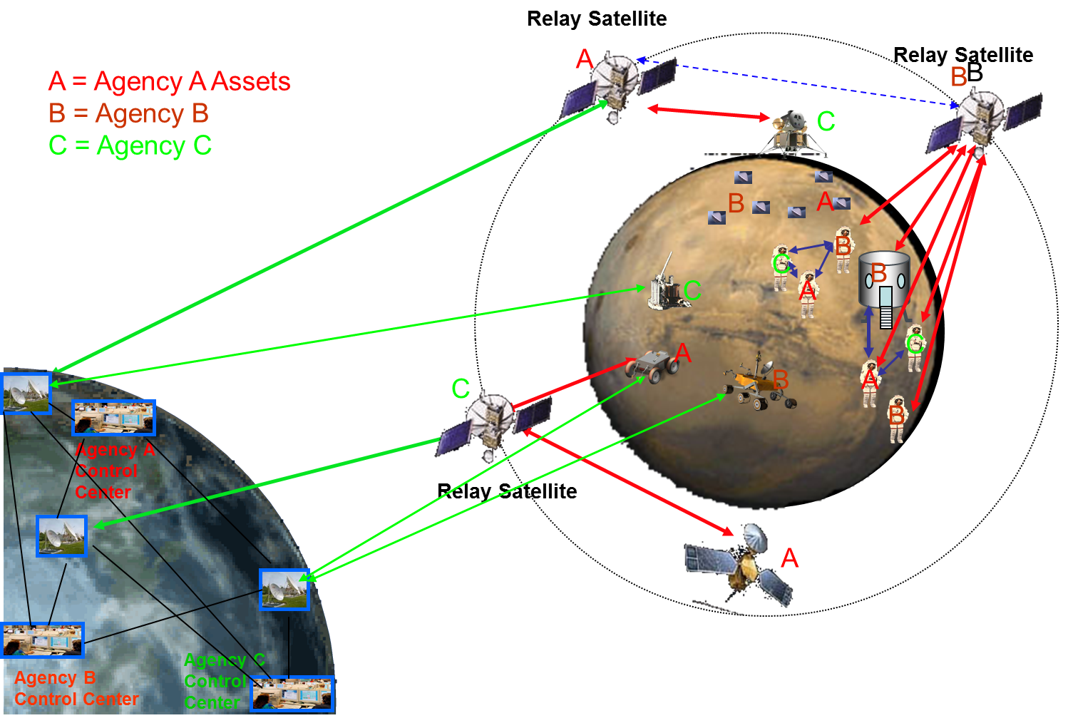
Future Vision: Integrated Operations
Space Internetworking
Services
6.

Slide 48
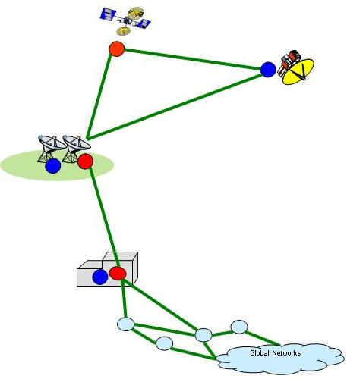
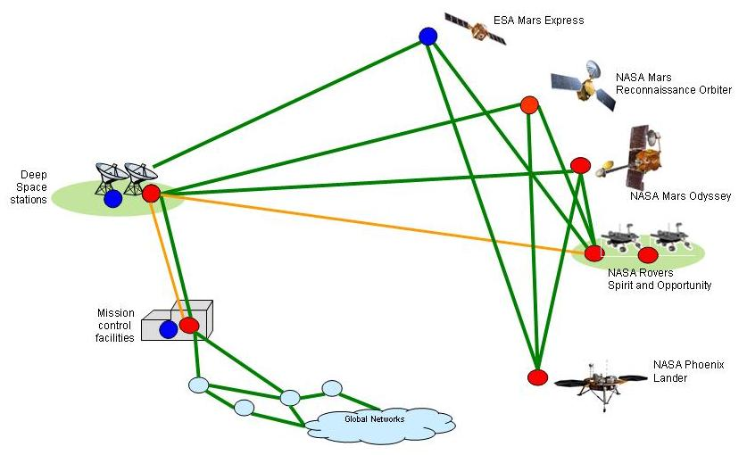
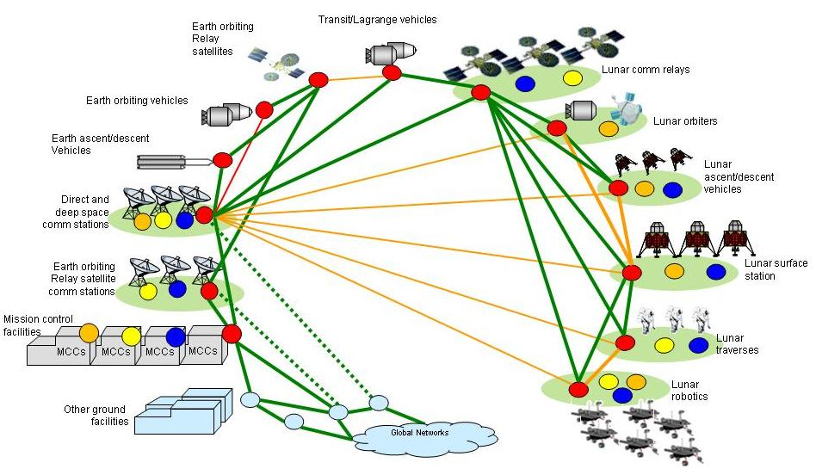
A clear way forward to a
networked architecture
6.
Space Internetworking
Services
(DTN)
Space
Packet
IP
DTN
Classical Point-to-Point
CCSDS
Space Link Protocols
Current Mars Network
  Increasing reliance on international cooperation
  Smooth, backwards-compatible evolution to future space internetworking
  Increasing reliance on data relays and the need to transition towards a networked architecture
Potential Lunar Network
Notes:
Main Points:
Space Missions started out as POINT-TO-POINT architectures – and many still are
The current Mars Network NASA Odyssey, represents the beginnings of a MULTIPOINT architecture with extensive reliance on DATA RELAYS
NASA: Odyssey and MRO; ESA: Mars Express
ESA Mars Express
Implements the same CCSDS Prox-1 protocol as the two NASA orbiters and the Spirit/Opportunity landers
Spirit/Opportunity successfully relayed via Mars Express
Over 95% of total Spirit/Opportunity data returned via the relays
Future architectures – such as Lunar – becoming more networked and more international

Slide 49
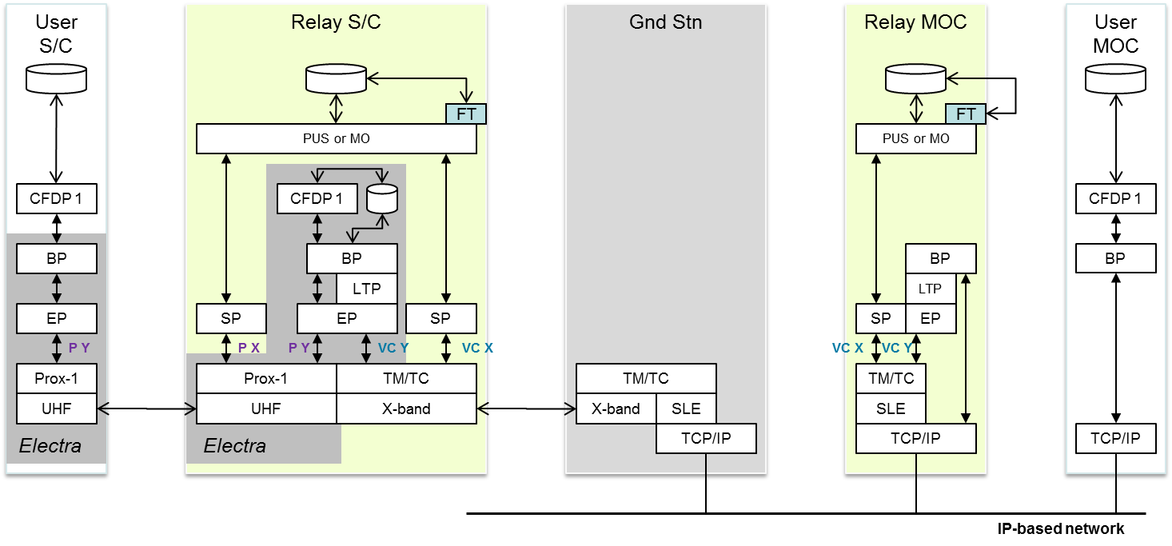
Space System Internetworking
Evolution Options
6.
Space Internetworking
Services
DTN operating at Agency A
Agency B operations are based on DTN end-to-end, including class-1 CFDP over DTN
A DTN node is added at the Orbiter MOC;
Interface between MOCs is streaming, not file-based, for DTN-enabled user
Notes:
Main Points:
Space Missions started out as POINT-TO-POINT architectures – and many still are
The current Mars Network NASA Odyssey, represents the beginnings of a MULTIPOINT architecture with extensive reliance on DATA RELAYS
NASA: Odyssey and MRO; ESA: Mars Express
ESA Mars Express
Implements the same CCSDS Prox-1 protocol as the two NASA orbiters and the Spirit/Opportunity landers
Spirit/Opportunity successfully relayed via Mars Express
Over 95% of total Spirit/Opportunity data returned via the relays
Future architectures – such as Lunar – becoming more networked and more international

Slide 50
SSI End-to-End Forward
All DTN
6.
Space Internetworking
Services
Notes:
Main Points:
Space Missions started out as POINT-TO-POINT architectures – and many still are
The current Mars Network NASA Odyssey, represents the beginnings of a MULTIPOINT architecture with extensive reliance on DATA RELAYS
NASA: Odyssey and MRO; ESA: Mars Express
ESA Mars Express
Implements the same CCSDS Prox-1 protocol as the two NASA orbiters and the Spirit/Opportunity landers
Spirit/Opportunity successfully relayed via Mars Express
Over 95% of total Spirit/Opportunity data returned via the relays
Future architectures – such as Lunar – becoming more networked and more international

Slide 51
SSI End-to-End Return
All DTN
6.
Space Internetworking
Services
Notes:
Main Points:
Space Missions started out as POINT-TO-POINT architectures – and many still are
The current Mars Network NASA Odyssey, represents the beginnings of a MULTIPOINT architecture with extensive reliance on DATA RELAYS
NASA: Odyssey and MRO; ESA: Mars Express
ESA Mars Express
Implements the same CCSDS Prox-1 protocol as the two NASA orbiters and the Spirit/Opportunity landers
Spirit/Opportunity successfully relayed via Mars Express
Over 95% of total Spirit/Opportunity data returned via the relays
Future architectures – such as Lunar – becoming more networked and more international

Slide 52
Asynchronous Message Service
(AMS)
Space Internetworking
Services
6.
The AMS Working Group FINISHED AND CLOSED
Completed standardizing messaging middleware for flight mission communications.
  AMS provides “message bus” functionality for flight missions, including both publish/subscribe and client/server interaction models.
  Unlike JMS or DDS, AMS is a wire protocol rather than a service spec
    Conformant implementations are interoperable, no gateways needed.
  Unlike AMQP, AMS is peer-to-peer, not reliant on a message broker
    High performance, fault tolerant.
  Unlike RTPS, AMS is designed to run efficiently over space links
    Uses a built-in delay-tolerant and disruption-tolerant multicast tree.
Overall benefit: Flight-system capable, loosely-coupled, simplified interfaces
  Overall reduction in interface complexity
Completed publication of Blue Book, and closed Working Group
Reference implementation is available as open source, included in JPL’s “ION” software distribution at: http://www.openchannelfoundation.org/projects/ION/

Slide 53
Other New Work Areas
Space Internetworking
Services
6.
Voice and Video WGs
  Classic problem of Voice/Video degradation from analog/digital conversions during cross support
  Digital video adds more complexity
  Plan to establish “profiles” of cross-supported commercial standards
  Addressing both ground systems (between MCC’s) and flight systems interoperability

Slide 54
Other New Work Areas
Mission Ops &
Info Mgt Services
3.
Telerobotics WG
  Seeking to develop standardized protocols for operating space-borne robotic systems
Planning Systems (Future BOF)
  Seeking to develop standardized interfaces for exchange of Mission Operations Planning Data, for both robotic and human spaceflight programs.

Slide 55
CCSDS Summary
Take-home message: Still much work to be done
  Enabling interoperability between international agencies for future missions – both Earth-Orbital and Exploration
  Long-range vision – automated routing and delay tolerant networking for deep space crosslinks between spacecraft and surface systems
  Near-term need – evolutionary approach to sustain cross-support agreements with other agencies.
Organizations with a stake in the future of Space Missions and the expertise to contribute to CCSDS should become engaged.

Slide 56
Other Opportunities for NSPO to participate in international activities

Slide 57

SpaceOps
SpaceOps Committee organizes the SpaceOps Conferences every two years
  Also other publication and outreach functions
Valuable forum for exchanging info on the most important phase of a spaceflight mission: Operations!
The next SpaceOps Conferences:
  Pasadena California (JPL), May 2014
  Daejeon Korea (KARI) May 2016
Also, participation in the committee may be of interest to NSPO
  Committee meets about twice per year
www.SpaceOps.org.

Slide 58

Space Generation Advisory Council
SGAC is a non-profit organization that represents 18-35 year olds in international space policy at the United Nations, at agencies, in industry, and in academia
    Founded as a result of the 1999 UNISPACE III conference
    SGAC has had permanent observer status in the UN COPUOS since 2001 and has been a member of the UN Economic and Social Council since 2003
    Is headquartered in Vienna, Austria and is hosted by the European Space Policy Institute
    SGAC has a volunteer network of more than 4,000 members in over 100 countries
  Conferences
    Space Generation Congress (SGC)
    Space Generation Fusion Forum
  Year-round Projects
  Pragmatic Policy Suggestions
    Reports to United Nations COPUOS committee
    Recommendations from Space Generation Congresses
  Scholarships
  Special Projects
    ISECG-NASA Videos, IAA Study Groups, European Space Expo, etc.

Slide 59
IOAG Catalog
The IOAG maintains a listing of communications ground stations that are available for international cross-support.
NSPO sites are not currently included
If NSPO has antenna sites that might be available to other agencies or organizations, to cross-support other programs, NSPO should submit the appropriate technical info to the IOAG.
This allows mission planners in other agencies to know what is available.
It may also be of interest to NSPO planners to see what comm resources are available to support your missions.
Of course, cross-support with other agencies is achieved only through other negotiations for bilateral support.
If NSPO is interested, contact Angel Oria at angel.oria-1@nasa.gov,
Also CC the IOAG chairman Michael Schmidt (Michael.Schmidt@esa.int) and IOAG secretariat, Stephanie Wan (Stephanie.Wan@nasa.gov).

