Slide 1


> 210 participants
CNES 20 CNSA 20
DLR 19 ESA 48
FSA 8 JAXA 16
NASA 67 UKSA 7
ASI 1 EUMETSAT 1
South Korea 3
CCSDS Opening Plenary |  | 6th November 2017 The Hague, Netherlands
08:45 | Opening remarks and ESA welcome | Nestor Peccia, CESG Chair
09:00 | CCSDS meeting overview: Administrative, Boot Camp, Meetings | David Ross, NASA HQ
09:10 | CESG Open Issues & More | Nestor Peccia, CESG Chair
09:20 | Systems Engineering Area objectives | Peter Shames, SEA Area Director
09:30 | Mission Ops and Information Mgt Services Area objectives | Mario Merri, MOIMS Area Director
09:40 | Cross Support Services Area objectives | Margherita Di Giulio, CSS Deputy Area Director
09:50 | Space Link Services Area objectives | Gian-Paolo Calzolari, SLS Area Director
10:00 | Space Internet Services Area objectives | S. Burleigh, SIS Area Director
10:10 | Spacecraft Onboard Interface Services Area objectives | J. Wilmot, SOIS Deputy Area Director
10:20 | Closing remarks; Adjourn

Slide 2
Administrative Overview
Registration will be set up near a central location and will also double as the Secretariat area through the rest of the week.
Recommended meeting and break schedules are as follows:
    Start time 08:45
    Coffee break 10:30-10:45
    Lunch Break 12:00-13:00
    Coffee Break 15:30-15:45
    End time 17:30
Coffee, tea, and water will be available all day in each of the meeting rooms.
Lunch will be on your own from 12:00-13:00. Tickets for the lunch buffet (at The Gallery Restaurant) are available at the registration desk for €25 per day. Other restaurants are available nearby.
Please let the Secretariat staff know as soon as possible if you will not be using your meeting room at your scheduled time.
WiFi access:
  SSID: Marriott Conference Password: N/A
Notes:
2

Slide 3
Administrative Overview - Meetings
Date | WG/CMC | Host | Location | Date | Comments
Fall 2017 | WG/CESG | ESA | The Hague, Netherlands | 6-9 November 2017
 | CMC/SC13 | ESA | Darmstadt, Germany | 13-15 November 2017
Spring 2018 | WG/CESG | NASA | Gaithersburgh, MD, USA | 09-13 April 2018
 | CMC/SC13 | CNSA | China | 04-17 May 2018
Fall 2018 | WG/CESG | DLR | Berlin, Germany | 15-19 October 2018
 | CMC/SC13 | DLR | Germany | 22-24 October 2018
Spring 2019 | WG/CESG | NASA | USA | TBD Date
 | CMC/SC13 | CSA | Montreal, Canada | 11-13 June 2019
Fall 2019 | WG/CESG | ESA | ESA – ESOC | TBD Date
 | CMC/SC13 | ESA | ESA – ESOC | TBD Date
Spring 2020 | WG/CESG | NASA | USA | TBD Date
 | CMC/SC13 | CNSA | CNSA | TBD Date
Fall 2020 | WG/CESG | ESA | ESA | TBD Date
 | CMC/SC13 | ESA | ESA | TBD Date
4-Day
5-Day
Notes:
3

Slide 4
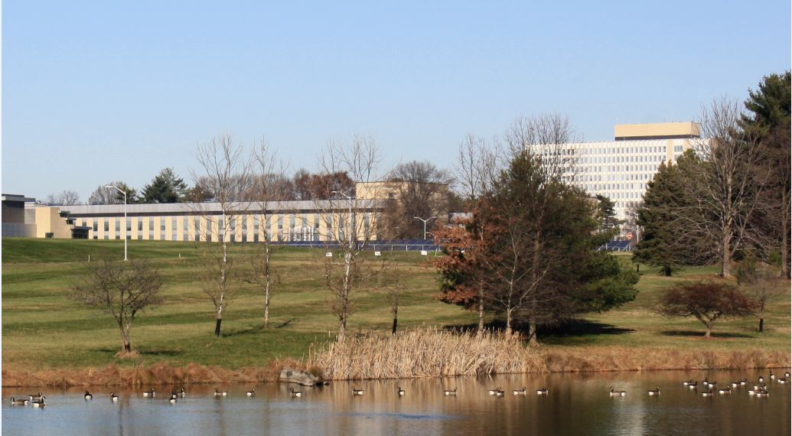

Spring 2018 CCSDS Technical Meetings
9 – 13 April, 2018
U.S. National Institute of Standards and Technology
100 Bureau Drive
Gaithersburg, MD 20899
NIST
Gaithersburg, Maryland outside of Washington, DC
Free shuttle to/from meetings from nearby hotels and Metro (subway)
Very nice facilities, cafeteria in the same building
CESG to meet at NIST the following Monday, April 16
See NIST.GOV for local information
Additional information to be posted on CCSDS.ORG
Washington

Slide 5



CCSDS Technical Editors:
“Boot Camp”
Tom Gannett - CCSDS Chief Technical Editor
Peter Shames – CCSDS SEA Area Director
The purpose of the technical editor “boot camp” is to improve overall quality and enable faster processing of documents submitted to the Secretariat by familiarizing working group technical editors with CCSDS requirements for technical content, publication style and procedures for document submission.
IT IS MANDATORY THAT ANY PERSON ASSIGNED TO BE THE EDITOR OF A CCSDS DOCUMENT ATTEND A BOOT CAMP.
This week, Boot Camp is scheduled for:
Session
Room
Thursday, 08:45- 12:30
Van Gogh

Slide 6
CCSDS Overview
Active Publications
Currently Active Publications: 147 Normative (Blue & Magenta): 88
Informative (Green): 59
Downloadable for free from www.ccsds.org
All major pubs since 1982: ~336
(Some were historical mission needs
or superseded technology)
865 space missions have adopted and used various CCSDS standards

Slide 7
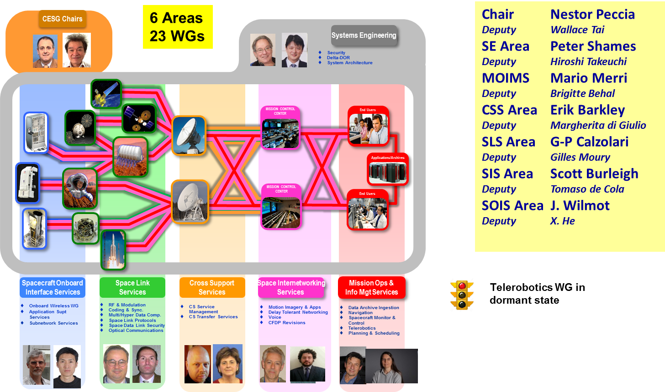
CESG Organization + E2E Overview
Notes:
7

Slide 8
CESG Open Issues & more
CESG main topics addressed since May 2017
  Conditions raised by ADs/DADs on CESG Polls
  Change of CCSDS liaison to IOAG
  Strategic Plan Update
  SOIS / SIS Areas future
  CWE RID tool
  WG mailing Lists and CWE login accounts
Project resources in the FW CWE
  83 Approved Projects with 6 behind schedule
  52 Draft Projects
  Only 1 Project still missing Proto 2 resources
CESG meeting on Friday 10th November – Main topics
  Analysis of conditions raised by ADs/DADs on CESG polls
  IOAG: Liaison, SC#1, SC#2, ICPA
  SOIS / SIS Areas Future
  CTE Document Queue
  Documents with due date for R/U/S
  Mailing List and mapping to CWE login accounts
A perceived small issue turning out in a mess
135 PROJECTS

Slide 9
CMC Poll Statistics since June 2017
CMC Polls
  Publication
    SLS MHDC Image Data Compression, Issue 2
    SLS MHDC Spectral Preprocessing Transform for Multi/Hyper spectral Image Compression
    SLS C&S TM /TC Synchronization and Channel Coding, Issue 3
    SLS RFM RFM Systems Part 1: Earth Stations and Spacecraft
    MOIMS SM&C MO – Monitor and Control Services
    SOIS WIR RFID Tag Encoding Specification
    MOIMS SM&C MO – MAL Binding to TCP/IP Transport and Split Binary Encoding
    SIS Voice WG Voice and Audio Communications
    SEA SANA CCSDS S/C Identification Field Code Assignment Control Procedure
  Agency Review
    CSS CSTS Tracking Data Service
    SLS RFM Radio Frequency and Modulation Systems—Part 1: Earth Stations and Spacecraft
    MOIMS SM&C MO MAL Binding to HTTP Transport and XML Encoding
    MOIMS SM&C MO Message Abstraction Layer Binding to ZMTP Transport
    CSS CSTS Guidelines for Specifications of Cross Support Transfer Service
    MOIMS SM&C MO Common Services
  Approval of Charters
    SIS MIA WG Charter update
  Approved New Projects
    SOIS WIR High Data Rate Wireless Network Communications
    MOIMS NAV Navigation Events Message
    MOIMS DAI Data Archive Architecture Description Document (DAADD)
    SLS SDLS Protocol Extended Procedures (EP)
    SLS C&S TC Synchronization and Channel Coding -- Summary of Concept and Rationale
    SIS MIA Specifications for Real-time Protocol as transport for voice & video
Poll on-going
Poll on-going

Slide 10
CESG Poll Statistics since June 2017
CESG Polls, not through CMC Poll yet (Conditions raised by ADs / DADs)
  Agency Review
    SLS OPT Optical Communications Physical Layer
    SLS C&S Variable Coded Modulation Protocol
    MOIMS SM&C MO Mission Data Product Distribution Services
    SIS DTN CCSDS Streamlined Bundle Security protocol
  CESG Chair will analyse the poll conditions to determine the causes, e.g.
    WG schedule too optimistic, Quality of Documents, WG Issues, Related AD / DAD not making an in depth check of the books, Others
    CESG Chair will present his findings at F17 CESG Meeting
Agency Review closed long time ago (August 2016)
  SOIS APP XML Specification for Electronic Data Sheets
  SOIS APP Specification for Dictionary of Terms Electronic Data Sheets
Closed Agency Reviews – WG preparing material for delivery to CTE and start poll for Publication
  CSS SM Simple Schedule Format Specification
  MOIMS SM&C MO MAL C++ API
  MOIMS NAV Pointing Request Message
Issue Book Updates + Prototyping delayed. Lack of resources

Slide 11
CESG OTHER ISSUES
Document Status – Issues with Docs with Date due To be discussed at F17 Meeting

Slide 12
  NWI – STATUS
Already approved by CMC
WG Chair did not submit Project for approval yet
Request for CMC approval will be issued asap

Slide 13
CESG WG Chair / Deputy Chair Overview

Slide 14
RESOURCES
36 BBs
19 MBs
21 GBs
6 OBs
1 YBs

Slide 15
IOAG / ICPA
Approved IOAG Service Catalogue 1 v2.1
  Following services have no related CCSDS Draft Project
    CORS- Off-line Radio Metric Service
    DDORS - CSTS D-DOR Service
    Forward CFDP File Service
    Forward Packet File Service
    Return CFDP File Service
    Return Packet File Service
  IOAG Priorities were delivered by SC WG
    CCS SM WG to discuss this week the following Services with Priority 1 and need date 2020
      Service Agreement Development
      Request the information required to provide a cross support
      Planning Information
      Event Sequences
      Service Package
IOAG Update SC#2
  CESG expects an approved update of SC#2 by Q4 2017
  Following services have no related CCSDS Draft project
    Time Services (Clock Correlation Procedures, Time Synchronisation , Time Transfer)
    SEA BoF to be resurrected with all Areas participating.
  Forward Frame-CSTS & AOS Uplink
    it looks there are no C&S and RFM standards to support uplink of AOS Frames
    CMC action on requirements for cross support of AOS uplink still open
Current SM WG
Draft Projects

Slide 16
What are we still missing in the CCSDS CWE ?
A RID System integrated in CWE with powerful reporting capability
A polling system allowing online capabilities
  to generate resolutions
  To generate automatically the polls
  To track raised conditions and its completion
An online capability to generate automatically the schedule of periodic review of documents and CTE document Queue
Improved on-line Operating Plan
Automation of Strategic Plan
Improved Printing capabilities
Improved Registration System (e.g. de-registration, automatic generation of LOIs
Improved configuration between WG mailing lists and CWE login accounts
etc
etc

Slide 17
SEA Meeting Objectives: 1/1
Security WG
  Link Layer Security (BB) Joint with SLS, SDLS & SLP updates published
  Key Management (GB, MB) MB draft in work, application being worked in SDLS
  Network Layer Security Testing IP, evaluating DTN & cloud based testing (ready)
  Application Credentials Developing white book
  Standard security section Mandatory
Delta-DOR WG
  Overview document (GB) GB, planning v2 revision
  Delta-DOR implementation architecture (MB) BB, published Jun 2013
  Quasar catalog Update Procedure (MB) Including SANA X-band Catalog, queued for publication
  Delta-DOR Operations (MB) MB, produced v2 revision, queued for publication
System Architecture (SAWG) BoF
  CCSDS Application & Support Architecture GB Analyze & describe MOIMS & SOIS application architectures
  RASDS refresh Re-confirmed, TC20 / SC 14 resolution in review
  CCSDS Ontology On hold for now
  SCID Procedures document Freq bins, RIDs resolved, queued for publication
SANA Steering Group (SSG)
  SANA Steering Group (SSG) Active, meeting this week
  CCSDS Registry Re-Engineering SANA Registries have been re-engineered
Time Exchange / Sync Standards BoF In discussion with SIS, SLS, & MOIMS
  Initial exploration of topics

Slide 18
MOIMS Meeting Objectives: 1/2
Data Archive Ingestion WG (DAI)
  MB: Information Preparation to Enable Long Term Use (IPELTU) More work required
  MB: Open Archival Information System (OAIS) : 5y revision External review on-going
  MB: Audit and Certification of Trustworthy Digital Repository: 5y revision External review on-going
  MB: Digital Archive Architecture Design Document Project approved
  OB: DEDSL XML Resolution to publish submitted
  DAI Architecture Analysis Discussion at CCSDS level
Navigation WG (NAV)
  GB: Navigation Data - Definitions and Conventions Resolution to publish after Fall17
  BB: Pointing Request Message (PRM - ESA, NASA/CNES/JAXA/AGI) Resolution to publish on hold will be revived
  BB: Attitude Data Message (ADM - CNES, ESA): 5y revision On-going/Discussion
  BB: Tracking Data Message (TDM - NASA, ESA): 5y revision On-going/Discussion -> AR
  BB: Orbit Data Message (ODM - NASA, ESA): 5y revision On-going/Discussion
  BB: Navigation Data Message (NDM - no prototype): 5y revision Discussion
  BB: Re-entry Data Message (RDM - ESA, DLR) Resolution for AR after Fall17
  BB: Navigation Hardware Message (NHM) On hold/Discussion
  BB: Events Message (EVM) Project approved
Notes:
NAV
Pointing Requests Message (PRM): Resolution to publish remains on hold, but the issue was reportedly resolved on 17-Oct-2017. Once Fran makes the final changes (in an informative annex, non-normative), a request to revive resolution to publish will be sent.
Tracking Data Message (TDM): A draft that we hope will be ready for Agency Review is in preparation (very slow pace, very little progress since last "simple report").
Navigation Data—Definitions and Conventions Green Book: Version 4 updates are in progress. A draft (3.5) will be distributed shortly for discussion at the Fall Meetings. At this point we plan to request the CESG Poll and publication after the Fall Meetings.
Re-Entry Data Message (RDM): White Book #5 will be in WG review for a few more days, then a White Book #6 will be produced. This standard is maturing rapidly. We are planning to request a Resolution for an Agency Review at the Fall 2017 meetings. We have requested a document number but one has not yet been assigned.
Orbit Data Message (ODM): The most recent draft (P2.36) continues in WG review through next week, after which the Lead Editor will make non-controversial revisions that don't require discussion. P2.36 will still be the version of record as of the Fall Meetings. We have several topics to discuss at the Fall Meetings, after which an update P2.37 can be produced (current target around 01-Dec-2017).
Attitude Data Messages (ADM): Version 2 updates are in progress. Review of the most recent draft (P1.4) was concluded today, and we should have a P1.5 update prior to the Fall 2017 meetings.
Navigation Data Messages XML Specification (NDM/XML): Changes to schemas have been the focus. Some required changes/corrections to schemas have been coded, tested, and posted on the SANA Registry. An XML section for the RDM has been produced, and a partial section for the ODM has been produced (the ODM update still has new material in flux so it is not time effective to try to finalize the schema at this point). A first draft of the modified document has not yet been produced, and will likely not be produced until after the Fall Meetings.
Events Message (EVM): The project has been officially approved. We plan to work on a schedule at the Fall 2017 meetings. We will also discuss whether or not the name of the standard should be changed (suggested name: "Navigation Events Message").
Navigation Hardware Message (NHM): No change since last report. We had no discussion on the recent telecon.
DAI
OAIS MB:
Working through received suggested changes at weekly DAI Webex meetings
Status of all suggested changes available at: http://review.oais.info/
105 open comments
94 closed comments
Decision made at 5 year review to update the document to reflect updates in digital archiving
Official French translation of OAIS still in process
Audit and Certification of TDRs MB (ISO 16363)
Working through received suggested changes at weekly DAI Webex meetings
Most work on this will follow completion of OAIS
Since changes in OAIS could prompt changes in Audit and Certification
Status of all suggested changes available at: http://review.oais.info/
13 open comments
Decision made at 5 year review to update the document to reflect updates in digital archiving
DEDSL XML Schema OB
At top of CCSDS Editor’s Queue 20170926
AD approved resolution to publish to CESG 20170710
IPELTU MB
Plan to discuss way forward at upcoming CCSDS Fall meeting
No resources identified to work on updates to document
Options – ID resources or is it possible to publish as GB?
AD and DAD provided commented on 20170901
They did not understand how it integrates with OAIS
They expected a more ‘in-depth’ document
DAI Chair submitted document to AD for resolution for publication on 20170828
Digital Archive Architecture Design Document MB
Small NASA/JPL team working on initial draft
Started work 20170731 following project approval
Expect to review materials at CCSDS Fall meeting
MC approved project 20170728

Slide 19
MOIMS Meeting Objectives: 2/2
Spacecraft Monitor & Control WG (SM&C)
  GB: MO Services Concept: 5y revision Discussion, final version Jan18
  BB: Monitor & Control Services (ESA, DLR) Published!
  BB: Common Services (ESA, CNES) Solved CESG conditions for AR
  BB: Mission Product Data Distribution Services (ESA, CNES) Solving CESG conditions for AR
  BB: TCP/IP Transport Binding and Split Binary Encoding (ESA, CNES) Solved CESG conditions for publication
  BB: HTTP Transport Binding and XML Encoding (ESA, NASA/JPL) Solved CESG conditions. Under AR (due 23Dec17)
  BB: ZeroMQ Transport Binding (CNES, ESA) Solved CESG conditions for AR
  MB: C++ MAL API (NASA) Completed AR, RIDs disposed
  BB: XML Telemetric & Command Exchange (XTCE) (NASA, no prototype assumed) Awaiting OMG approval (Nov?)
Mission Planning & Scheduling WG (MP&S)
  GB: Mission Planning and Scheduling Submitted for publication
  BB: Mission Planning and Scheduling (ESA, DLR) Progressing nominally
Telerobotics WG (TEL)
  Will not meet, WG in dormant status
  GB: Telerobotics Standard Roadmap Published
  BB: Telerobotic Standard On hold. Demoted to draft

Slide 20
CSS Meeting Objectives
Cross Support Transfer Services WG
  Cross Support Transfer Service Framework (BB) Published
  Monitored Data Service (BB) Published
  Tracking Data Service (BB) Dispose R1 Review RIDS; prototype coordination
  Concept (GBs) Finalize for release to AD
  Guidelines (MB) CMC Poll
  Forward Frame Advance recommendation; prototype plan
Cross Support Service Management WG
  Schedule Publication Format (BB) In final publication processing
  Planning Information Format (BB) Review, assess readiness for Red-1 Agency Review Terrestrial Generic File Transfer (BB) Review, determine Red-1 Agency Review date
  Service Management Utilization Request Format (BB) Review, determine Red-1 Agency Review date
  Service Package (BB) Review, Red-1 timeline
CSS (Area Level)
  Service Control – CSTS & CSSM Discuss, coordinate (event sequence v SC-CSTS)
Notes:
20

Slide 21
SLS Meeting Objectives: 1/2
RF & Modulation WG
  401.0-B RF & Modulation:
    Turn-around ratios for EESS 7/8 GHz Red 2.6.11A Review of RIDs
    Stations sweep specifications Pink 2.1.4A/B Review of RIDs
    Telemetry ranging Finalization of draft Recommendation
    Flexible turn-around ratios and MSPA Initial recommendation discussion
    GMSK+PN ranging Recommendation update discussion
    Station frequency stability Recommendation update discussion
  ACHIEVEMENTS: ; 413.1-G-1 Simultaneous Transmission of GMSK Telemetry and PN Ranging. Green Book. Issue 1. May 2017.Published; 401.0-B-27 Radio Frequency and Modulation Systems (updates to Modulations for EESS and DDOR) . Issue 27. October 2017 Published; 413.0-G Bandwidth-Efficient Modulations: Summary of Definition, Implementation, and Performance” Issue 3 (Waiting CESG Poll to be) Published;
Space Link Code/Sync WG
  Best Practice for VCM/ACM 431.1-M Reply to Conditions on draft Red-1 VCM Magenta Book (with RFM)
  SCCC Blue Book 131.2-B-1 5-year review or reconfirmation
  DVB-S2 Blue Book 131.3-B Proposal for extension (new project)
  TM coding profiles 131.4-M 5-year review or reconfirmation
  ACHIEVEMENTS: 131.0-B-3 TM Synchronization and Channel Coding. Issue 3. September 2017 Published; 231.0-B-3 TC Synchronization and Channel Coding. Issue 3. September 2017. Published;
Space Link Protocols WG
  USLP Review RIDs from Unified Space Data Link Protocol RED-3 Agency Review
  Review updated USLP Green Book
  Discuss Technical Corrigenda to add USLP (when published) to Coding Blue Books [TC Sync & Coding, TM Sync & Coding, SCCC, DVBS-2] (with C&S WG)
  702.1-B-1 IP over CCSDS Space Links 5-year review or reconfirmation

Slide 22
SLS Meeting Objectives: 2/2
Space Data Link Security (SDLS) WG
  Extended Protocol Blue Book 355.1 Finalization of RED Book v1
  Review final interoperability testing results
  Extended Protocol Green Book 350.5 Review contributions
  ACHIEVEMENTS: 350.5-G SDLS Core Protocol Green Book: (Waiting CESG Poll to be) Published;
Multispectral & Hyperspectral Data Compression (MHDC) WG
  CCSDS-120.3-G, “Spectral Pre-processing Transform for Multispectral & Hyperspectral Image Compression”
      Review newest draft and check if ready for publication (book supports recently released 122.1-B)
  CCSDS-123.1-B: Near-Lossless Compression via Extension of CCSDS-123.0-B
      Reach consensus on remaining technical details of the standard (supported methods for “fast” mode, rate control, entropy coder)
      Cross-verification plans
  Discuss potential new project: compression of “housekeeping-like” telemetry data
  ACHIEVEMENTS: 122.0-B-2 Image Data Compression. Blue Book. Issue 2. September 2017 Published; 122.1-B-1 Spectral Preprocessing Transform for Multispectral and Hyperspectral Image Compression. Blue Book. Issue 1. September 2017 Published;
Optical Communications WG
  Optical Communications “Physical Layer” and “Coding & Synchronization” Blue Books.
    Deep Space Scenario: High Photon Efficiency (HPE) Scenario - Finalize replies to Poll condition for Physical Layer book and finalize Coding Book to submit for agency review.
    Near Earth Scenario for Low Complexity (LC) Systems: Work towards reaching a consensus on LC.
  Real Time Weather and Atmospheric Characterization Data: Drafting Magenta Book.
  High Data Rate (HDR) Near Earth Scenario: Review updates for 2 Orange Books.
  ACHIEVEMENTS: 140.1-G Real Time Weather and Atmospheric Characterization Data. Green Book. Issue 1. May 2017 Published;

Slide 23
SIS Meeting Objectives: 1/2
CFDP Revisions WG
  Monday AM (Gauguin)
  Discuss way forward for interoperability testing
Motion Imagery WG
    Tuesday PM (Vermeer)
      Review RTP Video technical challenges; presentation by DLR
      Begin outlining a CCSDS RTP Blue Book
      Update the project schedule for the RTP Blue Book.
Voice WG
    Working Group will not meet
  Voice and Audio Communications Blue Book is in CMC poll
  Green Book is in editor’s queue, will be submitted to CESG poll when ready
Notes:
23
23

Slide 24
SIS Meeting Objectives: 2/2
Delay Tolerant Networking WG
  Wednesday AM and PM (Gauguin)
    WG Status
    NASA AES DTN Project Status
    Schedule-Aware Bundle Routing (SABR): spec and implementation update
    IETF DTN WG Status and CCSDS interactions / roadmap
      BPBIS
      Security
      Network Management
    New Work Discussions
      Network management
      First Hop / Last Hop Communications
  Thursday PM (Rembrandt)
    NASA DTN Antarctica Demonstration
    KARI DTN Testing Update
    Other interoperability tests / demonstrations
Notes:
24
24

Slide 25
SOIS Area Meeting Objectives 1/2
SOIS-APP WG and SOIS-SUBNET WG joint meeting
  Major focus - to resolve any remaining issues for SOIS Electronic Data Sheet (EDS) blue book for release in FY18, so that it may be ready for international programs such as Deep Space Gateway
    Develop schedule for release before end of September 2018.
    Develop interoperability test plan.
    Review feedback from current prototyping activities (ESA & NASA).
  Review draft EDS & DoT overview green book.
  Review draft SOIS architectural overview green book
    Work with SEAS area to clarify the SOIS architecture
    Architectural mappings for NASA, ESA, and CAST
  Review updated SOIS SUBNET Packet Service magenta book 1st WG draft.
  Mission infusion updates for SEDS and tooling. cFS, CAST, ESA
  Liaison with other CCSDS and external groups, MOIMS, DTN, CFDP, SEA XML SIG to align concepts
  Discussion with SLS-SLP WG on Space Packet Protocol namespace extensions
Notes:
25
25

Slide 26
SOIS Area Meeting Objectives 2/2
SOIS-WIR WG
  Not attending the fall meeting in person
    All WG work currently focused on NASA-sponsored Orange Book
    concurrent dial-in meeting being held this week on North American time
  High Data-rate External Wireless Network Communications Orange Book
    Goal is to provide standard recommendation to support wireless voice/video/data in habitat proximity network
    Will draw heavily from LTE experience in public safety wireless networks
    joint SCAN/Advanced Exploration Systems (AES)-funded testbed at University of Colorado Boulder being stood up to support validation testing
    Aiming to release first draft of OB in January 2019 in time to provide input to contract solicitation for Deep Space Gateway habitation module
    Target OB completion by Fall 2020 face-to-face meeting
      Strongly interested in participating with a partner agency for book development and interoperability testing
      OB being written in BB style
        Along with turnkey testing capability, will enable rapid pivot to BB should a second test partner be identified
Notes:
26
26

Slide 27
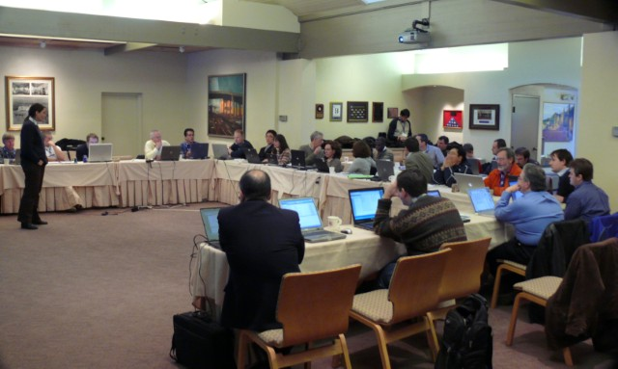





Have a great meeting week!
08:45
17:30
?

