Slide 1
Space Communications Cross Support – Architecture Definition Document (SCCS-ARD) Update – 4 January 2021
SES SAWG
4 January 2021
John Pietras
Global Science and Technology, Inc.

Slide 2
Candidate topics
Consolidating protocol requirements into section 6
Cleaning up the representation of transfer services
Issue: No ABA Space User Node requirements in section 4

Slide 3
Consolidating protocol requirements into section 6 (1 of 13)
Proposal tentatively approved at 7 December 2020 telecon
Replace references to specific protocols in sections 4 and 5 with their abstract “layer” names, with a reference to the appropriate subsection of section 6 (Communications View)
E.g., replace “ABA ESLTs shall implement one or both AOS or TM frame decoding functions (references [X], [Y], [Z])” with “ABA ESLTs shall implement frame synchronization and decoding functions, as specified in 6.?”, where 6.? lists the current protocol requirements for ABA ESLTs
Put all information regarding optional/required/recommended protocols in section 6
Proposal: adopt an extended set of PICS Proforma notations in the tables
M: mandatory
O: optional
O<n>: optional, but support of at least one of the group of options labeled by the same numeral <n> is required
R<n>: the recommended option of a group of options labeled by the same numeral <n> (if and as appropriate)
C<n>: conditional as defined in corresponding expression below the table
J Pietras agreed to flesh out examples for presentation at the January SAWG telecon
Summary observations
Section 4 (Services) requirements refer to “services” and their underlying protocols (e.g., RAF, FCLTU, FF-CSTS), whereas Section 5 (Physical) requirements refer to production functionality (e.g., frame synchronization and decoding functions)
Attempts to address all aspects in a single table proved unwieldy

Slide 4
Consolidating protocol requirements into section 6 (2 of 13)
Summary observations
Section 4 (Services) requirements refer to “services” and their underlying protocols (e.g., RAF, FCLTU, FF-CSTS), whereas Section 5 (Physical) requirements refer to production functionality (e.g., frame synchronization and decoding functions)
Attempts to address all aspects in a single table proved unwieldy
Modified approach: two sets of tables in section 6
Mappings of services to protocols (used for cross references from section 4)
Mappings of production functionality to protocols (used for cross references from section 5)
I was able to work examples of the services-to-protocols tables, but the production-functionality-to-protocols table(s) are still To Be Supplied
To accommodate future additions in the services-to-protocols tables, Table 6-4 (Required and Optional ABA ESLT Terrestrial Side Protocols) and been broken into 3 tables
6-4: Required and Optional ABA ESLT Terrestrial Side Protocols for Space Communication
6-5: Required and Optional ABA ESLT Terrestrial Side Protocols for Radiometric Data
6-6: Required and Optional ABA ESLT Terrestrial Side Protocols for Service Management

Slide 5
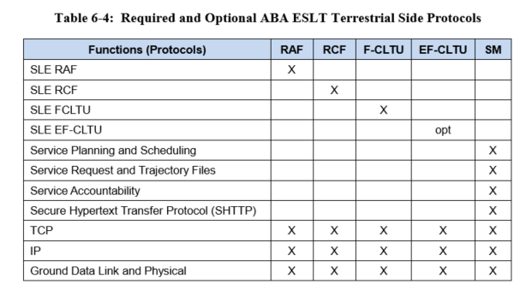
Consolidating protocol requirements into section 6 (3 of 13)
Table 6-4 from M-1 issue of SCCS-ARD

Slide 6
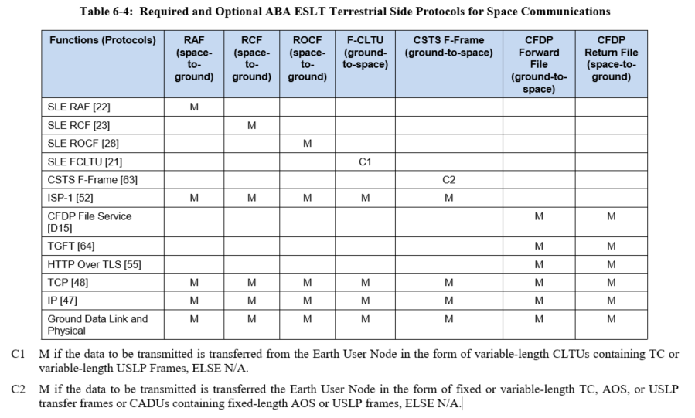
Consolidating protocol requirements into section 6 (4 of 13)
New table 6-4

Slide 7
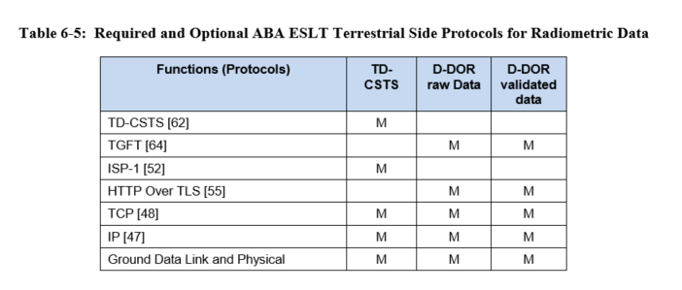
Consolidating protocol requirements into section 6 (5 of 13)
New table 6-5

Slide 8
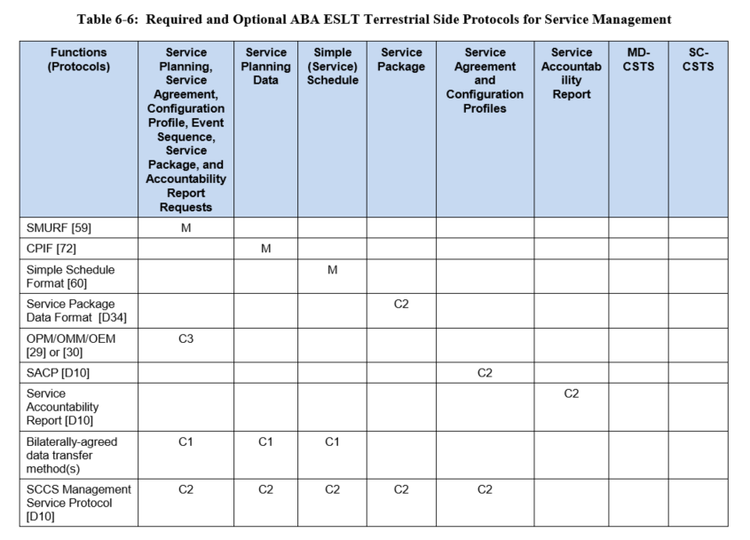
Consolidating protocol requirements into section 6 (6 of 13)
New table 6-6 (part 1)

Slide 9
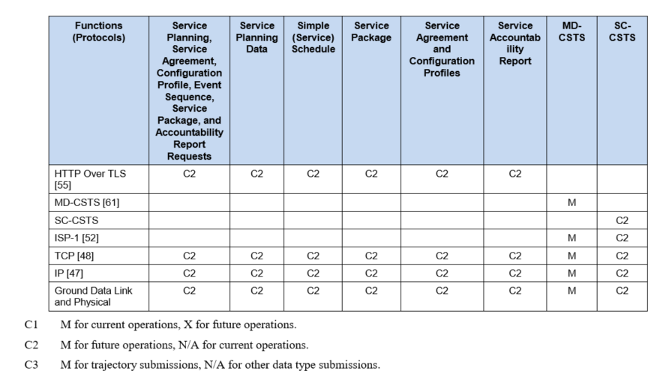
Consolidating protocol requirements into section 6 (7 of 13)
New table 6-6 (part 2)

Slide 10
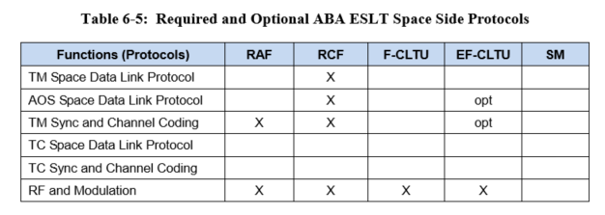
Consolidating protocol requirements into section 6 (8 of 13)
Table 6-5 from M-1 issue of SCCS-ARD

Slide 11
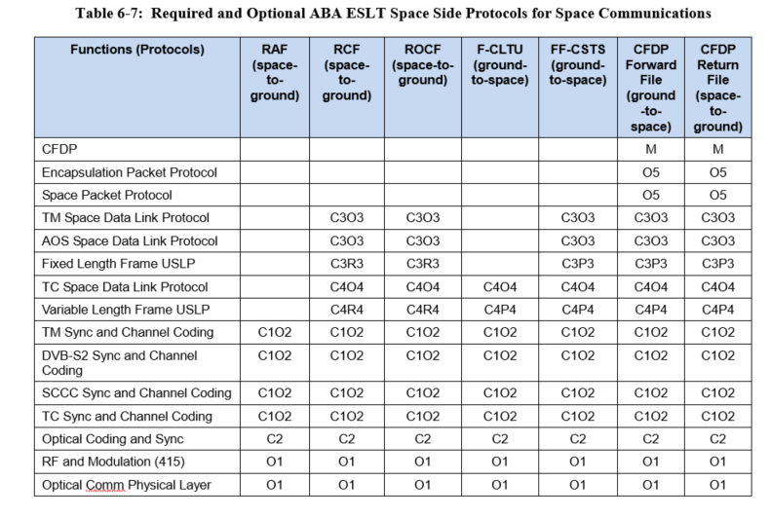
Consolidating protocol requirements into section 6 (9 of 13)
New Table 6-7 (part 1)

Slide 12
Consolidating protocol requirements into section 6 (10 of 13)
New Table 6-7 (part 2, conditions and options)

Slide 13
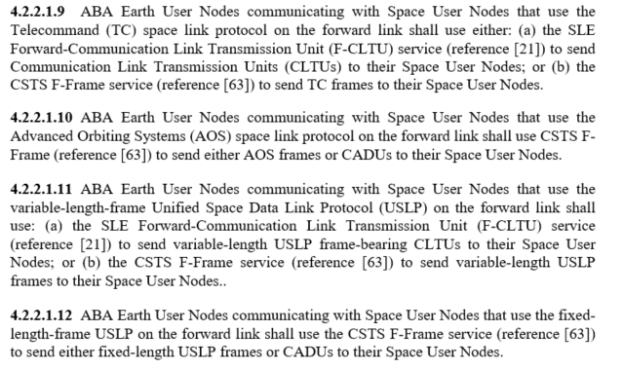
Consolidating protocol requirements into section 6 (11 of 13)
Resulting simplifications in section 4 (1st example)
Explicit identification of combinations in section 4 (“old style”)

Slide 14
Consolidating protocol requirements into section 6 (12 of 13)
Resulting simplifications in section 4 (1st example)
References to section 6 tables (“new style”)

Slide 15
Consolidating protocol requirements into section 6 (13 of 13)
Resulting simplifications in section 4 (1st example)
References to section 6 tables (“new style”)
Explicit identification of combinations in section 4 (“old style”)

Slide 16
Cleaning up the representation of transfer services
Problem: some of the protocol diagrams misrepresent protocol functionality that is not specific to SLE transfer services and CSTSes by making them part of those services’ “Processing”
E.g., the VC and MC Mux functions of the ESLT are included in the FF-CSTS Processing functional element even though those protocol functions are used by other (non transfer service) services: CFDP, DTN, and IP over CCSDS
Proposed change: Confine the SLE/CSTS Processing functional elements to represent only the service provision and service-specific production functions associated with that service (if any)
Protocol functionality that is shared with other services is represented explicitly
Some examples follow – more changes if this approach is adopted

Slide 17
Figure 6-1: ESLT Fwd / Ret Service Provider Protocol Stack Building Blocks – original
SLE F-CLTU
Processing
CSTS F-Frame
Processing
(Frame Muxing)
SLE F-CLTU
CSTS F-Frame
TCP
Issue:
erroneously
attributes
VC & MC
muxing to
FF-CSTS
Code & Sync
TCP
RF & Mod
IP
RF & Mod
IP
a) SLE F-CLTU
c) CSTS F-Frame
(multiplex)
Issue:
erroneously
attributes
all VC & MC
demuxing to
SLE RCF.
Each RCF
instance
performs
MC/VC Demux
only for its
(single) service
user
SLE RCF
Processing
(Frame De-Muxing)
SLE RAF
Processing
SLE RAF
SLE RCF
Frame Sync & De-Code
TCP
Frame Sync & De-Code
TCP
RF & De-Mod
IP
RF & De-Mod
IP
b) SLE RAFs
d) SLE RCFs
(de-multiplex)

Slide 18
Figure 6-8: Service User / Provider ABA CSTS Forward-File Building Block - original
Issue: Forward File service has nothing to do with FF-CSTS. The only reason FF-CSTS is in this diagram is that frame muxing is (erroneously) attributed to being “owned” by FF-CSTS
CSTS Forward-
File Processing
CFDP
CSTS Transfer File
Encapsulation
TC/AOS Link Framing
CSTS F-Frame
Delivery Service
(Frame Muxing)
User CSTS Forward-
File Application
CSTS F-Frame
CSTS Transfer File
Code & Sync
TCP
TCP
RF & Mod
IP
IP
a) ABA CSTS Forward-File Service Provider
Using CFDP File Delivery over SPP and CSTS F-Frame
b) ABA User CSTS Forward-File
(Requires CSTS Transfer-File in Service Provider)

Slide 19
Figure 6-1: ESLT Fwd / Ret Service Provider Protocol Stack Building Blocks – revised
SLE F-CLTU
Processing
FF-CSTS Processing
SLE F-CLTU
VC & MC MUX
CSTS F-Frame
TCP
Code & Sync
TCP
RF & Mod
IP
RF & Mod
IP
VC & MC Mux
function is
separated from
CSTS F-Frame
production
a) SLE F-CLTU
c) FF-CSTS
Callouts are only for this explanation: not to be included in ARD
SLE RAF
Processing
SLE RCF
Processing
SLE RAF
SLE RCF
Each RCF
instance
performs
MC/VC Demux
only for its
(single) service
user
Frame Sync & De-Code
TCP
Frame Sync & De-Code
TCP
RF & De-Mod
IP
RF & De-Mod
IP
b) SLE RAFs
d) SLE RCFs
(de-multiplex)
SLE and CSTS “Processing” is defined as provision and service-specific production (if any)

Slide 20
Figure 6-8: Service User / Provider ABA CSTS Forward-File Building Block - revised
CSTS Forward-
File Processing
User CSTS Forward-
File Application
CFDP
Encapsulation
TC/AOS Link Framing
VC & MC MUX
Terrestrial Generic File Transfer
Terrestrial Generic File Transfer
Code & Sync
TCP
TCP
RF & Mod
IP
IP
a) ABA CSTS Forward-File Service Provider
Using CFDP File Delivery over EPP
b) ABA User CSTS Forward-File
(Requires Terrestrial Generic File Transfer
Provider)
FF-CSTS-specific entities disappear from the Forward File service profile

Slide 21
Figure 6-9: Service Provider ABA CSTS Return-File Building Block (original)
D-DOR Correlation
Processing
Offline Radiometric
Processing
TDM File
CSTS Return-
File Processing
TDM File
CFDP
CSTS Transfer File
Encapsulation
TM/AOS Link Framing
SLE RCF
Delivery Service
(Frame De-Muxing)
SLE RCF
Frame Sync & De-Code
TCP
RF & De-Mod
IP
ABA CSTS Return-File Service Provider
Using CFDP File Delivery over SPP and SLE RCF

Slide 22
Figure 6-9: Service Provider ABA CSTS Return-File Building Block (revised)
D-DOR Correlation
Processing
Offline Radiometric
Processing
TDM File
CSTS Return-
File Processing
TDM File
CFDP
CSTS Transfer File
Encapsulation
MC/VC Demux
(independent of
RCF service
Instances)
TM/AOS Link Framing
MC & VC Demux
Frame Sync & De-Code
TCP
RF & De-Mod
IP
ABA CSTS Return-File Service Provider
Using CFDP File Delivery over EPP

Slide 23
Figure 6-2: ESLT Radiometric Service Provider Protocol Stack Building Blocks - original
CSTS F-Frame
Processing
(Frame Muxing)
CSTS F-Frame
Ranging Sequence Generation
Code & Sync
TCP
RF & Mod
IP
Ranging Data
TD-CSTS
Processing
(Real-time Radiometric Data)
Ranging
Signal
Doppler Data
SLE RCF
Processing
(Frame De-Muxing)
TD-CSTS
TCP
SLE RCF
Ranging Sequence Recovery
Frame Sync & De-Code
IP
TCP
RF & De-Mod
IP
TD-CSTS Ranging & Radiometric Data

Slide 24
Figure 6-2: ESLT Radiometric Service Provider Protocol Stack Building Blocks - revised
In the case of TD-CSTS, the TD-CSTS Processing functional element performs both service provision and TD-specific production: no change to TD-CSTS oval
CSTS F-Frame
Processing
VC & MC MUX
CSTS F-Frame
Ranging Sequence Generation
Code & Sync
TCP
RF & Mod
IP
Ranging Data
TD-CSTS
Processing
(Real-time Radiometric Data)
Ranging
Signal
Doppler Data
SLE RCF
Processing
TD-CSTS
TCP
SLE RCF
Ranging Sequence Recovery
Frame Sync & De-Code
IP
TCP
RF & De-Mod
IP
TD-CSTS Ranging & Radiometric Data

Slide 25
Issue: No ABA Space User Node requirements in Section 4 (1 of 2)
M-1 section 4 outline
4.2.2 ABA Service User Service Requirements
4.2.2.1 Current ABA Service User Service Requirements
All requirements are for ABA Earth User Node only
4.2.2.2 Future ABA Service User Requirements
All requirements are for ABA Earth User Node only
4.2.3 ABA Service Provider Requirements
4.2.3.1 Current ABA Service Provider Requirements
All requirements are for ABA ESLTs only (which is okay)
4.2.3.2 Future ABA Service Provider Requirements
All requirements are for ABA ESLTs only (which is okay)
4.3.2 Future SSI Service User Requirements
Includes requirements on both EUNs and SUNs
4.3.3 Future SSI Service Provider Requirements
4.3.3.1 Future SSI Earth Based Service Provider Requirements
4.3.3.2 SSI Earth Management/Routing Node Service Provider Requirements
4.3.3.3 SSI Space Based Service Provider Requirements
4.3.3.4 Future SSI Last Hop Service Provider Requirements

Slide 26
Issue: No ABA Space User Node requirements in Section 4 (2 of 2)
Do ABA SUNs “see” “services”?
If so, do we document them in separate subsections under 4.2.2 (ABA Service User Service Requirements) or combine them as is done in 4.3.2 (Future SSI Service User Requirements)?

