Slide 1
UAFv2 and RASDSD++ A comparison of features
Peter Shames
CCSDS Systems Architecture WG
10 Apr 2023

Slide 2
OMG UAF 2.0
Enterprise Architecture modeling framework
Intended to support large enterprises and portfolio management
Supports modeling down to capabilities and resources, suitable for acquisition specification
Leverages ISO 42010
Defines a metamodel with: Strategic, Operational, (enterprise) Service, Resources (people, organizations, systems), and Security Viewpoints
Supported by NoMagic (Magic Draw), Sparx EA, IBM Rhapsody
Integrates with SysML, but no defined SA framework in SysML

Slide 4
CCSDS RASDS++
System and Systems of Systems Architecture modeling framework
Intended to support description of project technical architecture
Supports modeling of systems, subsystems, components down to the level of detailed design initiation
Leverages ISO 42010 and RM-ODP (ISO 10746)
Defines a metamodel with: Enterprise, Functional, Physical (Connectivity, Structural, other adaptations), Protocol, Information, (system) Service, and Operational Viewpoints.
Security appears in several viewpoints
Supported by PPT and Word meta-models, no other formal tooling (yet)
Has been mapped using a SysML Profile, but no defined SA framework in SysML

Slide 6
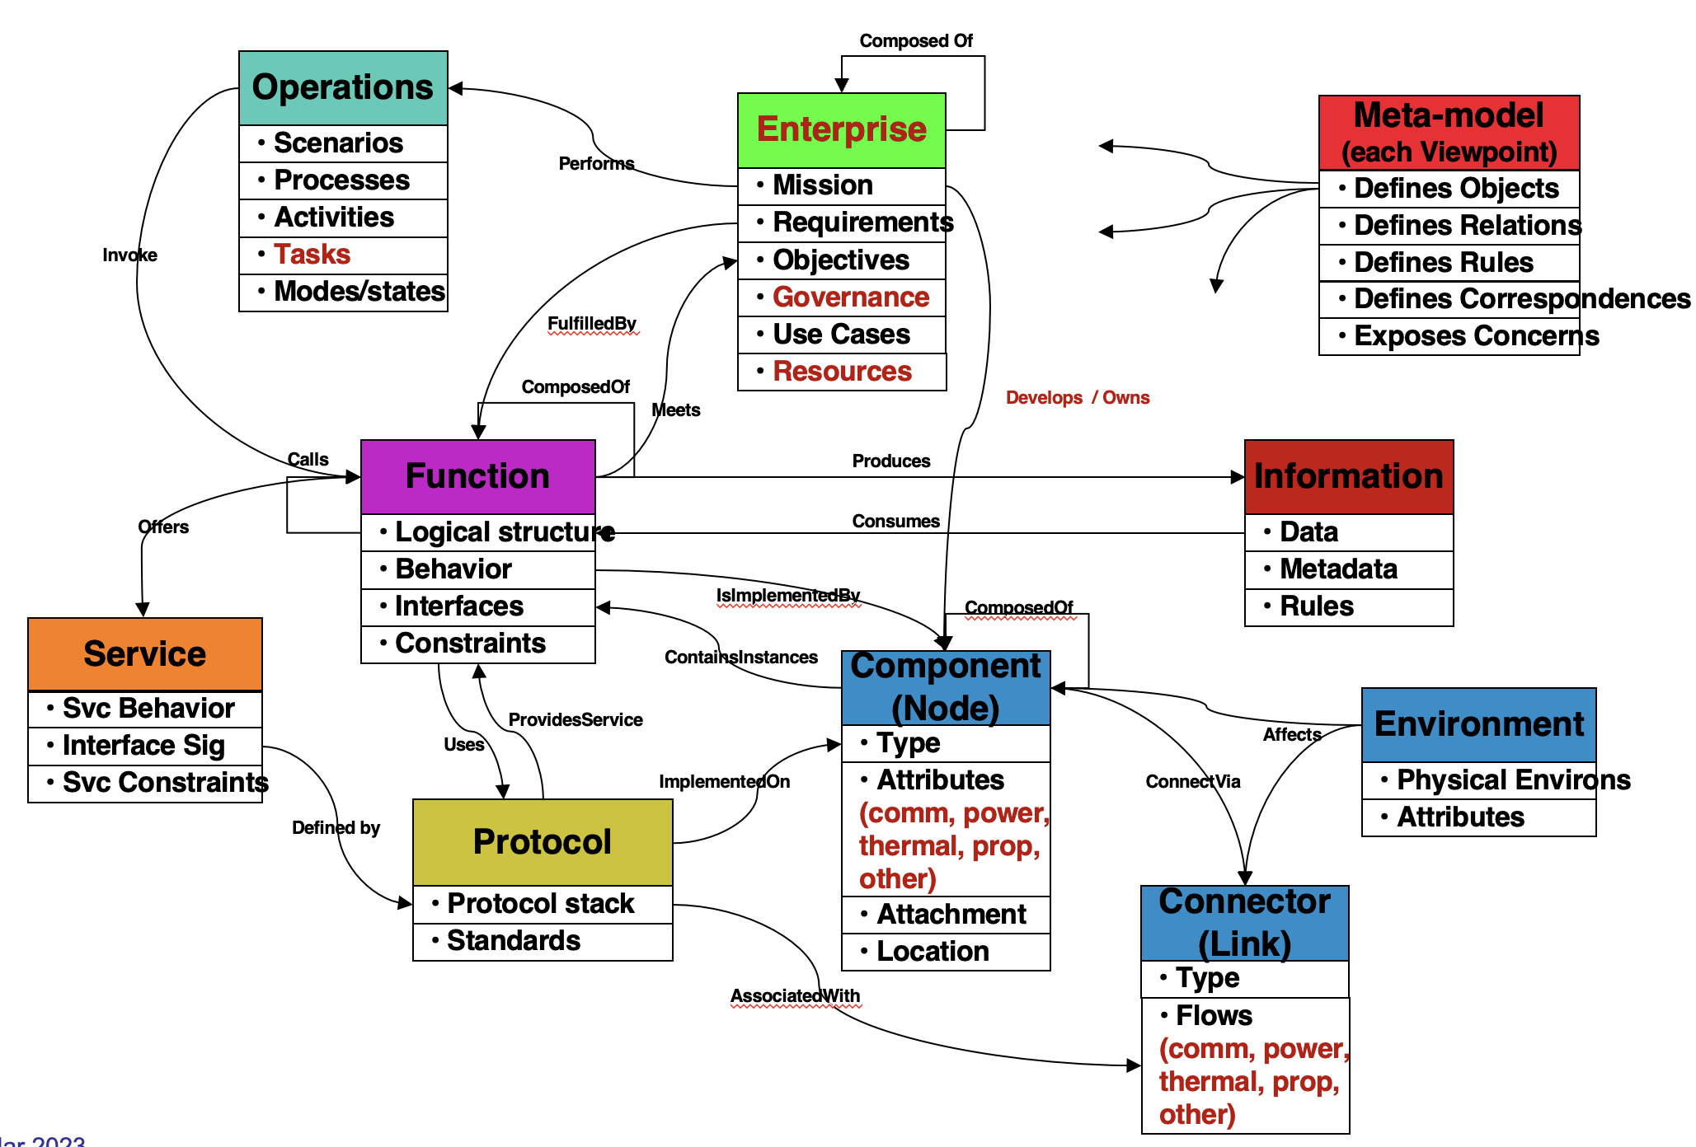
UAF is focused on the “What”
RASDS++ is focused on the “How”

