Slide 1
Security Concept of the CCSDS Mission Operations Services
Marcus Wallum, Maxime Garnier, Daniel Fischer
16/10/2018

Slide 2
Overview
Current concept and identified issues
  AuthID separate from message authentication
  Vulnerable to Man In The Middle attack
  Delegation of security concerns to transport layer
Proposed solutions for Authentication and Authorisation
  Modular Architecture
  Login Service -> Secure Login Service
  Central Authority Service
  Authenticity schemes: symmetric, asymmetric
Conclusions and Recommendations

Slide 3
Context and Objectives
The project:
Work performed during Traineeship over period of 6 months: Maxime Garnier
Analyse the security concept of MOS
Highlight concerns
Propose solutions
Implement a proof of concept with a reference (ESA) implementation
Focus on Authentication and Authorisation
  - Confidentiality and Access Control briefly considered
This presentation: communicate the work done, discuss findings, consider how best to accommodate (if agreed) in MO CCSDS concept / documentation

Slide 4
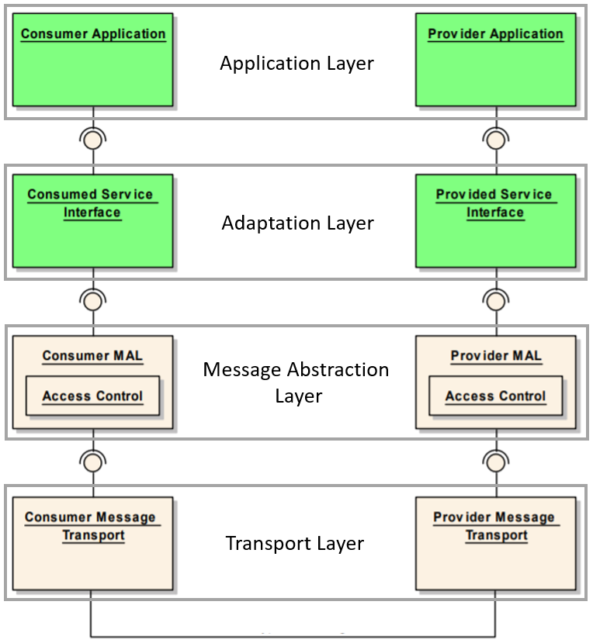
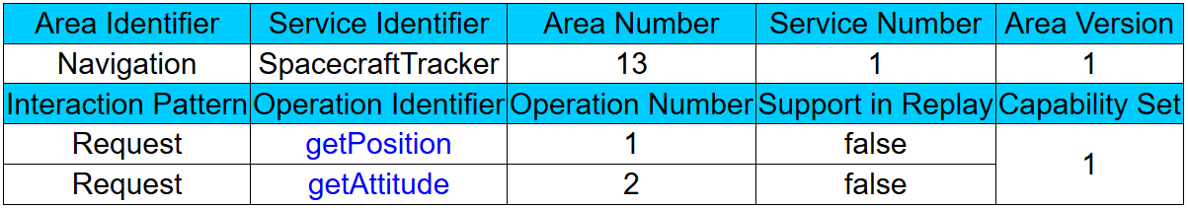
Mission Operations Services
Service specification

Slide 5
Definition
Access control
Authentication
Data integrity
data authentication
Consumer
Consumer
Provider
msg
Attacker
Are these issues covered? Recap on current concept…

Slide 6
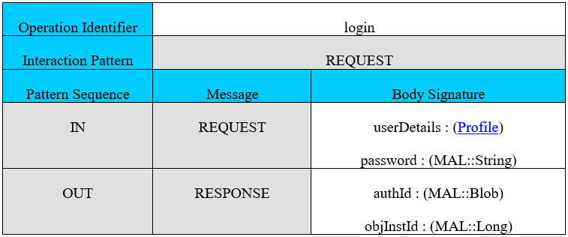
Current concept - Authentication
MAL
Cons/prov
Application
MO Login Service CSI
Transport Layer
MO Login
Service
Access control
Profile(user)/hash(Password)
AuthId
AuthId /msg
AuthId/msg
AuthId /msg
Go to MO Services
AuthId/msg
Go to MO Services
MO Service
CSI : Consumed service interface

Slide 7
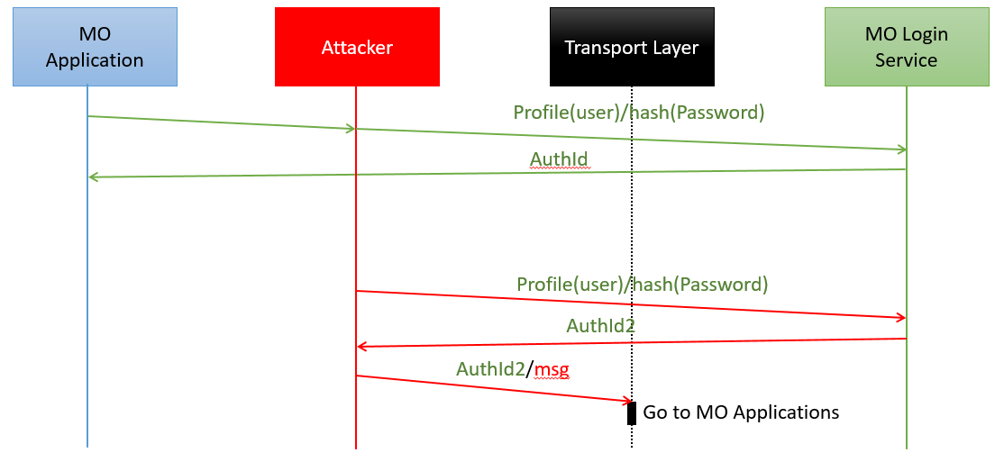
Authentication concerns

Slide 8
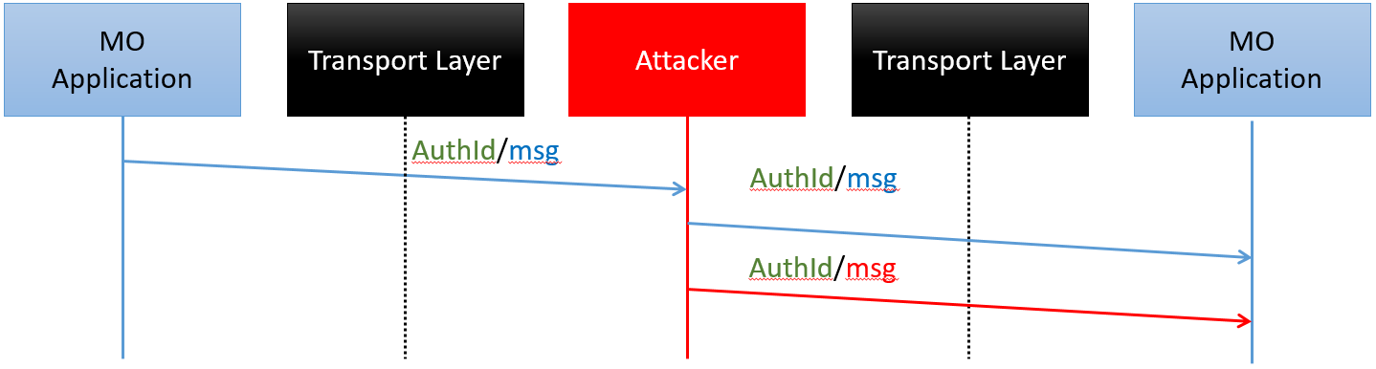
Authentication concerns

Slide 9
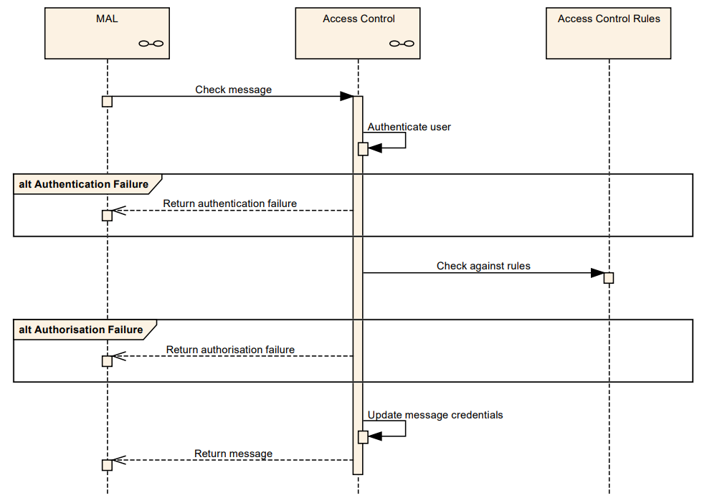
Current concept – Access Control and Authorisation
Provided by the Access Control (AC):
  Interface of the MAL
  Called before sending / after reception of messages
  Authentication of the authId
  Authorisation of messages based on AuthID
  Deployment-specific
Notes:
It is not specifically stated that the AC can interact with other services in a system

Slide 10
Current concept – Data Integrity is Delegated
According to the standards :
  The communication protocol shall provide a secure channel
    Authentication
    Data integrity
    (confidentiality)

Slide 11
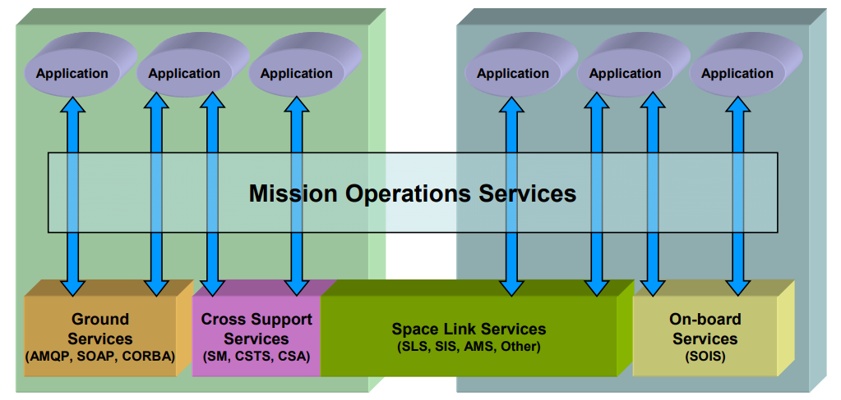
Security delegation concerns
MOS are end-to-end application-level services and may be carried over communications protocols appropriate to the environment. (MOS concept, CCSDS)

Slide 12
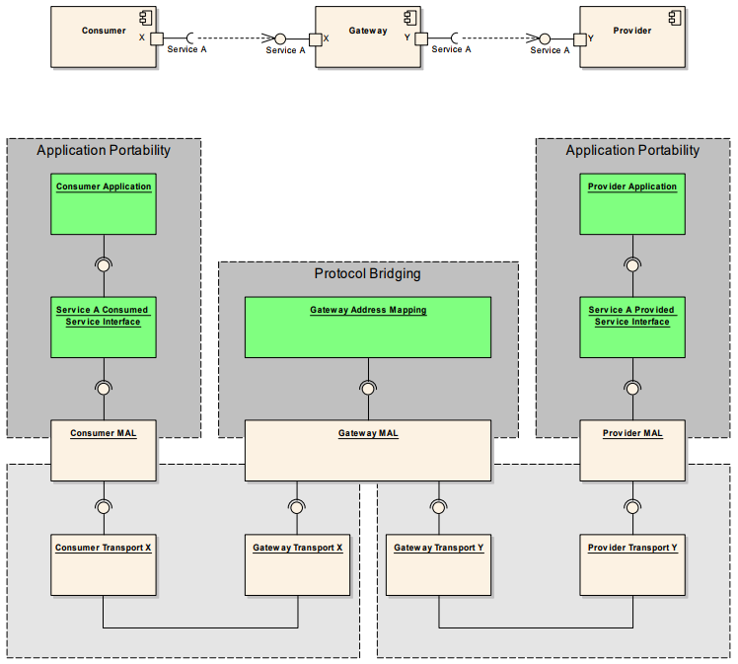
Security delegation concerns
Consumer and provider are interoperable with different encoding/transport
Requires protocol-mapping gateway
Gateway vulnerable -> routing at higher layers typically requires removal of protection – no end-to-end security
Notes:
Loss of modularity, security layer in each transport protocol of the system has to be implemented and maintained with the complexity ensuing.
Does not provide access control based on the MAL Message (e.g. operation, fields, etc.)
The MO standards and recommended practices consider a dependency between the transport layer, authId and the AC. This implies a loss of modularity and increases the complexity of the system.
According to the recommended practice [AD-01], “Mission Operations Services are end-to-end application-level services and may be carried over communications protocols appropriate to the environment”. As a consequence, services shall be interoperable through different transport layer and encoding. In order to address this functionality the protocol matching gateway (Figure 24) is introduced by the recommended practice [AD-02].
This gateway deals with MAL message to route them to the appropriate transport layer. As a consequence, any protection provides by the transport layer are removed. MAL message are vulnerable in this gateway and can be modified. If this gateway is corrupted, the man-in-the-middle attacks on the authentication and data authentication presented above can be performed.
The protection of message provides by the transport layer is dependent to the transport layer technology. So, the protection cannot be automatically translated from one transport layer technology to another.

Slide 13
Security delegation concerns
Gateway between different transports and encodings vulnerable.
- breaches are potentially transitory (reuse of the authId, across transport layers)
Security services may be implemented at multiple layers of the mission data system simultaneously
  - different implementations can mitigate different threats
Implementing security features in the MAL provides real end-to-end security and could make these features independent of the transport
  – avoids need for standardisation of transport security (TCP/IP vs Controller Area Network)
  - MO publications hint at a dependency between the transport layer, authId and the AC. This implies a loss of modularity and increases complexity
Notes:
Loss of modularity, security layer in each transport protocol of the system has to be implemented and maintained with the complexity ensuing.
Does not provide access control based on the MAL Message (e.g. operation, fields, etc.)
The MO standards and recommended practices consider a dependency between the transport layer, authId and the AC. This implies a loss of modularity and increases the complexity of the system.
Moreover, these standards confirm the MAL passes the message down to the transport layer, that the authentication identifier (consumer identifier) could be used by the transport layer : “It is possible for this security credential to be used by the protocol below TCP for authentication or even confidentiality purposes (e.g., IPsec), but that is not specified here.”
As a consequence the security of the MAL and the transport layer could be considered dependent. If this is the case, it should be made clear and explicit.
End-to-end security could be implemented on the application layer, convoyed with a secure transport layer and maybe through a secure data link between ground and spacecraft. Security in each layer answers to different issues and mitigates different kinds of attacks.
One of the purposes of the MAL is the abstraction of the transport layer, therefore implementing security features in the MAL could make these features independent of the transport. Also, it could mean reduced effort to secure the system. Indeed, MO services permit different transport layer protocols/technologies in a system (Figure 24) and not all have standardised security implementations widely available. For example, it is common nowadays to secure the TCP/IP transport layer, but this not the case for the CAN (Controller Area Network). Thus, to have a secure standardised system implementing security in the transport layer, the security for each kind of transport layer has to be studied and standardised.
Moreover, the security has to be maintained for each protocol layer used in the system, maybe with different central authorities, which make the system and its management more complex.
Obviously, security implemented in the transport layer does not make assumptions of the layer above and only secures the communication between two points. If the authId is stolen by some arbitrary means, the transport layer could not prevent reuse by an attacker. In an example of such an attack (Figure 25), the channels are secured between x.x.x.1 and x.x.x.2, and between x.x.x.1 and x.x.x.3. However, in theory User1/authId1 messages should not come from x.x.x.3, the transport layer is not aware of this issue.
So, a weakness in one kind of transport could lead to the compromise of the system by reusing the authId stolen, in another kind of transport layer.
In addition implementing security only in the transport layer, with different kinds of transport, could potentially make gateways between those two kinds of transport layer a point of weakness in the chain. Unless the security technology changing and exchange between two transport layers is itself analysed and secured, messages could be attacked during the translation
Security in both layers is useful, and the choices to implement security depend on the context of the system. As a consequence, the MO standards and recommended practices could propose some points of standardisation to secure the MAL in terms of data authentication for deployments needing this security.

Slide 14
Proposed solution
Reference architecture to provide :
Secure authentication
  With a third party service (Security Service / Secure Login Service)
Message data authentication
  Use cryptographic signature to sign message
  Build authenticity scheme (chain of trust)
Keep the access control deployment specific

Slide 15
Overview of the architecture
Secure authentication with a Secure Login service (SLS)
Negotiation and retrieval of an authId
Use of the information contained in the authId to sign message
Computation and verification of the signature by the Access Control
Generic encoding of messages
Signature in the dedicated field for authId in the MAL header
Notes:
SLS provides real authentication between consumer/provider (the authentication protocol and for the technology to secure a channel in order to exchange cryptographic materials)
Use authID field in the MAL header to contain a crypto signature of the message
authId contains cryptographic materials to sign message
In order to compute or verify the signature, a requirement for this concept is to encode MAL messages with a generic encoding common to all Access Control instances in the system . Indeed, the encoding in the MAL shall be common to every Access Control in the system, in order to compute the same signature of message.
Is this a new requirement which must be met if your approach is to be adopted? If yes I would mention that explicitly

Slide 16
Modularity
Access control
Authorisation
A
Signature
Computation
Security
Service
Security
Service
AuthId
negotiation
Central
Authority
Service
AuthId negotiation
Signature
Verification
Central Authority CSI
Secure authentication
Secure channel
Authenticity scheme
Notes:
The different steps of the concept are :
Secure authentication of consumer or provider with the Secure Login service.
Negotiation of an authId containing materials (key, certificate…) used thereafter to sign messages. It also contains a piece of data for authorisation purpose.
Signature computation of message and check for authorisation in the Access Control, sending side.
Signature verification of message and check for authorisation in the Access Control, reception side.
Interaction with the Central Authority if it is needed, to retrieve material and verify a cert.
The proof of concept is modular in order to propose a reference architecture which different data authentication schemes can adhere to, allowing deployment-specific tailoring and adaptation. In this way it follows the concept of the MOS to enable flexibility regarding the implementation of components.
The skeleton presented above allows to build authentications and secure channels, data authentication schemes, and access control models independently of each other.
the components to build an data authentication scheme i.e. to exchange cryptographic materials (protected by the authentication component), components to verify and compute a signature and the Central Authority Service :
AuthId Negotiation component
Signature Computation component
Signature Verification component
Central Authority Service
The components to enable access control model to be deployment-specific :
Authorisation component (Secure Login Service Provider)
Authorisation component (Access Control)

Slide 17
Login Stage : Secure Login Service
SLS Provider
Secure
authentication
Secure
authentication
Database
authId negotiation
authId negotiation
Central
Authority
Service
SLS Consumer
Any Consumer
Any Provider
SLS Consumer
AuthId
AuthId/msg
AuthId
AuthId/msg
Database
AC
AuthId/msg
AC
MAL
Database
MAL
MO Application
MO Application

Slide 18
Login Stage : Secure Login Service components
MO Login Service Service Interface
  To stay compliant with standards
Security Service (proposition)
  MO service
  Provide Secure Authentication
  Provide Secure Channel
MO Login Service
CSI
MO Login Service
PSI
Consumer
Provider
Security
Service
Security
Service

Slide 19
Login Stage : Secure Login Service components
AuthId negotiation (proposition)
  Perform negotiation of authId
  Plugged to the Security Service
“Consumer”
“Provider”
AuthId negotiation
AuthId
negotiation
Authorisation component (proposition)
  Only present in the SLS Provider
  Get a piece of data (authorisationData) for authorisation purpose
A

Slide 20
Security Service and AuthId Negotiation Pseudo Service
“Consumed
Service
Interface”
“Provided
Service
Interface”
SecureRequest
AuthId
negotiation
Security
Service
Security
Service
AuthId negotiation
SecureInvoke
UnsecureInvoke
Notes:
Refer also to the AC <-> System security server in the MO documentation

Slide 21
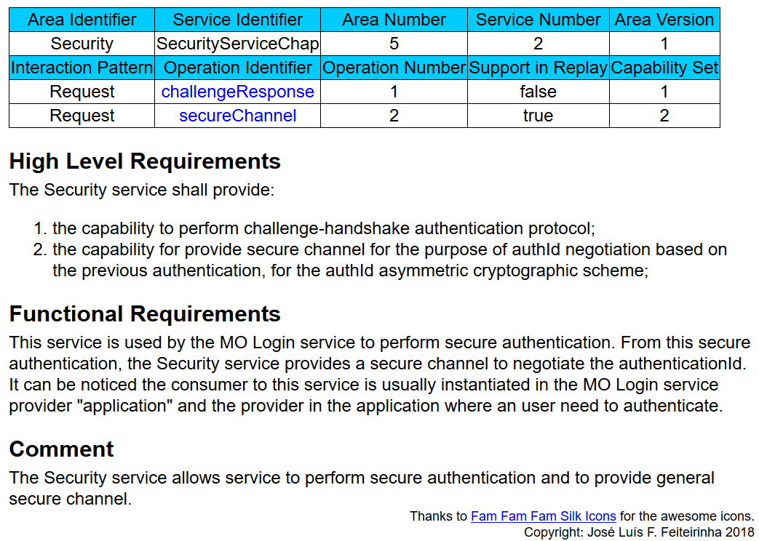
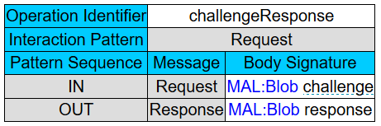
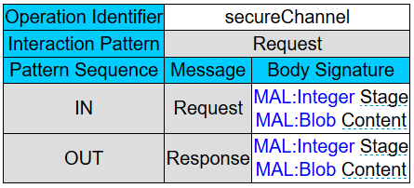
Specification of the specific Security Service
Authentication
Security
Service
Security
Service
SecureRequest
AuthId
negotiation
AuthId negotiation
“Consumed
Service
Interface”
“Provided
Service
Interface”

Slide 22
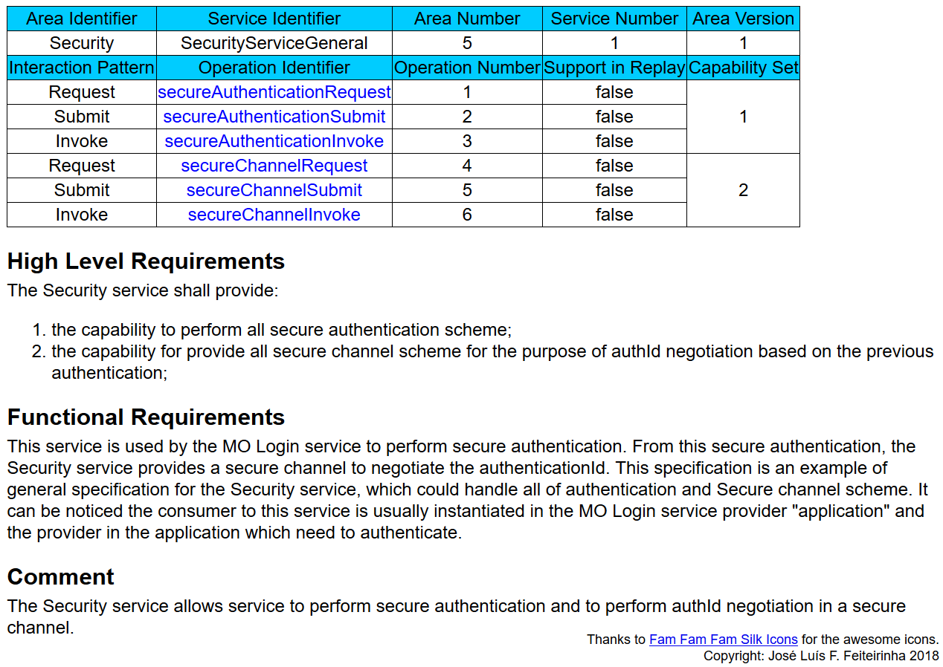
Specification of a general Security Service
Authentication
Security
Service
Security
Service
secureRequest
AuthId
negotiation
AuthId negotiation
secureSubmit
secureInvoke

Slide 23
Login Stage : Authentication
SLS Provider
Secure
authentication
Secure
authentication
Database
authId negotiation
authId negotiation
Central
Authority
Service
SLS Consumer
Any Consumer
Any Provider
SLS Consumer
AuthId
AuthId/msg
AuthId
AuthId/msg
Database
AC
AuthId/msg
AC
MAL
Database
MAL
MO Application
MO Application

Slide 24
Login Stage : Authentication
Database
Database
URI
login
AuthId negotiation
Security Service
MO Login Service PSI
MO Login Service CSI
Security Service
AuthId Negotiation
prfl,
password
A
Black Box
Secure Login service provider
Secure Login service consumer
A
Authorisation component
MO Application

Slide 25
Login Stage : Authentication
Database
Database
URI
AuthId negotiation
Security Service
MO Login Service PSI
MO Login Service CSI
Security Service
AuthId Negotiation
A
Secure Login service provider
Secure Login service consumer
A
Authorisation component
MO Application

Slide 26
Login Stage : Authentication
Database
Database
URI
AuthId negotiation
Security Service
MO Login Service PSI
MO Login Service CSI
Security Service
AuthId Negotiation
Request : prfl, URI
A
Secure Login service provider
Secure Login service consumer
A
Authorisation component
MO Application
Notes:
We can avoid that by using the directory service

Slide 27
Login Stage : Authentication
Database
Database
URI
AuthId negotiation
Security Service
MO Login Service PSI
MO Login Service CSI
Security Service
AuthId Negotiation
Request : prfl, URI
Prfl, URI
Secure Authentication
A
Secure Login service provider
Secure Login service consumer
A
Authorisation component
MO Application
Notes:
A secure authentication requires a three-way exchange. Several kinds of authentication protocols exist; here the challenge-handshake authentication protocol (CHAP)[RD-04] is presented:
MO application requests a challenge to the MO Login service with its username and other information
The MO Login service challenges MO Application with a random number
MO application concatenates the challenge and the password before using an hash function, and send the value obtained
The authenticator performs the same operation and compares the values received and its value.

Slide 28
Login Stage : Authentication
Database
Database
URI
AuthId negotiation
Security Service
MO Login Service PSI
MO Login Service CSI
Security Service
AuthId Negotiation
Request : prfl, URI
Prfl, URI
Secure Authentication
Prfl
Ok
AD
A
Secure Login service provider
Secure Login service consumer
A
Authorisation component
AD : AuthorisationData
MO Application

Slide 29
Login stage : AuthId Negotiation
SLS Provider
Secure
authentication
Secure
authentication
Database
authId negotiation
authId negotiation
Central
Authority
Service
SLS Consumer
Any Consumer
Any Provider
SLS Consumer
AuthId
AuthId/msg
AuthId
AuthId/msg
Database
AC
AuthId/msg
AC
MAL
Database
MAL
MO Application
MO Application

Slide 30
Login Stage : Authentication
Database
Database
URI
AuthId negotiation
Security Service
MO Login Service PSI
MO Login Service CSI
Security Service
AuthId Negotiation
Request : prfl, URI
Prfl, URI
Secure Authentication
Prfl
Ok
AD
A
Secure Login service Provider
Secure Login service Consumer
A
Authorisation component
AD : AuthorisationData
MO Application

Slide 31
Login Stage : AuthId Negotiation
Database
Database
URI
AuthId negotiation
Security Service
MO Login Service PSI
MO Login Service CSI
Security Service
AuthId Negotiation
Request : prfl, URI
Prfl, URI
Secure Authentication
Prfl
Ok
AD
A
AuthId negotiation
Secure Login service provider
Secure Login service consumer
A
Authorisation component
AD : AuthorisationData
MO Application

Slide 32
Login Stage : AuthId Negotiation
Database
Database
URI
AuthId negotiation
Security Service
MO Login Service PSI
MO Login Service CSI
Security Service
AuthId Negotiation
Request : prfl, URI
Prfl, URI
Secure Authentication
Prfl
Ok
AD
A
AuthId negotiation
AuthId
Response : AuthId, loginInstance
Secure Login service provider
Secure Login service consumer
A
Authorisation component
AD : AuthorisationData
MO Application

Slide 33
Login Stage : Authentication
Database
Database
URI
login
AuthId negotiation
Security Service
MO Login Service PSI
MO Login Service CSI
Security Service
AuthId Negotiation
prfl,
password
A
Black Box
authId,
loginInst
Secure Login service provider
Secure Login service consumer
MO Application

Slide 34
Signature stage
SLS Provider
Secure
authentication
Secure
authentication
Database
authId negotiation
authId negotiation
Central
Authority
Service
SLS Consumer
Any Consumer
Any Provider
SLS Consumer
AuthId
AuthId/msg
AuthId
AuthId/msg
Database
AC
AuthId/msg
AC
MAL
Database
MAL
MO Application
MO Application

Slide 35
Signature stage : Access Control components
Authorisation component
  Perform access control based on the message and authorisationData
Signature Computation component
  Encode the message (Generic encoding)
  Compute the signature
Signature Verification component
  Encode the message (Generic encoding)
  Verify the signature
Central Authority Consumed Service Interface
  - Provide cryptographic material and CA function
Authorisation
Signature Computation
Signature
Verification
Central Authority CSI
Notes:
Calculation and verification of the cryptographic signature depends on the specific encoding of data being hashed. Therefore, as a requisite for the presented concept, MAL messages must be encoded using a generic encoding common to every Access Control in the deployment. Indeed, the encoding in the MAL shall be common to every Access Control in the system, in order to compute the same signature of message.

Slide 36
Signature stage : Signature computation
SLS Provider
Secure
authentication
Database
authId negotiation
Central
Authority
Service
SLS Consumer
Any Consumer
Any Provider
AuthId1
AuthId1/msg
Database
MAL
AC
AC
MAL
Database
MO Application
MO Application

Slide 37
Signature stage : Signature computation
MAL
AuthId1/msg
Sending Side
Reception Side
Access Control
MAL
CA
Central Authority Consumed Service Interface

Slide 38
Signature stage : Signature computation
MAL
AuthId1/msg
Sending Side
Reception Side
AuthId1/msg
Authorisation
Signature
Computation
CA
Access Control
MAL
CA
Central Authority Consumed Service Interface

Slide 39
Signature stage : Signature computation
MAL
AuthId1/msg
Sending Side
Reception Side
AuthId1/msg
Authorisation
Authorise
Signature
Computation
CA
Access Control
MAL
CA
Central Authority Consumed Service Interface

Slide 40
Signature stage : Signature computation
MAL
AuthId1/msg
Sending Side
Reception Side
AuthId1/msg
Authorisation
AuthId1/msg
Signature
Computation
Compute signature
CA
Access Control
MAL
CA
Central Authority Consumed Service Interface

Slide 41
Signature stage : Signature computation
MAL
AuthId1/msg
Sending Side
Reception Side
AuthId1/msg
Authorisation
AuthId1/msg
Signature
Computation
CA
Access Control
AuthId2/msg
MAL
Transport
CA
Central Authority Consumed Service Interface

Slide 42
Signature stage : Signature verification
SLS Provider
Secure
authentication
Database
authId negotiation
Central
Authority
Service
SLS Consumer
Any Consumer
Any Provider
AuthId1
AuthId1/msg
Database
AC
AuthId2/msg
AC
Database
MAL
MAL
MO Application
MO Application

Slide 43
Signature stage : Signature verification
MAL
AuthId2/msg
Sending Side
Reception Side
Access Control
MAL
CA
Central Authority Consumed Service Interface

Slide 44
Signature stage : Signature verification
MAL
AuthId2/msg
Sending Side
Reception Side
AuthId2/msg
Signature
Verification
Verify signature
CA
Authorisation
Access Control
MAL
CA
Central Authority Consumed Service Interface

Slide 45
Signature stage : Signature verification
MAL
AuthId2/msg
Sending Side
Reception Side
AuthId2/msg
Signature
Verification
CA
authorisationData/msg
Authorisation
Authorise
Access Control
MAL
CA
Central Authority Consumed Service Interface

Slide 46
Signature stage : Signature verification
MAL
AuthId2/msg
Sending Side
Reception Side
AuthId2/msg
Signature
Verification
CA
authorisationData/msg
Authorisation
Access Control
msg
MAL
Application
CA
Central Authority Consumed Service Interface

Slide 47
Proof of concept
Challenge-Handshake authentication protocol
Secure channel, AES/GCM 256 bytes
Authenticity scheme :
  asymmetric cryptography, Public Key Infrastructure (PKI)
    DSA 2048 bytes
    RSA 2048 bytes
  symmetric cryptography based on Kerberos,
    HMAC 256 bytes
Access control
Security
Service
Security
Service
AuthId negotiation
AuthId
negotiation
Central Authority CSI
Central
Authority
Service
Signature
Verification
Signature
Computation
Authorisation
A

Slide 48
Test
TestService
  Request : String
  Response : String
String
Provider TestService
Consumer TestService
String
BasicMonitor (ESA github)
  Publish-Subscribe interaction pattern

Slide 49
Access control
Authorisation
A
Signature
Computation
Security
Service
Security
Service
AuthId
negotiation
Central
Authority
Service
AuthId negotiation
Signature
Verification
Central Authority CSI
Secure authentication
Secure channel
Authenticity scheme

Slide 50
Login Stage : Challenge-handshake authentication protocol authentication
ConsumerTS : K₁
ConsumerTS : K₁
URI
Security Service
MO Login Service PSI
MO Login Service CSI
Security Service
Request( prfl, URI )
Prfl, URI
challenge
challenge
H(challenge:K₁)
H(challenge:K₁)
Verify response
Ok/not Ok
Secure Login Service Consumer
Secure Login Service Provider
Consumer TestService Application

Slide 51
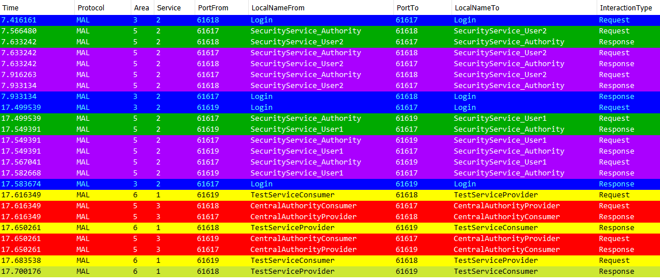
Wireshark capture
Authentication ProviderTS
Authentication ConsumerTS

Slide 52
Access control
Authorisation
A
Signature
Computation
Security
Service
Security
Service
AuthId
negotiation
Central
Authority
Service
AuthId negotiation
Signature
Verification
Central Authority CSI
Secure authentication
Secure channel
Authenticity scheme

Slide 53
Secure channel
ConsumerTS : K₁
ConsumerTS : K₁
URI
AuthId Negotiation
Security Service
MO Login Service PSI
MO Login Service CSI
Security Service
AuthId Negotiation
Ok
processing
Request(Blob)
K₁
encrypt
Blob
decrypt
Request(Blob)
Response(Blob)
processing
Blob
encrypt
Response(Blob)
processing
authId
Secure Login Service Consumer
Response(loginInstance, authId)
Secure Login service Provider
Consumer TestService Application

Slide 54
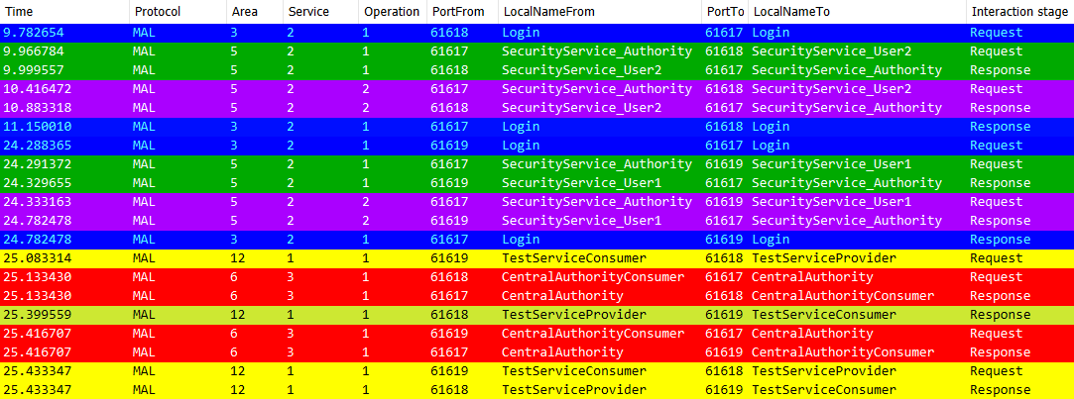
Capture Wireshark

Slide 55
Capture Wireshark

Slide 56
Proof of concept
Challenge-Handshake authentication protocol
Secure channel, AES/GCM 256 bytes
Authenticity scheme :
  asymmetric cryptography, Public Key Infrastructure (PKI)
    DSA 2048 bytes
    RSA 2048 bytes
  symmetric cryptography based on Kerberos,
    HMAC 256 bytes
Access control
Security
Service
Security
Service
AuthId negotiation
AuthId
negotiation
Central Authority CSI
Central
Authority
Service
Signature
Verification
Signature
Computation
Authorisation
A

Slide 57







Asymmetric authenticity scheme
SLS Provider
Private key
Secure
authentication
Database
Public key
authId negotiation
Central
Authority
Service
AD
SLS Consumer
Any Consumer
Any Provider
AuthId1
AuthId1/msg
AuthId3/msg
Database
AC
AuthId2/ msg
AC
Database
MAL
MAL
MO Application
msg
MO Application
AD
AD
Notes:
The data authentication scheme using asymmetric cryptography is a public key infrastructure. The Secure Login Service acts as a Certification and Registration Authority, each consumer or provider application authenticates to the Secure Login Service to register for a digital certificate and get the private key, then messages are signed with this private key. The Central Authority distributes the public key associated to the certificate.
A protocol which uses this kind of authId (Figure 14) is detailed below. The features of this protocol are:
Prerequisite: All users possess the public key of a central authority (K_{public} )
Single sign-on strategy: User1 just has to perform one authentication and it can compute its own authId for each message.
AuthId is self-sufficient, user2 can securely authenticate messages only with the authId (and K_{public}).
Protocol
User1 performs a secure authentication with a central authority
A pair of asymmetric keys are computed (K_{public} – K_{private}) and sends their public key to the central authority in a secure way (see section 2.2.6 for considerations here). This secure way could be a function provided by the central authority to perform secure, authenticated , with integrity and maybe encrypted, transmission, in order to avoid attackers which could send their own public key
The central authority concatenates name of the user, the public key of this user and some metadata like role of the user or expiry of authId. It signs these information with its private key (K_{private} ),

Slide 58
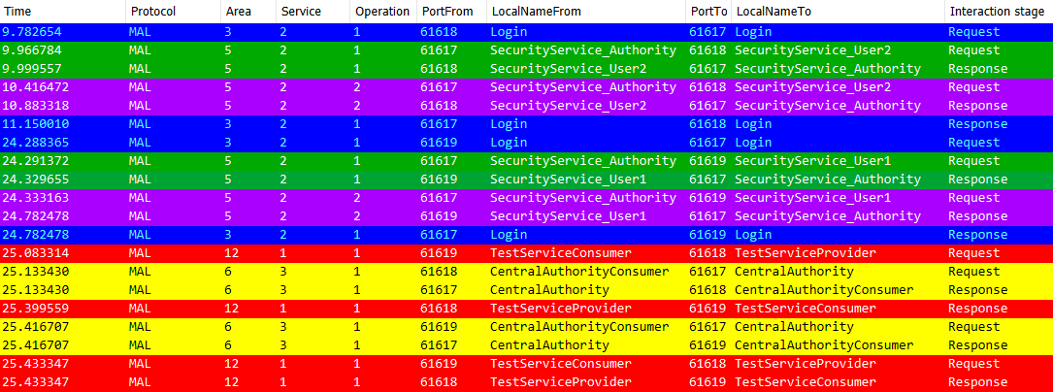
Test Service
ProviderTS
Provider TestService

Slide 59
Test Service
ConsumerTS
Provider TestService
Consumer TestService

Slide 60
Test Service
String
Provider TestService
Consumer TestService

Slide 61
Test Service
Verify signature
String
Provider TestService
Consumer TestService
Central
Authority
Service
Send response

Slide 62
Test Service
String
Provider TestService
Consumer TestService
String

Slide 63
Test Service
Central
Authority
Service
Verify signature
Provider TestService
Consumer TestService
String

Slide 64
Test Service
String
Provider TestService
Consumer TestService
String

Slide 65
Proof of concept
Challenge-Handshake authentication protocol
Secure channel, AES/GCM 256 bytes
Authenticity scheme :
  asymmetric cryptography, Public Key Infrastructure (PKI)
    DSA 2048 bytes
    RSA 2048 bytes
  symmetric cryptography based on Kerberos,
    HMAC 256 bytes
Access control
Security
Service
Security
Service
AuthId negotiation
AuthId
negotiation
Central Authority CSI
Central
Authority
Service
Signature
Verification
Signature
Computation
Authorisation
A

Slide 66

Basic concept
SLS Provider
Secure
authentication
Database
authId negotiation
Central
Authority
Service
SLS Consumer
Any Consumer
Any Provider
msg
AuthId1
AuthId1/msg
Database
AC
AuthId2/msg
AC
Database
MAL
MAL
MO Application
MO Application
Notes:
The data authentication scheme using symmetric cryptography is inspired by Kerberos. Cryptographic materials exchange takes place in order to obtain at the end, a session key associating the consumer or provider sending the message and the Access Control receiving the message. The message is signed using this session key, being sent securely in the message itself.

Slide 67



Symmetric authenticity scheme : Kerberos
SLS Provider
Central
Authority
Service
AC
AC
AC
AC
MAL
MAL
MAL
MAL
Any Consumer
Any Consumer2
Any Provider
Any Provider2
MO Application
MO Application
MO Application
MO Application
Notes:
Prerequisite : All users share a secret key pair with the central authority
An authentication has to be performed for each new pair of users
Each pair of users communicate with a shared session key provided by the central authority
This protocol could be extended to perform access control, because a new session key is instantiated for each pair of users. It is essentially the same as Kerberos tickets.
User1 performs a secure authentication with the central authority
The central authority sends to user1 a session key (K_{session}) and a token, composed of the same session key, the username to authenticate and metadatas (role, expiry). This token is encrypted by the key of user2. Session key and token are sent securely, for example encrypted with the key of user1 (K)
Now, user1 possesses the session key (K_{session}) and a token which only user2 can read. User1 computes a hash of the message and encrypts it with the session key (K_{session}). This encrypted hash and the token form the authId.
User2 can retrieve session key (K_{session}) from the token and can verify message data authentication with the encrypted hash.

Slide 68
Symmetric authenticity scheme : Kerberos
SLS Provider
Secure
authentication
authId negotiation
Central
Authority
Service
token
SLS Consumer
AC
AC
AC
AC
MAL
MAL
MAL
MAL
Any Consumer
Any Consumer2
Any Provider
Any Provider2
MO Application
MO Application
MO Application
MO Application
Notes:
User1 performs a secure authentication with the central authority

Slide 69
Symmetric authenticity scheme : Kerberos
SLS Provider
Central
Authority
Service
AC
AC
AC
AC
MAL
MAL
MAL
MAL
token
Any Consumer
Any Consumer2
Any Provider
Any Provider2
MO Application
MO Application
MO Application
MO Application

Slide 70
Symmetric authenticity scheme : Kerberos
SLS Provider
Central
Authority
Service
URI (Any Provider)
token
AC
AC
AC
AC
MAL
MAL
MAL
MAL
Any Consumer
Any Consumer2
Any Provider
Any Provider2
MO Application
MO Application
MO Application
MO Application

Slide 71
Symmetric authenticity scheme : Kerberos
SLS Provider
Central
Authority
Service
AC
AC
AC
AC
MAL
MAL
MAL
MAL
Any Consumer
Any Consumer2
Any Provider
Any Provider2
MO Application
MO Application
MO Application
MO Application

Slide 72
Symmetric authenticity scheme : Kerberos
SLS Provider
Central
Authority
Service
msg
AC
AC
AC
AC
MAL
MAL
MAL
MAL
Any Consumer
Any Consumer2
Any Provider
Any Provider2
MO Application
MO Application
MO Application
MO Application

Slide 73
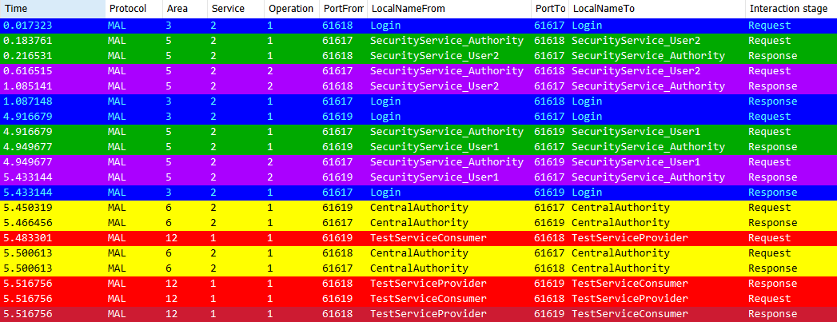
Test Service
Central
Authority
Service
Provider TestService
Consumer TestService

Slide 74
Test Service
Verify signature
String
Provider TestService
Consumer TestService
Send response

Slide 75
Test Service
String
Provider TestService
Consumer TestService
Central
Authority
Service
Send response

Slide 76
Test Service
String
Provider TestService
Consumer TestService
String

Slide 77
Test Service
String
Provider TestService
Consumer TestService
String

Slide 78
Authenticity scheme comparison
Symmetric
authId :
  HMAC : 64 bytes
More complex (more storage, more keys, more management)
Asymmetric
authId :
  RSA : 544 bytes
  DSA : 164 bytes
Need more computational power
Not widely available in space
Notes:
RSA (Rivest–Shamir–Adleman): encryption key public, decryption key private – based on factoring primes
Often used to establish an exchange of symmetric key which can be used subsequently (to save slow computation)
Digital Signature Algorithm, or DSA, uses a different algorithm for signing and encryption to RSA, yet provides an equivalent level of security
According to the construction of this data authentication scheme and the algorithms used, the overhead of data per message implied by the authId is at least 576 bytes for RSA and 192 bytes for DSA, depending on the additional data put on it. It can be compared of the MAL header size, around 160 bytes, for TCP\IP encoding [RD-07].
In the symmetric data authentication scheme, a session key is needed for each couple of “Any Consumer/Provider” and Access Control in the system. Moreover, each Access Control in the system needs a secret key shared with the Central Authority.
As a consequence, the key management related to the symmetric data authentication scheme is more demanding in term of key management than the asymmetric data authentication scheme.
The asymmetric data authentication scheme avoids this issue, however with a cost of computation and overhead of data.

Slide 79
Issues identified
For the proposed security concept:
  Centralisation implied by the SLS and the Central authority
    - Latency - SPoF - Trusted CA among all parties
  Messages are encoded twice (in AC now in addition to at transport layer)
  - Efficiency - Computation
For the ESA MOS implementation
  MAL not available to the Access Control
  Missing calls to the Access Control
  No distinction between the directions of messages
Notes:
These issue can be mitigated by putting different SLS and Central Authority in close sub-network. However, synchronisation issues between the SLS and the Central Authorities then need to be addressed. The encoding of the message in the Access Control shall be generic and independent of the Transport Layer.
Trusted CA among all parties – may be mitigated with overlapping certs, or threshold cryptography
Several parties (more than some threshold number) must cooperate in the decryption or signature protocol.
ESA:
Some calls to the Access Control were missing at sending or reception depending on the interaction pattern. These missing calls were fixed to run the proof of concept.
The Access Control had not access to the MAL to interact with services. A reference of the MAL was given to the Access Control to run the proof of concept and allow the Access Control to interact with the Central Authority.
The direction of message (sending or reception) were not specified with the call of the Access Control, unlike the specification in the recommended practice [AD-02, 4.4.4.a)]. The implementation was not fixed following this issue. A flag was set in the authId waiting for a fix of the implementation

Slide 80
Issues identified
For the MOS current concept and documentation (various: BB, GB, Reports)
  Delegation of security to the transport layer
  Unsecure authentication
  field “password” to “additional authentication material”
  Ensure and emphasise that AC can communicate with services in the system
  A number of ambiguities and inconsistencies in terminologies and descriptions – security glossary of terms to be adopted
Notes:
security processes can be more powerful and less complex if the AC can communicate with other services in the system. This permits to relieve developers of security concerns, avoiding the need to perform management of the AC in the application layer.

Slide 81
Future Work and Improvements
Address key management concepts: storage, states, procedures (between different SLS and CA services)
Test a wide deployment, simulate typical latencies, investigate different CA structures and deployments
Test different crypto algos / authentication protocols
Develop (Role-based) Access Control concept
Test confidentiality implementation

Slide 82
Conclusion
Security concerns :
  Authentication
  Access control / authorisation with the authId
  Delegation of data authentication to the communication protocol
Reference architecture proposition to provide :
  Secure authentication
  End-to-end data authentication, independent of communication protocols
  Modular flexibility
Proof of concept :
  Asymmetric cryptography authenticity scheme
  Symmetric cryptography authenticity scheme

Slide 83
Follow up
Project documents are available for more detail
How best to capture concerns and improvements?
  RD-04 above has proposed changes related to identified issues:
RD-02 | TN : Authentication and Access Control for MO Services
RD-03 | Proof of Concept report
RD-04 | Proposed Modifications to MO standards and recommend practices
RD-05 | Final report: Overview of Security in the MOS Framework
AD-01 | MO Services concept | CCSDS 520.0-G-3 |  | 12/2010
AD-02 | MO Reference model | CCSDS 520.1-M-1 |  | 07/2010
AD-03 | MO Common Services | CCSDS 522.0-R-2 Draft 6 |  | 03/2017
AD-04 | MO Message Abstraction Layer-Java Api | CCSDS 523.1-M-1 |  | 04/2013
AD-05 | MO-Message Abstraction Layer binding to HTTP transport and XML encoding | CCSDS 524.3-R-1 |  | 09/2017
AD-06 | MO-Message Abstraction Layer binding to ZMTP transport | CCSDS 524.4-R-1 |  | 11/2017
AD-07 | MO-Message Abstraction Layer binding to TCP/IP transport and split binary encoding | CCSDS 524.2-B-1 |  | 11/2017
AD-08 | MO Message Abstraction Layer | CCSDS 521.0-B-2 |  | 03/2013
Notes:
Some of these changes are minor and transitory i.e. the same change applies across multiple identical annexes

Slide 84
Recommendations (1/2)
For the Login service, change the definition of the password as “MAL::String password” into “MAL::Blob key”, to allow the possibility to use a cryptographic key.
  It is at the application discretion to use a cryptographic key, a “human-friendly” password or both, by accessing the key with a “human-friendly” password.
Clarify that the authentication identifier does not authenticate the message data.
  Further, the authentication identifier is secure only if it is associated with a secure implementation (secure transport layer, message signature …)
Fix ambiguities of definitions, and description of processes, roles. Align security term definitions in particular with the Security Glossary of Terms.
  Applies across a number of MO books / recommended practices

Slide 85
Recommendations (2/2)
The Reference Model [CCSDS 520.1-M-1, 3.6.3] discarded the opportunity for the MAL to provide data authentication because the encoding stage takes place in the transport layer.
  The use of a general encoding, independent of the transport layer, in the AC could resolve this issue.
As a consequence, the possibility for message data authentication to be provided in the MAL by the AC could be re-visited.
  end-to-end message data authentication is achieved independently of the Transport Layer
  Mirrors the concept of MOS being Transport Layer agnostic, ensuring separation and non-reliance of the security function from the Transport Layer
The possibility for the AC to interact with services in the system should be explicit
Notes:
With the ambiguity of definitions the AC role of “provide authentication” [4.4.4] should be clarified, and should be consistent in all MO standards and recommended practices.
To enable a better understanding of the MO standards and recommended practices, more precise definition and an explicit border between definitions of authentication, data origin authentication and integrity would be beneficial.
Depending on the MO standards or recommended practices, it is unclear what has to be authenticated, consumers, providers or operators (humans). Entities needed authentication should be consistent in the standards.
In addition, different terminologies are used in the MO standards and recommended practices : “technology dependent security credential”, “consumer identifier”, “authentication identifier”, “consumer credential”, “consumer id”, “verified credential”, “user credential”. It should be made more clear, the difference between these terminologies or use the same.
Moreover, the possibility for the transport layer to obtain the reference of the Access Control, and to use the “technology dependent security credential” should be clarified.
The capacity of the Access Control, to interact with an entity outside its MAL (see 0), could be emphasized and made explicit throughout the MO standards and recommended practices. Moreover, such functionality is mandatory for realizing the data authentication schemes presented in this document.
In order to avoid cross-checking between MO standards and recommended practices about security features, a standard or recommended practice about security in the context of MO Services could be produced.
Moreover, these standards confirms what it is suggest in The MAL passes the message down to the transport layer (see 0), that the authentication identifier (consumer identifier) could be used by the transport layer : “It is possible for this security credential to be used by the protocol below TCP for authentication or even confidentiality purposes (e.g., IPsec), but that is not specified here.”
As a consequence the security of the MAL and the transport layer could be considered dependent. If this is the case, it should be made clear and explicit.

Slide 86
Thank you for your attention!
Q&A and Discussion

Slide 87
Backup slides

Slide 88
Access Control: Login Stage
Database
Database
URI
AuthId negotiation
Security Service
MO Login Service PSI
MO Login Service CSI
Security Service
AuthId Negotiation
Request : prfl, URI
Prfl, URI
Secure Authentication
Prfl
Ok
AD
A
AuthId negotiation
AuthId
Response : AuthId, loginInstance
Secure Login service provider
Secure Login service consumer
A
Authorisation component
AD : AuthorisationData
MO Application

Slide 89
Role Based Access control
Authentication
material
Privilege
*,*,*,*
Control
1,1,2,2
Privilege
UserInfo
Role
Privilege
2,1,5,2
Telemetry
Privilege
1,1,2,2
Username1
4,1,2,2
Role
Privilege
Authentication
material
Privilege
1,*,*,*
Aggregation
Privilege
1,1,*,*
Role
Privilege
2,1,2,*
UserInfo
Privilege
1,1,2,2
Username2
: COM Object
Area, service, capability set, operation
: COM Attribute
Notes:
According to the standard [AD-03, 3.3] (Figure 28), when a user is logged, the MO Login service has to instantiate a LoginInstance COM object linked to a LoginRole COM object.
LoginRole contains an identifier. This identifier identifies the role of the user but the meaning of role is not defined in the standard [AD-03]. This loginRole can be used for access control because it is a defined role for users in the system.
There is no other information in the standard [AD-03] related to performing access control.
In order to perform access control, the AC in the MAL needs information to deal with the received messages. This information can be retrieved with several mechanisms and some proposals are presented.
Moreover, the MO standards and recommended practices do not propose solutions for what can be used to discriminate a message for access control. It is proposed an extension to the COM object loginRole.
This implementation attempts to answer to the problem of lack of specification. It is compliant with both proposals above. It is proposed here a way to discriminate users and messages for access control.
Archive and COM object can be used to store access control materials in a modular way. In addition, it can be useful for the storage of authentication materials too. In this way, all information about a user can be stored at the same place and linked with a web of roles and privileges.
A modular structure of roles and privilege inspired by RD-02 is presented here
A privilege is an operation allowed, it can be several operations because of ‘*’. Numbers represent: area, service, version and operation.
Roles are associated to Privileges. New Roles are easily created by choosing which privileges are to be associated. The concept can be extended by creating bunches of privileges to help configuration of new roles.
UserInfo contains cryptographic material for authentication and username. In addition, it contains a list of authorised roles for this user. The Roles and Privileges objects provide an easy way to define the rights of a user in the system.

Slide 90
Role Based Access control
Authentication
material
Privilege
*,*,*,*
Control
1,1,2,2
Privilege
UserInfo
Role
Privilege
2,1,5,2
Telemetry
Privilege
1,1,2,2
Username1
4,1,2,2
Role
Privilege
Authentication
material
Privilege
1,*,*,*
Aggregation
Privilege
1,1,*,*
Role
Privilege
2,1,2,*
UserInfo
Privilege
1,1,2,2
Username2
: COM Object
Area, service, capability set, operation
: COM Attribute

Slide 91
Role Based Access control
Authentication
material
Privilege
*,*,*,*
Control
1,1,2,2
Privilege
UserInfo
Role
Privilege
2,1,5,2
Telemetry
Privilege
1,1,2,2
Username1
4,1,2,2
Role
Privilege
Authentication
material
Privilege
1,*,*,*
Aggregation
Privilege
1,1,*,*
Role
Privilege
2,1,2,*
UserInfo
Privilege
1,1,2,2
Username2
: COM Object
Area, service, capability set, operation
: COM Attribute

Slide 92
Role Based Access control
Authentication
material
Prfl :
username = “username1”
role = “Telemetry”
Control
UserInfo
Role
Telemetry
Username1
Role
Authorisation (SLS Component)
Authentication
material
Agregation
UserInfo
Role
Username2
: COM Object
: COM Attribute
Secure Login Service Provider
Authorisation Database

Slide 93
Login Stage
Database
Database
URI
AuthId negotiation
Security Service
MO Login Service PSI
MO Login Service CSI
Security Service
AuthId Negotiation
Request : prfl, URI
Prfl, URI
Secure Authentication
Prfl
Ok
AD
A
AuthId negotiation
AuthId
Response : AuthId, loginInstance
Secure Login service provider
Secure Login service consumer
A
Authorisation component
AD : AuthorisationData
MO Application

Slide 94
Role Based Access control
Authentication
material
Prfl :
username = “username1”
role = “Telemetry”
Control
UserInfo
Role
Telemetry
Username1
Role
Authorisation (SLS Component)
Authentication
material
Agregation
UserInfo
Role
Username2
: COM Object
: COM Attribute
Secure Login Service Provider
Authorisation local Database

Slide 95
Role Based Access control
Authentication
material
Prfl :
username = “username1”
role = “Telemetry”
Control
UserInfo
Role
Telemetry
Username1
Role
Authorisation (SLS Component)
Authentication
material
Agregation
authorisationData = Telemetry
UserInfo
Role
Username2
: COM Object
: COM Attribute
Secure Login Service Provider
Authorisation local Database

Slide 96
Role Based Access control
SLS Provider
Secure
authentication
Database
authId negotiation
Central
Authority
Service
SLS Consumer
Any Consumer
Any Provider
AuthId1
AuthId1/msg
msg
Database
AC
AuthId2/msg
AC
Database
MAL
MAL
MO Application
MO Application

Slide 97
Role Based Access control
MAL
AuthId2/msg
Sending Side
Reception Side
AuthId2/msg
Signature
Verification
CA
authorisationData/msg
Authorisation
Authorise
Access Control
MAL

Slide 98
Role Based Access control
AuthorisationData : Telemetry
msg
Privilege
*,*,*,*
Control
1,1,2,2
Privilege
get role
Role
Privilege
2,1,5,2
Privilege
1,1,2,2
Privilege
4,1,2,2
Privilege
1,*,*,*
Authorisation Access Control component
Aggregation
Privilege
1,1,*,*
Role
Privilege
2,1,2,*
Privilege
1,1,2,2
Access Control
Authorisation local Database

Slide 99
Role Based Access control
AuthorisationData : Telemetry
msg
Privilege
*,*,*,*
Control
1,1,2,2
Telemetry
Privilege
get role
Role
Privilege
2,1,5,2
Privilege
1,1,2,2
Privilege
4,1,2,2
Privilege
1,*,*,*
Authorisation Access Control component
Aggregation
Privilege
1,1,*,*
Role
Privilege
2,1,2,*
Privilege
1,1,2,2
Access Control
Authorisation local Database

Slide 100
Role Based Access control
AuthorisationData : Telemetry
msg
Central Authorisation Service
get role
Database
Authorisation Access Control component
Access Control
Notes:
A potentially better way to implement is to proceed with dynamic access control. A central server can provide the information needed to discriminate a message. A local server stores this information with an expiry date, to decrease traffic load on the server. In this case, interactions with the central server are performed in the AC. Access control processes are transparent for the application layer.
This solution offers many ways to perform access control very precisely.
Advantages
Dynamic, powerful and precise access control
Less data to store
Disadvantages
Not compliant with the MAL standard about interactions in the AC
More traffic
The first proposal is to proceed with a self-sufficient access control, the AC in a MAL does not need to interact with another central server to provide authorisation of the message.
Access control can be based on information embedded in the authId of the message and the rules stored locally (Figure 30), provided by configuration file for example. New configurations can be pushed to a consumer in the application layer to modify the access control rules.
Advantages
Compliant with MO standards and recommended practices
Disadvantages
authID depends on access control implementation
Complexity to maintain all local rules
Not really secure, rules can be outdated. If a user’s access rights is revoked, such a system cannot take quickly into account this revocation and this user could still operate with parts of the system with outdated rules.
Application layer has to update local rules

Slide 101
Access Control example
AuthorisationData : Telemetry
msg
Central Authorisation Service
get role
Telemetry
Database
Authorisation Access Control component
Access Control

Slide 102
Role Based Access control
AuthorisationData : Telemetry
msg
Central Authorisation Service
get role
Privileges
Database
Authorisation Access Control component
Access Control

Slide 103
Role Based Access control
AuthorisationData : Telemetry
msg
Privilege
*,*,*,*
Control
1,1,2,2
Privilege
get role
Role
Privilege
2,1,5,2
Telemetry
Privilege
1,1,2,2
Role
Privilege
4,1,2,2
Privilege
1,*,*,*
Authorisation Access Control component
Aggregation
Privilege
1,1,*,*
Role
Privilege
2,1,2,*
Privilege
1,1,2,2
Access Control
Authorisation local Database

Slide 104
Role Based Access control
AuthorisationData : Telemetry
msg
Privilege
*,*,*,*
Control
1,1,2,2
Telemetry
Privilege
get role
Role
Privilege
2,1,5,2
Telemetry
Privilege
1,1,2,2
Role
Privilege
4,1,2,2
Check msg operation
Privilege
1,*,*,*
Aggregation
Privilege
1,1,*,*
Role
Privilege
2,1,2,*
Privilege
1,1,2,2
msg
Access Control
Authorisation local Database

Slide 105
Confidentiality
MAL
MAL
MAL
header
header
Access Control
Access Control
header
header
Blob
Transport Layer Binding
Transport Layer Binding
Transport Layer
Transport Layer
Bytes
Bytes
Notes:
Generic encoding,
digital signature/hash needs to act on bytes and not on the MAL object
used the generic encoding of ESA
Does not change what is fed to the transport layer, it encodes, signs, then discards the data, the signature is inserted in the message header. the original data is then fed to the transport layer. At the receiver end, it is decoded and the key is re commuted for comparison.

Slide 106
Confidentiality
header
Encoding
Signature
Computation/Verification
Bytes
Encryption
Bytes
header
Blob

Slide 107
Confidentiality
MAL
AuthId2/msg
Sending Side
Reception Side
AuthId1/msg
AuthId2/msg
Authorisation
Signature
Verification
CA
AuthId1/msg
authorisationData/msg
Signature
Computation
Authorisation
CA
Access Control
AuthId2/msg
msg
MAL
Transport
Application
Notes:
The analysis and the proof of concept mainly deals with message data authentication, it appears the justification to provide this function in the MAL could probably be applied also to confidentiality in the MAL. It could constitute an additional area of study, analysis and a new proof of concept.

Slide 108
Confidentiality
Architecture of signature reusable
  Compliant with the architecture presented
  Symmetric authenticity scheme reusable (symmetric session key)
Encoding of the body not dependant on the transport layer
  Use of generic encoding
  Loss of efficiency

