Slide 1
GSSNG – NST Scheduling scenarios
A brief overview of the message exchange patterns between NST and the new Scheduling System at GSOC

Slide 2
Outline
Review of the scheduling scenarios
Request GSOC to NST
Acceptance of scheduling request
Rejection of scheduling request
Cancellation of scheduling request (User side)
Modification of schedule request (User side)
Cancellation of scheduling request (Provider side)
Service-Packages‘ state machine in GSSNG
GSSNG messages examples
Service Package Request
Service Package Data Format
Delete Service Package Request
Info Request

Slide 3
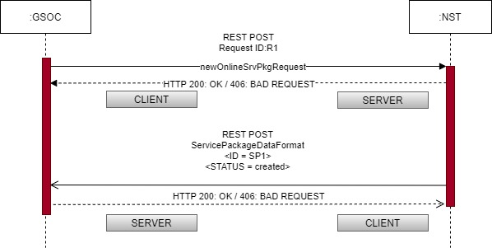
Scenario 1 - Scheduling Request issued by GSOC to NST
A customer of DLR (or the scheduling officer) introduces the request in the online GSOC scheduling system (GSSNG).
The request format is generated at GSSNG and sent via REST POST method, to NST scheduling system.
After receiving the request, NST acknowledges the request by sending a service-package-data-format to GSOC.

Slide 4
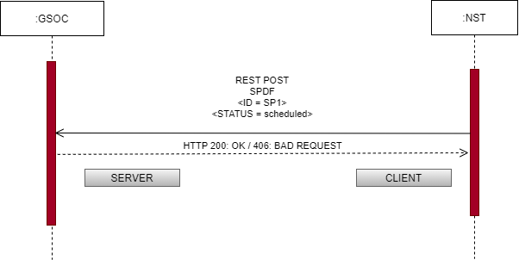
Scenario 2 - Use Case 2: Schedule Request is accepted at NST
After checking internally for available resources, NST reaches a decision on the schedule request and decides to support the requested pass.
After the decision has been taken, NST system has to notify GSOC system about the scheduling decision. It does so by sending the same Service Package in SPD Format with the updated status
(CREATED -> SCHEDULED).

Slide 5
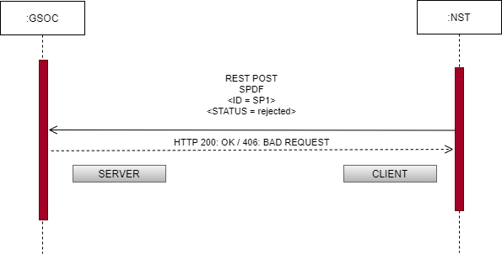
Scenario 3: Schedule Request is REJECTED at NST
After checking internally for available resources, NST reaches a decision on the schedule request and decides not to provide support for the requested pass.
After the decision has been taken, NST system has to notify GSOC system about the scheduling decision. It does so by sending the same Service Package in SPD Format with the updated status (CREATED -> REJECTED).

Slide 6
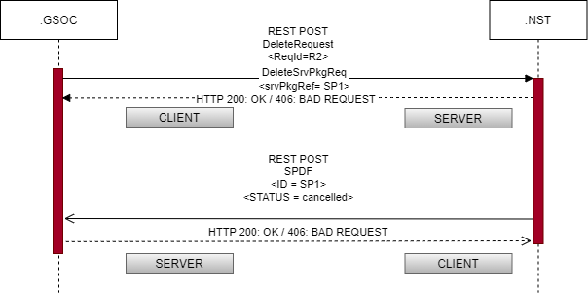
Scenario 4: Schedule Request is CANCELLED at GSOC (User side)
The DLR customer ( or the scheduling officer for them) withdraws the requested passage (for any reason). It does so by sending via REST POST a Deletion request (DeleteSrvPkgReq).
NST acknowledges the withdrawal and sends the SPDF of the cancelled Service-Package with the status updated to "cancelled".

Slide 7
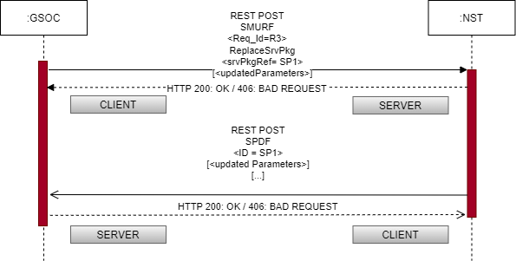
Scenario 5: Service Package is modified at GSOC (User side)
The DLR customer ( or the scheduling officer for them) changes the requested booking (for any reason). for example by changing configuration profile for the pass or the requested start/stop times. It does so by sending via REST POST an Update request (ReplaceSrvPkg).
NST acknowledges the updates and sends the SPDF of the modified Service Package including the updated parameters in the body of the xml message.

Slide 8
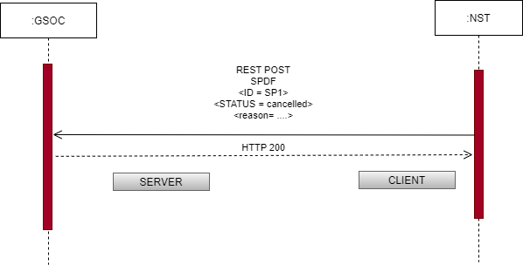
Scenario 6: Service Package is CANCELLED at NST (Provider side) after being SCHEDULED
The DLR customer ( or the scheduling officer for them) changes the requested booking (for any reason). for example by changing configuration profile for the pass or the requested start/stop times. It does so by sending via REST POST an Update request (ReplaceSrvPkg).
Neustrelitz acknowledges the updates and sends the SPDF of the modified Service Package including the updated parameters in the body of the xml message.

Slide 9
Service Packages‘ State Machine in GSSNG
In GSSNG every Service-Package follows the following State machine ( reflected on its status property):
The state ARCHIVED is applied immediately after the workflows of previous states have been completed.

Slide 10
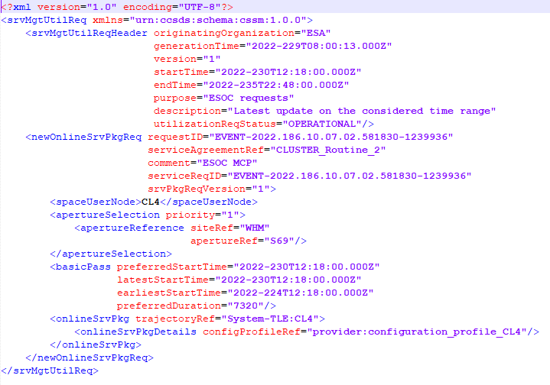
GSSNG messages examples – Service Package Request

Slide 11
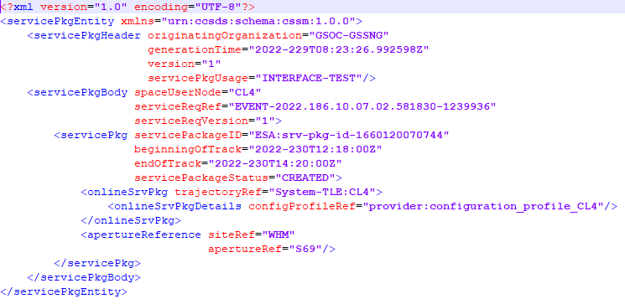
GSSNG messages examples – Service Package Data Format

Slide 12
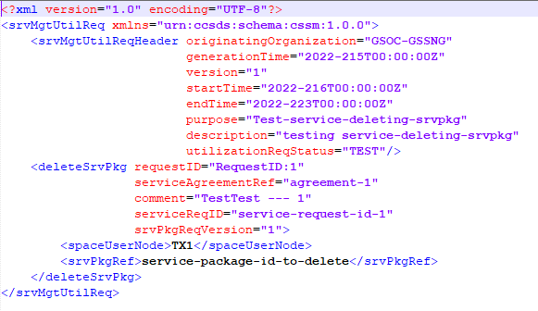
GSSNG messages examples – Delete Service Package

Slide 13
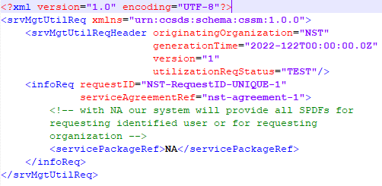
GSSNG messages examples – Info Request

Slide 14
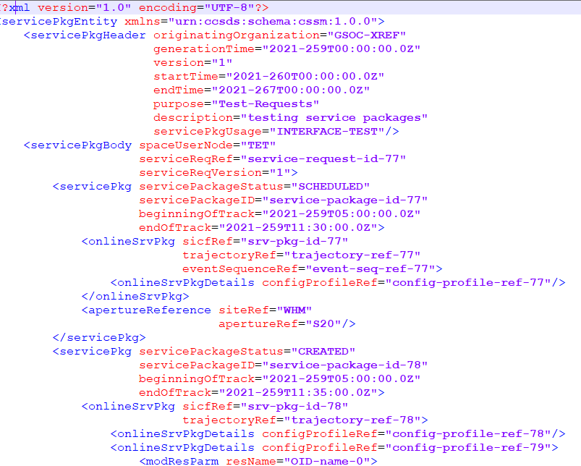
GSSNG messages examples – Info Request Result

Slide 15
Thank you for your attention! Q & A

