Slide 1
CCSDS Fall 2022 Toulouse Meetings
CSSM WG Meeting Summary
02 Nov 2022

Slide 2
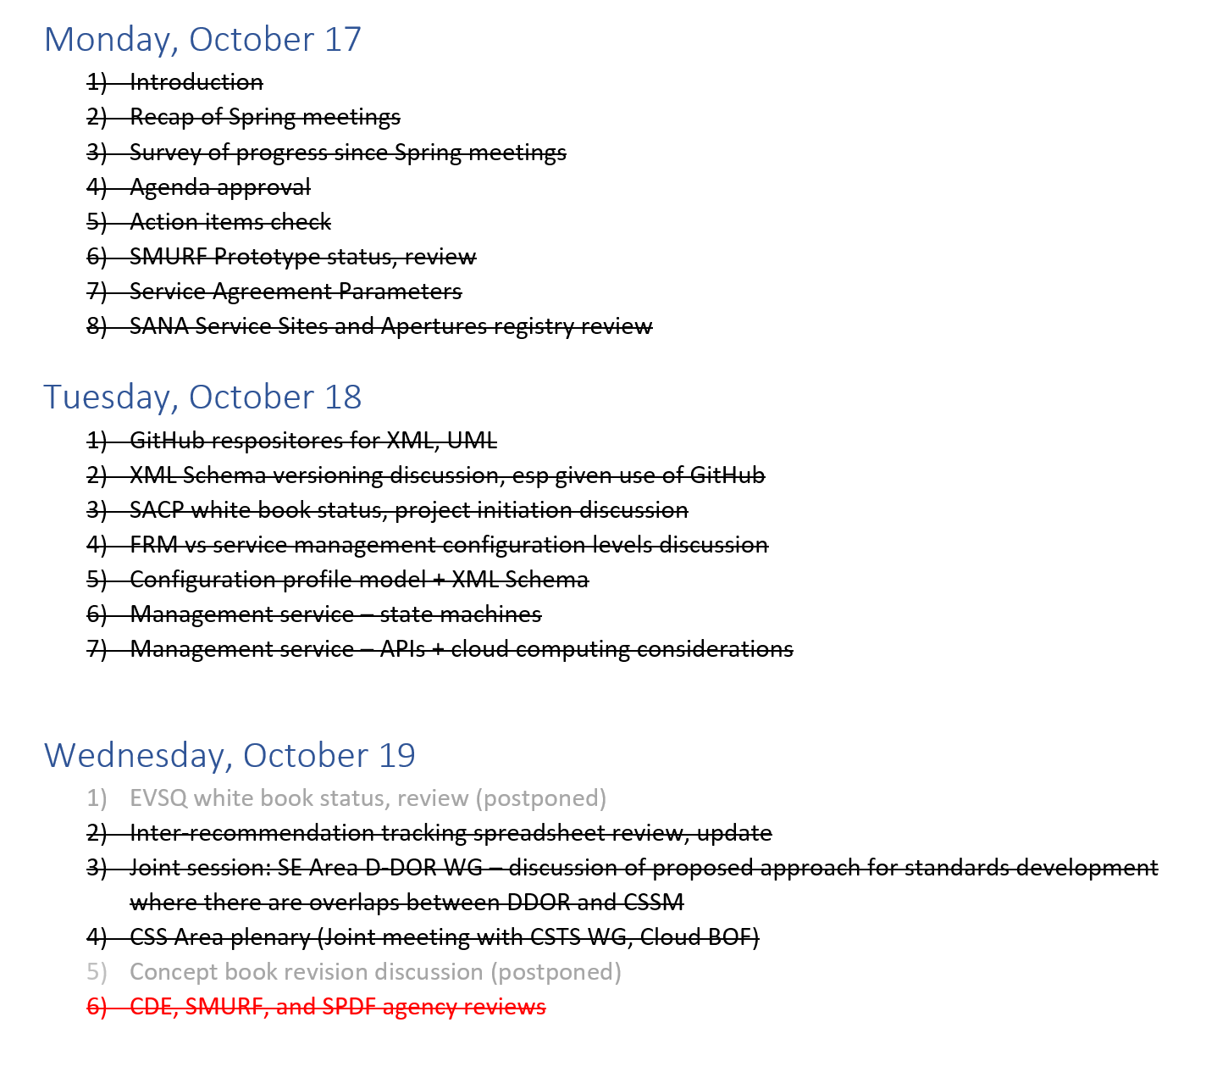
Agenda/Agenda Status for Fall Meetings

Slide 3
SMURF Prototype Status/Review (also SPDF)
SMURF prototyping between ESA and DLR is essentially complete
“modResParm” (pass specific configuration profile parameter modificiation) not yet prototyped
Most of the issues are not SMURF issues per se but related to interpretation of various parameters referenced via the SMURF
Service agreement reference – project vs spacecraft?
Aperture names can coordinates (we still have issues with SANA Service Sites and Apertures registry)
SICF identifiers – pass by pass vs “permanent” identifiers
Current operational practice tends to be with “permanent” identifiers
Trajectory reference – pass by pass vs “permanent” identier
Current operational practice tends to be with “permanent”
DLR prototype is able to generate SPDF

Slide 4
Service Sites and Apertures Registry Review
Spot checked multiple site and aperture definitions
Many service sites have the same coordinates (for western Siberia)
Frequency band information is often lacking – indicated as “other” for many apertures
Short names generally do not look like real operational names
The list of services listed for the apertures tend to be cut-and-paste of services from the IOAG service catalog
E.g, forward and return file which was always a rather fanciful service definition and does not exist at all
CNES aperture defintions for Aussaguel site are generally in good shape

Slide 5
Service Agreement Parameters
We walked through the spreadsheet designed by M. Gnat
Inputs have been provided by DLR and UKSPACE/Goonhilly
WG membership is requested/reminded to please provide inputs on the spreadsheet (cwe login required)
https://cwe.ccsds.org/css/docs/CSS-SM/CWE%20Private/Book%20Production/Blue/Service%20Agreement%20and%20Service%20Config%20Profile/White%20Book/Planning%20and%20Dev%20Materials/Service_Agreement_collection_2022-10-13.xlsx?d=wb080ab900784442c965b291713e48019

Slide 6
GitHub repositories
Looked at repositories for UML Model, XML Schema, and XML instances that have been set up in github (see https://github.com/cssAreaGH )
Added A. Crowson, M. Gnat, and E. Barkley as collaborators for the 3 repositories
Others are welcome to become collaborators as well
Requires creation of a github account if not already done
A. Crowson and M. Gnat to be added to the CCSDS CSS Area github email distribution list

Slide 7
XML Schema Versioning & GitHub
We agreed that the file naming conventions for blue book schemas will be retained
The blue book file name will be used from the start of development of particular schema
For subsequent blue-2, etc., a new repository will be established
Agreed on having a service management version
Implies a management configuration file to indicate what versions of the XML Schema files consititute which version of service management
E.g., Service Management 2.0 has SMURF Version X, SPDF Version Y, etc.
Management configuration file also to be maintained in github
Agreed on using namespace vesioning for different blue book releases
Agreed to use native xsd version attribute numbers
E. Barkley, A. Crowson, and M. Gnat agreed to an action to set up a a github “sandbox” repository to prototype the versioning approach outlined and report on how it does and/or does not work

Slide 8
SACP White Book Status/Project Initiation
Review of white book
M. Unal requests that the service agreement include a list of parameters that cannot change as part of a service request (i.e. modResParm)
Terminology such as “customParameter” needs to be make consistent with “established” terminology such as “extensibility point”
The “dependency configuration profile” (i.e., wiring diagram from the original FRM concept material) does not really seem to have a point any more
To be left in the book for the time being
Noted that SMURF indicates the mapping to the SICF (i.e., the SLE transfer services), not the configuration profile
The SMURF SICF reference is to a single file, implies that the SICF is required to have all of the SLE instances needed represented)
Noted that, if using “permanent” SICFs, that the information can be kept in the service agreement
SACP project initiation
DLR offered a preliminary commitment for prototyping
NASA/GSFC offered a preliminary commitment for prototyping
ESA offered to investigate feasibility for supporting prototyping
Action to E. Barkley to update the draft project schedule definition in the CWE

Slide 9
Management Service – State Machines
Reviewed presentation from Spring 2019 (Mountain View)
Discussion re service package request re-surfaced considerations as to standing order being too complex in a cross support environment
Some agreement in principal that request could be reduced to just a single service request
But also noted that consideration of going to another agency review (given the fairly significant change likely) was not desirable

Slide 10
Management Service -- APIs
Reviewed a presentation from E. Barbieri on internal DLR scheduling, service package states, and APIs
Shows use of ReST POST re SMURF and SPDF exchanges
Both client and server have webservers running to allow for POST exchanges
Looked at the API definitions for AWS (Amazon) Ground Station
Similarity with CCSDS SM S-1 noted
Various states are implied by the API definitions
Agreed that we start work on a management services book outline
Conceptually this consists of state machines with the APIs being the transition edges along the states (of the state machine)

Slide 11
Inter-recommendation Tracking Spreadsheet
Reviewed the inter-recommendation tracking spreadsheet, noted the following
Book model to add book abbreviations (e.g., SSF, SPDF, etc.)
Has been updated with latest referential framework diagram
Service management header is out of date – E. Barkley to update
State machine models are out of date – M. Gnat to update
Sana registry types is out of date – update needed but at a low priority
ADD terms referenced – needs to be checked – but at a very low priority
XML Schema Conventions – E. Barkley to update re “rules of engagement” in using GitHub, etc.
Behavioral considerations – a reminder that we are collecting these in the spreadsheet

Slide 12
Joint Session with DDOR WG
See presentation “221019-ProposedApproach-DOR-CSSM-Stds.pptx” for details on the proposed approach
Recognized that SE D-DOR standards need to operate where CSS CSSM standards are not implemented
Recognized that SE DOR standards need to also operate in a context where CSS CSSM standards are implemented
Conclusion of the joint session
SE D-DOR WG will continue with work on the DDOR Magenta 3 book
CSSM WG will indicate where, in the case of conflict, the CSSM information will take precedence in the case that both the DOR and CSSM standards are being used simultaneously; this includes
Configuration profile DOR tones
Spacecraft DOR tone on/off times
Ground observation sequence
CSSM WG agreed to provide sample language when available to indicate how SE D-DOR standards are being treated in CSSM standards context
CSS AD agreed to provide information to SE D-DOR WG on DOR related parameters that are being captured in the CSS Area FRM (Functional Resource Model)

Slide 13
CSS Area Plenary
Discussed the FRM and event definitions and event sequence
H. Dreihahn observed that the events at the level of the FRM offer a confirmation of the state changes in the event sequence
Discussion re FRM and configuration levels
Agreed that a level 5 definition can be added which implies configurable, in a managed service context, during tracking pass execution (SC-CSTS)
Agreed that CSSM WG will continue developing the configuration levels spreadsheet and then send to the CSTS WG for considerations re level 5 definitions

Slide 14
Agency Adoption Plans
JAXA provided a presentation on developing a generic ICD for implementation of service management
Presentation illustrates the various service management parameters and JAXA’ approach re implementation
Agreed that this needs further consideration, examination by the WG
ESA and DLR already have significant SMURF implementations
Various white book versions are supported
ESA: v0.6 and v0.9
Willing to support v0.10 if that is what JAXA wants
DLR: v0.9 and v 0.16
Both DLR and ESA have implemented the SSF
Discussed when SMURF blue book might be available
If there are no subsequent agency reviews, July 2023 is likely the earliest date
JAXA representatives indicated that they want to implement the SMURF now
NASA/NSN
Sees accountability standards as a ripe area for adoption as some of their commercial providers have nothing in place for this
W. Eddy provided a presentation on potential applicability of management service for NSN (slides cannot be released until permission is granted)
NASA/DSN
SSF implemented
Supported CPIF prototyping
Some preliminary discussions have occurred internally re adoption of SMURF and SPDF

Slide 15
AOB – Accountability Standard
W. Eddy noted that commercial providers that NSN deals with tend lack any real kind of accountability report and/or don't provide anything
Agreed to look at some existing material including
ESA ICD on accountability
NASA/DSN post pas report
A general request/action to the WG to provide relevant material for eventual accountability standard into the Service Accounting/White Book/Planning and Dev Materials directory
More specific request/action to E. Barkley, E. Barbieri, M. Unal to provide inputs for NASA/DSN, DLR, ESA/ESTRACK respectively

Slide 16
AOB – Engagement with Commercial Providers
Discussed publishing a success story
ESA and DLR significant SMRUF implementations
ESA, DLR, NASA/DSN – SSF implementation
SSC (Swedish Space Corporation) SSF implementation, supports SMURF request for SSF
Action to E. Barkley to find out what happened to CCSDS press room
Noted that as management service begins to be developed we can create a publicly viewable GitHub repository for API definitions

Slide 17
AOB – latest IOAG Service Catalog 1 draft
M. Gnat walked through the latest updates for IOAG Service Catalog 1, especially section 5 on management service
The WG had no objections to the revised section
Noted that the updated service catalog will likely be available sometime in January 2023

Slide 18
AOB – Developer’s Forum
Prototype findings, management service, and agency adoption plans led to a discussion of the different ways in which the data formats and ReST APIs are being implemented
Some sort of forum among the interested agencies could help in promoting interoperability by settling on common methodology for API/implementations
Idea is to get the lead engineers/developers to discuss during a multi-lateral technical interchange meeting different implementation considerations and techniques
This could also help to speed standards infusion
Difficulty of arranging such a face-to-face meeting was noted
An option discussed was to set aside 1 to 1.5 days at the Spring 2022 meetings (assuming they will be in-person) if a sufficient number of leading engineers can be confirmed and/or travel arranged

Slide 19
Current Book Status
CSSM Document | Document Number | Current Status
Concept Green Book | CCSDS 902.0-G-1 | Published/overdue for 5Y refresh
Simple Schedule Format Specification | CCSDS 902.1-B-1 | Published; 5Y refresh due 2023
Planning Information Formats | CCSDS 902.2-B-1 | Published
Service Package Data Formats | CCSDS 902.4-B-1 | In agency review
Service Agreement and Service Configuration | CCSDS 902.5-B-1 | Project initiation in progress
Space Link Event Sequence Data Format | CCSDS 902.6-B-1 | Pre-project draft in progress
Service Catalog | CCSDS 902.7-M-1 | Pre-project draft completed
Service Accounting | CCSDS 902.8-B-1 | Not started
Service Management Utilization Request Formats | CCSDS 902.9-B-1 | In agency review
Management Services (Automation) | CCSDS 902.10-B-1 | Intial scope identified
Best Practices | CCSDS 902.11-M-1 | Not started
Terrestrial Generic File Transfer | CCSDS 927.1-B-1 | Published
CSSA Service Management Common Data Entities | CCSDS 902.12-M-1 | Published; M2 in agency review
Abstract Event Definition | CCSDS 902.13-M-1 | Published

