Slide 1
DLR implementation status of CSS SM
CSS SM Fall Meetings 2022, Toulouse
Edoardo Barbieri, DLR/GSOC
Marcin Gnat, DLR/GSOC

Slide 2
Outline
Ground Station Scheduling Next Generation – a brief overview
SM Supported Entities and data structures in GSSNG database
SMURF implementation status

Slide 3
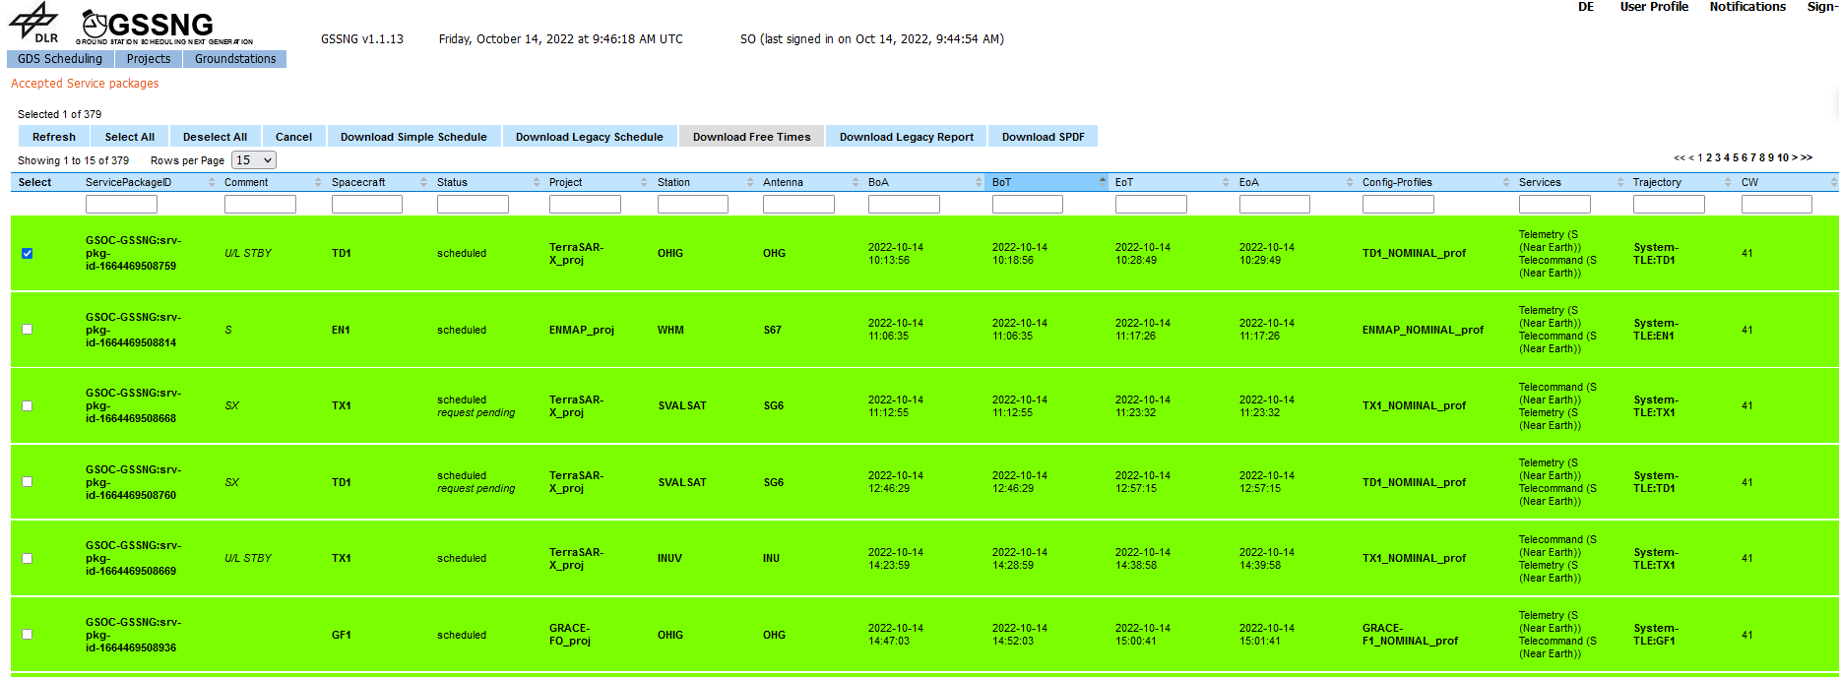
Ground Station Scheduling Next Generation
Web-Based Scheduling Software
Implements some data structures from CSS-Service Management
Scheduling revolves around the Service Package data entity

Slide 4
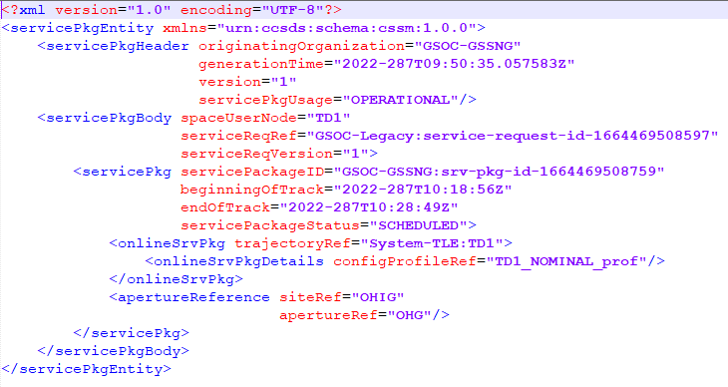
Ground Station Scheduling Next Generation
Supports SPDF

Slide 5
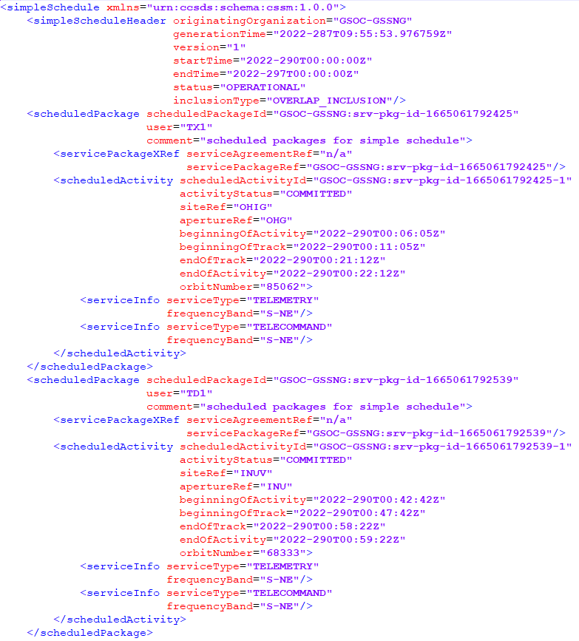
Ground Station Scheduling Next Generation
Supports Simple Schedule v9 and v16

Slide 6
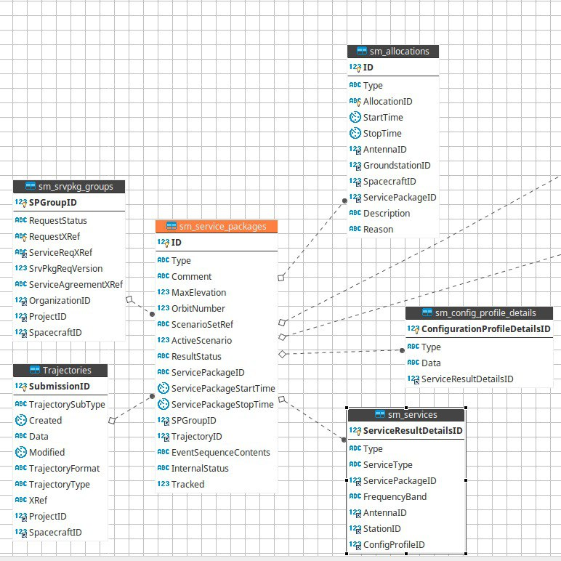
Data Entities in GSSNG Database
A few data entities from CSS-SM were chosen to be persisted in a Relational database
Mainly entities with relation to Service Package
Database Tables from CSS-SM are marked wtih „sm“

Slide 7
SMURF – Implementation Status
Priority was given to those requests necessary for the purpose of scheduling and booking resources.
Request type | Data Entities | Implementation Status | Comments
Planning Information Request
Report Request | Simple Schedule |  | Applicable to all SCHEDULED service packages in our system
 | Accounting Report |  | Waiting for CCSDS recommendation

Slide 8
SMURF – Implementation Status
Request type | Data Entities | Implementation Status | Comment
Information Request | Configuration Profile |  | Placeholder implementation
 | Event Sequence |  | May be implemented in the future
 | Service Agreement |  | Waiting for standards
 | Service Package |  | Available on demand as SPDF
 | Trajectory |  | Trajectory data is fetched from our internal FD service by requesting for norad ids
 | DDOR Scan Pattern
 | Service Instance Configuration File (SICF) |  | Implementation in SM context not in place, but file is used

Slide 9
SMURF – Implementation Status
Request type | Data Entities | Implementation Status | Comments
Service Package Request | New Online Request |  | Supported via REST or ftp
 | Replace Online Request
 | New Offiline Request
 | Replace Offline Request
 | Replace Service Package |  | Used for SPs modifications
 | Delete Service Package
 | Delete Service Package Request

Slide 10
SMURF – Implementation Status
Request type | Data Entities | Implementation Status | Comments
Submission Request | Trajectory Submission Req. |  | Supported in v16 flavour
 | Configuration Profile Submission Request |  | Supported but CPs are not persisted
 | Event Sequence Submission Request
 | DDOR Scan Pattern Submission Request
 | Service Instance Configuration File

