Slide 1
CCSDS Service Management + DDOR Standards
Proposed Approach re Coordination for Standards Development re SEA DOR and CSS CSSM WGs
29 September 2022

Slide 2
Background/Intro (1/2)
SE Area DOR WG (SEA-D-DOR) has produced and is producing standards for coordinating and processing inter-agency Differenced Doppler One-Way Ranging (DDOR) measurements
CSS Area CSSM WG (CSS-SM) has produced and is producing standards for inter-agency cross support service management including, but not limited to service package request, service package definition, event sequence, and configuration profile
Common to both these efforts is the need for specifying a scan pattern for performing a DDOR measurement
For the CSS-SM standards, for the service management messages involved, there is a commonly defined service management header
The CSS-SM service management header as well as the service package request, configuration profile, and event sequence overlap some of the information found in the SEA-D-DOR definition for the scan pattern
The overlapping set of concerns have to do with
Spacecraft DDOR Tones in SEA-D-DOR, Configuration Profile in CSS-SM
Spacecraft DOR Tones on/off time in SEA-D-DOR, Event Sequence in CSS-SM
Ground Observation definition/scan pattern in SEA-D-DOR, Service Request and Service Package in CSS-SM
This is not surprising as SEA-D-DOR standards need to operate in an environment (such as we currently have) where standardized CSS-SM service management is only partially adopted and still in development
At the same time, it would be good for agencies that do adopt the CSS-SM standards to be able to incorporate SEA-D-DOR such that there are a consistent set of standards that address both service management and DDOR

Slide 3
Background/Intro (2/2)
J. Border, when he was chair of the SEA-D-DOR , did some work with the CSS-SM and jointly we developed a scan pattern definition that more-or-less works
At least from the CSS-SM perspective
Following is
Reference information re CSSM program of work
Current 506.0-M-2 DDOR Ground Observation Sequence definition
XML DDOR Scan Pattern definition developed jointly with Jim Border
Proposed approach for development and coordination

Slide 4
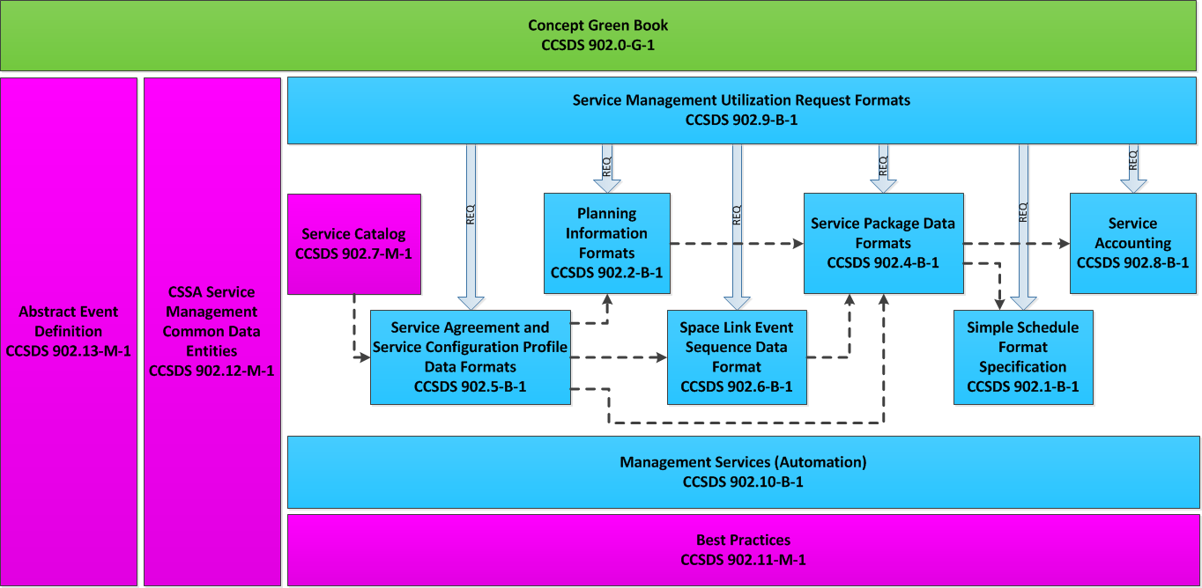
CSSM Program of Work Overview

Slide 5
506.0-M-2 DDOR Grnd Obs Seq w CSSM Cmts (1/4)
In CSSM context, this is all addressed via a common service management header
SMURF (Service Management Utilization Request Format) 902.9 is where service request is defined
Including DDOR scan pattern

Slide 6
506.0-M-2 DDOR Grnd Obs Seq w CSSM Cmts (2/4)
Spacecraft DOR Tones (ddorConfigProfileId) will be part of the configuration profile definition
But quasar flux, etc. will not be part of the CSSM configuration profile definition
DorOn/DorOff times addressed by Event Sequence Book – 902.6
Multi-spacecraft scan patterns do not currently fit will within CSSM – more work required

Slide 7
506.0-M-2 DDOR Grnd Obs Seq w CSSM Cmts (3/4)
Don’t anticipate CSSM will address Quasar Table
CSSM plans to include this kind of info either in SMURF Book (902.9) for request and SPDF Book (902.4) for execution

Slide 8
506.0-M-2 DDOR Grnd Obs Seq w CSSM Cmts (4/4)
Similar to previous slide this will be included with SMURF and SPDF books
Good work has been done on this, working with previous DDOR WG Chair (Jim Border)
Following Slides show this work

Slide 9
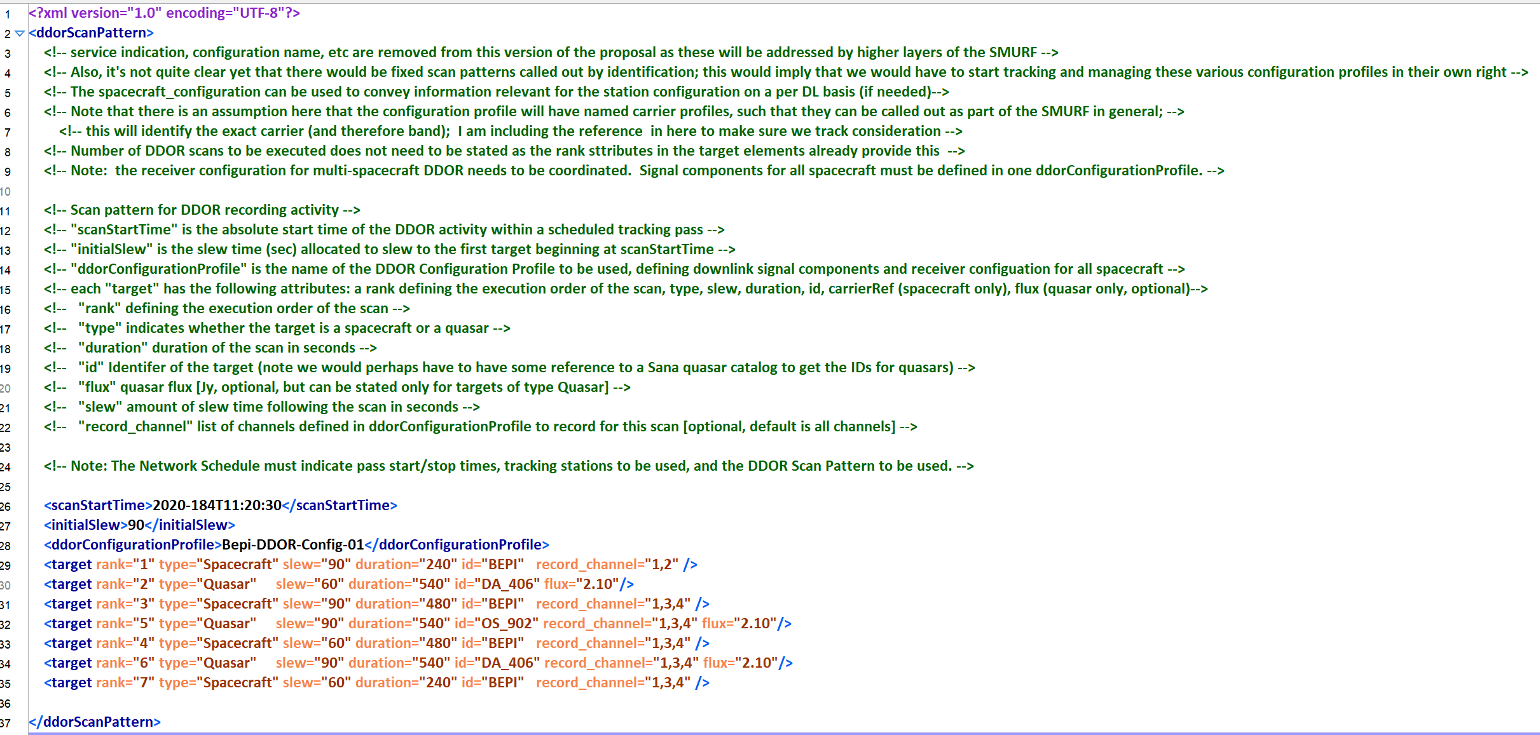
SEA-D-DOR WG Scan Pattern Definition (Taken from 506X0P3_18nov2020 – XML Text)

Slide 10
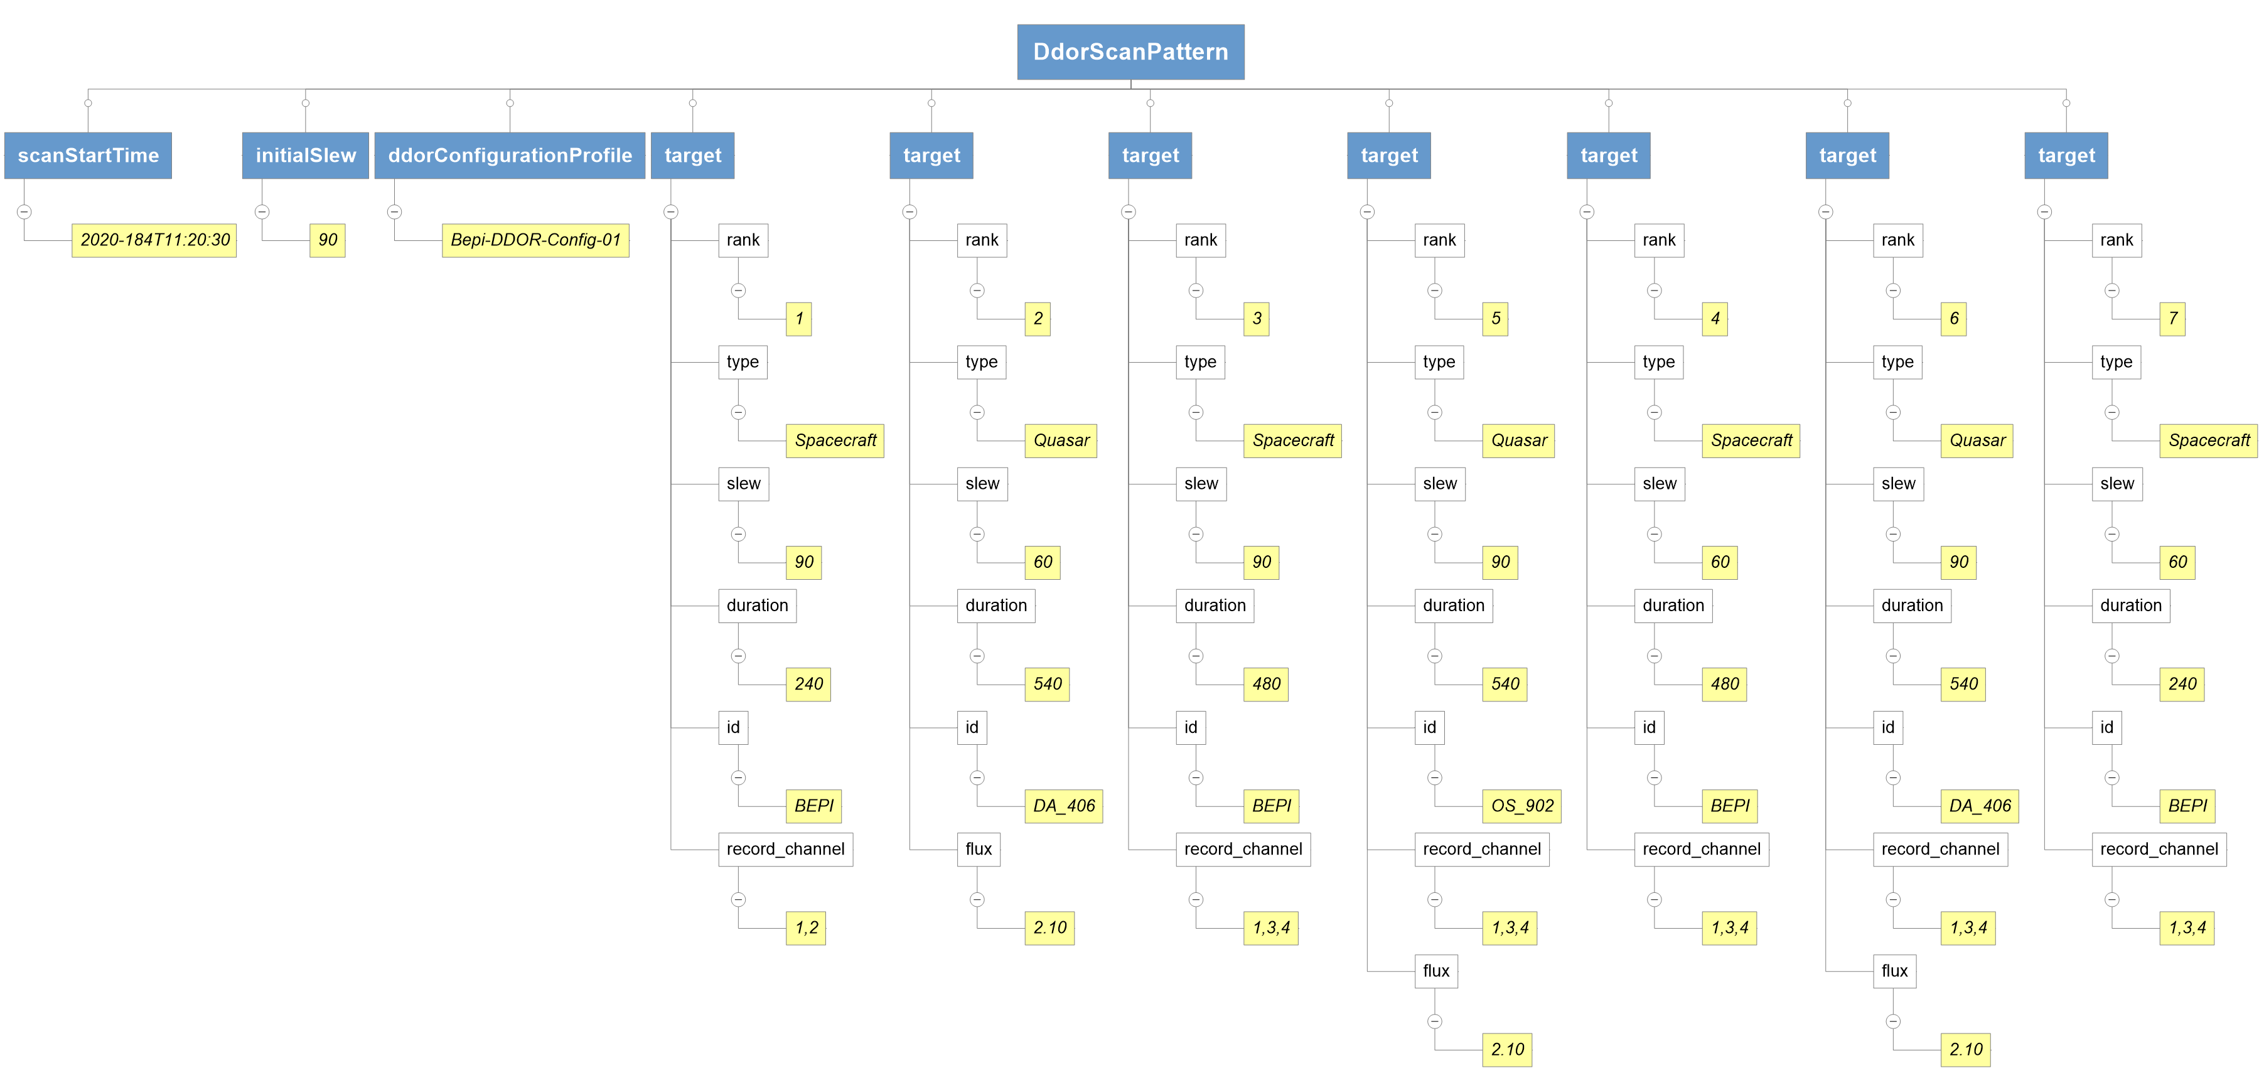
SEA-D-DOR WG Scan Pattern Definition (Taken from 506X0P3_18nov2020 – Graphical Version)

Slide 11
CSS-SM Envisioned Process and DDOR Fit
General process envisioned and mapping from DDOR considerations in a standardized service management context (process is notional, not exact)
DOR Tone definitions can fit in here
DOR Tones On/Off can fit in here
Scan Pattern can be attached here

Slide 12
Proposed approach, from CSS-SM WG perspective
Spacecraft DOR Tone Definitions:
The CSS Area in general has developed the Functional Resource Model (FRM) – a standardized model of all the functions, in the abstract, that a ground station needs to provide along with configuration, monitoring and control parameters (for each function)
This leads to standardized monitor data item definitions as well as standardized configuration parameter definitions
Proposed approach is to
include the DOR Tone definitions in the FRM, which means it will, in turn, be part of the CSS-SM defined configuration profile (i.e., CCSDS 902.5, in development)
Request the SEA-D-DOR WG to review the DOR Tone definitions in the FRM
Spacecraft DOR Tone On/Off Times:
The CSS Area has a draft of recommendation for sequencing of space link services in progress (CCSDS 902.6)
As this addresses the entire set of space link service sequencing (e.g., command (uplink), telemetry (downlink) modulation, ranging tone modulation (uplink and downlink), DDOR tones (downlink)), it is proposed that information in the event sequence would ultimately take precedence over DOR tone on/off times defined in information conveyed outside the context of service management, when/where service management is implemented
Ground observation, Scan Pattern:
In general, CSSM WG prefers that DDOR WG develop the definitions needed for DDOR
But can this be done in XML ?
Seem to have a good start with work done with Jim Border
In general: understood that DDOR standards have to be useable where standardized service management does not exists or its implementation is not sufficiently complete
But also foresee that CSSM WG standards will be adopted and therefore CSSM WG proposes to take the approach of indicating what parts of DDOR standards might be ignored or “overridden” in a CSSM context
E.g., if the CSSM event sequence indicates spacecraft DDOR tones on at time A, propose to indicate that a scan pattern definition indicating time other than time A will be ignored
This would be done via adding NOTEs in the CSSM recommendations as appropriate
The NOTEs will be collected and distributed to the DDOR WG for consideration/review

Slide 13
Comments, Questions, Discussion
?

