Slide 1
Configuration Profiles And Space Link Service Profiles – Recommendations for OID, Classifier, and FRIN Usage
22 May 2018
John Pietras
Global Science and Technology, Inc.

Slide 2
Recommendation: Use Classifiers instead of OIDs in Service Management Information Entities
OIDs were introduced in CSTSes for the purpose of identifying functional resource types and the parameters, events, and directives of those FR types
However, every FR type, parameter, event, and directive has a text classifier that is formally defined to be the equivalent of each OID
Although SM info entities must be able to reference individual FR instances, parameters, event, and directives, it is not necessary for SM info entities to carry the OIDs themselves: the corresponding classifiers can be used in naming
The only requirement is that the systems that exchange SM info entities be able to translate between classifiers and OIDs (i.e., “under the covers”)
SANA Registry makes this authoritative and unambiguous
Recommendation is the SM info entities use only classifiers and not OIDs
Reduces info entity complexity
Approach is already being used in the current draft of the Config Profile Tech Note
The only other in-progress SM product affected would be the SMURF Service Package Request OIDParameter class (suggest it be renamed RespecifiedParameter, since that’s it purpose anyway)

Slide 3
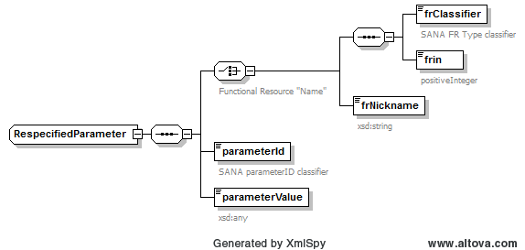
Proposed RespecifiedParameter Type for SMURF (XML Schema)

Slide 4
Corollary: OIDs are Absolutely Needed Only for Parameters that Must be Accessible by CSTSes
We do not need to define/register OIDs for parameters that aren’taccessible by CSTSes
The new SM configuration profile parameters would only need to have OIDs if they are to be read and/or reconfigured via MD-CSTS and/or SC-CSTS (for example)
frin
Configurable (configuration profile) and re-specifiable (Service Package Request, e.g., to make a FR instance an alias of an FR instance in another configuration profile), but not real-time reconfigurable: no access by SC-CSTS
No benefit to querying the frin via MD-CSTS, since the MD-CSTS user would need the FRIN to address the FR instance that contains the frin parameter
frNickname
Configurable (configuration profile) and re-specifiable (Service Package Request, e.g., to make a FR instance an alias of an FR instance in another configuration profile), but not real-time reconfigurable: no access by SC-CSTS
Would any user need to query the frNickname during Service Package execution? If so, it whould get an OID
<required interface>ProviderFrNames
Configurable (configuration profile) and re-specifiable (Service Package Request, e.g., to link to an FR in another configuration profile), but not real-time reconfigurable: no access by SC-CSTS
Would any user need to query these parameters during Service Package execution? If so, the would get OIDs

Slide 5
Recommendation: Define FRIN Subranges Based on FR Type OIDs
FRINs must be unique with the Configuration Profiles that are referenced by and Service Package Request/Service Package Result (and Event Sequence)
Mission engineers may be confused by open-ended options for assigning FRINs
Recommendations:
Create subranges of FRINs for each FR Type
Use the relative distinguished node number of the FR Type OID as the basis of the subranges: multiple the node number by 100 to provide a subrange [nodeNumber*100 : nodeNumber*100+99]
E.g., the FR Type OID for the Antenna FR is .1.3.112.4.4.2.1.1, where the final “1” is the node number, so the range for AntennaFr FRINs would be [100:199]

Slide 6
Recommended Practice: Link FRINs and frNicknames
Missions should use the same (frin:frNickame) pair for the same functional resource instance across all configuration profiles
E.g., for a Mission that has both an X-Band and an S-Band transmitter, and multiple return link configuration profiles for each:
Use the same (frin:frNickame) pair for the Return 401 Space Link Carrier Reception FR instance in all X-Band return link configuration profiles (e.g., (2101, “X-BandReturnCarrier”)
Use the same (frin:frNickame) pair for the Return 401 Space Link Carrier Reception FR instance in all S-Band return link configuration profiles (e.g., (2102, “S-BandReturnCarrier”)
Allows Mission SW (and operators) to always equate the same FRIN and nickname with the same physical function

