Slide 1
AI 2018-0411-15
ScenarioID exercise
SMURF vs SPF
CSS SM Teleconference,
Marcin Gnat, DLR/GSOC

Slide 2
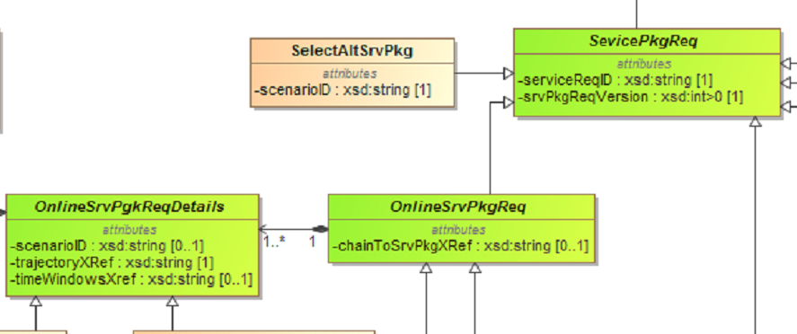
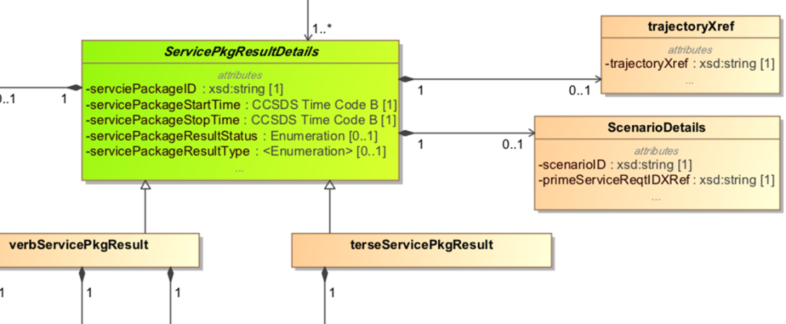
Introduction
Aim of the exercise is to check how the current implementation of scenarios (withing SMURF and SPF through usage of scenarioID) is performing
SPF
SMURF

Slide 3
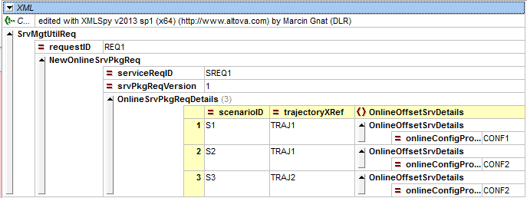
New Request
SMURF
?
SPF
The SMURF allows requesting multiple scenarios within one request
The SPF can convey in response mutliple service packages with unique identification (however full identification is possible only with servicePackageID and primeServiceReqIDXref)
The way of showing the active scenario is not 100% intuitive (through servicePackageResultType, where everything which is not-“alternate“ is the active scenario -> needs „exclusive rights“ for not-alternate)
There is no way to explicitely mark initial scenario, without a need to issue SelectAlternativeScenario (except the first defined scenario in a request is per default the „active“ one).

Slide 4
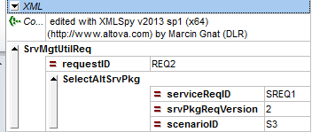
Select alternative scenario
SMURF
SPF

Slide 5
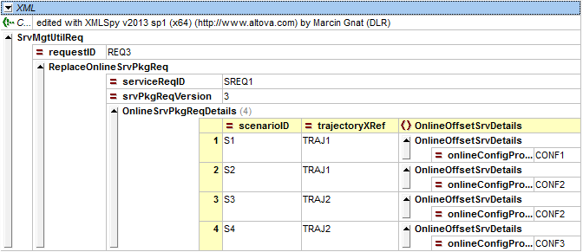
Add additional scenario
SMURF
SPF
NOTE:
The servicePackageID‘s changed!
The the „active“ selection is being resetted to the very first one!

Slide 6
Summary
The SMURF allows requesting multiple scenarios within one request
The SPF can convey in response mutliple service packages with unique identification
The scenario identification is only possible by different combinations of
serviceReqID and scenarioID (SMURF)
servicePackageID and serviceReqID (SPF), scenarioID plays secodary role
There is no possibility to explicitely define default active scenario when requesting, unless we assume silently, that the very first defined scenario is automatically the active one. This has however a drawback when issuing Replace request (see previous page)
The status of „active“ scenario being kept in ServicePackageResultType requires, that there is only one SP allowed in a „scenario-group“ which has a Type of „new“ or „update“ or „flexibility change“, whereas all other need to be „alternate“.
Side issue: there is no way to differentiate between new, update or flexibility change for alternate/non-active scenarios…

