Slide 1
Configuration Profiles And Space Link Service Profiles
CCSDS Spring 2018 Workshop
NIST
Gaithersburg, MD
9-13 April 2018
John Pietras
Global Science and Technology, Inc.

Slide 2
Outline
Material based on Requirements for Simple Configuration Profiles and Service Agreements CSSA Tech Note version 1.1
Space Link Service Profiles, Configuration Profiles, and the relationships within and among them
Example Space Link Service Profiles
  Forward CLTU Space Link Service Profile
  Return Online Real-Time Communications Space Link Service Profile
Examples of Configuration Profiles that combine the example Space Link Service Profiles in different ways to get different features
Examples of Service Packages that use the Configuration Profiles in different combinations
Questions/issues

Slide 3
Space Link Service Profiles, Configuration Profiles, and the Relationships Within and Among Them
Space Link Service Profiles
  The templates (schemas) for the “cookie cutter” building blocks of Configuration Profiles
  Space Link Service Profiles do not exist on their own – they are only instantiated within Configuration Profiles
  Comprised of instances of Functional Resources
  Mappable to the “services” as defined and used in the Simple Schedule (APA-AZ/EL, TELEMETRY, RANGING, etc.)
  More than one instance of a Space Link Service Profile type may exist in the same Configuration Profile, as long as they are in different frequency bands
Configuration Profiles
  Each Configuration Profile is comprised of one or more Space Link Service Profiles
  Service Package Requests and Service Package Results reference one or more Configuration Profiles

Slide 4
Configuration Profile Building Blocks (“Cookie Cutters”)
Space Link Service Profiles
Single-service configuration profiles
  One for each Space Link Service Profile
Configuration Profile “container” class for Mission-defined multi-service configuration profiles
These will be normatively defined in the Service Agreement/Configuration Profile Blue Book

Slide 5
Service Profiles (1 of 2)
Space Link Service Profiles exist only for Space Link Service (SLS) configurations as described in the Functional Resource Reference Model Tech Note
  Retrieval (return) and Forward Offline Data Delivery configurations do not involve active space links and most of them are therefore not scheduled and so are not the subject of Configuration Profiles
    They are, however, subject to Service Agreement-level specifications, e.g., how much capacity is allocated to the Mission’s in-tray for each instance of the Terrestrial File Service Provider
    Issue – if return offline services are not scheduled, what is the purpose of the OFFLINE-TM-PROVISION Service Type in the Simple Schedule
15 (or only 12?*) baseline Space Link Service Profiles
  7 Forward Communication Space Link Service Profiles
  5 (or only 2?*) Return Communication Space Link Service Profiles
  3 Radiometric Space Link Service Profiles
  Names of the 15 current services are listed in the Backup section
The Tech Note will provide proof-of-concept XML schemas for a subset of the Space Link Service Profiles
  The SA/CP Blue Book will define the normative XML schema for each Space Link Service Profile

Slide 6
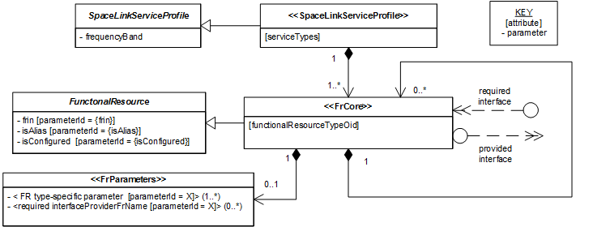
Service Profiles (2 of 2)
Space Link Service Profile metamodel

Slide 7
Configuration Profiles (1 of 3)
A Configuration Profile contains one or more instances of the SpaceLinkServiceProfile abstract class
  Each Space Link Service Profile class is a specialization of SpaceLinkServiceProfile
The Tech Note will provide proof-of-concept XML schemas for a subset of the single-service Configuration Profiles
  The SA/CP Blue Book will define the normative XML schema for the single-service Configuration Profile schema for each baseline Space Link Service Profile
  Missions can use these single-service schemas to generate single-service Configuration Profiles with minimum tailoring

Slide 8
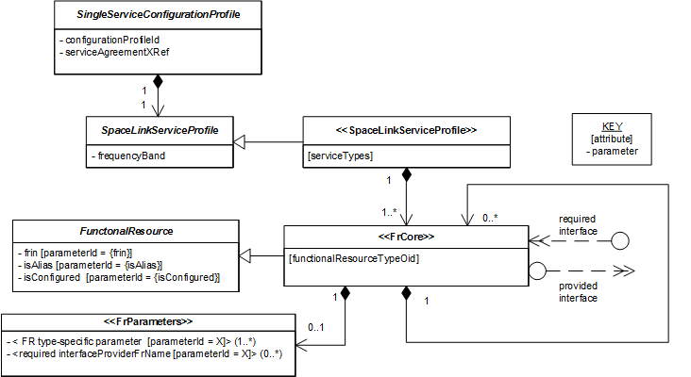
Configuration Profiles (2 of 3)
Single Space Link Service Configuration Profile Template Metamodel

Slide 9
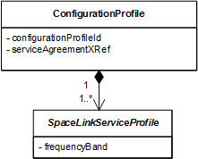
Configuration Profiles (3 of 3)
Multiple-service Space Link Service Configuration Profile Class

Slide 10
Representation of Relationships (1 of 2)
Functional Resource Alias
  Represented in UML/XML as a subclass/derived type that contains no parameters and has the Functional Resource Name of a FR instance for which a fully-populated instance exists, either:
    Within the same Configuration Profile (can be validated when the Configuration Profile is validated)
    Within a Configuration Profile that is referenced by the Service Package Request that references the Configuration Profile that contains the alias (can only be validated as part of the validation of the individual Service Package Request)
Primary Relationships (primary data flows within Space Link Service Profiles)
  Examples: an Antenna FR instance provides a modulated waveform access point to a Forward 401 Space Link Carrier Transmission FR instance, a Forward 401 Space Link Carrier Transmission FR instance provides a forward physical channel symbol stream access point to a Forward TC Sync and Channel Encoding FR instance, etc.
  Expressed in UML as composition
  SAP Accessor
  Expressed in XML as containment in complex elements

Slide 11
Representation of Relationships (2 of 2)
Ancillary Relationships (provide supporting information between Space Link Service Profiles)
  7 ancillary relationship types exist in the baseline set of Space Link Service Profiles
    Transmit Frequency
    CLCW
    Pointing Angles
    Ranging Timing Signaling
    Receive Frequency
    Range and Doppler
    CFDP-PDU
  Represented in UML as provided/required interfaces
  Represented in XML as ProviderFrName parameters in FRs with required interfaces that point to the FRs with the peer provider interfaces
provided interface required interface

Slide 12
Example Space Link Service Profiles, Single-Service Configuration Profiles and Service Packages that Use Single Service Profiles
2 example Space Link Service Profiles are fleshed out for further proof-of-concept (UML Class Diagram)
  Forward CLTU
  Return Online Real-Time Communication
  (Draft) configuration parameters adopted from SANA Functional Resource registry
    All configuration parameters are included in the Configuration Profile FRs, even though some may actually be set by the Service Agreement
A single-service Configuration Profile for each of the 2 Space Link Service Profiles (UML class diagrams)
An instance of each of the 2 single-service Configuration Profiles
An example Service Package that uses two separate single-service Configuration Profiles
An example Service Package that uses only a single-service Forward CLTU Space Link Service Configuration Profile
An example Service Package that uses only a single-service Return Online Real Time Communication Space Link Service Configuration Profile

Slide 13
Example Multi-Service Configuration Profile and Service Packages that Use It
Example Service Packages using a combined Forward CLTU Space Link Service and Return Online Real Time Communication Space Link Service Configuration Profile
  Both Forward and Return Service Package
  Forward-link-only Service Package
  Return-link-only Service Package

Slide 14
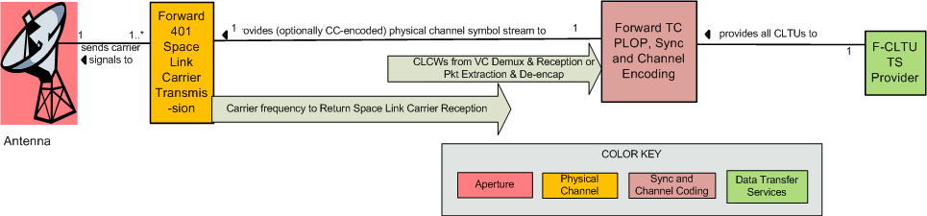
Forward CLTU Space Link Service Profile (Informal Representation)

Slide 15
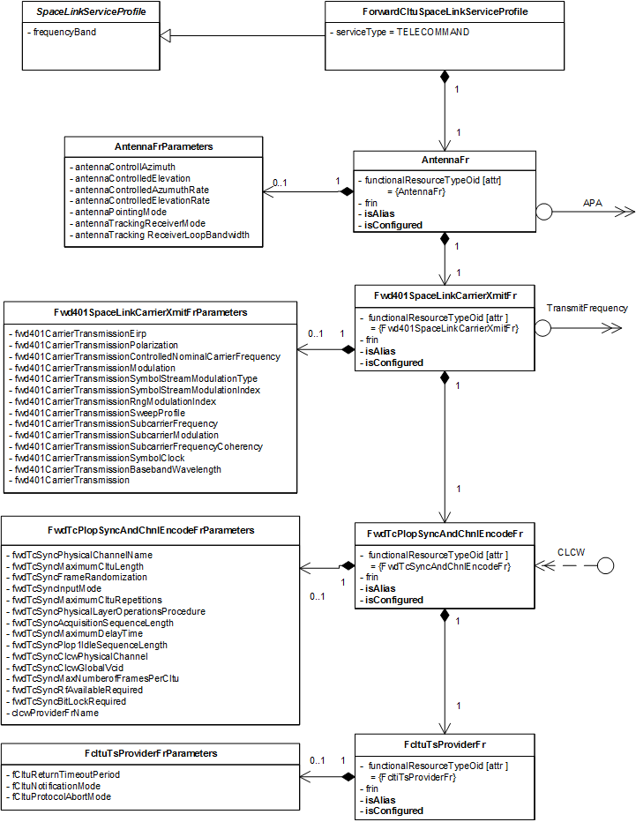
Forward CLTU Space Link Service Profile Template UML Class Diagram
If isAlias = false, AntennaParameters must be
present, populated, and are used in a
configuration profile
If isAlias = true, AntennaParameters is ignored
and any Service Package that uses this service
profile MUST also contain a service profile with
a fully-populated Antenna FR with the same
FRIN

Slide 16
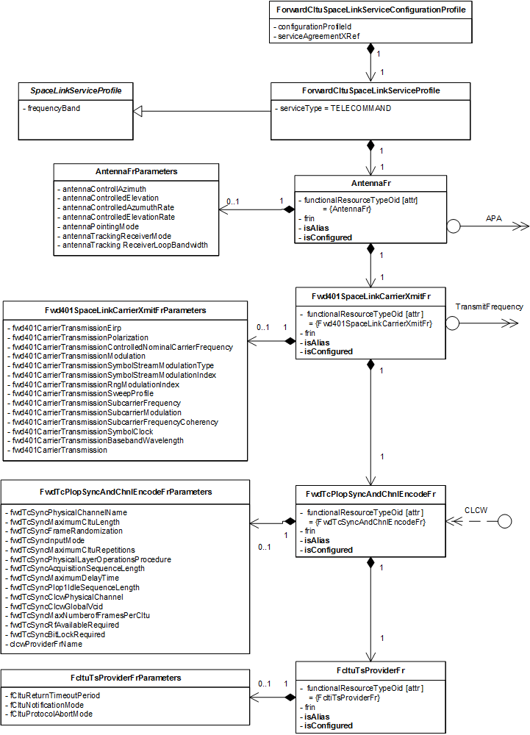
  Forward CLTU Space Link Service Single-Service Configuration Profile Template UML Class Diagram

Slide 17
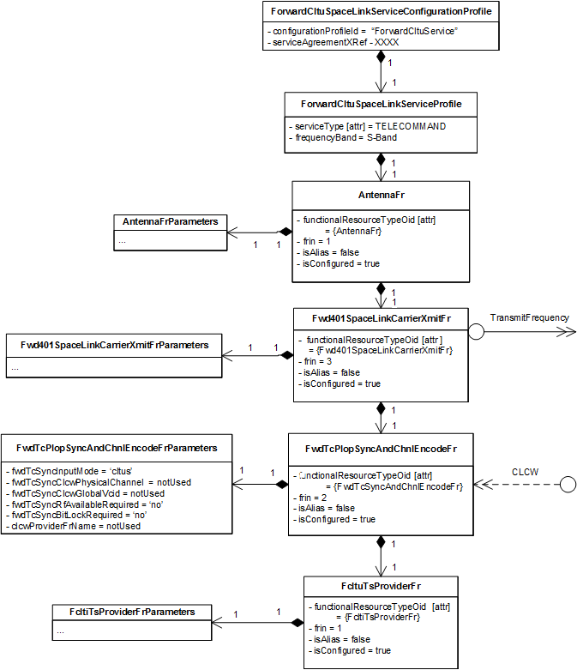
  Forward CLTU Space Link Service Single-Service
  Configuration Profile Example (Instantiated Objects)
All isConfigured parameters are set to true
  All FRs will be included in a scheduled Service Package unless respecified out
All isAlias parameters are set to false
  All FR Parameters objects are included and fully populated, and will be used in a scheduled Service Package unless respecified out by setting isAlias to true
Parameters related to the optional CLCW required interface are set to notUsed
  They must be respecified in a Service Package if CLCWs are to be used

Slide 18
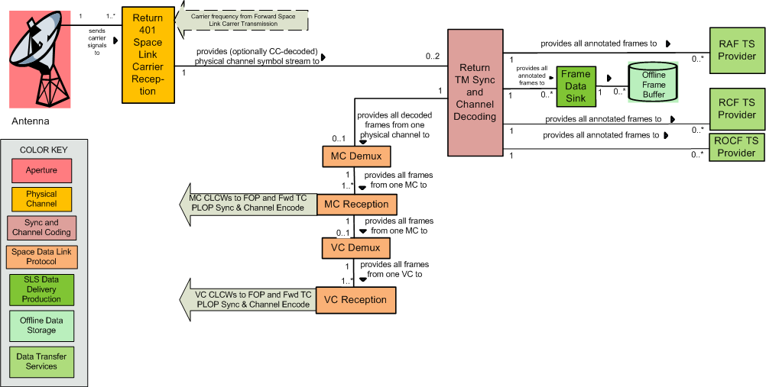
Return Online Real-Time Communication Space Link Service Profile (Informal Representation)

Slide 19
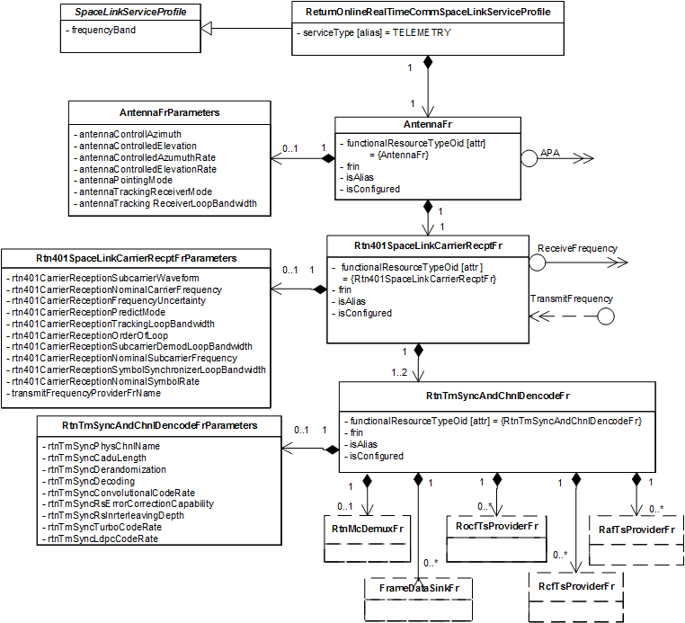
Return Online Real-Time Communication Space Link Service Profile Template UML Class Diagram (1 of 3)

Slide 20
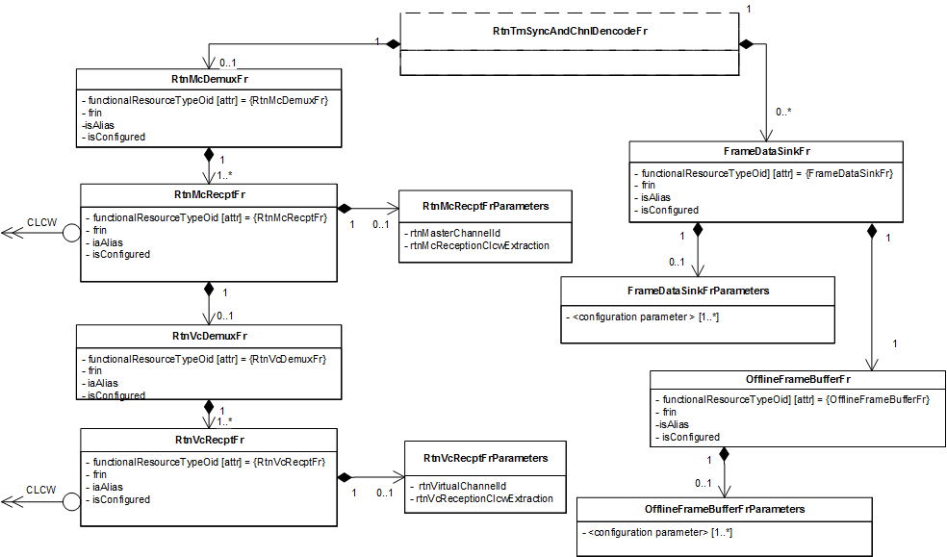
Return Online Real-Time Communication Space Link Service Profile Template UML Class Diagram (2 of 3)

Slide 21
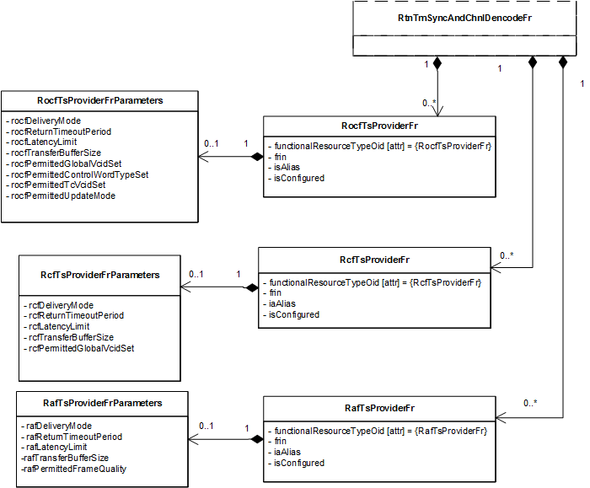
Return Online Real-Time Communication Space Link Service Profile Template UML Class Diagram (3 of 3)

Slide 22
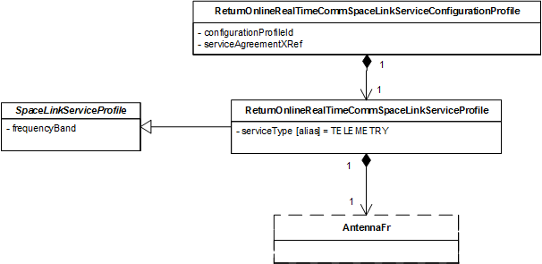
Return Online Real-Time Communication Space Link Service Single-Service Configuration Profile Template UML Class Diagram (partial)
Return Online Real-Time Communication Space Link Service Profile Template UML Class Diagram (3 of 3)

Slide 23
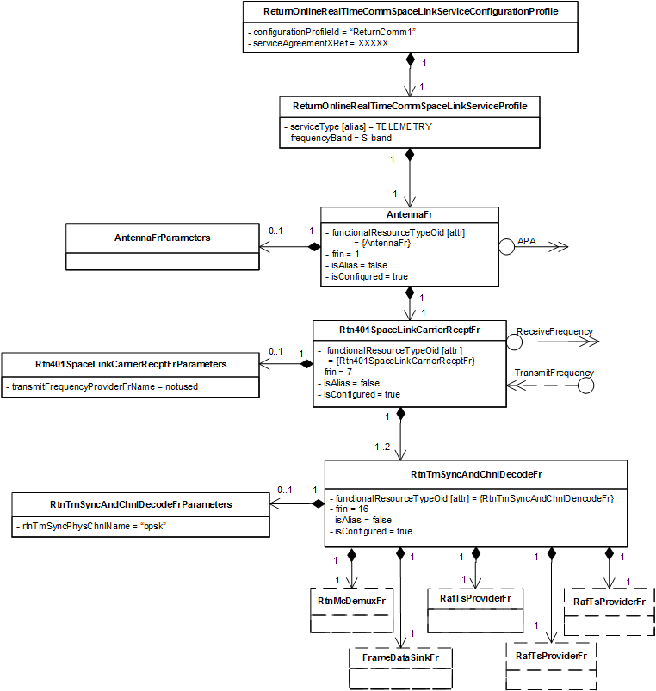
Return Online Real-Time Communication Space Link Service Single-Service Configuration Profile Example (1 of 3)

Slide 24
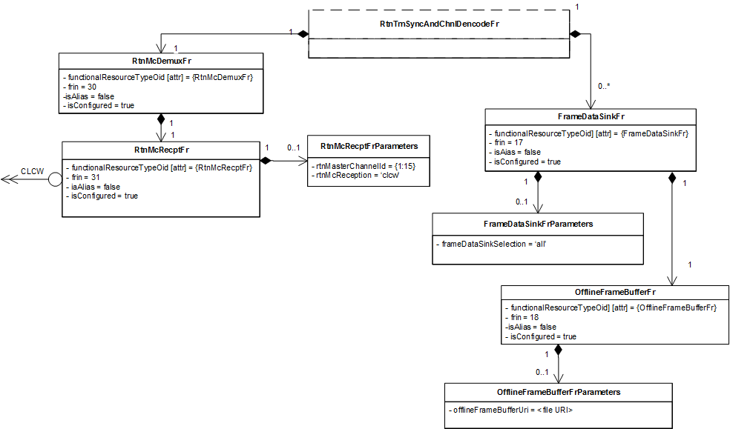
Return Online Real-Time Communication Space Link Service Single-Service Configuration Profile Example (2 of 3)

Slide 25
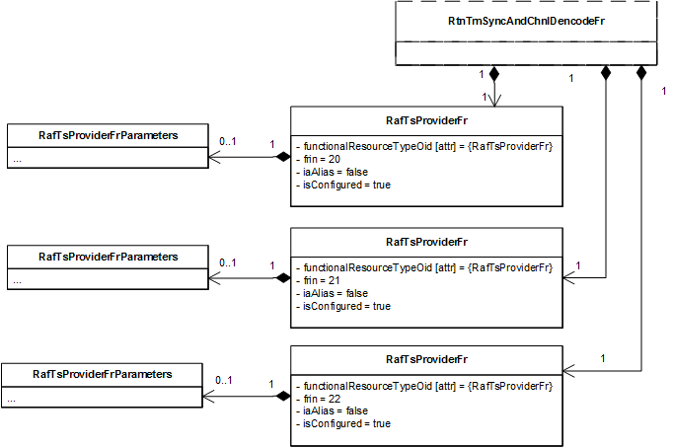
Return Online Real-Time Communication Space Link Service Single-Service Configuration Profile Example (3 of 3)

Slide 26
Example Service Package Using Forward CLTU Service and Return Comm 1 ConfigProfiles
Service Package contains (references) the Forward CLTU and Return Comm 1configuration profiles
  Forward CLTU Service starts 2 minutes after beginning of Service Package, ends 10 minutes before end of Service Package
  Return Online Real Time Communication service starts and ends concurrently with the Service Package
Respecifications in the Service Package:
  Link Forward TC PLOP Sync and Channel Encoding FR to Return VC Reception FR that supplies CLCWs for GVCID {1:15:3}
  Set Link Forward TC PLOP Sync and Channel Encoding FR to use RF Available and Bit Lock flags in CLCWs
  Make the return link Antenna an alias of the forward link Antenna to share the single aperture
  Link the Return 401 Space Link Carrier FR to the Forward 401 Space Link Carrier FR as the provider of the Transmit Frequency to which the return link is to be made coherent
    Also (not shown) reconfigure any other parameter of the Return 401 Space Link Carrier FR to make it coherent
  Set RAF TS Provider Instance isConfigured to false so that it is not scheduled

Slide 27
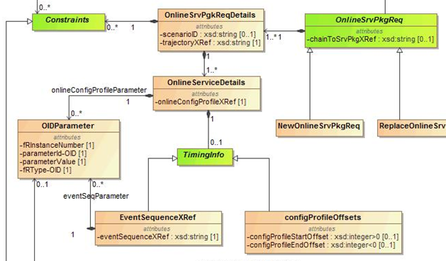
SMURF – Online Service Package Request Details

Slide 28
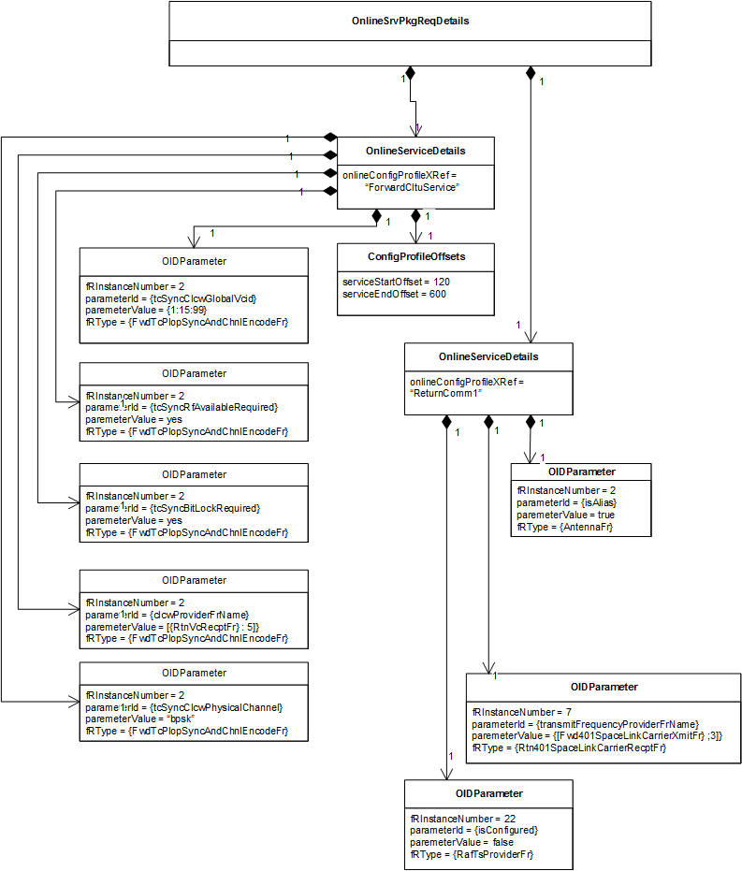
Example Service Package Using the Forward CLTU Service and Return Comm 1 Config Profiles (1 of 2)
Respecifications are used to link the forward and return profiles

Slide 29
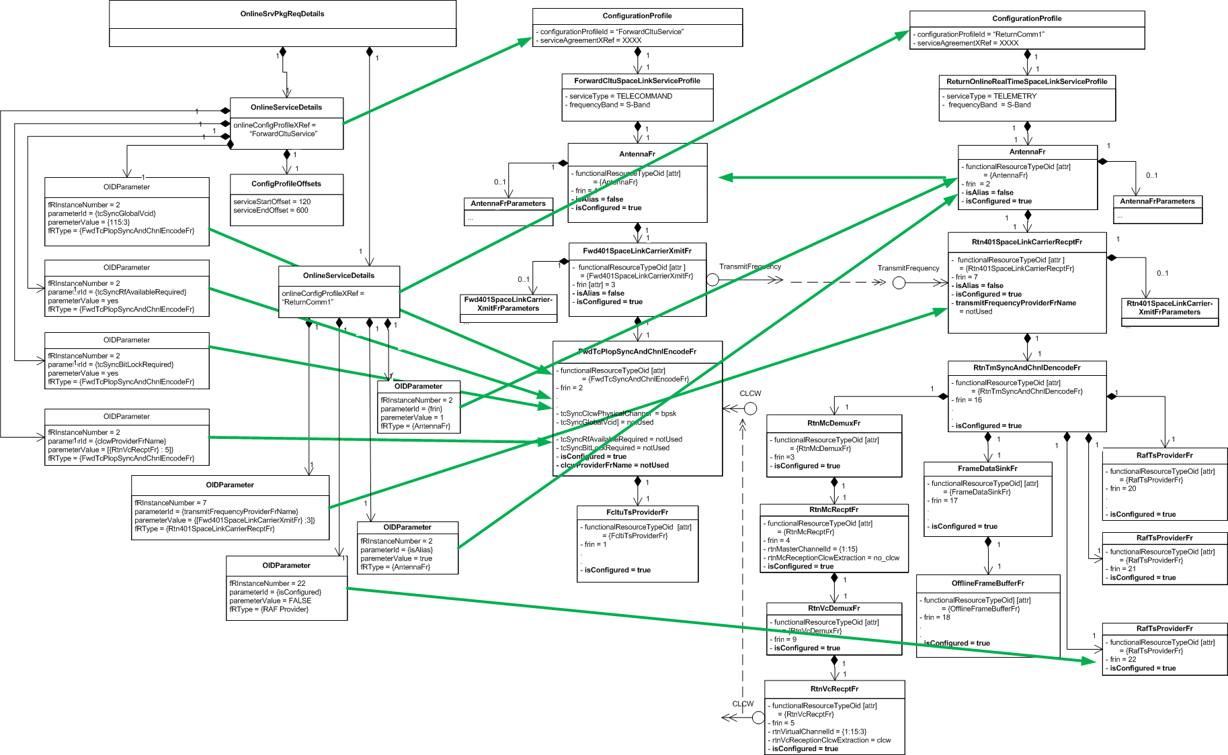
Example Service Package Using the Forward CLTU Service and Return Comm 1 Config Profiles (2 of 2)

Slide 30
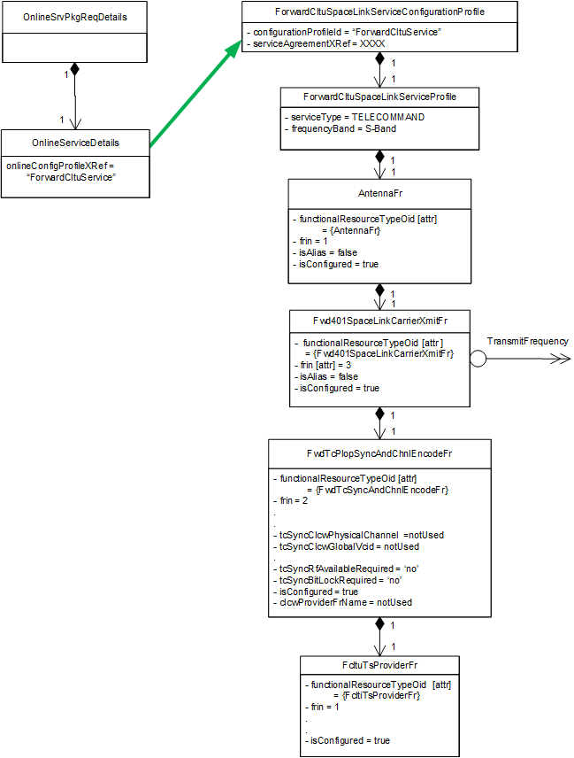
Example Service Package Using Only the Forward CLTU Service

Slide 31
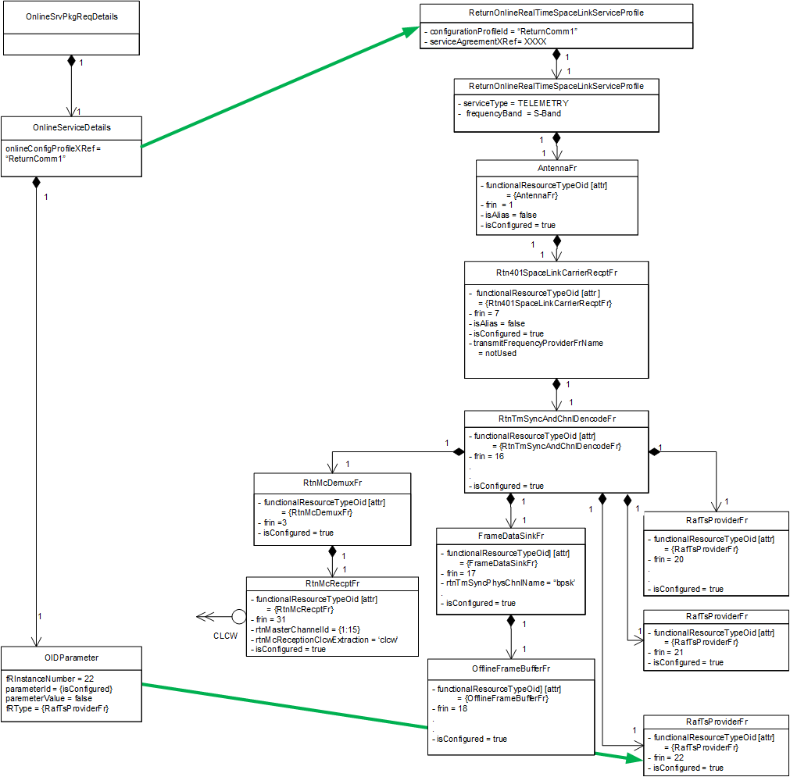
Example Service Package Using Only the Return Comm 1 Config Profile

Slide 32
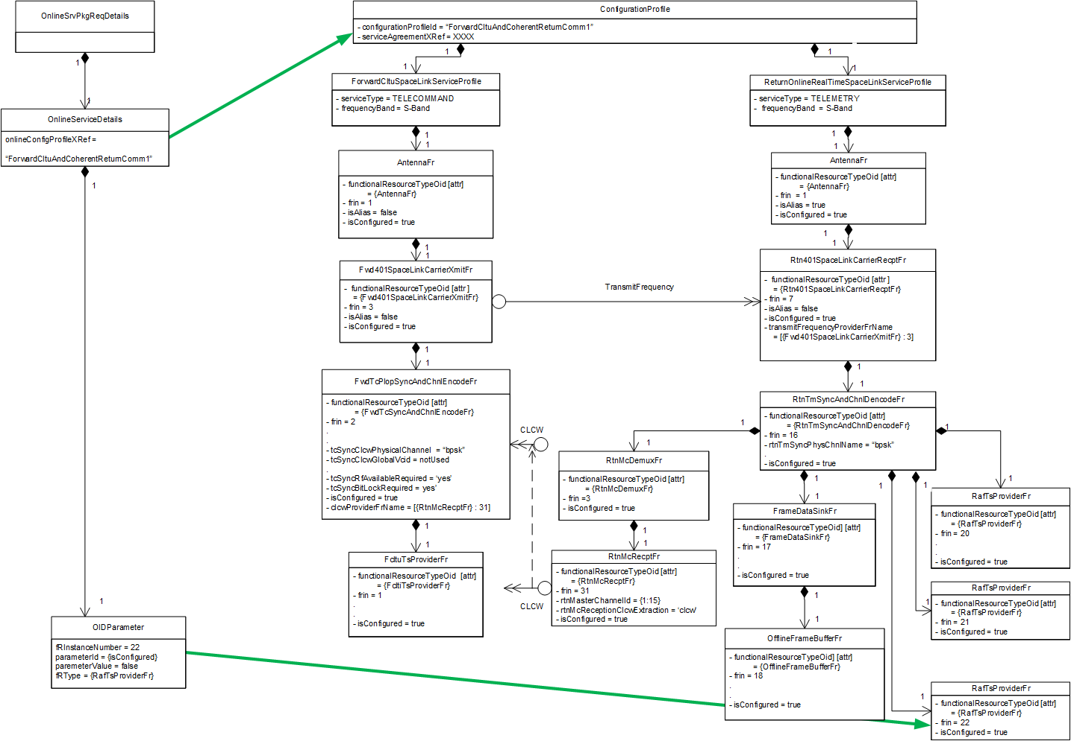
Example Configuration Profile Containing Both a Forward CLTU SLSP and a Return Online Real Time Communication SLSP

Slide 33
Example Service Package Using Combined Configuration Profile for Forward and Return Services
33

Slide 34
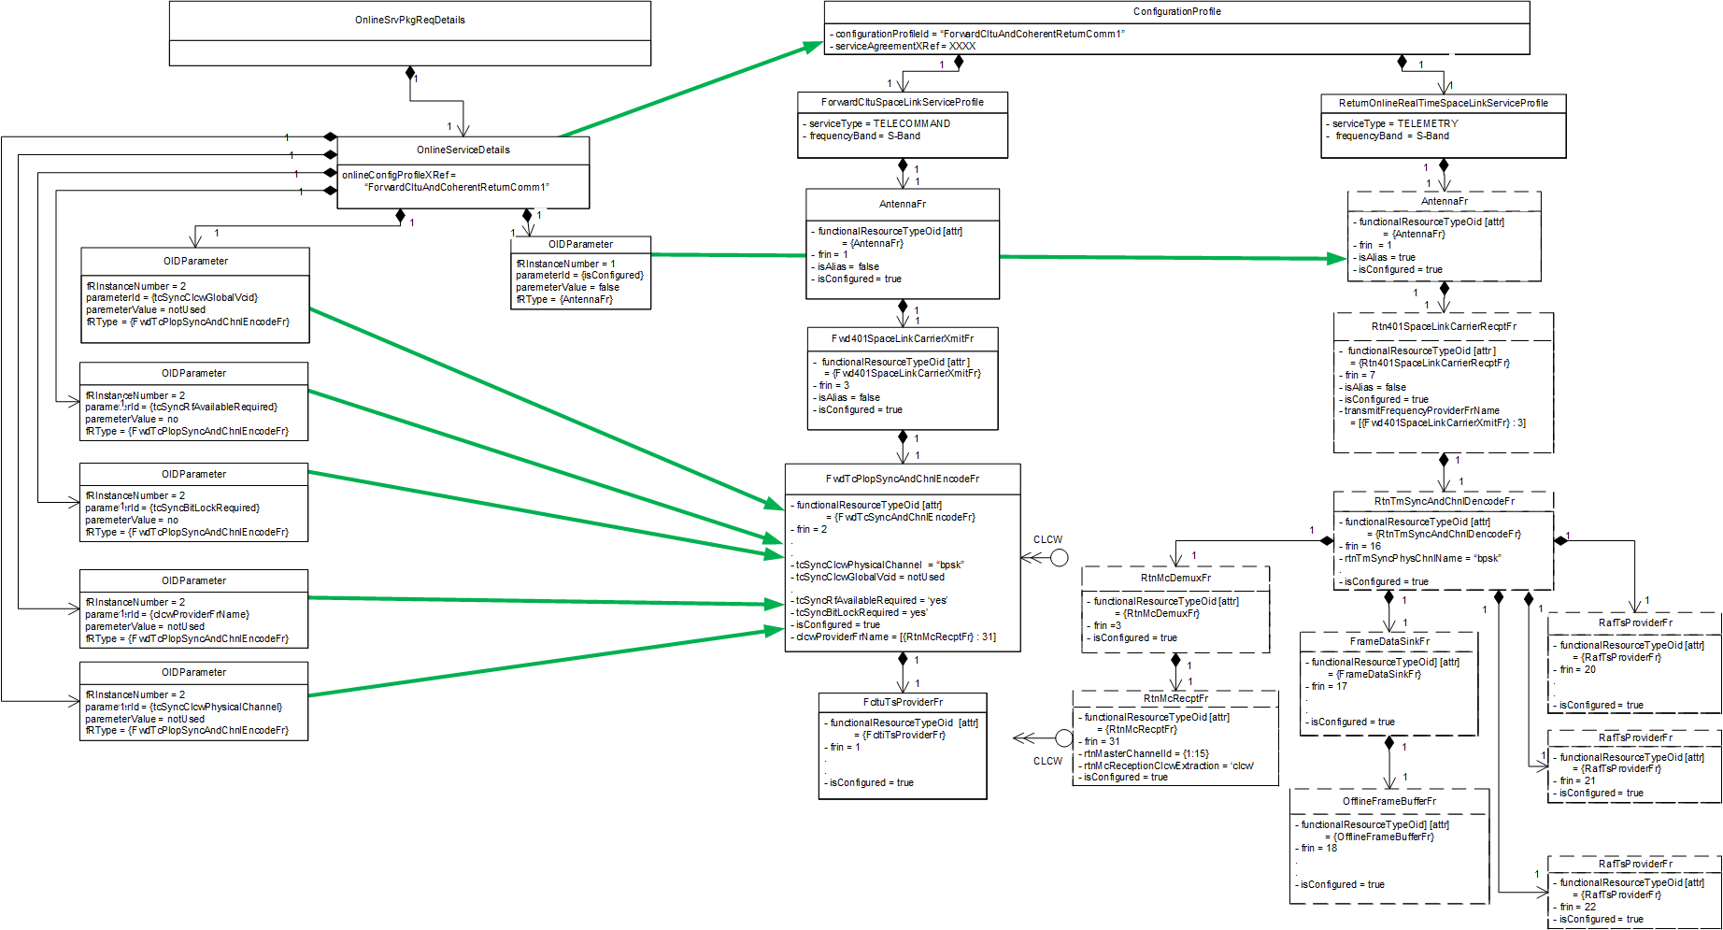
Example Service Package Using Combined Configuration Profile for Forward-Link-Only Service

Slide 35
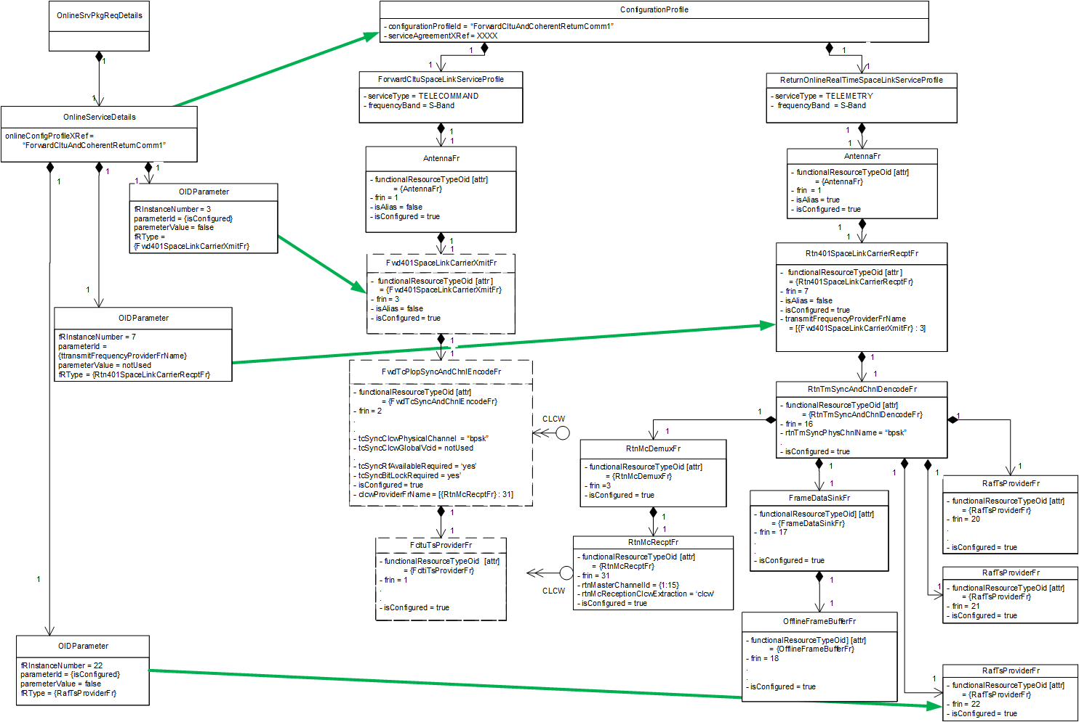
Example Service Package Using Combined Configuration Profile for Return-Link-Only Service

Slide 36
Questions/Issues
Are offline services scheduled?
Configuration parameter definitions in the SA/CP Blue Book
  Copy full definitions from SANA Registry?
  List only the classifiers?
  Just point to the specific “area” of the SANA Registry?
CSTS service-instance-identifier parameter includes spacecraftId and facilityId (both OIDs) subfields
  These will be common across all CSTSes in a given Configuration Profile
  Should they be stated once in a Configuration Profile, or separately in each CSTS instance?

Slide 37
Backup

Slide 38
Current Baseline Space Link Service Profiles
7 Forward Communication Space Link Service Profiles
  Forward CLTU > TELECOMMAND
  Telecommand Real-Time Multiplexed > TELECOMMAND
  Forward AOS CADU > TELECOMMAND
  Forward AOS Multiplexed > TELECOMMAND
  (Telecommand File Multiplexed*) > TELECOMMAND
  (Forward AOS File Multiplexed*) > TELECOMMAND
  (Forward CLTU with ROCF*) > TELECOMMAND
5 Return Communication Space Link Service Profiles
  Return Online Real-Time Communication > TELEMETRY, OFFLINE-TM-RECORDING
  Offline Return All Frames Delivery > OFFLINE-TM-PROVISION
  Offline Return Channel Frames Delivery > OFFLINE-TM-PROVISION
  Return Online File Communication* > TELEMETRY, OFFLINE-TM-RECORDING
  Offline Return File Delivery** > OFFLINE-TM-PROVISION
3 Radiometric Space Link Service Profiles
  Online Real-Time Tracking Data > APA-AZ/EL, APA-X/Y, RANGING, DOPPLER
  Delta-DOR Data Collection > DELTADOR
  Open Loop Data Collection > RF-ONLY
*Services require capabilities that have not yet been specified
**Offline Return File Delivery is also used for Delta-DOR and Open Loop data delivery

Slide 39
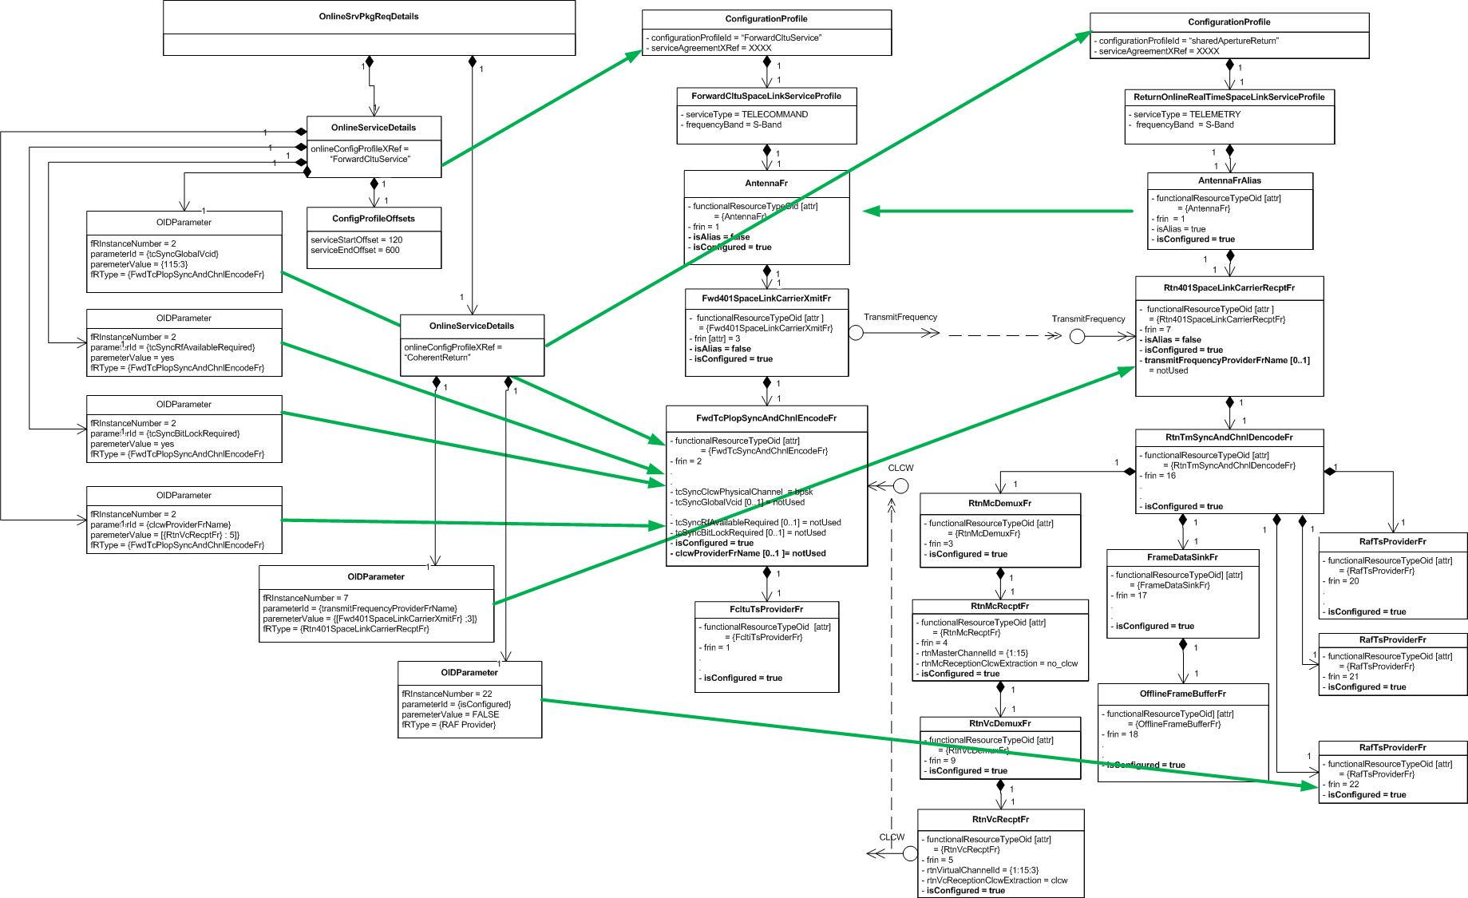
Service Package Combining forwardCltuService and sharedApertureReturn Config Profiles
The two separate Configuration Profiles have separate offsets

Slide 40
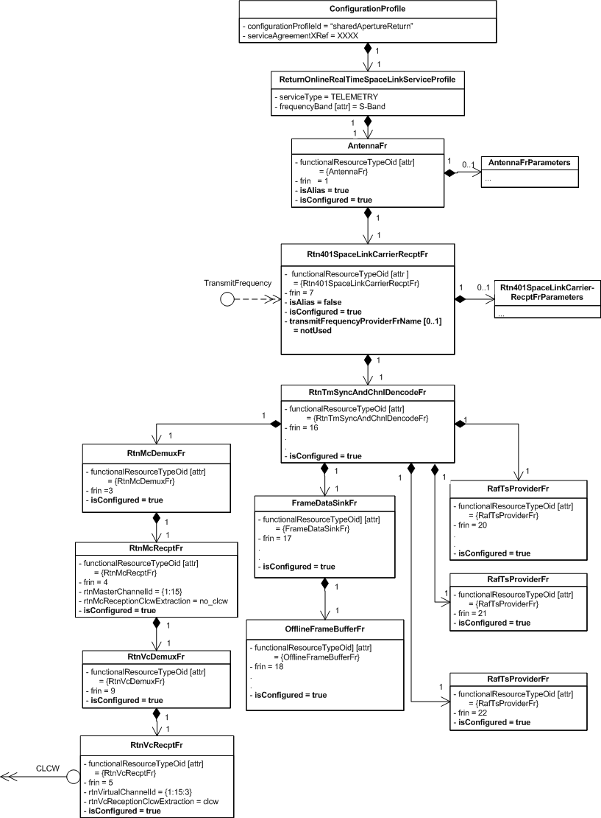
Shared Aperture Return Configuration Profile
isAlias = true requires that this
Config Profile be used in conjunction
with a Config Profile that specifies
the Antenna FR configuration
Optional TransmitFrequency
required interface parameter
is set to notUsed; must be
respecfied in Service Package to
make the return link coherent
isAlias = true indicates that these
parameters are ignored

Slide 41
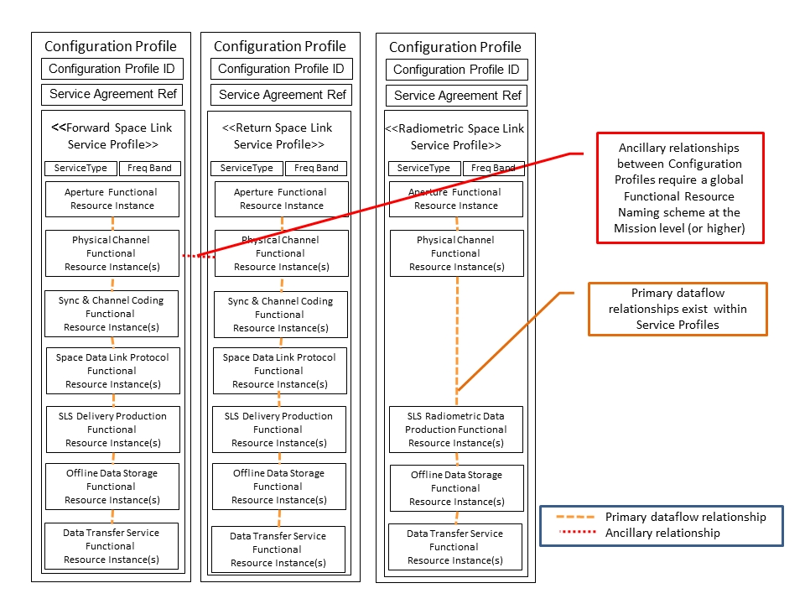
3 Configuration Profiles, Each Composed of a Single Space Link Service Profile (Stereotypical)

Slide 42
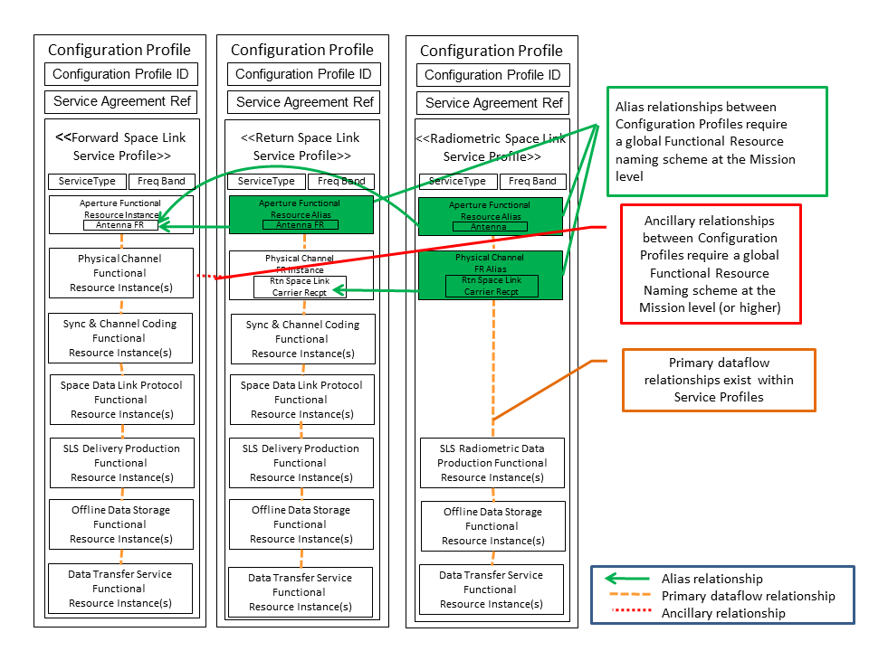
3 Configuration Profiles, Each Composed of a Single Space Link Service Profile with Aliases

Slide 43
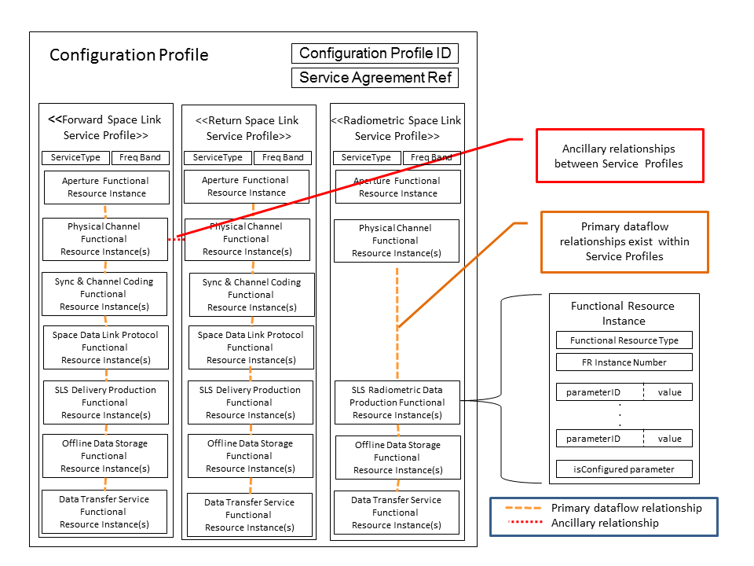
Configuration Profile Composed of Three Space Link Service Profiles (Stereotypical)

Slide 44
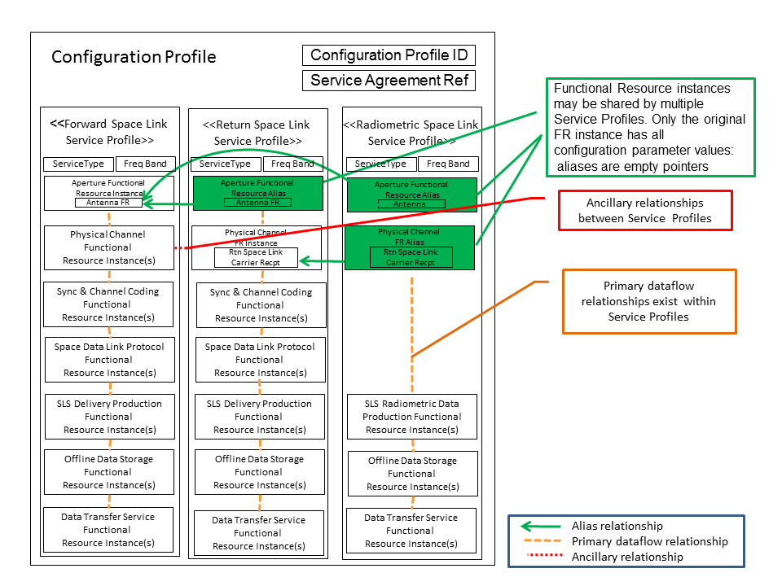
Configuration Profile Composed of Three Space Link Service Profiles with Aliases (Stereotypical)

Slide 45
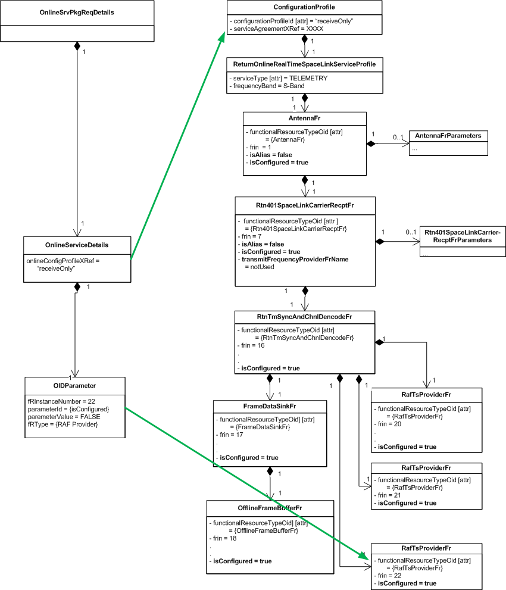
Service Package Containing Receive-Only Configuration Profile

