Slide 1
Issues/observations during implementation of CSS SM
Part 2
CSS SM Spring Meetings 2018, Geithersburg
Marcin Gnat, DLR/GSOC

Slide 2
Summary
Remember that sentence from the last time:
This presentation is the first (but definitely not last) input out of „development war front“ to the WG...
Well… I‘m a visionary!

Slide 3
SMURF - ReportReq – infinite report loop
There is no possibility to ask for specific station/antenna for the Antenna Free Times report.
The only constraints to the Report Request are:
times (coming from the SrvMgtHeader),
spacecraft (from RequestType/user)
But there is no possibility to constraint the Free Times to specific station or antenna. This may lead to situation, such that if agency asked for Free Times will include possibly antennas of other agencies in their “portfolio”, they will ask these third party agencies also for the Free Times. If these third party agencies now include also the antennas of the prime agency, we actually get into the infinite loop of asking for the free times and never get actual final response.

Slide 4
SMURF - ReportReq – infinite report loop
Other words:
Agency A has 3 antennas: A1, A2, A3 and B1 from agency B.
Agency B has 2 own antennas (B1, B2) and uses also A1 (has it in portfolio, system, whatever).
Mission C is asking A for free times for their spacecraft for specific time frame.
A can’t deliver immediate answer, because B1 does not belong to them. So A forwards the request to B.
B has also A1 antenna, so it can’t give and answer and asks A back, for free times…
And so ad infinitum…

Slide 5
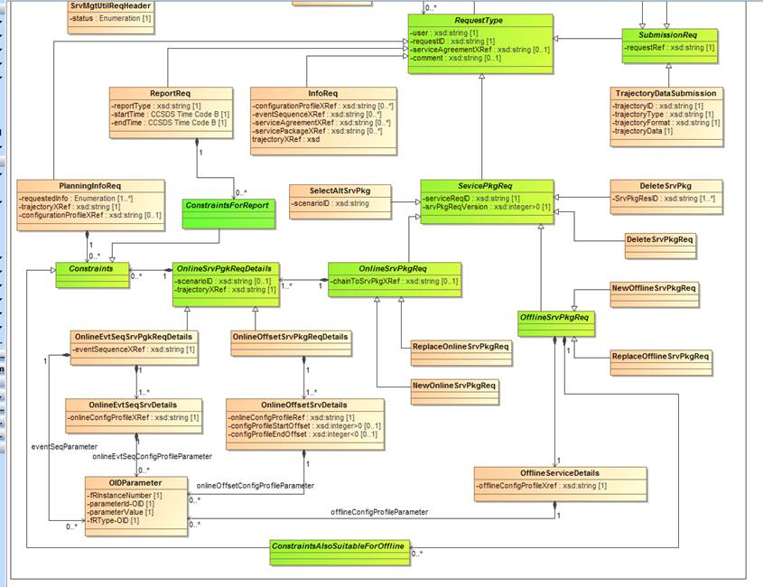
SMURF - ReportReq – infinite report loop
The quick proposal would be:
either add additional (optional) Site/Antenna attributes to ReportReq…
- .. or add abstract class analogue to OfflineConstraints, called for example ConstraintsForReport, which would be limited to the Aperture constraints. (see diagram below, I used v0.5 as basis).

Slide 6
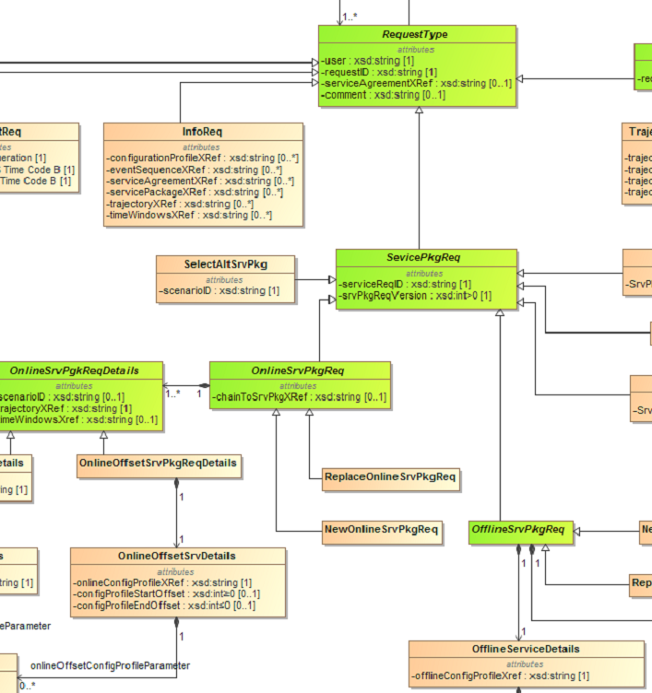
SMURF - SelectAltSrvPkg
In the current version the SelectAltSrvPkg is a specialization of the ServicePkgReq.
The question is, do we envision alternative Service Package for OfflineServices?
If yes, than OfflineServiceDetails class needs also „scenarioID“ parameter.
If not, than SelectAltSrvPkg class shall rather be a specialization of OnlineSrvPkgReq (like Replace… and New…)
-scenarioID: xsd:string

Slide 7
SMURF – requestID vs serviceReqID
There is no possibility to ask for specific station/antenna for the Antenna Free Times report.
The only constraints to the Report Request are:
times (coming from the SrvMgtHeader),
spacecraft (from RequestType/user)
But there is no possibility to constraint the Free Times to specific station or antenna. This may lead to situation, such that if agency asked for Free Times will include possibly antennas of other agencies in their “portfolio”, they will ask these third party agencies also for the Free Times. If these third party agencies now include also the antennas of the prime agency, we actually get into the infinite loop of asking for the free times and never get actual final response.

Slide 8
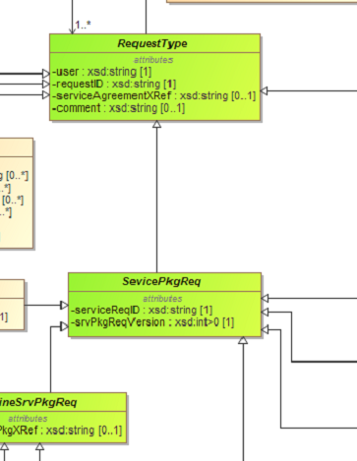
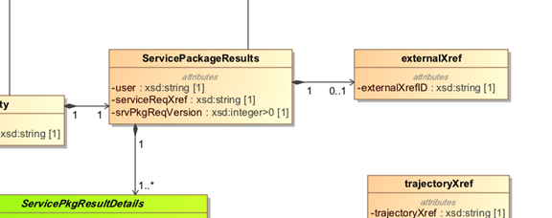
SMURF – requestID vs serviceReqID
SMURF
When looking at the SMURF and SPF (Service Package Format), it is not clear what are the actual dependencies and use cases for the requestID and externalXrefID.
Is it the requestID of SMURF which shall be X-referenced by the externalXrefID?
?
SPF
3.1.5.1 The externalXref class is optional and shall constitute optional reference information provided by the user mission in the originating Service Package Request.

