Slide 1
AI 2017-0512-11 follow up
SM Information Entities‘
State Machines & Lifecycles
CSS SM Spring Meetings 2018, Geithersburg
Marcin Gnat, DLR/GSOC

Slide 2
Introduction
Various Information Entities go through various lifecycles and some require actual State Machines
Considered IE‘s:
Service Package
Service Package Request (New / Delete…)
Report Request
Info Request
Submission Request
Planning Info Request
Configuration Profile
Trajectory
Event Sequence
Service Agreement
Planning Information
Reports (i.e. Simple Schedule)

Slide 3
Introduction
Following IE‘s are considered as „one-way“ or „one-time-event“, thus having no actual lifecycle or state machine:
Report Request
Info Request
Submission Request
Planning Info Request
Reports (i.e. Simple Schedule)
Planning Information

Slide 4
Service Package / Changes
Added SASP operation (Select Alternative SP)
Slight changes in operations (i.e. added implicite CSP – Create Service Package) and naming, main states stay as already presented before

Slide 5
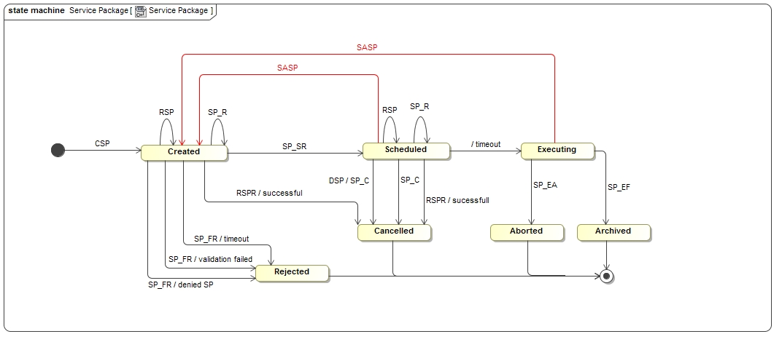
Service Package State Machine
CSP – Create Service Package
SASP – Select Alternative SP
RSP – Replace Service Package
RSPR – Replace Service Package Request
DSP – Delete Service Package
SP_SR – SP Succesful Return
SP_FR – SP Failed Return
SP_C – SP Cancelled
SP_R – SP Replaced
SP_EA – SP Execution Aborted
SP_EF – SP Execution Finished

Slide 6
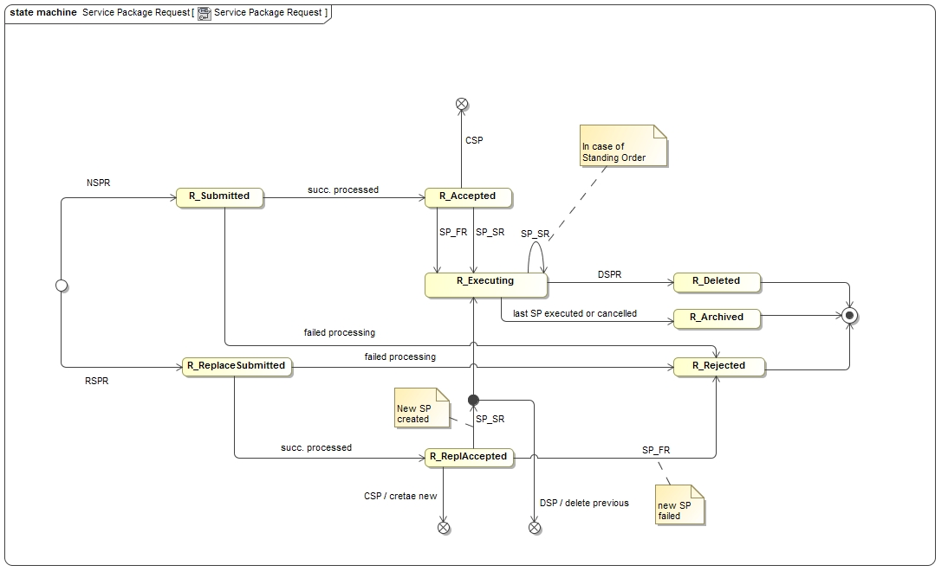
Service Package Request State Machine
CSP – Create Service Package
NSPR – New SP Request
RSPR – Replace SP Request
DSPR – Delete SP Request
SP_SR – SP Successful Return
SP_FR – SP Failed Return
SP_C – SP Cancelled
SP_R – SP Replaced
SP_EA – SP Execution Aborted
SP_EF – SP Execution Finished

Slide 7
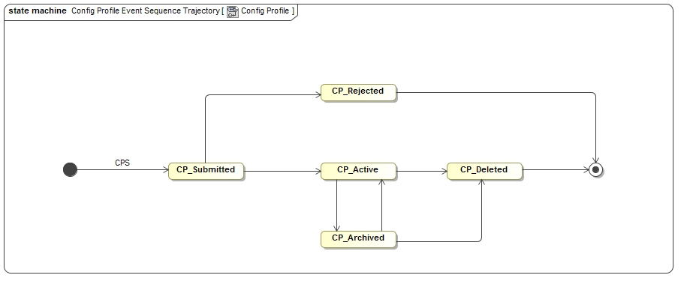
Configuration Profile State Machine/Lifecycle?

Slide 8
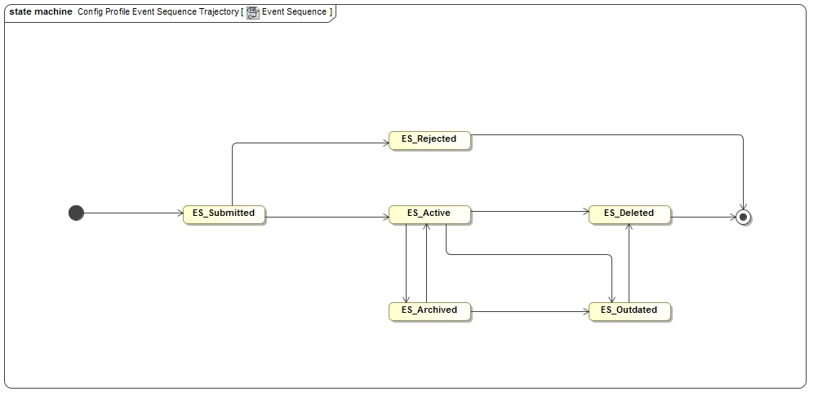
Event Sequence State Machine/Lifecycle?

Slide 9
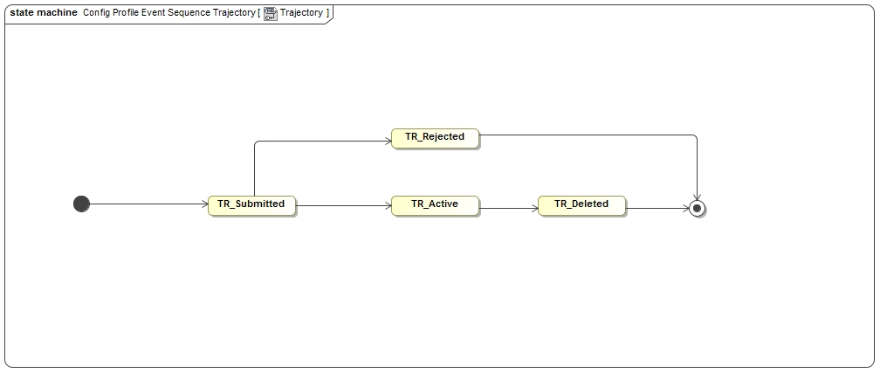
Trajectory State Machine/Lifecycle?

Slide 10
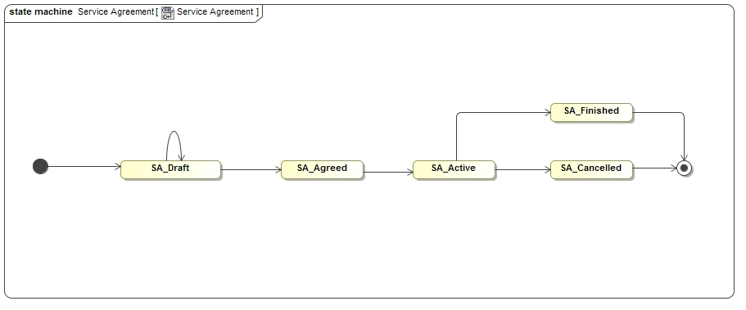
Service Agreement State Machine/Lifecycle?

