Slide 1
Simple Configuration Profile And Service Agreement
CSSMWG Workshop
Berlin, Germany
15 October 2018
Updated with meeting comments/results
John Pietras
Global Science and Technology, Inc.

Slide 2
Outline
“Simple” Service Agreement
“Simple” Configuration Profiles
New additions only
Proposed Future Work
Discussion?

Slide 3
“Simple” Service Agreement
A Service Agreement consists of:
A collection of Configuration Profiles*
Persistent configuration information that underlies and spans individual Service Packages
Permanent Data Transfer Service configuration profiles
Other constraints on SM services (e.g., number of outstanding Service Package Requests allowed)?
This topic is not addressed by the Simple Configuration and Service Agreement Requirements Tech Note
* During the meeting we discussed whether the Configuration Profiles are actually part of the Service Agreement or still separate Information Entities. They could be either. The important think is that Configuration Profiles can stand alone in their ability to set the initial values of configuration parameters and specify what the allowed values/ranges of modified values of those parameters can take. We concluded by affirming that they are part of the Service Agreement.

Slide 4
Service Agreement: a Collection of Configuration Profiles (1 of 2)
Previous (Blue-1) concept: Service Agreement contains constraints on Configuration Profiles
Constraints applied in validation of separately-created Configuration Profiles
Constraints applied in validation of modification of Configuration Profile parameter values in a Service Package Request
Constraints applied in validation of real-time configuration parameter value changes during the execution of a Service Package
Approach problematic in defining expression of constraints (expressiveness vs. verbosity/complexity)
Simplified Service Agreement concept: all Configuration Profiles are part of the Service Agreement and validated as part of the validation of the Service Agreement itself
No separate creation of Configuration Profiles: no ambiguity about what is allowed in a Configuration Profile
Each configuration parameter has two (new) attributes to facilitate subsequent (Service Package Request, Service Package execution
value: the value that the configuration profile sets (required); and
either:
agreedList: enumerated list of values that are permitted for re-specification or real-time reconfiguration (optional); or
agreedRange: range of values that are permitted for re-specification or real-time reconfiguration (optional)

Slide 5
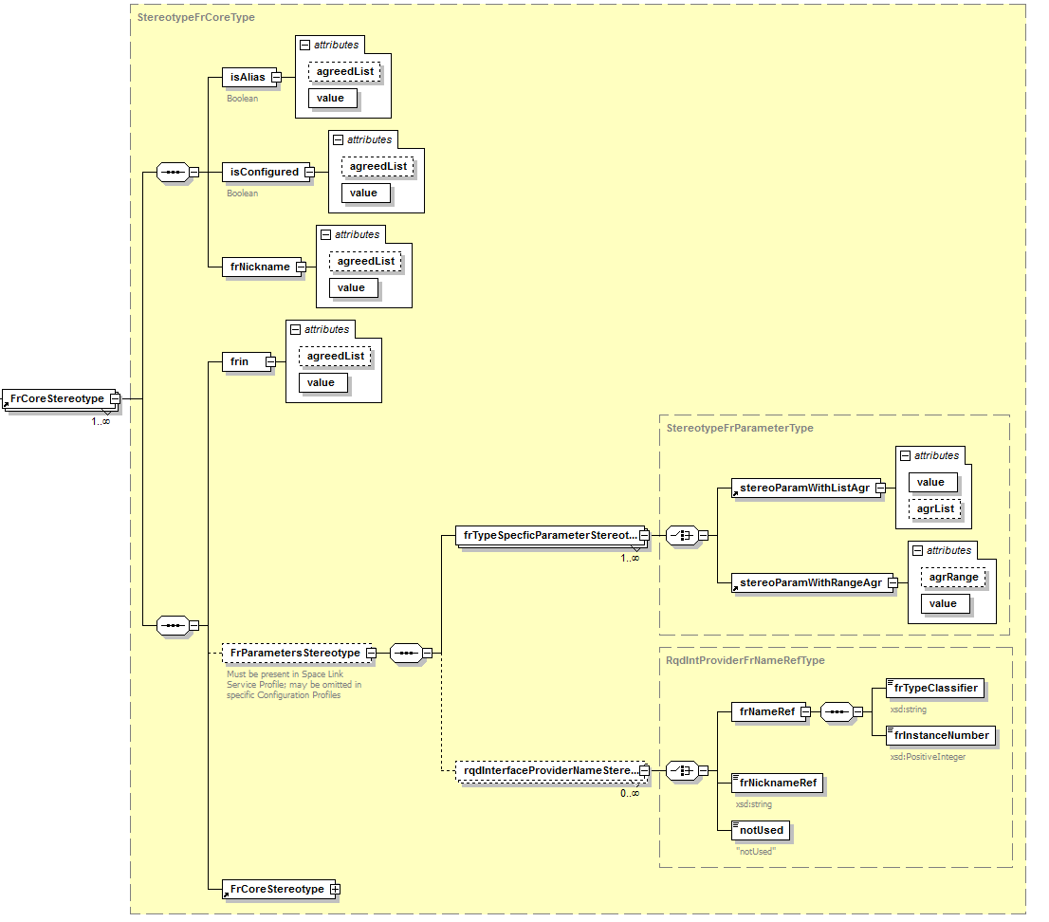
Service Agreement: a Collection of Configuration Profiles (2 of 2)

Slide 6
Service Agreement Persistent Information: ESLT and Aperture
List of sites:apertures that may be scheduled in the context of the Service Agreement
Common text names, OIDs, or both?
Are there any other site/aperture characteristics or constraints that need to be recorded in the Service Agreement?

Slide 7
Service Agreement Persistent Information: Offline Data Storage
Eight offline data storage FR types:
Offline Frame Buffer;
TDM Recording Buffer;
Non-validated Radiometric Data Store;
D-DOR Raw Data Store;
Open Loop Data Store;
Validated Radiometric Data Store;
Return File Data Store; and
Forward File Data Store
For each ESLT included in the Service Agreement:
The number of data stores of each type
The name (TBD format) of each data store
The storage allocation (GB) of each data store
Data storage retention policies
Deletion (e.g., FIFO vs. LIFO, retention period)
By Provider CSSS, ESLT, data storage type, or individual data store?

Slide 8
Service Agreement Persistent Information: Transfer Service Ports
In lieu of dynamic service management, the SLE Service Instance Configuration File (SICF) SLE Transfer Service configuration information contains references to fixed sets of one or more sockets SLE TS sockets ([IP address:TCP port] pairs) at each supporting ground station
ISP-1 allows multiple sockets to be associated with the same SLE service instance to facilitate redundancy and failover
These fixed TCP sockets are defined in what some networks call “proxy files”
If we adopt a similar approach for Extensible CSSM, the Service Agreement would be the (conceptual) repository for such SLE and CSTS socket specifications
Is this acceptable?
What are the alternatives (e.g., dynamic allocation of TCP sockets as part of the scheduling process)?
Discussion: Put this information in the Service Agreement to be used as the default value(s). If a Provider CSSS can dynamically assign TS sockets, it will do so as part of the Service Package Result
Configuration Profiles may have to include placeholder (deferred value) configuration parameters to allow for the return of dynamically-assigned TCP socket info

Slide 9
Service Agreement: Permanent Data TS Configuration Profiles
A permanent data transfer service is one that is established directly by the Service Agreement
Different from scheduled Retrieval and Offline Forward services in that that are not scheduled through Service Package Requests
Each permanent data transfer service instance has its own dedicated configuration profile
Start and stop times may specify any duration within the lifetime of the Service Agreement
5 permanent data transfer service profiles:
Permanent RAF Offline
Permanent RCF Offline
Permanent TD-CSTS Complete
Return File Transfer
Forward File Transfer

Slide 10
Configuration Profiles: Updates Since Spring Meeting (1 of 2)
value and agreedList/agreedRange parameter attributes facilitate value modification in Service Package Requests and during Service Package execution
OIDs eliminated from FR and configuration parameter “names” in configuration profiles
FR instance names (formally defined as {FR Type (OID): FRIN (Integer)}
The name of the XML FR type (e.g., “AntennaFr”) is required to be based on the SANA FR Registry-specified classifier for the OID
XML FR type name == classifier (FR type OID)
Each FR instance has a user (Mission) defined text FR Nickname that is used to reference the FR instance
FR Nickname == {XML FR type name : FRIN (Integer)}
FR parameter name (formally defined as { {FR Type (OID): FRIN (Integer)} : parameterId (OID)}
parameterId component uses SANA FR Registry-specified classifier
XML parameter name == classifier (parameter OID)
FR parameter name = {FR Nickname : XML parameter name}

Slide 11
Configuration Profiles: Updates Since Spring Meeting (2 of 2)
Added a template for creation of CCSDS-standard multiple Space Link Service Configuration Profiles
Recommended Practice for algorithmically generating FRIN values

Slide 12
Proposed Future Work
Update configuration parameters of the FRs in the currently-defined Space Link Service Profiles based on vetting of those FR parameters, in particular:
Forward 401 Space Link Carrier Transmission
Return 401 Space Link Carrier Reception
Develop initial XML Schema types for Online Real-Time Tracking Space Link Service Profile/Configuration Profile
Progress now possible since component FR configuration parameters has been (tentatively) defined
Remove unnecessary parameter definitions from Tech Note, point to SANA FR Registry
List only names (classifiers) of configuration parameters
Document reasons for missing SANA Registry parameters
E.g., initial pointing angles are not in configuration profiles because they are computed from service package requests and trajectory information
Facilitate identification of normative Tech Note material for migration to draft Recommended Standard
(If time is available) develop initial XML Schema types for Forward AOS Frame Space Link Service

