Slide 1
XFDU for TGFT
9 May 2017
John Pietras
Global Science and Technology, Inc.

Slide 2
Outline
Concept for using XFDUs for TGFT
Simplification of XFDU Manifest for TGFT (component by component)
File naming conventions
Extending XFDU with TGFT-specific and TGFT-using-service-specific metadata
Example XFDU Manifest

Slide 3
Concept for using XFDUs for TGFT (1 of 2)

Slide 4
Concept for using XFDUs for TGFT (2 of 2)

Slide 5
Simplification of XFDU Manifest for TGFT (Component by Component)
In the Tech Note, section 2 provides the rationale fro inclusion/exclusion of attributes and parameters, and section 3 provides the resulting composition rules
The standard CCSDS XFDU Manifest comprises five major components
Package Header
Information Package Map
Data Object Section
Metadata Section
Behavior Section

Slide 6
Top-Level XFDU Manifest Schema
Version of the XFDU specification.
For TGFT, value is “1.0”
Intended to contain
executable code
– not used for TGFT

Slide 7
Package Header
For TGFT, default value is “PkgHdr”, but services
may redefine (e.g., for sequences of XFDUs)
For TGFT, at least one instance is
required, containing a required
extension element

Slide 8
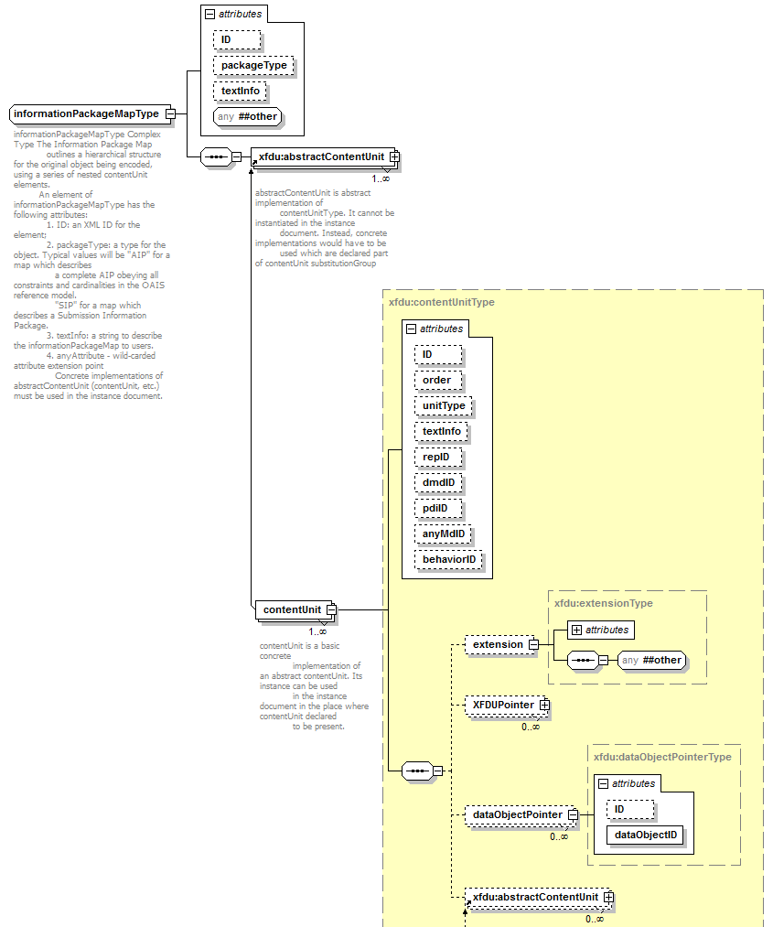
Information Package Map
For TGFT, this is required and is used
to identify the service to which the
XFDU belongs
For TGFT, required for XFDU
Packages containing more than one
Payload data file
Points to the set of metadataObjects
associated with the payload data file
For this content unit
For TGFT, used to add per-payload-
data-file, TGFT-specific and TGFT-
using-service-specific metadata
One Content Unit
per payload
data file
Points to Data Object
for the payload data file
For TGFT, only one
Data Object per
Content Unit

Slide 9
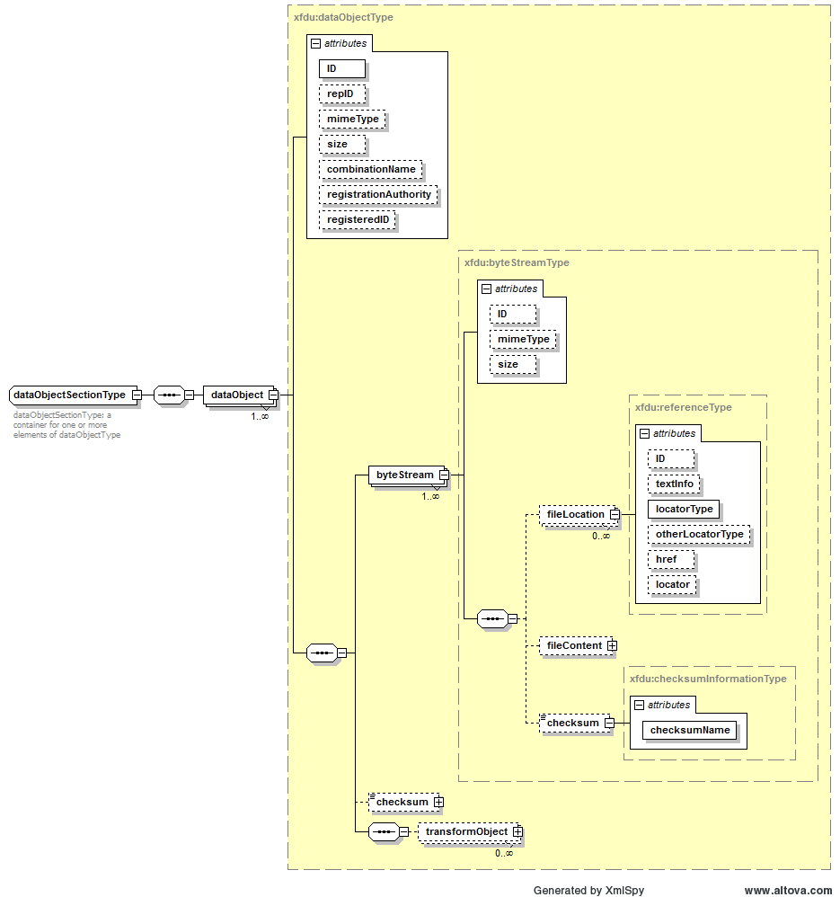
Data Object Section
Pointed to by dataObjectID attribute of
informationPackageMap:contentUnit:dataObjectPointer
element
For TGFT, this is always “URL”
For TGFT, is the URL of the
payload data file within the
same zipped/tarred
XFDU Package
For TGFT, only
one byteStream
per dataObject

Slide 10
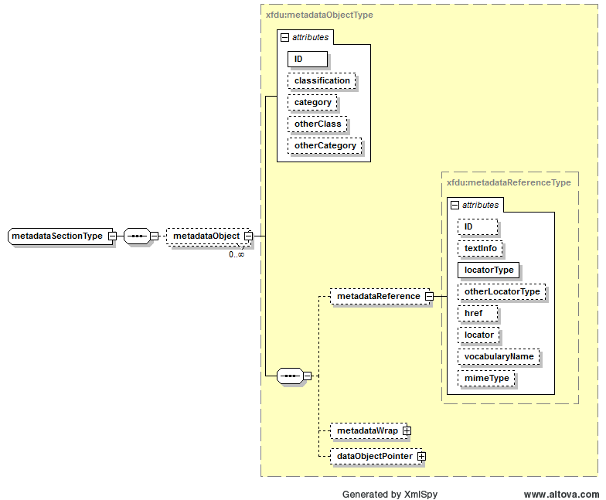
Metadata Section
For TGFT, this is either absent
or “OTHER” (use defined by service)
Pointed to by anyMdID
attribute of content unit(s)
For TGFT, this is either absent
or “OTHER” (use defined by service)
For TGFT, this is either absent or the
name of the service-specific classification
For TGFT, this is either absent or the
name of the service-specific category
For TGFT, this is
always “URL”
For TGFT, is the URL of the
metadata file within the
same zipped/tarred
XFDU Package
-OR-
File at remote location

Slide 11
File Naming and Packaging Conventions
XFDU Package
Packaged as a zipped/tarred folder containing
XFDU Manifest file
One or more payload data files
Zero or more metadata files
XFDU Package name = <service-specific part>+<timestamp part>.zip|tar
<service-specific part> constrained to the character set {[a-z], [0-9], -, _, .}
<timestamp part> is a modified CCSDS ASCII Time Code B: <YYYY>-<DDD>T<hh>-<mm>-<ss>Z (dashes instead of colons in HHMMSS substring)
XFDU Manifest file naming convention is left to the service, except that the file extension type shall be “.xfdu”
Payload data file naming convention is left to the service
Embedded metadata file naming convention is left to the service
Remote metadata file naming conventions are left to the creators of those files

Slide 12
Extending XFDU with TGFT-Specific and TGFT-Using-Service-Specific Metadata
Two TGFT XFDU extension schema types are defined
TgftXfduExtensionType to add TGFT-standard metadata parameters that apply to the XFDU Package as a whole
TgftContentUnitExtensionType to add metadata parameters that apply to individual payload data files
Actual TGFT parameters of both schema types are still TBD: the following are examples

Slide 13
Candidate TGFT XFDU Extension Metadata Parameters Identified at Rome Meeting (1 of 2)
Number of Files: Not covered by XFDU standard; could be added to TgftXfduExtensionType
File Name: Covered by XFDU standard
File version: Not covered by XFDU standard; could be added to TgftContentUnitExtensionType
Creation Date (of individual payload files): Not covered by XFDU standard; could be added to TgftContentUnitExtensionType
File Content Type (not sure what this means. XFDU has mime and unitType attributes that may service this purpose)
File size: Covered by XFDU standard
File encoding (binary, ASCII, etc.): Not covered by XFDU standard; could be added to TgftContentUnitExtensionType
Security Credentials (per each payload data file?): Not covered by XFDU standard; could be added to TgftContentUnitExtensionType

Slide 14
Candidate TGFT XFDU Extension Metadata Parameters Identified at Rome Meeting (2 of 2)
Originator: Not covered by XFDU standard; could be added to TgftXfduExtensionType
Recipient: Not covered by XFDU standard; could be added to TgftXfduExtensionType
Valid dates (start/end times): Not covered by XFDU standard;
Is this for the whole XFDU Package or for each individual payload data file?
Description/Reason: Presumably covered by the various text attributes
Checksum: Covered by XFDU standard
Category: Not covered by XFDU standard; what does this mean? (could be added to TgftContentUnitExtensionType)
Identifier: Multiple identifiers throughout the XFDU Manifest, but do they service the purpose intended by this?
Sequence Number: Covered by the order attribute of the Content Unit

Slide 15
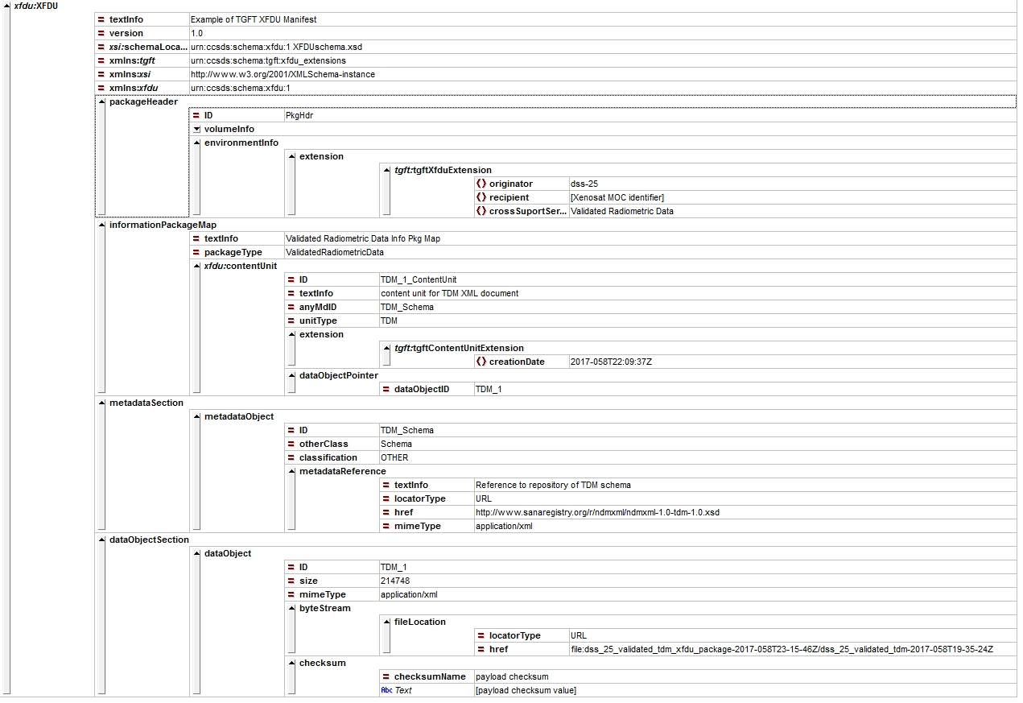
Example XFDU Manifest (XmlSpy Grid View)
SANA repository
.tdm
TDM file embedded in XFDU Package

