Slide 1

AI 2017-0512-52 & 53
Service Management: Management Services
Requirements and Concept
CSS SM Fall Meeting 2017
Den Haag
Anthony Crowson, Telespazio VEGA / ESA

Slide 2
What’s all this about then?
Actions AI 2017-0512-52 & 53
  Draft high-level requirements for the Management Services book
  Draft concept for extensible management services
Discussion today: recap & check on scope, concept
Project description: Management Services (Automation)
“Normative recommendation on methods and protocols for automated exchange of service management information entities”

Slide 3
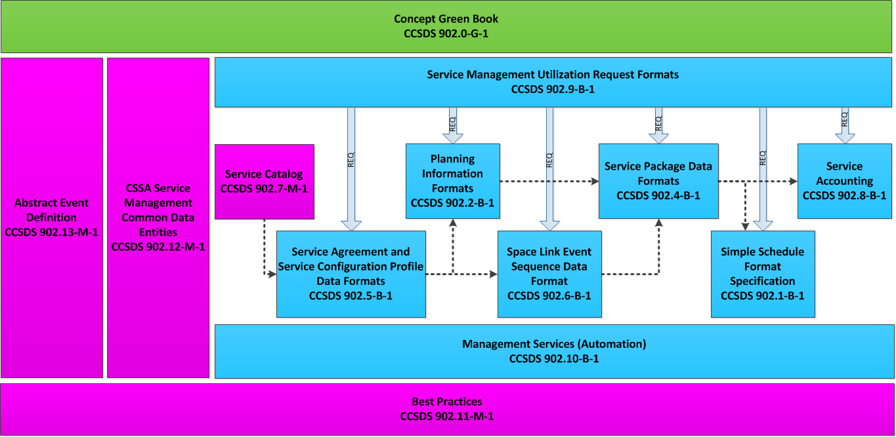
Relation to other books
PUBLISHED
Approved
DRAFT
Approved
DRAFT
DRAFT
DRAFT
DRAFT
Approved
NO DRAFT
NO DRAFT
DRAFT
DRAFT

Slide 4
Scope (from GB draft)
“robust, reliable, and controlled exchange of Information Entities and management messages associated with the use and applicability of those Information Entities”
“provide Management Services that
  address activities in all phases of the SCCS Mission Lifecycle for which standard services are appropriate,
  will be robust as Service Management technologies and capabilities evolve, and
  use the most appropriate underlying technology (or technologies) for the task.”
“address both routine and spacecraft emergency services.”

Slide 5
More scope (?) (from GB draft)
The SCCS SM Information Entities each contain […] the state of the Information Entity itself. This makes the Information Entity independent of the underlying transfer service used to exchange the Information Entities between UM and PM.
Message transfer technologies will continue to evolve and improve […]. In order to maximize the opportunity to take advantage of that evolution, [Management Services] will be defined in a layered fashion such that they are cleanly decoupled from the underlying data transfer technologies by a well-defined set of service primitives. This layered approach will permit underlying technologies to be replaced over time with no effect on the functionality of the Management Services.

Slide 6
Management Services “Stack”
Service interactions
  using Information Entities in other SM Books
  Specifying behaviour expectations
Generic / Abstract Primitives
  Synch / Asynch operation, notification…
Technology / Protocol use
  HTTPS, XML, TGFT, SOAP, RSS, MAL, Email, RFC 1149, …
Request Service Package
SMURF
Service Package result

Slide 7
Service Interactions
Specific services
Specific operations and behaviours
Reference to Blue Books for data formats
May need updating to follow Blue Book evolution

Slide 8
Common Requirements
Reliable Message Transfer
  At underlying technology level
Interaction over Public Networks
Support Asynchronous Operation
Security
  Confidentiality
  Authentication & Authorisation
Extensibility
  Future SM recommendations
  Private extension

Slide 9
Services. What services?
B-1 had Service Package Service, Configuration Profile Service etc.
We now have
  Data Formats - multiple Blue/Magenta Books
  Management Services (Automation)
We have – not fully formalised
  SCCS Mission Support Lifecycle
  Information Entity lifecycles
  Service Management Activities (“Exchange Planning Information”)

Slide 10
Lifecycles, Activities

Slide 11
Interaction Patterns
Synchronous request-response
Asynchronous response (?)
Notification (is this sufficient for async case?)

Slide 12
Methods and Protocols
Apparent general agreement on “REST” approach
Need for e.g. file-based fallback also expressed
  Does that need to be standardised?
REST/http is straightforward to specify
  Mapping to multiple protocols less so (incl security…)
Separate abstraction layer may lose REST simplicity
Pure REST needs some fitting in to SM
  “Resource”-based approach is not perfect match
  SMURF “request” approach
  Effectively linked to HTTP
Degree of layering / decoupling TBD

