Slide 1
Service Management Closing Plenary
Fall Meeting 2017
C. R. Haddow November 2017

Slide 2
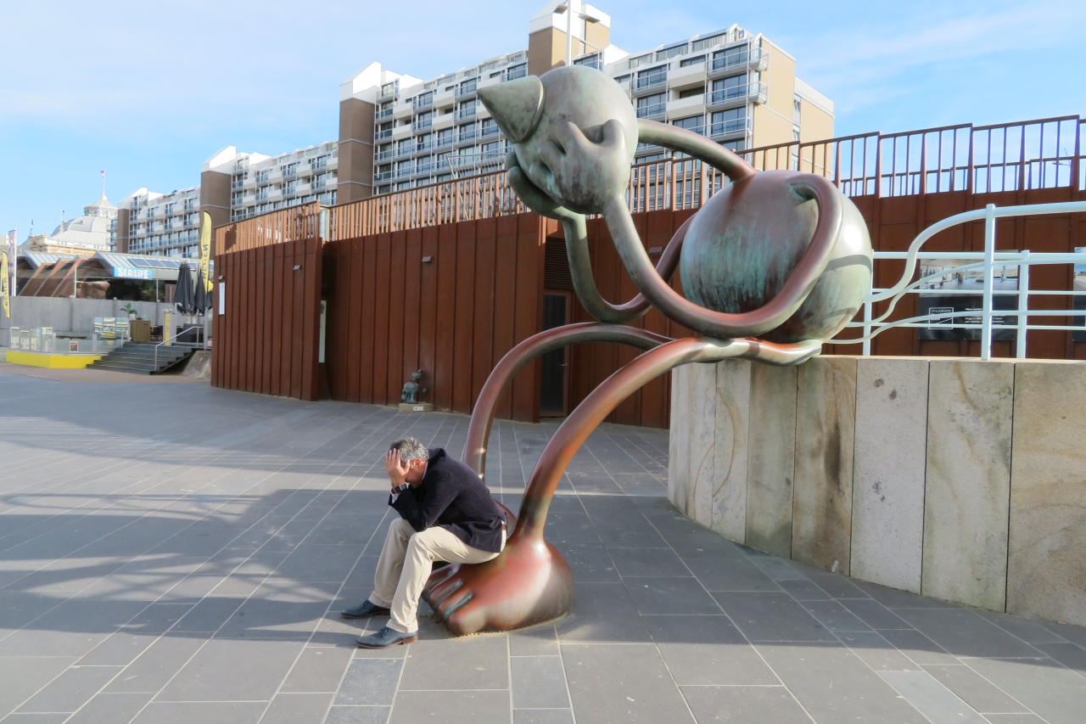
The Effect of Service Management…

Slide 3
Achievements at Den Haag Meeting
TGFT
Progress on White Book – now aim to go to Agency review after Gaithersburg
Discussion on prototyping
SMURF
Useful discussion of SMURF - identified some missing items
Replace Service package request
“Time Windows”
Progress on White Book – now aim to go to Agency review after Gaithersburg
PIF
Resolved outstanding issues
Progress on White Book – now aim to go to Agency review after Gaithersburg

Slide 4
Achievements at Den Haag Meeting
Management Services
Progress made on high level concepts.
Usefulness of considering lifecycle/state machine clearly indicated by disucssion
Config Profile
Useful discussions on Config Profile construction rules
This provides input for the Config Profile Book.
Service Package
Working group updated on current status.
Service Catalogue
Working group updated on current status.

Slide 5
Achievements at Den Haag Meeting
Joint Session with CSTS.
Reviewed subject of Event Sequences
Discussion of IOAG priorities wrt CSS Area.

Slide 6
Many thanks to everybody for the hard work!
Hope to see you all in Gaithersburg

