Slide 1
Service Package Result Draft White Book
8 Nov 2017
Jean-Pierre Chamoun
NASA - GSFC

Slide 2
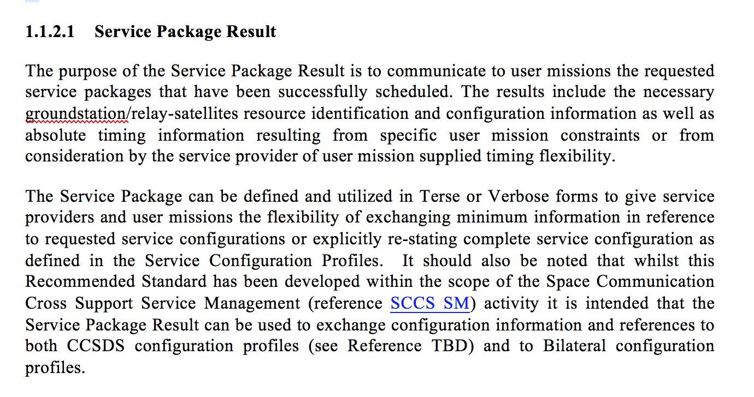
Service Package Result Scope

Slide 3
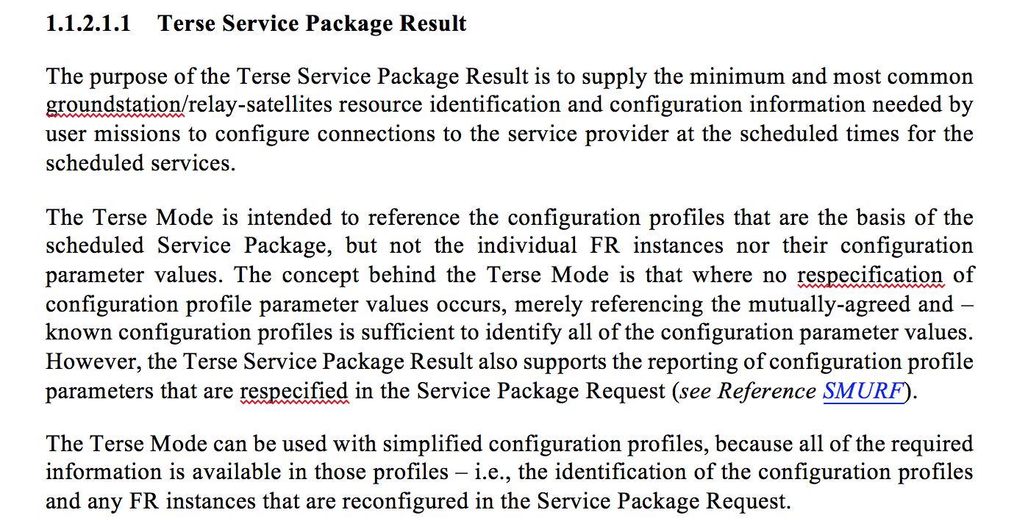
Service Package Result Scope: Terse Mode

Slide 4
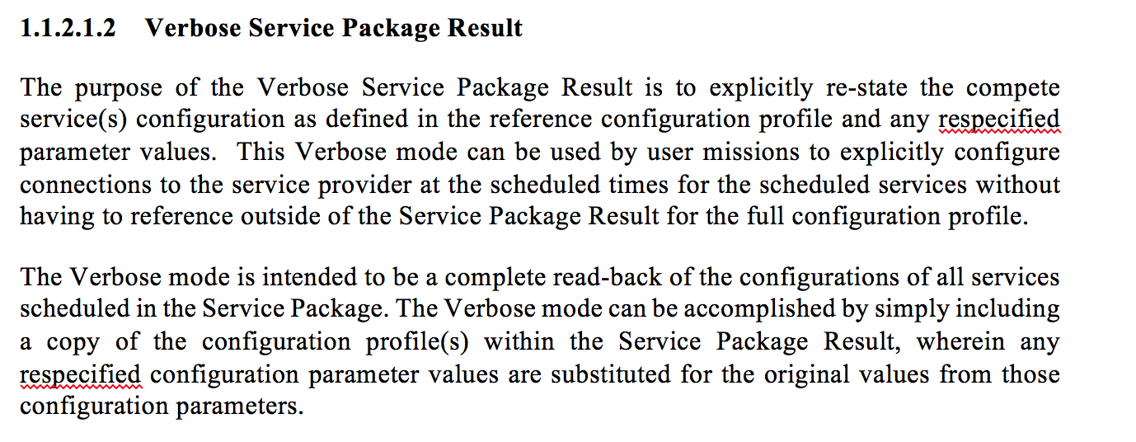
Service Package Result Scope: Verbose Mode

Slide 5
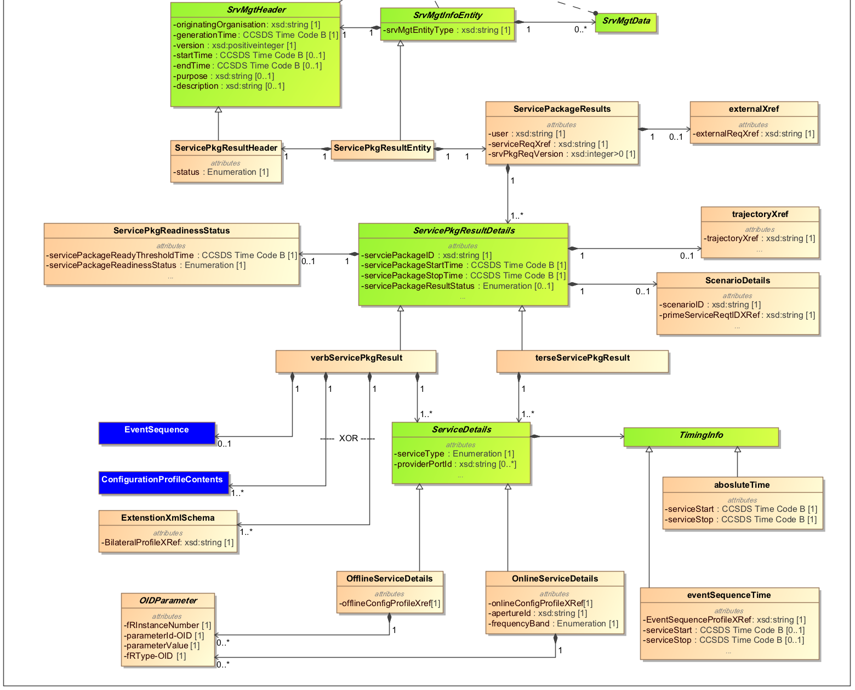
Service Package Result

Slide 6
Service Package Result
Service
Package
Request
Info
Service
Package
Info
Verbose
Info
Min
(terse)
Info

Slide 7
Service Package Result: ServicePkgResultHeader Class
Mandatory - Status of the result is used to identify the various phases and use cases for which the results are generated
Parameter | Description | Data Type | Data Units
Status | The status of the Service Package Result. | Enumeration The following values are permitted TEST indicates that the service package result has been generated for test purposes only. PROVISIONAL indicates that the service package result is provisional and may still be subject to change. OPERATIONAL indicates that this is an operational service package result. | n/a

Slide 8
Service Package Result: ServicePkgResultEntity Class
Mandatory
Parameter | Description | Data Type | Data Units
srvMgtEntityType | See Table A-1. of reference [7]. | Xsd:string — For the service package result the only permitted value for this parameter is the string “SERVICE PACKAGE RESULT” | See Table A-1. of ref. [7].

Slide 9
Service Package Result: ServicePackageResults Class externalXref Class
Mandatory - Provides references to the originating SP request
Parameter | Description | Data Type | Data Units
User | Optional Parameter. This can be used to specify the user to which the result is relevant. These will typically be spacecraft names as specified in SANA. | Xsd:string—Permitted values registered in SANA | n/a
serviceReqID | Service request identifier. | xsd:string | n/a
srvPkgReqVersion | Service request version number. This is used to specify the version of the service request. The submitter of the service package request is responsible for specifying this value. The version of a resubmitted service package request must be greater than that specified for any previously submitted version of the same service package request. | xsd:integer>0 | n/a
Optional- Reference to an external Request ID (user mission defined). Potentially helps to identify activities requested /scheduled across service providers
Parameter | Description | Data Type | Data Units
externalReqXref | Mandatory parameter. This parameter is used to reference a request ID assigned by the user when submitting the originating Service Package Request | xsd:string | n/a

Slide 10
Service Package Result: ServicePkgResultDetails Class
Mandatory
Parameter | Description | Data Type | Data Units
scheduledPackageID | An identifier that is unique for every ScheduledPackage in a schedule. It should be noted that if a schedule is regenerated then the scheduledPackageID for a particular Scheduled Package may change | xsd:string | n/a
scheduledServicePackageStartTime | Time at which the Service Package is scheduled to start. The scheduled start of the Service Package corresponds to the earlier of: a) the scheduled start of signal acquisition for the first (earliest-starting) space link carrier; and b) the scheduled start time of the first (earlieststarting) transfer service instance in the Service Package. | CCSDS ASCII Time Code B | n/a
scheduledServicePackageStartTime | The time at which the Service Package is scheduled to stop. The scheduled start of the Service Package corresponds to the later of: a) the scheduled end of signal acquisition for thelast (latest-ending) space link carrier; and b) the scheduled stop time of the last (latestending) transfer service instance in the Service Package. | CCSDS ASCII Time Code B
servicePackage- DefinitionThreshold Time | Optional - The latest time (in UTC) at which all elements required for the execution of the SLS Service Package can be defined or redefined. | CCSDS ASCII Time Code B | UTC
servicePackage- ReadinessStatus | Optional - Summary status of the readiness of the Service Package for execution. The values are: – ‘ready’: All required Service Package itemsare currently defined; – ‘not ready’: One or more required ServicePackage items must still be defined. | Enum | n/a
servicePackageStatus | Optional - This is used to indicate that the Service Package Result only addresses part of the Service Package Request. This can be used for a long duration request, cross provider request - ‘complete’: all services request are included in this result - ‘partial’: not all services scheduled or to be scheduled from the request are included in this result | Enum | n/a
servicePackageResultType | Optional – This is used to provide context as to the reason why the result is was generated: -‘new’: used for results generated by a new service package request -‘update’: used for results generated by an update service package request -‘alternate’: used for results generated by a select alternate service package request -‘flexibility change’: used for results generated by a service package change initiated by the service provider within flexibility of the request | Enum | n/a
Note:

Slide 11
Service Package Result: ScenarioDetails Class trajectoryXref Class
Optional
Parameter | Description | Data Type | Data Units
scenarioID | Mandatory parameter. This parameter is be used to specify the scenario to which the Service Package belongs. This is defined by the request submitter and must uniquely (for that user) define the scenario to be used. | xsd:string | n/a
primeServiceReqtIDXRef | Mandatory parameter. This parameter is used to specify the scenario ID of the Service Package containing the services that will be configured to support the space link carrier(s)
Optional
Parameter | Description | Data Type | Data Units
trajectoryXRef | This is used to specify a reference to the trajectory that the provider will used to configure and execute the Service Package | xsd:string | n/a

