Slide 1
Strawman of proposed event sequence structuring
Response to AI 2017-0512-16
E. Barkley NASA/JPL
11 Oct 2017

Slide 2
Contents
Why do you need event sequences and what are they?
Usage scenario outline
Outline of proposed event sequences for CCSDS SM
Communication sequencing illustration/example
Mapping to information entity (ie. the strawman proposal)
Next Steps
General discussion items

Slide 3
Why do you need event sequences and what are they?
If you explore a long ways from home, your spacecraft cannot be controlled in real-time
  Case in point: Voyager-2 is ~32 hours round trip light time from earth
    So if you send a command to it you won’t know for about 32 hours if the spacecraft received it and if it was okay
  More case in point: Cassini (which was recently intentionally guided into Saturn) had a body mounted antenna/radar – just because it was visible from earth does not mean you can talk to it; the spacecraft was sequenced well in advance and that sequence needed to be coordinated across the 2.6 hour roundtrip light time delay

Slide 4
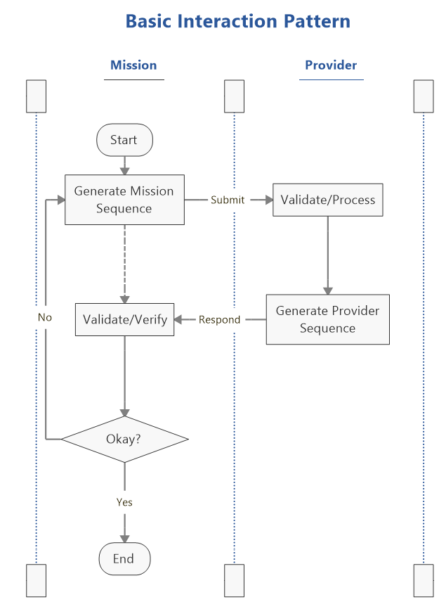
Usage Scenario Outline
Envisioned that there are in fact two information entities required
  Mission Sequence – Indicates what the mission wants to have happen
  Provider Sequence – Offers confirmation and/or adjustment of what mission wants to do factoring in what provider can/cannot do
  See “Basic Interaction Pattern” for prior to tracking pass/contact execution
During execution the Provider sequence is used to check events are occurring as expected and adjusting service production to accommodate events
  Further discussion of this aspect is out of scope for this presentation – eventually to be considered as part of “Control Architecture” and SC-CSTS efforts

Slide 5
Sequencing Communications Illustration (telemetry example)
(Re-)start Return
Carrier
Start data transport
End Return Carrier
End of Return Carrier
Stop data transport
Symbol rate
change
Start of Return Carrier
Trajectory
Start data transport
Data availability
at higher symbol rate
Data availability
at lower symbol rate
Return Carrier availability
Tracking Pass
t1
t2
t3
t4
t5
t6
t7
t8
Data Transport State
Data Transport State
Return Carrier Available State
Return Carrier Available State
Notes:
Change title of event sequence “passing being planet X”
Add vertical dashed lines (relating time events on traj and time line)
Add horizontal dashed lines for timing diagram – i.e. Timing diagram conventions

Slide 6
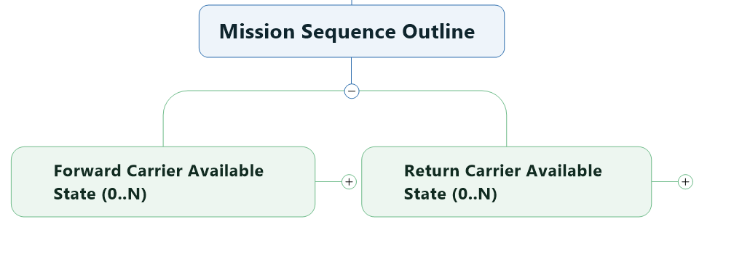
Mapping to Information Entity….
Start data transport
End Return Carrier
End of Return Carrier
Stop data transport
Symbol rate
change
Start of Return Carrier
Trajectory
Start data transport
Data availability
at higher symbol rate
Data availability
at lower symbol rate
Return Carrier availability
t1
t2
t3
t4
t5
t6
t7
t8
Data Transport State
Data Transport State
Return Carrier Available State
Return Carrier Available State

Slide 7
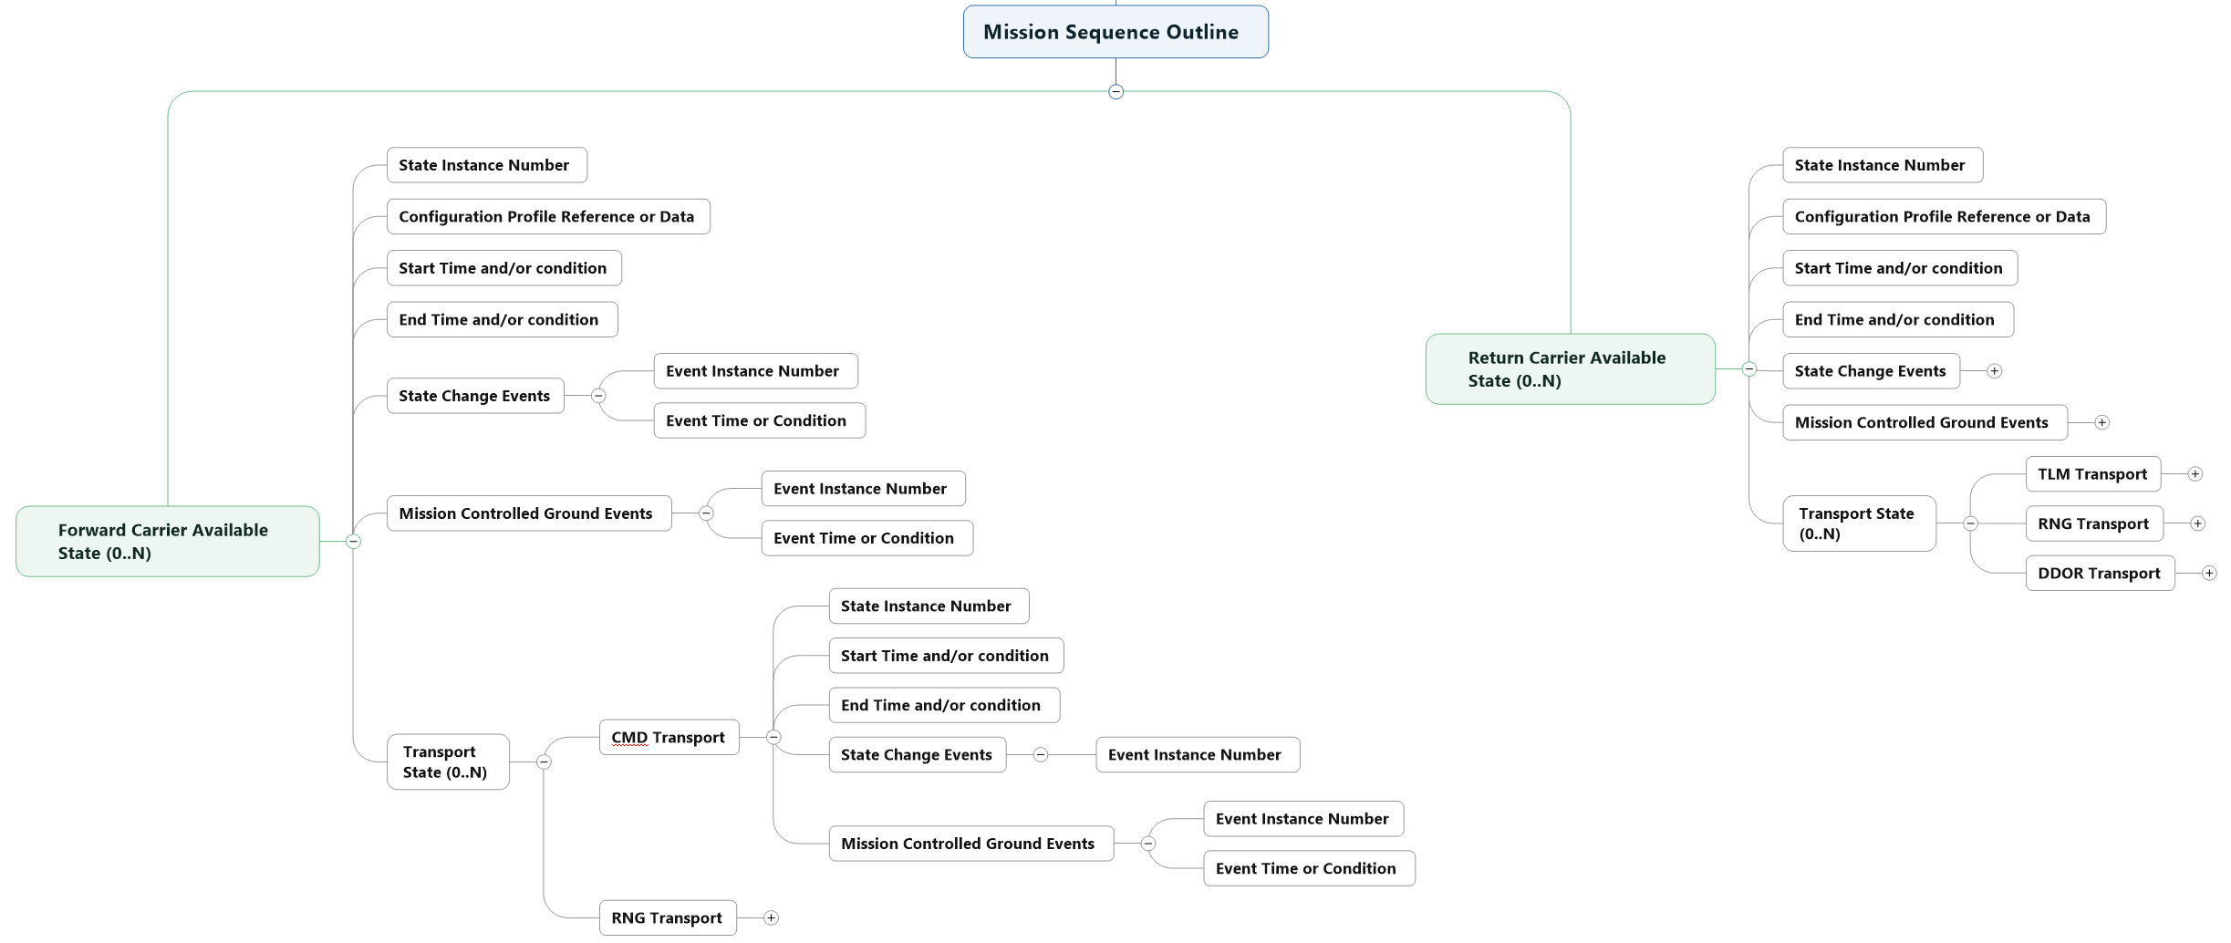
Mapping to Information Entity….

Slide 8
Mapping to Information Entity….
Sequences are organized on a per carrier (spacelink) basis; as many or as few as needed (e.g, a mission that has 2 forward carriers and 3 return carries works as well as a “simple” 1 forward and 1 return mission)

Slide 9
Mapping to Information Entity….
Carriers appear in terms of availability states. Key items here
a) Unique identification relative to the sequence (State Instance Number)
b) reference to the configuration information or actual configuration information itself
c) Time span of the state either in absolute times or relative to a condition/event (e.g, BOT + 300 seconds, EOT - 300 )

Slide 10
Mapping to Information Entity….
Each [Fwd|Rtn] Carrier Available State allows for self-transition via State Change Events: e.g, for a RTN Carrier if there is an expected change in observed radiated power, an EIRP offset can be supplied. Mission Controlled Ground Events can also be supplied – these are sequenced control settings that “extra-spacecraft” ie, communication artefacts not controlled by the spacecraft by controlled by the mission – e.g., for the FWD Carrier, the provider may default to ramping the forward carrier for Doppler compensation observed at the spacecraft; turn such compensation off during a portion of the FWD Carrier Available state can be accomplished here.

Slide 11
Mapping to Information Entity….
Each [Fwd|Rtn] Carrier Available State allows for carrier specific data transport state – which in fact are the services we manage! The FWD Carrier available state allow for Command and Ranging Services; the RTN Carrier Available State (CAS)allows for Telemetry, Ranging, and DDOR (tones). Potential extension point for other services. Transport states are composed like the CAS in terms of instance ID, start/end time/conditions, state change events and mission controlled ground events.

Slide 12
Next Steps
Develop and present more of the absolute time vs relative time facility
A provider sequence needs to be outlined
  Will provide some additional data from provider side
    Time system translations (not talked here but the distinction between SCET and UTC needs to be addressed)
    Meta data to indicate adjustments from provider point of view

Slide 13
General Discussion Items
Fit relative to “default” (maybe virtual) event sequence for “simple” tracking passes, especially those near earth
Configuration profiles, FRM and Event sequences
Fit with Service Package Result

