Slide 1
Initial Thoughts on Event Sequences

Slide 2
Context
Input to this presentation is the Erik’s ‘Strawman of proposed event sequence structuring’ from 11 Oct 2017
Still not too clear about the goal of Event Sequences
Provide a common understanding for mission and network provider what shall happen during a pass
Support pass automation at the ground station?
Mission specific ad-hoc actions (change bitrate) at defined intervals?
X-support?
Output seems to be ‘mission sequence’ and (per carrier) a ‘provider sequence’ – differences?

Slide 3
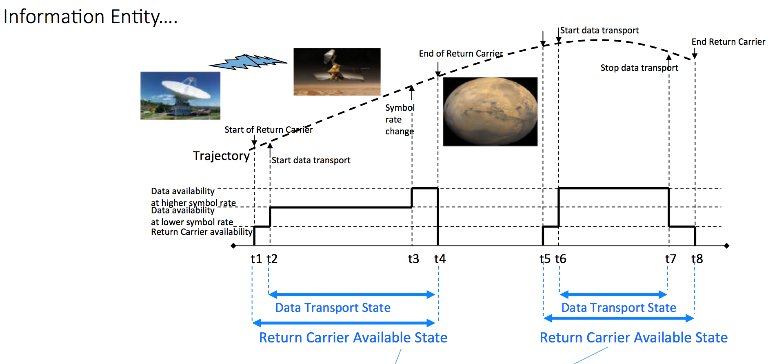
Sates and State Machines
Apparently the Event Sequences are representing sequences of states:

Slide 4
Formalize State Machines
One-way tracking
If we know states we can model state machines
What triggers state transitions?
?
?
Two-way tracking

Slide 5
Functional Resource Model
Can we use the Functional Resource Model (FRM) somehow in the context of Event Sequences?
The FRM is an abstraction of ground equipment, in principle it can provide
Observable events (e.g. loss of lock, CLCW information)
Directives to do something (e.g. start uplink)
Parameters for monitoring
Can we use the FRM ‘Vocabulary’ in terms of
Events -> Real Time Events / Predicted Events
Directives -> Real Time / Time Tagged

Slide 6
Try an Example

Slide 7
Example
State Machine
FRM Event
Carrier Lock
FRM Event
Frame Sync
#2
[rate=high]
[rate=low]
Un-Locked
Return Carrier Locked
Data Transport
[rate=high]
[rate=low]
FRM Directive (time tagged or real time)
Change Symbolrate
State sequence (Time Domain)
Carrier Lock
Frame Sync
Directive Change Symbol Rate
Carrier Lock
Frame Sync
Un-Locked
Return Carrier Locked
Data Transport
[rate = low]
Un-Locked
Return Carrier Locked
Data Transport
[rate = high]

Slide 8
All events and states occur in two flavors
Predicted
Realtime
At pass execution time they should ‘match’ with some margin. If FRM concepts are used we can use
MD-CSTS for Real Time Event Detection
SC-CSTS for Directive Invocation (or time tagged)
Can Event Sequences been seen as a layer on top of the FRM?
If we do *not* use the FRM vocabulary, how do MD-CSTS and SC-CSTS relate to Event Sequencing?

