Slide 1
Configuration Profiles And Space Link Service Profiles
8 November 2017
John Pietras
Global Science and Technology, Inc.

Slide 2
Outline
Space Link Service Profiles, Configuration Profiles, and the relationships within and among them
Example Space Link Service Profiles
  Forward CLTU Space Link Service Profile
  Return Online Real-Time Communications Space Link Service Profile
  Online Real-Time Tracking Space Link Service Profile
Examples of Configuration Profiles that combine the example Space Link Service Profiles in different ways to get different features
Much of the material in this briefing has not yet been added to the most-recently uploaded version of the Tech Note. The Tech Note will be updated in the near future

Slide 3
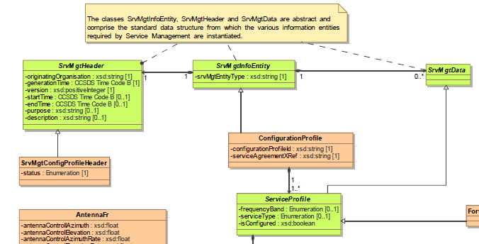
Service Management Header Context
The work described in this presentation will eventually have to be integrated into the Service Management Header, but that has not yet been done
  The diagram below is the top of a strawman class diagram generated by Marcin Gnat

Slide 4
Space Link Service Profiles, Configuration Profiles, and the Relationships Within and Among Them
Space Link Service Profiles
  The templates (schemas) for the “cookie cutter” building blocks of Configuration Profiles
  Space Link Service Profiles do not exist on their own – they are only instantiated within Configuration Profiles
  Comprised of instances of Functional Resources
  Mappable to the “services” as defined and used in the Simple Schedule (APA-AZ/EL, TELEMETRY, RANGING, etc.)
  More than one instance of a Space Link Service Profile type may exist in the same Configuration Profile, as long as they are in different frequency bands
Configuration Profiles
  Each Configuration Profile is comprised of one or more Space Link Service Profiles
  Service Package Requests and Service Package Results reference one or more Configuration Profiles

Slide 5
Configuration Profile Building Blocks (“Cookie Cutters”)
Space Link Service Profiles
Single-service configuration profiles
  One for each Space Link Service Profile
Configuration Profile “container” class for Mission-defined multi-service configuration profiles
These will be normatively defined in the Blue Book

Slide 6
Service Profiles
17 baseline Space Link Service Profiles (currently)
  8 Forward Communication Space Link Service Profiles
  5 Return Communication Space Link Service Profiles
  4 Radiometric Space Link Service Profiles
  Names of the 17 current services are listed in the Backup section
The Blue Book will define the XML schema for each baseline Space Link Service Profile
Example Space Link Service Profiles fleshed out for further proof-of-concept
  (Draft) configuration parameters adopted from SANA Functional Resource registry
    All configuration parameters are included in the Configuration Profile FRs, even though some may actually be set by the Service Agreement
  UML diagrams generated for the example Space Link Service Profiles
  3 example Space Link Service Profiles
    Forward CLTU
    Return Online Real-Time Communication
    Online Real-Time Tracking

Slide 7
Configuration Profiles
A Configuration Profile contains one or more instances of the SpaceLinkServiceProfile abstract class
  Each Space Link Service Profile class is a specialization of SpaceLinkServiceProfile
The Blue Book will define a single-service Configuration Profile schema for each baseline Space Link Service Profile
  Missions can use these single-service schemas to generate single-service Configuration Profiles with minimum tailoring

Slide 8
Representation of Relationships (1 of 2)
Functional Resource Alias
  Represented in UML/XML as a subclass/derived type that contains no parameters and has the Functional Resource Name of a FR instance for which a fully-populated instance exists, either:
    Within the same Configuration Profile (can be validated when the Configuration Profile is validated)
    Within a Configuration Profile that is referenced by the Service Package Request that references the Configuration Profile that contains the alias (can only be validated as part of the validation of the individual Service Package Request)
Primary Relationships (primary data flows within Space Link Service Profiles)
  Examples: an Antenna FR instance provides a modulated waveform access point to a Forward 401 Space Link Carrier Transmission FR instance, a Forward 401 Space Link Carrier Transmission FR instance provides a forward physical channel symbol stream access point to a Forward TC Sync and Channel Encoding FR instance, etc.
  Expressed in UML as composition
  SAP Accessor
  Expressed in XML as containment in complex elements

Slide 9
Representation of Relationships (2 of 2)
Ancillary Relationships (provide supporting information between Space Link Service Profiles)
  7 ancillary relationship types exist in the baseline set of Space Link Service Profiles
    Transmit Frequency
    CLCW
    Pointing Angles
    Ranging Timing Signaling
    Receive Frequency
    Range and Doppler
    CFDP-PDU
  Represented in UML as provided/required interfaces
  Represented in XML as ProviderFrName parameters in FRs with required interfaces that point to the FRs with the peer provider interfaces
provided interface required interface

Slide 10
Example Single-Service Profiles and Service Package
3 example Space Link Service Profiles are fleshed out for further proof-of-concept (UML Class Diagram)
  Forward CLTU
  Return Online Real-Time Communication
  Online Real-Time Tracking
  (Draft) configuration parameters adopted from SANA Functional Resource registry
    All configuration parameters are included in the Configuration Profile FRs, even though some may actually be set by the Service Agreement
A single-service Configuration Profile for each of the 3 Space Link Service Profiles (UML class diagram
An instance of each of the 3 single-service Configuration Profiles
An example Service Package that uses multiple single-service Configuration Profiles

Slide 11
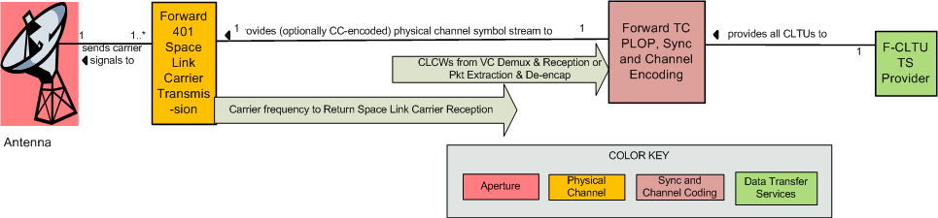
Forward CLTU Space Link Service Profile (Informal Representation)

Slide 12
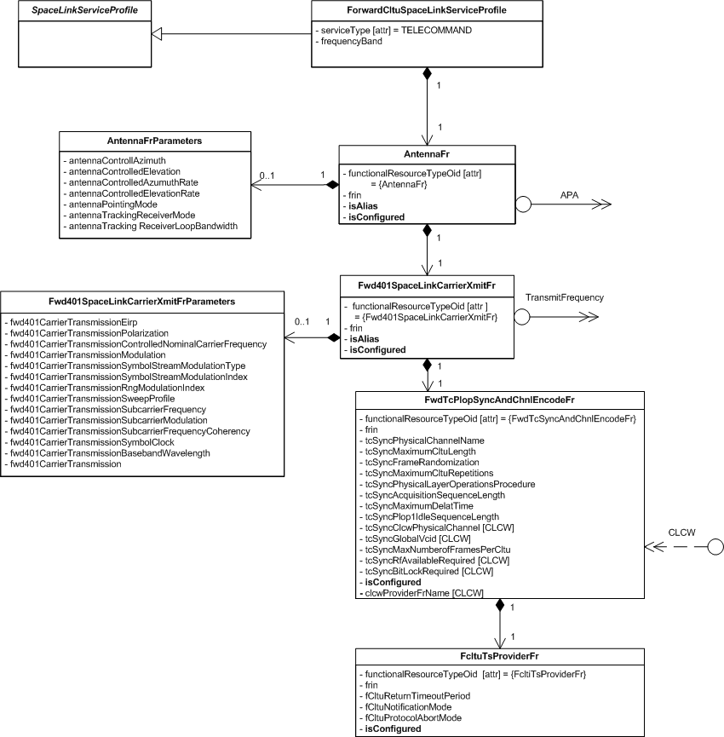
Forward CLTU Space Link Service Profile UML Classes
If isAlias = false, AntennaParameters must be
present, populated, and are used in a
configuration profile
If isAlias = true, AntennaParameters is ignored
and any Service Package that uses this service
profile MUST also contain a service profile with
a fully-populated Antenna FR with the same
FRIN
“[CLCW]” notation indicates that the
parameter requires a non-’unused’
value when the CLCW ancillary
interface is required

Slide 13
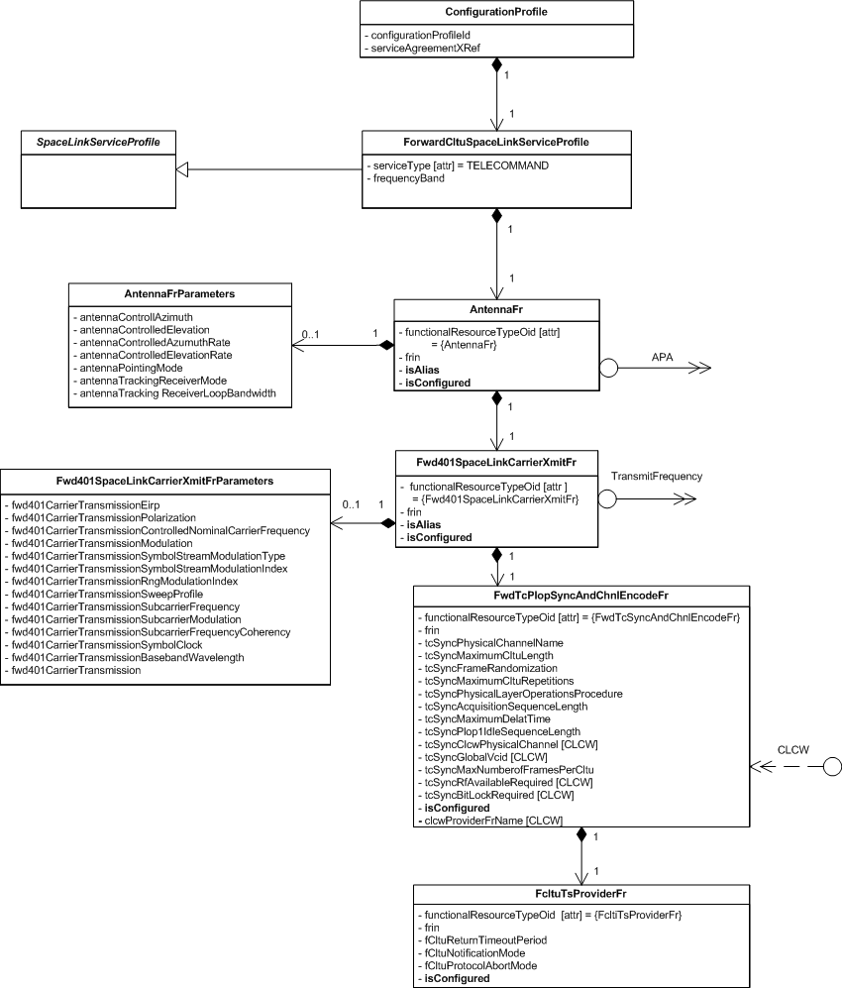
  Forward CLTU Service Configuration Profile UML Classes

Slide 14
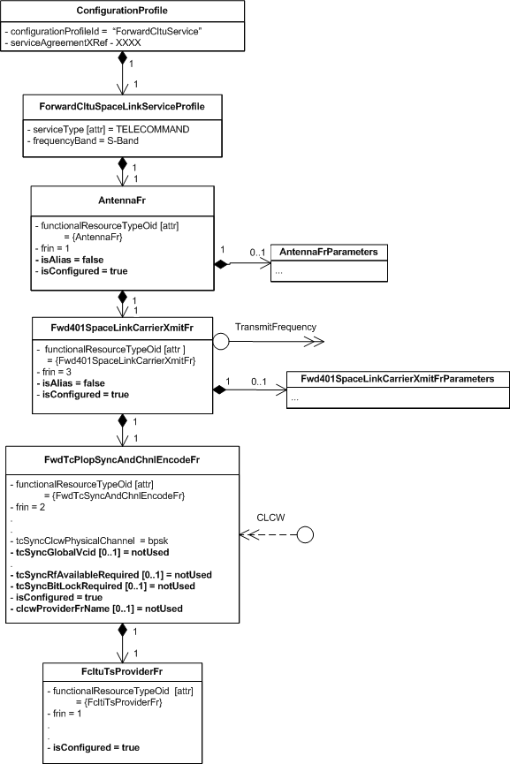
  Forward CLTU Service Configuration Profile Example (Instantiated Objects)
All isConfigured parameters are set to true
  All FRs will be included in a scheduled Service Package unless respecified out
All isAlias parameters are set to false
  All FR Parameters objects are included and fully populated, and will be used in a scheduled Service Package unless respecified out by setting isAlias to true
Parameters related to the optional CLCW required interface are set to notUsed
  They must be respecified in a Service Package if CLCWs are to be used

Slide 15
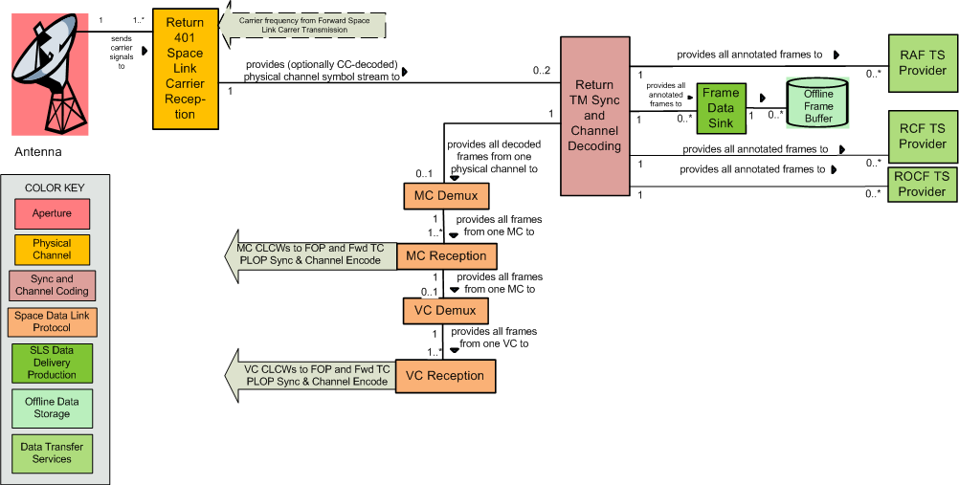
Return Online Real-Time Communication Space Link Service Profile (Informal Representation)

Slide 16
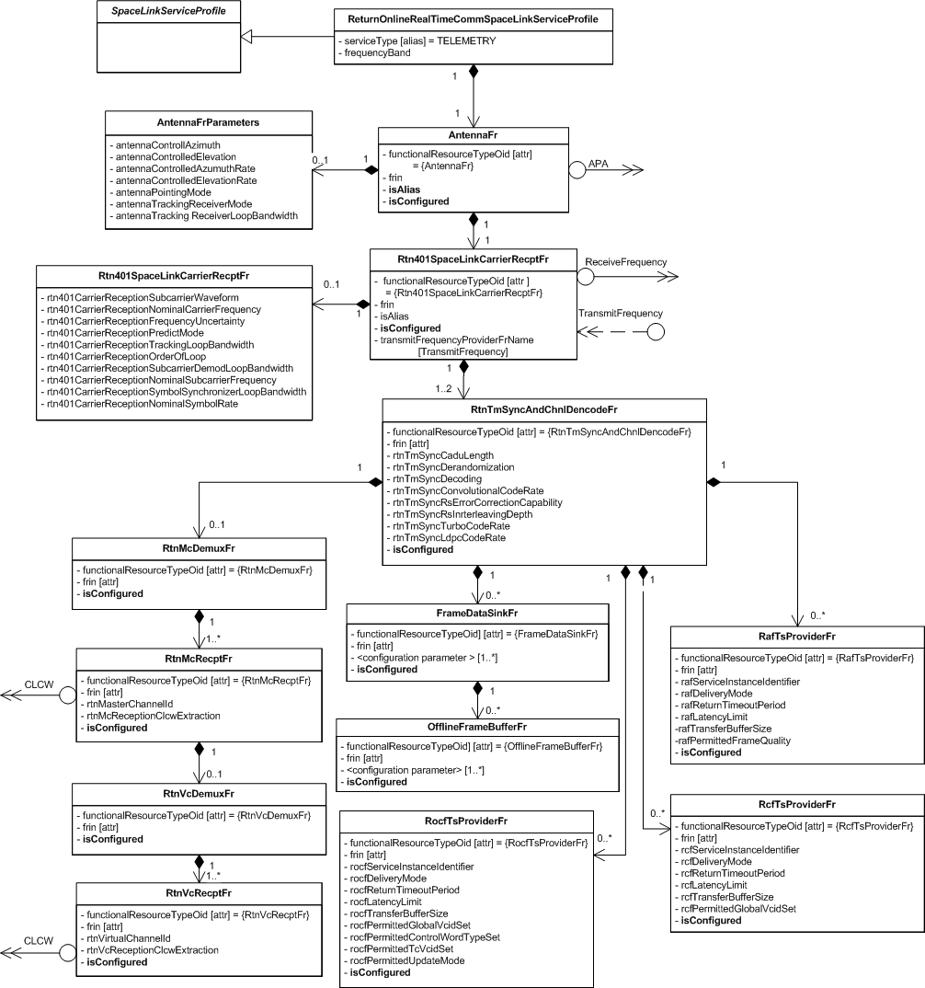
Return Online Real-Time Communication Space Link Service Profile UML Classes

Slide 17
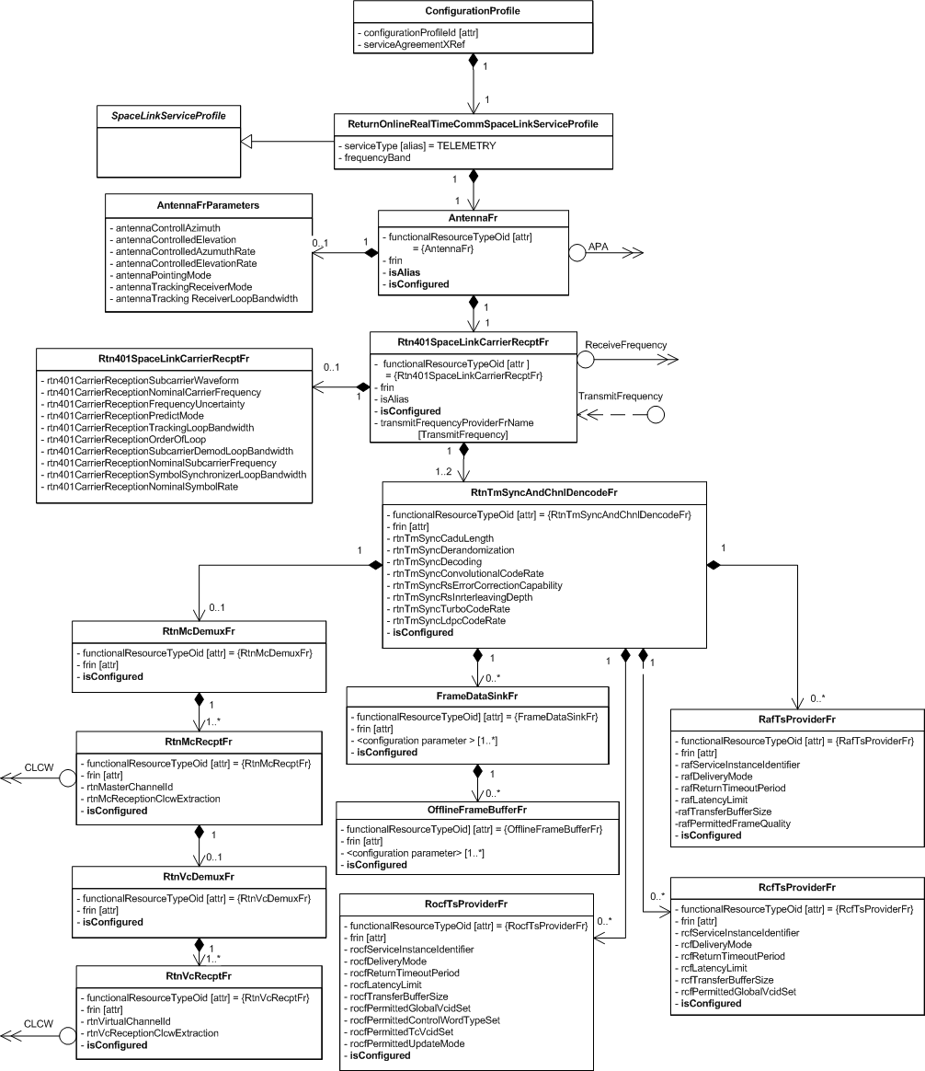
Return Online Real-Time Communication Configuration Profile UML Classes

Slide 18
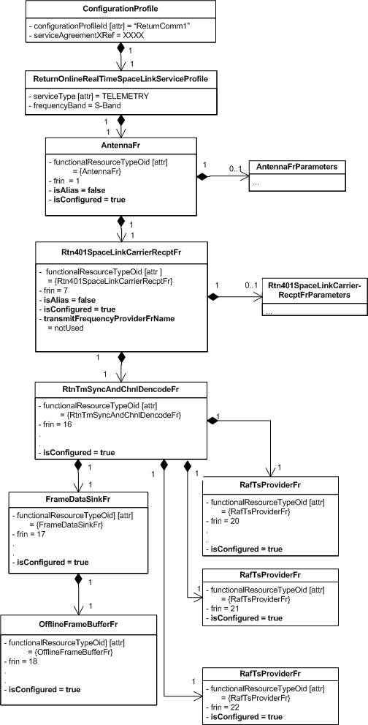
Return Online Real-Time Communication Configuration Profile Example

Slide 19
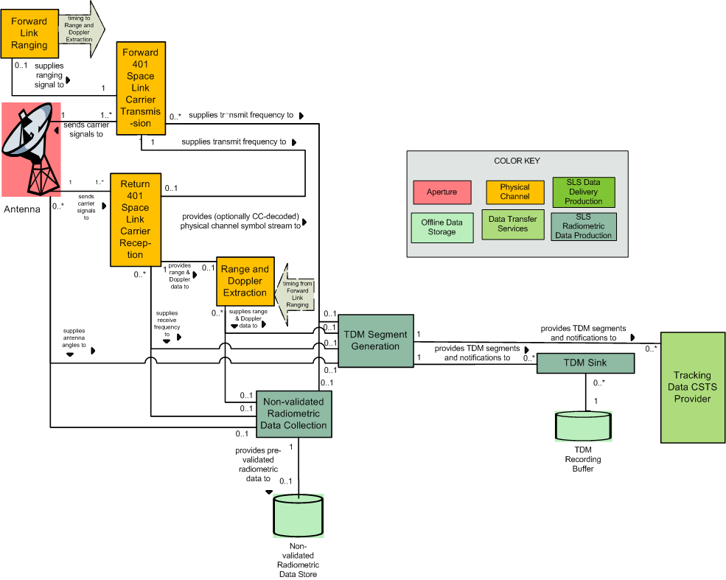
Online Real-Time Tracking Space Link Service Profile (Informal Representation)
Used for
  APA AZ/EL
  APA X/Y
  Doppler
  Ranging
These are ancillary,
not primary, interfaces,

Slide 20
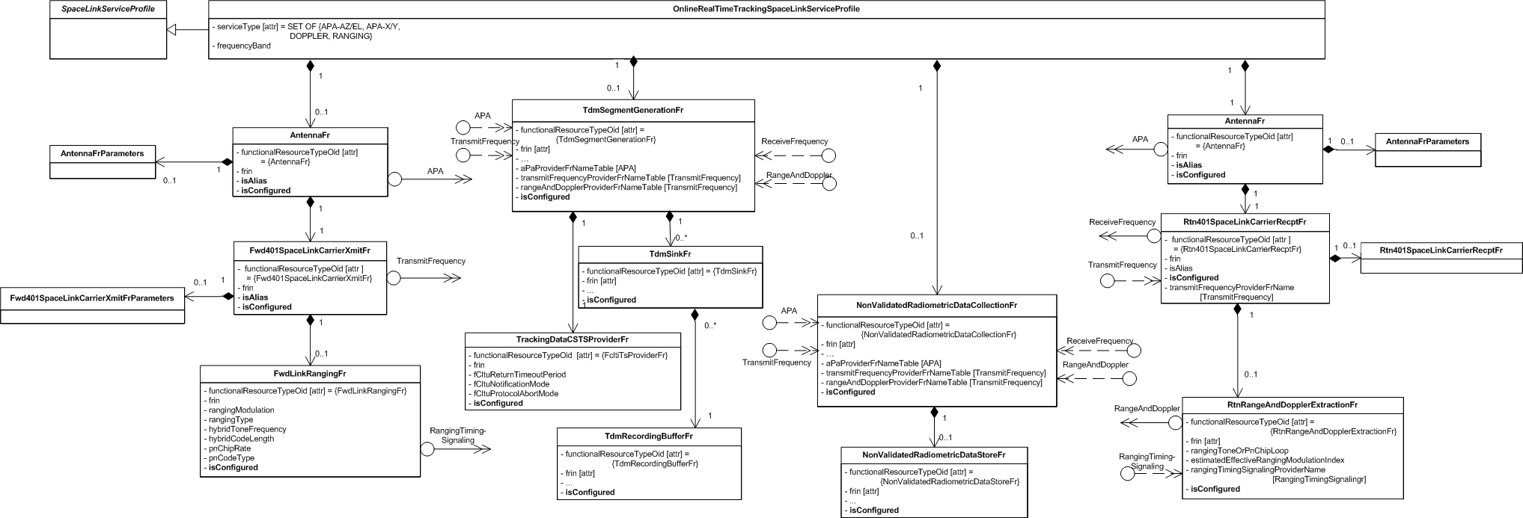
Online Real-Time Tracking Space Link Service Profile UML Classes

Slide 21
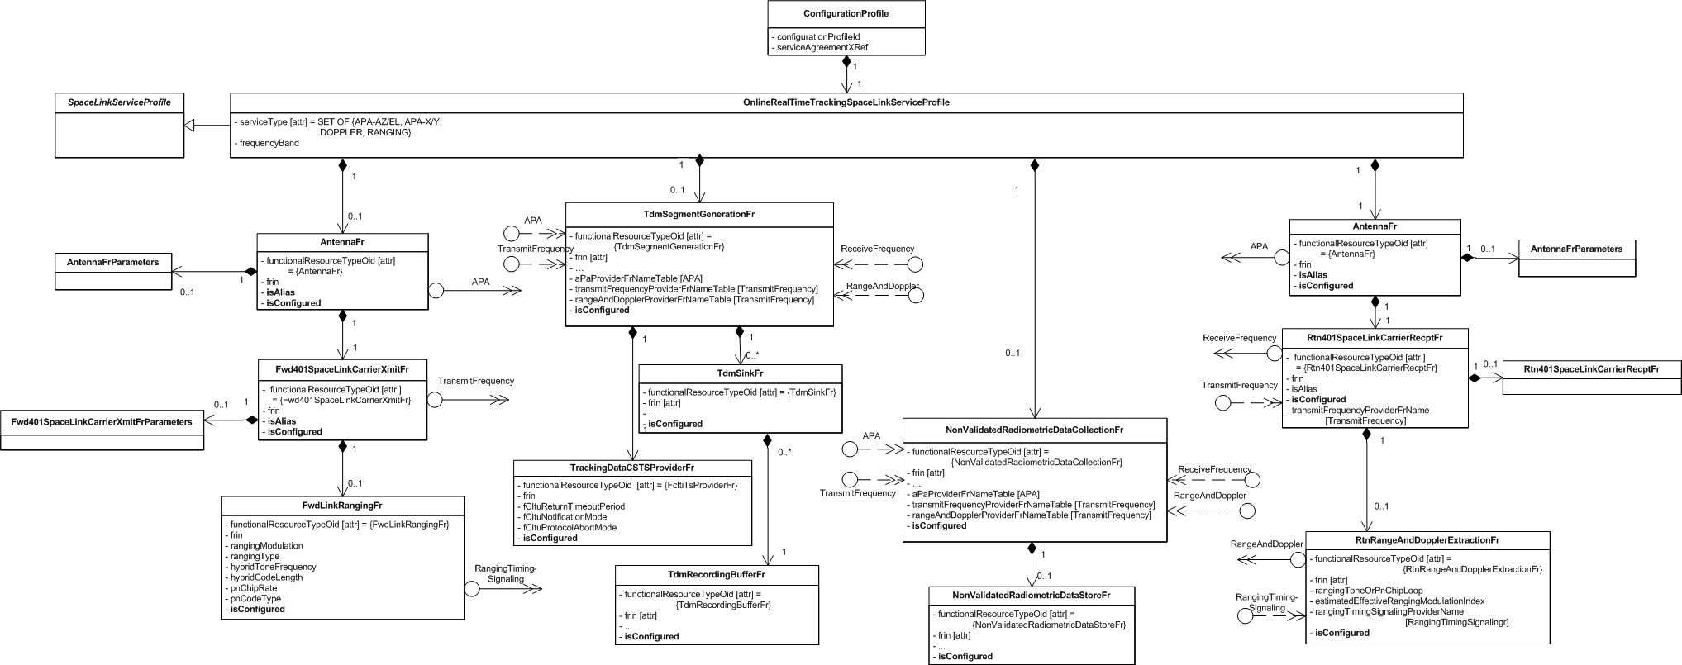
Online Real-Time Tracking Configuration Profile UML Classes

Slide 22
Example Service Package Using Forward CLTU Service and Return Comm 1 ConfigProfiles
Service Package contains (references) the Forward CLTU and Return Comm 1configuration profiles
  Forward CLTU Service starts 2 minutes after beginning of Service Package, ends 10 minutes before end of Service Package
  Return Online Real Time Communication service starts and ends concurrently with the Service Package
Respecifications in the Service Package:
  Link Forward TC PLOP Sync and Channel Encoding FR to Return VC Reception FR that supplies CLCWs for GVCID {1:15:3}
  Set Link Forward TC PLOP Sync and Channel Encoding FR to use RF Available and Bit Lock flags in CLCWs
  Make the return link Antenna an alias of the forward link Antenna to share the single aperture
  Link the Return 401 Space Link Carrier FR to the Forward 401 Space Link Carrier FR as the provider of the Transmit Frequency to which the return link is to be made coherent
    Also (not shown) reconfigure any other parameter of the Return 401 Space Link Carrier FR to make it coherent
  Set RAF TS Provider Instance isConfigured to false so that it is not scheduled

Slide 23
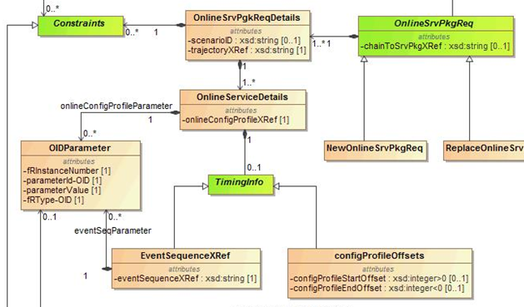
SMURF – Online Service Package Request Details

Slide 24
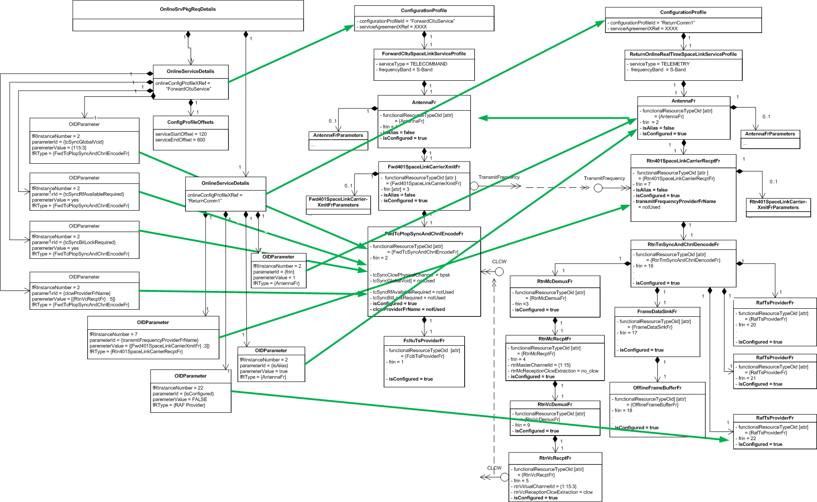
Example Service Package Using the Forward CLTU Service and Return Comm 1 Config Profiles
Respecifications are used to link the forward and return profiles

Slide 25
Flexibility in Developing Mission Configuration Profiles
“Pre-connected” single Space Link Service Configuration Profiles to minimize need for Service Package respecifications
  Forward CLTU with CLCW configuration profile
  Coherent Return configuration profile
Multiple space link services pre-connected in a single configuration profile
  CombinedForwardAndReturn configuration profile

Slide 26
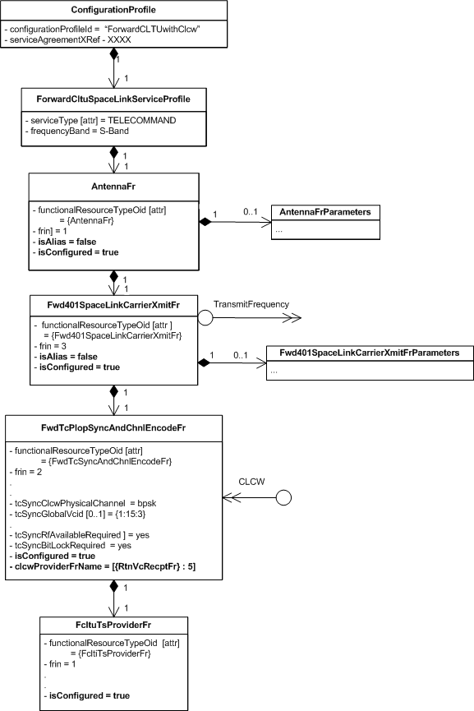
  Forward CLTU with CLCW Configuration Profile
Profile is preconfigured be used
in conjunction with a return comm
service configuration profile that
supplies VC-CLCWs for
VC {1:15:3} via RtnVcRecptFr #5

Slide 27
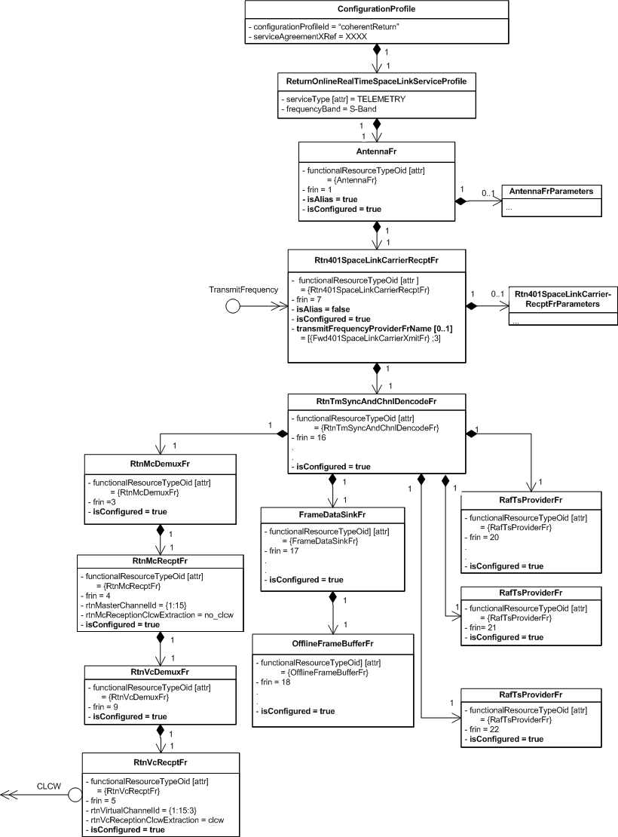
Coherent Return Configuration Profile
Profile has Antenna parameters defined
but is preconfigured to be an Alias of
the Antenna with FRIN = 1
(creating the profile with the parameters
allows it to be used with a separate
Antenna if necessary)
This configuration profile is
preconfigured to be used in conjunction
with a forward comm service
configuration profile that
supplies Transmit Frequency via
Fwd401SpaceLionkCarrierXmitFr #7

Slide 28
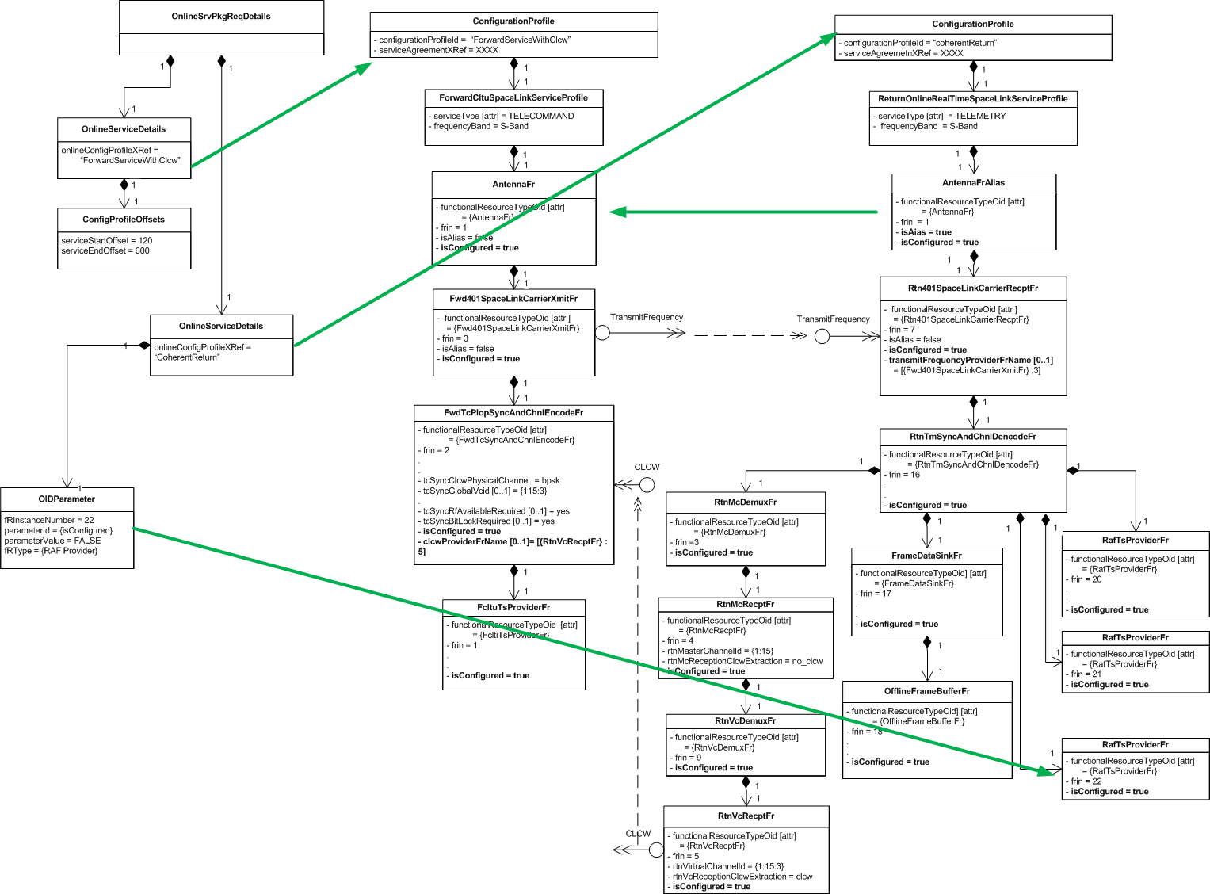
Example Service Package Using the Coherent Return and Forward CLTU With Clcw Configuration Profiles
Only respecification is to
disable 3rd RAF instance
28

Slide 29
Single Configuration Profile Containing Multiple Space Link Service Profiles
Can be used to pre-connect all nominal interfaces between service profiles, e.g.,
  Link Forward TC PLOP Sync and Channel Encoding FR to Return VC Reception FR that supplies CLCWs
  Set Link Forward TC PLOP Sync and Channel Encoding FR to use RF Available and Bit Lock flags in CLCWs
  Make the return link Antenna an alias of the forward link Antenna to share the single aperture
  Link the Return 401 Space Link Carrier FR to the Forward 401 Space Link Carrier FR as the provider of the Transmit Frequency to which the return link is to be made coherent
All services with the same configuration profile get the same start and stop time offsets when used in a Service Package

Slide 30
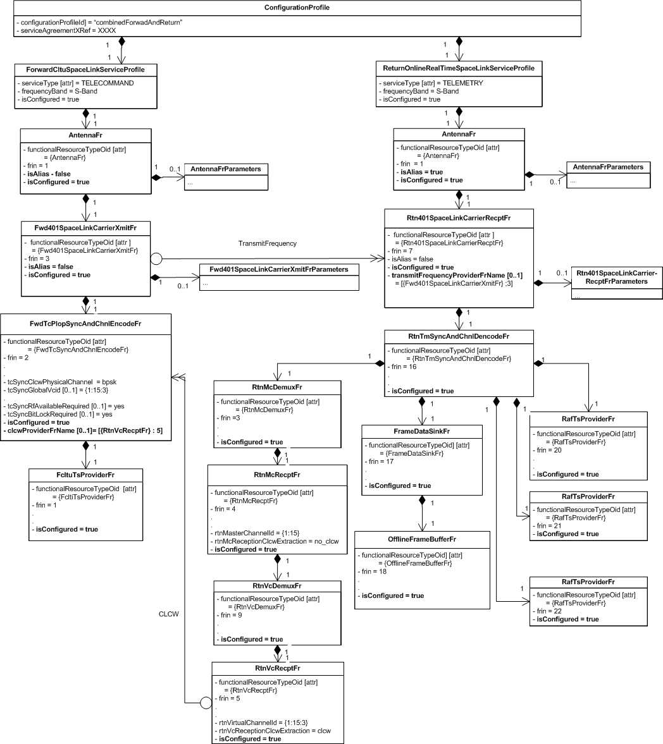
Combine Forward and Return Service Configuration Profile
isAlias = true requires that this
Config Profile be used in conjunction
with a Config Profile that specifies
the Antenna FR configuration
isAlias = true indicates that these
parameters are ignored

Slide 31
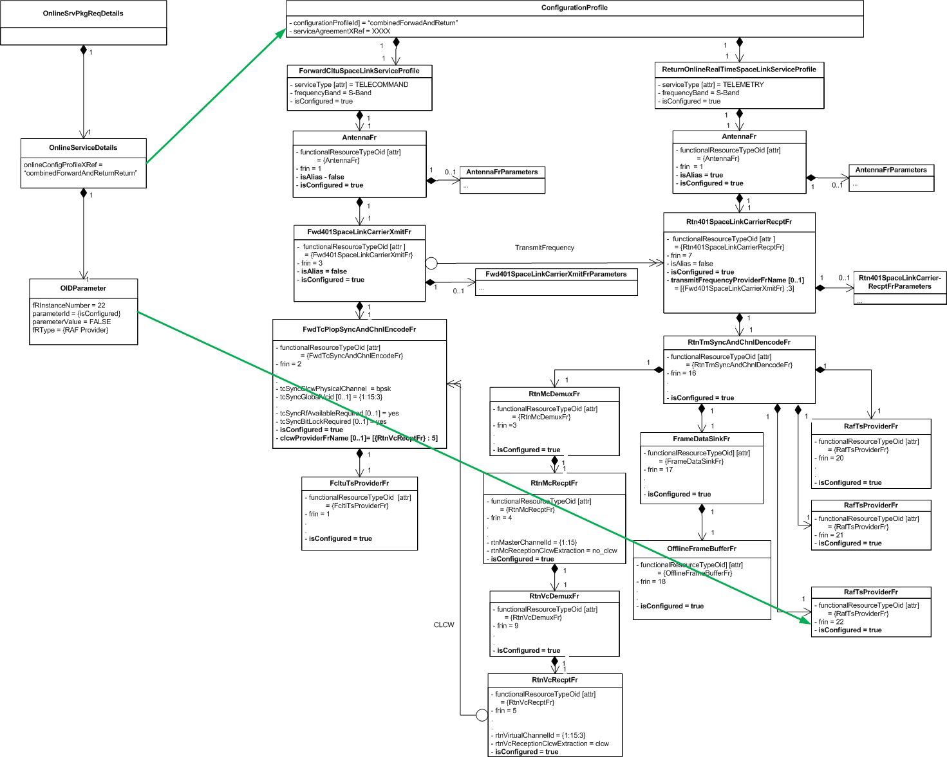
Service Package Using the Combined Forward and Return Service Configuration Profile
Only respecification is to
disable 3rd RAF instance
When the combined Configuration
Profile is used in a Service Package,
both services have the same start and
stop time offsets (concurrent with
Service Package times)

Slide 32
Multi-Service Configuration Profiles vs. Multiple Single Service Configuration Profiles
Multi-service configuration profiles
  Advantages
    Inter-service relationship information is internal to the configuration profile
    Routinely-used groups of services called in with only one reference
  Disadvantages
    All services in config profile share the same offsets
    The same Service Profile has to be repeated in each Configuration Profile that uses it
Multiple single-service configuration profiles
  Advantages
    Each service can have its own timing offsets
    Unique Service Profiles need to be created only once each
  Disadvantages
    Inter-service relationship info may have to be “wired up” by Service Package Request
      Possible mitigation: default connections that are only re-specfied if needed

Slide 33
Backup

Slide 34
Current Baseline Space Link Service Profiles
8 Forward Communication Space Link Service Profiles
  Forward CLTU > TELECOMMAND
  Telecommand Real-Time Multiplexed > TELECOMMAND
  Forward AOS CADU > TELECOMMAND
  Forward AOS Frame > TELECOMMAND
  Forward AOS Multiplexed > TELECOMMAND
  (Telecommand File Multiplexed*) > TELECOMMAND
  (Forward AOS File Multiplexed*) > TELECOMMAND
  (Forward CLTU with ROCF*) > TELECOMMAND
5 Return Communication Space Link Service Profiles
  Return Online Real-Time Communication > TELEMETRY, OFFLINE-TM-RECORDING
  Offline Return All Frames Delivery > OFFLINE-TM-PROVISION
  Offline Return Channel Frames Delivery > OFFLINE-TM-PROVISION
  Return Online File Communication** > TELEMETRY, OFFLINE-TM-RECORDING
  Offline Return File Delivery** > OFFLINE-TM-PROVISION
4 Radiometric Space Link Service Profiles
  Online Real-Time Tracking Data > APA-AZ/EL, APA-X/Y, RANGING, DOPPLER
  Online Delta-DOR Data Collection > DELTADOR
  Online Open Loop Data Collection > RF-ONLY
  Offline Real-Time Tracking Data Delivery > No service in the Simple Schedule
*Services require capabilities that have not yet been specified
**Offline Return File Delivery is also used for Delta-DOR and Open Loop data delivery

Slide 35
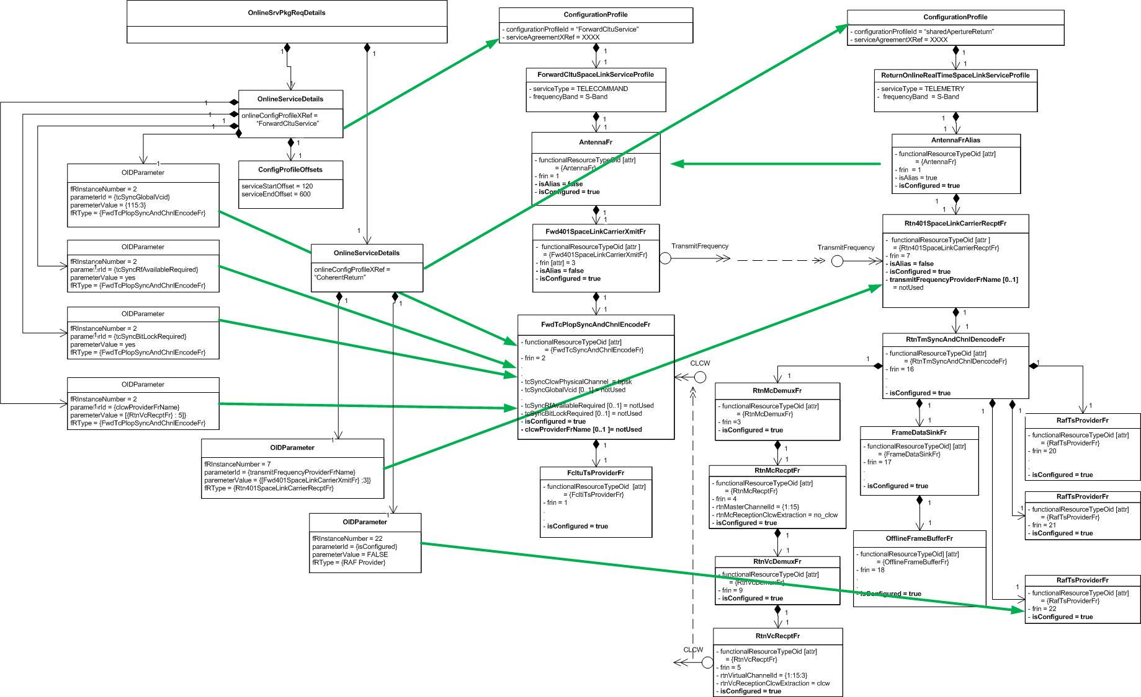
Service Package Combining forwardCltuService and sharedApertureReturn Config Profiles
The two separate Configuration Profiles have separate offsets

Slide 36
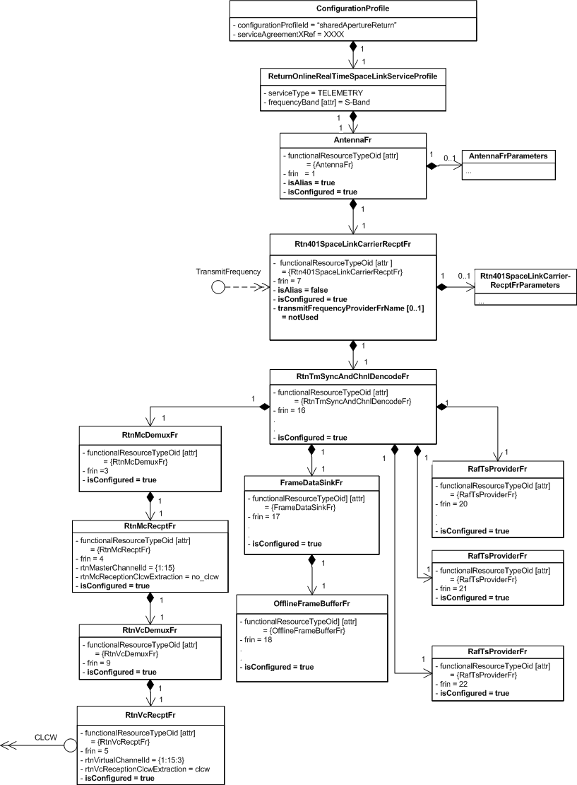
Shared Aperture Return Configuration Profile
isAlias = true requires that this
Config Profile be used in conjunction
with a Config Profile that specifies
the Antenna FR configuration
Optional TransmitFrequency
required interface parameter
is set to notUsed; must be
respecfied in Service Package to
make the return link coherent
isAlias = true indicates that these
parameters are ignored

Slide 37
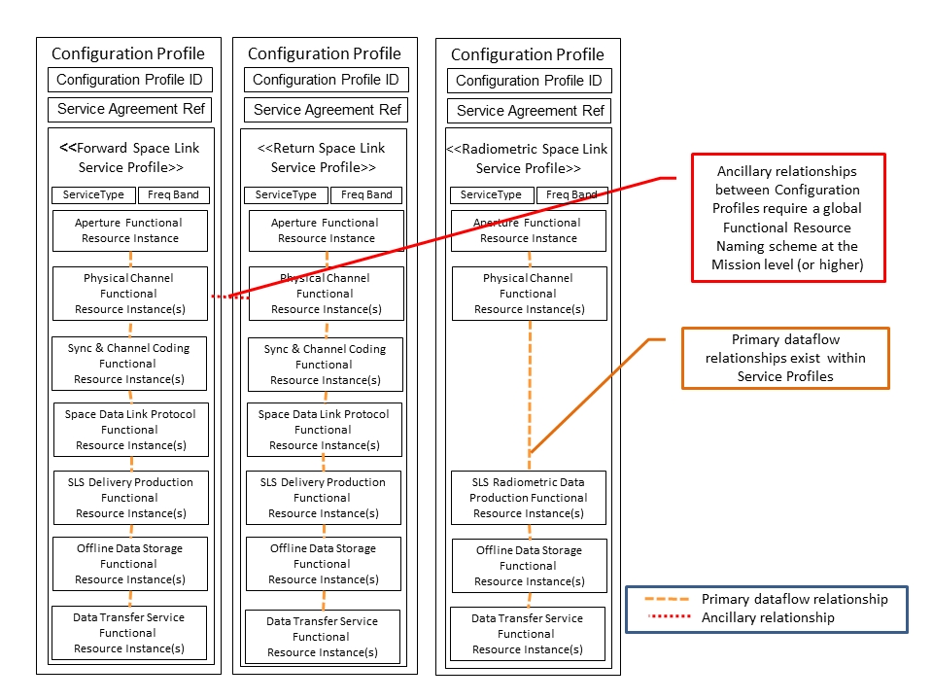
3 Configuration Profiles, Each Composed of a Single Space Link Service Profile (Stereotypical)

Slide 38
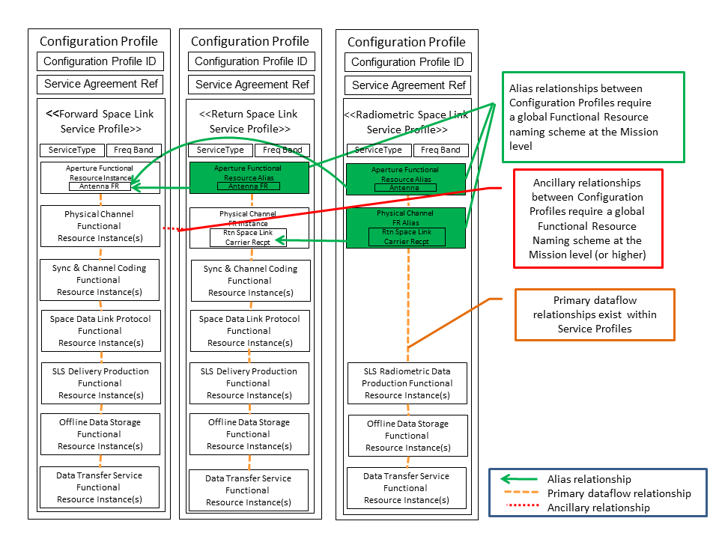
3 Configuration Profiles, Each Composed of a Single Space Link Service Profile with Aliases

Slide 39
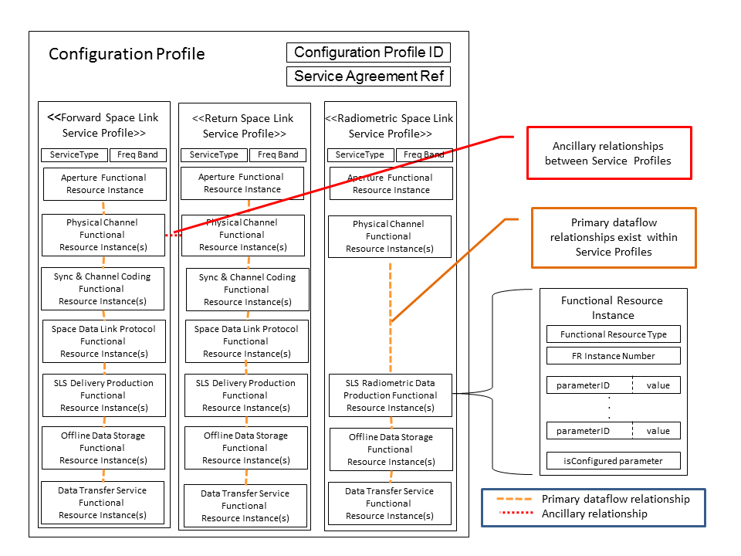
Configuration Profile Composed of Three Space Link Service Profiles (Stereotypical)

Slide 40
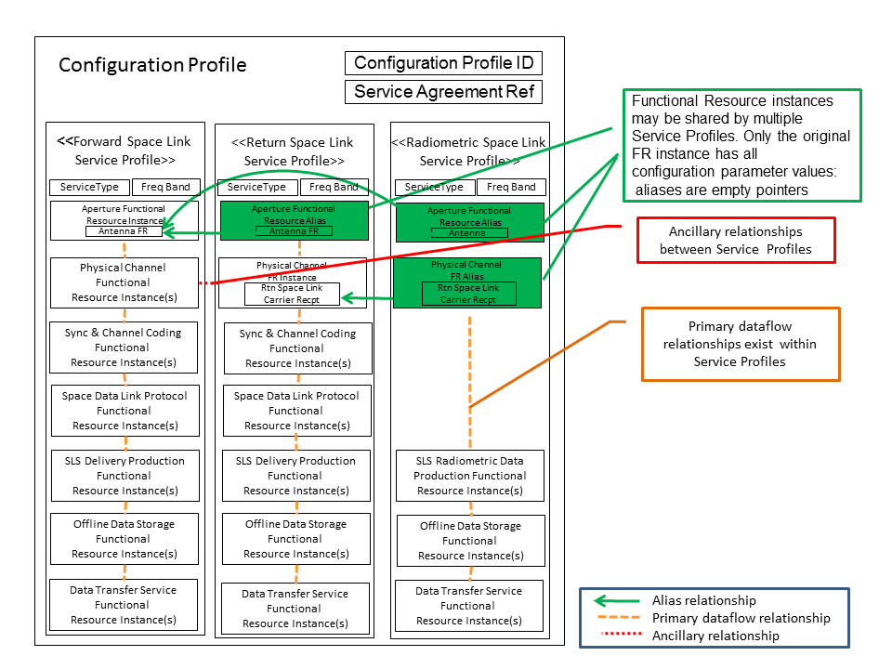
Configuration Profile Composed of Three Space Link Service Profiles with Aliases (Stereotypical)

Slide 41
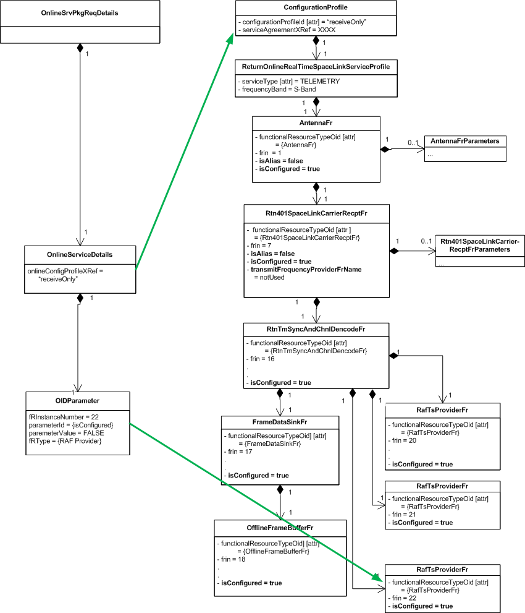
Service Package Containing Receive-Only Configuration Profile

