Slide 1
CCSDS Scheduling interface - ESA implementation 2017
Martin Unal
07/11/2017

Slide 2
Objectives
Implement a CCSDS based interface to request/provide operational spacecraft supports from/to external entity.
Harmonise interface & processes
Reduce effort in the establishment of interface with new partner
Flexible implementation allowing the future evolution of the standard
User/Provider implementation to ease testing

Slide 3
Standard version
The implementation is based on the following CCSDS publications :
[AD1] Simple Planning Request CCSDS Draft 902.9.0.00
[AD2] Simple Schedule CCSDS 902.1-R1

Slide 4
Partners
The interface is now in use between ESOC and
INTA (Spain) for CLUSTER and METOP support
RKPNI (Russia) for EXOMARS support
It is foreseen to use it with DLR for INTEGRAL support to replace the old email based exchange.
In the future, ESOC intend to migrate legacy interface already in place with DSN, KSAT and SSC.

Slide 5
Sample new request
<?xml version="1.0" encoding="UTF-8"?>
<SrvMgtUtilReq xmlns="urn:ccsds:schema:cssm:1.0.0"
xmlns:fn="http://www.w3.org/2005/xpath-functions"
xmlns:xsi="http://www.w3.org/2001/XMLSchema-instance"
xmlns:xs="http://www.w3.org/2001/XMLSchema"
xmlns:xmi="http://www.omg.org/XMI"
xmlns:ems="http://esa.egos.ems"
xmlns:emsmodel="platform:/resource/esa.egos.ems.portal.model/schemas/Ems.xsd"
xsi:schemaLocation="urn:ccsds:schema:cssm:1.0.0 SchemaCssmSmurf-v1_0_0.xsd http://esa.egos.ems EmsExternal.xsd">
<srvMgtEntityType>SERV_PACKAGE_REQ</srvMgtEntityType>
<srvMgtUtilReqHeader originatingOrganization="ESA"
generationTime="2017-297T13:31:02.000Z"
status="OPERATIONAL"
version="1"
startTime="2017-322T19:35:00.000Z"
endTime="2017-322T20:58:00.000Z"
purpose=""
description=""/>
<newSrvPkg user="CL1"
requestID=""
serviceAgreementXRef="CLUSTER_Routine_2.Cluster_1_US.Cluster_1_USD.CL1"
comment="ESOC MCP"
serviceReqID="OSSUPD_20171118T193500_20171118T205800_20171024T133102_v01-00.CLU1-O">
<basicStartTimeConstraint preferredStartTime="2017-322T19:45:00.000Z"
earliestStartTime="2017-322T19:45:00.000Z"
latestStartTime="2017-322T19:45:00.000Z"/>
<basicDurationConstraint preferredDuration="PT58M" minDuration="PT58M" maxDuration="PT58M"/>
<basicApertureConstraint siteRef="MSP1" apertureRef="MSP1" priority="1"/>
</newSrvPkg>
</SrvMgtUtilReq>

Slide 6
Sample new request – Field used
<?xml version="1.0" encoding="UTF-8"?>
<SrvMgtUtilReq xmlns="urn:ccsds:schema:cssm:1.0.0"
xmlns:fn="http://www.w3.org/2005/xpath-functions"
xmlns:xsi="http://www.w3.org/2001/XMLSchema-instance"
xmlns:xs="http://www.w3.org/2001/XMLSchema"
xmlns:xmi="http://www.omg.org/XMI"
xmlns:ems="http://esa.egos.ems"
xmlns:emsmodel="platform:/resource/esa.egos.ems.portal.model/schemas/Ems.xsd"
xsi:schemaLocation="urn:ccsds:schema:cssm:1.0.0 SchemaCssmSmurf-v1_0_0.xsd http://esa.egos.ems EmsExternal.xsd">
<srvMgtEntityType>SERV_PACKAGE_REQ</srvMgtEntityType>
<srvMgtUtilReqHeader originatingOrganization="ESA"
generationTime="2017-297T13:31:02.000Z"
status="OPERATIONAL"
version="1"
startTime="2017-322T19:35:00.000Z"
endTime="2017-322T20:58:00.000Z"
purpose=""
description=""/>
<newSrvPkg user="CL1"
requestID=""
serviceAgreementXRef="CLUSTER_Routine_2.Cluster_1_US.Cluster_1_USD.CL1"
comment="ESOC MCP"
serviceReqID="OSSUPD_20171118T193500_20171118T205800_20171024T133102_v01-00.CLU1-O">
<basicStartTimeConstraint preferredStartTime="2017-322T19:45:00.000Z"
earliestStartTime="2017-322T19:45:00.000Z"
latestStartTime="2017-322T19:45:00.000Z"/>
<basicDurationConstraint preferredDuration="PT58M" minDuration="PT58M" maxDuration="PT58M"/>
<basicApertureConstraint siteRef="MSP1" apertureRef="MSP1" priority="1"/>
</newSrvPkg>
</SrvMgtUtilReq>

Slide 7
Sample update request
<?xml version="1.0" encoding="UTF-8"?>
<SrvMgtUtilReq xmlns="urn:ccsds:schema:cssm:1.0.0"
xmlns:fn="http://www.w3.org/2005/xpath-functions"
xmlns:xsi="http://www.w3.org/2001/XMLSchema-instance"
xmlns:xs="http://www.w3.org/2001/XMLSchema"
xmlns:xmi="http://www.omg.org/XMI"
xmlns:ems="http://esa.egos.ems"
xmlns:emsmodel="platform:/resource/esa.egos.ems.portal.model/schemas/Ems.xsd"
xsi:schemaLocation="urn:ccsds:schema:cssm:1.0.0 SchemaCssmSmurf-v1_0_0.xsd http://esa.egos.ems EmsExternal.xsd">
<srvMgtEntityType>SERV_PACKAGE_REQ</srvMgtEntityType>
<srvMgtUtilReqHeader originatingOrganization="ESA"
generationTime="2017-297T13:31:02.000Z"
status="OPERATIONAL"
version="1"
startTime="2017-321T02:24:00.000Z"
endTime="2017-321T08:50:00.000Z"
purpose=""
description=""/>
<updateSrvPkg user="CL3"
requestID="CLU3_2017_321_030900_S__"
serviceAgreementXRef="CLUSTER_Routine_2.Cluster_3_US.Cluster_3_USD.CL3"
comment="ESOC MCP"
serviceReqID="OSSUPD_20171117T022400_20171117T085000_20171024T133102_v01-00.CLU3-O">
<basicStartTimeConstraint preferredStartTime="2017-321T03:09:00.000Z"
earliestStartTime="2017-321T03:09:00.000Z"
latestStartTime="2017-321T03:09:00.000Z"/>
<basicDurationConstraint preferredDuration="PT5H26M"
minDuration="PT5H26M"
maxDuration="PT5H26M"/>
<basicApertureConstraint siteRef="VIL1" apertureRef="VIL1" priority="1"/>
</updateSrvPkg>
</SrvMgtUtilReq>

Slide 8
Sample update request – Field used
<?xml version="1.0" encoding="UTF-8"?>
<SrvMgtUtilReq xmlns="urn:ccsds:schema:cssm:1.0.0"
xmlns:fn="http://www.w3.org/2005/xpath-functions"
xmlns:xsi="http://www.w3.org/2001/XMLSchema-instance"
xmlns:xs="http://www.w3.org/2001/XMLSchema"
xmlns:xmi="http://www.omg.org/XMI"
xmlns:ems="http://esa.egos.ems"
xmlns:emsmodel="platform:/resource/esa.egos.ems.portal.model/schemas/Ems.xsd"
xsi:schemaLocation="urn:ccsds:schema:cssm:1.0.0 SchemaCssmSmurf-v1_0_0.xsd http://esa.egos.ems EmsExternal.xsd">
<srvMgtEntityType>SERV_PACKAGE_REQ</srvMgtEntityType>
<srvMgtUtilReqHeader originatingOrganization="ESA"
generationTime="2017-297T13:31:02.000Z"
status="OPERATIONAL"
version="1"
startTime="2017-321T02:24:00.000Z"
endTime="2017-321T08:50:00.000Z"
purpose=""
description=""/>
<updateSrvPkg user="CL3"
requestID="CLU3_2017_321_030900_S__"
serviceAgreementXRef="CLUSTER_Routine_2.Cluster_3_US.Cluster_3_USD.CL3"
comment="ESOC MCP"
serviceReqID="OSSUPD_20171117T022400_20171117T085000_20171024T133102_v01-00.CLU3-O">
<basicStartTimeConstraint preferredStartTime="2017-321T03:09:00.000Z"
earliestStartTime="2017-321T03:09:00.000Z"
latestStartTime="2017-321T03:09:00.000Z"/>
<basicDurationConstraint preferredDuration="PT5H26M"
minDuration="PT5H26M"
maxDuration="PT5H26M"/>
<basicApertureConstraint siteRef="VIL1" apertureRef="VIL1" priority="1"/>
</updateSrvPkg>
</SrvMgtUtilReq>

Slide 9
Sample delete request
<?xml version="1.0" encoding="UTF-8"?>
<SrvMgtUtilReq xmlns="urn:ccsds:schema:cssm:1.0.0"
xmlns:fn="http://www.w3.org/2005/xpath-functions"
xmlns:xsi="http://www.w3.org/2001/XMLSchema-instance"
xmlns:xs="http://www.w3.org/2001/XMLSchema"
xmlns:xmi="http://www.omg.org/XMI"
xmlns:ems="http://esa.egos.ems"
xmlns:emsmodel="platform:/resource/esa.egos.ems.portal.model/schemas/Ems.xsd"
xsi:schemaLocation="urn:ccsds:schema:cssm:1.0.0 SchemaCssmSmurf-v1_0_0.xsd http://esa.egos.ems EmsExternal.xsd">
<srvMgtEntityType>SERV_PACKAGE_REQ</srvMgtEntityType>
<srvMgtUtilReqHeader originatingOrganization="ESA"
generationTime="2017-297T13:31:02.000Z"
status="OPERATIONAL"
version="1"
startTime="2017-309T11:13:00.000Z"
endTime="2017-309T18:50:00.000Z"
purpose=""
description=""/>
<deleteSrvPkg user="CL1"
requestID="CLU1_2017_309_115800_S__"
serviceAgreementXRef="CLUSTER_Routine_2.Cluster_1_US.Cluster_1_USD.CL1"
comment="ESOC MCP"
serviceReqID="CLU1_2017_309_115800_S__">
<basicApertureConstraint siteRef="MSP1" apertureRef="MSP1" priority="1"/>
</deleteSrvPkg>
</SrvMgtUtilReq>

Slide 10
Sample delete request – Field used
<?xml version="1.0" encoding="UTF-8"?>
<SrvMgtUtilReq xmlns="urn:ccsds:schema:cssm:1.0.0"
xmlns:fn="http://www.w3.org/2005/xpath-functions"
xmlns:xsi="http://www.w3.org/2001/XMLSchema-instance"
xmlns:xs="http://www.w3.org/2001/XMLSchema"
xmlns:xmi="http://www.omg.org/XMI"
xmlns:ems="http://esa.egos.ems"
xmlns:emsmodel="platform:/resource/esa.egos.ems.portal.model/schemas/Ems.xsd"
xsi:schemaLocation="urn:ccsds:schema:cssm:1.0.0 SchemaCssmSmurf-v1_0_0.xsd http://esa.egos.ems EmsExternal.xsd">
<srvMgtEntityType>SERV_PACKAGE_REQ</srvMgtEntityType>
<srvMgtUtilReqHeader originatingOrganization="ESA"
generationTime="2017-297T13:31:02.000Z"
status="OPERATIONAL"
version="1"
startTime="2017-309T11:13:00.000Z"
endTime="2017-309T18:50:00.000Z"
purpose=""
description=""/>
<deleteSrvPkg user="CL1"
requestID="CLU1_2017_309_115800_S__"
serviceAgreementXRef="CLUSTER_Routine_2.Cluster_1_US.Cluster_1_USD.CL1"
comment="ESOC MCP"
serviceReqID="CLU1_2017_309_115800_S__">
<basicApertureConstraint siteRef="MSP1" apertureRef="MSP1" priority="1"/>
</deleteSrvPkg>
</SrvMgtUtilReq>

Slide 11
Sample reply
<?xml version="1.0" encoding="utf-8"?>
<simpleSchedule xmlns="urn:ccsds:schema:cssm:1.0.0"
xmlns:fn="http://www.w3.org/2005/02/xpath-functions"
xmlns:emsmodel="platform:/resource/esa.egos.ems.portal.model/schemas/Ems.xsd"
xmlns:xsi="http://www.w3.org/2001/XMLSchema-instance" xmlns:xmi="http://www.omg.org/XMI"
xmlns:ems="http://esa.egos.ems"
xsi:schemaLocation="urn:ccsds:schema:cssm:1.0.0 SchemaCssmSimpleSchedule-v1_0_0_b1.xsd http://esa.egos.ems EmsExternal.xsd">
<srvMgtEntityType>SIMPLE_SCHEDULE</srvMgtEntityType>
<simpleScheduleHeader originatingOrganization="INTA" generationTime="2017-243T13:44:47.889Z"
status="OPERATIONAL" version="1" startTime="2017-235T08:32:12.000Z"
endTime="2017-273T17:35:00.000Z" purpose="INTA response" description="Schedule response">
<stringParameter name="contentFilter" value="INTAMSP" />
</simpleScheduleHeader>
<scheduledPackage scheduledPackageId="CLU3_2017_242_082600_S__" user="CL3" comment="">
<servicePackageXRef serviceAgreementRef="CLUSTER_Routine_2.Cluster_3_US.Cluster_3_USD.CL3"
servicePackageRef="CLU3_2017_242_082600_S__" />
<scheduledActivity scheduledActivityId="CLU3_2017_242_082600_S__" activityStatus="COMMITTED"
siteRef="MSP1" apertureRef="MSP1" beginningOfActivity="2017-242T08:16:01.000Z"
beginningOfTrack="2017-242T08:26:00.000Z" endOfTrack="2017-242T09:00:00.000Z"
endOfActivity="2017-242T09:15:00.000Z">
<serviceInfo serviceType="TBD" />
</scheduledActivity>
</scheduledPackage>
<scheduledPackage scheduledPackageId="META_2017_243_095029_S__" user="META" comment="">
<servicePackageXRef serviceAgreementRef="METOP_A_Routine_1.on_request.Metop-B.METB"
servicePackageRef="META_2017_243_095029_S__" />
<scheduledActivity scheduledActivityId="META_2017_243_095029_S__" activityStatus="COMMITTED"
siteRef="MSP1" apertureRef="MSP1" beginningOfActivity="2017-243T09:05:29.000Z"
beginningOfTrack="2017-243T09:50:29.000Z" endOfTrack="2017-243T10:04:43.000Z"
endOfActivity="2017-243T10:04:43.000Z">
<serviceInfo serviceType="TBD" />
</scheduledActivity>
</scheduledPackage>
</simpleSchedule>

Slide 12
Sample reply – Field used
<?xml version="1.0" encoding="utf-8"?>
<simpleSchedule xmlns="urn:ccsds:schema:cssm:1.0.0"
xmlns:fn="http://www.w3.org/2005/02/xpath-functions"
xmlns:emsmodel="platform:/resource/esa.egos.ems.portal.model/schemas/Ems.xsd"
xmlns:xsi="http://www.w3.org/2001/XMLSchema-instance" xmlns:xmi="http://www.omg.org/XMI"
xmlns:ems="http://esa.egos.ems"
xsi:schemaLocation="urn:ccsds:schema:cssm:1.0.0 SchemaCssmSimpleSchedule-v1_0_0_b1.xsd http://esa.egos.ems EmsExternal.xsd">
<srvMgtEntityType>SIMPLE_SCHEDULE</srvMgtEntityType>
<simpleScheduleHeader originatingOrganization="INTA" generationTime="2017-243T13:44:47.889Z"
status="OPERATIONAL" version="1" startTime="2017-235T08:32:12.000Z"
endTime="2017-273T17:35:00.000Z" purpose="INTA response" description="Schedule response">
<stringParameter name="contentFilter" value="INTAMSP" />
</simpleScheduleHeader>
<scheduledPackage scheduledPackageId="CLU3_2017_242_082600_S__" user="CL3" comment="">
<servicePackageXRef serviceAgreementRef="CLUSTER_Routine_2.Cluster_3_US.Cluster_3_USD.CL3"
servicePackageRef="CLU3_2017_242_082600_S__" />
<scheduledActivity scheduledActivityId="CLU3_2017_242_082600_S__" activityStatus="COMMITTED"
siteRef="MSP1" apertureRef="MSP1" beginningOfActivity="2017-242T08:16:01.000Z"
beginningOfTrack="2017-242T08:26:00.000Z" endOfTrack="2017-242T09:00:00.000Z"
endOfActivity="2017-242T09:15:00.000Z">
<serviceInfo serviceType="TBD" />
</scheduledActivity>
</scheduledPackage>
<scheduledPackage scheduledPackageId="META_2017_243_095029_S__" user="META" comment="">
<servicePackageXRef serviceAgreementRef="METOP_A_Routine_1.on_request.Metop-B.METB"
servicePackageRef="META_2017_243_095029_S__" />
<scheduledActivity scheduledActivityId="META_2017_243_095029_S__" activityStatus="COMMITTED"
siteRef="MSP1" apertureRef="MSP1" beginningOfActivity="2017-243T09:05:29.000Z"
beginningOfTrack="2017-243T09:50:29.000Z" endOfTrack="2017-243T10:04:43.000Z"
endOfActivity="2017-243T10:04:43.000Z">
<serviceInfo serviceType="TBD" />
</scheduledActivity>
</scheduledPackage>
</simpleSchedule>

Slide 13
Sample reply - RKPNI
<simpleSchedule xmlns:xsd="http://www.w3.org/2001/XMLSchema" xmlns:xsi="http://www.w3.org/2001/XMLSchema-instance" xmlns="urn:ccsds:schema:cssm:1.0.0"> <srvMgtEntityType>SIMPLE_SCHEDULE</srvMgtEntityType>
<simpleScheduleHeader originatingOrganization="RKPNI" generationTime="2017-223T02:00:02.025Z" status="TEST" version="1" startTime="2017-213T00:00:00.000Z" endTime="2017-244T00:00:00.000Z" purpose="" description="" />
<scheduledPackage scheduledPackageId="7f3fadfe-9c5c-e711-80dc-0cc47a15b33f" user="PROVIDER-CSSS“
originatingRequestId="944DD2EE-B672-4616-BD73-2E48EF2D8DF7">
<scheduledActivity scheduledActivityId="7f3fadfe-9c5c-e711-80dc-0cc47a15b33f" activityStatus="TENTATIVE" siteRef="BLK" apertureRef="BLK" beginningOfActivity="2017-090T22:59:00.000Z" beginningOfTrack="2017-091T00:00:00.000Z" endOfTrack="2017-241T00:00:00.000Z" endOfActivity="2017-241T01:03:00.000Z">
<serviceInfo serviceType="UNUSED" frequencyBand="ALL" /> </scheduledActivity> </scheduledPackage>
<scheduledPackage scheduledPackageId="2af1d9a1-0f5c-e711-80dc-0cc47a15b33f" user="EXMO" originatingRequestId="OSSUPD_20170813T024139_20170813T083000_20170621T084252_v01-00.EXMOBLK-O">
<servicePackageXRef serviceAgreementRef="TGO_1.daily_tracking.nominal_definition.EXMO" servicePackageRef="2af1d9a1-0f5c-e711-80dc-0cc47a15b33f" />
<stringParameter name="comment" value="Station is unavailable" />
<scheduledActivity scheduledActivityId="2af1d9a1-0f5c-e711-80dc-0cc47a15b33f" activityStatus="UNAVAILABLE" siteRef="BLK" apertureRef="BLK" beginningOfActivity="2017-225T01:40:39.000Z" beginningOfTrack="2017-225T02:41:39.000Z" endOfTrack="2017-225T08:30:00.000Z" endOfActivity="2017-225T09:33:00.000Z">
<serviceInfo serviceType="TBD" frequencyBand="X-BAND" /> </scheduledActivity> </scheduledPackage>
<scheduledPackage scheduledPackageId="6c697914-55e6-4cdf-a8ea-f52b4c6288fe" user="UNALLOCATED">
<scheduledActivity scheduledActivityId="6c697914-55e6-4cdf-a8ea-f52b4c6288fe" activityStatus="AVAILABLE" siteRef="BLK" apertureRef="BLK" beginningOfTrack="2017-241T01:03:00.000Z" endOfTrack="2017-244T00:00:00.000Z">
<serviceInfo serviceType="UNUSED" frequencyBand="X-BAND" /> </scheduledActivity> </scheduledPackage>
<scheduledPackage scheduledPackageId="3935edba-7374-e711-80de-0cc47a15b33f" user="EXMO" originatingRequestId="RKPNI_TEST.2017-213T11:48:00.000Z">
<servicePackageXRef serviceAgreementRef="RKPNI_TEST" servicePackageRef="3935edba-7374-e711-80de-0cc47a15b33f" />
<scheduledActivity scheduledActivityId="3935edba-7374-e711-80de-0cc47a15b33f" activityStatus="COMMITTED" siteRef="KLZ" apertureRef="KLZ" beginningOfActivity="2017-213T11:31:09.000Z" beginningOfTrack="2017-213T12:33:09.000Z" endOfTrack="2017-213T16:33:09.000Z" endOfActivity="2017-213T17:37:09.000Z">
<serviceInfo serviceType="TBD" frequencyBand="X-BAND" /> </scheduledActivity> </scheduledPackage></simpleSchedule>

Slide 14
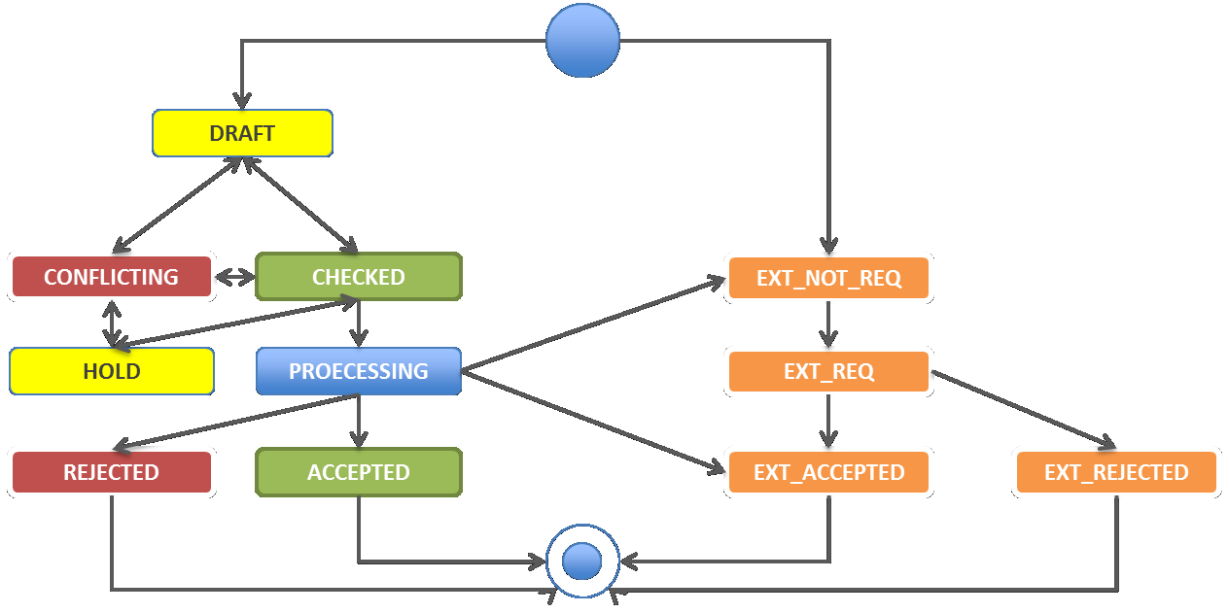
Request State Cycle

Slide 15
Process
On a weekly basis :
Updated request are issued.
Latest provider support status is checked, for each activity requested present in the reply, based on the activityStatus flag value
COMMITTED => Ext_Requested -> Ext_Accepted
UNAVAILABLE=> Ext_Requested -> Ext_Rejected
If the request activity is missing, no action is taken (Stays Ext_Requested)
Activity with activityStatus=“COMMITTED” different to or missing in the internal representation are flagged to the operator for action
Align to provider proposed time and parameter value
Generate a new request toward the external provider to align provider schedule with user wishes
Outcome is published towards end users

Slide 16
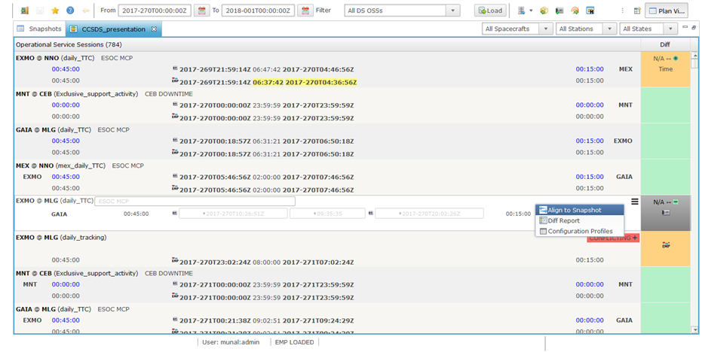
Delta view example (EMSP)

Slide 17
Implementation
One file per request => Ease troubleshooting and request follow-up
Time ranged reply
Update request can be replaced by (Delete & Add) if required by the provider
Activity time are included for information
updateSrvPkg shall not be used to change the apertureRef (use del/add)
TENTATIVE and AVAILABLE “activityStatus” value are currently not processed.
It is foreseen to use AVAILABLE when the provider want to advertise free time
TENTATIVE concept is considered by ESA as equivalent to a non response from the provider (Ext_Requested).

Slide 18
Lesson learned
Usage of different names in the request and the reply is source of confusion.
Ambiguity in the usage of the ID elements (requestID, serviceReqID, scheduledPackageId, scheduledActivityId). Who is the owner ? How shall they be linked ?
Rejection process of an Update or Delete request is unclear.
Redundant information can be contradicting
e.g. apertureRef can be different in a previous request referring to the same requestID
Process on how to use the two standards is unclear and could lead to incompatible implementation.
The intended usage of each fields should be clarified (Ownership, remove redundancy, define lifecycle).
Consider to use the same format in the request and in the reply.

