Slide 1
Service Management Introduction
Fall Meeting 2017
C. R. Haddow November 2017

Slide 2
Recap from San Antonio Meeting 1
Simple Service Book (BB): 2nd Agency review in progress
Planning Information Format (BB): some re-work required studying structuring; related to planning to support scheduling vs expression of wider ranging set of events; actions in progress
Terrestrial Generic File Transfer (BB): Determined XFDU usage/incorporation – XFDU plan identified
Service Management Utilization Request Format (BB) : Determined fit re configuration profile and event sequence

Slide 3
Recap from San Antonio Meeting 2
Interaction with other WGs
  NAVWG – definition of event (re Planning Information Format; believed to be finalized now)
  CSTS – control architecture discussion (Tech note may be needed)

Slide 4
Simple Schedule – Where are we ?
Red 2 review completed
Book updated as per agreed dispositions
  However there were still some issues with having the Event definition as an annex in the Simple Schedule
  First attempt to resolve this was to define a Yellow Books containing
    Event definition (relevant to other Areas, e.g. Nav W/G)
    Data structures common to the various books in the SM W/G
  This was deemed to be unacceptable, so alternative approach was to turn the Yellow Book into 2 Magenta books
    One containing the Event definition (relevant to other Areas, e.g. Nav W/G)
    The other containing data structures common to the various books in the SM W/G
  Current plan is to issue Simple Schedule referencing the 2 draft Magenta (i.e. Red) Books.

Slide 5
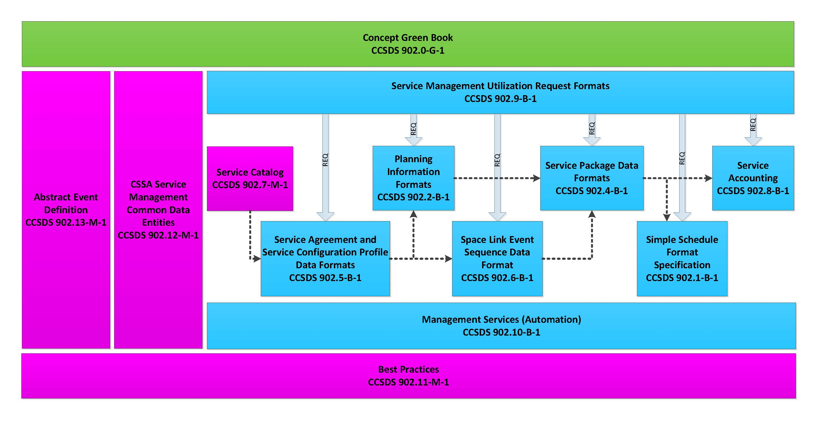
Updated Document Context Diagram

Slide 6
Current Document List
Concept Green Book CCSDS 902.0-G-1
Simple Schedule Format Specification CCSDS 902.1-B-1
Planning Information Formats CCSDS 902.2-B-1
Currently unassigned CCSDS 902.3-B-1
Service Package Data Formats CCSDS 902.4-B-1
Service Agreement and Service Configuration Profile Data Formats CCSDS 902.5-B-1
Space Link Event Sequence Data Format CCSDS 902.6-B-1
Service Catalog CCSDS 902.7-M-1
Service Accounting CCSDS 902.8-B-1
Service Management Utilization Request Format CCSDS 902.9-B-1
Management Services CCSDS 902.10-B-1
Best Practices CCSDS 902.11-M-1
Service Management Common Data Entities CCSDS 902.12-M-1
Abstract Event Definition CCSDS 902.13-M-1

Slide 7
Agenda for Fall 2017 Meeting

