Slide 1


AI 2017-0512-11
Service Package State Machine
Second strawman
CSS SM Fall Meetings Den Haaaaag,
8-November-2017
Marcin Gnat, DLR/GSOC

Slide 2
Introduction
Comparison state machine of SM-1 vs. proposed SM-2
  Attributes in SM-1 for representing the state
  SP State Machine SM-1
  SP State Machine SM-2 Strawman

Slide 3
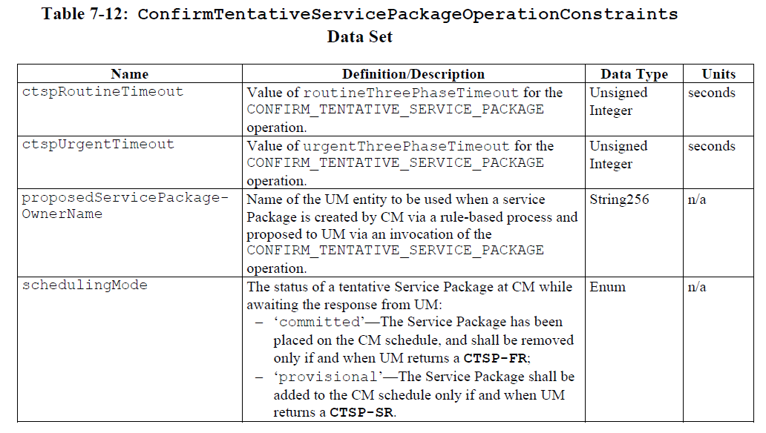
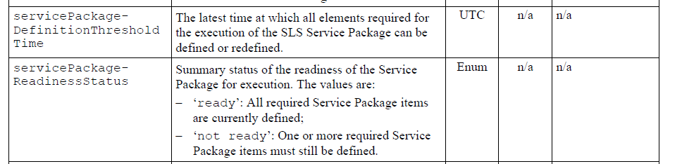
Introduction

Slide 4
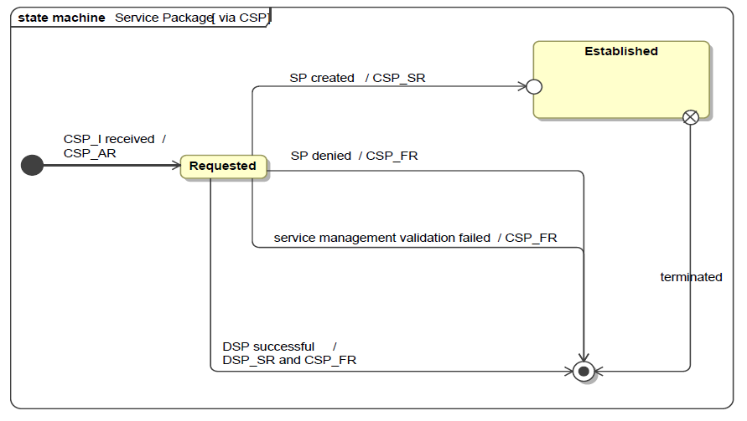
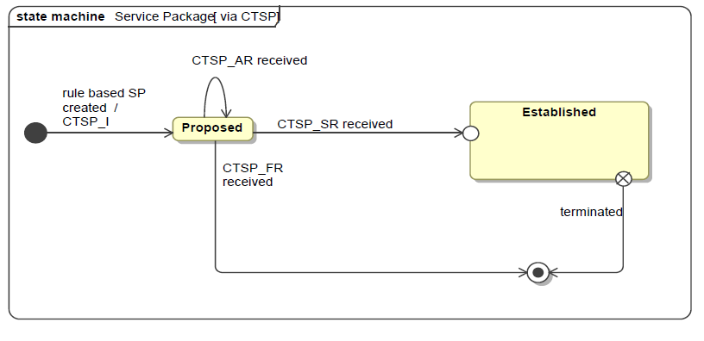
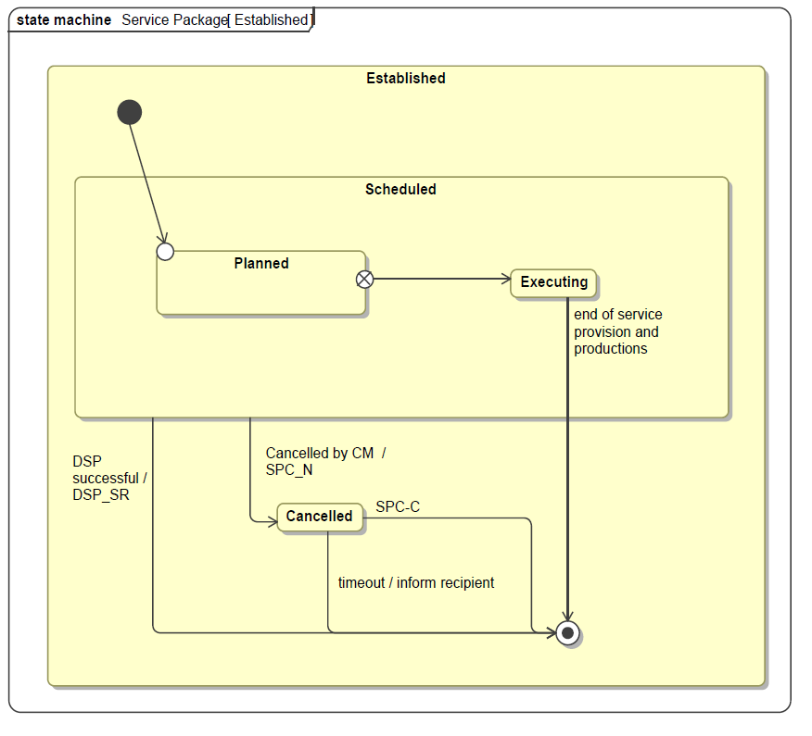
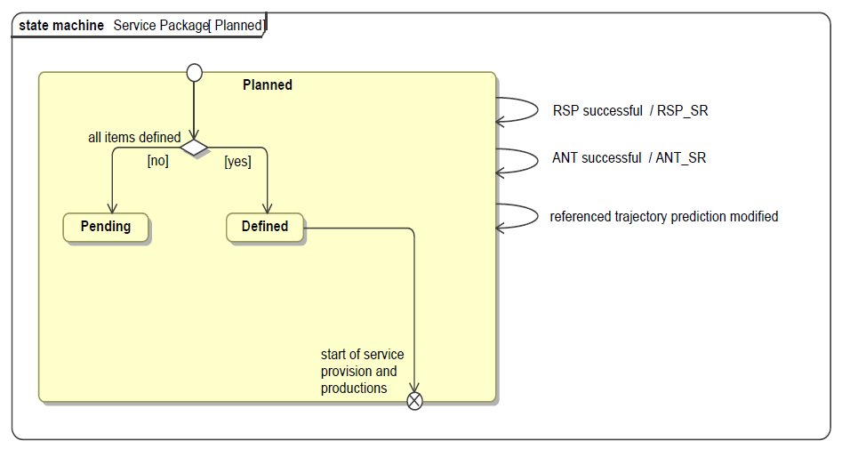
SP State Machine from SM-1

Slide 5

SP State Machine – SM-2 proposal strawman
1st version (eye killing)

Slide 6
SP State Machine – SM-2 proposal strawman v2
NSP – New Service Package
SONSP – Standing Order NSP
RSP – Replace Service Package
DSP – Delete Service Package
SP_TSR – SP Tentative Successful Return
SP_SR – SP Succesful Return
SP_FR – SP Failed Return
SP_C – SP Cancelled
SP_M – SP Modified
SP_A – SP Aborted
SP_F – SP Finished

Slide 7
Questions, observations and issues
Summary:
Entry point is:
  ether the New Online (or Offline) Service Package Request
  Or the Standing Order (Recurring) which makes SP‘s to „pop up“
It is assumed that modifications to SP (which lead to SP_M message) are silently accepted by the user, thus the state of the SP does not change. User needs to watch for SP_M arrival, and eventually react (RSP or DSP)...
Or... We introduce „Modified“ status explicitely

Slide 8
SP State Machine – SM-2 w/ “Modified”
NSP – New Service Package
SONSP – Standing Order NSP
RSP – Replace Service Package
DSP – Delete Service Package
SP_TSR – SP Tentative
Successful Return
SP_SR – SP Succesful Return
SP_FR – SP Failed Return
SP_C – SP Cancelled
SP_M – SP Modified
SP_A – SP Aborted
SP_F – SP Finished
SP_CM – SP Confirm Modification

Slide 9
Questions, observations and issues
Summary:
What do we do with chunking? Requests which result in very long SP. In case provider can handle chunks of such SP differently or at all only one chunk at a time, what is the status of SP? Should we have „chunk status“?
Possibilities:
  Treat chunks as separate SP‘s (chained) -> thus the Request for such SP will be effectively the recurring request (chaining)
  Give another state maschine / substatus to such SP (readinessStatus?)
Finally the simplified version for ones with no use for „Planned“ status:

Slide 10
SP State Machine – SM-2 w/o “Planned”

Slide 11
Questions, observations and issues
- What about „new“ and „not so new anymore“. Do we need to distinguish between them?

