Slide 1
Forward Frame CSTS Discussion Items
13 November 2017
Reflecting Comments and Decisions at the Fall 2017 Workshop
John Pietras

Slide 2
Discussion Items
Significance of ‘processing successful’ (2017Fall Workshop status update)
Applicable subset of TM Sync and Channel Encoding functions
User reconfiguration of dynamically-modifiable procedure configuration parameters (2017 Fall Workshop status update)
Throw Event procedure (2017 Fall Workshop status update)
Discussion Item Resolutions
Ability to extend a CSTS specification beyond the provisions of the Guidelines
Specification of the prime procedure type(s)
Normative dependency on Guidelines
Frame identification validation
Frame length validation
Invalid frame handling
VC multiplexing
Access to underlying production process monitored parameters & notifiable events
Specification of production processing
Allocation of Idle CADU generation
Scope of Throw Event Procedure
Extension or refinement of Behavior (Guidelines issue)

Slide 3
Significance of ‘processing successful’
F-CLTU NOTIFY has 'cltu-radiated' notification type and cltu-status = 'radiated‘ parameter
Formally defined as actual completion of radiation, but in practice is often estimated
Estimation is okay for F-CLTU because delay from FF provision to antenna is essentially deterministic
Data Processing NOTIFY has 'data processing completed' event and data-processing-status = 'successfully processed‘ parameter
Should these be interpreted as “frame radiated”?
If so, they cannot be calculated by simple delays from release from the FF service instance(s), due to randomizing delays caused by multiplexing
Reasonably accurate estimates of radiation would at least involve instrumenting the MC Mux function to signal frame release to sync and channel encoding on a GVCID basis
If they are not to be interpreted as “frame radiated”, what should they mean?
Simply that the frame has been released by the FF instance to the underlying VC mux function?
9 November 2017 Status update: W. Hell will look into this

Slide 4
Applicable Subset of TM Sync and Channel Encoding Functions
There is no formal CCSDS specification of the sync and channel coding that is to be applied on a synchronous (e.g., AOS) forward link
Long-standing assumption that TM sync and channel coding Blue Book functions would apply
However, only a (not yet identified) subset applies
CCSDS is starting to address the definition of that subset
In lieu of a formal CCSDS definition, the Forward Frames specification will treat the AOS Sync and Channel Encoding FR as a requirements of the FF service and document the functional requirements in the normative production functions Annex
References to specific sections of the TM sync and channel coding Blue Book
Additional requirement for Idle CADU insertion
Question: what assumptions should we make about what TM sync and channel coding functions to “import”?

Slide 5
User Reconfiguration of Dynamically-Modifiable Procedure Configuration Parameters
Status update: Discussed at the Fall Workshop and decided to limit the directives to the inactive state of the procedure. However, that might be a protocol violation. Current approach under investigation is to add the parameters to the respective START operations
Data Processing procedures’ dynamically-modifiable procedure configuration parameters
BDP
maximum-forward-buffer-size
input-queue-size
processing-latency-limit
SCDP: input-queue-size
Should service users be able to modify some or all of these values? If so, which ones?
Consideration of behavior when directives are consistent with current state of the procedure (e.g., direct input-queue-size to be smaller than the queue contents at the time of receipt of the directive)
If so, by what means?
Through EXECUTE-DIRECTIVE operations as part of the derived DP procedures?
Add EXECUTE-DIRECTIVE to BDP, limited to changing these procedure-specific parameters
Add a ‘change input queue size’ directive to SCDP’s existing E-D operation
Cover the capability through the already-planned separate Throw Event procedure
Probably not a good idea - could get sticky separating each user’s access to her own procedure parameters vs. “master user-only” access to underlying production parameters (e.g., bit rate)

Slide 6
Throw Event Procedure
The Throw Event procedure will be added to the FF-CSTS
Provides F-CLTU THROW-EVENT capabilities in lieu of future Service Control CSTS
Will be designated as an optional procedure: future implementations of FF service can ignore it if SC-CSTS is available
Whether or not a FF-CSTS can use the Throw Event procedure should be a non-dynamically-modifiable configuration parameter
Properly-constructed configuration profiles limit to only one “master” FF-CSTS instance per forward space link physical channel
Will be available in both synchronous and asynchronous mode of FF-CSTS
How to treat “non-Throw Event enabled” users of FF-CSTS that try to invoke a the Throw Event EXECUTE-DIRECTIVE?
Don’t even configure the procedure for non-master users: results in invalid-PDU PEER-ABORT, or
“Configure” the procedure but make it off limits: requires a new ‘directive invocation not allowed’ diagnostic (extension)
Status update (9 November 2017): In principle, directive attempts from non-authorized users will be rejected, not aborted (see email “Forward Frame service optional Throw Event procedure” from John Pietras to Hell et al (13 November 2017) for ongoing discussion on the details of making this work)
NOTE: the FSP specification has a throwing-of-events-enabled Service Management parameter but no behavior is specified for when a non-enabled user attempts to throw an event

Slide 7
Discussion Item Resolutions

Slide 8
Ability to Extend a CSTS Specification Beyond the Provisions of the Guidelines
What is the underlying philosophy regarding the comprehensiveness and “normativity” of the Guidelines?
At the 28 September 2017 CSTS WebEx, the WG agreed in principle to the interpretation that the Guidelines are just that – “guidelines” that provide “recipes” for CSTSes that follow the nominal concepts for CSTSes
Any CSTS should follow the Guidelines to the greatest extent possible and practical, but if a service has circumstances that are not addressed by the Guidelines, that service specification can go beyond the Guidelines as long as those extensions are explicitly identified in the service specification
Guidelines document does not have to be amended to cover one-off cases
Analogy to Framework, which provides an “escape mechanism” to create service-original procedures when adoption of or derivation from existing procedures is infeasible
Service-original procedures can be subsequently incorporated into Framework if they prove to be useful for multiple services --> “outside Guidelines” provisions could be included later into Guidelines if they have use in multiple services
Suggested changes to the Guidelines book have been generated to reflect this resolution
Whether the Guidelines are Yellow or Magenta, it will be the CSTSWG that creates new CSTSes. Review, discussion, and consensus will prevent ridiculous deviations from the Guidelines

Slide 9
Specification of the Prime Procedure Type(s?) (1 of 3)
Resolution: The two-mode approach will be used (see slide 3 of 3)
Currently, the Guidelines and Concept specify that each CSTS has one Prime Procedure type, of which there is only one (prime) instance
Although there may be multiple secondary instances of that same procedure type
Issue: because the Forward Frames service will operate exclusively on synchronous (e.g., AOS) frames (and CADUs) in some configurations and exclusively on asynchronous frames (e.g., Telecommand) frames in other configurations, the service must allow two prime procedure types – Buffered Data Processing and Sequence-Controlled DP, respectively
Programmatic and administrative considerations require that a single CSTS handle all forward frame-level services, so these two cases can’t be broken into two separate services
This issue was raised in the CSTS SFW Red-1 review, and the approved resolution was to allow more than one prime procedure type to be declared for a CSTS, with the type to be set by Service Management on a per-service-instance basis (CSTS SFW Red-1 RID NASA-TJR-06, 2011)
The major advantage of this solution was that it wouldn’t affect the Framework itself, only the Guidelines for construction of CSTSes and the Concept (i.e., that a CSTS could have different prime procedure types, depending on the service configuration)

Slide 10
Specification of the Prime Procedure Type(s?) (2 of 3)
Due to resource constraints that led to deferring work on the Guidelines, this resolution was forgotten until 2015
The issue was re-raised, but the subsequent discussion and telecon re-focused on whether the two procedure types were actually needed for Forward Frames, or just one could handle both
The need for two the two types of procedures was subsequently examined by W. Hell, who confirmed the need for the need for the two procedure types to handle sync and async frames
However, as a group we never resolved the initial issue: how to specify the ability to declare that a CSTS can have multiple prime procedure types, and how is the prime procedure set for a given CSTS instance?
J. Pietras assumed that the 2011 RID resolution was re-confirmed, but that assumption was not shared
We must resolve this issue before we can complete the Forward Frames specification

Slide 11
Specification of the Prime Procedure Type(s?) (3 of 3)
Possible alternative to allowing multiple prime procedure types
Define two modes (Sequence Controlled and Buffered*) of the FF service, each of which is specified (essentially) as if it were its own service, but sharing the common procedures (Association Control, Cyclic Report, Information Query, and (proposed) Notification)
Each mode would be defined with its single prime procedure type – Buffered DP for synchronous mode and Sequence-Controlled DP for asynchronous mode
For service management/configuration management purposes, the two modes could each be given a unique Functional Resource Type
Interest was expressed in this approach at the 28 September CSTSWG telecon. It will be used as the basis for the first draft of Section 3
*Previously, these modes were called asynchronous and synchronous, respectively.
However, it’s not necessary to tie these modes to the behavior of the underlying
channel synchronization methods, and it could hamper future uses of the FF service.

Slide 12
Normative Dependency on Guidelines (1 of 2)
Resolution: verbose mode will be used
Original concept for CSTS specifications was to keep them as terse (thin) as possible, relying on Guidelines to supply unwritten definition of normative material
“How to read a CSTS specification” role (in contrast to “how to write a CSTS specification”)
E.g., section 3 of a specification would state “Table 3-1 is the Procedures of the <XYZ service>, as specified in 4.5.3 of [Guidelines].” (full stop)
The table itself would be the normative specification of the component procedures of the service
The reader of the CSTS specification would have to read the Guidelines to know how to read the table, e.g., that “[P]” designates the prime procedure, how to interpret the Number of Instances value for prime vs. secondary procedure, etc.

Slide 13
Normative Dependency on Guidelines (2 of 2)
Terse approach could not be used for MD-CSTS and TD-CSTS because Guidelines would not be in place in time for their release
Those specifications spell out the requirements and can stand alone
E.g., the MD-CSTS specification states “The On-Change-Option Cyclic Report procedure shall be the prime procedure…” and “The On-Change-Option Cyclic Report procedure shall be refined and extended from the Cyclic Report procedure defined in reference [<CSTS SFW>]”, and Table 3-1 is merely a summary visual representation of the explicitly-stated requirements
Original plan was to have later CSTS specifications revert to the terse mode once the Guidelines had been published
Issue: Publishing Guidelines as a Yellow Book would prohibit its use as a normative reference for reading CSTS specifications
Can a Magenta Book be normatively referenced in this way?
Concern: Requiring both Guidelines and a CSTS specification to correctly interpret (and implement) that specification may result in misinterpretations or missed requirements that full statement within the specification itself (see MD-CSTS examples above) would minimize
For comparison purposes, the first draft of section will use the spelled-out style for the asynchronous mode and the terse style for the synchronous mode

Slide 14
Frame Identification Validation (1 of 2)
Resolution: GVCID mask approach will be used
SLE FSP support only Telecommand packets: packet identification is specific to TC packets
FSP-TRANSFER-DATA diagnostics:
‘unsupported packet version’
‘incorrect packet type’
‘invalid packet apid’
FF equivalent of FSP packet ID validation: each FF service instance shall validate that the frames it receives are for the designated VC
Proposal: have FF-service instance validate GVCID (TFVN:SCID:VCID) instead of only VCID
More complete validation
Issue: the different space data link protocols have different header structures. Does FF need to normatively call out all of the different SDLPs that are supported?
Implies re-specification & recoding whenever a new SDLP is added to the FF service

Slide 15
Frame Identification Validation (2 of 2)
Proposal: validate GVCIDs using a bit mask instead of explicitly calling out space data link protocols
Extensible to new SDLPs: configurable parameter instead of complied code
Normative definition of bit masks in Annex (or Magenta book?)
4-octet address field, 4-octet mask works with Telecommand, AOS, and USDLP (also works for CADU)
Telecommand: TFVN (2), [Flags & Spare] (4), SCID (10), VCID (3)
Mask: 11000011111111111110000000000000
AOS: TFVN (2), SCID (8), VCID (6)
Mask: 11111111111111110000000000000000
USLDP: TFVN (4), SCID (16), [S/D] (1) VCID (6)
Mask: 11111111111111111111011111100000
CADU: don’t care
Mask: 00000000000000000000000000000000; Value: 00000000000000000000000000000000

Slide 16
Frame Length Validation
Resolution: min & max length values to be used in both procedures
Should the Sequence-Controlled Frame Data Processing procedure validate that incoming “frames” are a specified length or smaller?
Should the Buffered Frame Data Processing procedure validate that incoming “frames” are a specified length, period?
Consideration: these criteria match the current definition of asynchronous (variable length) and synchronous (fixed length) transfer frames, but will that necessarily always be so?
Use of the sequence-controlled procedure does not necessarily imply variable length frames
Use of the buffered procedure does not necessarily imply fixed-length frames
We could “future proof” this aspect by having both procedures test against both a minimum length (possibly set to zero) and a maximum length
For fixed-length frames both would be configured to the same value
The first drafts of sections 4 (Sequence-Controlled Frame Data Processing) and 5 (Buffered Frame Data Processing) are written using the min and max limits as strawmen

Slide 17
Invalid Frame Handling
What should happen when a frame is received with the wrong GVCID, or is too long or too short)?
Sequence-Controlled DP uses the confirmed variant of PROCESS-DATA (P-D) operation, so it could reject and return a negative result with (new extension) ‘invalid GVCID’, frame too long’, or ‘frame too short’) diagnostic
Or is it a deep-enough problem that it should trigger a PEER-ABORT?
Buffered DP P-D operation is unconfirmed. Options are:
Discard and keep working (silent failure of invocation)
Change to the confirmed variant and include the ‘invalid GVCID’ diagnostic
Side-effect: almost always will result in tons of unneeded positive result returns just to gracefully trap the (hopefully very rare) invalid GVCID or frame size
PEER-ABORT with diagnostic ‘invalid GVCID’, ‘frame too long’, or ‘frame too shortl’
Discard P-D invocation, NOTIFY ‘invalid GVCID’, ‘frame too long’, or ‘frame too shortl’
Do both procedures necessarily need to use the same approach: i.e., negative return or PEER-ABORT?
Strawman SCFDP uses additional P-D diagnostics and BFDP uses additional PEER-ABORT negative result diagnostics to see how the two approaches would look
Actual use of P-D diagnostics vs. PEER-ABORT vs. NOTIFY in either or both procedures is still subject to further analysis and discussion
If a PEER-ABORT is triggered, what happens to any data that may still be in the Input Queue?
Resolution: (a) add diagnostics to SCDP PROCESS-DATA; (b) add notifications to BDP NOTIFY

Slide 18
VC Multiplexing (1 of 3)
Resolution
Retain the 3 mux schemes at both the VC and MC Mux layers
latest-processing-start-time is when frame is released from the Input Queue
Add Note that the radiation time is not deterministically related to the processing start time, and that users should take that into account if they set this parameter value
W. Hell will look into this further, and the results may have an effect
Current concept: FF will use the same VC multiplexing schemes as SLE Forward Space Packet
FIFO
Absolute priority
Polling vector
The SDLP specs define multiplexing as occurring at both the VC level and at the MC level
SDLP specs defer muxing scheme to “project organizations”
FSP defined the aforementioned set of schemes for the VC level
How will FF-CSTS deal with MC-level muxing schemes?
Ignore it (e.g., always FIFO)?
Create a second tier of muxing schemes?
J. Pietras proposed using a singe-level muxing scheme based on GCVID, not merely VCID

Slide 19
VC Multiplexing (2 of 3)
At the 28 September 2017 CSTS WebEx, W. Hell expressed concern that the proposed single-level muxing scheme based on GVCID might not provide the same capabilities as the two-level approach
J. Pietras expressed his belief at the time that it would cover the same set of possibilities, but upon further consideration it is not true in general: it holds for the case of 2-level muxing with priority schemes at both the VC and MC layers, but not when the muxing schemes are different at the two layers
For now at least, the two-level approach will be assumed, with the same 3 muxing schemes available for MC muxing
Lingering concern: does having different muxing schemes at the VC and MC layers give the Mission the level of control that it might need?
A combination of two-tiered multiplexing plus GVCID multiplexing in the MC Mux would provide the ability to deterministically control the muxing across all GVCID combinations

Slide 20
VC Multiplexing (3 of 3)
How much do the underlying muxing schemes affect the FF transfer service?
Properly speaking, the schemes are a function of the service production and have no effect on the performance of the transfer service itself
Do the multiplexers affect the criteria for considering a frame to have been “released” from the Input Queue?
VC Mux may be ready to release a frame to MC Mux, but MC Mux may not be ready to accept it (e.g., due to frames from higher-priority Master Channel)?
Does the VC Mux take the frame from the FF Input Queue ASAP and store it in its own internal queue (whether or not the frame can actually be muxed immediately into the MC ),
Does the VC Mux take the frame from the FF Input Queue when that FF instance’s VC “window” opens into the parent MC frame stream (whether or not that MC actually has the “window” into the physical channel symbol stream, possible causing the frame to be queued by the MC Mux), or
Do the combined VC and MC Muxes wait until a “path is clear” to the forward link symbol stream before pulling the frame from the Input Queue
Interpretation/implementation affect the effective meaning of
Timely transfer mode for BFDP
latest-data-processing-start-time parameter for SCFDP
Related to the interpretation of ‘processing successful’

Slide 21
Access to Underlying Production Process Monitored Parameters
SLE services make various parameters of underlying production monitorable via the GET-PARAMETER operation
E.g., for F-CLTU: acquisition-sequence-length, modulation-frequency, plop-in-effect, rf-available-required
This requires the parameters to be specified within the SLE service itself, specifically within the ASN.1 for the SLE service
FF-CSTS will make the underlying production monitored parameters available via the Information Query and Cyclic Report procedures
FF-CSTS will use the inherent capabilities of the Information Query and Cyclic Report procedures to access underlying parameter values using their Parameter Labels (Functional Resource Type: Parameter Identifier) or Parameter Names (Functional Resource Name: Parameter Identifier)
Framework IQ and CR procedures do not need to be extended!
We may want to define the default list of parameters for FF-CSTS

Slide 22
Access to Underlying Production Process Monitored Notifiable Events
SLE services make various event notifications of underlying production available via the ASYNC-NOTIFY operation
E.g., for F-CLTU: ‘cltu radiated’
This requires the notifications to be specified within the SLE service itself, specifically within the ASN.1 for the SLE service
FF-CSTS will add a Notification procedure to make the underlying production event notifications available
FF-CSTS will use the inherent capabilities of the Notification procedure to subscribe to and be notified of underlying production events using their Event Labels (Functional Resource Type: Event Identifier) or Event Names (Functional Resource Name: Event Identifier)
Framework Notification procedure does not need to be extended!
We may want to define the default list of events for FF-CSTS

Slide 23
Specification of Production Processing
Resolution: Approach accepted
Production processing is addressed (and illustrated) in the Service Production, Service Provision, and Cross Support View subsections of Section 2 of each CSTS specification
There is a distinction between specification of production that is unique to a CSTS and identification of production processing that is assumed to underlie the CSTS but is otherwise specified elsewhere
Production processing that is unique to the CSTS should be normatively specified as part of the CSTS specification because there is no other place that that specifies it
Functionality
Managed parameters
Mapping to Functional Resource type
Examples: Monitored Data Collection function (MD-CSTS), TDM Segment Generation function (TD-CSTS), TDM Recording Buffer function (TD-CSTS)
NOTE: Normatively specifying service-unique production functions is not (yet) addressed by the Guidelines
There may be FF-specific production processing related to the generation of idle CADUs
Underlying production processing that is formally defined elsewhere (e.g., in other CCSDS Blue Books) need only to be informatively identified, not normatively specified, in the CSTS specification
FF-CSTS has a rich set of underlying production functions that are formally defined elsewhere, e.g., Space Data Link Protocol, Sync and Channel Coding
FF-CSTS should have an informative annex that goes deeper into the underlying production

Slide 24
Proposed Figure 2-1: Production and Provision of the Forward Frames Services
Probably will be modified depending on how Idle CADUs are generated

Slide 25
Proposed Figure 2-2: Example of Management and Provision of Forward Frame Service Instances for a Service Package
Probably will be modified depending on how Idle CADUs are generated

Slide 26
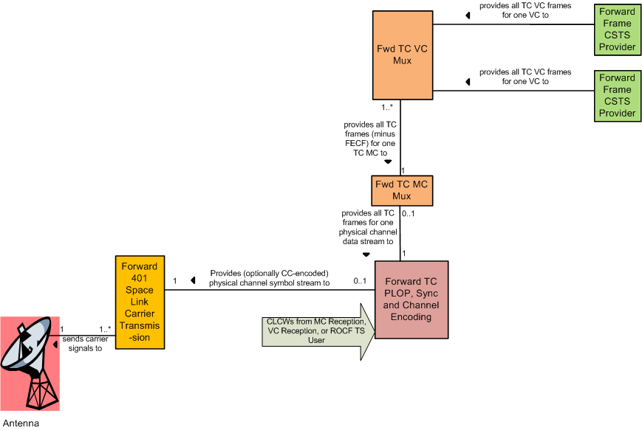
Forward Frames Production Informative Annex: Sequence-Controlled Mode – Telecommand Frames Example
NOTE: FRs could change if multiplexing is performed at the global VC level

Slide 27
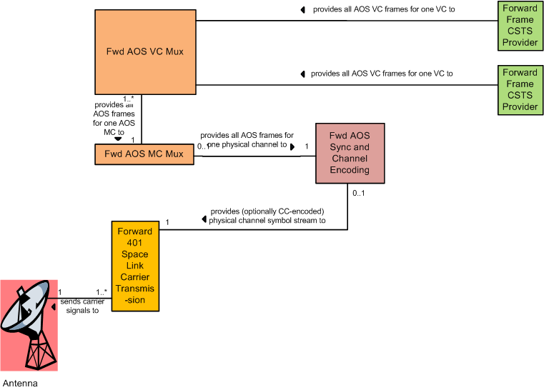
Forward Frames Production Informative Annex: Buffered Mode – AOS Frames Example
AOS MC Mux includes
insertion of Idle Frames
NOTE: FRs could change if multiplexing is performed at the global VC level

Slide 28
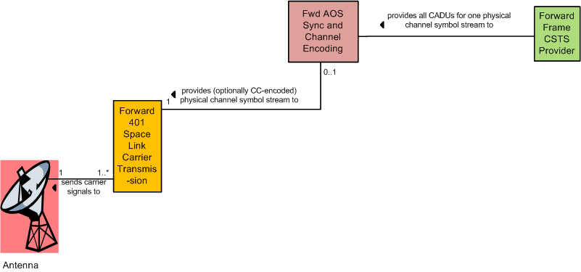
Allocation of AOS Idle CADUs (as currently shown in FR Reference Model Tech Note)
Bypasses all sync and channel
coding functionality except optional
convolutional encoding
This won’t work if we assume that Fwd AOS S&CD has *only* a subset of TM Sync and Channel Coding BB because it does not address idle CADU insertion
However:
idle CADU insertion really is a form of “channel synchronization”
CCSDS is undertaking to formally define AOS Sync and Channel Encoding
Resolution: until that CCSDS “standard” is available, we will normatively define AOS Sync and Channel Encoding functional requirements in the FF Production Normative Annex, including Idle CADU Generation as an optional function
Propose to SLS Area that it be included in the “standard”

Slide 29
Allocation of AOS Idle CADUs Alternative 1: Idle CADU Generation Performed by the Forward Frame TS Provider Itself
FF Provider also generates idle CADUs
Bypasses all sync and channel
coding functionality except optional
convolutional encoding
There being only one FF provider instance for CADU service makes this theoretically feasible
Pro: doesn’t affect the functionality of the other FRs
Con: would require possibly non-trivial extension of Buffered DP state machine to recognize absence of a user-supplied “data” unit and provide an idle CADU

Slide 30
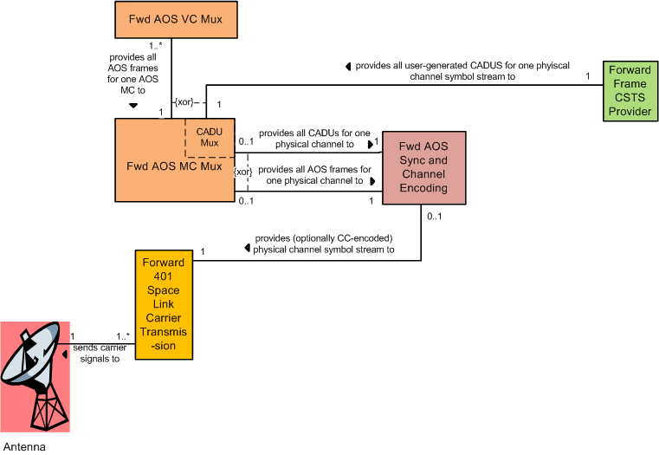
Allocation of AOS Idle CADUs Alternative 2: MC Mux Modified to Generate Idle CADUS
In CADU mode, bypasses all
sync and channel coding
functionality except optional
convolutional encoding
MC Mux is
now bimodal
Analogous to the way Enhanced F-CLTU inserts Idle CADUs
Pro: doesn’t increase population of FR types
Con: every version of a synchronous MC Mux must be made bimodal
Additional CADU Idle functionality in the MC Mux FR would probably be specified in a normative annex of the FF-CSTS specification

Slide 31
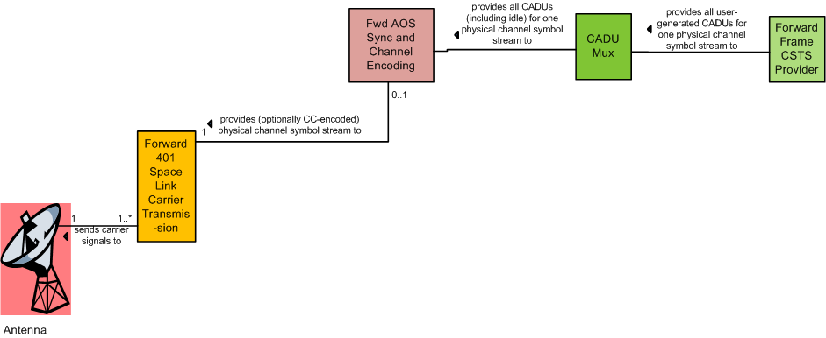
Allocation of AOS Idle CADUs Alternative 3: FF-specific CADU MUX FR
Bypasses all sync and channel
coding functionality except optional
convolutional encoding
Generates Idle CADUs if
necessary and muxes them
with user-generated CADUs
Recognizes that CADU muxing is only used in conjunction with FF service
Pro: keeps every version of a synchronous MC Mux FR more directly aligned with its source Blue Book
Con: adds a new FR type (although TS-specific production “helper” FRs are anticipated and supported by the FR Reference Model)
CADU Mux function would probably be specified in a normative annex of the FF-CSTS specification

Slide 32
Allocation of AOS Idle CADUs Alternative 4: FF-specific CADU Mux & CC Encoder FR
Generates Idle CADUs if
necessary and muxes them
with user-generated CADUs,
and optionally convolutionally-encodes
them
Eliminates using the Fwd AOS Sync and Channel Encoding FR altogether for CADUs
Pro: keeps every version of a synchronous MC Mux FR more directly aligned with its source Blue Book
Con: adds a new FR type (although TS-specific production “helper” FRs are anticipated and supported by the FR Reference Model)
Could be considered a one-off Sync and Channel Encoding FR type

Slide 33
Scope of Throw Event Procedure
Should the scope of the Throw Event procedure be limited to only the production that directly supports the forward link that carries the master user’s VC, or should it be wider (e.g., the whole Service Package)?
Scope affects the constraints on the Throw Event EXECUTE-DIRECTIVE operation
SFW Throw Event doesn’t have a default scoping, unlike the Cyclic Report, Information Query, and Notification SFW procedures, (i.e., limited to the production that directly supports the service instance)
Requires that the service refine the SFW procedure to specify the scoping
Resolution: Scope will be limited to resource that directly support the forward frame flow
If the scoping is limited to only the production that directly supports the forward link that carries the master user’s VC, what is the diagnostic for trying to access “out of scope” FR instances?
Can we stretch (refine?) the interpretation of the existing ‘invalid functional resource instance’ diagnostic (“the specified instance of the FT Type … does not exist”) to mean “does not exist for this instance of the FF service”?
If we can’t do this, we’ll have to extend the Throw Event procedure to add a new diagnostic
Preliminary resolution: Definition of the existing diagnostic will be refined

Slide 34
Extension or Refinement of Behavior (Guidelines Issue)
Resolution (9 November 2017) – W. Hell will investigate and update Guidelines if appropriate
The FF service needs to add normative Behavior to both derived procedures
Additional reasons for rejection (invalid GVCID, length errors)
(TBD) Allow user to change dynamically-modifiable procedure configuration parameters for that procedure instance
Guidelines are currently mute on adding behavior
Only mentions refinement of behavior, as pertaining to “narrowing the specification of the behavior of the parent procedure”
Proposal: adding behavior should be recognized as extension
Add a 3rd bullet to Guidelines section 3.6.3:
c) adding new behavior(s) to the specification of the behavior of the parent procedure

