Slide 1
Functional Resource Reference Model – Activity Since Spring
October 2018
John Pietras
Global Science and Technology, Inc.

Slide 2
Agenda
FRs for the Tracking Data CSTS
Included in the July 2018 version (v1.4) of the Functional Resource Reference Model Tech Note
Review of FRs for the Forward Frame CSTS
Support activity for the forthcoming Forward Frame CSTS Recommended Standard
Documented in the Functional Resources for the Forward Frame CSTS White Paper (October 2018)
Results still need to be folded back into the FR Ref Model Tech Note
Global considerations/comments arising from these activities

Slide 3
FRs for the Tracking Data Service (1 of 2)
The TD-CSTS book has been almost ready for Red-1 review for over a year
The FRs related to the Tracking Data service had been TBD until this past summer
TDM Segment Generation
TDM Recording Buffer
TD-CSTS Provider

Slide 4
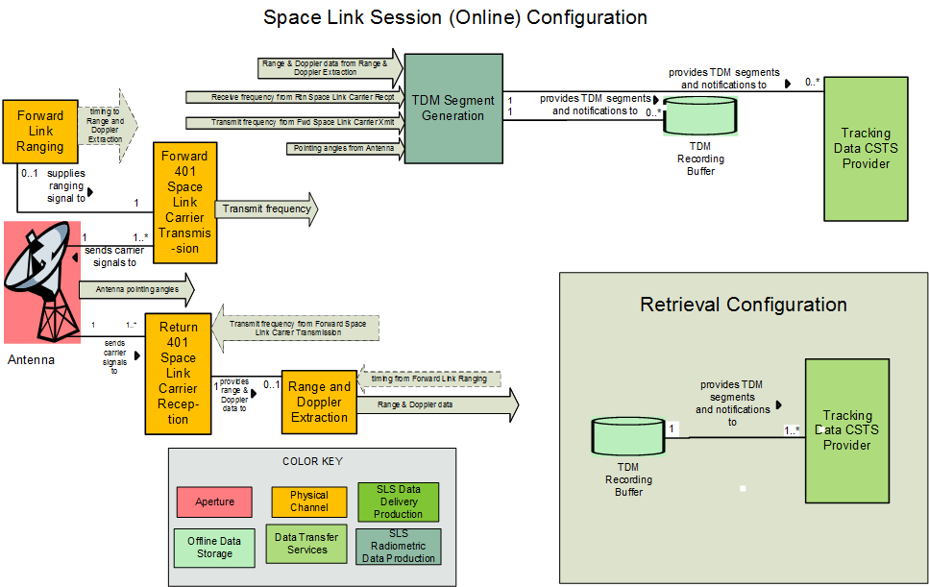
FRs for the Tracking Data Service (2 of 2)

Slide 5
TDM Segment Generation FR (1 of 5)
Collects various types of tracking data into TDM atomic segments for storage and/or transfer via the TD-CSTS
carrier power;
carrier power to noise spectral density ratio;
ranging power to noise spectral density ratio;
Doppler (instantaneous);
Doppler (integrated);
range;
receive frequency;
transmit frequency;
transmit frequency rate; and
antenna angle pairs.

Slide 6
TDM Segment Generation FR (2 of 5)
Because TD-CSTS can report on all tracking activities (of the specified types) in a single synthesized “TDM”, there may be multiple instances of the same type of tracking data in the same TDM
Different instances of tracking data are referred to as paths
Different paths may carry the same data type but are differentiated by the associated metadata (e.g., the target spacecraft)
Each path is given a trackingDataPathId that is unique over all paths supported by an instance of the TDM Segment Generation FR type
For each tracking data type, FR definition specifies the source FR (type or stratum) of the input data and the mapping of the Service Package configuration information into the correct TDM data and metadata types
E.g., TDM metadata defines the actors in the production of carrier power data as PARTICIPANTS_1 (signal-receiving ground facility) and PARTICIPANTS_2 (signal source (spacecraft))
TDM Segment Generation FR specification maps PARTICIPANTS_1 to the SANA-registered name of the ESLT
TDM Segment Generation FR specification maps PARTICIPANTS_2 to the SANA-registered name of the transponder on the Space User Node

Slide 7
TDM Segment Generation FR (3 of 5)
For each tracking data type, FR definition specifies the contents of the resulting TDM Atomic Segment
E.g., for the Carrier Power Atomic Segment
META_START
TIME_SYSTEM = UTC
START_TIME = <time that the carrier power is sampled>
STOP_TIME = <time that the carrier power is sampled>
PARTICIPANT_1 = <name of the ESLT>
PARTICIPANT_2 = <name of the Space User Node[-<frequency band>]>
MODE = SEQUENTIAL
PATH = 2,1
RECEIVE_BAND = <frequency band>
META_STOP
DATA_START
CARRIER_POWER = <received carrier power in dBW>
DATA_STOP

Slide 8
TDM Segment Generation FR (4 of 5)
Configuration parameters are a set of xxxPathTable parameters, one for each tracking data type
Each row of the table specifies the values that map into the TDM metadata values of the TDM Atomic Segments
Each row is keyed by its trackingDataPathId value
Each row has the frName of the FR instance that is the source of the measurements

Slide 9
TDM Segment Generation FR (5 of 5)
Read-only parameter
tdmSegmentGenResourceStatus
configured
operational
interrupted
halted
Notification event
tdmSegmentGenResourceStatusChange
Directives – none
After the configuration parameters, read-only parameter, and event have been approved and recorded in the SANA FR Registry, these tables will be removed from the FR Ref Model Tech Note

Slide 10
TDM Recording Buffer (1 of 2)
Records all TDM Atomic Segments for the Mission for complete delivery via the TD-CSTS
Retains trackingDataPathId information with TDM Atomic Segments

Slide 11
TDM Recording Buffer (2 of 2)
Data retention
What’s the right granularity?
Over all data types, or per data type?
FIFO, other?
2 strawman retention policies in book as of now
FIFO: Oldest TDM segments discarded first, regardless of type
Balanced FIFO: Oldest segment of each category is discarded until balance is adequate space is reached
Configuration parameters
tdmRcrdBufferMaxStorageAllocation
tdmRcrdBufferRetentionPolicy
No Read-only parameters (should add resource status)
No notification events (should add resource status change)
No directives

Slide 12
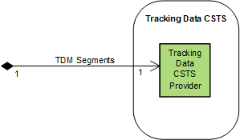
TD CSTS Provider
Represents an instance of TD-CSTS
Configuration parameters
Some inherited from CSTS (e.g., production status)
Almost all of the rest are identified in the TD-CSTS specification
tdTrackingDataPathList: list of subscribed-to trackingDataPathIds
Read-only parameters
Service instance state
Production status
Notification events
Production status change
Production configuration change
Directives - none

Slide 13
Review of FRs for the Forward Frame CSTS (2 of 2)
Aperture stratum
RF Aperture FR Set
(Space Link) Physical Channel stratum
CCSDS 401 Forward Physical Channel Transmission FR Set
CCSDS 415 Forward Physical Channel Transmission FR Set
CCSDS 401 Return Physical Channel Reception FR Set
CCSDS 415 Return Physical Channel Reception FR Set
Synchronization and Channel Coding stratum
Forward TC Synchronization and Channel Encoding FR Set
Forward AOS Synchronization and Channel Encoding FR Set
Return TM Synchronization and Channel Decoding FR Set
Space Link Protocol stratum
Forward TC Space Link Protocol Transmission FR Set
Forward AOS Space Link Protocol Transmission FR Set
Forward Unified Space Link Protocol Transmission FR Set
Return TM/AOS Space Link Protocol Reception FR Set
Return Unified Space Link Protocol Reception FR Set
Data Transfer Services stratum
…
Forward Frame CSTS FR Set
…

Slide 14
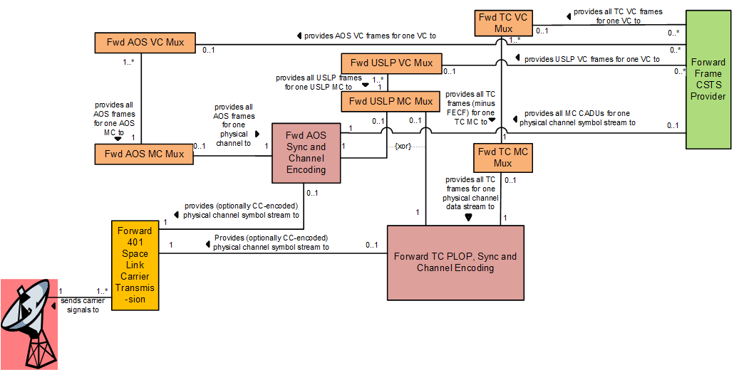
Review of FRs for the Forward Frame CSTS (2 of 2)

Slide 15
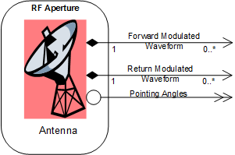
Aperture Stratum
RF Aperture FR Set
Contains Antenna FR
Summary evaluation
No CCSDS-standard antenna makes it difficult to determine completeness, adequacy for all Agencies
No FF-specific parameters or functionality
General agreement that the parameters should be vetted
Are initial pointing angles configured?
More on this later

Slide 16
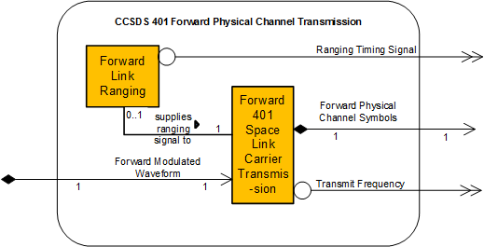
(Space Link) Physical Channel stratum
CCSDS 401 Forward Physical Channel Transmission FR Set
Only Forward 401 Space Link Carrier Transmission is relevant to FF service
Summary evaluation
No FF-specific issues
Missing physical channel name parameter: what is the significance?
General agreement that the parameters should be further vetted before fully approving for SANA FR registry

Slide 17
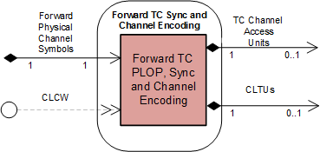
Synchronization and Channel Coding stratum (1 of 4)
Forward TC Synchronization and Channel Encoding FR Set
One member: Forward TC PLOP, Synchronization and Channel Encoding
Summary evaluation
Configuration parameters had to be added/modified to add LDPC
Erroneous intermixing of resource status and forward link status
What is the significance of the CLCW Physical Channel config parameter?
‘data unit processing completed’ event needed to be added
‘discard data units’ directive needed to be added

Slide 18
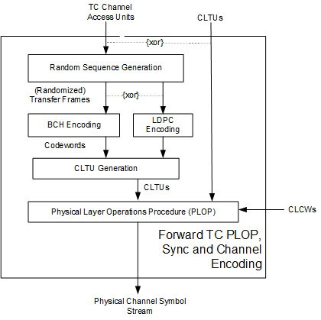
Synchronization and Channel Coding stratum (2 of 4)

Slide 19
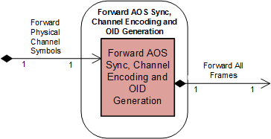
Synchronization and Channel Coding stratum (3 of 4)
Forward AOS Synchronization, Channel Encoding and OID Generation
“New” FR to represent functionality of applying TM Sync and Channel Coding on the forward link
Based on preliminary inputs from Ken Andrews (JPL)
Summary Evaluation
Significant rework of the whole concept of the FR
Significant changes to current Candidate SANA Registry data
Parameters associated with LDPC slicing needed to be added
Parameters associated with OID Generation needed to be added
‘data unit processing completed’ event needed to be added
‘discard data units’ directive needed to be added

Slide 20
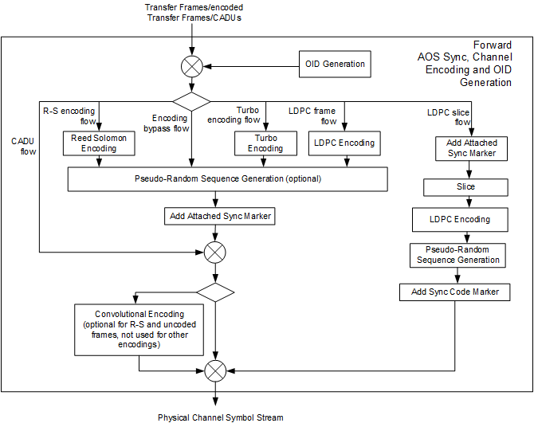
Synchronization and Channel Coding stratum (4 of 4)

Slide 21
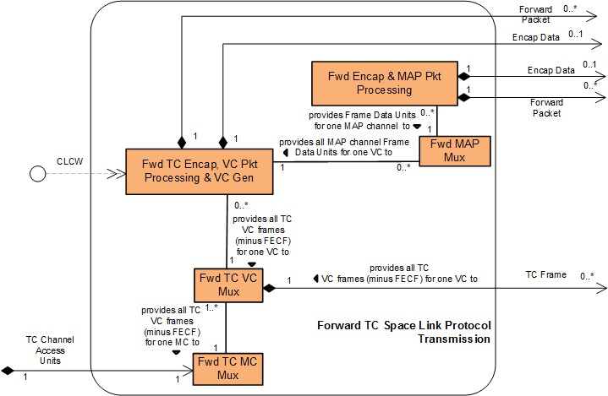
Space Data Link Protocol stratum (1 of 5)
Forward TC Space Link Protocol Transmission FR Set
Only the Forward TC MC Mux and Forward TC VC Mux FRs are relevant to the FF service

Slide 22
Space Data Link Protocol stratum (2 of 5)
Forward TC MC Mux summary evaluation
Several parameters needed to be added associated with systematic retransmission
‘discard data units’ directive needed to be added
Forward TC VC Mux summary evaluation
Several parameters needed to be added associated with systematic retransmission
‘ ‘discard data units’ directive needed to be added

Slide 23
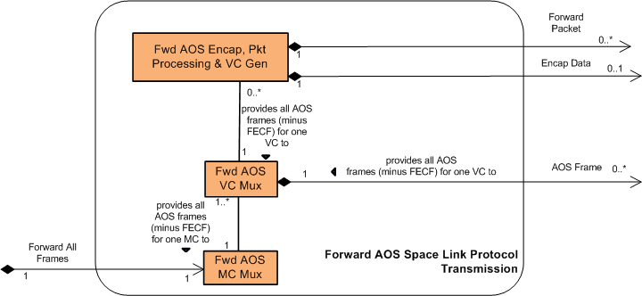
Space Data Link Protocol stratum (3 of 5)
Forward AOS Space Link Protocol Transmission FR Set
Only the Forward AOS MC Mux and Forward AOS VC Mux FRs are relevant to the FF service
Forward AOS MC Mux summary evaluation
Frame length parameter needed to be added
‘discard data units’ directive needed to be added
Forward AOS VC Mux summary evaluation
‘discard data units’ directive needed to be added
23

Slide 24
Space Data Link Protocol stratum (4 of 5)
Forward Unified Space Link Protocol Transmission FR Set
Even though Unified shares much functionality with both the TC and AOS SLDPs (for variable-length frames and fixed-length frames, respectively) in the end it seemed easier to create new FR types rather than try to add the functionality to the current Forward TC and Forward AOS FRs
Only the Forward USLP MC Mux and Forward USLP VC Mux FRs are relevant to the FF service
Forward USLP MC Mux summary evaluation
Combines TC MC Mux and AOS MC Mux functionality, gated by a fwdUslpMcMuxTransferFrameType parameter (‘fixed length’, ‘variable length’)
Forward USLP VC Mux summary evaluation
‘Combines TC VC Mux and AOS VC Mux functionality, gated by a fwdUslpVcMuxTransferFrameType parameter (‘fixed length’, ‘variable length’)

Slide 25
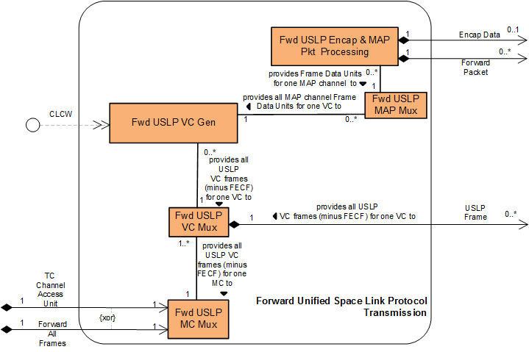
Space Data Link Protocol stratum (5 of 5)

Slide 26
Global Considerations/Comments (1 of 3)
Some parameters listed as configured: true are configured by EM as a product of the cross support service management (e.g., scheduling) and not directly available to the Mission as configured parameters (e.g., antenna controlled pointing angles)
Comment: these are configuration parameters on the local FR level, just not accessible individually by the Mission
The White Paper currently keeps these as configured parameters but assumes that the associated CCSDS-standard Configuration Profiles will not include them as specific parameters but instead will define how they are configured as a product of cross support service management

Slide 27
Global Considerations/Comments (2 of 3)
Should information sharing among FRs be assumed, and to what degree?
E.g., a TC MC Mux FR instance will be connected to multiple TC VC Mux FR instances by a service management configuration profile.
Each TC VC Mux FR instance generates its own Master Channel
Since the configuration “knows” what TC VC Mux FR instances are connected to a given TC MC Mux FR instance, does that TC MC Mux FR instance also have to be explicitly “told” through a validMCIds parameter what MCIds are allowed?
That is, isn’t that implicit in the configuration setup?
If a validMCIds parameter is includes, what if its value conflicts with the actual configuration?
Does the existence of a valid MCIds parameter imply that the TC MC Mux FR instance is actively checking the inputs?
What if CSSM configuration profiles aren’t used to configure the FR instances?
Proposed approach (the one inherent in the White Paper)
Include all parameters needed to configure an FR instance as configured parameters (avoids second-guessing about what information is available from other FR instances)
If information is derivable from configuration profile information in CSSM Configuration Profiles, exclude such parameters from those configuration profiles and explain (in the CP definitions) how the “missing” parameter values are derived
The redundant configuration parameters are still available to be read by the Mission (e.g., validMCIds value will be synthesized from the configuration profile information)
Active error checking of inputs by FR instances is outside the scope of FR definitions. If an implementation does error checking it’s behavior must be defined locally

Slide 28
Global Considerations/Comments (3 of 3)
Resource status of production FRs (currently called “production status in candidate SANA FR registry)
Currently labelled as configuration parameters in registry to allow Element Management (EM) to move status among configured, operational, and halted
From mission perspective it is NOT a configured parameter
Comment: “status” connotes “what it observed”. It is awkward to use it as the mechanism to take action.
For consideration: keep the “statuses” as read-only, and define directives for use by EM
Allows more explicit control of who can or cannot affect the status
Follow-up: should these directives be defined for the baseline FR and limited to EM, or defined in an extension subtree available only to EM?

