Slide 1
Functional Resource Reference Model Tech Note (v0.13)
CCSDS Spring Workshop
9-13 April 2018
Gaithersburg, MD
John Pietras

Slide 2
Agenda
Summary of changes since Summer 2016 version
Tech Note top-level Table of Contents
Reference model concepts
Functional Resource Sets
“template”
2 example Functional Resource Sets
Issues/concerns/work to be done
Relationships among FR Reference Model Tech Note, FR Editing Tool, SANA FR Registry, and other CSSA “products”

Slide 3
Summary of Changes Since Summer 2016 Version (1 of 2)
Change from Service Component-based model to Functional Resource Set-based model
Service Components were containers for Functional Resource instances that were instantiable on their own (for Service Management purposes)
Functional Resource Sets are “lighter weight” – they are simply groupings of Functional Resource types used for purposes of identifying what FR types are tightly coupled to each other (e.g., the set of FRs that represent the various functional layers of a given space data link protocol)
FR Sets are not instantiable on their own
FR Sets are also used in Service Management to manage the number of combinations of FR types in configuration profiles
Elimination of several mostly-redundant “views”
Extra views were interesting but labor-intensive
Eliminated views can be reconstructed as “an exercise by the reader”

Slide 4
Summary of Changes Since Summer 2016 Version (2 of 2)
Elimination of detailed Service Agreement/Configuration Profile concepts/construction sections
SA/CP concepts have evolved significantly from those in the Summer 2016 version
Current SA/CP are (and will continue to be) developed and documented in the Requirements for Simple Configuration Profiles and Service Agreements CSS Area Tech Note
Normative aspects of the Tech Note will then be published in the Service Agreement and Configuration Profile Formats Recommended Standard

Slide 5
Tech Note Top-Level Table of Contents
Introduction
Reference Model Concepts
Functional Resource Sets
Acronyms and Abbreviations Annex (TBS)
Identified Future Functional Resource Sets Annex

Slide 6
Reference Model Concepts – Functional Resource
A Functional Resource is an abstraction of a cross-support function (processing step) performed on space communication, tracking or management (monitoring and control) data
A Functional Resource represents a cohesive, atomic set of space communication functionality with which can be associated single instances of management parameters, monitored parameters, real-time control directives, and notification events
configuration
parameters
directives
Functional
Resource
type
space data to
be processed
processed space data
monitored
parameters
notification
events
Originally the FR concept had been conceived as a framework for naming monitored parameters and notifiable events in the context of the MD-CSTS
Subsequently the FR concept has been extended to include managed parameters (for Service Management) and directives (real-time control)

Slide 7
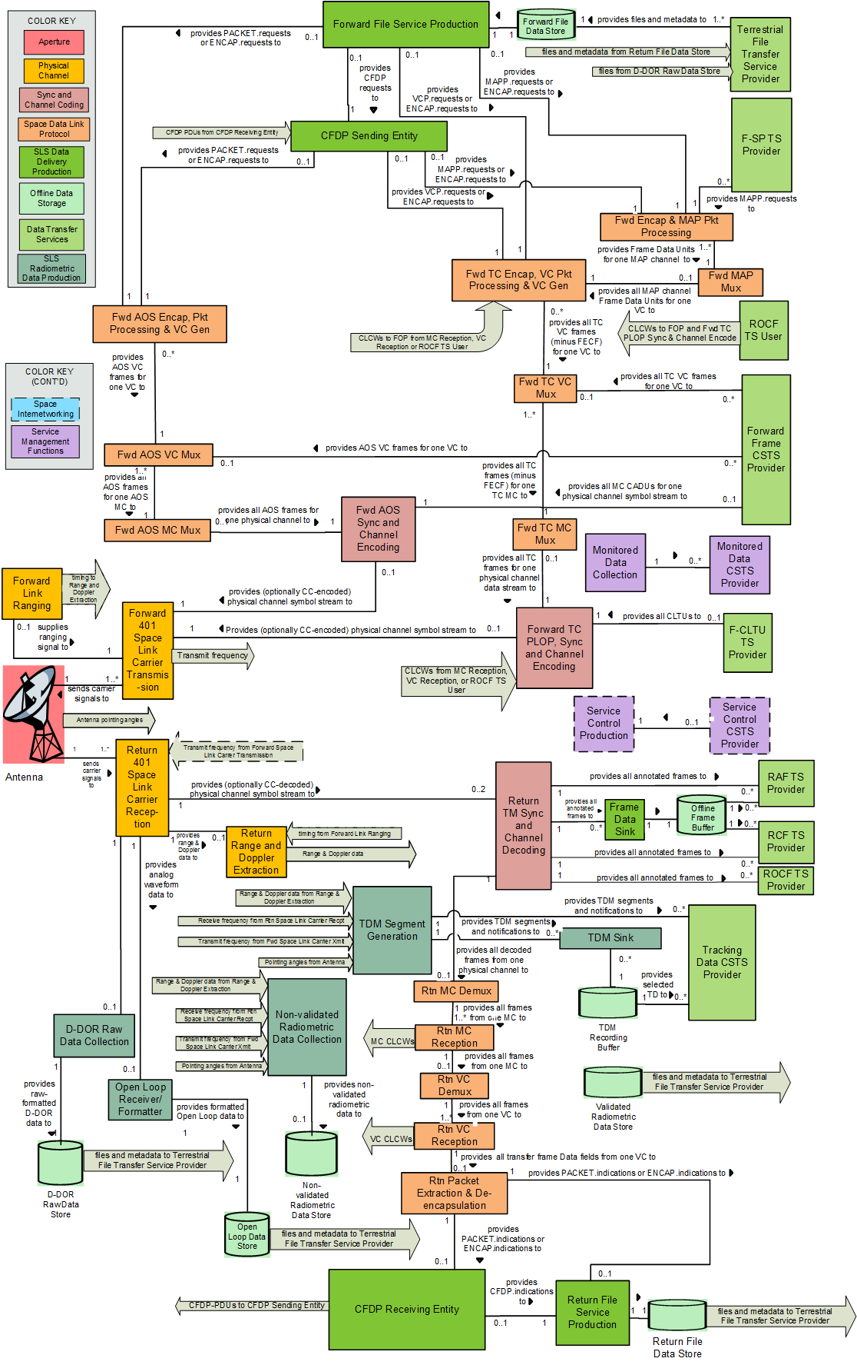
Reference Model Concepts – Core Collection of Functional Resource (Full Diagram)
This diagram cannot
continue to be extended
With new FR types

Slide 8
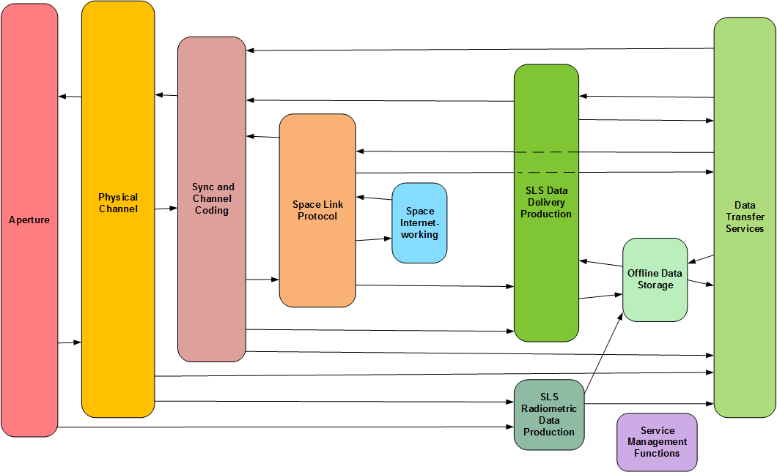
Reference Model Concepts – Functional Resource Stratified Model
Abstract layered model for categorizing Functional Resources

Slide 9
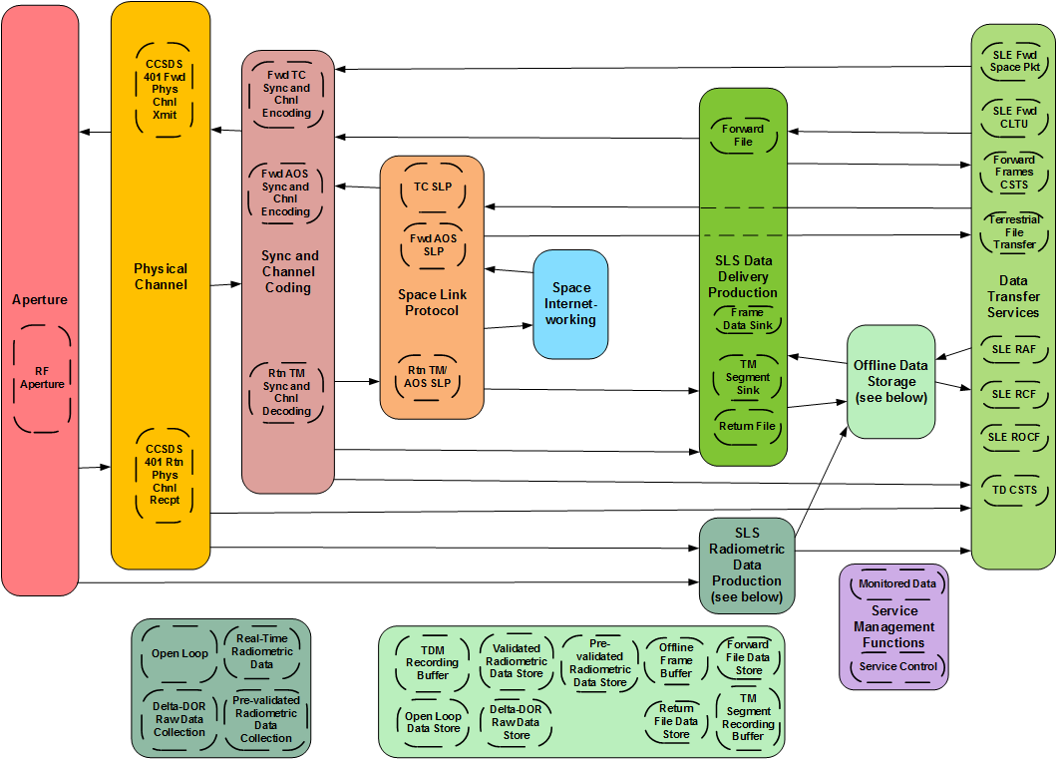
Reference Model Concepts – Functional Resource Sets (1 of 2)
A Functional Resource Set (FR Set) is a concrete group of Functional Resources within a given Functional Resource stratum

Slide 10
Reference Model Concepts – Functional Resource Sets (2 of 2)
FR Sets can have one or more component FRs
FRs within an FR Set are strongly coupled, e.g., because they are derived from a single Recommended Standard and are designed to work with each other
FRs in different FR Sets relate to each other in terms of the kind of relationship/interface that their FR Sets have with each other, e.g., FR Sets in the Aperture FR stratum have a Modulated Waveform service access relationship with FR Sets in the Physical Channel FR stratum
Two kinds of relationships between FRs in different FR Sets
Service Access Point: the connection by which one FR accesses another FR for the exchange of data that is primary to the purpose of the accessing FR
Ancillary interface: ancillary information provided by one FR that is required by the processing performed by the FR
FR Sets are the lowest level of “building blocks” of Service Management Configuration Profiles

Slide 11
Reference Model Concepts – Service Configuration Categories (1 of 2)
FR Sets interact with each other in different ways, depending on the service configuration category in which they are used
3 service configuration categories
Space Link Session (SLS) configuration category
Retrieval configuration category
Forward offline data delivery configuration category
SLS configuration category
The configurations that comprise the functions of the Earth Space Link Terminal (ESLT) that involve the transfer of data across an active space link in “real time”
Configurations in the SLS category must have FR Sets in the Aperture and Physical Channel strata
Service Agreements specify the allowed ranges/sets of values of FR configuration parameters that are used in SLS configurations
Configuration Profiles specify the value of each FR configuration parameter of the FRs that are used in Forward Offline Data Delivery

Slide 12
Reference Model Concepts – Service Configuration Categories (2 of 2)
Retrieval configuration category
The configurations that comprise the functions of the Earth Space Link Terminal (ESLT) that involve the extraction and delivery of data previously acquired during a Space Link Session
Stored communication data
Stored radiometric data
Service Agreements specify the values of FR configuration parameters that are used in Retrieval configurations
The current thinking is that there will be not be Configuration Profiles for the FRs that are used in Retrieval configurations
Forward Offline Data Delivery configuration category
The configurations that comprise the functions of the Earth Space Link Terminal (ESLT) that involve the reception and storage of data to be transmitted during an upcoming Space Link Session
Currently only the (proposed) Forward File service uses FRs configured in this category
Service Agreements specify the values of FR configuration parameters that are used in Forward Offline Data Delivery configurations
The current thinking is that there will be not be Configuration Profiles for the FRs that are used in Forward Offline Data Delivery configurations

Slide 13
Functional Resource Sets – “template” (1 of 2)
Section 3 of the Tech Note contains the descriptions of the current set of Functional Resource Sets
For each FR Set, a diagram is provided that represents:
the FRs that comprise that FR Set;
the relationships among the FRs within the FR Set;
which FR has the Accessor role; and
the SAPs and ancillary interfaces of the FRs within the FR Set

Slide 14
Functional Resource Sets – “template” (2 of 2)
For each Functional Resource type in the FR Set:
the corresponding Functional Resource Type classifier is listed;
the pertinent CCSDS Recommended Standard(s) is(are) and the specific functions are identified. If the FR performs multiple functions, a diagram of the internal structure of the FR is provided;
relationships of the functional resource with other functional resources outside the Functional Resource Set, in terms of SAPs that are accessible by external FRs, SAPS of external FRs that are accessed by the functional resource, ancillary interfaces that are provided by the FR, and ancillary interfaces that are required by the FR (and if the ancillary interfaces are optionally required, the conditions under which they are required);
the SANA Functional Registry subtree under which the configuration parameters for the FR are defined is identified;
the SANA Functional Registry subtree under which the read-only parameters for the FR are defined is identified;
the SANA Functional Registry subtree under which the notification events for the FR are defined is identified; and
the SANA Functional Registry subtree under which the directives for the FR are defined is identified.

Slide 15
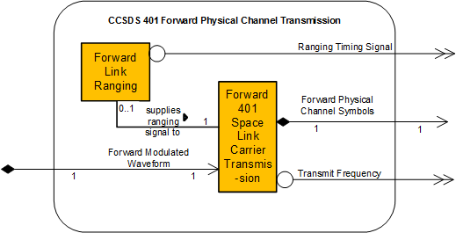
Example 1: CCSDS 401 Forward Physical Channel Transmission FR Set (1 of 4)
The CCSDS 401 Forward Physical Channel Transmission Functional Resource Set of the Physical Channel stratum comprises the following FR types:
Forward 401 Space Link Carrier Transmission; and
Forward Link Ranging

Slide 16
Example 1: CCSDS 401 Forward Physical Channel Transmission FR Set (2 of 4)
Forward 401 Space Link Carrier Transmission (3.2.1.1)
The functional resource classifier of the Forward 401 Space Link Carrier Transmission FR Type is fwdSpaceLinkCarrierTransmission
The Forward 401 Space Link Carrier Transmission FR corresponds to the radio frequency modulation transmission functions specified in the CCSDS Radio Frequency and Modulation Systems: Part 1 – Earth Stations and Spacecraft Recommended Standard (reference [X])
Relationships with external Functional Resource Sets (3.2.1.1.1)
The Forward 401 Space Link Carrier Transmission FR accesses Forward Modulated Waveform SAP that can be accessed by multiple users (if it is a multi-band antenna)
The Forward 401 Space Link Carrier Transmission FR has a Forward Physical Channel Symbols SAP that can be accessed by a single Accessor
The Forward 401 Space Link Carrier Transmission FR provides a Transmit Frequency ancillary interface

Slide 17
Example 1: CCSDS 401 Forward Physical Channel Transmission FR Set (3 of 4)
Configuration parameters (3.2.1.1.2)
The configuration parameters of the Forward 401 Space Link Carrier Transmission FR are specified in the SANA Functional Resource Registry (reference [Y]) under the parameters subtree ({fwdSpaceLinkCarrierTransmission 1}), where for the configuration parameters the configured attribute = “true”
Read-only parameters (3.2.1.1.3)
The read-only parameters of the Forward 401 Space Link Carrier Transmission FR are specified in the SANA Functional Resource Registry (reference [Y]) under the parameters subtree ({fwdSpaceLinkCarrierTransmission 1}), where for the read-only parameters the configured attribute = “false”
Notification events (3.2.1.1.4)
The notification events for the Forward 401 Space Link Carrier Transmission FR are specified in the SANA Functional Resource Registry (reference [Y]) under the events subtree ({fwdSpaceLinkCarrierTransmission 2})
Directives (3.2.1.1.5)
The directives that are invokable on the Forward 401 Space Link Carrier Transmission FR are specified in the SANA Functional Resource Registry (reference [Y]) under the directives subtree ({fwdSpaceLinkCarrierTransmission 3})
Directives required by other functions (3.2.1.1.5.1)
The directive with the classifier fwd401CarrierTransmissionSetControlParameters is required to be supported in any service configuration in which the SLE Forward CLTU service (reference [A]), SLE Forward Space Packet service (reference [B]), Forward Frame CSTS with Master Throw Event implemented and enabled (reference [C]), or the planned Service Control CSTS are present

Slide 18
Example 1: CCSDS 401 Forward Physical Channel Transmission FR Set (4 of 4)
Forward Link Ranging (3.2.1.2)
The Functional Resource classifier of the Forward Link Ranging FR Type is fwdLinkRanging
The Forward Link Ranging FR generates the ranging signal that is applied to the forward physical channel. Depending on the ranging technology used, the ranging signal takes the form of:
ranging tones as defined in CCSDS 401 (reference [F]); or
a pseudo-noise (PN) sequence as defined in CCSDS 414 (reference [G])
The time of radiation of the ranging signal is provided to the Range and Doppler Extraction FR so that on reception of the ranging signal replica the round-trip delay can be determined
Relationships with external Functional Resource Sets (3.2.1.2.1)
The Forward Link Ranging FR provides a Ranging Timing Signal ancillary interface
Configuration parameters (3.2.1.2.2)
Read-only parameters (3.2.1.2.3)
Notification events (3.2.1.2.4)
Directives (3.2.1.2.5)

Slide 19
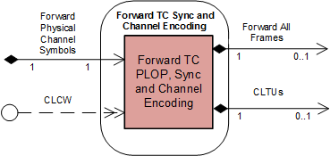
Example 2: Forward TC Synchronization and Channel Encoding FR Set (1 of ?)
The Forward TC Synchronization and Channel Encoding Functional Resource Set of the Synchronization and Channel Coding Stratum consists of the Forward TC PLOP, Synchronization and Channel Encoding FR

Slide 20
Example 2: Forward TC Synchronization and Channel Encoding FR Set (2 of 5)
Forward TC PLOP, Synchronization and Channel Encoding (3.3.1.1)
The Functional Resource classifier of the Forward TC Synchronization and Channel Encoding FR Type is fwdTcPlopSyncAndChnlEncoding
The Forward TC PLOP, Synchronization and Channel Encoding FR corresponds to the following functions:
the Random Sequence Generation function of the TC Synchronization and Channel Coding Recommended Standard (reference [M]);
the BCH Encoding function of the TC Synchronization and Channel Coding Recommended Standard;
the LDPC Encoding function of the TC Synchronization and Channel Coding Recommended Standard;
the CLTU Generation functions of the TC Synchronization and Channel Coding Recommended Standard;
the Physical Layer Operations Procedure (PLOP) of the TC Synchronization and Channel Coding Recommended Standard;
the emission of ‘data unit processing complete’ CSTS event notifications, as required by the CSTS Data Processing procedure, Buffered Data Processing procedure, or Sequence Controlled Data Processing procedure (4.6.3.4 of reference [N]) and specified in 3.3.1.1.5; and
the discarding of all data units with specified service-instance-id upon receipt of a CSTS ‘discard all data units’ directive, as require by the CSTS Data Processing procedure, Buffered Data Processing procedure, or Sequence Controlled Data Processing procedure (4.6.3.4 of reference [N]) and specified in 3.3.1.1.6.
An instance of the Forward TC PLOP, Synchronization and Channel Encoding FR is configured to process either transfer frames or CLTUs
When configured to support transfer frames, the FR performs: (optionally) Random Sequence Generation, either BCH Encoding or LDPC Encoding, CLTU Generation, and the PLOP
When configured to process CLTUs, the FR performs the PLOP

Slide 21
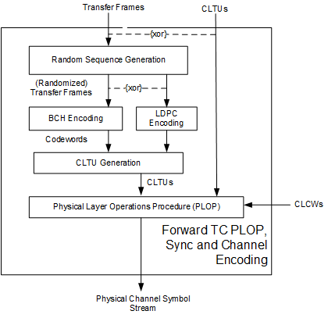
Example 2: Forward TC Synchronization and Channel Encoding FR Set (3 of 5)
Internal Structure of the Forward TC PLOP, Synchronization and Channel Encoding Functional Resource

Slide 22
Example 2: Forward TC Synchronization and Channel Encoding FR Set (4 of 5)
Regulation of the resource status by bit lock and RF availability status of the forward space link (3.3.1.1.1)
Specifies dependency of the resource status of the FR on the No Bit Lock and No RF Available flags in incoming CLCWs
Relationships with external Functional Resource Sets (3.3.1.1.2)
The Forward TC PLOP, Synchronization and Channel Encoding FR accesses the Forward Physical Channel Symbols SAP
The Forward TC PLOP, Synchronization and Channel Encoding FR has a Forward All Frames SAP that can be accessed by a single Accessor
The Forward TC PLOP, Synchronization and Channel Encoding FR has a CLTU SAP that can be accessed by a single Accessor
The Forward TC PLOP, Synchronization and Channel Encoding FR requires a CLCW ancillary interface when the resource status of the FR instance is configured to be regulated by the No Bit Lock and/or No RF Available flags of the CLCW

Slide 23
Example 2: Forward TC Synchronization and Channel Encoding FR Set (5 of 5)
Configuration parameters (3.3.1.1.3)
Also includes proposed new fwdTcSyncInputMode parameter and modifications of definitions of some existing parameters
If accepted, these additions/changes would be included in the SANA FR Registry and removed from future versions of the Tech Note
Read-only parameters (3.3.1.1.4)
Notification events (3.3.1.1.5)
‘data unit processing complete’ event (3.3.1.1.5.1)
Specifies required behavior to emit an ‘data unit processing complete’ event notification for each radiated transfer frame
Cites the Forward Frame CSTS as the source of the requirement
Directives (3.3.1.1.6)
Directives required by other functions (3.3.1.1.6.1)
‘discard all data units’ directive (3.3.1.1.6.2)
Specifies required behavior to discard data units when directed to do so
Cites the Forward Frame CSTS as the source of the requirement

Slide 24
Issues/Concerns/Work to be Done
Population/confirmation of FR parameters (especially configuration parameters), events, and directives
CSTSWG has an initial “actionee list” for developing and reviewing the P/E/Ds for the highest-priority FRs, but no firm schedule for doing so
Resources to pursue this are spread thin
Data Store FRs related to Terrestrial Generic File Transfer (TGFT)
Relationships between file data store FRs and the Terrestrial File Transfer Service Provider FR do not accurately reflect the push-only nature of TGFT
Next draft of Tech Note will address this issue: may result in addition and/or removal of some FRs
General concerns about Data Sinks and Data Stores
Some Data Store FRs have Data Sinks to feed them, others do not
Rationale for this is not evident in current FR definitions
Next draft of the Tech Note will address this issue: may result in addition and/or removal of some Data Sink FRs
Monitored Data Collection FR will probably be deleted in next draft
Service Control Production FR will probably be deleted in next draft

Slide 25
Relationships among FR Ref Model Tech Note, FR Editing Tool, SANA FR Registry, and other CSSA “products” (1 of 4)
Functional Resource Reference Model
Establishes the framework within which Functional Resource types are categorized
Identifies all of the FR types by Functional Resource Set (including placeholders for future FR Sets & FRs)
Identifies the sources of definitions of the functionality of each FR type
By reference to primary specifications of the FR’s functionality (e.g., CCSDS space data link protocol Blue Books)
In response to requirements levied by CCSDS services that make use of the FR (FR Ref Model specifies the normative definition)
Identifies the relationships among FR types
Explicitly within each FR Set
“Functionally” with FRs in other FR Sets
Primary relationships
Ancillary interfaces
Points to the configuration parameters, read-only parameters, notification events, and directives (P/E/Ds) that are specified in the SANA FR Registry
References are in terms of classifiers – the string-name tags that are assigned to the Object Identifiers that are assigned to the P/E/Ds in the SANA Registry (the normative repository for the P/E/D definitions)
FR Ref Model may contain temporary “working” commentary on existing SANA Registry P/E/D identifications/definitions
FR Ref Model may contain temporary P/E/D identifications/definitions in preparation for inclusion in the SANA Registry

Slide 26
Relationships among FR Ref Model Tech Note, FR Editing Tool, SANA FR Registry, and other CSSA “products” (2 of 4)
SANA FR Registry
Normative source for Object Identifier (OID) and classifier assignments* of the Functional Resource Types for CCSDS-standard Functional Resources registered under the crossSupportFunctionalities subtree
CCSDS-CSS-CROSS-SUPPORT_FUNCTIONALITIES {iso(1) identified-organization(3) standards-producing-organization(112) ccsds(4) css(4) crossSupportResources(2) crossSupportFunctionalities}
Normative source for the OID and classifier assignments*, definitions, data types, and engineering units for the P/E/Ds of the CCSDS-standard Functional Resources
Functional Resource Editor
Tool used to build an XML document that contains the information contained in the SANA FR Registry
Draft versions of the XML document can be expanded and edited
Approved versions of the XML document are uploaded to the SANA Registry
*For CSTSes, the classifiers for the FR Types and P/E/Ds are defined by the
Recommended Standards for those services, with OID assignment deferred
to the SANA FR Registry

Slide 27
Relationships among FR Ref Model Tech Note, FR Editing Tool, SANA FR Registry, and other CSSA “products” (3 of 4)
Service Agreements (SM)
Service Agreements put bounds on possible sets or ranges of FR configuration parameters
Configuration Profiles (SM)
Configuration Profiles are defined as collections of Functional Resource instances with set initial values for the FR configuration parameters
Event Sequences
Varies FR configuration parameter values over time or due to occurrence of events (direct use of FR information)
Service Management Utilization Request Format (SMURF) – Service Package Request
References Configuration Profiles (indirect use of FR information)
Re-specifies values of FR configuration parameters in the referenced Configuration Profiles (direct use of FR information)
Simple Schedule (SM)
References Configuration Profiles (indirect use of FR information)

Slide 28
Relationships among FR Ref Model Tech Note, FR Editing Tool, SANA FR Registry, and other CSSA “products” (4 of 4)
Service Package Result (SM)
References Configuration Profiles only in terse mode (indirect use of FR information)
Includes as-scheduled contents of Configuration Profiles in verbose mode (direct use of FR information)
Monitored Data CSTS (CSTS)
Subscribes to reporting of current parameter values and notification events of FR instances (direct use of FR information)
Service Control CSTS (CSTS)
Subscribes to reporting of current parameter values and notification events of FR instances (direct use of FR information)

Slide 29
Backup Slides

Slide 30
SLS Configuration Category

Slide 31
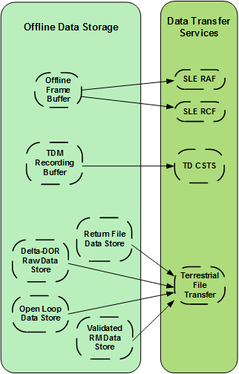
Retrieval Configuration Category

Slide 32
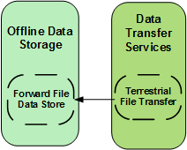
Forward Offline Data Delivery Configuration Category

