Slide 1

Joint Subcommittee Meeting
ISO/TC 20/SC 13 and ISO/TC 20/SC 14
Berlin, DE
23 May 2011
Overview of the CCSDS Program of Work
CCSDS Engineering Steering Group

Slide 2


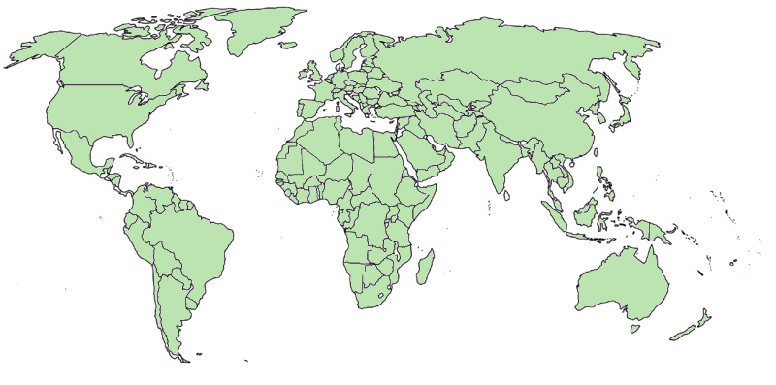

CCSDS – Participation Overview
CCSDS – An Agency-Led International Committee
Currently 11 Member agencies
Currently 28 Observer Agencies
  Agencies represent 26 nations
Currently 141 Commercial Associates
Also functions as an ISO Committee
  TC20/SC13 - Space Data & Info Transfer Systems
  Represents 20 nations
OBSERVER
AGENCIES
ASA/Austria
BFSPO/Belgium
CAS/China
CAST/China
CLTC/China
CSIR/South Africa
CSIRO/Australia
DCTA/Brazil
DNSC/Denmark
EUMETSAT/Europe
EUTELSAT/Europe
GISTDA/Thailand
HNSC/Greece
IKI/Russia
ISRO/India
KARI/Korea
KFKI/Hungary
MOC/Israel
NCST/USA
NICT/Japan
NOAA/USA
NSARK/Kazakhstan
NSPO/Taipei
SSC/Sweden
SUPARCO/Pakistan
TsNIIMash/Russia
TUBITAK/Turkey
USGS/USA
MEMBER
AGENCIES
ASI/Italy
CNES/France
CNSA/China
CSA/Canada
DLR/Germany
ESA/Europe
FSA/Russia
INPE/Brazil
JAXA/Japan
NASA/USA
UKSA/UK
e
e
e

Slide 3
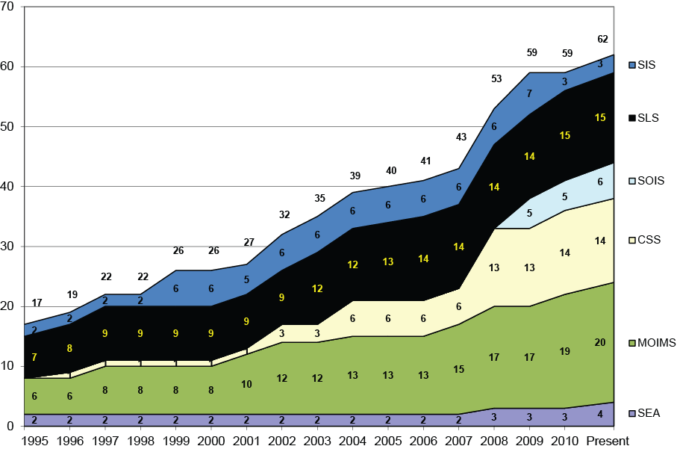

CCSDS Overview
62 Standards and Practices
518 missions
and counting…

Slide 4
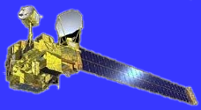












CCSDS Architectural Overview
Information Architecture
Security
Space Assigned Numbers Auth.
Delta-DOR
Time Correlation/Synchronization
Information Svcs Architecture
Systems
Engineering
Systems
Engineering
MCC
MCC
ARCHIVE
& APPLS
Spacecraft
Onboard
Interface
Services
Spacecraft
Onboard
Interface
Services
Space
Link
Services
Space
Link
Services
Cross
Support
Services
Cross
Support
Services
Space
Internetworking
Services
Space
Internetworking
Services
Mission Ops
& Info. Mgt.
Services
Mission Ops
& Info. Mgt.
Services
Onboard Wireless WG
Application Support Services
Onboard Plug-n-Play
RF & Modulation
Space Link Coding & Sync.
Multi/Hyper Data Compress.
Space Link Protocols
Next Generation Uplink
Space Data Link Security
Planetary Communications
Optical Coding and Mod
CS Service Mgt
CS Transfer Svcs
Cross Support Architecture
Reference Arch.
Asynch Messaging
IP-over-CCSDS Links
Motion Imagery & Apps
Delay Tolerant Networking
Voice
Data Archive Ingestion
Navigation
Info. Pack. & Registries
Spacecraft Monitor & Control
Digital Repository Audit/Certification
Thirty-one working groups (some in formative stages )

Slide 5
CCSDS Structure and Organization
Systems
Engineering
ISO
Liaisons
Infrastructure providers
Stakeholders
Missions / Programs
CCSDS
CCSDS Secretariat
CCSDS Management Council (CMC)
Space Assigned Numbers Authority
CCSDS Engineering Steering Group
Spacecraft
Onboard
Interface
Services
Space
Link
Services
Cross
Support
Services
Space
Internetworking
Services
Mission Ops
& Info. Mgt.
Services
WG’s
WG’s
WG’s
WG’s
WG’s
WG’s
WG’s
WG’s
WG’s
WG’s
WG’s
WG’s
WG’s
WG’s
WG’s
WG’s
WG’s
WG’s

Slide 6

CCSDS Relationships with ISO
ISO
Liaisons
Infrastructure providers
Stakeholders
Technical Committee 20 (ISO/TC20): Aircraft and Space Vehicles
Other
TCs
Missions / Programs
Missions / Programs
CCSDS
Subcommittee 13
(ISO/TC20/SC13):
Space Data and
Information Transfer
Systems
Other
SCs
Subcommittee 14
(ISO/TC20/SC14):
Space Systems
and Operations
TC20/SC13
Heads of Delegation
(CCSDS CMC)
CCSDS Secretariat
CCSDS Management Council (CMC)
ISO
CCSDS Management Council (CMC)
Space Assigned Numbers Authority
(Secretariat: AIAA)
(Secretariat: NASA)
CCSDS Engineering Steering Group
CCSDS Engineering Steering Group
Spacecraft
Onboard
Interface
Services
Systems
Engineering
Space
Internetworking
Services
Space
Debris
Interfaces,
Integration
& Test
Operations &
Ground Support
Design
Engineering
& Production
Environment
(natural &
induced)
Program
Management
Materials and
Processes
Space
Link
Services
Cross
Support
Services
Mission Ops
& Info. Mgt.
Services
WG’s
WG’s
CCSDS
WG’s
WG’s
WG’s
WG’s
WG’s
WG’s
WG’s
WG’s
WG’s
WG’s
WG’s
WG’s
WG’s
WG’s
WG’s
WG’s

Slide 7
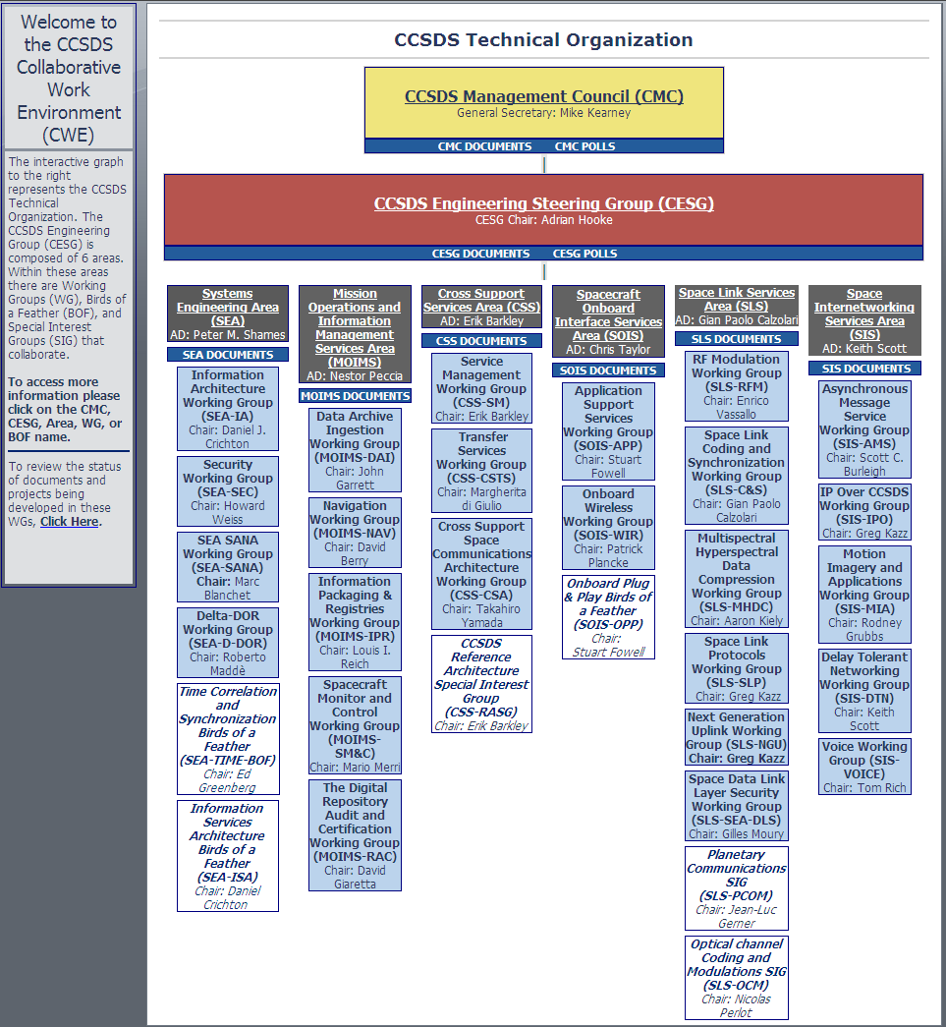
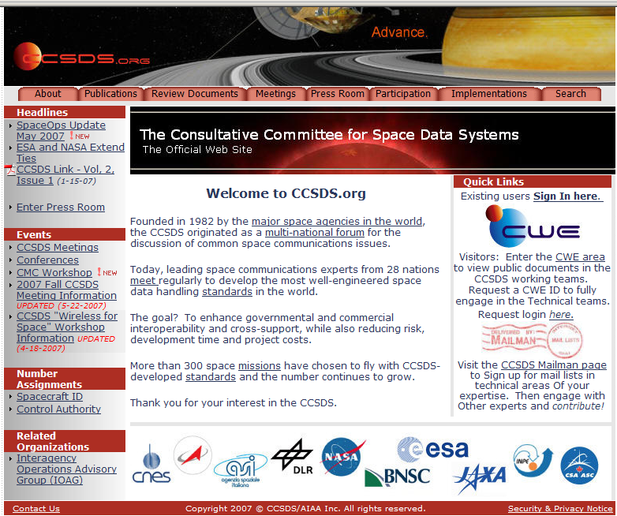


Access to CCSDS Technical WG info: www.ccsds.org > CWE

Slide 8
CCSDS Work Plan
CCSDS Areas
  SEA
  MOIMS
  CSS
  SOIS
  SLS
  SIS

Slide 9
Systems Engineering Area (SEA)
Objective
  Guide overall CCSDS architecture for space mission communications, operations, and cross-support
  Support the CESG in evaluating consistency of all area programs of work with the defined architecture
  Create cross-cutting working groups and BoFs as required to progress the work of CCSDS
Focus
  Define reference architectures for describing space mission communications, operations, and cross-support standardization
  Coordinate and collaborate with other areas about architectural choices and options
  Define standards for cross cutting topics such as security and discrete architecture frameworks, and for those that cross cut multiple layers of protocols
  Support other working groups and BoFs that are addressing cross cutting issues
SEA Working Groups
  Information Architecture Working Group
  Security Working Group
  Delta-DOR Working Group
  Space Assigned Numbers Authority Working Group
  Time Correlation and Synchronization BoF
  Information Services Architecture BoF

Slide 10
AMS / MAL Alignment SIG
CCSDS Boot Camp
CCSDS Procedures
CCSDS Architectural Overview
Information Architecture
Security
Space Assigned Numbers Auth.
Delta-DOR
Time Correlation/Synchronization
Information Svcs Architecture
Systems
Engineering
Systems
Engineering
MCC
MCC
ARCHIVE
& APPLS
Spacecraft
Onboard
Interface
Services
Spacecraft
Onboard
Interface
Services
Space
Link
Services
Space
Link
Services
Cross
Support
Services
Cross
Support
Services
Space
Internetworking
Services
Space
Internetworking
Services
Mission Ops
& Info. Mgt.
Services
Mission Ops
& Info. Mgt.
Services
Onboard Wireless WG
Application Support Services
Onboard Plug-n-Play
RF & Modulation
Space Link Coding & Sync.
Multi/Hyper Data Compress.
Space Link Protocols
Next Generation Uplink
Space Data Link Security
Planetary Communications
Optical Coding and Mod
CS Service Mgt
CS Transfer Svcs
Cross Support Architecture
Reference Arch.
Asynch Messaging
IP-over-CCSDS Links
Motion Imagery & Apps
Delay Tolerant Networking
Voice
Data Archive Ingestion
Navigation
Info. Pack. & Registries
Spacecraft Monitor & Control
Digital Repository Audit/Certification
Thirty-one working groups (some in formative stages )

Slide 11
Systems Engineering Area (SEA)
Information Architecture
Scope: | Space information management practices
Objectives: | Define a cross cutting reference architecture for information modeling and management, provide a more complete information viewpoint specification for RASDS
Relevance: | Several working groups in different areas need a common information architecture reference model, terms and definitions are otherwise ad hoc
Deliverables: | Green Book (Descriptive) Reference Architecture for Space Information Management
Security
Scope: | Security services and practices for securing space missions
Objectives: | Specification of cross cutting security services and models for mission use, in space and on ground
Relevance: | Security of data and services for space mission operations
Deliverables: | Blue Books (Recommended Standards) for providing interoperable authentication, encryption, and access control and practices (Magenta Books) for applying them and assessing and securing mission and operational deployments
Delta-Differential One-way Ranging (Delta-DOR)
Scope: | Services for Delta-DOR tracking, data exchange and practices
Objectives: | Specification of interoperable Delta-DOR practices for agency cross support
Relevance: | High precision plane of sky tracking of missions is required for accurate deep space navigation and maneuvers
Deliverables: | Blue Books for cross supported Delta-DOR data exchanges and interoperable practices (Magenta Books) for performing them

Slide 12
Systems Engineering Area (SEA)
Space Assigned Numbers Authority (SANA)
Scope: | “Magic” numbers and names defined and used by CCSDS standards
Objectives: | Facilitate registration and management of CCSDS assigned numbers and names
Relevance: | CCSDS documents define a variety of different assigned numbers and names, if these are extended or assigned over time it is best if they are in an updatable registry rather than in a document
Deliverables: | A process for operating and guiding the SANA registrar, definitions of registries and requirements on managing and updating them, and an on-line service with a variety of registries (operational)
Time Correlation and Synchronization BoF
Scope: | Standards for exchange of time and for correlating space & ground clocks
Objectives: | Create interoperable standards and practices to replace current ad hoc approaches
Relevance: | As more missions participate in multi-agency collaborative exploration standards for coordinating operations and correlating observations become more important
Deliverables: | Interoperable standards (Blue Book) for exchanging time and correlating and synchronizing clocks
Information Services Architecture BoF
Scope: | Cross cutting standards for the creation of interoperable service oriented architecture (SOA) components and patterns for information services discovery and utilization
Objectives: | Define common components and practices for registry / repository services and patterns of use
Relevance: | “SOA” is now a paradigm tied to vendor products, in order to deploy interoperable information services standardized components, interfaces, and patterns of use are required
Deliverables: | A reference architecture with component level definitions (Blue Book) and a defined set of patterns for their use, a recommended practice (Magenta Book) describing their use

Slide 13
Mission Operations and Information Management Systems (MOIMS)
Objective
  Address all of the flight execution phase applications that are required to operate the spacecraft and its ground system in response to mission objectives, and their associated detailed information management standards and processes.
  Ensures that application standards exist which facilitate the smooth transition of space mission information between the “mission operations” systems and the “mission utilization” systems.
Focus
  Primarily on the “Mission Operations” functions that occur on a timescale driven by the flight path of the space vehicle.
  “Mission Utilization” occurs on a timescale that is convenient for users and is often conducted by a separate community.
MOIMS Working Groups
  Data Archive Ingestion
  Navigation
  Spacecraft Monitoring and Control
  Digital Repository Audit and Certification

Slide 14
Mission Operations and Information Management Systems (MOIMS)
Digital Archive Ingestion Working Group
Scope: | Digital Archives
Objectives: | Define a detailed reference architecture for archiving, including identification of service interfaces.
Relevance: | Potentially applicable to all Archives
Deliverables: | Define the methodology to be used for the submission and ingest of digital data sources and digital metadata, for the identification of digital data within the archive, for the search and retrieval of digital data and metadata and for the long term preservation of archives.
Digital Repository Audit and Certification Working Group
Scope: | Digital Archives
Objectives: | Definition of criteria to certify archives.
Relevance: | Potentially applicable to all Archives
Deliverables: | Produce standards that establishes the criteria that a repository/archive must meet to be designated an ISO Trusted Digital Repository.
Information Packaging and Registries Working Group
Scope: | Data packaging techniques and their association with the registration of schemas/data definitions.
Objectives: | Develop specifications for an extensible framework for packaging data and metadata
Relevance: | Potentially applicable to a vast set of data interchanges
Deliverables: | XML Packaging Recommendations

Slide 15
Mission Operations and Information Management Systems (MOIMS)
Navigation Working Group
Scope: | The Navigation Working Group provides a discipline-oriented forum for detailed discussions and development of technical flight dynamics standards.
Objectives: | Develop specifications to facilitate the transmission (and interoperability) of Navigation Data across Agencies
Relevance: | Navigation Data transfer is increasing in the last years
Deliverables: | Tracking, Spacecraft Attitude and Orbit data. Conjunction assessment data that will warn spacecraft operators of pending close approaches between their spacecraft and another spacecraft or on-orbit debris. Requests related to Pointing Spacecraft instruments and/or onboard antennas. History or Prediction of the Spacecraft Attitude (orientation) and/or Trajectory (position)). Predicted Orbital Events Spacecraft Maneuver summary information. Perturbations that affect a spacecraft orbit/attitude.
Spacecraft Monitoring & Control Working Group
Scope: | Operational Concept and set of Services to support Spacecraft & Control at the application layer
Objectives: | Definition of an extensible set of services to support the operational concept together with its information model and behaviours. This includes (non exhaustively) ground systems such as Automatic Command and Control, Data Archiving and Retrieval, Flight Dynamics, Mission Planning, Automation, and Performance Evaluation.
Relevance: | Many potential application M&C Systems.
Deliverables: | Operational Concept, set of common and core services. Definition of the standard information set to be exchanged for SM&C purposes (e.g. XTCE)

Slide 16
Cross Support Services (CSS)
Objective
  CSS Area addresses how Tracking, Telemetry and Command (TTC) network resources are made available by one organization to another
  Define what services are required at various cross-support interface points
  Determine how services are exposed, scheduled and used by organizations to confederate infrastructure to support mission execution
Focus
  Definition of cross support communications architecture
  Terrestrial transfer of mission data between mission operations centers and TTC networks
  Terrestrial transfer radiometric observables
  Management of TTC network services/interfaces re Mission spacecraft spacelink + terrestrial data transfers
CSS Working Groups
  Cross Support Architecture
  Cross Support Transfer Services
  Service Management
  CCSDS Reference Architecture (Special Interest Group)
Notes:
16

Slide 17
Cross Support Services (CSS)
Cross Support Architecture
Scope: | “Traditional” and space internetworking cross support communications architecture
Objectives: | Identify and Define the Architecture for Communications Cross Support
Relevance: | Assist in reasoning in identifying and exposing services for definition
Deliverables: | Magenta Book (Best Practice) Cross Support Space Communications Architecture
Cross Support Transfer Services
Scope: | Terrestrial data transfer between mission operation systems and TTC networks
Objectives: | Specification of reusable transfer services framework and framework-based services
Relevance: | Cross support data transfer services occur on a daily basis among current member agencies
Deliverables: | Blue Books (Recommended Standards) for the data transfer services framework, engineering monitor data transfer, tracking data transfer, and delivery of unframed telemetry*
Service Management
Scope: | Management of spacelink and terrestrial data transfer services
Objectives: | Specification of management services framework and framework-based management services for coordination and utilization of TTC networks
Relevance: | Interagency network utilization occurs on a daily basis among current member agencies
Deliverables: | Blue Books for the management services framework and management service recommendations for management of forward, return, and radiometric data service**
Notes:
17
17

Slide 18
Cross Support Services (CSS)
Reference Architecture Special Interest Group
Scope: | CCSDS Reference Architecture
Objectives: | Facilitate technical alignment of recommendations within CCSDS
Relevance: | General CCSDS scope has scaled dramatically over the last ~10+ years (from modulation/coding schemes to mission operations + space internetworking)
Deliverables: | Development of appropriate engineering artifacts to assist coordination and reasoning with regard to potentially overlapping recommendations and/or any gaps
Notes:
18
18

Slide 19
Space Link Services (SLS)
Objective
  Develop efficient space link communications standards for space links interconnecting a spacecraft either with its ground support system or with another spacecraft.
  Provide Agencies' new generations of space missions with telecommand and telemetry capabilities beyond current technologies addressing new needs for higher data rates, better link performances, and more performing ranging systems, as well as lower cost and higher security.
Focus
  SLS area concentrates on layers 1 & 2 (of OSI protocol stack), these include namely : RF & modulation, channel coding and data link layer protocol.
  Both long-haul (e.g.: spacecraft to ground) and proximity links (e.g.: orbiter to lander).
  Two additional functions are also covered by the SLS area : data compression for end to end data transfer optimization, and ranging for accurate orbit determination.
SLS Working Groups
  Radio Frequency & Modulation
  Coding & Synchronisation
  Space Link Protocols
  Next Generation Uplink
  Multi/Hyperspectral Data Compression
  Space Data Link Security (Joint with SEA)
  Optical Coding and Modulation (SIG)
  Planetary Communications (SIG)
Notes:
RF & Mod
WB
red book (eff. Mod 32GHz agency review completed)
Remove normative material, create pink sheets. All inputs available except from CNES
Space Link Codes

Slide 20
Space Link Services (SLS)
Radio Frequency & Modulation Working Group
Scope: | Develop modulation recommendations for 22 (the band near 22 GHz), 26 and 32 GHz high rate links and for missions supported by data relay satellites at 2 GHz
Objectives: | Study future satellites requirements in terms of modulation schemes with high efficiency
Relevance: | Identify the most appropriate RF & modulation schemes to be applied by each mission
Deliverables: | Blue Books (Recommended Standards) for RF & Modulation, Ranging. Green Books (Informational Report).
Coding & Synchronisation Working Group
Scope: | Develop and maintain standards and report on Coding and Synchronization for Space Links
Objectives: | Provide Agencies’ new generations of space missions with coding schemes offering higher data rates and better link performances, possibly at lower cost
Relevance: | Identify the most appropriate Coding & Synchronisation schemes to be applied by each mission
Deliverables: | Blue Books (Recommended Standards) for Coding & Synchronisation. Magenta Book (Best Practice) Telemetry Coding Profiles. Support Space Green Books (Informational Report).
Space Link Protocols Working Group
Scope: | Develops and adapts wherever possible link layer protocols for new mission environments as e.g. proximity communication, potentially for formation flying, missions utilizing high rate, etc.
Objectives: | Review the Proximity-1 Data Link Protocol, including Prox-1 Green book update, and provide new or updated recommendations for CCSDS Data Link layer protocols
Relevance: | The Data Link Protocols are the backbone for data transfer over CCSDS Links
Deliverables: | Blue Books (Recommended Standards) for Space Data Link Protocols. Green Books (Informational Report).
Notes:
20
RF & Mod
WB
red book (eff. Mod 32GHz agency review completed)
Remove normative material, create pink sheets. All inputs available except from CNES
Space Link Codes

Slide 21
Space Link Services (SLS)
Multispectral & Hyperspectral Data Compression Working Group
Scope: | Develop recommendations for lossless and lossy compression suitable for onboard compression of data from multispectral and hyperspectral imagers
Objectives: | Provide Agencies’ new generations of space missions with efficient data compression methods
Relevance: | Modern Spacecraft are capable of producing enormous data volumes, and thus effective compression is important to increase data return over space communications channels
Deliverables: | Blue Books (Recommended Standards) for Lossless and Lossy Data Compression. Green Books (Informational Report).
Space Data Link Security Working Group
Scope: | Provide authentication, confidentiality, integrity check and anti-replay protection at the data link layer for TM and TC transmission between Satellite Control Center and Spacecraft
Objectives: | Develop a Space Data Link Security protocol and its extension, fully compatible with CCSDS space data link protocols (TM, TC, AOS) and independent from the cryptographic algorithm selected by the mission
Relevance: | Civilian missions are targeted since dual use and defence missions use confidential non cross-supported security protocols
Deliverables: | Blue Books (Recommended Standards) for SDLS core protocol recommendation, SDLS protocol extension recommendation. Green Books (Informational Report).
Notes:
21
RF & Mod
WB
red book (eff. Mod 32GHz agency review completed)
Remove normative material, create pink sheets. All inputs available except from CNES
Space Link Codes

Slide 22
Space Link Services (SLS)
Next Generation Uplink Working Group
Scope: | Develop requirements for achieving increases in uplink data rate by taking an integrated approach in investigating bandwidth efficient modulation techniques, along with the appropriate channel coding methods coupled with the use of the most appropriate link layer protocols
Objectives: | Develop the functional and performance requirements for a CCSDS telecommand standard accommodating data rates up to 10 Mb/s
Relevance: | Complement the existing CCSDS TC standard developed many years ago
Deliverables: | Green Book (Informational Report) Requirements on other CCSDS Working Groups associated with NGU proposals, NGU Green Book.
Optical Coding and Modulation Special Interest Group
Scope: | Provide a discussion forum for cooperation and cross-support on Optical Communications
Objectives: | Identify application profile having consensus for a standardized technical solution
Relevance: | Optical Communications are becoming more and more interesting with powerful performances
Deliverables: | Concept Paper for creating a WG to start standardization on Optical Links
Planetary Communications Special Interest Group
Scope: | Survey and report on agencies needs and planning for lunar and martian local communications/navigation infrastructure (surface coms/nav and surface-orbit coms/nav)
Objectives: | Propose in case of consensus creation of a WG, define recommended standard/practice.
Relevance: | A preliminary coarse inventory of communications/navigation requirements (URD) is needed
Deliverables: | Concept Paper for creating a WG to start standardization on Planetary Communications
Notes:
22
RF & Mod
WB
red book (eff. Mod 32GHz agency review completed)
Remove normative material, create pink sheets. All inputs available except from CNES
Space Link Codes

Slide 23
Space Internetworking Services (SIS)
Objective
  Provide services and protocols to address networked interactions:
    between spacecraft and earth-based resources,
    among spacecraft,
    between spacecraft and landed elements, and
    within heterogeneous spacecraft.
  The SIS Area deals with services and protocols that are independent of specific link technology and independent of application-specific semantics (network – application layers of the OSI reference model). The SIS Area accommodates all ranges of delay, interactivity, and directionality, although not all protocols are appropriate for all environments.
Focus
  Basic networked services (message transfer, file transfer)
  Space-capable internetwork layer and supporting protocols
  Voice and Motion Imagery
SIS Working Groups
  Delay Tolerant Networking (DTN)
  Asynchronous Messaging Service (AMS)
  Internet Protocols over CCSDS (IPO)
  Motion Imagery and Applications (MIA)
  Voice (VOICE)
Notes:
23
23
23

Slide 24
Space Internetworking Services (SIS)
Delay Tolerant Networking (DTN)
Scope: | Networked communications in space environments (including intermittently-connected)
Objectives: | Specify network and associated protocols (e.g. network management, routing, quality of service) to support communications in a wide range of relevant environments
Relevance: | Underpinning for space-based internetworking
Deliverables: | Blue Book specifying a reliability mechanism for CCSDS Data Links (LTP) Blue Book specifying an internetworking protocol that functions in space environments (BP)
Asynchronous Message Service
Scope: | Message-oriented communications in space environments including connected and disrupted
Objectives: | Publish a Recommended Standard (Blue Book) for asynchronous message exchange in space flight operations
Relevance: | AMS is a protocol suitable to support general applications including CCSDS SOIS message transfer service and CCSDS SM&C Message Abstraction Layer
Deliverables: | Green Book and associated Blue Book specifying the AMS and Remote AMS protocols
Internet Protocols Over CCSDS (IPO)
Scope: | Missions that want to use Internet Protocols (IP) for networked communications
Objectives: | Describe the recommended method of transferring CCSDS recognized IP PDUs over the four underlying internationally standardized CCSDS link layer protocols
Relevance: | IP is a mature networking technology suitable for (relatively) low-latency (relatively) low-delay environments; existing CCSDS documents allow a number of ways to carry IP and further profiling to limit the number of different mechanisms was desired
Deliverables: | Blue Book describing the preferred mechanisms for encapsulating IP packets in CCSDS data links
Notes:
24
24
24

Slide 25
Space Internetworking Services (SIS)
Motion Imagery and Applications (MIA)
Scope: | Motion Imagery (video) communications (including human-to-human, camera-to-human, maybe image recognition / robotic vision in the future), including ground-to-ground, between space and ground, and space-to-space; includes networked video (NOT analog)
Objectives: | Review existing commercial, CCSDS, and other international standards for video Provide a set of ‘best practices’ describing: Compression standards and implementations Packetization of compressed and uncompressed data streams Distribution formats Common references and quality standards
Relevance: | Multiple space agencies are now utilizing motion imagery on spacecraft and sharing that video between spacecraft (docking and rendezvous) and between ground control centers.
Deliverables: | Green Book of Motion Imagery Communications Blue book of Motion Imagery Communications
Voice (VOICE)
Scope: | Voice communications (typically human-to-human), including ground-to-ground, between space and ground, and space-to-space; includes networked voice and ‘traditional’ analog voice transmission as required
Objectives: | Provide a set of ‘best practices’ describing how to encode and encapsulate voice, and the recommended mechanisms for transmitting voice
Relevance: | Nearly every human space mission requires voice communications; standardization reduces costs and improves quality by removing the need for transcoding.
Deliverables: | Green Book of Voice Communications for Human Spaceflight Magenta book of Voice Communications for Human Spaceflight
Notes:
25
25
25

Slide 26
Standard Onboard Interface Services (SOIS)
Objective
  Provide services and where applicable protocols for onboard communication:
    to software applications
    between spacecraft subsystems,
    to sensors and actuators.
  SOIS focuses on insulating mission specific applications from the underlying details of the avionics implementation
Scope
  A relatively new area working in a complex environment, must take account of Agency and institutionalized implementations
  Promoting reuse of software and “avionics building blocks”
  Interoperability (payloads, wireless apps, sensor and actuators)
  Cross-area interfaces with MOIMS and SIS
Focus
  Standard services for mission applications
  Standard services for underlying subnetworks
  Recommendations for the use of wireless technology
SIOS Working Groups
  Application support services
  Subnetwork services
  Wireless

Slide 27
Standard Onboard Interface Services (SOIS)
SOIS Subnetwork services Working Group
Scope: | Subnetwork communication services for onboard usage
Objectives: | Publish a recommended set of services that any onboard subnetwork (Bus, lan, serial) should provide
Relevance: | Applicable to all spacecraft
Deliverables: | Series of Magenta books (ESA is developing SOIS compliant ECSS protocols for all commonly used subnets)
SOIS Application support services Working Group
Scope: | Communication services typically required by onboard applications
Objectives: | Publish a recommended set of services to be provided to onboard applications regardless of the underlying infrastructure
Relevance: | Applicable to all spacecraft
Deliverables: | Series of Magenta books
Wireless Working Group
Scope: | Missions, launchers, human spaceflight
Objectives: | Evaluate commercial standards and technology and make recommendations of the most appropriate use in the space environment
Relevance: | Many potential applications in AIV, for rapid sensor deployment, harness reduction, inventory management
Deliverables: | Series of magenta books targeting specific use cases (currently low rate sensor busses and Inventory management

Slide 28
Backup Material

Slide 29
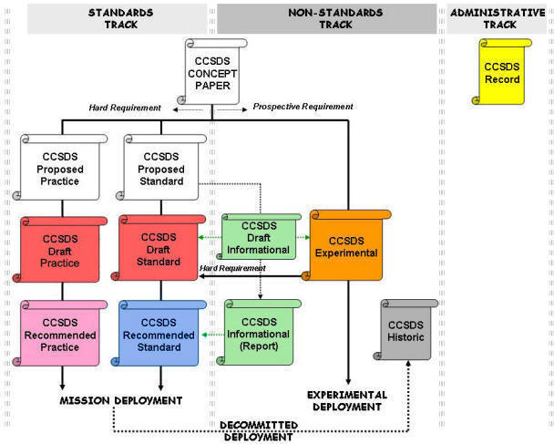
CCSDS Process – Colors of Books
Blue Books: Recommended Standards – Verified for Interoperable Implementations (with options specified)
Magenta Books: Recommended Practices – Normative, but not for directly implementable for interoperability
Red Books: Drafts of Blue or Magenta books not yet approved
Orange Books: Experimental – New Technology or Single-Agency
Green Books: Informational, concepts, etc.
Yellow Books: Technical reports, Procedures, etc.
Silver Books: Historical (deprecated)

Slide 30
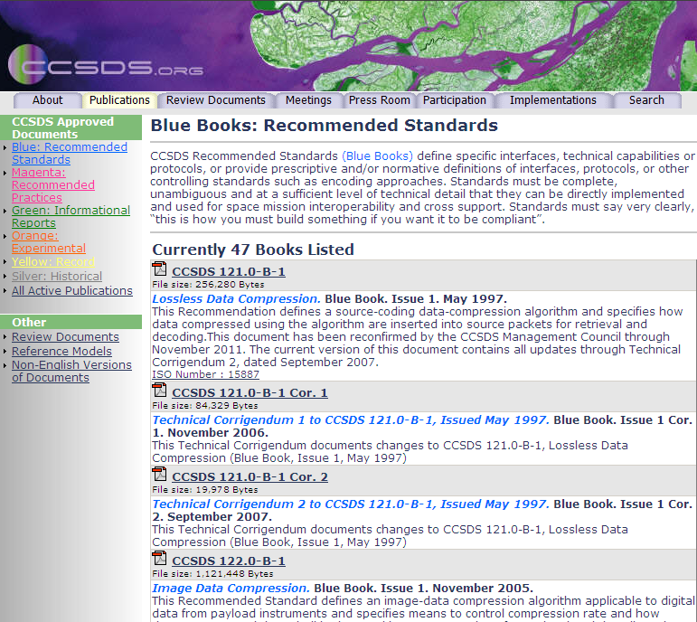
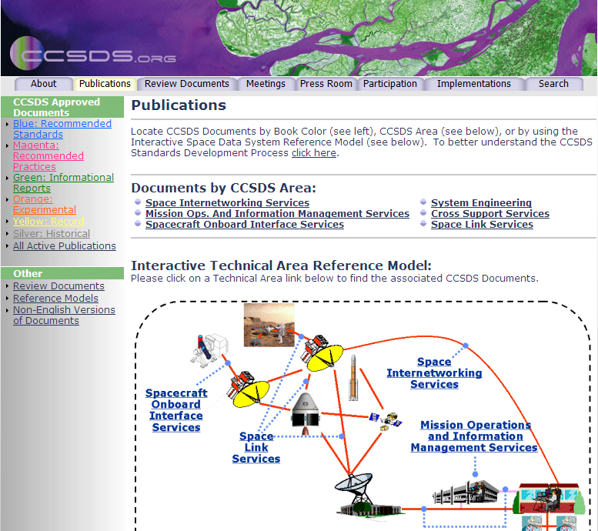


Access to CCSDS Publications
www.ccsds.org > Publications

Slide 31
Cross Support Services (CSS) Area Overview
Space Element
TTC Network
Mission Ops
Data Transfer
Interface (Spacelink)
Management
Management
Service Mgmt Interface
Internal Management
Space Link Services
Internal
(Transfer Service Production)
Transfer
Management
Service Provision
Telemetry +
Radiometric
Functions
Data Transfer Interfaces (Terrestrial)
RF and
Modulation
Equipment
Command
Function
Transfer
Service
Users

Slide 32
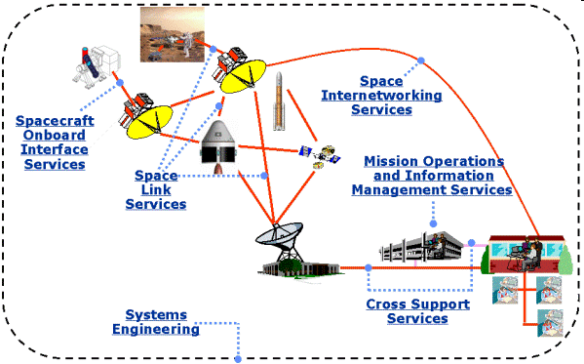
Cross Support Services (CSS) Area Overview

Slide 33
Space Internetworking Systems (SIS):
Portfolio and Active Work Items

Slide 34
Standard Onboard Interface Services (SOIS)

