Slide 1

CCSDS Overview
The Consultative Committee for Space Data Systems
August 2014
Mike Kearney
CCSDS Chair & General Secretary
NASA MSFC EO-01
256-544-2029
Mike.Kearney@nasa.gov
CCSDS
Advancing Technology
With International Agreements
To Use That Technology

Slide 2
Agenda
CCSDS Background (scope, participation, etc.)
CCSDS Architecture, Organization, Processes
Access to CCSDS Online
Summary
Notes:
Please confirm agenda reflects final changes to document

Slide 3
The Essential Message
CCSDS:
Advancing Technology
With International Agreements
To Use That Technology
Simultaneously Developing
CAPABILITY
and COOPERATION
For Our Mutual Benefit

Slide 4
The Essential Message
This work must be done before new programs begin.
By they time new programs have firm requirements, their path is set, and they will not adopt new standards.
They only adopt standards that are available at their program start.
Right now, it is critically important to prepare for upcoming international missions that are not yet formulated.
New missions have new communications needs;
New technology is changing the game rapidly;
Therefore, a responsive standardization program is
more important than ever.

Slide 5
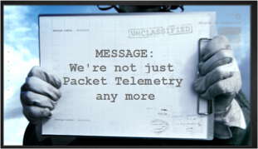
CCSDS – Scope and Origins
CCSDS = The Consultative Committee for Space Data Systems
Communications and data systems standards.
Since 1982 starting at the lower layers of the protocol stack.
Now:
  Throughout the entire ISO communications stack
  Plus other Data Systems areas (architecture, archive, security, XML exchange formats, etc.
  End to end data/comm architecture for any mission

Slide 6

On CCSDS Standards
MYTH
When an innovative technology is rapidly brought to the standards community, it is vetted with a larger user base, facilitating widespread adoption of innovative technology.
This reduces the risk of new technology with “more eyes on the problem.”
Standards stifle innovation
FACT
CCSDS stimulates advanced technology
by adopting, adapting, developing
and solidifying innovations with
exposure to a wider community
This spreads the cost of technology development over a larger user base.
This enables joint missions, for cost sharing and increased capabilities.
This improves operations,
with familiar interfaces and more options for contingency recovery.
MYTH
Standards delay implementation
FACT
Not if the innovation is brought into the
standards process early. Delays result
from reluctance to standardize,
not from standardization

Slide 7


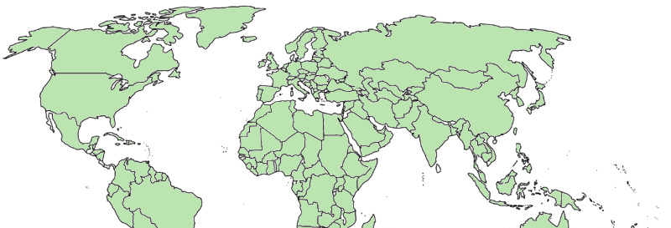

CCSDS Overview - Participation
CCSDS – An Agency-Led International Committee
  Currently 11 Member agencies
  Currently 29 Observer Agencies
  Agencies represent 27 nations (and 3 European orgs)
  Currently 118 Commercial Associates
  ~160-180 attendees at Spring/Fall meetings
Also functions as an ISO Subcommittee
  TC20/SC13 - Space Data & Info Transfer Systems
  Represents 20 nations
OBSERVER
AGENCIES
ASA/Austria
BFSPO/Belgium
CAS/China
CAST/China
CLTC/China
CSIRO/Australia
DCTA/Brazil
DNSC/Denmark
EUMETSAT/Europe
EUTELSAT/Europe
GISTDA/Thailand
HNSC/Greece
IKI/Russia
ISRO/India
KARI/Korea
KFKI/Hungary
MOC/Israel
NCST/USA
NICT/Japan
NOAA/USA
NSARK/Kazakhstan
NSPO/Taiwan
SANSA/South Africa
SSC/Sweden
SSO/Switzerland
SUPARCO/Pakistan
TsNIIMash/Russia
TUBITAK/Turkey
USGS/USA
MEMBER
AGENCIES
ASI/Italy
CNES/France
CNSA/China
CSA/Canada
DLR/Germany
ESA/Europe
FSA/Russia
INPE/Brazil
JAXA/Japan
NASA/USA
UKSA/UK
e
e
e

Slide 8
CCSDS Overview
Currently Active Publications: 135 Normative (Blue & Magenta): 85
Informative (Green): 52
Downloadable for free from www.ccsds.org
All major pubs since 1982: ~285
(Some were historical mission needs
or superseded technology)
Active Publications
718 space missions have adopted and used various CCSDS standards
Missions

Slide 9



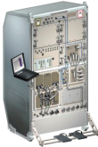





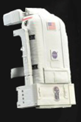






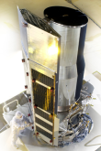
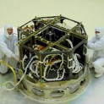

CCSDS Overview
End-to-End Architecture
Six Technical Areas,
Twenty-Six Teams
Systems Engineering
Working Group (producing standards)
Birds-Of-a-Feather stage (pre-approval)
Special Interest Group (integration forum)
Security
Delta-DOR
Timeline Data Exchange
XML Standards and Guidelines
Typical Mission Profile
One Organization’s Assets
MISSION CONTROL
CENTER
End Users
Applications/Archives
MISSION CONTROL
CENTER
End Users
Another Organization’s Assets
Spacecraft Onboard
Interface Services
Space Link
Services
Cross Support
Services
Space Internetworking
Services
Mission Ops &
Info Mgt Services
Onboard Wireless WG
Application Supt Services (incl. Plug-n-Play)
RF & Modulation
Space Link Coding & Sync.
Multi/Hyper Data Compress.
Space Link Protocols
Next Generation Uplink
Space Data Link Security
Optical Coding and Mod
CS Service Management
CS Transfer Services
Cross Supt Service Arch.
Motion Imagery & Apps
Delay Tolerant Networking
Voice
CFDP over Encap
CFDP Revisions
Data Archive Ingestion
Navigation
Spacecraft Monitor & Control
Digital Repository Audit/Certification
Telerobotics

Slide 10

CCSDS Structure and Organization
Systems Engineering
Liaisons
Infrastructure providers
Stakeholders
Missions / Programs
CCSDS
CCSDS Secretariat
CCSDS Management Council (CMC)
Space Assigned Numbers Authority
CCSDS Engineering Steering Group
Spacecraft Onboard
Interface Services
Space Link
Services
Cross Support
Services
Space Internetworking
Services
Mission Ops &
Info Mgt Services
WG’s
WG’s
WG’s
WG’s
WG’s
WG’s
WG’s
WG’s
WG’s
WG’s
WG’s
WG’s
WG’s
WG’s
WG’s
WG’s
WG’s
WG’s

Slide 11
CCSDS Relationships with ISO
Technical Committee 20 (ISO/TC20): Aircraft and Space Vehicles
Other
TCs
Missions / Programs
CCSDS
Subcommittee 13
(ISO/TC20/SC13):
Space Data and
Information Transfer
Systems
Other
SCs
Subcommittee 14
(ISO/TC20/SC14):
Space Systems
and Operations
TC20/SC13
Heads of Delegation
(CCSDS CMC)
CCSDS Secretariat
CCSDS Management Council (CMC)
ISO
CCSDS Management Council (CMC)
Space Assigned Numbers Authority
(Secretariat: AIAA)
(Secretariat: NASA)
CCSDS Engineering Steering Group
CCSDS Engineering Steering Group
Space
Debris
Interfaces,
Integration
& Test
Operations &
Ground Support
Design
Engineering
& Production
Systems Engineering
Space Link
Services
Space Internetworking
Services
Environment
(natural &
induced)
Program
Management
Materials and
Processes
Spacecraft Onboard
Interface Services
Cross Support
Services
Mission Ops &
Info Mgt Services
WG’s
WG’s
CCSDS
WG’s
WG’s
WG’s
WG’s
WG’s
WG’s
WG’s
WG’s
WG’s
WG’s
WG’s
WG’s
WG’s
WG’s
WG’s
WG’s

Slide 12
CCSDS Strategic Plan
The CCSDS Plan for the Future
Towards Cross-cutting functions and coherent architecture-wide integration
Towards standardized Onboard Interfaces and Services
Towards Standardized Mission Operations Services and complete Navigation Message Standardization
Towards an extensible Space Communications Cross Support Service Management and Transfer Services
  (Cross Support of Communications Assets)
Towards an unified Space Data Link Protocol, optical links, new sync and channel coding schemes and compression
Towards standardized Space System Internetworking Services and the Solar System Internet (SSI)
Systems Engineering
Space Link
Services
Space Internetworking
Services
Spacecraft Onboard
Interface Services
Cross Support
Services
Mission Ops &
Info Mgt Services

Slide 13



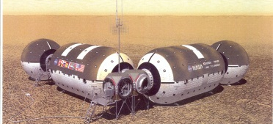
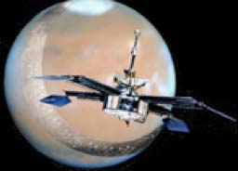

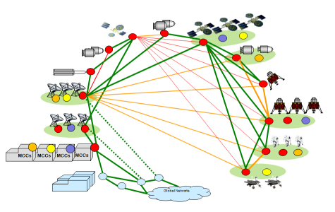
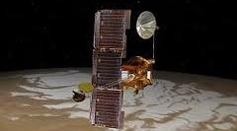



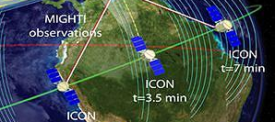
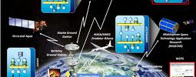

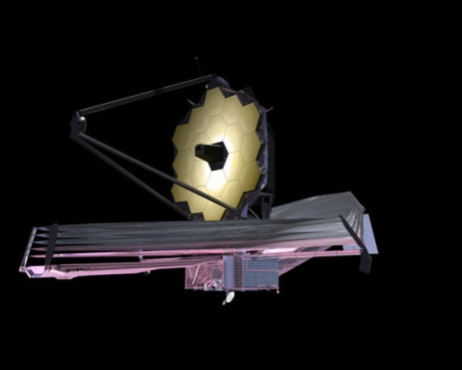
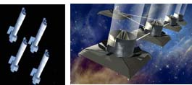
Future Mission Drivers
PAST
PRESENT
DRIVERS FOR THE
FUTURE
In Situ Exploration
Human Expeditions
Long Duration, High Reliability
Mobile comm protocols
Voice, Video, Medical handling
Onboard Autonomy
Highly integrated ops
Shuttle/SpaceLab
CCSDS packets
International Space Station
Adv. Orbital Sys (AOS)
Early DTN Prototyping
Asteroid/Surface Exploration
Autonomy, High bandwidth
Multi-Agency Mission Ops
Complex Deep Space Missions
Human or robotic exploration
Longer Duration
Mobile comm protocols
Fully automated routing
Network-Managed DTN
Optical Communications
Complex human or robotic
Scenarios for remote surface missions
Fully automated Space Internetworking
Brief Recon Flyby,
Short-Lived Probes
Direct-to-Earth links
Missions designed for orbital relays, Longer duration
Orbital Remote Sensing
Long Duration, high bandwidth
High Spatial, Spectral, & Temporal Resolution
Low Latency Comm
Complex link topologies
SensorWebs for synchronized remote sensing
Single-Spacecraft Survey/Sensors
Spacecraft Constellations
and formation flying
Multi-Discipline and
Multi-Resource SensorWebs
Next Generation Observatories
More Capability
Multiple Spacecraft drive network needs
Even Greater Capacities require new coding schemes
Located Even Farther from Earth
Single-Spacecraft Observatories in LEO
Greater Distances
Higher bandwidth
Next Generation
Observatory Complexes

Slide 14

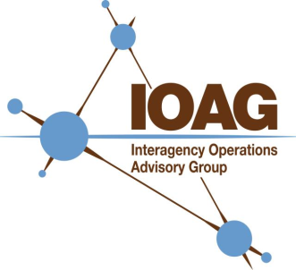


CCSDS Overview
Organizational Interrelationships
IOAG provides to CCSDS the IOAG priorities and guidance for future communications/operations plans
IOP
CCSDS Participants bring in other agencies/industry inputs, mission needs and technology drivers.
ISECG, SFCG, ICG and other peer groups
CCSDS participant inputs bring in needs of individual organizations
Close Coordination for Discipline Topics
Technology
Drivers
SISG
OLSG
& Other
sub-groups
CCSDS MEMBER AGENCIES (11) direct inputs
OBSERVER AGENCIES (28) direct inputs
MISSIONS AND PROGRAMS with direct funding

Slide 15
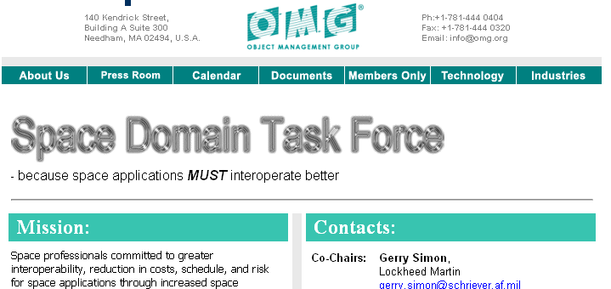

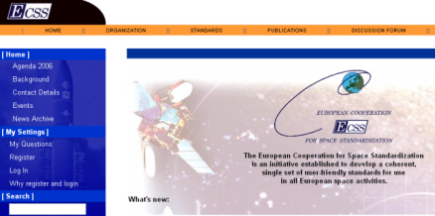
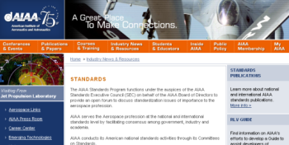
Some Organizational Interrelationships
OMG: Object Management Group
Industry standards for exchange of application information among vendor products
CCSDS/OMG have some common standards and periodic joint meetings
IETF: Internet Engineering Task Force
IRTF: Internet Research Task Force
Open international standards for IP suite and DTN
CCSDS uses such industry standards as a basis, whenever possible
ECSS: European Consortium for Space Standards - European regional standards for space mission support
CCSDS/ECSS coordinate on compatible standards
AIAA: American Institute of Aeronautics and Astronautics
North American regional standards for space mission support
Regional Standards coordination, and AIAA provides Secretariat support for CCSDS, ISO TC20/SC13 and SC14

Slide 16
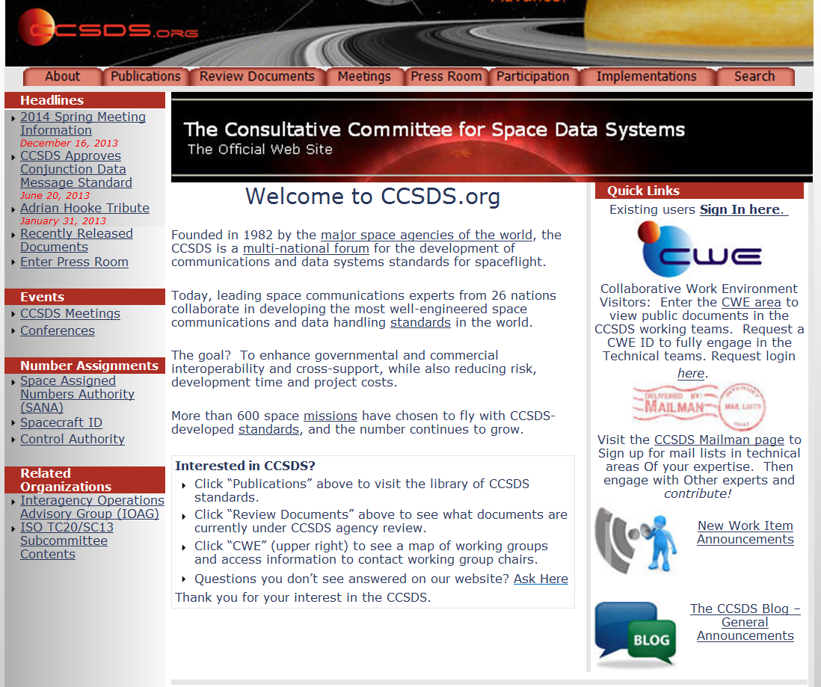
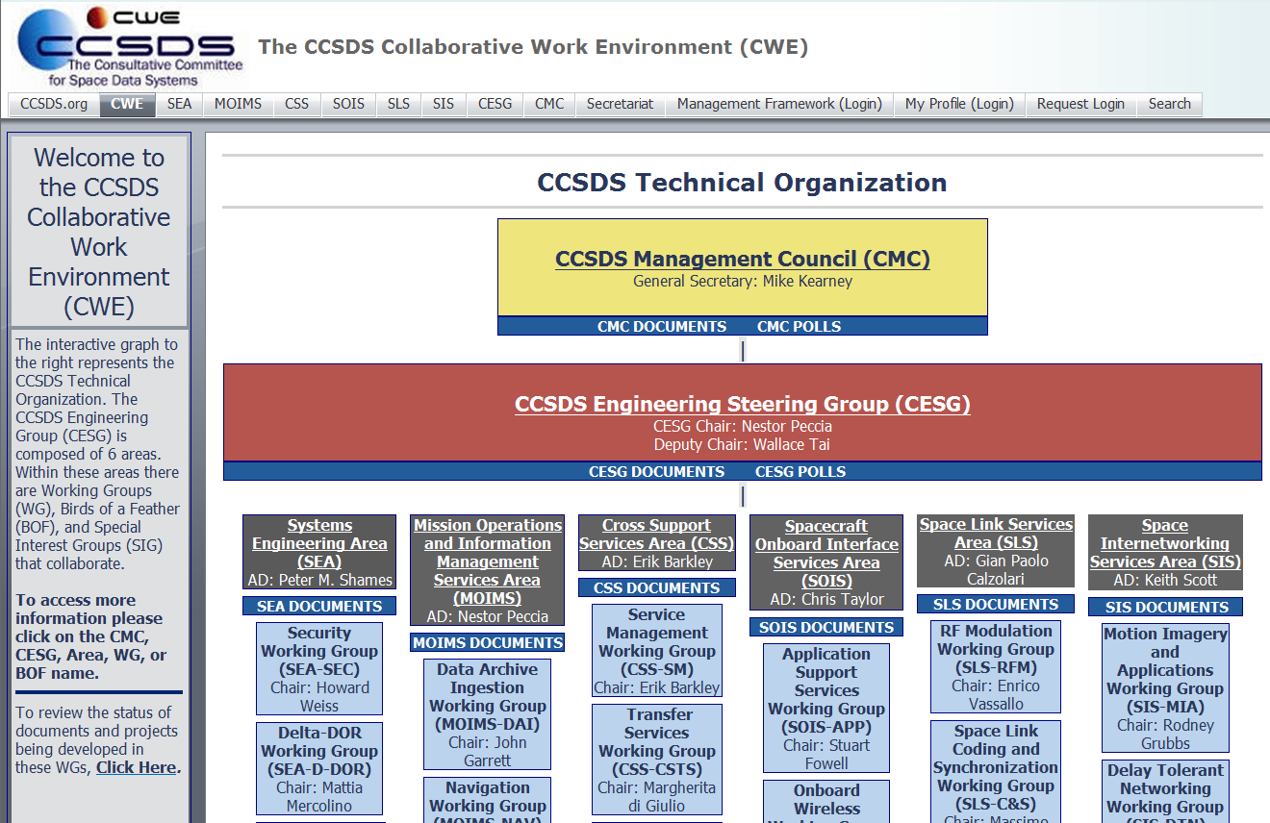
Online Resources
www.CCSDS.org
CWE.CCSDS.org
Public Website
Overview info (About tab)
Access to published standards (Publications tab)
Comment on documents in review
Meeting info & logistics
Commercial implementations
Missions that have adopted CCSDS
New Work Items Announcements
General Announcements (Blog)
Development environment for developing new standards
Access to Areas’ and WGs’ materials
(some private areas require ID/PW)
Contact info for ADs and WG leads
Access to schedule/status of current standards development projects
Collaborative Work Environment

Slide 17
CCSDS Summary
Take-home message: Still much work to be done
  Enabling interoperability between international agencies for future missions – both Earth-Orbital and Exploration
  Long-range vision – automated routing and delay tolerant networking for deep space crosslinks between spacecraft and surface systems
  Near-term need – evolutionary approach to sustain cross-support agreements with other agencies.
Organizations with a stake in the future of Space Missions and the expertise to contribute to CCSDS should become engaged.

Slide 18
Backup/Alternative Charts

Slide 19
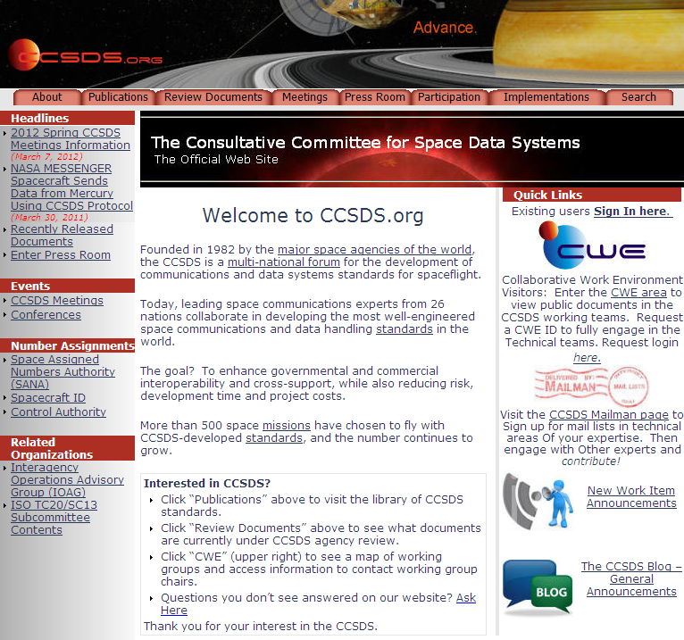

Access to CCSDS General Announcements
New Work Item Announcements
Find out about new initiatives and technology developments that you can contribute to, and you missions can benefit from.
The CCSDS Blog
General events, meetings, new publications, etc.
Under Construction: The CCSDS WIKI
Soon to come

Slide 20
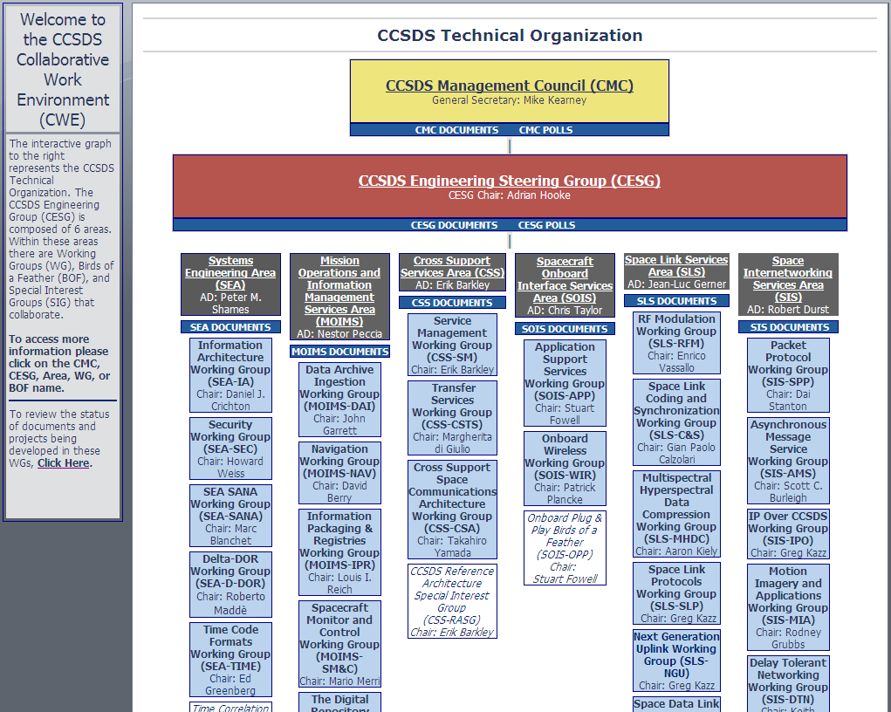


Access to CCSDS Technical WG info: www.ccsds.org > CWE

Slide 21
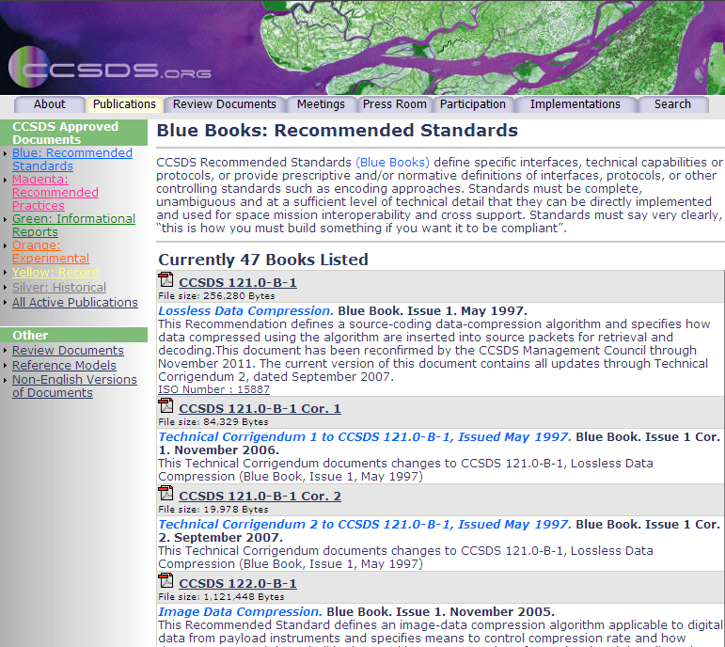
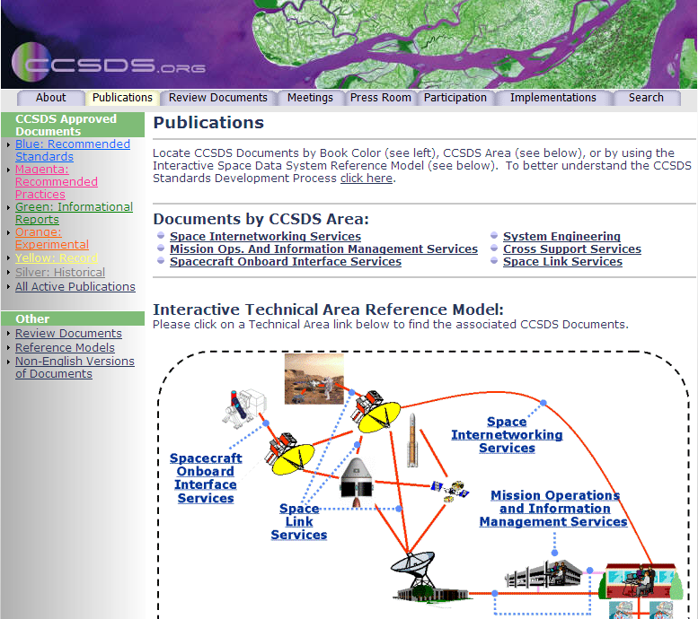


Access to CCSDS Publications
www.ccsds.org > Publications

Slide 22


Field Guide to CCSDS Book Colors
BLUE BOOKS
Recommended Standards
Normative and sufficiently detailed (and pre-tested) so they can be used to directly and independently implement interoperable systems (given that options are specified).
ORANGE BOOKS
Experimental
Normative, but may be very new technology that does not yet have consensus of enough agencies to standardize.
MAGENTA BOOKS
Recommended Practices
Normative, but at a level that is not directly implementable for interoperability. These are Reference Architectures, APIs, operational practices, etc.
YELLOW BOOKS
Administrative
CCSDS Procedures, Proceedings, Test reports, etc.
GREEN BOOKS
Informative Documents
Not normative. These may be foundational for Blue/Magenta books, describing their applicability, overall archtecture, ops concept, etc.
SILVER BOOKS
Historical
Deprecated and retired documents that are kept available to support existing or legacy implementations. Implication is that other agencies may not cross-support.
RED BOOKS
Draft Standards/Practices
Drafts of future Blue/Magenta books that are in agency review. Use caution with these… they can change before release.
PINK BOOKS/SHEETS
Draft Revisions For Review
Draft Revisions to Blue or Magenta books that are circulated for agency review.
Pink Books are reissues of the full book, Pink Sheets are change pages only.

