Slide 1
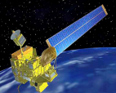
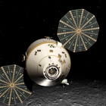
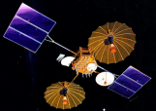
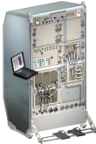
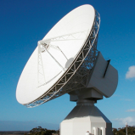
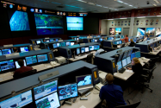
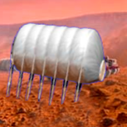
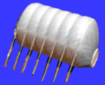
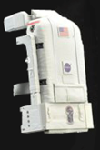
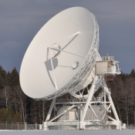
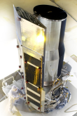
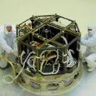
CCSDS Overview End-to-End Architecture
Six Technical Areas,
Twenty-Six Teams
Systems Engineering
Working Group (producing standards)
Birds-Of-a-Feather stage (pre-approval)
Special Interest Group (integration forum)
Security
Delta-DOR
Timeline Data Exchange
XML Standards and Guidelines
Typical Mission Profile
One Organization’s Assets
MISSION CONTROL
CENTER
End Users
Applications/Archives
MISSION CONTROL
CENTER
End Users
Another Organization’s Assets
Spacecraft Onboard
Interface Services
Space Link
Services
Cross Support
Services
Space Internetworking
Services
Mission Ops &
Info Mgt Services
Onboard Wireless WG
Application Supt Services (incl. Plug-n-Play)
RF & Modulation
Space Link Coding & Sync.
Multi/Hyper Data Compress.
Space Link Protocols
Next Generation Uplink
Space Data Link Security
Optical Coding and Mod
CS Service Management
CS Transfer Services
Cross Supt Service Arch.
Motion Imagery & Apps
Delay Tolerant Networking
Voice
CFDP over Encap
CFDP Revisions
Data Archive Ingestion
Navigation
Spacecraft Monitor & Control
Digital Repository Audit/Certification
Telerobotics

