Slide 1
SOIS EDS and MIL-STD-1553
Progress towards standardisation
Richard Melvin & Stuart Fowell
Friday, 14 November 2014

Slide 2
MIL-STD-1533B Key Characteristics
Synchronous bus that runs at a known frequency
On the order of 8Hz, or 10Hz.
For cases such as AOCS control loops processing gyro data, it is normal for data to be read at the full bus frequency.
i.e. up to 10 times a second.
Limited Bandwidth (1970s technology)
half-duplex command/response protocol
Up to 31 remote terminals (devices).
Up to 31 subaddresses per device; typically used to mark different data sets.

Slide 3
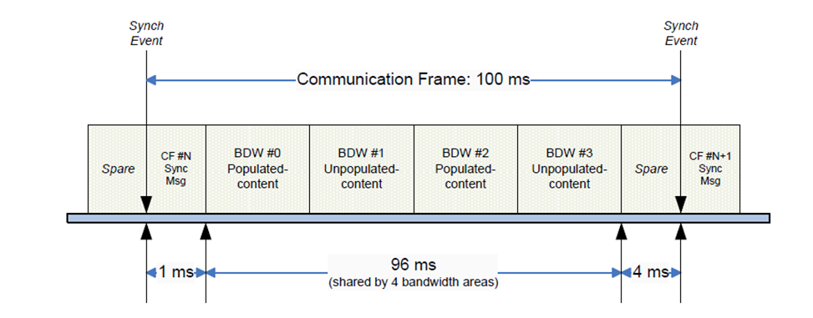
MILBUS Synchronisation Example

Slide 4
SOIS Device Virtualisation/Access Services over MILBUS
Applications
Sync
Frame N
Data Read(s)
Frame N-1
Read Ind
Sync
Frame N+1
Data Read(s)
Frame N
Read Ind
DVS/DAS
DVS/DAS
Frame N
PDU Write(s)
Frame N-1
PDU Read(s)
Frame N+1
PDU Write(s)
Frame N
PDU Read(s)
SYS
PS/MAS
SYS
PS/MAS
Sync
Frame N
PDU Write(s)
Frame N-1
PDU Read(s)
Sync
Frame N+1
PDU Write(s)
Frame N
PDU Read(s)
ECSS 1553 Services
Clock
Interrupt
Frame N
PDU Write(s)
Frame N-1
PDU Read(s)
Interrupt
Frame N+1
PDU Write(s)
Frame N
PDU Read(s)
MIL-STD-1553B BC Hardware
RT Device
RT Device

Slide 5
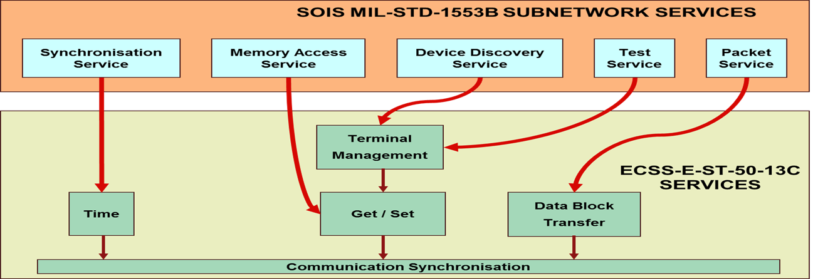
Subnetwork/ECCS MILBUS layer

Slide 6
Device Supplier’s Dilemma
They know what their device does
They have access to CCSDS and ESA standards
They need to work out what their datasheet should contain
But can’t, if there is any project-specific tailoring between the layer they know and the layer they are supposed to define.

Slide 7
Standardisation Gap
CCSDS Standard
Device-specific, specified by datasheet
DVS/DAS
PS/MAS
Currently project-specific, specified by implementation design
ESA Standard
ECSS 1553 Services
US Military Standard
MIL-STD-1553B RT
MIL-STD-1553B BC

Slide 8
Key Issues: Polling
Efficient usage of limited milbus bandwidth requires specification of a polling plan in advance.
Polling plan can’t really be specified in the datasheet as will differ between missions.
SOIS standards leave this area open:
Asynchronous primitives with a ‘transaction id’ with implemention-defined semantics
Which leaves room for saying you sometimes get back data without explicitly asking for it

Slide 9
Key Issues: ECSS 1553 options
Support for all ECSS services is optional within the standard
MAS/ECSS_1553 mapping layer assumes full implementation of the ECSS block transfer service
Block transfer service is commonly not actually present in target device.
Non-ESA missions presumably not using ECSS 1553 anyway.

Slide 10
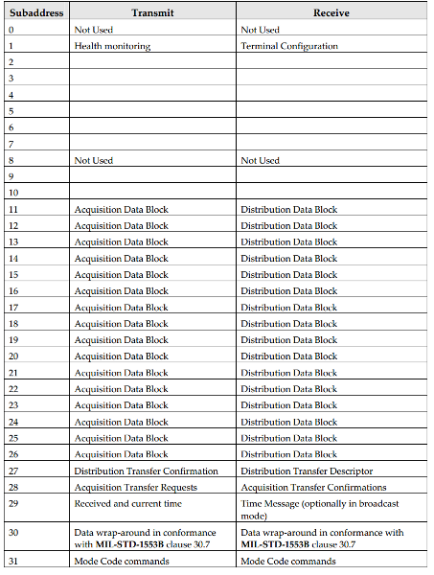
ECSS1553 Subaddress Allocation

Slide 11
Key Issues: Mode Commands
No support in SOIS subnetwork protocols for sending milbus mode commands.
May be neccesary for device functionality.
Could be a custom project-specific mapping extension
but how does data sheet supplier know about the extension in order to use it?

Slide 12
Some Solution Options
Drop support for ‘legacy’ MIL-STD.
Define SOIS DDPS, implement with a tight binding to ECSS 1553 layer.
Tie down and define PS/MAS ECSS 1553 mapping
Treat legacy MIL-STD as a first-class interface at same level as PS/MAS, directly accessed from datasheet
Be more specific at DAS/DVS and datasheet layers as to what _interaction patterns_ are actually supported by an interface.
Define all required options in the link characteristics section of datasheet.

Slide 13
CCSDS MO Interaction patterns
SEND
SUBMIT
REQUEST
INVOKE
PROGRESS
PUBLISH/SUBSCRIBE

Slide 14
Interaction Patterns: SEND
Simple unacknowledged operation
Consumer
Provider
SEND (Body)

Slide 15
Interaction Patterns: PUB/SUB
Multi-provider, multi-consumer data broadcast
Consumer
Broker
Provider
Register (Filter)
Acknowledge
*PUBLISH (Data)
*NOTIFY (Data)
Deregister
Acknowledge

Slide 16
Conclusion
More work required

Slide 17
EDS Interfaces and Interaction patterns
Interface Element | Options | Arguments | Pattern | Transaction
Parameter | sync |  | REQUEST | yes
 | async |  | EVENT? | no
Command | sync | No out or inout arguments | SUBMIT | yes
 |  | inout, or both in and out | REQUEST | yes
 |  | No in or inout arguments | REQUEST | yes
 | async | No out or inout arguments | SEND | no
 |  | inout, or both in and out | illegal
 |  | No in or inout arguments | EVENT? | no

