Slide 1
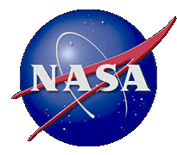
NASA Perspective on Optical Link Study Group Findings
John Rush
Director, Technology & Standards Division
NASA Space Communication and Navigation Office

Slide 2
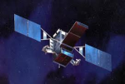
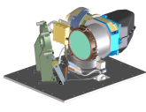
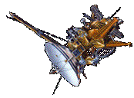
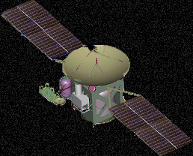
NASA Optical Communication Technology Strategy
March 2012
2013
2017
2020
2025
LLCD
Technology Transfer
Commercialized
Near Earth Missions
Near Earth
Flight Terminal
LADEE
Demo
GEO Demo –
LCRD
LEO Demo
Commercialization
Optical Module
DPSK
Modem
Controller
Electronics
Key DOT
Technology
Identification
&
Development
Candidate Deep Space
Host Demo Mission
Other Deep Space Missions
Deep Space
Flight Terminal
SCaN Optical
Ground Infrastructure
Optical Comm
Ground Stations (LLGT, OCTL, Tenerife)
LCRD
SCaN Operational Optical Ground Stations
Added as Mission Needs Require
(including International Space Agency Sites)
Technology Investment and Development
SNSPD arrays, photon counting space receiver, ground receiver detection array, NAF APD/nanowire det., COTS quadrant spatial-acquisition detectors
Stabilization
Detectors
Vibration
Systems Engineering
Laser Power/Life
Pointing
Mini FOG
Spacecraft disturbance rejection platform, piezo-based point-ahead mechanism
CFLOS Analysis, Optical Comm Cross Support
PPM Laser Transmitter
Low-noise laser
Flexured Gimbal Mount

Slide 3
NASA Optical Communication Technology Strategy Executing the Roadmap in 2012
March 2012
2013
2017
2020
2025
LLCD
Near Earth Missions
Near Earth
Flight Terminal
Technology Transfer
Commercialized
LADEE
Demo
GEO Demo –
LCRD
LEO Demo
Key DOT
Technology
Identification
&
Development
Candidate Deep Space
Host Demo Mission
Other Deep Space Missions
Deep Space
Flight Terminal
SCaN Optical
Ground Infrastructure
Optical Comm
Ground Stations (LLGT, OCTL, Tenerife)
LCRD
SCaN Operational Optical Ground Stations
Added as Mission Needs Require
(including International Space Agency Sites)
Technology Investment and Development
Stabilization
Detectors
Vibration
Systems Engineering
Laser Power/Life
Pointing
Infusion into LEO
Infusion into LEO, Deep Space host demo, ground infrastructure
Infusion into LEO and near earth
Infusion into ground stations
Infusion into Deep Space host demo and near earth
Infusion into near earth

Slide 4
OLSG Findings – NASA Perspective
Cloud obscuration at ground stations are a major issue
Multiple ground stations in view increase availability
Ground station locations should be selected with statistical anti-correlation for clouds
A great business case for cross support
Aviation safety rules represent an additional challenge to ground stations with powerful uplink beacons
Eye-safe wavelengths may provide opportunity to alleviate the constraints
Agreement on wavelength is basic to optical cross support
Analogous to frequency bands in RF cross support
Assuming agreement on basic wavelength can be reached, the next step is common standards for:
modulation
coding
communication acquisition methods
tracking techniques

Slide 5
The Standards Development Effort
Standardization should be preceded with extensive research into the techniques and methods that work best
Near term start probably not beneficial
Technology exchange forum should be first step
When Standards effort starts perhaps multiple Working Groups should be formed to address specific areas such as modulation, optimized protocols
Acquisition and tracking techniques should also be captured in standards
Standards should be in place by the early 2020’s
Standards should include instructions on how to coordinate weather data among our ground stations

