Slide 1
Simplification of Configuration Profile Structure
8 March 2016
CSSMWG Telecon
John Pietras
Global Science and Technology, Inc.

Slide 2
Agenda
Issues with Fall 2015 approach
Overview of new (and hopefully improved) approach
Issue mitigation
Class diagrams, etc.

Slide 3
Issues with Fall 2015 Approach
Too many pieces needed to create a configuration profile
Each Service Component Profile could be separately established
Intended to support re-use of Service Component Profiles
Service Component Connections object needed to link together Service Component Profiles to form a Configuration Profile
Magnitude of linkages counter-weighs benefits of Service Component Profile re-usability
All linkages among Service Component Profiles are via cross-referencing SAP and Accessor ports
Accessor port instance references the peer SAP port instance
Cross-referencing information adds bulk to configuration profiles
Keeping cross references straight is completely outside the purview of XML validation

Slide 4
Issues Mitigation (1 of 2)
Every Configuration Profile contains all of the Service Component Profiles that it uses
Service Combination Profile object has been eliminated
Containment replaces SAP/Accessor port pairs for primary linkages between Service Component Profiles
Eliminates cross-referencing information from these linkages, which constitute the majority of linkages among Service Component Profile
Use of subtype substitution enforces proper linkages
A SAP of type XYZ contains an Accessor of type XYZ (or a subtype thereof)
Example
The RF Aperture SC Profile contains a Forward Modulated Waveform SAP, which contains a Forward Modulated Waveform Accessor
The CCSDS 401 Forward Physical Channel Transmission SC Profile is cast as a subtype of the Forward Modulated Waveform Accessor
Ergo, CCSDS 401 Forward Physical Channel Transmission SC Profile can be contained by the Forward Modulated Waveform SAP of the RF Aperture SC Profile

Slide 5
Issues Mitigation (2 of 2)
Some Service Component Profiles have relationships with multiple other Service Component Profiles, but containment can be used to express at most one of these relationships
Ancillary relationships with other SC Profiles are implemented using a cross-referencing mechanism
The UML provided/required interface terminology has been adapted for these ancillary relationships
An object that possesses ancillary information that is needed by other objects has a provided interface by which that information is made available
An object that needs ancillary information that is available from another object has a required interface that links to a peer provided interface

Slide 6
ConfigurationProfileInfoEntity Class Diagram

Slide 7
ConfigurationProfileContents Class Diagram - Fall 2015

Slide 8
Current ConfigurationProfileContents Class Diagram

Slide 9
RF Aperture Service Component Profile

Slide 10
CCSDS 401 Forward Physical Channel Transmission Service Component Profile

Slide 11
Bakeoff Service Combination Profile Diagram (Graphical Notation) – Fall 2015

Slide 12
Bakeoff Service Combination Profile Diagram (Graphical Notation) – Current Version

Slide 13
Example Service Combination Profile Notional Data Structures (partial) – Fall 2015
RF Aperture SC Profile
Fwd Mod Waveform
SAP Port 1
- Instance 1
Rtn Mod Waveform
SAP Port 2
Service Combination Profile
Service
Component
Connections
Pointing Angles
SAP Port 3
PortAssociatonSet
SAP port: [{RfApertureSc}:1]: [{FwdModWaveform SAP}:1]
CCSDS 401 Fwd Phys
Channel SC Profile
Fwd Phys Chnl Symbols
SAP Port 1
Fwd Mod Waveform
Accessor Port 1
PairedAccessorPort
Accessor port: [{Ccsds401FwdPhysChnlXmitSc}:1]: {FwdModWaveform Accessor}:1]
- Instance 1
Transmit Frequency
SAP Port 2
Ranging Signal Timing
SAP Port 3
PortAssociatonSet
SAP port: [{TcSyncChnlEncodeSc}:1]: [{FwdPhsyChnlSymbols SAP}:1]
PairedAccessorPort
Accessor port: [{Ccsds401FwdPhysChnlXmitSc}:1]: {FwdPhsyChnlSymbols Accessor}:1]
TC Sync & Channel Encoding
SC Profile
Fwd Phys Chnl Symbols
Accessor Port 1
- Instance 1
Fwd All Transfer Frames
SAP Port 1

Slide 14
Example Service Combination Profile Notional Data Structures (partial) – Current Version
Aperture
RF Aperture SC Profile
- Instance 1
Pointing Angles
Provided IF
Fwd Mod
Waveform
SAP
Rtn Mod
Waveform
SAP
Fwd Mod
Waveform
Accessor
CCSDS 401 Fwd Phys
Channel SC Profile
Transmit Frequency
SAP Provided IF
- Instance 1
Ranging Signal Timing
SAP Provided IF
Fwd Phys Chnl
Symbols
SAP
Fwd Phys Chnl
Symbols
Accessor
TC Sync & Channel
Encoding SC Profile
- Instance 1
Fwd All Transfer
Frames SAP

Slide 15
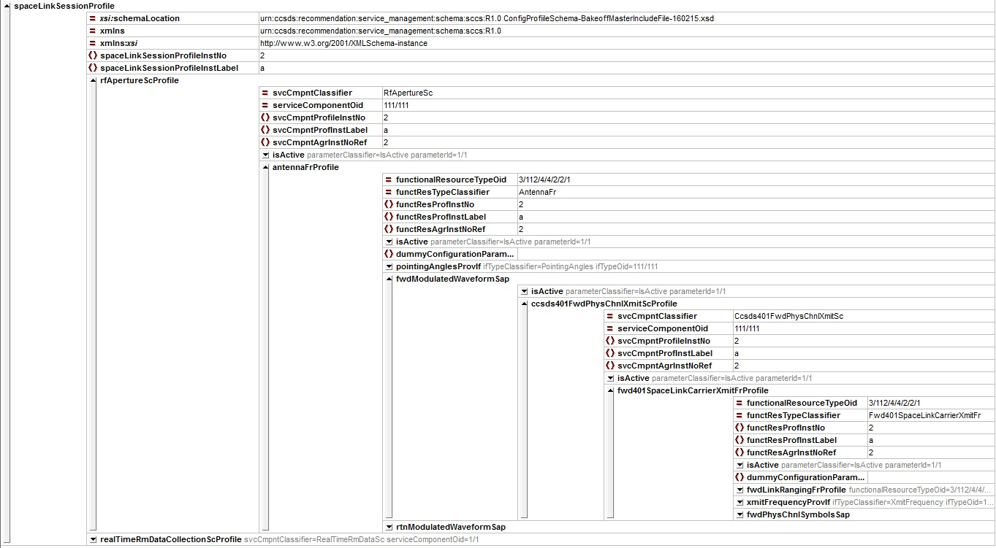
Bakeoff XML Instance Document – XMLspy Grid View

