Slide 1

CSSM Meeting Summary
CCSDS CSSM Technical Meetings
Cleveland, Ohio, USA
04 – 08 April 2016

Slide 2
  Agenda & Coverage at Meeting Conclusion
All topics addressed with the exception of Action Items Review at the end of the meeting; generally covered as part of work planning; will be addressed at first post-meeting telecon

Slide 3
  SOS and SANA Registry Creation
Reviewed material creation of SOS SANA Registries creation
  No significant inputs

Slide 4
  Planning Data Book Review
Review re White Book
  “PLANNING_INFO” does not align with current information entities in Green Book; action item assigned
  Status – agreed to with TEST and OPERATIONAL as planning is understood to always be provisional (ie. Remove “PROVISIONAL” status)
  Definition of “sun alignment angle” needed; action item assigned
  Agreed to remove AOS/LOS in favor of directional COM-START/COM-END
    Start/End in forward vs return direction
  1st draft of XML Schema available but not reviewed
    Background (not on critical path) schema generation efforts underway (output from magic draw)
XML Schema is in first draft
  Side bar on auto generated schema vs hand-build schemas
  Agreed to keep auto generate as a background project
    But keep it removed from critical path – hand crafted schema will do for now (pending review)
Need to sort out which source to use for planetary body identification
  Question of what source to point to in SANA registry

Slide 5
  Planning Data Prototype Test Plan
Reviewed draft of test plan
Noted that prototype partners – ESA/NASA – have yet to identified the individuals involved
Agreed to change the tittle of the book to PIF → Planning Information Format to avoid overload/confusion with Adobe PDF
  Supporting changes need to update the concept book and M. Gnat’s overview diagrams
Walked-thru of success criteria
  Agreed to add that all of the other success criteria are conducted in the context of a realistic/real-world use cases

Slide 6
  External XML Schema Management
Reviewed Presentation from J. Pietras, A. Crowson “Guidelines for Use of External Schemas“
  Summary of presentation
    Further investigation needed into constraints on use of xsd:anyType to carry payloads constructed through externally-defined schemas
    Regardless of whether externally-defined are used to create xsd:anyType payloads, or are imported by SM schemas, those external schemas must be valid
    Existence of “qualified” version of external schema required for use of imported data types
    May also be required for xsd:anyType-carried instance documents (TBD)

Slide 7
  Service Package Update (1/2)
See presentation by J.P. Chamoun
  Key points include
    Status information to indicate service package readiness
      Distinct from overall result
      Can also be with respect to a request that results in several service packages
Clarified the relationship between the notions of “chaining” and scenarios
  Fundamental distinction
    “chaining” is in request space to express alternate (prioritized chaing) of requests until a request is granted
    Scenarios – expression of tracking scenarios in a committed space (i.e., for one granted service package)
    See next slide for more details

Slide 8
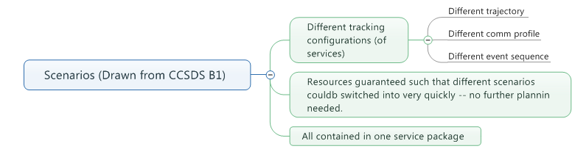
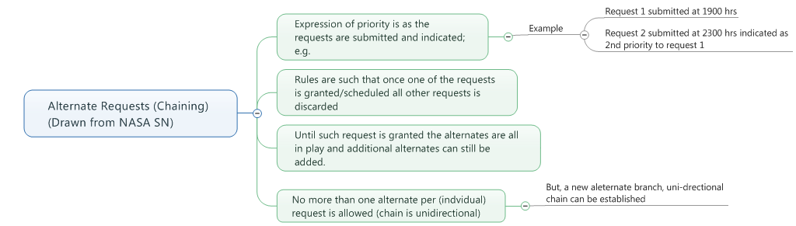
  Service Package Update (2/2)

Slide 9
  SMURF Review
Clarified chaining vs scenarios and their accommodation in the SMURF
  Checked that class diagram can allow chainging of requests
  Revised class diagram for scenario definition
Agreed to focus on basic constraints
  Advanced constraints to be dealt with later
Agreed to separate class definitions for on-line vs. off-line service request definition
  Class diagram updated during the meetings
Semantics of “delete” – is this to delete the request (or should it be) or delete a service package result (should it allow for both)
  C. Haddow to look into different delete semantics and report back to WG
Discussion re Basic Constraints
  Basic start time (see figure 3-2 of the draft recommendation) seems to be for only the 1 to 1 service request:service package and not standing orders. Standing orders can incorporate the remaining set of basic constraints
  Question of putting constraints in configuration profile vs service package request
    Need to keep in mind that implementers are not necessarily to going to implement all books – issue of where do constraints have their “home”
  Also discussed basic handover constraint and noted that it could be “forced” for equipment reasons for some providers
    E.g., for NASA/SN service via multiple access (antenna) might go through a handover where as via single access it might continue uninterrupted

Slide 10
  Configuration Profile/Service Agreement Review
Reviewed progress to date on configuration profile/service agreement
  See presentation by J. Pietras in CWE
General discussion about how much of the “theory” to expose in the end standard
Considering removing the constraints in favor of just constraints expressed in the SMURF (previous slide)

Slide 11
  Prototype Discussion
SMURF: Agreed that there are 5 major test cases based on the types of requests
TGFT:
  A major aspect is defining a header XFDU structure and then specific file types and header information for building the XFDU; list for consideration
    Off-line radiometric
    Deliver of files for uplink and CFDP Take a look a the IOAG catalog and then further consider (still some sorting out to do as to whether or not files of packets and/or frames are to be considered)
      FWD file into CFDP
      FWD file of packets on spacelink
      RTN file from CFDP
      RTN packets into file
      Output of validated radiamoteric data
      Transfer of “DDOR” raw file
Presentation from CNSA on TGFT prototyping
  Use of WebDAV and CentOS
  Agreed that TGFT prototyping stops with proper meta data packaging to allow for final deliver of a file and to allow as staging for a subsequent processing

Slide 12
  Concept Book Summary
Reviewed marked-up comments on document representing survey of changes due to introduction of SMURF and other work since concept originally published
Agreed to keep document updates internal for now
  Comments recorded in document
  Updates by Rome meeting

Slide 13
  CSS Area Plenary
Walked through presentation on new RMP
  Follow up questions about individually identifying SLE services on a per aperture basis and keeping registries consistent
    E.g., a new agency joins CCSDS → that agency unique “sub-OIDs” are automatically extended?
Walked through presentation on functional resource/registry tool and demonstrati
  General question of how does this get maintained – this is in fact now a front-end to the CSS OIDs in the overall OID registry

Slide 14
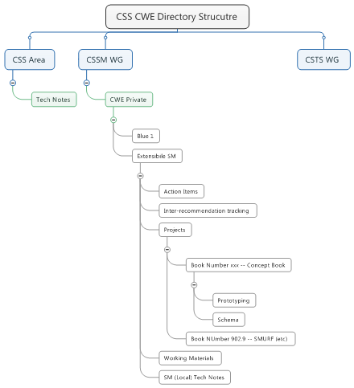
  CWE Directory Clean-up
Directory structure has become less organized over time. Proposed overview (see diagram) developed. Action to K. Tuttle to further develop and impelement

Slide 15
  Management Service Concept
Preliminary discussion re Management Service Concept
  Identified option for different approaches (just proposals for now)
    Option A
      Blue book for management service message format
        E.g., event notifications
      Magenta book for semantics/behavior
        Protocol recommendation – e.g, REST and recommended way to construct URLs, etc
        How to use enhanced constraints in SMURF to implement standing orders
        Indicate the type of semantic validation/consistency checks that should be done
          E.g, Also such things as deletion of standing order– this does what to service package already scheduled but not executed?
    Option B
      “All-in-one” similar to B-1
    In general, should re-examine B-1 information entity lifecycle state charts, etc.

Slide 16
  Service Catalog
Reviewed work done to put NASA SCaN Service catalog put into a magenta book format
Question as to whether this is a template or the service catalog?
  Current reading is that this its very specific template – the templates are to large degree pre-selected
Agreed that magenta book should address template for stating services in general and a practice for details going into SANA Registry – Sites and Apertures
Net conclusion is a confirmation that this project will be on magenta book track

Slide 17
  Event Sequencing Ideas from the DSN
Reviewed presentation from E. Barkley (Presentation in CWE)
  Essential premise/idea is to allow for expression for spacelink and data transport states relative to logical event definitions
  No objections noted
Still need to work on connection to configuration profile/functional resources

Slide 18
  Joint DDOR/CSSM Mtg
Agreed that the general issue to work on is the overall enterprise/lifecycle model in terms of sequence of steps and how the various information entities can and can not support the DDOR activities
  Do this first for single spacecraft DDOR
  It seems that we may have identified some interesting constraints for the planning request – e.g., provide two antennas both with mutual view for a long baseline of at least 120 minutes
  See 506 magenta book for examples of DDOR requests
Preliminary draft view of lifecycle was sketched:
Get available antennas
Develop DOR Details
Select quasars
Develop scan sequence
Tell mission what sequence is (times for DOR Tones On Off)
Execute DDOR Activities
(SMURF: Request DDOR SVC Time; a request per aperture to each agency)
Resolved event sequence from mission to TTC Provider SMURF: update svc package request
Note: CP ref includes DDOR tones for mission referenced

Slide 19
  Joint Mtg w/NAV WG
E. Barkley and C. Haddow had a joint meeting re event definitions with NAVWG (relates to Planning Information Format)
  Updated event structure changes (per Damstatdt) meeting okay
  Suggestion is to add a timescale indicator to the event definition – are time in UT1, TAI? , etc.
  Agreed to talk with S. Cooper re MOIMS MO event definitions
  Suggest of putting event definitions in SANA discussed
    Noted that this might need to imply variable structuring in SANA as event definitions will take a different sets and number of parameters
  Question of relative times vs absolute times – some concern that relative time event specification would not necessarily be the same as absolute
Based on joint meeting, C. Haddow circulated updated abstract event definition
  Input from WG requested

Slide 20
  SOS and DSN/ESA implementations
Briefing provided on ESA/ESTRACK and NASA/JPL/DSN implementation efforts for exchange of schedule information (see CWE)
  The two teams have agreed on an extension mechanism that is more general that that in the current SOS book
    Essentially use of XSD:ANY and a practice of self-describing meta-data rather than XSD:STRING type for additional parameters
  Judged as being okay as the main standardized SOS was still clearly visibility/parseable
  Agreed to keep this approach in mind for future data format books

Slide 21
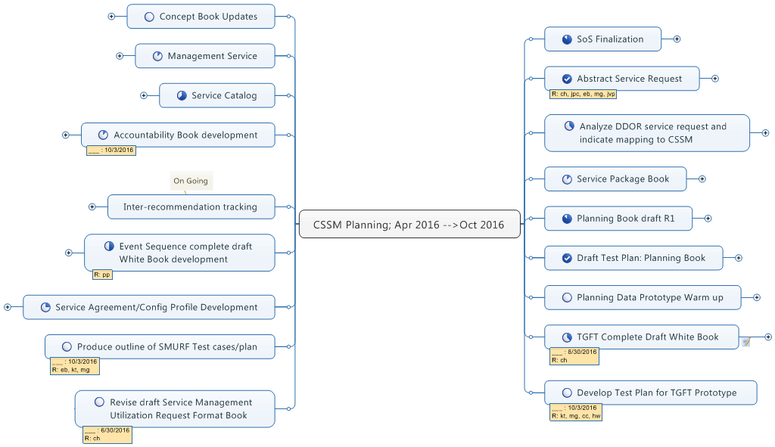
  Work Plan Apr ‘15 → Oct ’16 (1/5)

Slide 22
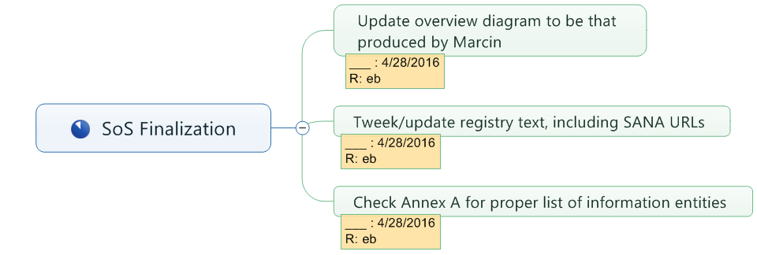
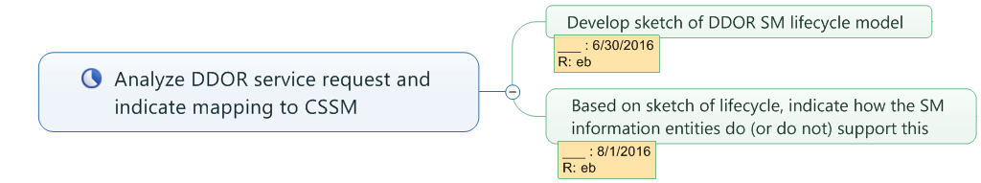
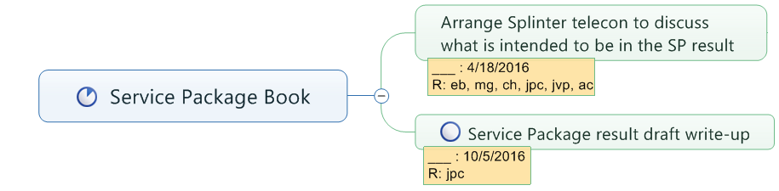
  Work Plan Apr ‘15 → Oct ’16 (2/5)

Slide 23

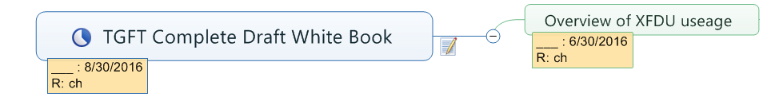
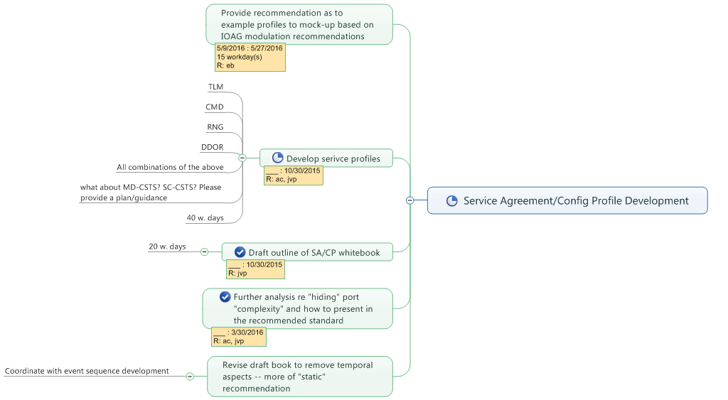
  Work Plan Apr ‘15 → Oct ’16 (3/5)

Slide 24
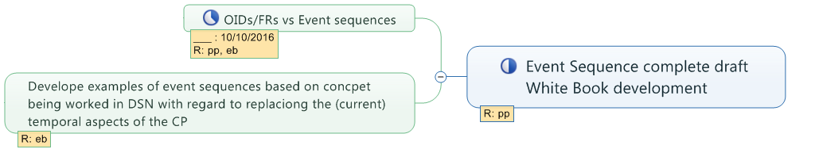
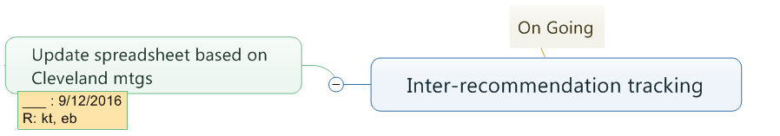
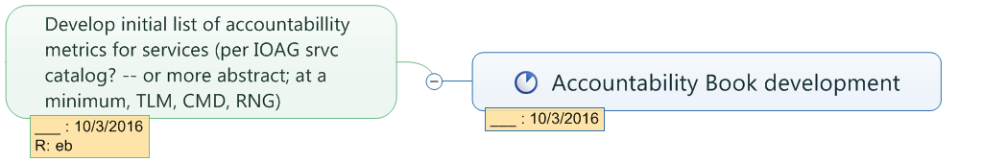
  Work Plan Apr ‘15 → Oct ’16 (4/5)

Slide 25
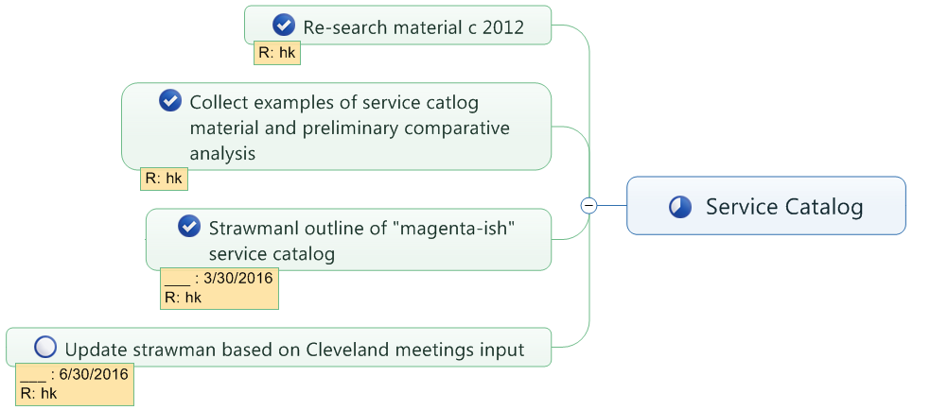
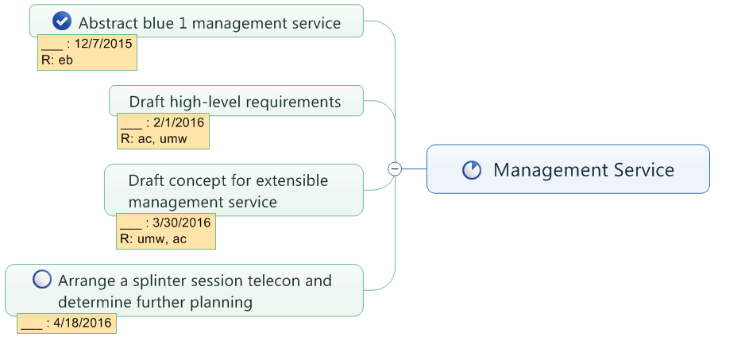
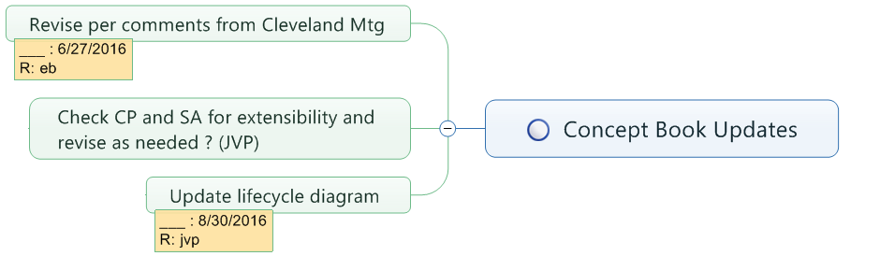
  Work Plan Apr ‘15 → Oct ’16 (5/5)

Slide 26
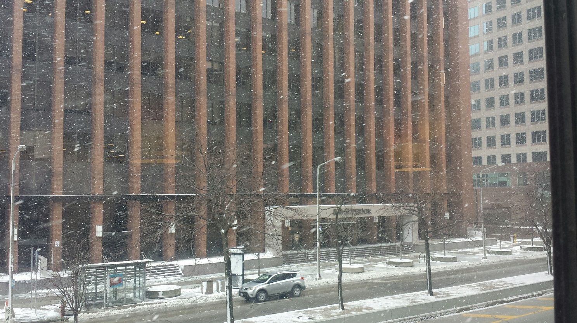
  Thank You
Thank you to
  Participants for traveling to and contributing to productive meetings
  NASA for providing the good conference facility
  The concentration enhancing winter weather

