Slide 1
Service Agreement & Configuration Profile White Book Overview and Status
4 – 8 April 2016
Cleveland, Ohio, USA
John Pietras
Global Science and Technology, Inc.

Slide 2
Outline
Introduce key Configuration Profile concepts through the Bakeoff Configuration Profile example
Present section-level outline and status of Service Agreement and Configuration Profile White Book
Summarize the technical contents of the sections of the book (with examples)
Example XML instance document for the Bakeoff Configuration Profile
Concluding thoughts

Slide 3
Bakeoff Configuration Profile Diagram
(SC Black-Box)

Slide 4
Bakeoff Configuration Profile (1 of 3)
1 antenna
  1 instance of RF Aperture SC Profile, containing 1 instance of Antenna FR Profile
1 forward 401 space link carrier
  1 instance of CCSDS 401 Forward Physical Channel Transmission SC Profile, containing:
    1 instance of Forward 401 CCSDS Space Link Carrier Transmission FR Profile
    1 instance of Forward Link Ranging FR Profile
  1 instance of TC Sync & Channel Encoding SP Profile, containing 1 instance of TC Sync & Channel Encoding FR Profile
3 instances of Forward Space Packet (FSP) service, all muxed into the same TC VC
  COP on VC, using CLCWs from return link MC on I channel
  1 instance of TC Space Link Protocol Transmission SC Profile, containing:
    1 instance of TC MC Mux FR Profile
    1 instance of TC VC Mux FR Profile
    1 instance of TC Encap, VC Packet Processing & VC Generation FR Profile
  3 instances of SLE Forward Space Packet SC Profile, each containing 1 instance of FSP TS Provider FR Profile

Slide 5
Bakeoff Configuration Profile (2 of 3)
1 return 401 space link carrier, with separate data streams on I & Q channels
  1 instance of CCSDS 401 Return Physical Channel Reception SC Profile, containing:
    1 instance of Return 401 CCSDS Space Link Carrier Reception FR Profile
    1 instance of Range and Doppler Extraction FR Profile
  1 instance of TM Sync & Channel Decoding SC Profile, containing 2 instances of TM Sync & Channel Decoding FR Profile (one for each if I & Q)
  1 instance of Return TM/AOS Space Link Protocol Reception SC Profile, containing:
    1 instance of MC Demux and Reception FR Profile
    1 instance of VC Demux and Reception FR Profile
3 instance of SLS (online) RAF service, all providing the frames from the Q-channel
  3 instances of SLE Return All Frames SC Profile, each containing 1 instance of RAF TS Provider FR Profile
1 instance of the Return Frame Capture service for I-channel frames
  1 instance of Frame Data Sink SC Profile, containing 1 instance of Frame Data Sink FR Profile
1 instance of SLS Raw Radiometric Data service (real-time TD-CSTS)
1 instance of the TDM Segment Storage service

Slide 6
Bakeoff Configuration Profile (3 of 3)
1 instance of SLS Raw Radiometric Data service (real-time TD-CSTS)
  1 instance of Real-Time Radiometric Data Collection SC Profile, containing:
    1 instance of TDM Segment Generation FR Profile
    1 instance of TDM Sink FR Profile
  1 instance of Tracking Data CSTS SC Profile, containing 1 instance of Tracking Data CSTS Provider FR Profile
1 instance of the TDM Segment Storage service
  Uses the same instance of Real-Time Radiometric Data Collection SC Profile listed above
  1 instance of TDM Recording Buffer SC Profile, containing 1 instance of TDM Recording Buffer FR Profile

Slide 7
FRs within the RF Aperture and CCSDS 401 Forward Physical Channel Transmission SCs

Slide 8
RfApertureScProfile Class Diagram

Slide 9
Ccsds401FwdPhysChnlXmitScProfile Class Diagram

Slide 10
White Book Outline and Status
Introduction – empty except for References
Overview – empty
Service Agreement Information Entity – complete draft section
Configuration Profile Information Entity - complete draft section
Core Service Components
  General structure for Service Component specifications
  Service Component specifications organized by Abstract Service Specification
  Section placeholders for all core Service Components
  Partial contents for Service Components involved in Bakeoff Configuration Profile and for the Forward Frames CSTS
Core Service Association and Ancillary Interface Type definitions – partially populated
Core Specializations of the Flexibilities and Constraints Class
  ServiceComponentTimeOffsets
  AperturePriorityConstraint
  ApertureAcceptabilityConstraints
Rules for Creating Configuration Profiles – first-level outline only
Annex A – Service Management Object Identifier Registration Tree (Strawman)

Slide 11
Section 3: Service Agreement Information Entity
A Service Agreement establishes the ranges or sets of values that configuration profiles can take on
A Service Agreement may contain:
  Zero or more Service Component Agreements
  Zero or one Configuration Profile Contents entity
Service Component Agreement
  Value ranges/sets for the configuration parameters of a single Service Component
  Identified by SC Agreement Name = [{Service Component Type OID}: SC Agreement Instance Number]
  Contains one or more Functional Resource Agreement entities
    Each FR Agreement is identified by its FR Type OID and FR Agreement Instance Number
  Multiple instances of the same FR Agreement type can exist in the same Service Component to allow specification of dependencies among the values within those FR Agreement instances
Service Component Agreements must be present in a Service Agreement if any of the following will be used by the Mission:
  Dynamic creation of Configuration Profiles (including in-line specification of Configuration Profile information in Service Package Requests);
  Re-specification of configuration parameter values in Service Package Requests;
  Real-time reconfiguration (e.g., via the Service Control CSTS); or
  Event sequencing
The Service Profile Contents entity allows for the establishment of configuration profile information as part of the Service Agreement

Slide 12
ServiceAgreementInfoEntity Class Diagram (Section 3)

Slide 13
ServiceAgreementInfoEntity Parameters
Must be reconciled with
SANA registries

Slide 14
Section 4: ConfigurationProfileInfoEntity Class Diagram

Slide 15
Section 4: ConfigurationProfileContents Class Diagram

Slide 16
Configuration Profile Contents Description
(1 of 3)
ConfigurationProfileContents is an abstract class with four (for now) specializations
  SpaceLinkSessionProfile – used to configure space links, associated productions, and real-time/online transfer services
  RetrievalProfile – used to configure return offline/complete transfer services (and associated production?)
  ForwardOnlineProfile – used to configure forward offline transfer services (and associated production?)
  ServiceManagementFunctionProfile - used to configure Monitored Data and Service Control CSTSes and associated production
ConfigurationProfileContents is a top-level class that allows configuration profiles to be used in other Info Entities (e.g., Service Agreement and Service Package Request)
Each specialization of ConfigurationProfileContents contains ServiceComponentProfile objects that are appropriate to that specialization
  Service Component Profiles that are derived from the abstract AccessorServiceComponent class
  Root Service Component classes
  The AccessorServiceComponent class supports the linking of Service Components through containment
  I.e., a Service Component accesses the “service” provided by another Service Component by being contained by it

Slide 17
Configuration Profile Contents Description
(2 of 3)
Some Service Components are not contained by other Service Components, but are contained by the service profiles themselves. These are root Service Component types
  Space Link Session Profile
    Contains Aperture and SLS Radiometric Data Production root Service Component Profile types
  Retrieval Profile
    Contains SLE Offline and CSTS Complete service provider and associated data storage Service Component Profile types
  Forward Offline Profile
    Contains forward offline transfer service and associated data storage Service Component Profile types
  Service Management Function Profile
    Contains Monitored Data and/or Service Control CSTS Provider and associated production Service Component Profile types
Each Service Component Profile contains one or more Functional Resource Profiles
  FR Profiles contain the Service Access Points (SAPs) that contain Accessor Service Components
  Each SAP in turn contains one or more concrete subclasses of the Accessor Service Component subclass of its service association type
    Example
      The RF Aperture SC Profile contains a Forward Modulated Waveform SAP, which contains a Forward Modulated Waveform Accessor
      The CCSDS 401 Forward Physical Channel Transmission SC Profile is cast as a subtype of the Forward Modulated Waveform Accessor
      Ergo, CCSDS 401 Forward Physical Channel Transmission SC Profile can be contained by the Forward Modulated Waveform SAP of the RF Aperture SC Profile

Slide 18
Configuration Profile Contents Description
(3 of 3)
Some Service Component Profiles have relationships with multiple other Service Component Profiles, but containment can be used to express at most one of these relationships
Ancillary relationships with other SC Profiles are implemented using a cross-referencing mechanism
  The UML provided/required interface terminology has been adapted for these ancillary relationships
  An object that possesses ancillary information that is needed by other objects has a provided interface by which that information is made available
  An object that needs ancillary information that is available from another object has a required interface that links to a peer required interface
  Provided and required interfaces are allocated to the FR Profiles that comprise the SC Profiles
The ConfigurationProfileContents class optionally contains flexibilities and constraints that can be applied to the Configuration Profile itself
  Flexibilities and constraints are expressed as conditions upon SCs or the Service Package, or relationships among SCs
  Configuration Profile-level flexibilities and constraints can be over-ridden in the Service Package Request

Slide 19
ConfigurationParameter Data Type
paramterId attribute (OID)
parameterClassifier attribute (compressed camelCase string)
Value constrained to be one of the following types
  A sequence of integers;
  A sequence of positive integers;
  A sequence of unsigned integers;
  A sequence of durations (in seconds);
  A sequence of durations (in milliseconds);
  A sequence of durations (in microseconds);
  A sequence of visible strings;
  A sequence of Booleans;
  A sequence of octet strings;
  A sequence of Real numbers;
  A sequence of Time (days and milliseconds since 1958/01/01 00:00:00);
  A sequence of Time (days and picoseconds since 1958/01/01 00:00:00);
  A sequence of enumerated values:
  A sequence of Object Identifiers;
  A sequence of any combination of items (a) – (n), above; or
  A set of any combination of items (a) – (n), above.

Slide 20
Section 5: Core Service Component Specifications (1 of 2)
Organized by Abstract Service Component, then Service Component
For each Service Component, specifies the Service Component Agreement and Service Component Profile contents and structure
Each Service Component Agreement specification contains
  Specification of ServiceComponentAgreement class attributes
    serviceComponentOid
    svcCmpntClassifier
  Identification, cardinality and containment hierarchy of FunctionalResourceAgreement instances contained by that ServiceComponentAgreement class
  Each FunctionalResourceAgreement class specification contains
  Specification of FunctionalResourceAgreement class attributes
    functionalResourceTypeOid
    functResTypeClassifier
  The set of agreement configuration parameters specific to that FR class

Slide 21
Section 5: Core Service Component Specifications (2 of 2)
Each Service Component Profile specification contains
  Specification of ServiceComponentProfile class attributes
    serviceComponentOid
    svcCmpntClassifier
  Identification, cardinality and containment hierarchy of FunctionalResourceProfile instances contained by that ServiceComponentProfile class
  Each FunctionalResourceProfile class specification contains
  Specification of FunctionalResourceProfile class attributes
    functionalResourceTypeOid
    functResTypeClassifier
  The set of profile configuration parameters specific to that FR class
  The SAPs contained by that FunctionalResourceProfile class
  The Provided Interfaces contained by that FunctionalResourceProfile class
  The Required Interfaces contained by that FunctionalResourceProfile class

Slide 22
Core Service Component Specifications
- Examples
RF Aperture SC specialization (RfApertureSc) of Aperture ASC
CCSDS 401 Forward Physical Channel Transmission SC specialization (Ccsds401FwdPhysChnlXmitSc) of Forward Physical Channel Transmission ASC
Representation of Service Components with multiple modes

Slide 23
RfApertureScAgreement Class Diagram

Slide 24
AntennaFrAgreement ConfigurationParameters Table (to be populated)

Slide 25
RfApertureScProfile Class Diagram

Slide 26
AntennaFrProfile ConfigurationParameters Table (to be populated)

Slide 27
Ccsds401FwdPhysChnlXmitScAgreement Class Diagram

Slide 28
Fwd401SpaceLinkCarrierXmitFrAgreement ConfigurationParameters Table

Slide 29
Ccsds401FwdPhysChnlXmitScProfile Class Diagram

Slide 30
Fwd401SpaceLinkCarrierXmitFrProfile ConfigurationParameters Table

Slide 31
Representation of Service Components with Multiple Modes
Forward Frames CSTS SC specializations of the Data Transfer Services ASC
Forward AOS Synchronization and Channel Encoding SC specialization (FwdAosSyncAndChnlEncodeSc) of the Forward Synchronization and Channel Encoding ASC

Slide 32
FwdFramesCsts_AosCadusScProfile Single Service Profile Diagram (SC Black Box)

Slide 33
FwdFramesCsts_AosVcFramesScProfile Single Service Profile Diagram (SC Black Box)

Slide 34
FwdFramesCsts_TcVcFramesScProfile Single Service Profile Diagram (SC Black-Box)

Slide 35
FwdAosSyncAndChnlEncodeScProfile Class Diagram

Slide 36
Forward Frames CSTS SC Specializations of the Data Transfer Services ASC
Forward Frames CSTS must be contained by three different SAPs
  FwdTcVcFrames
  FwdAosVcFrames
  FwdAosCadus
This requires that there be three AccessorServiceComponent types for Forward Frames CSTS
  FwdTcVcFramesAccessor
  FwdAosVcFramesAccessor
  FwdAosCadusAccessor
Result is three SC Profiles representing the three modes
  FwdFramesCsts_TcVcFramesScProfile
  FwdFramesCsts_AosVcFramesScProfile
  FwdFramesCsts_AosCadusScProfile
All 3 SC Profiles contain the same FR Profile type - FwsFramesCstsProviderFrProfile

Slide 37
FwdFramesCsts_AosCadusScProfile Class Diagram

Slide 38
Section 6.1: Core Service Association Types
Core Service Association Types (SAPs and Accessors) are available for use by all SCs/FRs
Examples
  Forward Modulated Waveform Service Association type
    CLASS FwdModulatedWaveformSap
    CLASS FwdModulatedWaveformAccessor
  Forward Physical Channel Symbols Service Association Type
    CLASS FwdPhysChnlSymbolsSap
    CLASS FwdPhysChnlSymbolsAccessor
  (22 more)

Slide 39
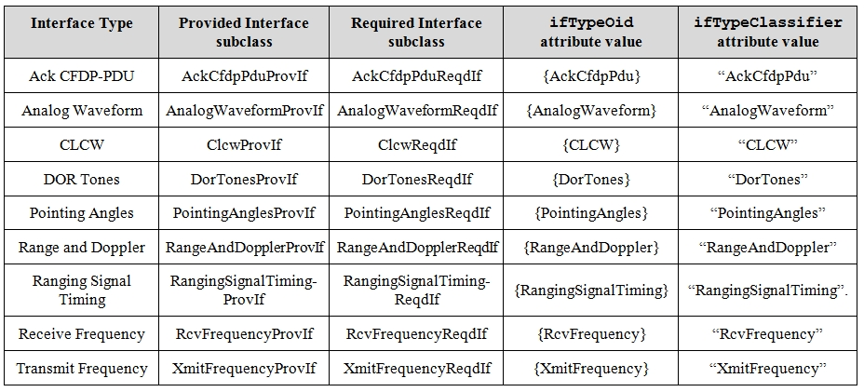
Section 6.2: Core Ancillary Interface Types
Core Ancillary Interface Types (Provided and Required Interfaces) are available for use by all SCs/FRs

Slide 40
Section 7: Flexibilities and Constraints
Allows for specification of relationships among Service Components in a “parallel” fashion
  Removing relationships from the containment hierarchy removes structural constraints that may limit flexibility in the future
  Can be used to express timing relationships, scenarios, alternate configurations, etc.
As of now, three Flexibility/Constraint class has been defined
  ServiceComponentTimeOffsets
  AperturePriorityConstraint
  ApertureFlexibilityConstraints

Slide 41
  ServiceComponentTimeOffsets
Provides equivalent functionality to SCCS-SM-B-1 capability to offset individual carrier start and stop times
Extends SCCS-SM-B-1 capability by:
  Allowing offsets to apply to any Service Component type
  Allowing offsets to be expressed with respect to other Service Components (in addition to with respect to the containing Service Package)
  ServiceComponentTimeOffsets class is used within a Configuration Profiles to express offset relationships among Service Components within the same Configuration Profile
  ServiceComponentTimeOffsets class could be used within a Service Package Request to express offset relationships among Service Components in the same or different Configuration Profiles within a Service Package Request

Slide 42
ServiceComponentTimeOffsets Class Diagram
“name” of the dependent Service Components
Service Package or
a different Service Component
“name” of reference point Service Component
(conditional)

Slide 43
  AperturePriorityConstraint
Provides functionality of SMURF BasicApertureConstraint
  Replicates SMURF structure (for now, anyway)
  Could be made less verbose and more robust by making it a single object containing a priority-ordered list of alertureRefs
Can be used in Configuration Profile or Service Package Request
  If initially specified in Configuration Profile, can be over-ridden by Service Package Request
Required to be an
Aperture SC OID

Slide 44
  ApertureAvailabilityConstraints
When combined with AperturePriorityConstraint, provides flexibility of
SCCS-SM-B-1
acceptabilityType parameter identifies whether list of apertureRefs is acceptable or unacceptable
Specification includes rules for relationship between PaerturePriorityConstraint and ApertureAvailabilityConstraints
Required to be an
Aperture SC OID

Slide 45
Section 8: Rules for Creating Configuration Profiles
Rules for wiring together different SCs to specify the functionality of Configuration Profiles
Organized by specializations of the Configuration Profile Contents abstract class
  Space Link Session Profiles
  Retrieval Profiles
  Forward Offline Profiles
  Service Management Function Profiles
This section is still To Be Supplied

Slide 46
Annex A: Object Identifiers Definition (Normative)
This annex will define
  the Object Identifier tree structure that is used for registering Service Component Types and their associated Provided and Required Interface classes;
  the procedures to be applied for the management of the Object Identifiers defined in this annex and for the creation of new Object Identifiers that need to be defined when new Service Components are specified;
  the top-level Object Identifiers themselves

Slide 47
Annex A: CSSM Object Identifier Registration Tree (Strawman Candidate)
iso
Identified
organization (3)
standard producing
organization (112)
Already defined
ccsds (4)
css (4)
cssm (3)
svcMgmtFrParamsEvents
AndDirectives (1)
serviceComponents (2)
serviceComponent
Interfaces (3)
crossSupportScs (1)
agencyScs (2)
crossSupportSc
Interfaces (1)
agencySc
Interfaces (2)
isConfigured (?)
apertureScs (1)
forwardPhyiscalChannel
TransmissionScs (2)
ServiceManagement
FunctionsScs (13)

Slide 48
CSSM Object Identifier Registration Tree in CSSA Context
cssm (3)
svcMgmtFrParamsEvents
AndDirectives (1)
serviceComponents (2)
serviceComponent
Interfaces (3)
crossSupportScs (1)
agencyScs (2)
crossSupportSc
Interfaces (1)
agencySc
Interfaces (2)
isConfigured (?)
apertureScs (1)
forwardPhyiscalChannel
TransmissionScs (2)
ServiceManagement
FunctionsScs (13)

Slide 49
Bakeoff Configuration Profile Diagram
(SC Black-Box)

Slide 50
Bakeoff Configuration Profile Notional Data Structures (partial)
Aperture
RF Aperture SC Profile
- Instance 1
Pointing Angles
Provided IF
Fwd Mod
Waveform
SAP
Rtn Mod
Waveform
SAP
Fwd Mod
Waveform
Accessor
CCSDS 401 Fwd Phys
Channel SC Profile
Transmit Frequency
SAP Provided IF
- Instance 1
Ranging Signal Timing
SAP Provided IF
Fwd Phys Chnl
Symbols
SAP
Fwd Phys Chnl
Symbols
Accessor
TC Sync & Channel
Encoding SC Profile
- Instance 1
Fwd All Transfer
Frames SAP

Slide 51
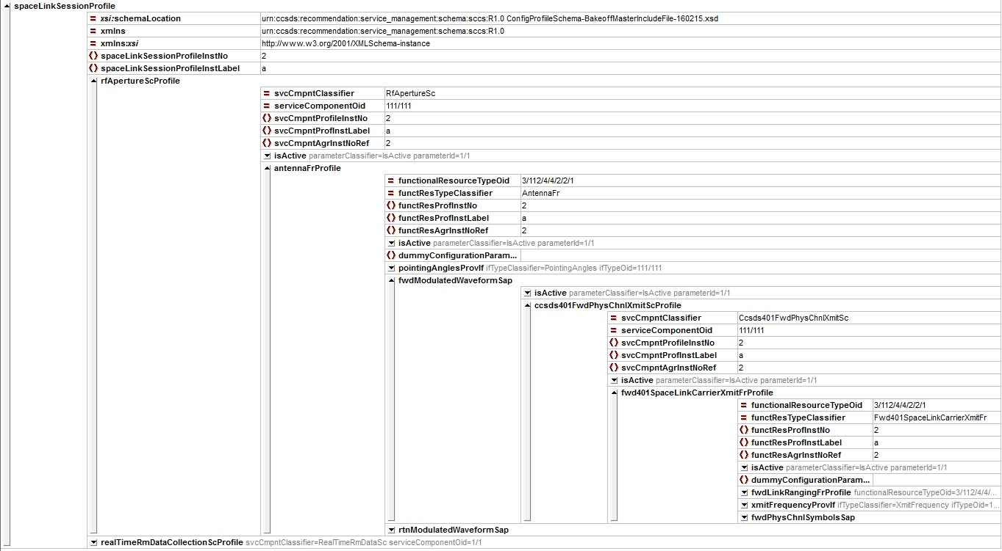
Bakeoff XML Instance Document –
XMLspy Grid View

Slide 52
Concluding Thoughts
Can We Simplify The Approach Even More?
  Perhaps we don’t need OIDs and Instance Numbers for Service Components, only for the FR instances contained within them
    Flexibilities and Constraints would be on FR instances instead of SC instances
  Would like to explore the pros and cons of such a simplification
Relationship to Service Catalog?
  E.g., can Service Catalog be expressed in terms of the ASCs and SCs
    Maybe not using that terminology, but will closely map to them

