Slide 1
Overview of Progress
TGFT protocal prototyping based on CCSDS

Slide 2
I. Introduction
What
Terrestrial Generic File Transfer Prototyping
Why
Facilitate file exchange between space agencies on the ground
Recommended Standard
Part of a file delivery about the space segment
Improve the level of interoperability among agencies
Security

Slide 3
I. Introduction
Reference
Cross Support Terrestrial File Transfer Concept. CCSDS NNN.N-G0.02
Terrestrial Generic File Transfer. CCSDS 927.1
RFC2518 Web based Distributed Authoring and Version. 1999
RFC4918 Web based Distributed Authoring and Version. 2007

Slide 4
II. Project Description
Work Completed
Requirement Analysis & Discussion
Deployment of Development Environment
Architectural Design

Slide 5
II. Project Description
Choose WebDAV protocal

Slide 6
II. Project Description
Server
Platform
OS
CentOS 6.5
WebServer
Apache httpd-2.2.15 WebDAV support
Functions
File Version Server
User Manage
Authority Manage
Client
Platform
OS
Windows
Functions
WebDAV Client

Slide 7
II. Project Description

Slide 8
II. Project Description
Work in Progress
Module Analysis & QA
User authentication
WebDAV request & response Packet Parsing Engine
Communication flow between C/S
XFDU about TGFT
System test cases

Slide 9
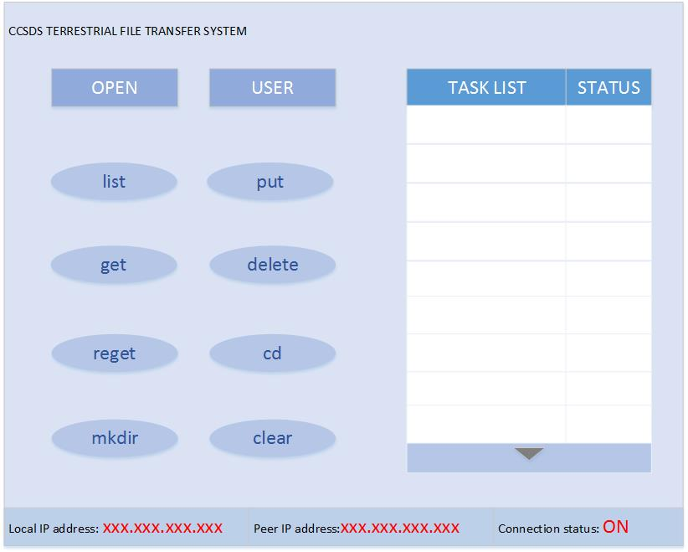
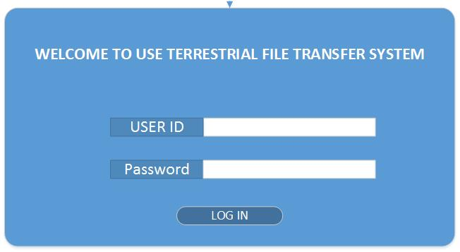
II. Project Description

Slide 10
II. Project Description
Work Remaining
Detailed Analysis
Single Test Cases
Coding & Debug
Testing

Slide 11
III. Summary & Dependency
The subject would be developed as a demo or API library or like the product?

Slide 12
III. Summary & Dependency
What is the logical relationship between TGFT and CFDP. Do we need to think about it? If so, How to deal with the process. In the document, it was mentioned that the possible use of the TGFT is as part of a file delivery chain in the document, which is required of CFDP.

Slide 13
III. Summary & Dependency
What about the directory structure on the web server in detail. It’s roughly known that there are in-Tray and out-Tray.

Slide 14
III. Summary & Dependency
E.g.
Agency A -> B
Agency A -> C
On the web server, There is a directory for A, who sends the respective files to B and C. How to distinguish which file belongs to B or C in the presentation lay, and how to process.

Slide 15
addition
Currently, the latest version we have is "927x1w0.00.doc" and "XML Formatted Data Unit (XFDU) Interoperation Testing.doc" provided by my colleague Yonghui, who downloaded the documents from the CWE.
In consideration that we can understand the requirements more clearly and more accurately, we hope we can directly contact someone to discuss the issue about BB and Prototyping more easily, or other convenient way.

